Slide 1

Rust
Flavio Boss & Daniel Eisner
Multiparadigmen Sprache
Geschwindigkeit und Speichersicherheit

Slide 2
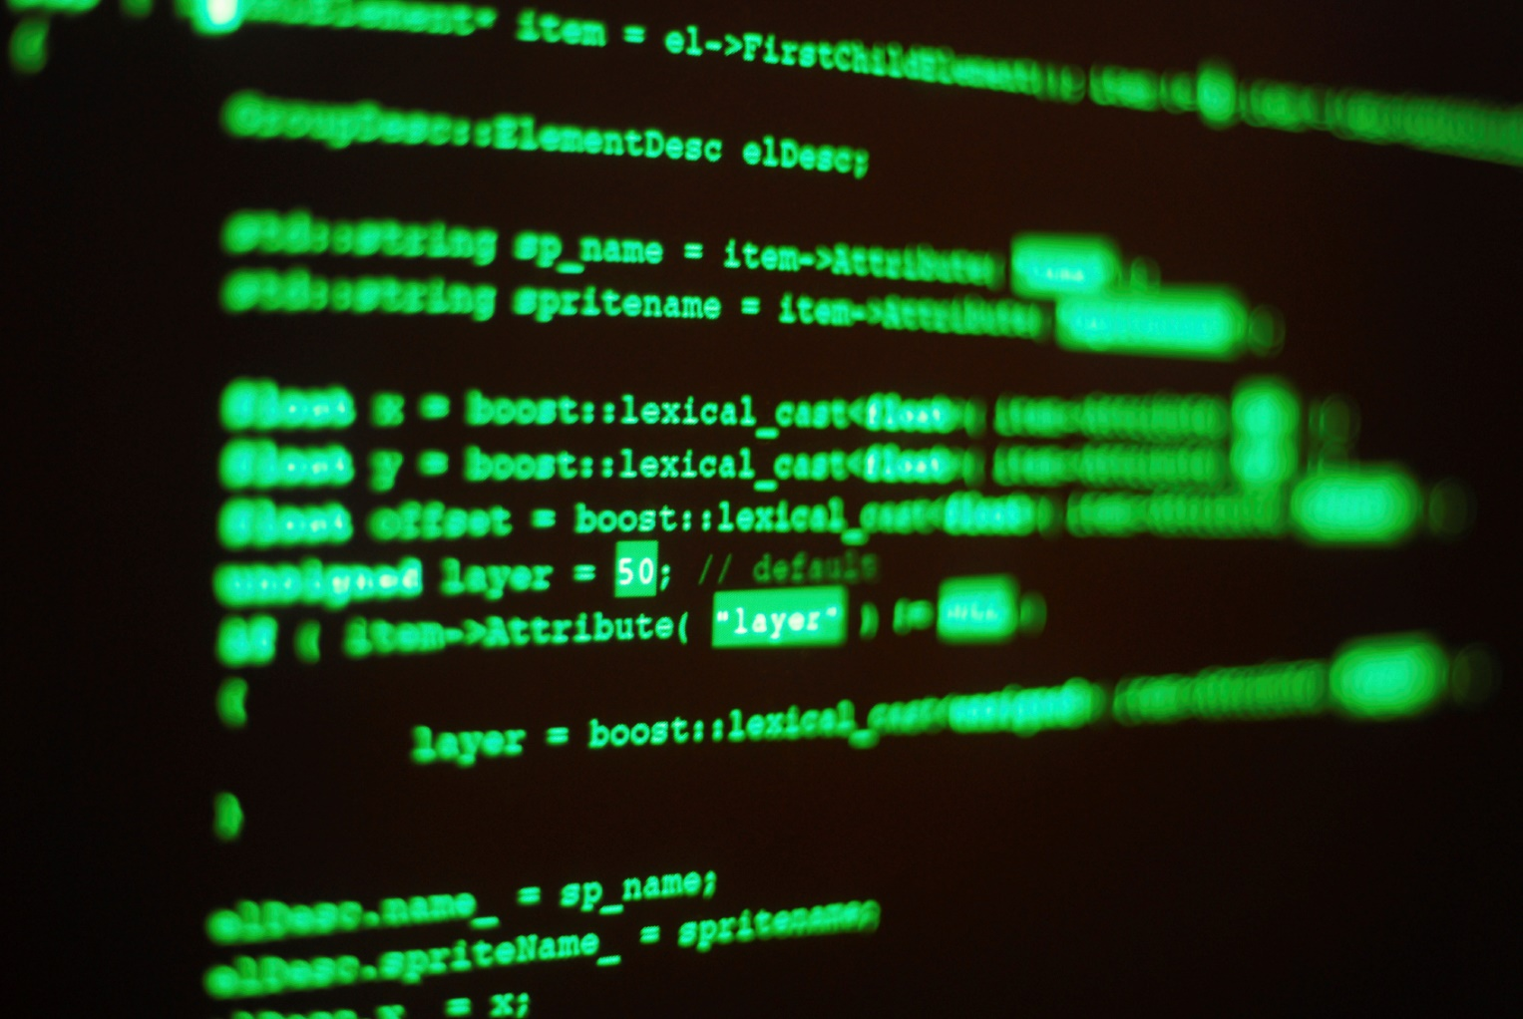
Code Demo

Slide 3
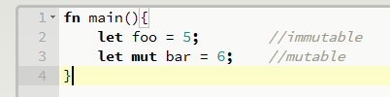
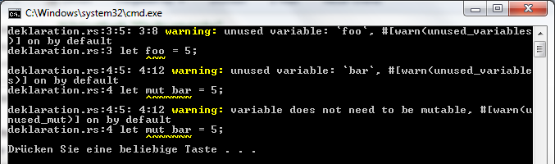
Mutable vs. Immutable

Slide 4
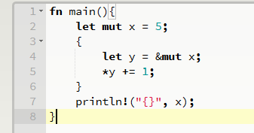
Scope & Ownership

Slide 5
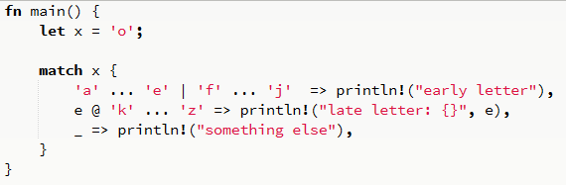

Patterns & Matching

Slide 6
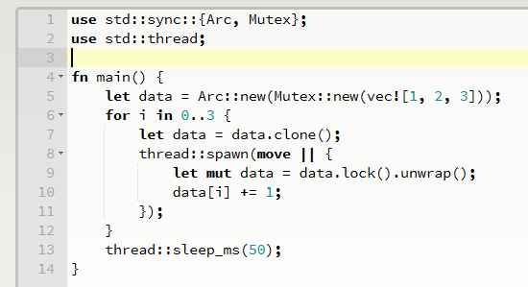
Spawn (Threads)
Java: serializable

Slide 7
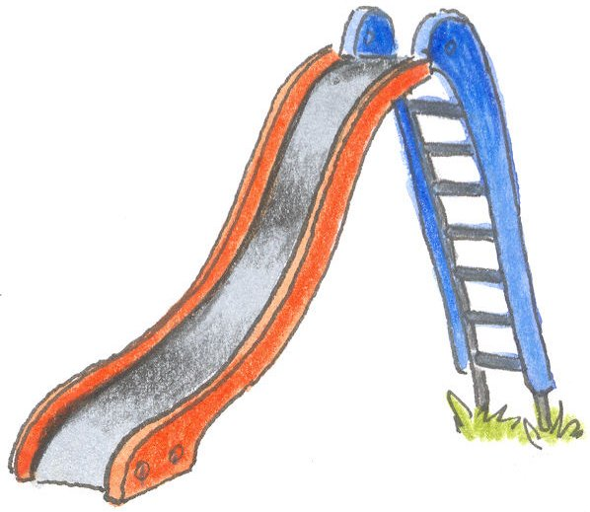

Channels (Threads)
Sender
Receiver
Notes:
Producer Consumer

Slide 8
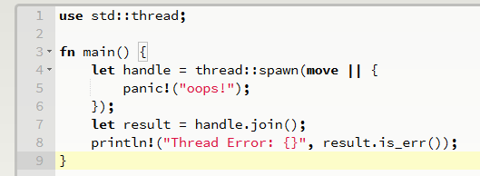
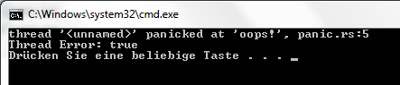
Panic (Threads)
fn main() {

Slide 9

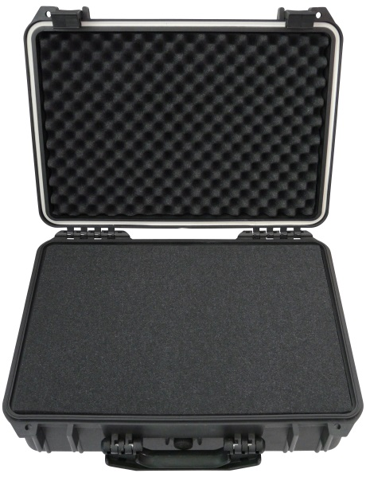
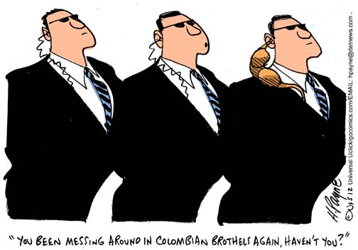
Fazit

