Slide 1


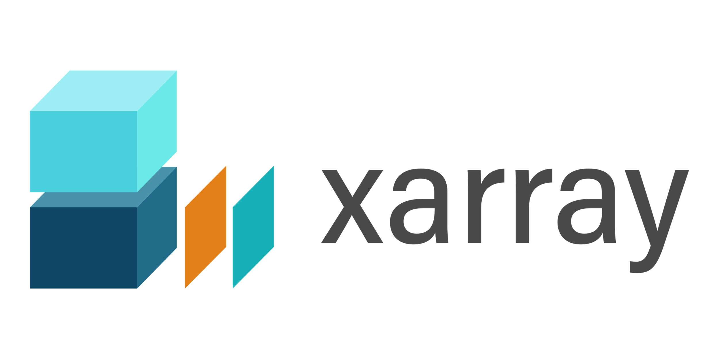

flixopt package
Initialization
Create a Model through our easy-to-use Python-API
Internal Translation & solving
translating interfaces to variables and constraints
Documentation & Evaluation
Structured access & export of solutions, initialization data & more. Restore from file
File I/O
File I/O
Solution files
User Interface files
MILP-Solver HiGHS, Gurobi, CBC, …
User Interface files
Restore used data from file

Slide 2


Pre v2.0.0
flixOpt package
… after
solving
flixOpt
framework for modeling
energy and material flow system
result-files of calculation
data-files
model & solve infos (json)
flixBase
vector based modeling framework
flixPost
framework for postprocessing
Optimization modeling language /
Solver API
others
i.g. CVXPY
*
* in progress / prepared for
MILP-Solver Gurobi, CPLEX, CBC, …

