Slide 1
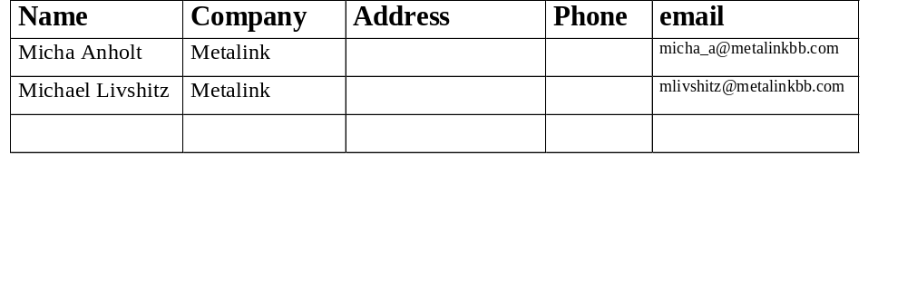
Waveform Generator
Date: 2006-11-12
Authors:
Notice: This document has been prepared to assist IEEE 802.11. It is offered as a basis for discussion and is not binding on the contributing individual(s) or organization(s). The material in this document is subject to change in form and content after further study. The contributor(s) reserve(s) the right to add, amend or withdraw material contained herein.
Release: The contributor grants a free, irrevocable license to the IEEE to incorporate material contained in this contribution, and any modifications thereof, in the creation of an IEEE Standards publication; to copyright in the IEEE’s name any IEEE Standards publication even though it may include portions of this contribution; and at the IEEE’s sole discretion to permit others to reproduce in whole or in part the resulting IEEE Standards publication. The contributor also acknowledges and accepts that this contribution may be made public by IEEE 802.11.
Patent Policy and Procedures: The contributor is familiar with the IEEE 802 Patent Policy and Procedures <http:// ieee802.org/guides/bylaws/sb-bylaws.pdf>, including the statement "IEEE standards may include the known use of patent(s), including patent applications, provided the IEEE receives assurance from the patent holder or applicant with respect to patents essential for compliance with both mandatory and optional portions of the standard." Early disclosure to the Working Group of patent information that might be relevant to the standard is essential to reduce the possibility for delays in the development process and increase the likelihood that the draft publication will be approved for publication. Please notify the Chair <stuart.kerry@philips.com> as early as possible, in written or electronic form, if patented technology (or technology under patent application) might be incorporated into a draft standard being developed within the IEEE 802.11 Working Group. If you have questions, contact the IEEE Patent Committee Administrator at <patcom@ieee.org>.

Slide 2
Phy Transmitter waveform generator
Micha Anholt- Metalink

Slide 3
Waveform Generator History
First presented in San Diego, got unanimous support of adding waveform generator as an informative annex to the standard, see
  11-06-1096-00-000n-waveform-generator-ppt.ppt
After the productive discussion the features, interfaces and debugging capabilities were identified
  Matlab Code
  Implement all 11n phy modes, including Non-HT modes
  Support debug vectors for intermediate signals
The interface was presented in Melbourne
  11-06-1400-01-000n-waveform-generator.ppt

Slide 4
Special Thanks to Contributors:
Edoardo Gallizio, Raffaele Riva, George Vlantis, STMicro
  LDPC waveform verification
Tom Pare, Ralink
  General useful comments, beamforming related comments.
Gal Basson and Eldad Perahia, Intel
  Waveform verification assistance
Krishna Pillai, Wipro
  For suggesting to use the TXVECTOR interface
Anuj Batra, TI
  For proposing the debug interface

Slide 5
Features
Either Command line based or GUI based
Input – complete information on how to generate the packet.
  Wherever possible and appropriate structure of input will follow TXVECTOR fields.
Output – sample files, debug vectors
  Sample files at 20/40/80 Mhz for all antennas
  Debug vector as a structure representing a tree.

Slide 6
Command Line Interface
total_td_sig = tx_n_highlevel (sim80211nconfig);
where
sim80211nconfig =
BitSource: ‘song11a.hex'
FORMAT: 'HT-MM'
L_LENGTH: 0
LENGTH: 0
MCS: 1
SHORT_GI: 0
STBC: 1
NUM_EXTEN_SS: 0
SMOOTHING: 1
NOT_SOUNDING: 1
LDPC_CODING: 1
AGGREGATION: 0
CW: 'HT_CW40'
CH_OFFSET: 'CH_OFF_40'
output_rate: 40
nTx: 2
SERVICE: [1x1 struct]
HT_SIG_RESERVED: 1
post_q_cdd: [0 0]
calib: 0
BF_Q_source: 'default'
win: 0.5

Slide 7
Debugging Information Available
[total_td_sig, dbinfo] = tx_n_highlevel (sim80211nconfig);
dbinfo =
data: [struct]
lstf: [struct]
lltf: [struct]
lsig: [struct]
htstf: [struct]
htsig: [struct]
htltf: [struct]
dbinfo.lstf =
symbols: [64x1 double]
full_band_symbols: [128x1 double]
after_legacy_cdd_symbols: [128x1x2]
fft_samples: [128x1x2 double]
after_cp: [1x2x320 double]
dinfo.data =
source_bits: [1136x1 double]
scrambled_bits: [1136x1 double]
encoded_bits: [2592x1 double]
stream_parse: {[2592x1 double]}
interleaved_bits: {[2592x1 double]}
data_symbols: [2x1296 double]
pilot_symbols: [2x72 double]
full_band_symbols: [128x12x2 double]
after_sts_cdd_symbols: [128x12x2 double]
after_spatial_expansion_symbols: [128x12x2 double]
after_fft_samples: [128x12x2 double]
after_cp_samples: [12x2x160 double]

Slide 8
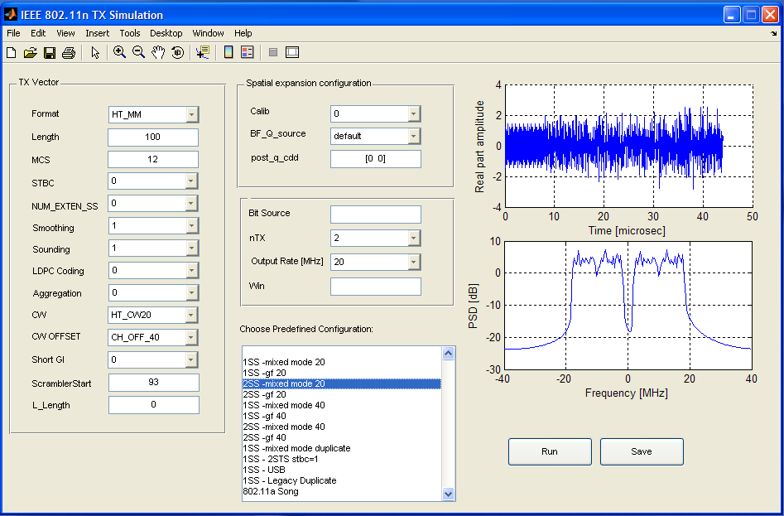
GUI

Slide 9
Interface Step by Step
Specify input bits source
Specify the TXVECTOR parameters
  FORMAT (HT-Mixed Mode, HT-GF, or non-HT)
  LENGTH, L_LENGTH
  MCS (0-76 for HT, mapped to values 0-7 for non-HT)
  CW, CH_OFFSET
  SMOOTHING, SOUNDING, AGGREGATION
  STBC, LDPC, SHORT_GI, NUM_EXT_SS
Specify number of transmit chains
Specify output sampling rate
Specify additional parameters
  Scrambler Initial Value
  Beam Forming Matrices
  Windowing Functions

Slide 10
Predefined Configurations
1SS HT Mixed Mode, 20MHz
1SS HT GF, 20MHz
2SS HT Mixed Mode, 20MHz
2SS HT GF, 20MHz
1SS HT Mixed Mode, 40MHz
1SS HT GF, 40MHz
2SS HT Mixed Mode, 40MHz
2SS HT GF, 40MHz
1SS HT Mixed Mode, 40MHz Duplicate
1SS 2STS STBC HT Mixed Mode, 40MHz
1SS HT Mixed Mode, 20MHz in upper 40MHz
1SS Legacy Duplicate
802.11a Song

Slide 11
Input parameters supported
Data Bit Source – Random or Read from File
Parameter Name | Parameter Value | Meaning
BitSource | [] | Source bits are randomly generated using Matlab random function
 | FileName | Read bits from file (hex byte per line)

Slide 12
Input parameters supported (cont.)
Name | Value | Meaning/Comment
FORMAT | NON_HT
 | HT_MM
 | HT_GF
L_LENGTH | 0 | Calculate According to Specification
 | 1-4095 | Override L-SIG value with this one
LENGTH | 0 | Sounding Packet
 | 1-65535 | Packet size in bytes. If read from file, LENGTH will be overridden by length of file data.
MCS | 0-76 | For HT packet this is MCS value, for non HT values 0-7 are mapped to not HT rates.
SHORT_GI | 0,1 | 0-Normal, 1-Short (0.4µs)
STBC | 0,1,2 | 0 No STBC, 1 or 2 extra streams (must be compatible with MCS value)

Slide 13
Input parameters supported (cont.)
Name | Value | Meaning/Comment
NUM_EXTEN_SS | 0,1,2,3
SMOOTHING | 0,1
SOUNDING | 0,1
LDPC_CODING | 0,1
AGGREGATION | 0,1
Number of Transmit Chains
Name | Value | Meaning
nTx | 1,2,3,4

Slide 14
Input parameters supported (cont.)
Service Parameters
Name | Value | Meaning
SERVICE.ScramblerStart | 1-127 | Scrambler Initial value
SERVICE.bits | Vector of 16 bits | All zeros for HT
Reserved Bits of HT-Sig
Name | Value | Meaning
HT_SIG_RESERVED | 0,1 | Value of reserved bits. Should be set to 1. 0 value can be used to verify that receiver ignores this bit.

Slide 15
Transmission Modes supported
20 MHz (HT and non-HT)
40 MHz HT
40 MHz HT Duplicate (MSC 32)
40 MHz non-HT Duplicate
Transmission in the upper/lower 20MHz of 40 MHz channel

Slide 16
Transmission Modes supported (cont.)
The following channel modes are supported through different values of CW and CH OFFSET
Transmission Mode | CW Value | CH OFFSET Value | Comments | Output sampling rates, MHz
20 MHz | CW20 | N/A | HT and non-HT | 20,40,80
40 MHz | CW40 | CH_OFF_40 | HT, including HT Duplicate, MCS32 | 40,80
40 MHz Legacy duplicate | CW40DN | CH_OFF_40 | Non-HT | 40,80
40 MHz Upper | CW40 | CH_OFF_20U | HT | 40,80
40 MHz Lower | CW40 | CH_OFF_20L | HT | 40,80

Slide 17
Spatial Expansions Supported
Spatial expansion matrix as required for calibration packet (clause 21.3.12.2)
Spatial expansion matrix, fixed over all carriers as defined in 21.3.10.10.1 case b), examples i) - v), then multiplied by cdd vector
User-defined spatial expansion matrix, which is fixed over all carriers
User-defined beamforming matrix, different for every carrier

Slide 18
Spatial Expansions Supported (cont.)
Name | Value | Meaning
calib | 0,1 | 1 means generate spatial expansion according to calibration packet (Clause 21.3.12.2)
BF_Q_source | ‘default’ | Uses default spatial expansion from draft examples 21.3.10.10.1 case b), examples i) - v), combined with cdd vector values
 | 'const+cdd' | Uses fixed matrix supplied externally by FixedQ variable combined with cdd vector values
 | ‘general’ | Uses carrier dependent spatial expansion matrices supplied externally by the Q variable
FixedQ | nTx by nSTS matrix | External fixed matrix to be used by 'const+cdd' option
postQ_cdd |  | cdd vector to be used as part of spatial expansion, after multiplication by the matrix. Should be set to 0 vector when using the 'general' option with matrices supplied externally
Q | a set of 64 or 128 matrices of size nTx by nSTS | a set of 64 or 128 matrices of size nTx by nSTS to be used for spatial expansion. Matrices should be ordered from carrier 0 to carrier 63 or 127

Slide 19
Options on how to relate the code to the specification?
Explicit text
  (~2000 lines -> about 32 pages of word document )
  Matlab code would be outlined as one long text piece.
  Strong affiliation of the code to the spec.
IEEE download
  Mention the link in the spec
  Binary files can be added, GUI interface.
  Easy to update the code, without changing the spec.
  This method had a strong majority within the PHY adhoc
  Need to find out how to submit it.
External download
  Same as the channel simulator
  No need to discuss the code within IEEE.

Slide 20
Q&A

