Slide 1














Linear Regression
Presented by
FCAI-CU-AI-Community

Slide 2
One a day as a ML Engineer your Manager Asked you to work on a problem

Slide 3

Our Problem
Given some attributes, we will discuss them in next slide
We want to predict Flight Ticket Price.

Slide 4
ID | airline | flight | source_city | destination_city | arrival_time | departure_time | stops | class | duration | days_left | price
0 | SpiceJet | SG-8709 | Delhi | Mumbai | Night | Evening | zero | Economy | 2.17 | 1 | 5953
1 | SpiceJet | SG-8157 | Delhi | Mumbai | Morning | Early_Morning | zero | Economy | 2.33 | 1 | 5953
2 | AirAsia | I5-764 | Delhi | Mumbai | Early_Morning | Early_Morning | zero | Economy | 2.17 | 1 | 5956

Slide 5
So, What Do you Think?
Is it suitable to solve it with traditional approach or use ML approach

Slide 6
ID | airline | flight | source_city | destination_city | arrival_time | departure_time | stops | class | duration | days_left | price
0 | SpiceJet | SG-8709 | Delhi | Mumbai | Night | Evening | zero | Economy | 2.17 | 1 | 5953
1 | SpiceJet | SG-8157 | Delhi | Mumbai | Morning | Early_Morning | zero | Economy | 2.33 | 1 | 5953
2 | AirAsia | I5-764 | Delhi | Mumbai | Early_Morning | Early_Morning | zero | Economy | 2.17 | 1 | 5956

Slide 7
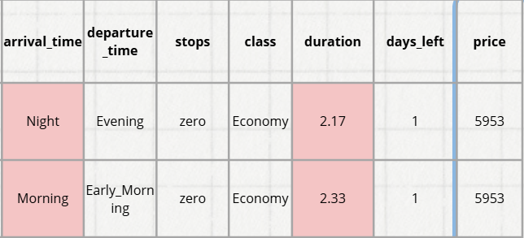
As you can see, when arrival_time and duration changed that didn’t affect the price so using rules will not benfit us.

Slide 8
ML Approach
Questions that need to be answered to select the appropriate algorithm:
Is problem Supervised or Unsupervised?
Is it classification or Regression?

Slide 9
price
5953
5953
5956
It is a Supervised Problem
because our target exists in data which is price

Slide 10
But What is the Difference between Classification and Regression?

Slide 11
 | Classification | Regression
Target | Discrete values | Continuous Values
Example | Cat or Dog, Spam or Ham | House Prices, Score in Exam

Slide 12
price
5953
5953
5956
It is a Regression Problem
Because price has continues values

Slide 13
So, prepare for meeting our first regression model which is
Linear Regression

Slide 14
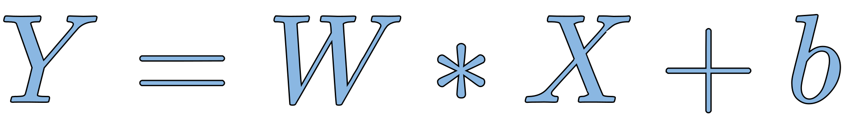
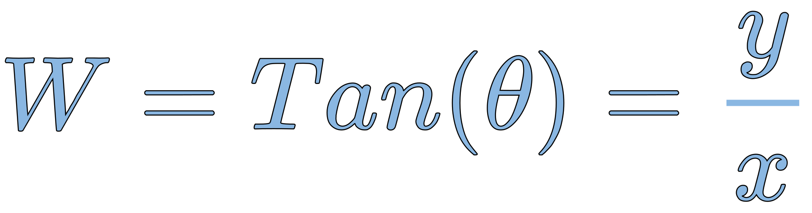
Remember straight line equation:
Where:
b
θ
b: is intercepted part from y-axis
Inputs: X
outputs: Y
variables: W, b

Slide 15
Linear Regression simply is just finding
best line to fit our data

Slide 16
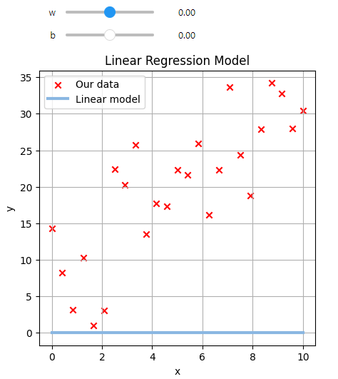
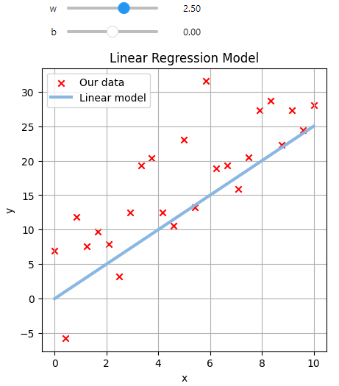
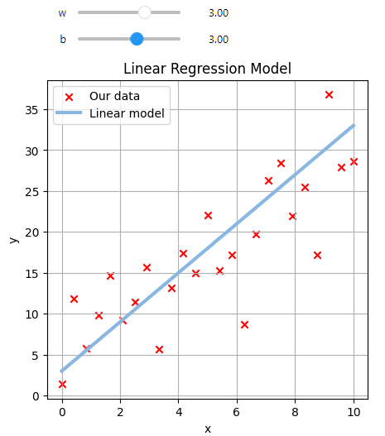
Which line is the best?
W = 0, b = 0
W = 2.5, b = 0
W = 3, b = 3

Slide 17
As humans, we can choose the best line, but how can a machine do that?

Slide 18
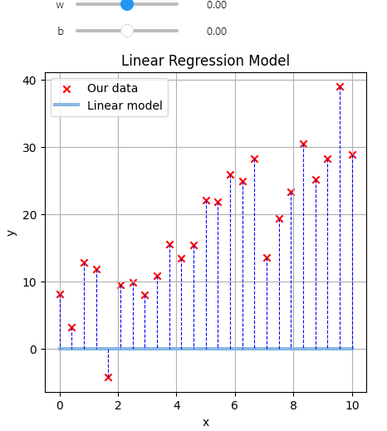
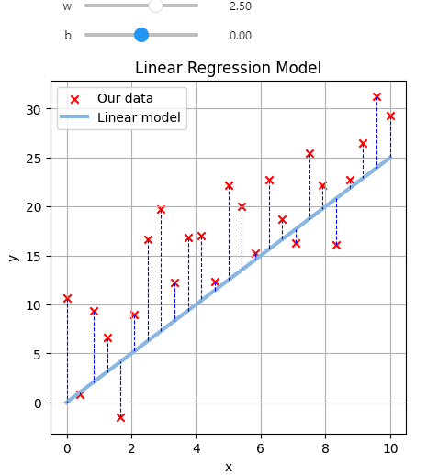
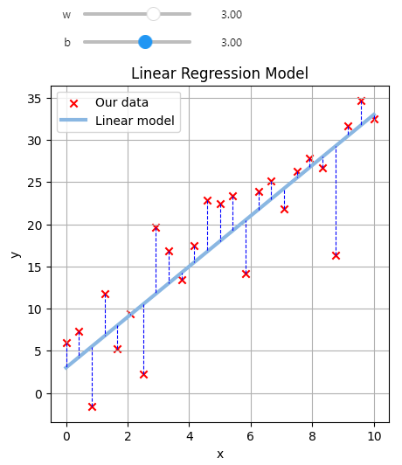
Is measuring distance between actual and predict
can help us?
W = 0, b = 0
W = 2.5, b = 0
W = 3, b = 3

Slide 19

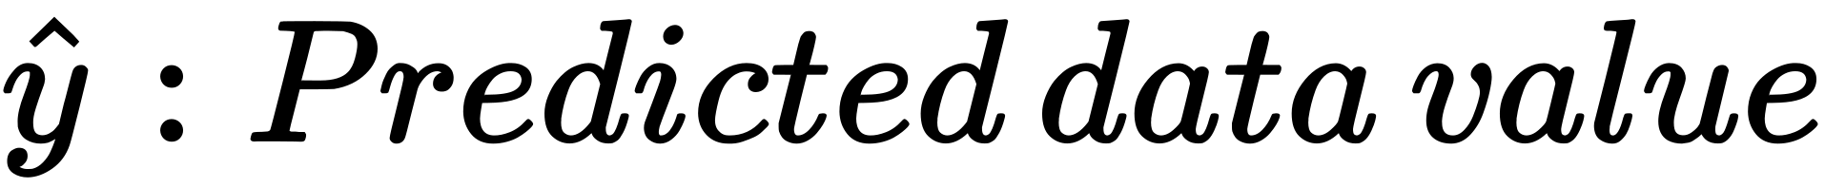
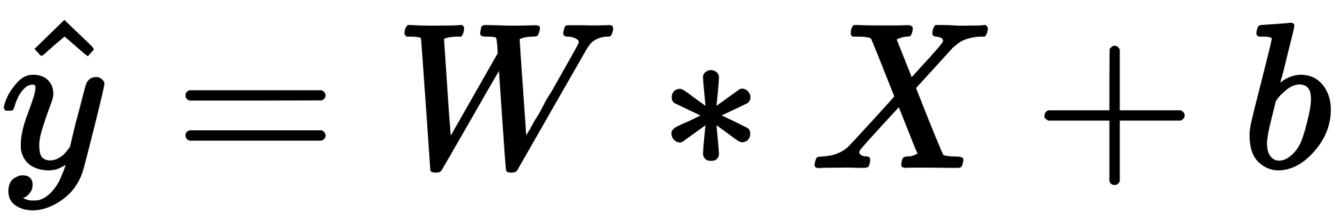
Lets define some symbols:

Slide 20

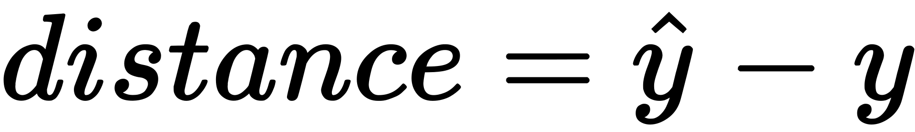
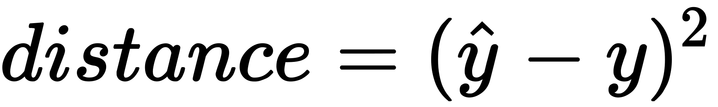
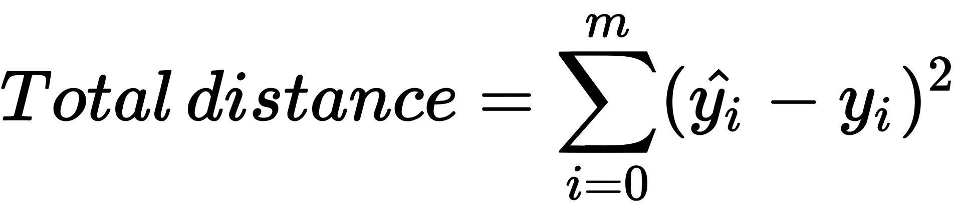
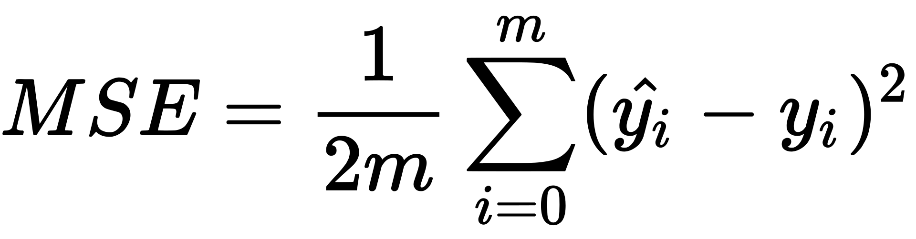

Slide 21
Now that we have calculated MSE what will we do with it?

Slide 22
Of course we need to minimize it
but how?

Slide 23
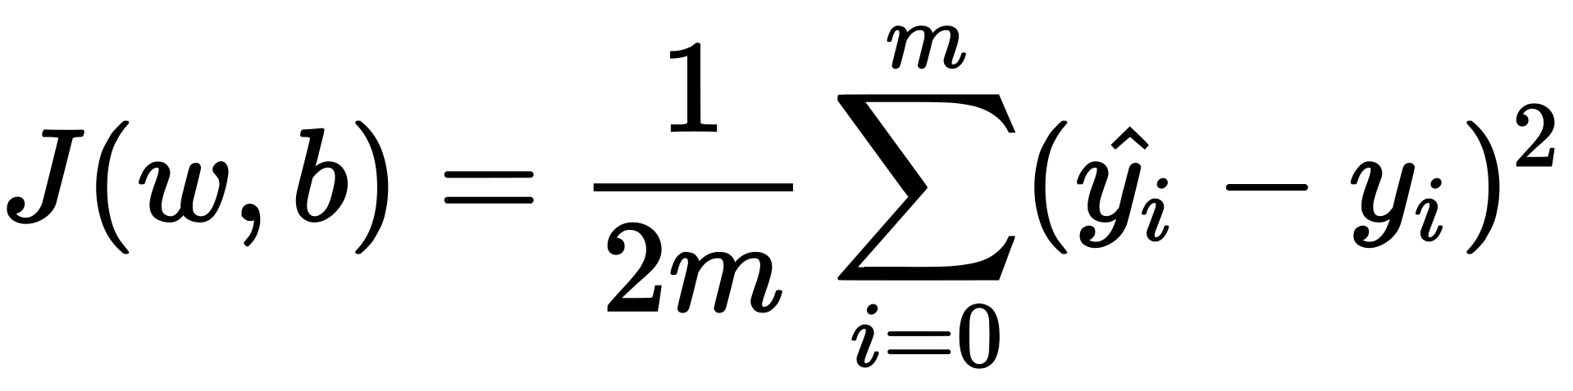
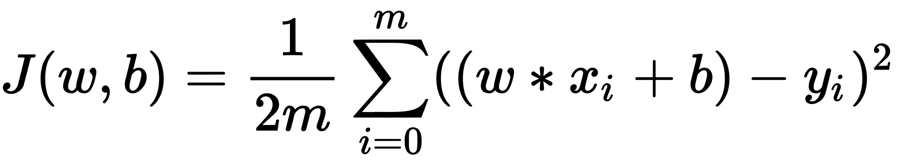
So as we can see in J(W, b) if we want to minimize its value we need to change either W, b, or both

Slide 24
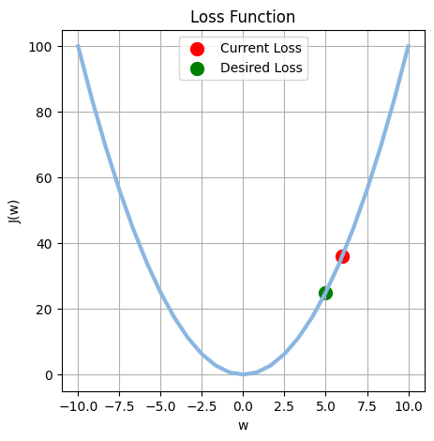
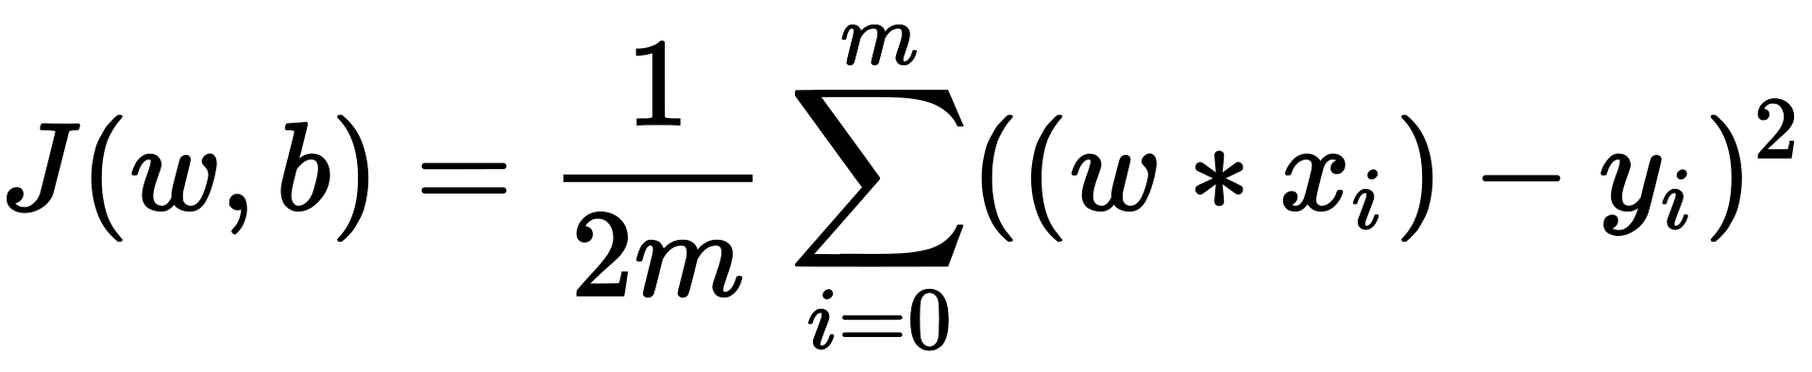
Lets assume our Loss function: J(W, b)
Has only one input which is W and b = 0

Slide 25
How we can move from the red dot to the green dot?

Slide 26
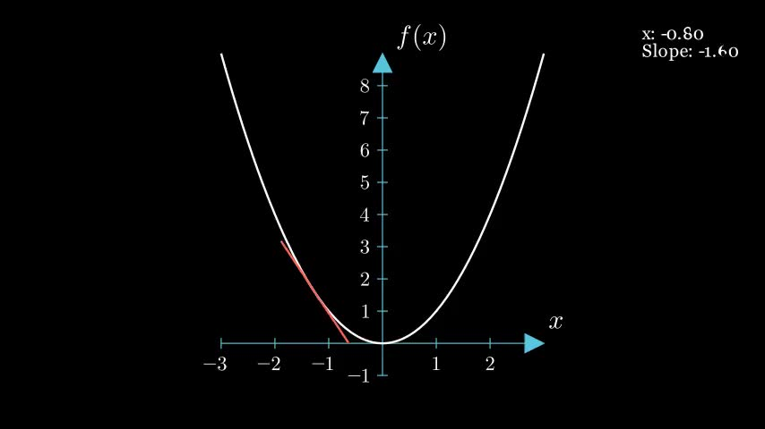

Slide 27
We can use the slope of the loss function to update the weights

Slide 28
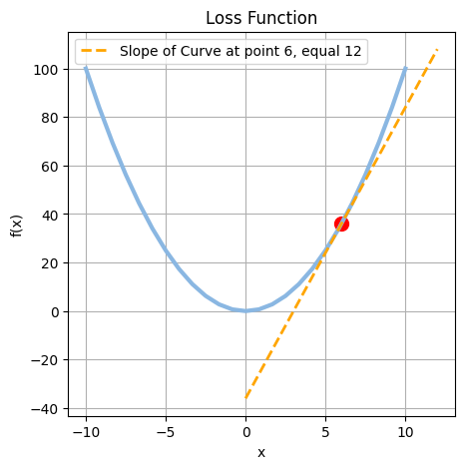
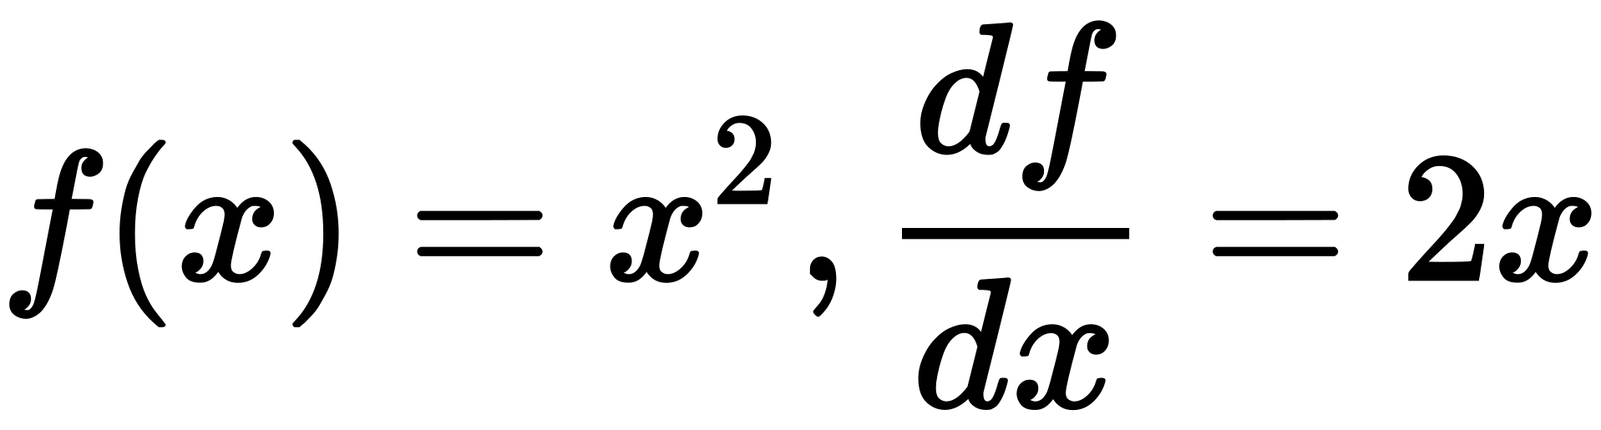
But actually, what is slope:
Slope have different interpretations but one of its interpretations is that it is the derivative of function.
Another interpretation is that it is tan(θ) , θ is angle made with x-axis

Slide 29
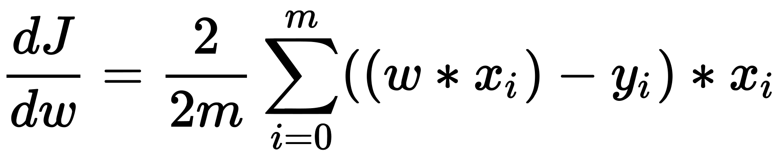
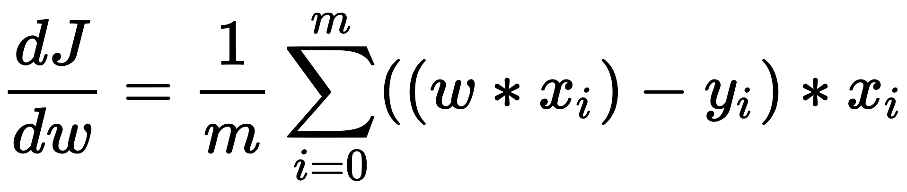

Slide 30
How can we use this
To Update W

Slide 31
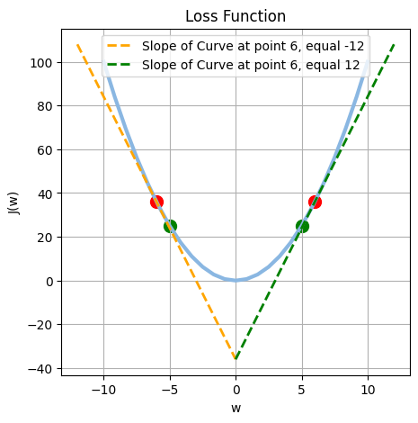
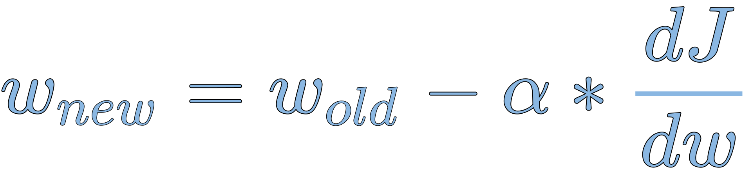

Slide 32
Repeat those three steps until convergence or reaching max iterations

Slide 33
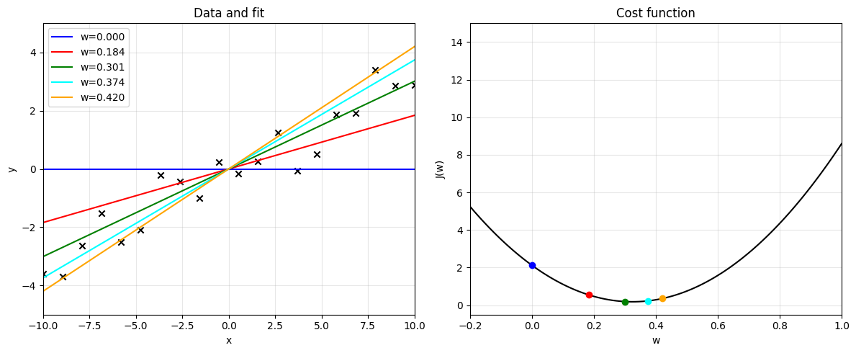
How slope of Line change by changing w

Slide 34

So, we made what we wanted
but, what is ?

Slide 35
is Called learning rate
It is first hyperparameter you meet.
It is used to control step of gradient towards global minima.
usually ranges between 0.1 to 0.0001

Slide 36
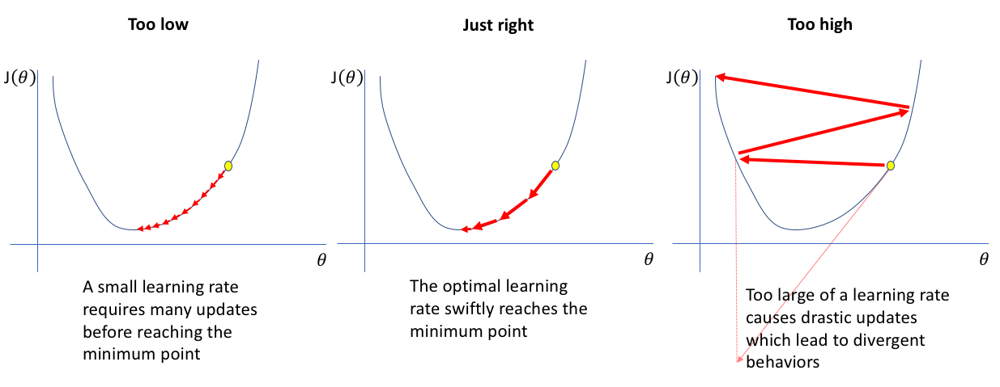
Learning rate values effect:

Slide 37
Lets sum up the whole idea

Slide 38
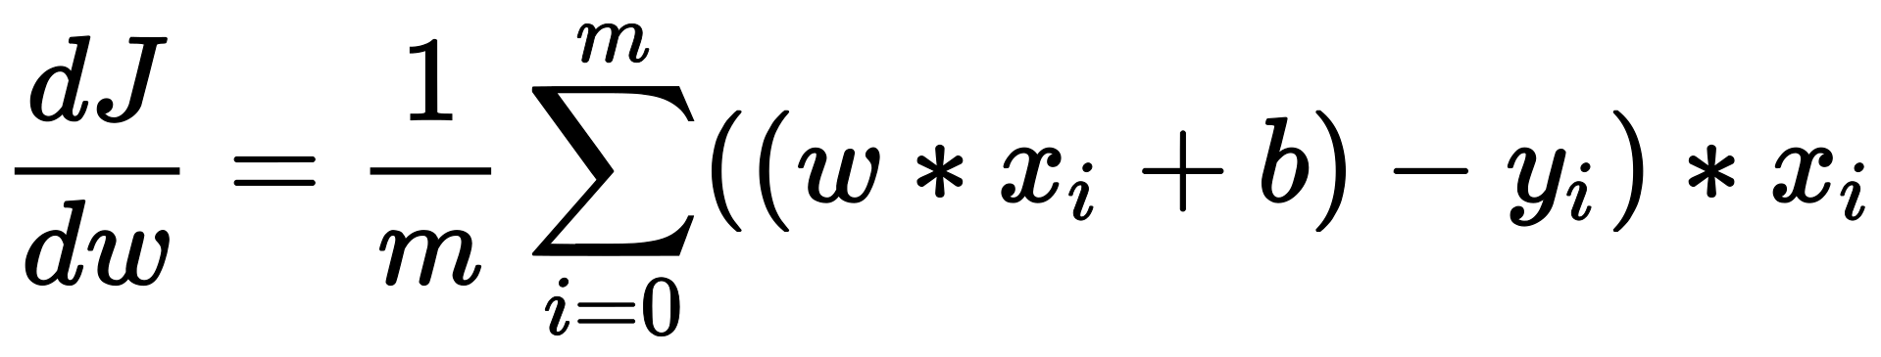
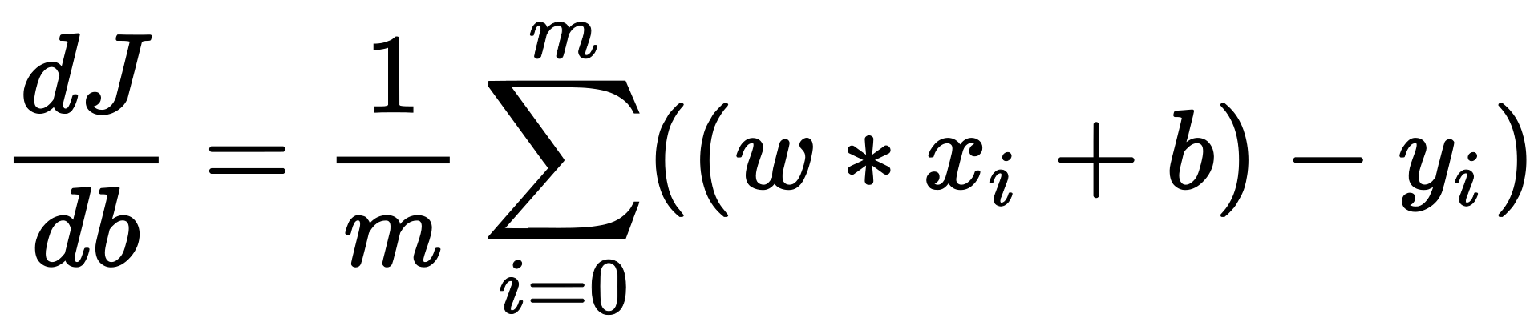
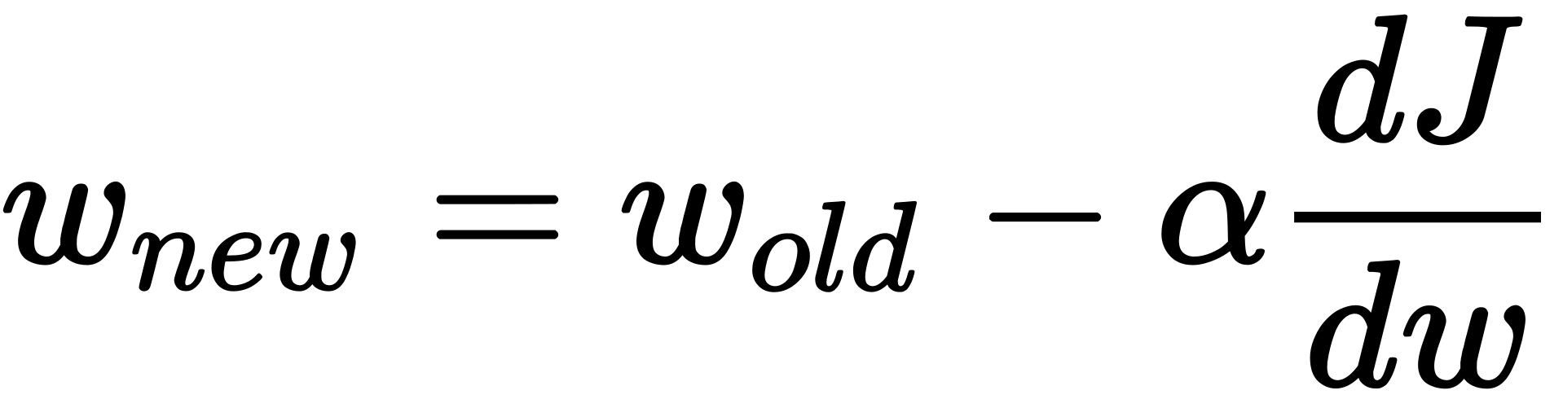
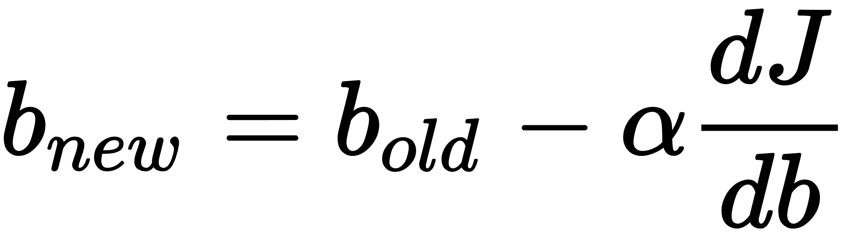
Gradient descent steps:
1- Start with random w and b
2- compute cost
3- compute derivative of cost with respect to w and b
3.1-
3.2-
4- use this derivative to update weight and bias
4.1-
4.2-
5- repeat 2,3,4 until converge or for some number of iterations

Slide 39
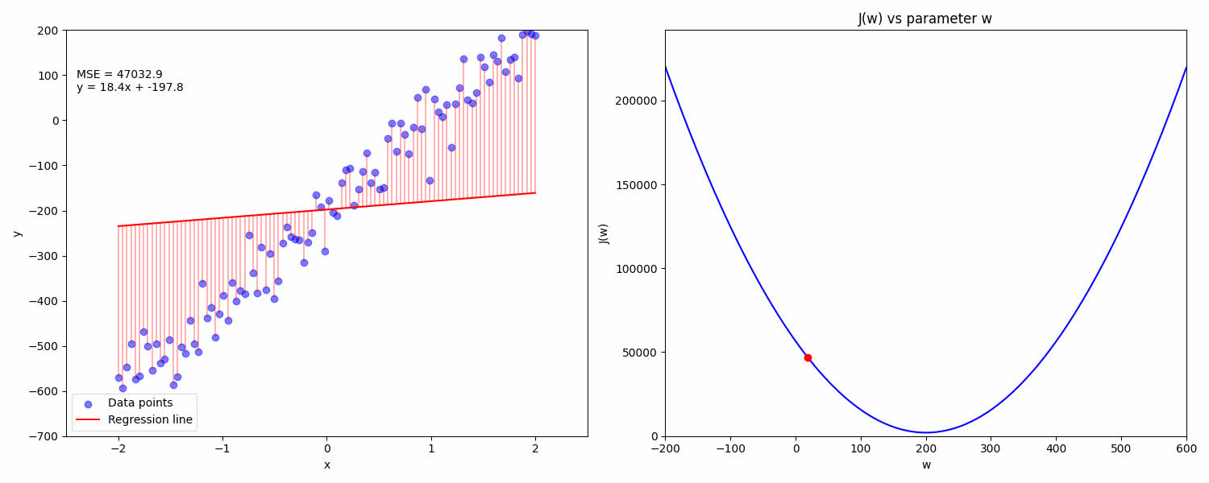
Gradient descent in action

Slide 40
Thank you very much!

