Slide 1
Usage and Implementation of
REST and GraphQL APIs
Markus Hösel

Slide 2
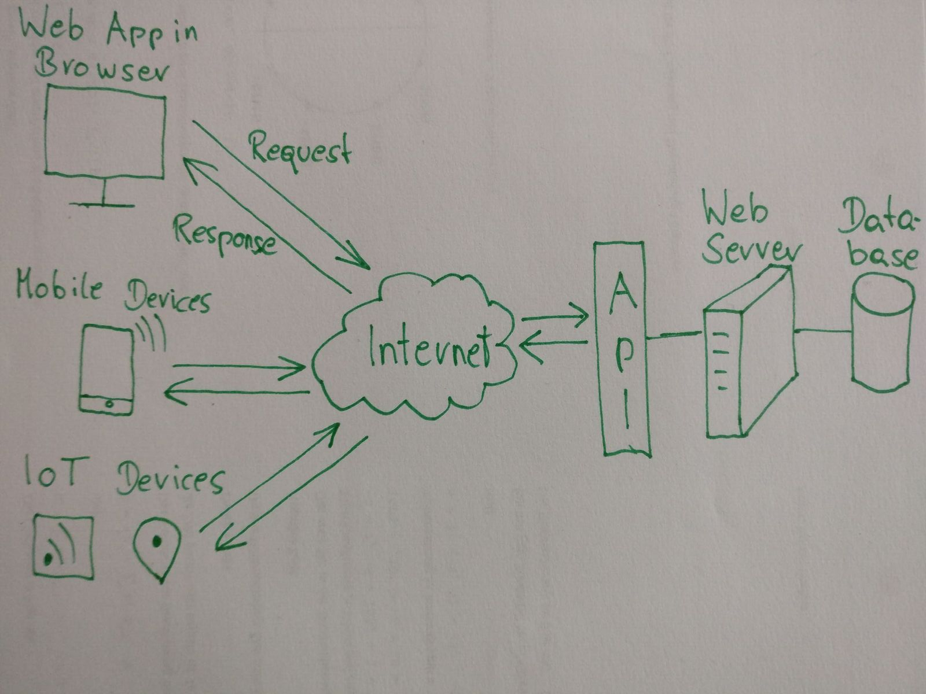
What is an API?

Slide 3
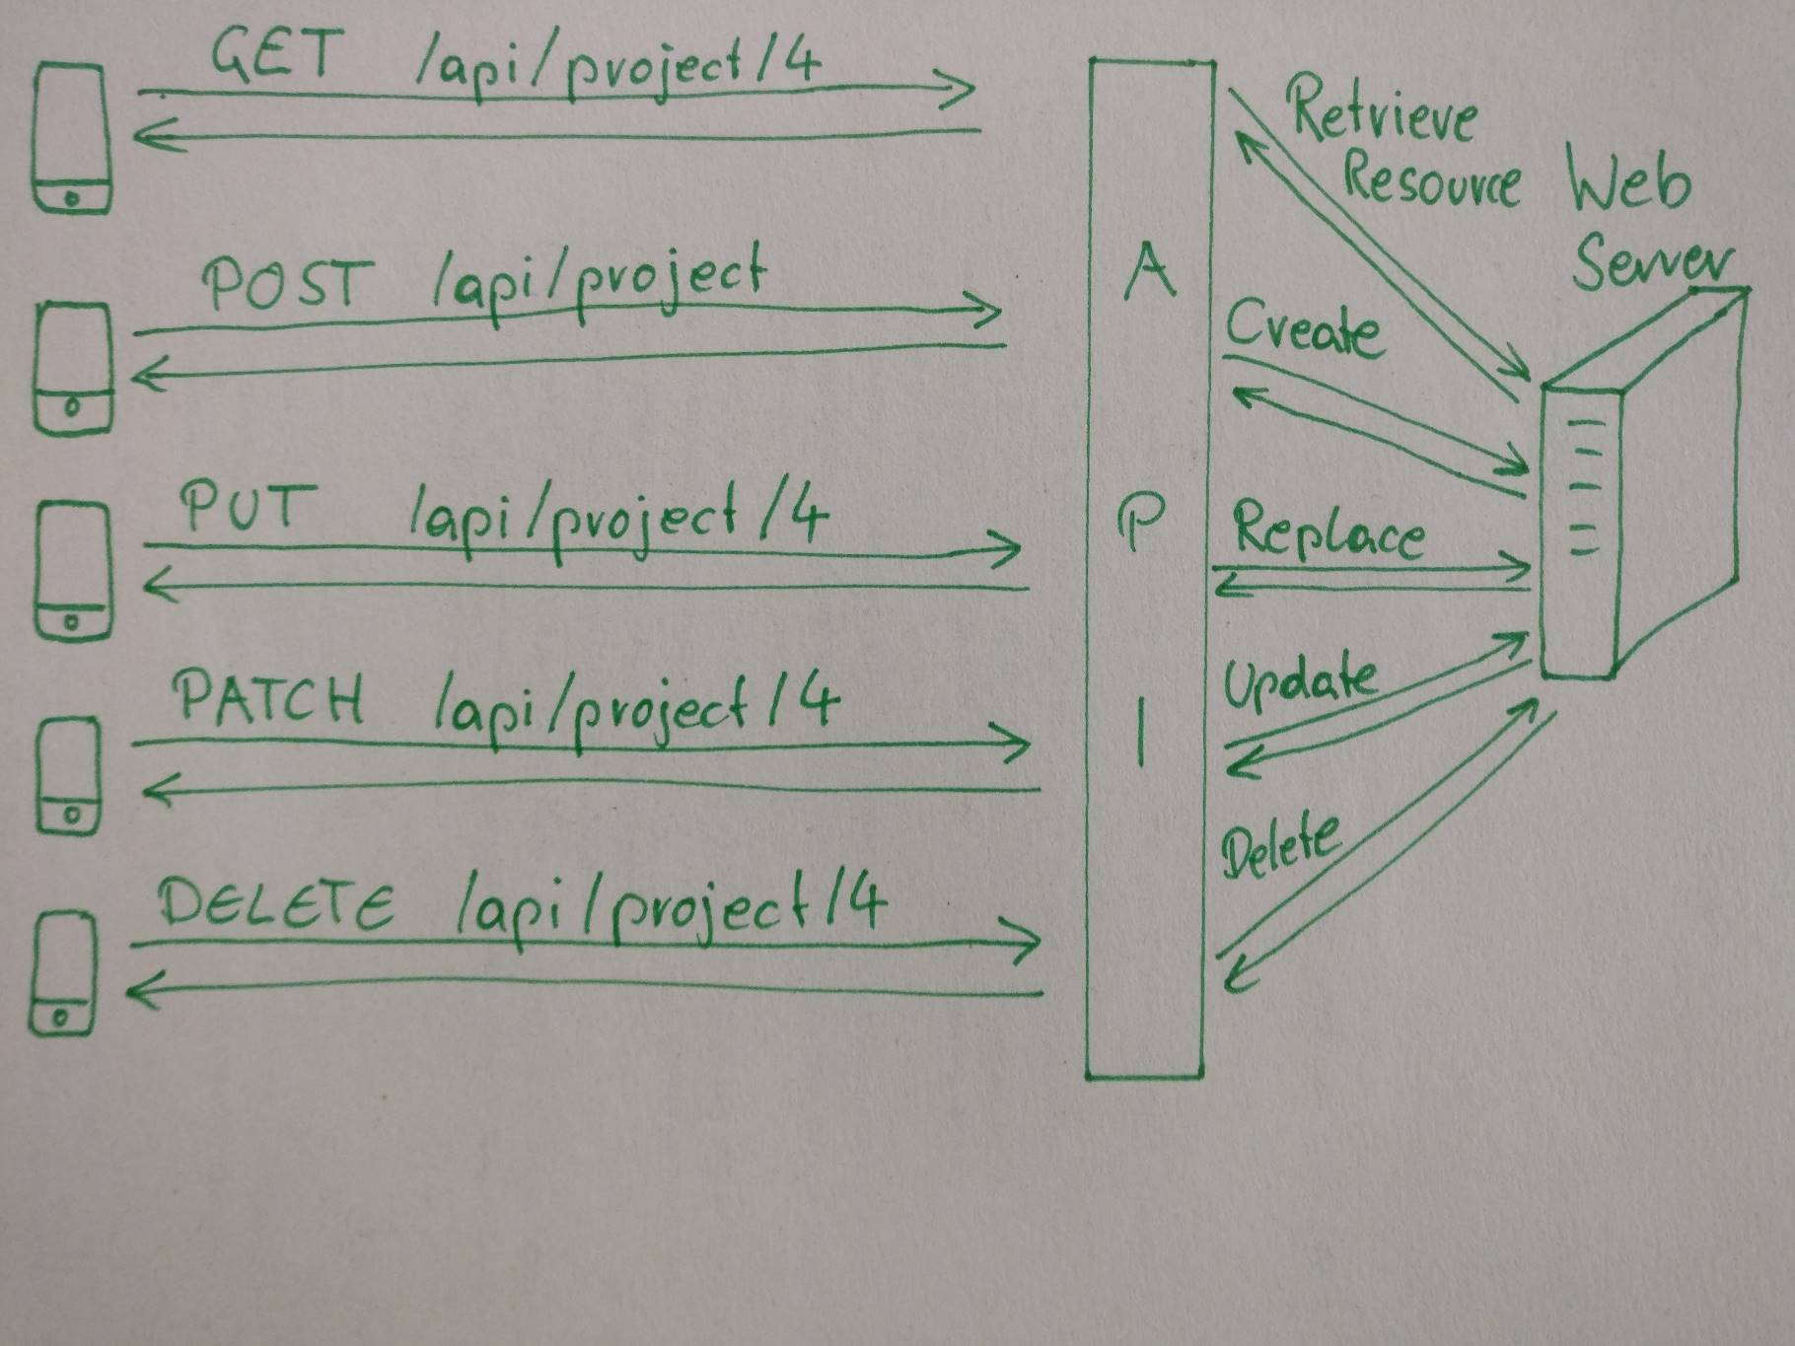
How does REST work?
Resource: { “id” : 4,
“name” : “awesomeProject”
“createdAt” : “2016-01-13” }

Slide 4
How to fetch data?
Querying Githubs REST API

Slide 5
How to fetch data?
Example shows how to get repository names from your Github followers.
First get your profile:
curl -X GET --header 'Accept: application/json' --header 'Authorization: Bearer <your token>' 'https://api.github.com/user'
Than get your followers
curl -X GET --header 'Accept: application/json' --header 'Authorization: Bearer <your token>' 'https://api.github.com/user/followers'
Than get the repos for each of your followers
curl -X GET --header 'Accept: application/json' --header 'Authorization: Bearer <your token>' 'https://api.github.com/users/<user>/repos'
Than get details for each repo
curl -X GET --header 'Accept: application/json' --header 'Authorization: Bearer <your token>' 'https://api.github.com/repos/<user>/<repo>‘
Than filter response to get only the name of the repos
Follow https://github.com/blog/1509-personal-api-tokens to get an access token

Slide 6
Overfetching
Underfetching
Main disadvantages

Slide 7
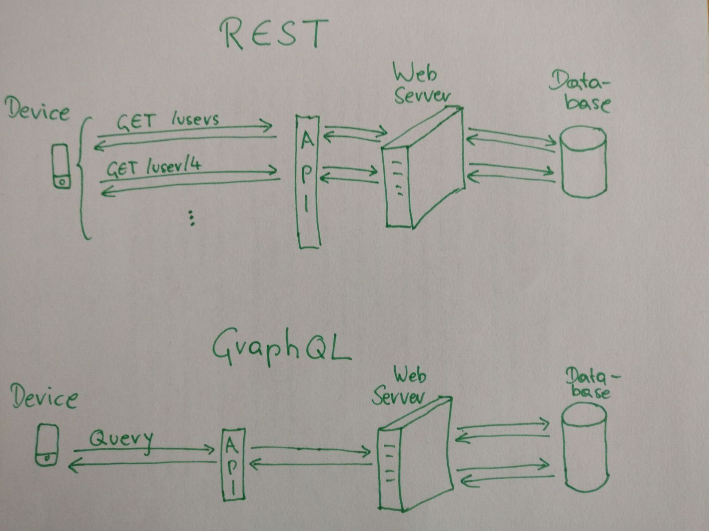
GraphQL for the rescue?

Slide 8
How does GraphQL work?
Single HTTP endpoint called /graphql
Uses only the HTTP POST verb
Two types
  query: retrieve data
  mutation: create, update and delete data
Returns exactly the data asked for!

Slide 9
How to fetch data?
Querying Githubs GraphQL API

Slide 10
How to fetch data?
Example shows how to get repository names from your Github followers.
Create your query:
curl -X POST --header 'Accept: application/json'
--header 'Authorization: Bearer Bearer <your token>'
-d '{"query":"query {
viewer { login,followers(first:30) {
edges {node{
name,repositories(first:30) {
edges {node{
name
}}
}
}}
}
}}"}' 'https://api.github.com/graphql'
Follow https://github.com/blog/1509-personal-api-tokens to get an access token

Slide 11
Caching
More complexity on server in order to resolve the query
Main disadvantages

Slide 12
Live Demo
Implementation of REST and GraphQL endpoint
Environment:
  Hapi webserver with Joi validation
  Swagger
  GraphiQL

Slide 13
Thank you.
  www.hoeselm.at
  mail@hoeselm.at

