Slide 2

What is git (1/2)?
Open Distributed Version Control System
  Open – as a software, as a community (example: git book!)
  Distributed – work locally, contribute globally
  Version Control – helps you, without getting in the way

Slide 3

What is git (2/2)?

Slide 4
How do I get started with git?
Get yourself the “official” cheat sheet
  https://services.github.com/on-demand/downloads/github-git-cheat-sheet.pdf
Download and install git
  https://git-scm.com/downloads
Try it out :-)
Read “the” git book
  https://git-scm.com/book/en/v2
Start collaborating online ... ;-)

Slide 5



Do you know the different online flavors?

Slide 6
Github
Sweetest logo ;-)
Used by FCCVienna
Free repos can be seen by everybody
You pay to get a “closed” repo
https://github.com

Slide 7
Bitbucket
Number 3 in category “logo”
Free repos are closed to the world
https://bitbucket.org/

Slide 8
Gitlab
Coolest logo
Perfect for free self hosting
https://gitlab.com

Slide 9
How to use a fork?
Forks help you collaborate on github
Forking – the “quick and dirty” explanation:
  Fork the project you want to contrib to
  Clone your fork locally
  Add your awesome code
  Sync everything with your fork on github
  Next step: Pull request (with the original project)
Great guide on github
  https://help.github.com/articles/fork-a-repo/

Slide 10
How to “pull a request”?
You have your forked code with your awesome new feature, but what now?
Pull request – the “quick and dirty” explanation:
  Go to your fork on github
  Click on the pull request button
  Leave a comment
  Create the request and wait for the original owner to respond
Great guide on github
  https://help.github.com/articles/about-pull-requests/

Slide 11
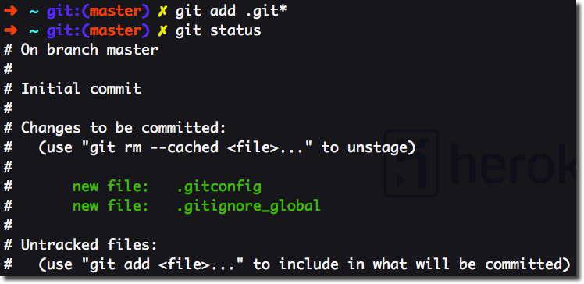
Live Demo?!

Slide 12
Where to go from here?
Create a wonderful .gitignore
Personalize your installation with git config
  Line endings (Win/Mac/Linux), pretty logs, and so much more
Get a graphical interface (gitg, github, …)
What to do when sh*t hits the fan?
  What went (wrong)? git diff, log, status
  How to fix it? git rebase, revert, reset, merge
  The best git command ever: git blame ;-)
Talk to others (online: gitter, irc, forums, stackoverflow, ...)

