Slide 1

Writing a Voting App ...

Slide 2
What comes too mind ?
... boo ? So feel R-bite
Do I need Angular or React.Js?
How to use Twitter with an App ?
Where to get a working MongoDB server?
Has someone done that before?
Any samples ?

Slide 3

Twitter
Register and get API keys for your App
I found a good sample for verification on scotch.io and on github
Google: Easy Node Authentificiation with Twitter Scotch.io
Github: fcc-basejump-voting-app
Github: fcc-voting-app

Slide 4

Used internet services
Heroku
Mlab.com for MongoDB
Keep passwords and urls in environment
Variables !!!! never put on them github !!!

Slide 5
What did I use ?
Simple HTML forms
EJS --- Embedded JavaScript Templates
Node.Js
Mongodb MongoClient
My brain from time to time

Slide 6
Simple HTML Form
<form action="/username" method="get">
<label for="username">Username: </label>
<input type="text" name="username">
<input type="submit" value="Login!" >
</form>

Slide 7
Embedded JS Templates %-)
... are supported by Express
... are activated by app.set('view engine', 'ejs');
... require a views directory
... are recognized by JS code in <> and %
Here's a sample
<%=list[i]%>

Slide 8
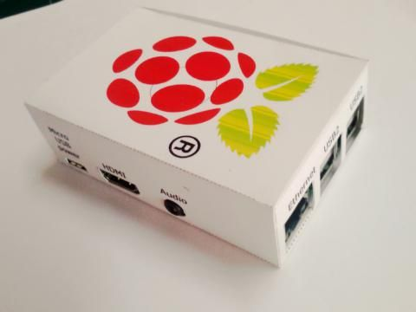
Which super computer is required?
I did this all on a raspberry pi 3 in a self made cardboard box
Maybe you could do it on your smartphone with a bluetooth keyboard

Slide 9
What to keep in mind?
Beware of the async callbacks etc. !
Using return values in functions between modules is handy but not with callbacks
You can make res or resolution a parameter in your function
Module this and module that does not work
Don't be to creative with data transfer (DOM,etc.)

Slide 10
MongoClient
Easy to use and close to the MongoShell
Easy understandable for beginners and newbies
Don't forget to open and close the DB after each access ((otherwise there might be errors))
Looks better in another file as an own module

Slide 11
Delay ?!
Time matters when it should already be done before it started
Should it work or should it just look good
How I urgent do I need my 3rd certificate ?

Slide 12

Thanks!
Www.github.com/MatthiasLiszt/fccvotingappwithtwitter

