Slide 1

Enhanced LLM-aided Testbench Generation
Automated Verilog Testbench Generation with Golden Reference Models

Slide 2
Project Overview
🎯 Automated testbench generation for Verilog modules
🤖 Leverages Large Language Models (LLMs) for intelligent code generation
✅ Creates comprehensive test patterns with verification logic
🔍 Generates Python golden reference models for expected outputs
⚡ Streamlines hardware verification workflow
Key Benefits:
Reduces manual testbench writing effort
Ensures comprehensive test coverage
Provides automatic pass/fail verification

Slide 3
Testbench Generation Framework: Inputs & Outputs
📥 INPUTS:
Natural Language Description
Text file describing module functionality
Input/output specifications
Expected behavior details
Verilog Module Code
The actual HDL implementation to be tested
May contain bugs to be detected
📤 OUTPUTS:
testbench_initial.v - Testbench with test patterns
golden_model.py - Python reference implementation
test_patterns_with_golden.json - Test data with expected outputs
testbench_final.v - Complete testbench with verification logic

Slide 4
5-Step Pipeline Workflow
Step 1-2: Input Handling
Natural Language Description + Verilog Code
Step 3: LLM Testbench Generation
Generate comprehensive test patterns
Step 4: Golden Model Generation
Python model + Expected outputs
Step 5: Testbench Update
Add verification logic & assertions
✅ Final Testbench Ready

Slide 5
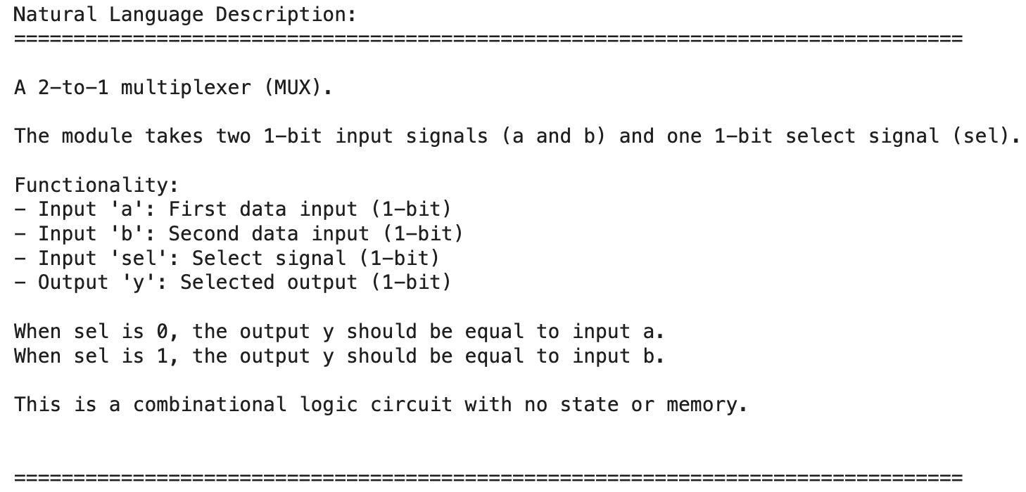
Example: 2-to-1 Multiplexer

Slide 6
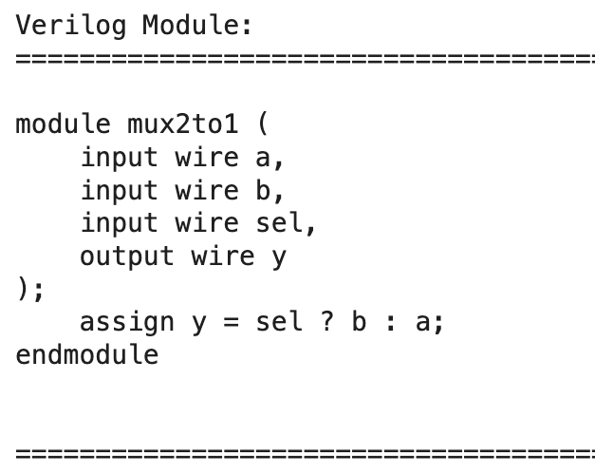
Example: 2-to-1 Multiplexer

Slide 7
Step 3: LLM-Powered Testbench Generation
📝 Process:
Extracts module information (name, inputs, outputs)
LLM generates comprehensive test patterns covering:
Corner cases (all 0s, all 1s)
Boundary values
Typical use cases
Random test patterns
Creates Verilog testbench skeleton
📄 Output: testbench_initial.v
Signal declarations
Module instantiation
Test pattern application
Basic $display statements
⚠️ Does NOT contain expected outputs yet

Slide 8
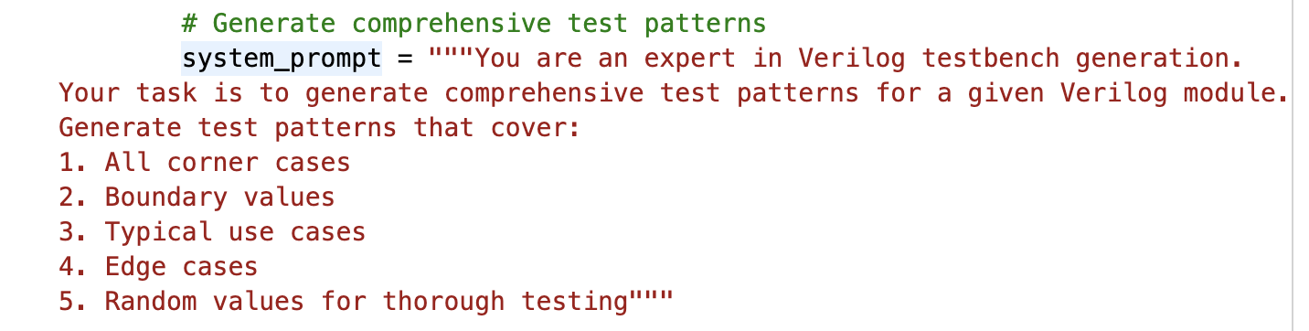
Testbench Generation Prompt

Slide 9
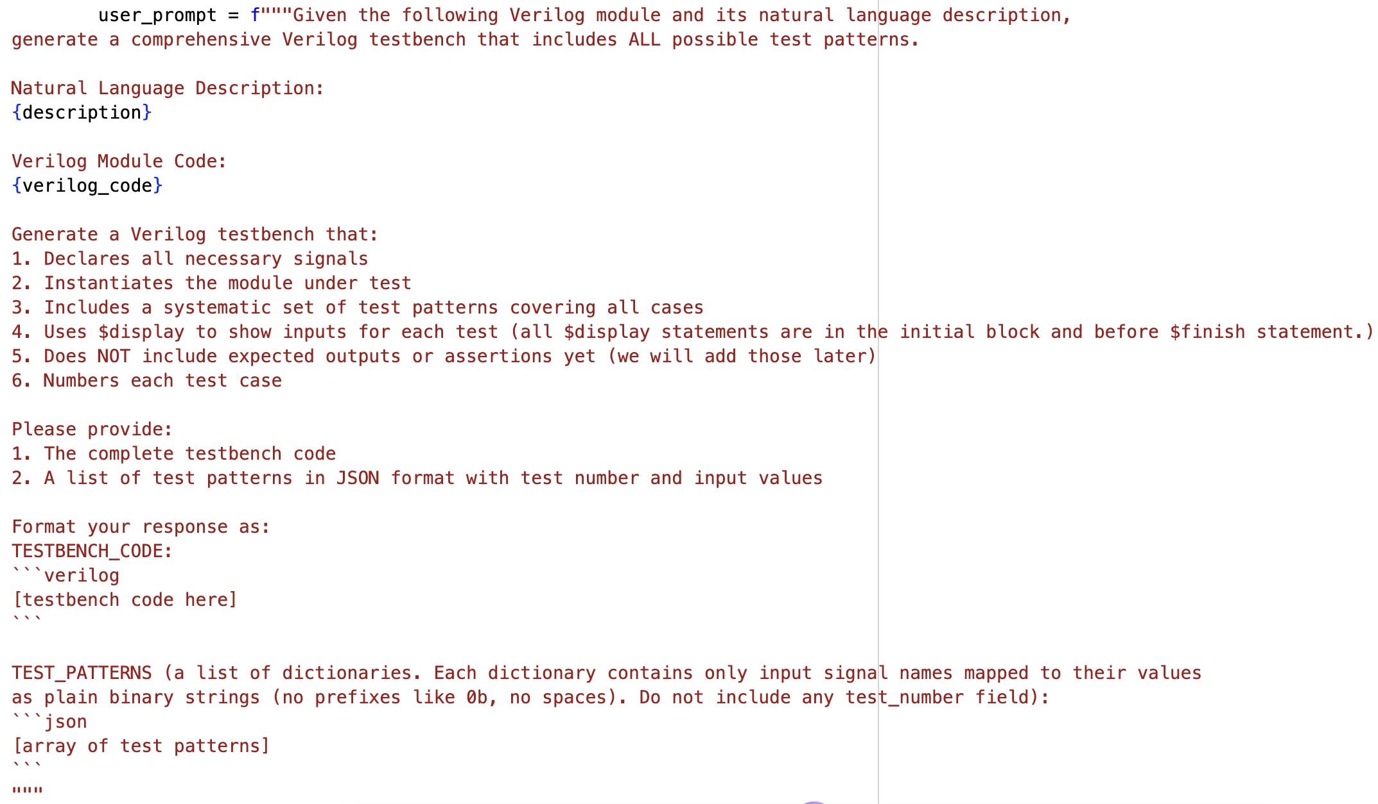
Testbench Generation Prompt

Slide 10
Step 4: Golden Model Generation
🐍 Python Golden Reference Model:
LLM converts natural language description to Python code
Implements expected module functionality
Independent verification reference
🔄 Golden Output Computation:
All test patterns executed through Python model
Expected outputs computed and saved
Results stored in JSON format
📄 Outputs:
golden_model.py - Python implementation
test_patterns_with_golden.json - Test data with expected results

Slide 11
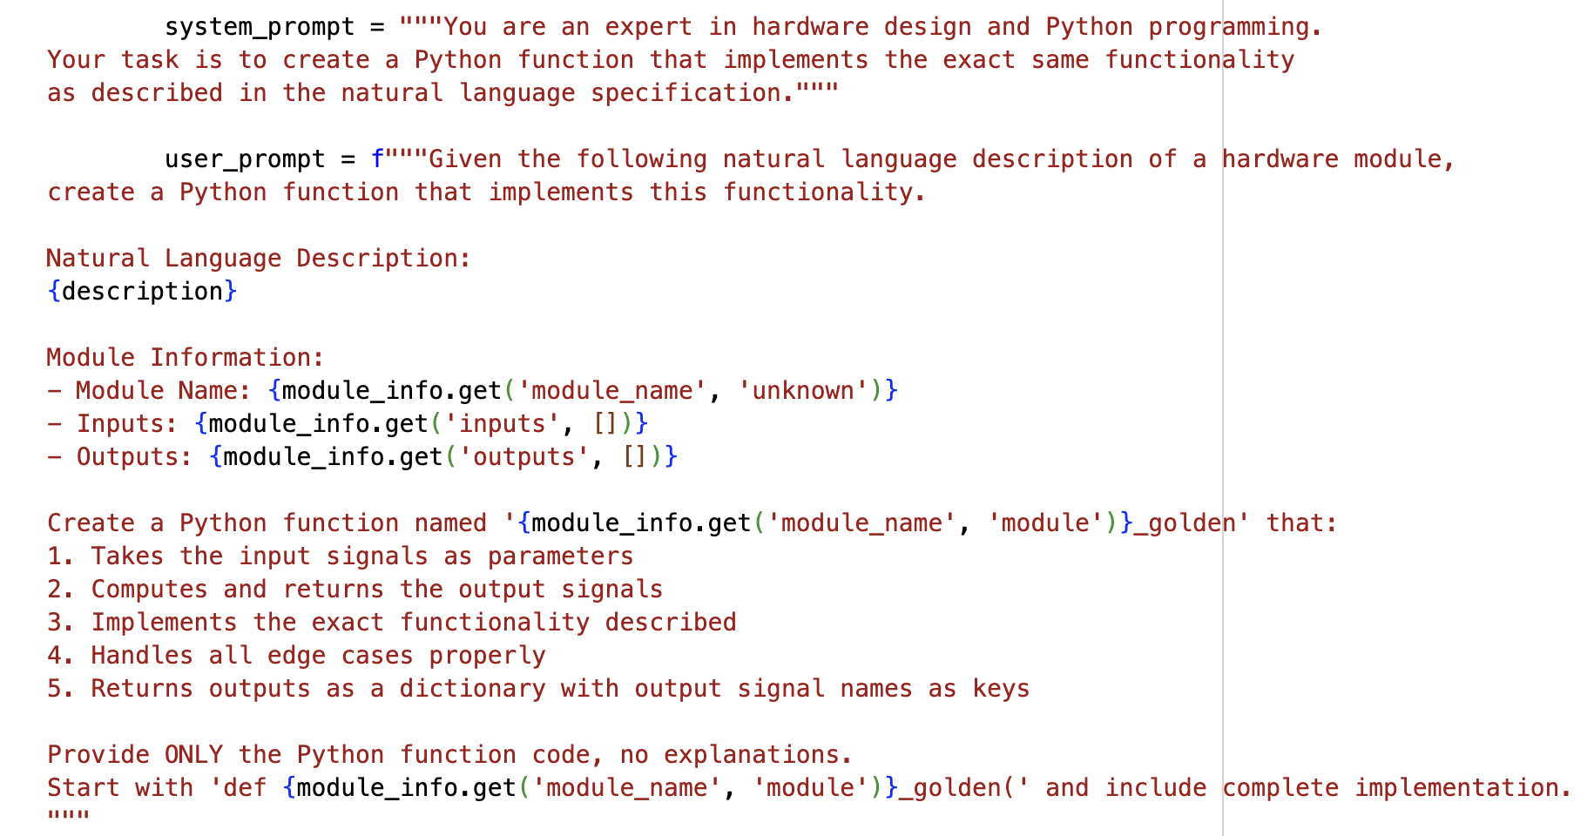
Golden Python Model Generation Prompt

Slide 12
Step 5: Testbench Enhancement with Verification
✨ Testbench Enhancement:
Adds verification logic for each test case
Injects expected outputs from golden model
Implements pass/fail tracking
Generates comprehensive test summary
✅ Verification Features:
Automatic comparison of actual vs expected outputs
Detailed error reporting for failures
Test statistics (total, passed, failed)
Color-coded output for easy debugging
📄 Output: testbench_final.v
Production-ready testbench with full verification

Slide 13
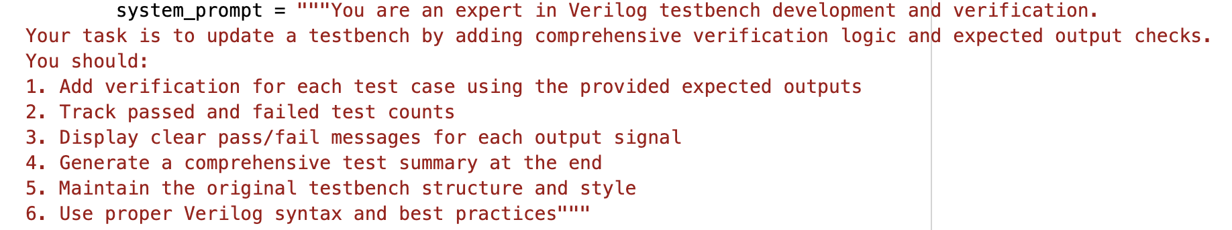
Testbench Enhancement Prompt

Slide 14
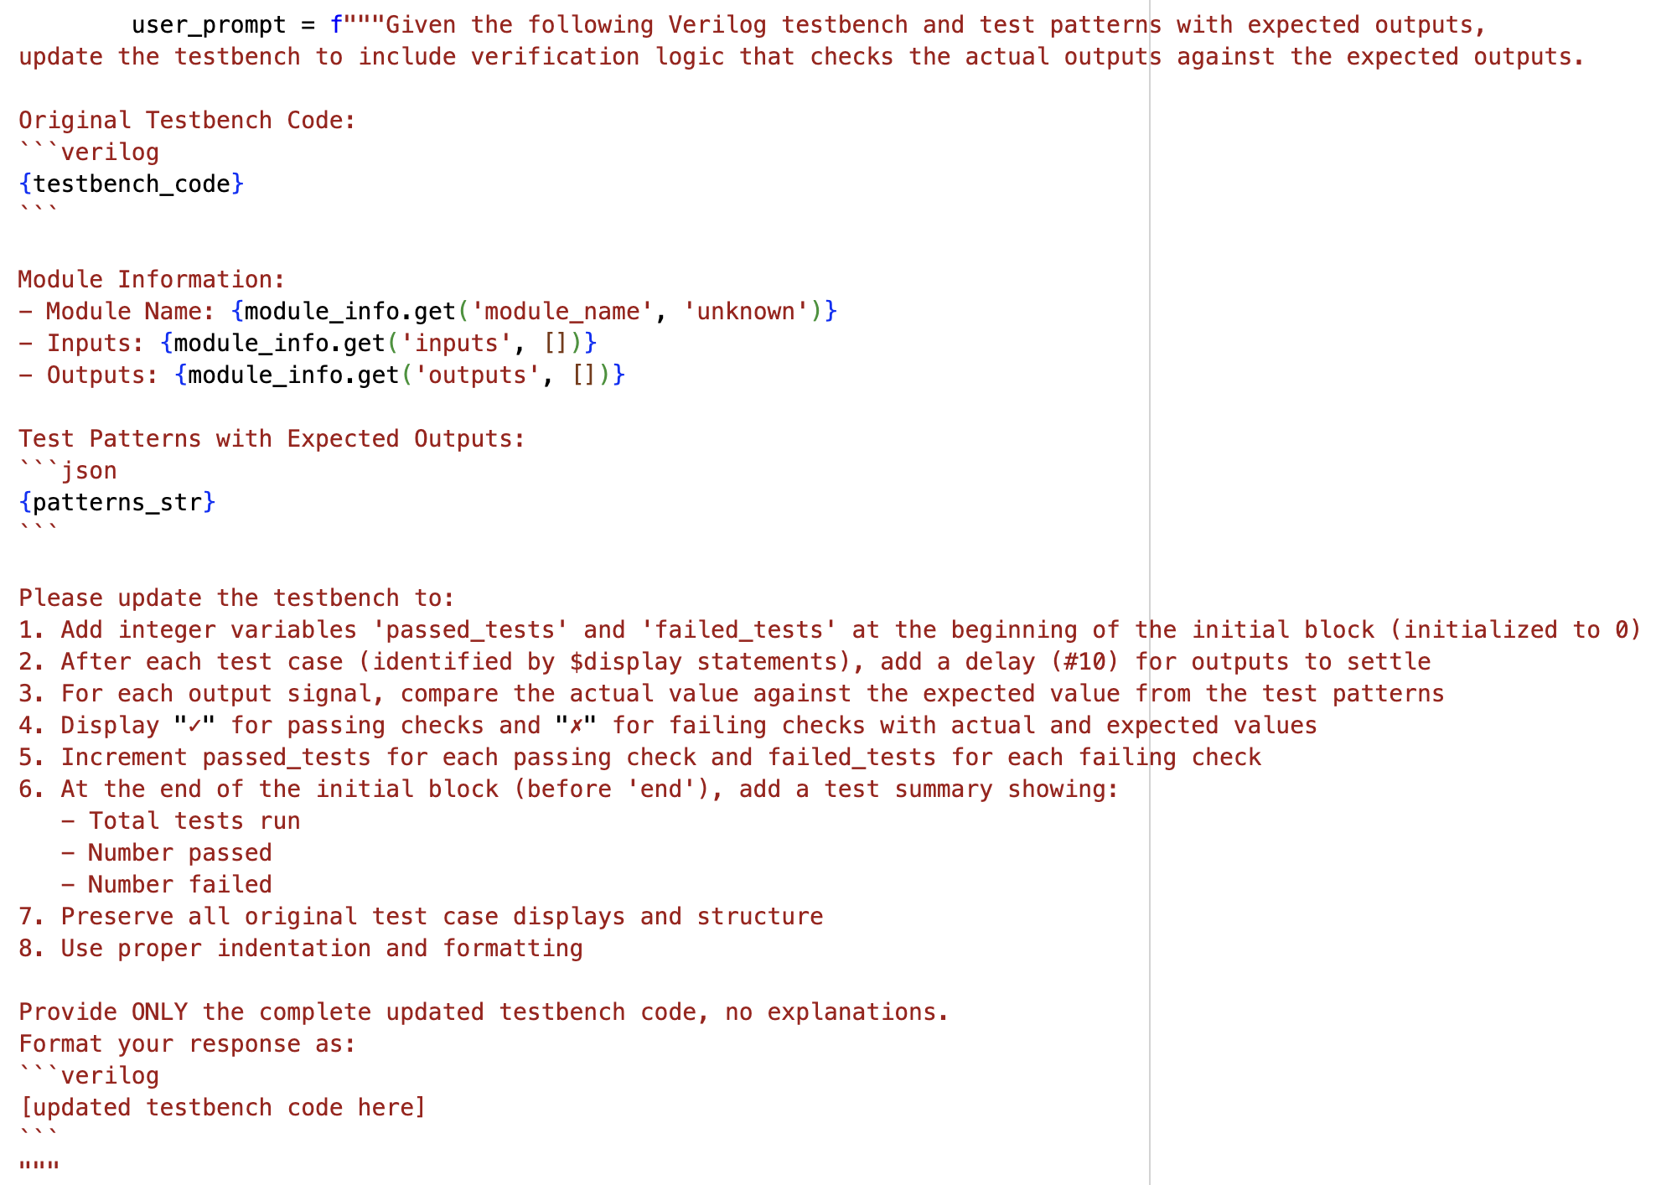
Testbench Enhancement Prompt

Slide 15
Iverilog-based Evaluation Framework
Verilog Module (Design Under Test)
testbench_final.v (Generated Testbench)
iverilog Compiler
sim.vvp (Compiled Binary)
vvp Simulator
📊 Simulation Results Test Summary (Pass/Fail)

Slide 16
Conclusion
🎉 LLM-aided Testbench Generation provides:
✅ Complete automation of testbench creation
✅ Comprehensive test coverage with minimal effort
✅ Golden reference models for verification
✅ Integration with standard simulation tools (iverilog)
✅ Significant time savings in hardware verification
🚀 Future Enhancements:
Support for sequential circuits and FSMs
Waveform generation and analysis
Coverage analysis and reporting
Integration with formal verification tools
📧 GitHub: https://github.com/FCHXWH823/LLM-aided-Testbench-Generation.git

