Slide 1


Veritas: Deterministic Verilog Code Synthesis from LLM-Generated Conjunctive Normal Form
Prithwish Basu Roy, Akashdeep Saha, Manaar Alam, Johann Knechtel, Michalis Maniatakos, Ozgur Sinanoglu, Ramesh Karri

Slide 2
Generative Models and Verilog code generation
LLMs vastly used around the world for coding
Can LLMs be used for Hardware Code generation? Yes

Slide 3
Early works
DAVE
ChipChat
Verigen
AutoChip

Slide 4
Early works - Verigen
Trained CodeGen-2b and 16Bs on open source Verilog code from github and text books
Performed better than the contemporary state-of-the-art GPT3.5
Open-source and testable

Slide 5
RTL-Coder
Used 27k prompt and solution pairs for training
Current SoTA with the highest pass@k values
Open-source and testable

Slide 6
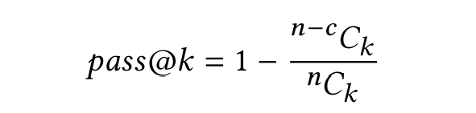
Evaluating the generated code – pass@k

Slide 7
Limitations of Verilog trained Models
Suffers with Syntax issues
Verification post-generation
Involves human intervention for testing

Slide 8
How can we produce codes that are more deterministic?
Can we integrate the verification and testing into the generation phase? Yes
Can we generate accurate code that does not require testing? Yes

Slide 9
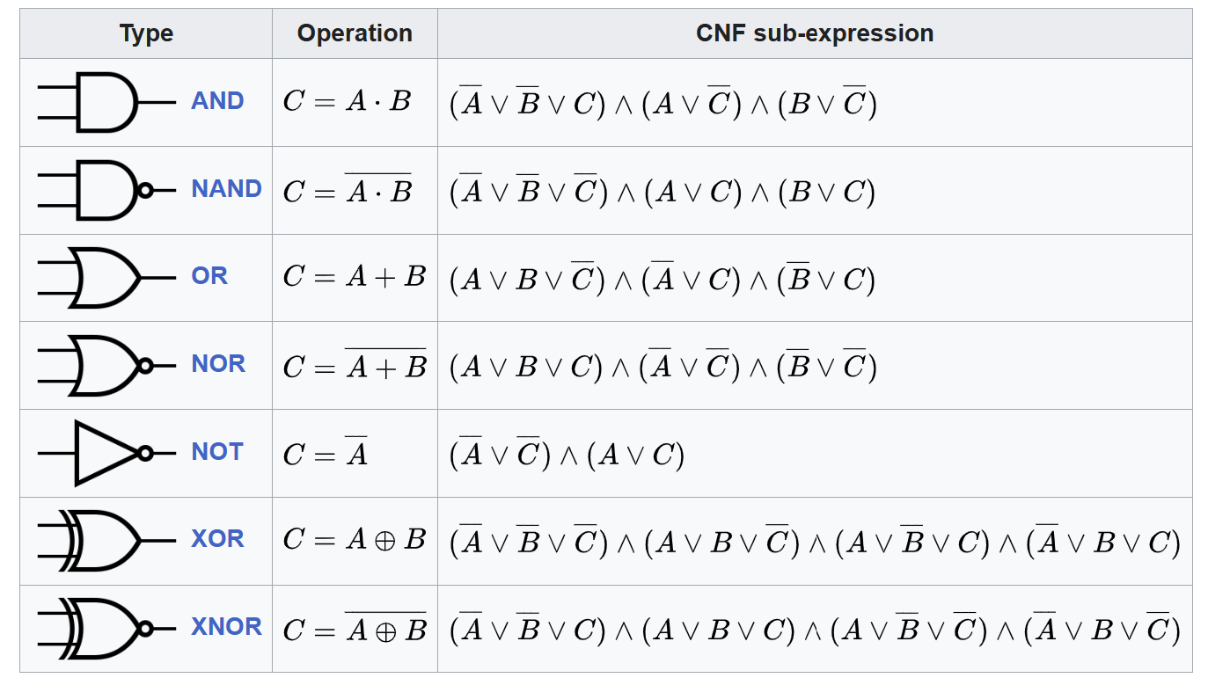
CNFs and logic gates
Each logic gates can be expressed as an equivalent Conjunctive Normal Form representation

Slide 10
CNF ↔ Logic Designs
Logic designs can be represented as a conjunction of Tseytin transformations of the comprising gate of the circuits.
From the CNF equation corresponding bench format of the design can be obtained

Slide 11

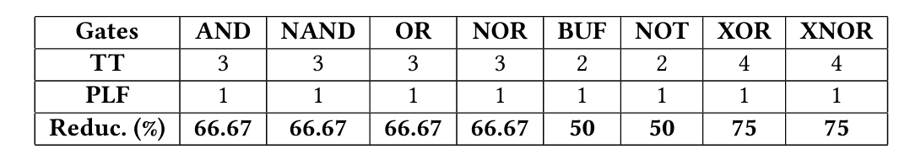
Tseytin expressions are large: Use PLFs
Tsetyin Expression of XOR
Equivalent Propositional Logic Formula of XOR

Slide 12
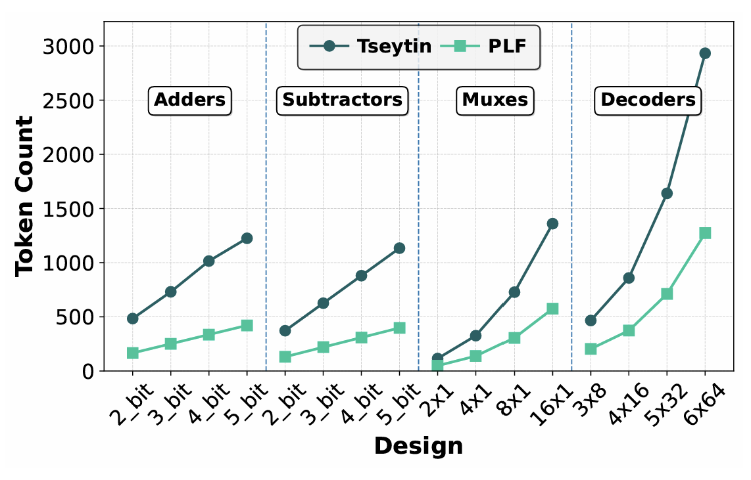
Tseytin and PLFs in terms of tokens

Slide 13
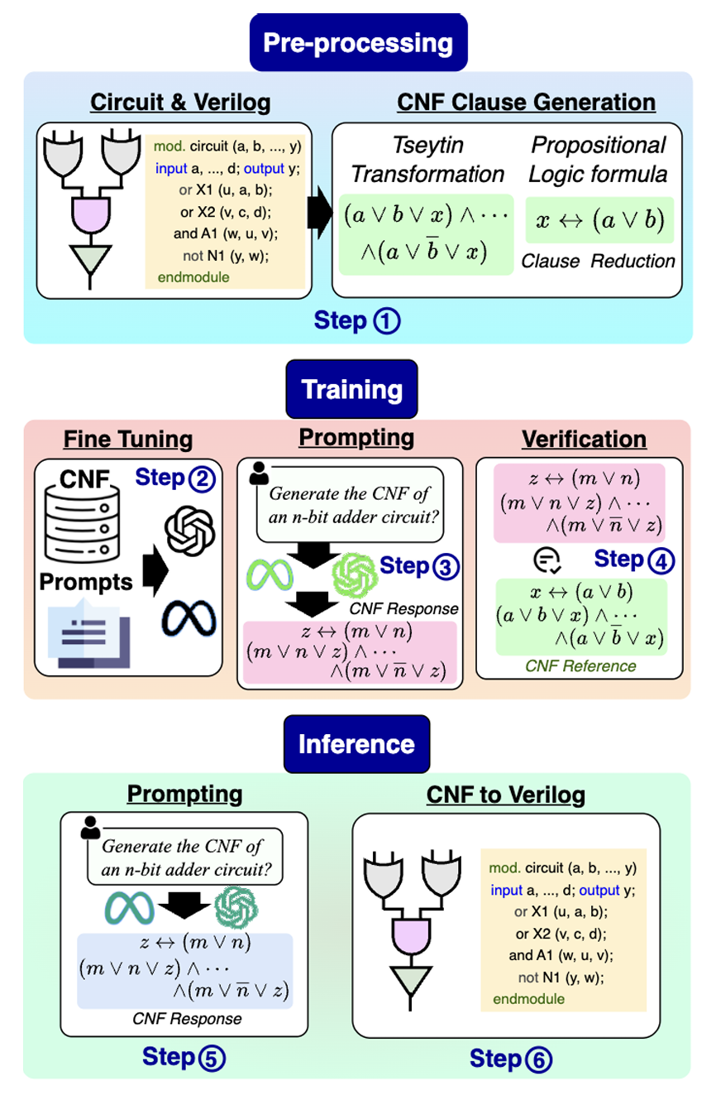
Overall flow of VeriCNF -Stage (1) : Pre-processing phase

Slide 14
Overall flow of VeriCNF -Stage (2) Training phase

Slide 15
Overall flow of VeriCNF - Stage (3) Inference phase

Slide 16
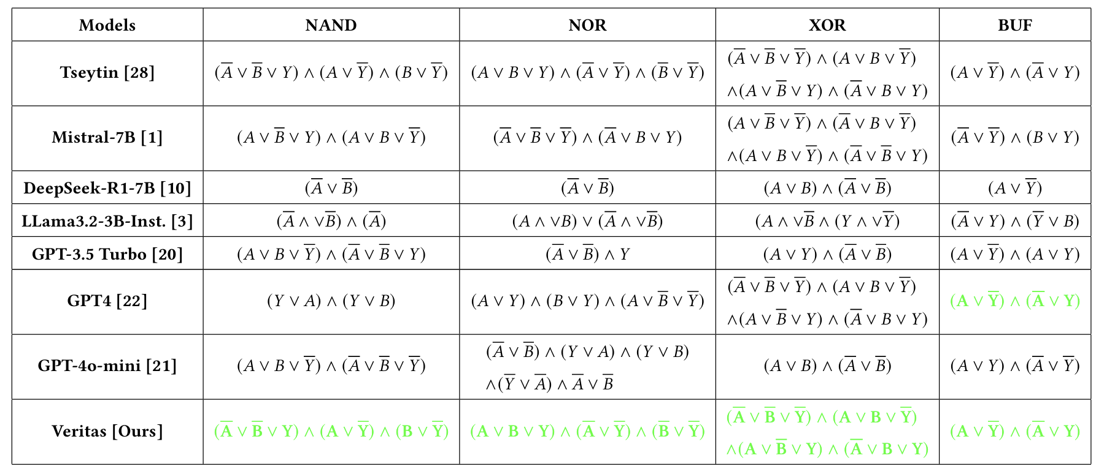
CaseStudy 1: CNF generation capability of base models

Slide 17
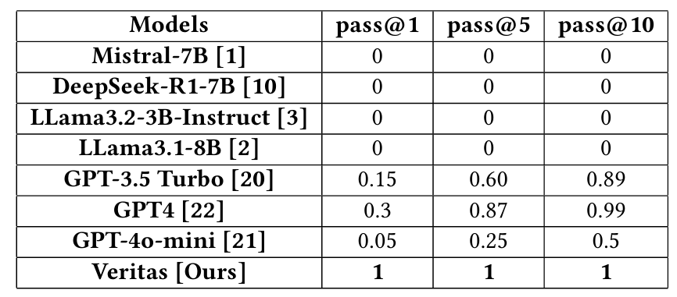
CaseStudy 1: CNF generation capability of base models

Slide 18
Case Study 2: Generating basic circuits
Successfully generated 2-4 bit adders
Successfully generated 2-4 bit subtractors
Successfully 2x1 to 16x1 MUXes
Successfully 2x4 to 5x32 Decoders

Slide 19
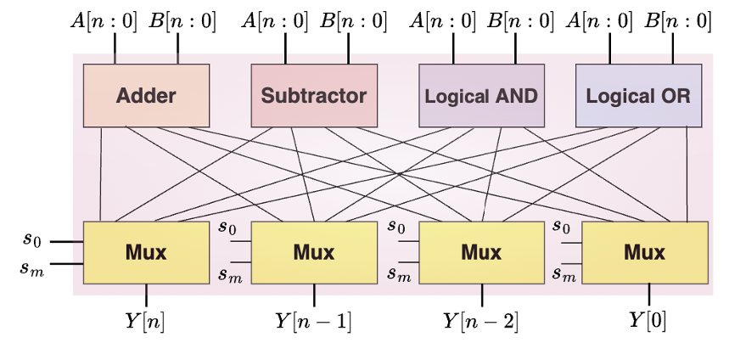
Case Study 3: Generating a small ALU

Slide 20
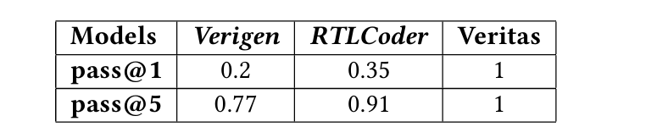
Final Comparison with the SoTA

