Slide 1

LLMs for Bug Detection – Security Assertions
Rahul Kande, Vasudev Gohil, Matthew DeLorenzo
Advisor: Prof. JV Rajendran
Texas A&M University

Slide 2
Massive Growth in HW Vulnerabilities
Hardware vulnerabilities emerging at an alarming rate
Total documented hardware vulnerabilities (CVEs) by year
How to detect vulnerabilities at the pre-silicon stage?
Assertion-based Verification
Source: National Vulnerability Database
Notes:
As hardware designs continue to increase in size and complexity over recent years, in part due to the trend of Moores law, this also results in a large increase in hardware vulnerabilities, in which design flaws by hardware engineers can be exploited by potential malicious attackers. This increase in hardware vulnerabilities is shown in the graph above, demonstrating a steep rise in hardware CVEs, or common vulnerabilities and exposures, over the past few years in particular. This is particularly concerning as hardware vulnerabilities often can not be easily patched like a software bug. Furthermore, if the underlying hardware is not secure, software programs that run on top can also vulnerable to malfunction, even if the software is completely secure on its own. Our hardware is assumed to be a root of trust in development and utilization, and should therefore be free of these vulnerabilities.
Therefore, hardware designers need methodologies to detect these vulenrabilities before the hardware is manufactured, or in the pre-silicon stage. One such way to accomplish this is a design strategy called assertion-based verification.

Slide 3
Hardware Assertions
Statements about a circuit design expected to be always be true.
SystemVerilog Assertions (SVA)
Critical component in hardware verification.
Verify individual functional properties, critical logic.
Detects vulnerabilities early in the design process.
Two types: immediate, and concurrent verifications.
Notes:
Hardware assertions can be defined as statements about a circuits design, or intended functionality, that are always expected to be true.
These statements can be utilized in programming languages for hardware design at the register level, such as SystemVerilog assertions.
These statements are meant to verify critical components with hardware verificatio, including individual functions and critical logic in the desing.
Through these statemetns, we are able to detect vulnerabilities early in the design process, enabling engineers to address them before manufacture.
When considering hardware assertions, there are two main types that are utilized, including immeadiate and concurrent verificaitons.

Slide 4
Immediate Assertions
If-statement.
Not dependent on clock/reset signals.
Ex: Ensure that the current_state is never 0.
immediate_assertion_name:
assert (current_state != 0)
else
error message $error("%m checker failed");
Notes:
Immeadate assertions can be thought of as simple if-statements as in programming, as these assertions are not dependent on clock or reset signals.
An example of this is shown above in which a designs state should never be qual to 0.
In this case we can create an dassertions that checks if the state is 0, and throws an error if the state is true.

Slide 5
Concurrent Assertions
More complex statements.
Span time, triggered relative to the clock edge.
Keyword “property”.
Ex: Check that an ack signal arrives 3-5 clock cycles after a request.
assert property (@(posedge clk) req |-> ##[3:5] ack);

Slide 6
Hardware Vulnerability Detection
module rsa_wrapper(
input clk,
input rst_ni,
input reglk,
input debug_req,
input jtag_unlock,
input [31:0] address,
input we,
input [31:0] wdata,
output [31:0] rdata
);
. . .
assign debug_en =
debug_reg & jtag_unlock;
assign read_en = (!reglk) || debug_en;
. . .
// Implement MD5 I/O memory map interface
// Read side
always @(clk) begin
if (!rst_ni)
. . .
else if(!we) begin
case(address[10:3])
0:
rdata <= read_en ? msg: 0;
. . .
default:
;
endcase // address[10:3]
end
end
. . .
endmodule
RISC-V Hack@DAC SoC
Register Lock Security Feature “Locked data is not accessible”

Slide 7

Hardware Vulnerability Detection
module rsa_wrapper(
input clk,
input rst_ni,
input reglk,
input debug_req,
input jtag_unlock,
input [31:0] address,
input we,
input [31:0] wdata,
output [31:0] rdata
);
. . .
assign debug_en =
debug_reg || jtag_unlock;
assign read_en = (!reglk) || debug_en;
. . .
// Implement MD5 I/O memory map interface
// Read side
always @(clk) begin
if (!rst_ni)
. . .
else if(!we) begin
case(address[10:3])
0:
rdata <= read_en ? msg: 0;
. . .
default:
;
endcase // address[10:3]
end
end
. . .
endmodule
RISC-V Hack@DAC SoC
Register Lock Security Feature “Locked data is not accessible”
Buggy Verilog Implementation

Slide 8
Hardware Vulnerability Detection
module rsa_wrapper(
input clk,
input rst_ni,
input reglk,
input debug_req,
input jtag_unlock,
input [31:0] address,
input we,
input [31:0] wdata,
output [31:0] rdata
);
. . .
assign debug_en =
debug_reg || jtag_unlock;
assign read_en = (!reglk) || debug_en;
. . .
// Implement MD5 I/O memory map interface
// Read side
always @(clk) begin
if (!rst_ni)
. . .
else if(!we) begin
case(address[10:3])
0:
rdata <= read_en ? msg: 0;
. . .
default:
;
endcase // address[10:3]
end
end
. . .
endmodule
RISC-V Hack@DAC SoC
Register Lock Security Feature “Locked data is not accessible”
Buggy Verilog Implementation
Hardware assertions
Constraints
assert property (@(posedge clk) disable iff ((!rst_ni))
(rdata != 0) |-> ($past(reglk) == 0) || ($past(jtag_unlock) == 1))
else $display("ERROR, Register access violated!!, time=%4d", $time);
Can we automate assertion generation?
Signal names
Syntax
Signal values
Conditions
Signal values
Timing

Slide 9





Limitations of Assertion-based Verification
Tedious manual effort
Error-prone
Scalability issues

Slide 10
(Security) Assertions by Large Language Models
R. Kande et al.
Published at IEEE TIFS 2024
Notes:
Prompts with varying level of detail and complexity automatically generated based on various codes and clues for the assertion/
From here the assertion file for a myriad of circuit designs is processed and altered through syntax correction tools, and simulated.

Slide 11
LLMs for Hardware Vulnerability Detection
(Security) Assertions by Large Language Models, TIFS 2024
93.55% accuracy
LLM evaluation framework
10 Benchmarks HW CWEs
7 Prompt Evaluation Metrics
2K+ Prompt Configurations
200K+ Assertions Generated
Accuracy varies extremely with prompts
0% accuracy
Notes:
More detail – more success
- Still need an amount fo security expertise

Slide 12

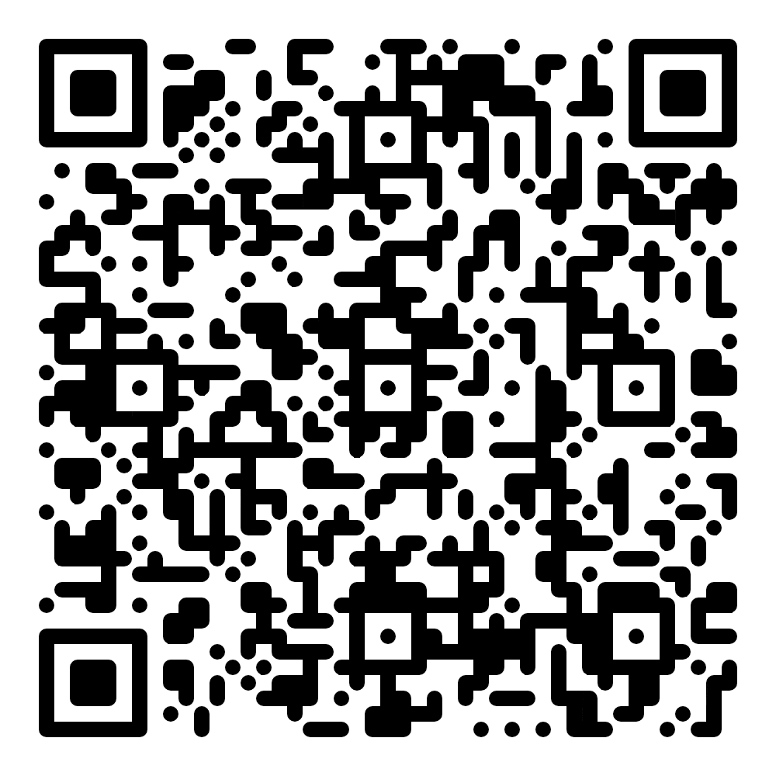
Demo
https://colab.research.google.com/drive/1OG5nmWKTvbsvfmMrlIy3L-0U1wzWOtkS?usp=sharing
Notes:
assert property (@(posedge clk) (signal == GREEN) |-> ($past(signal) == RED));

Slide 13
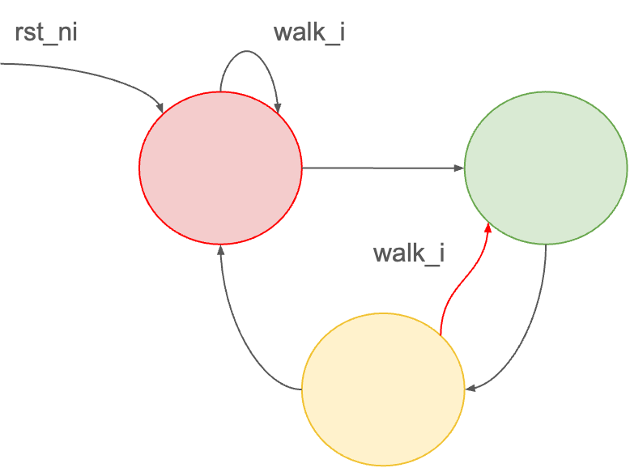
Tutorial Task – New Bug Diagram
Notes:
assert property (@(posedge clk) (signal == GREEN) |-> ($past(signal) == RED));

Slide 14
Tutorial Task – Solution Example
#@title Finding the bug - Solution
prompt = "Complete the following hardware assertion to check that at \
every positive edge of clk, if the value of the signal register is GREEN, then \
the value of the signal register in the previous clock cycle is RED\nassert property. "
prompt += "An example of hardware assertion to check that at every \
positive edge of clock, if the value of the data register is DONE, \
then the value of the data register in the previous clock cycle is either VALID\
or DONE is: assert property (@(posedge clk) (data == DONE) |-> ($past(data) == VALID) || ($past(data) == DONE));"
model = ChatGPT3p5() # <-- we are using ChatGPT 3.5
messages=[ # <-- this is the prompt to LLM
{"role": "system", "content": "You are a helpful assistant."},
{"role": "user", "content": prompt}
]
print(model.generate(messages)) # <-- this prints the response from the LLM
#print(model.generate(messages,seed=12345,temperature=0.0)) # <-- this tries to generate a deterministic response from the LLM
#check for something thats valid
#- transitions into red should happen through yellow or red.
#- similar - transitions into green - happen through red or green.
#- Check reset behavior -
#assert property (@(posedge clk) (signal == GREEN) |-> ($past(signal) == RED));
Notes:
assert property (@(posedge clk) (signal == GREEN) |-> ($past(signal) == RED));

Slide 15

Thank You
Matthew DeLorenzo
Secure and Trustworthy Hardware (SETH) Lab
https://seth.engr.tamu.edu
Texas A&M University
(Security) Assertions by Large Language Models

Slide 16
Conclusion

Slide 17
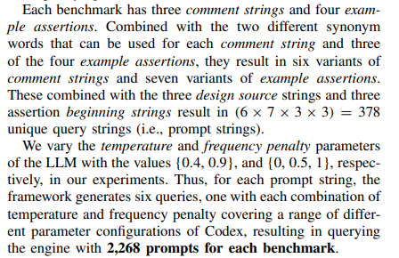

Slide 18

LLM Generation Process
Token | Probability
blue | 38%
clear | 20%
usually | 8%
the | 3%
…
More likely ↑
The
sky
is
blue
Less likely ↓

Slide 19

LLMs for Chip Design
⎯⎯⎯⎯⎯⎯
⎯⎯⎯⎯⎯⎯
⎯⎯⎯⎯⎯⎯
LLM
Iterative Chip Design
always @(posedge clk)
. . .
Verilog Generation
always @(posedge clk)
. . .
Finding Bugs

Slide 20
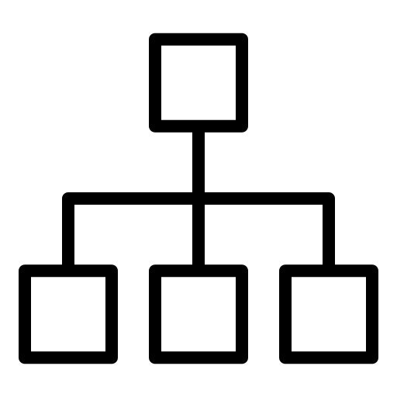
Ongoing and Future Work
On Hardware Security Bug Code Fixes By Prompting Large Language Models
Fixing Hardware Security Bugs with Large Language Models
FLAG: Finding Line Anomalies (in code) with Generative AI
Make Every Move Count: LLM-based High-Quality RTL Code Generation Using MCTS
always @(posedge clk)
. . .

Slide 21
Resources
Tutorial GitHub link: https://github.com/JBlocklove/LLMs-for-EDA-Tutorial/tree/main
Generating HDL with Feedback Loops
Colab: https://colab.research.google.com/drive/1Va3Jp5zwr4RW-zrCHIHQvJ8pmhN-EFpD?usp=sharing
Slides: https://docs.google.com/presentation/d/11LRoS_cXT9edCsGC3phwMg8PaxwQasIfkjv0TKSbjOY/edit?usp=sharing
VeriGen
Colab: https://colab.research.google.com/drive/1ej8KTGtwqz3k4ZKDTeprmhELZinbEIdQ?usp=sharing
Slides: https://docs.google.com/presentation/d/1YkYKaaPcDMpd8W5t-eU0Ay_4NxClxU_J5_VSo-iDZ10/edit?usp=sharing
LLM for Bug Detection
Colab: https://colab.research.google.com/drive/1NJKfDE5GxWru92vUK4k-kVncMK3Znufx?usp=sharing
Slides: https://tamucs-my.sharepoint.com/:p:/g/personal/gohil_vasudev_tamu_edu/EZLbyLfKxoZGk7YHE5QNPrUB_TlHbohVJ_FvL_GI__oLmw?e=Rpv4Wz

Slide 22
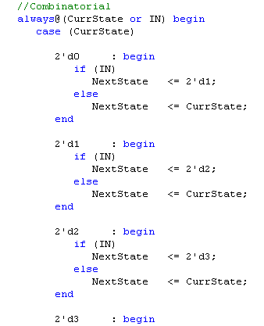

Hardware Design
Hardware (root-of-trust)
Register-Transfer-Level (RTL)
Hardware description languages (HDLs)
Verilog, SystemVerilog, VHDL
Thousands of RTL code lines
Synthesized into registers, wires and hardware logic
Is this RTL secure?

Slide 23



LLM Training Process
The
sun
rises
in
the
east
Token/word sequence seen so far
Predicted token
Training
Pre-Trained LLM
Synthetic Data (e.g., Cosmopedia)

Slide 24
LLM Generation Process
Token | Probability
blue | 38%
clear | 20%
usually | 8%
the | 3%
…
More likely ↑
The
sky
is
blue
Less likely ↓

Slide 25
LLMs for Chip Design
⎯⎯⎯⎯⎯⎯
⎯⎯⎯⎯⎯⎯
⎯⎯⎯⎯⎯⎯
always @(posedge clk)
. . .
LLM
Verilog Generation
Conversational Chip Design
always @(posedge clk)
. . .
define_design_lib . . .
set link_library . . .
. . .
Fixing Security Bugs
EDA Script Generation

