Slide 1

Hybrid-NL2SVA: Integrating RAG and Finetuning for LLM-based NL2SVA
Weihua Xiao, Derek Ekberg, Siddharth Garg, Ramesh Karri
25 Sep, 2025

Slide 2
Outline
Introduction
Methodology
Experimental Results
Conclusion

Slide 3



SystemVerilog Assertion (SVA)
Assertion used for verification
always_ff @(posedge clk) begin
if (!rst_n) begin
d1 <= 1'b0;
d2 <= 1'b0;
grant <= 1'b0;
end else begin
d1 <= req;
d2 <= d1;
grant <= d2;
end
end
assert property(
@(posedge clk)
disable iff (!rst_n)
req |->##2 grant
);
Natural Language to SVA (NL2SVA)
SVA
Verification
Verilog code
If req is 1 now, grant must be high exactly 2 cycles later.
Specification Document
Design Property

Slide 4
Related Works of NL2SVA: Rule-based
Natural Language Pattern | SVA Template
… | …
When <signal1> rises, then <signal2> must be high <N> cycles later. | assert property (@(posedge clk) $rose(<signal1>) |-> ##<N> <signal2>);
… | …
Best Matching
When req rises and holds high for 2 cycles, then grant must be 1 on the 3rd cycle.
Limitation of Rule-based Template
Rule-based Template
Need substantial manual effort
assert property(
@(posedge clk)
$rose(req) ##1 req[*2] |-> grant);
assert property(
@(posedge clk)
$rose(req) |-> ##3 grant
);
Miss hold condition
Wrong timing condition
Golden SVA
Generated SVA

Slide 5

Related Works of NL2SVA: LLM-based
assert property(
@(posedge clk)
$rose(req) ##1 req ##1 req |=> grant);
When req rises and holds high for 2 cycles, then grant must be 1 on the 3rd cycle.
Lack of SVA knowledge!
Generated SVA
Wrong use of |->, |=>
assert property(
@(posedge clk)
$rose(req) ##1 req[*2] |-> ##3 grant);
Golden SVA

Slide 6
Hybrid-NL2SVA: Summary & Contribution
RAG-based Framework for SVA Knowledge
RAG Database: Textbooks for Hardware Design & Verification
Customized RAG Framework: Hybrid Retrieval
Finetuning for Lightweight LLMs

Slide 7
Outline
Introduction
Methodology
Experimental Results
Conclusion

Slide 8
Customized RAG Framework: Database Construction
// code database
last paragraph + Code blocks (font-based detection) + next paragraph
// text database
Each paragraph of remaining texts
// how to work (Dynamic RAG framework)
Query type: code task / text task;
Get the corresponding database;
Do similarity search in the database;
Use extracted context information.
Database
Code database
Text database
Dynamic Chunk Splitting

Slide 9
Proposed dynamic chunk splitting
// code database
last paragraph + Code blocks (font-based detection) + next paragraph
// text database
Each paragraph of remaining texts
// how to work (Dynamic RAG framework)
Query type: code task / text task;
Get the corresponding database;
Do similarity search in the database;
Use extracted context information.
Database
Code database
Text database
Notes:
Two database:
Text database
Code database

Slide 10
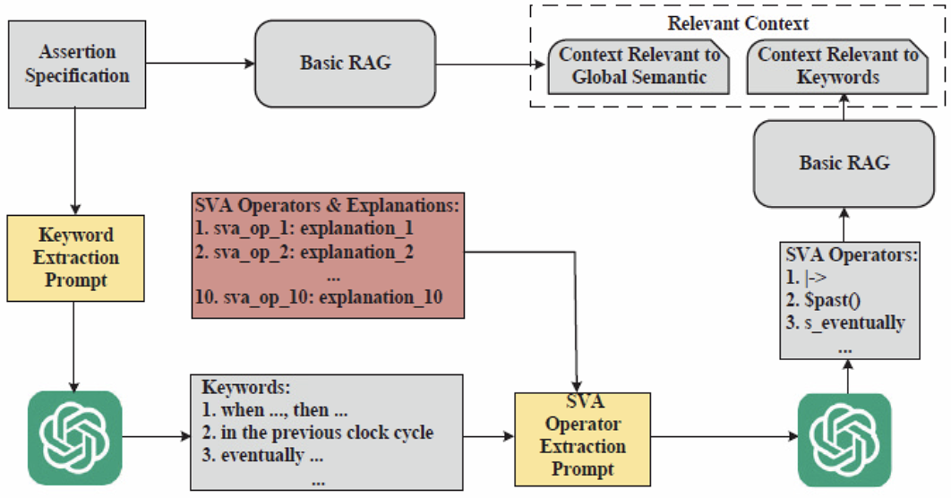
Customized RAG Framework: Hybrid-Retrieval

Slide 11
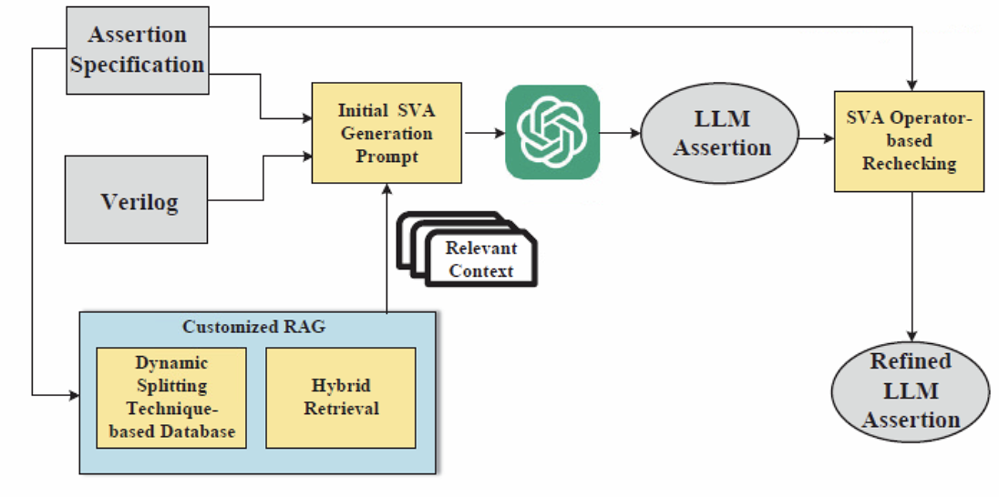
Customized RAG Framework: Overall Flow

Slide 12
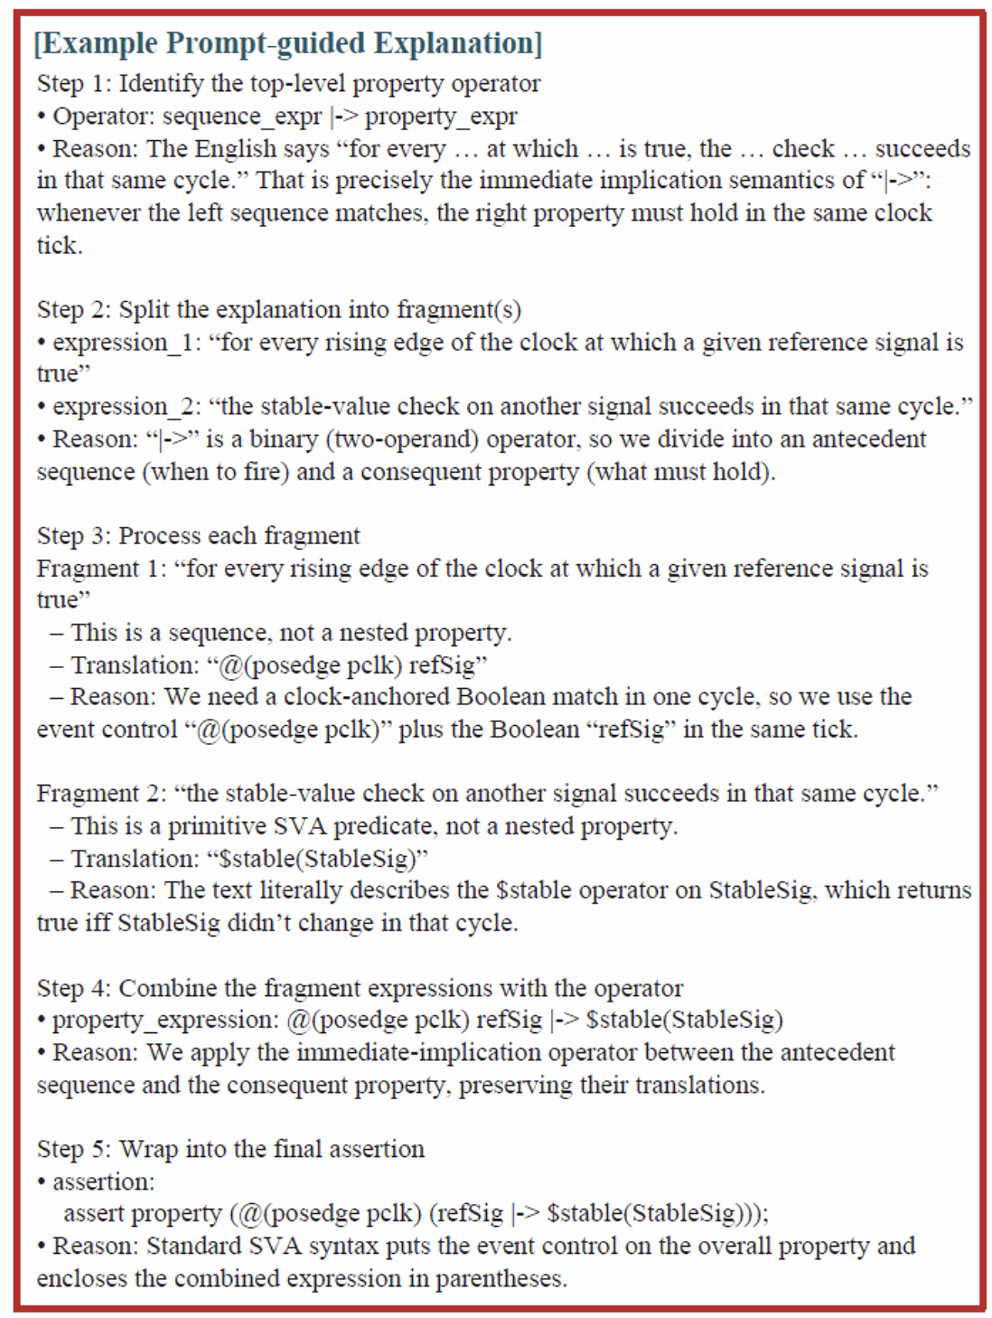
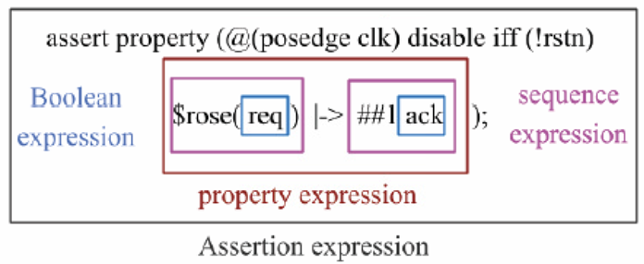
Synthetic Fine-tuning Dataset
for every rising edge of the clock at which a given reference signal refSig is true, the stable-value check
on another signal StableSig succeeds in that same cycle.

Slide 13
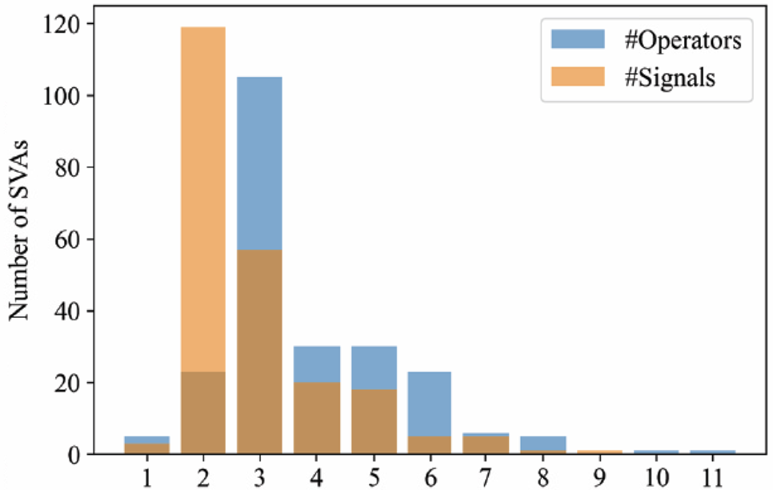
Evaluation Dataset
40 Designs
229 Concurrent Assertions + Human-generated Explanations
Number of SVA operators and signals in the 229 SVAs.

Slide 14
Outline
Introduction
Methodology
Experimental Results
Conclusion

Slide 15
Experimental Setup
Evaluation Metric:
Syntax Correct (SC)
Functionality Match (FM)
Verification Tool: Cadence JasperGold
Evaluate Customized RAG Framework:
RAG Database: 10 hardware design and verification textbooks
LLMs: DeepSeek v3, OpenAI gpt-4o-mini, CodeX,

Slide 16
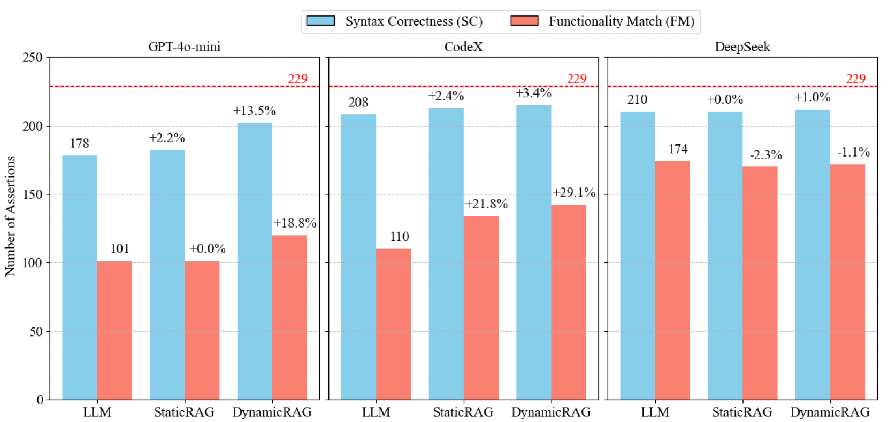
Evaluation Results: Dynamic Splitting

Slide 17
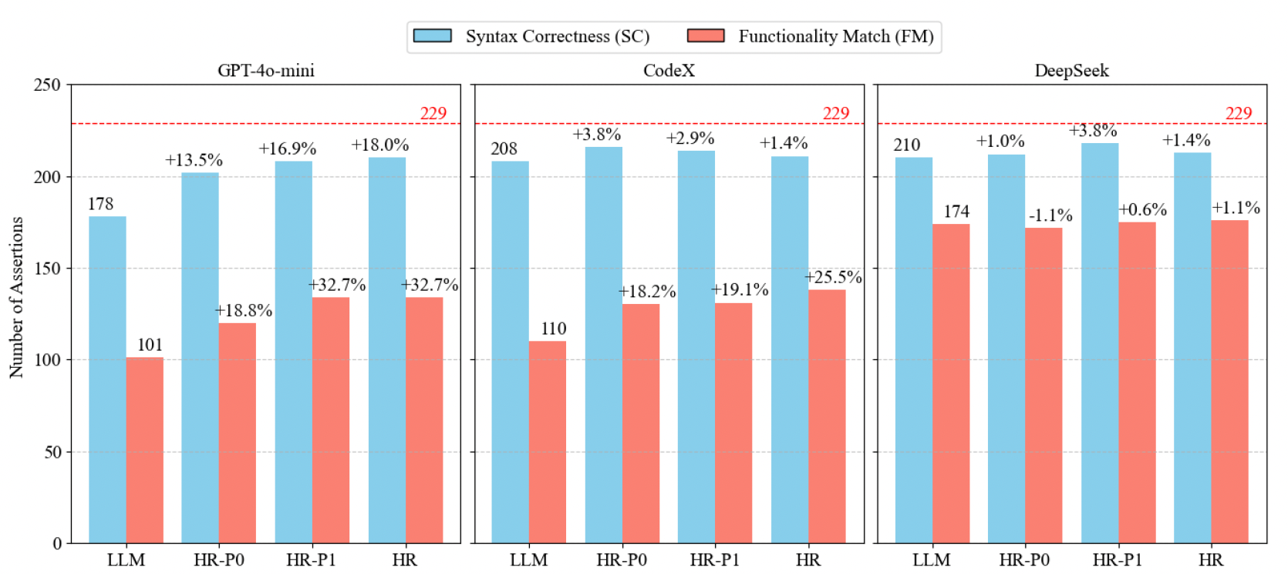
Evaluation Results: Hybrid Retrieval

Slide 18
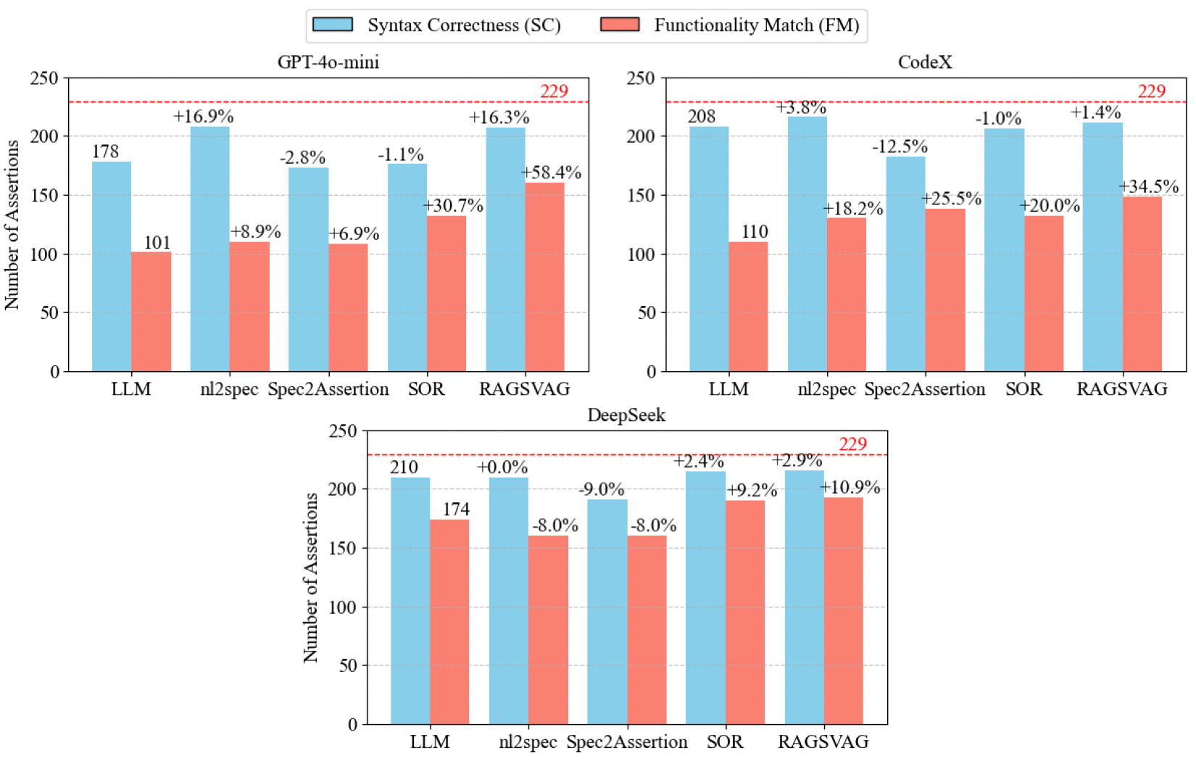
Evaluation Results: Customized RAG Framework

Slide 19
Experimental Setup
Finetuning LLM: Qwen2.5-Coder-7B-Instruct
Finetuning Dataset: 4070 datapoints
Golden SVA
Natural Language Explanation
Prompt-guided Explanation
Finetuning Framework: Llama-Factory [1]
8 A100 GPUs, ~2 hours

Slide 20
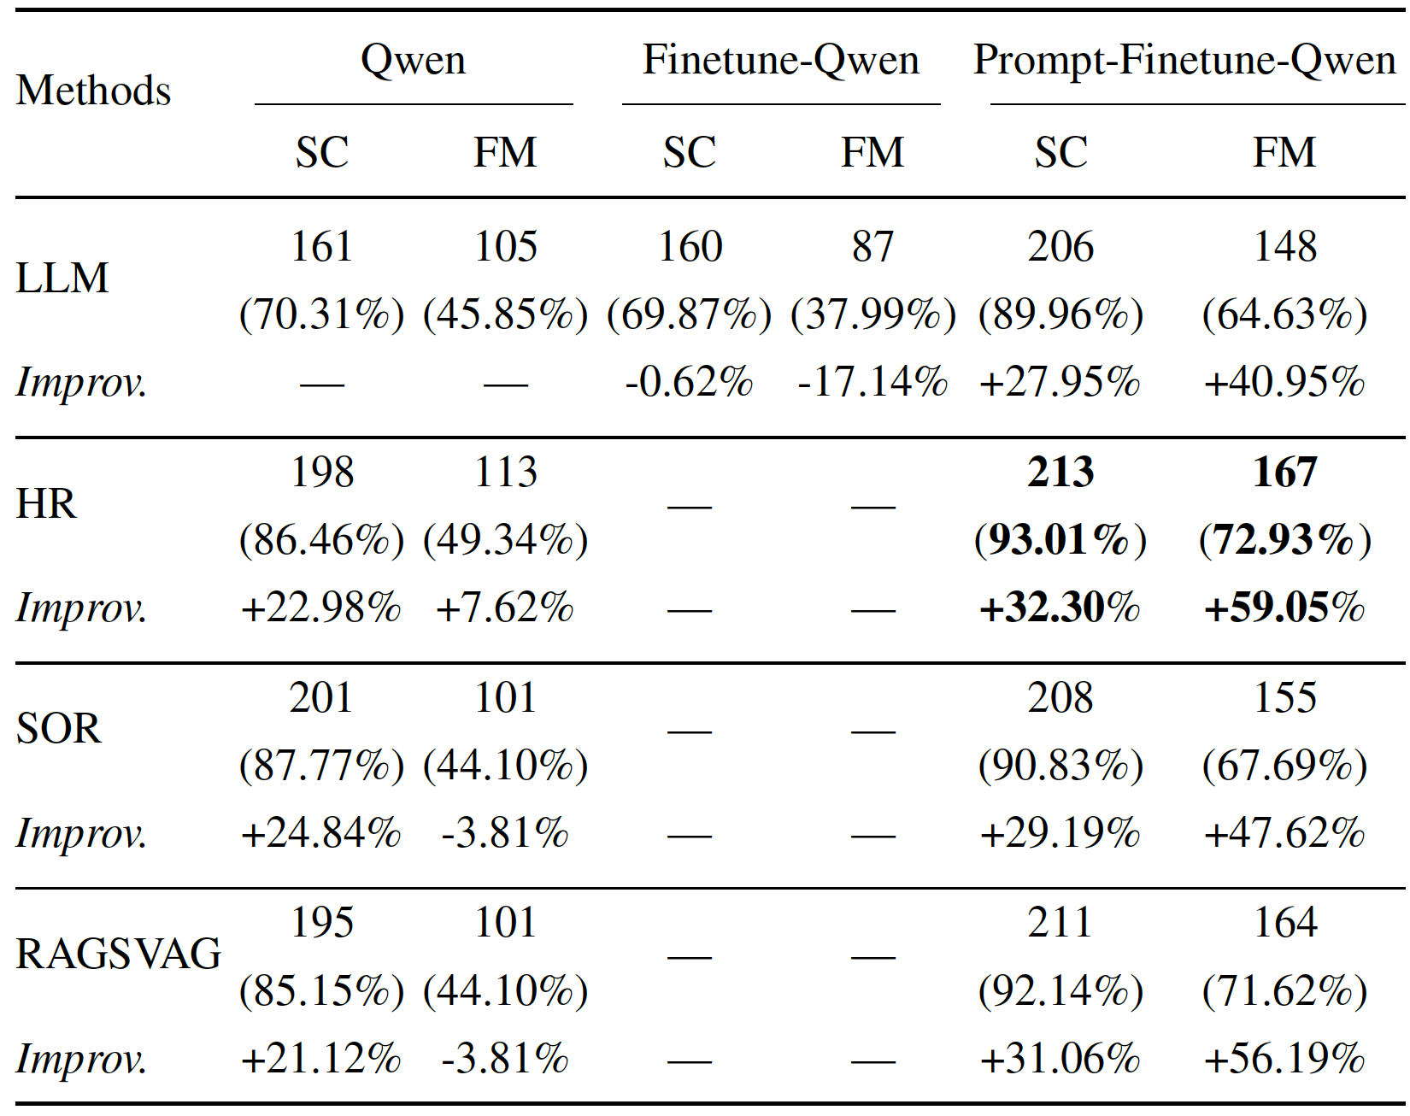
Evaluation Results: Finetuned LLM

Slide 21
Outline
Introduction
Methodology
Experimental Results
Conclusion

Slide 22
Conclusion
Customized RAG framework for NL2SVA
Dynamic Splitting + Hybrid Retrieval + Operator-based Rechecking
Synthetic fine-tuning dataset with prompt-guided explanations
Layer-by-layer breakdown: Boolean → Sequence → Property → Verification
Largest NL2SVA evaluation dataset to date
40 Verilog designs, 229 formally verified assertions with annotations
Evaluation across LLMs (GPT-4o-mini, CodeX, DeepSeek-V3, fine-tuned Qwen2.5-Coder-7B)

Slide 23
Thank you!

