Slide 1

Extended OPACT for General Approximate Compressors
University of Michigan-SJTU Joint Institute
Shanghai Jiao Tong University

Slide 2
^{Motivation}
OPACT is to co-minimize the area and introduced error of the approximate compressor tree based on ILP, consisting of two parts (only focus on the first stage of OPACT here):
ILP model of area;
ILP model of introduced mean error distance (MED) *
There are two types of approximate compressors:
approximate compressors with equally weighted outputs;
approximate compressors with unequally weighted outputs;
However, the OPACT’s ILP model of MED only supports the approximate compressors with equally weighted outputs;
Extend OPACT to support general approximate compressors.
2

Slide 3
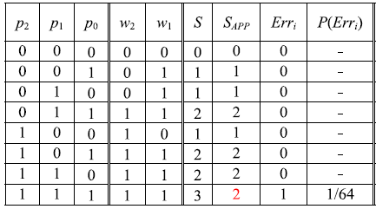
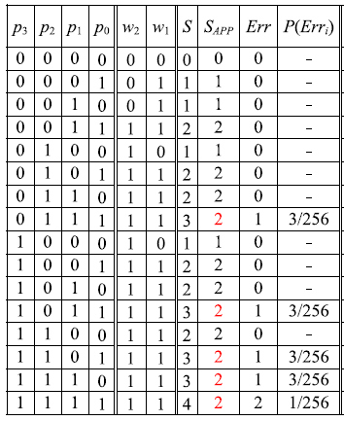





^{Preliminary about OPACT}
Approximate compressors with equally weighted outputs (used in OPACT)
Approximate 3:2 compressor
Approximate 4:2 compressor
0
1
0
1
2
Introduced error is positive under each input pattern!
3

Slide 4









^{Preliminary about OPACT}
ILP Model of Introduced MED
Bit
Position
1
2
3
……
Compression Stage 1
……
……
……
4

Slide 5







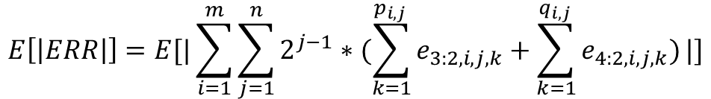
^{Preliminary about OPACT}
ILP Model of Introduced MED
1
2
3
……
Compression Stage 1
……
……
……
$$E\left[\left|ERR\right|\right]=E[|\sum_{i=1}^{m}{\sum_{j=1}^{n}{2^{j−1}∗(\sum_{k=1}^{p_{i,j} }{e_{3:2,i,j,k}}+\sum_{k=1}^{q_{i,j} }{e_{4:2,i,j,k}})}}|]$$
5

Slide 6

^{Extension of OPACT}
ILP Model of Introduced MED
$$MED=\frac{1}{2^{N}}\sum_{t=0}^{2^{N}−1}{|\sum_{i=1}^{m}{\sum_{j=1}^{n}{2^{j−1}∗\left(\sum_{k=1}^{p_{i,j} }{e_{3:2,i,j,k}^{p_{t}}}+\sum_{k=1}^{q_{i,j} }{e_{4:2,i,j,k}^{p_{t}}}\right)}}|}$$
$$=\frac{1}{2^{N}}\sum_{t=0}^{2^{N}−1}{|w^{T}∗e^{p_{t}}|}$$
$$e^{p_{t}}=\left[e_{cmp,i,j,k}^{p_{t}}:cmp∈\{3:2, 4:2\},i∈\left[1,m\right],j∈\left[1,n\right],k∈\left[1,\#cmp_{i,j}\right] \right],$$
$$w=\left[2^{0},…,2^{n−1},2^{0},…,2^{n−1}\right],$$
$$MED=\sum{\frac{\#(e^{p_{t}}=\left[−1,0,…,2,0,1,..,−2\right])}{2^{N}}∗|w^{T}∗\left[−1,0,…,2,0,1,..,−2\right]|}$$
$$=\sum{p((e^{p_{t}}=\left[−1,0,…,2,0,1,..,−2\right]))∗|w^{T}∗\left[−1,0,…,2,0,1,..,−2\right]|}$$
$$=E[|w^{T}∗e|]$$
$random variable vector: e=$ $\left[e_{3:2,1,1,1},…,e_{3:2,m,n,p_{m,n}},e_{4:2,1,1,1},…,e_{4:2,m,n,p_{m,n}}\right]$
6

Slide 7

Extension of OPACT: First Stage
ILP Model of Introduced MED: equally-weighted output compressors
Assumption: the introduced errors of approximate compressors with identical distribution
$$E[|w^{T}∗e|]$$
$$=E\left[\left|\sum_{i=1}^{m}{\sum_{j=1}^{n}{2^{j−1}∗\left(\sum_{k=1}^{p_{i,j} }{e_{3:2,i,j,k}}+\sum_{k=1}^{q_{i,j} }{e_{4:2,i,j,k}}\right)}}\right|\right]$$
$$=\sum_{i=1}^{m}{\sum_{j=1}^{n}{2^{j−1}∗\left(\sum_{k=1}^{p_{i,j} }{{E[e}_{3:2,i,j,k}]}+\sum_{k=1}^{q_{i,j} }{E[e_{4:2,i,j,k}]}\right)}}$$
$$=\sum_{i=1}^{m}{\sum_{j=1}^{n}{2^{j−1}∗\left(p_{i,j}∗E[e_{3:2}]+{q_{i,j}∗E[e}_{4:2}]\right)}}$$
Constants
7

Slide 8











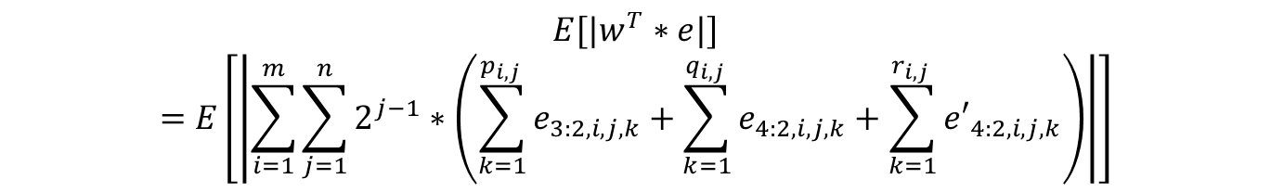
Extension of OPACT: First Stage
General ILP Model of Introduced MED
$$E[|w^{T}∗e|]$$
$$=E\left[\left|\sum_{i=1}^{m}{\sum_{j=1}^{n}{2^{j−1}∗\left(\sum_{k=1}^{p_{i,j} }{e_{3:2,i,j,k}}+\sum_{k=1}^{q_{i,j} }{e_{4:2,i,j,k}}+\sum_{k=1}^{r_{i,j} }{{e′}_{4:2,i,j,k}}\right)}}\right|\right]$$
0
1
0
1
2
2
1
0
8

Slide 9
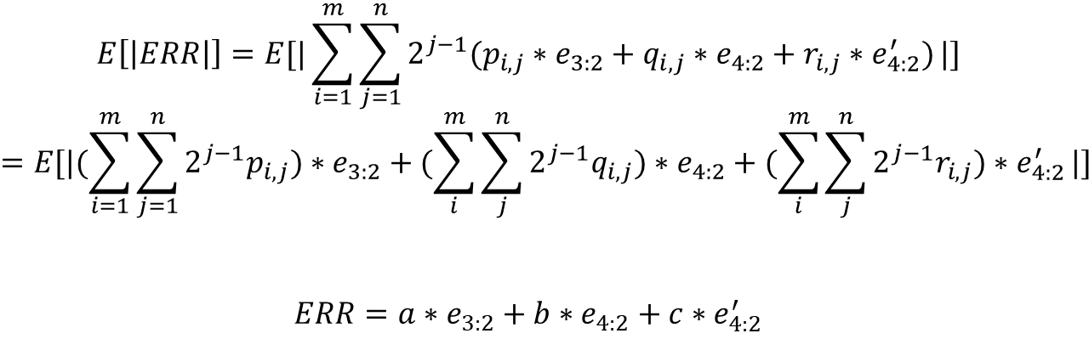



Extension of OPACT: First Stage
Approximation of General ILP Model
Worst case: $e_{3:2,i,j,k}=e_{3:2}$, $e_{4:2,i,j,k}=e_{4:2}$, ${e′}_{4:2,i,j,k}={e′}_{4:2}$
9

Slide 10
Extension of OPACT: First Stage
Approximation of General ILP Model
0
1
0
1
2
2
1
0
10

Slide 11











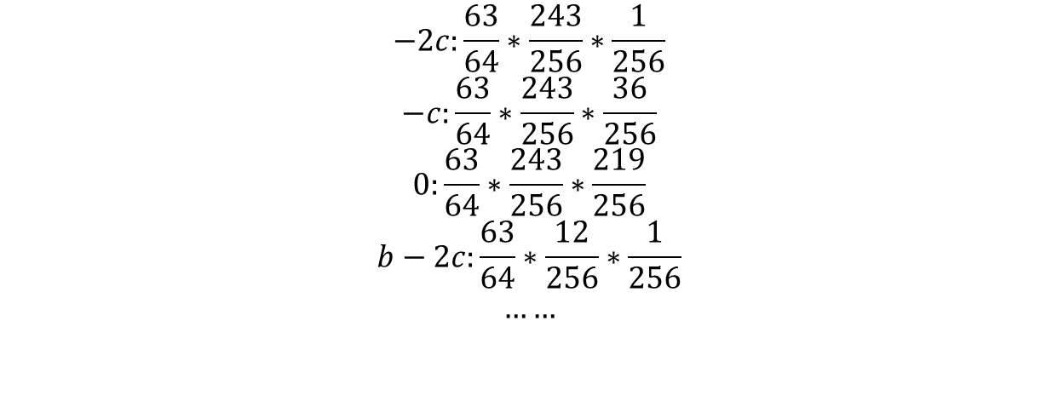
Extension of OPACT: First Stage
Approximation of General ILP Model
0
1
0
1
2
-2
-1
0
Complexity: $O(2∗3∗3)$
11

Slide 12
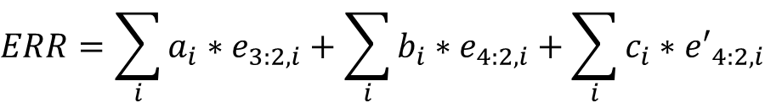
Extension of OPACT: First Stage
Approximation of General ILP Model
Better case: $e_{3:2,i,j,k}=e_{3:2,i}$, $e_{4:2,i,j,k}=e_{4:2,i}$, ${e′}_{4:2,i,j,k}={e′}_{4:2,i}$
$$ERR=\sum_{i}{a_{i}∗e_{3:2,i}}+\sum_{i}{b_{i}∗e_{4:2,i}}+\sum_{i}{c_{i}∗{e′}_{4:2,i}}$$
Complexity: $O(2^{i}∗3^{i}∗3^{i})$
12

Slide 13
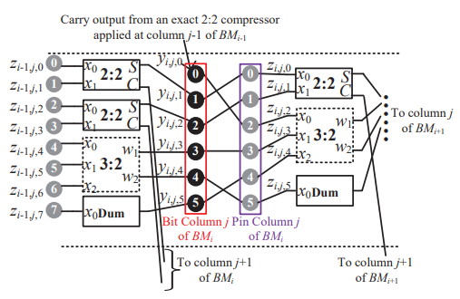

Extension of OPACT: Second Stage
Connection Order Optimization
Connection Binary Variables:
$b_{i,j,r,c}=1$: connect $r$-th bit to $c$-th pin
Connection Order Optimization:
$$\min{MED= \frac{1}{2^{N}}\sum_{t=0}^{2^{N}−1}{\begin{aligned}|w^{T}∗ \\ e^{p_{t}}(b_{i,j,r,c}:i,j,r,c)|\end{aligned}}}$$
13

Slide 14
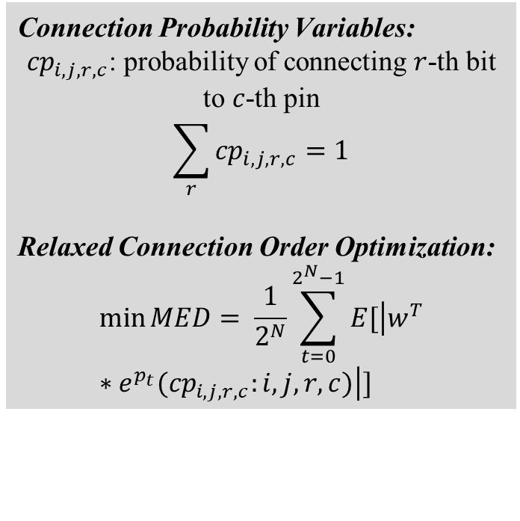
Extension of OPACT: Second Stage
Relaxation of Connection Order Optimization
Connection Probability Variables:
${cp}_{i,j,r,c}$: probability of connecting $r$-th bit to $c$-th pin
$$\sum_{r}{{cp}_{i,j,r,c}}=1$$
Relaxed Connection Order Optimization:
$$\min{MED= \frac{1}{2^{N}}\sum_{t=0}^{2^{N}−1}{E[\left|w^{T}∗e^{p_{t}}({cp}_{i,j,r,c}:i,j,r,c)\right|]}}$$
14

Slide 15
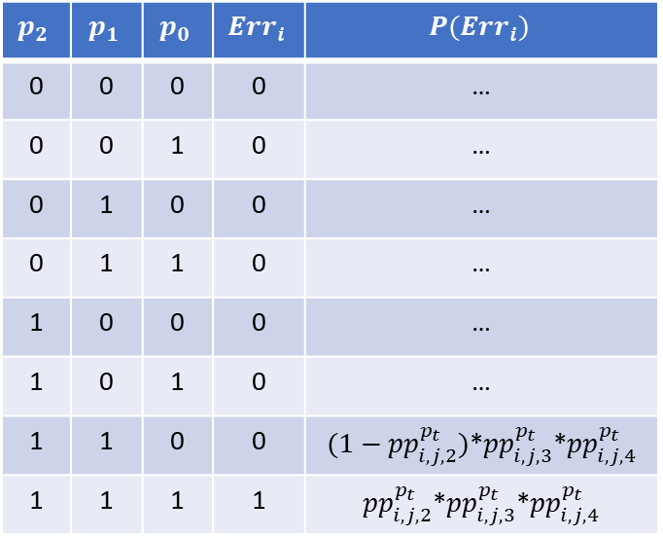

Extension of OPACT: Second Stage
Relaxation of Connection Order Optimization
Relaxed Connection Order Optimization:
${pb}_{i,j,k}^{p_{t}}:$ probability of being 1 of k-th bit
${pp}_{i,j,k}^{p_{t}}:$ probability of being 1 of k-th pin
$${pp}_{i,j,2}^{p_{t}}=\sum_{r}{pb_{i,j,r}^{p_{t}}∗cp_{i,j,r,2}}$$
$$p_{2}$$ | $$p_{1}$$ | $$p_{0}$$ | $$Err_{i}$$ | $$P(Err_{i})$$
0 | 0 | 0 | 0 | …
0 | 0 | 1 | 0 | …
0 | 1 | 0 | 0 | …
0 | 1 | 1 | 0 | …
1 | 0 | 0 | 0 | …
1 | 0 | 1 | 0 | …
1 | 1 | 0 | 0 | $(1−{pp}_{i,j,2}^{p_{t}})$*${pp}_{i,j,3}^{p_{t}}$*${pp}_{i,j,4}^{p_{t}}$
1 | 1 | 1 | 1 | ${pp}_{i,j,2}^{p_{t}}$*${pp}_{i,j,3}^{p_{t}}$*${pp}_{i,j,4}^{p_{t}}$
15

Slide 16

Extension of OPACT: Second Stage
Relaxation of Connection Order Optimization
Relaxed Connection Order Optimization:
$$\min{MED= \frac{1}{2^{N}}\sum_{t=0}^{2^{N}−1}{E[\left|w^{T}∗e^{p_{t}}({cp}_{i,j,r,c}:i,j,r,c)\right|]}}$$
=>
$$\min{MED= \frac{1}{2^{N}}\sum_{t=0}^{2^{N}−1}{E[{\left(w^{T}∗e^{p_{t}}\left({cp}_{i,j,r,c}:i,j,r,c\right)\right)}^{2}]}}$$
16

