Slide 1


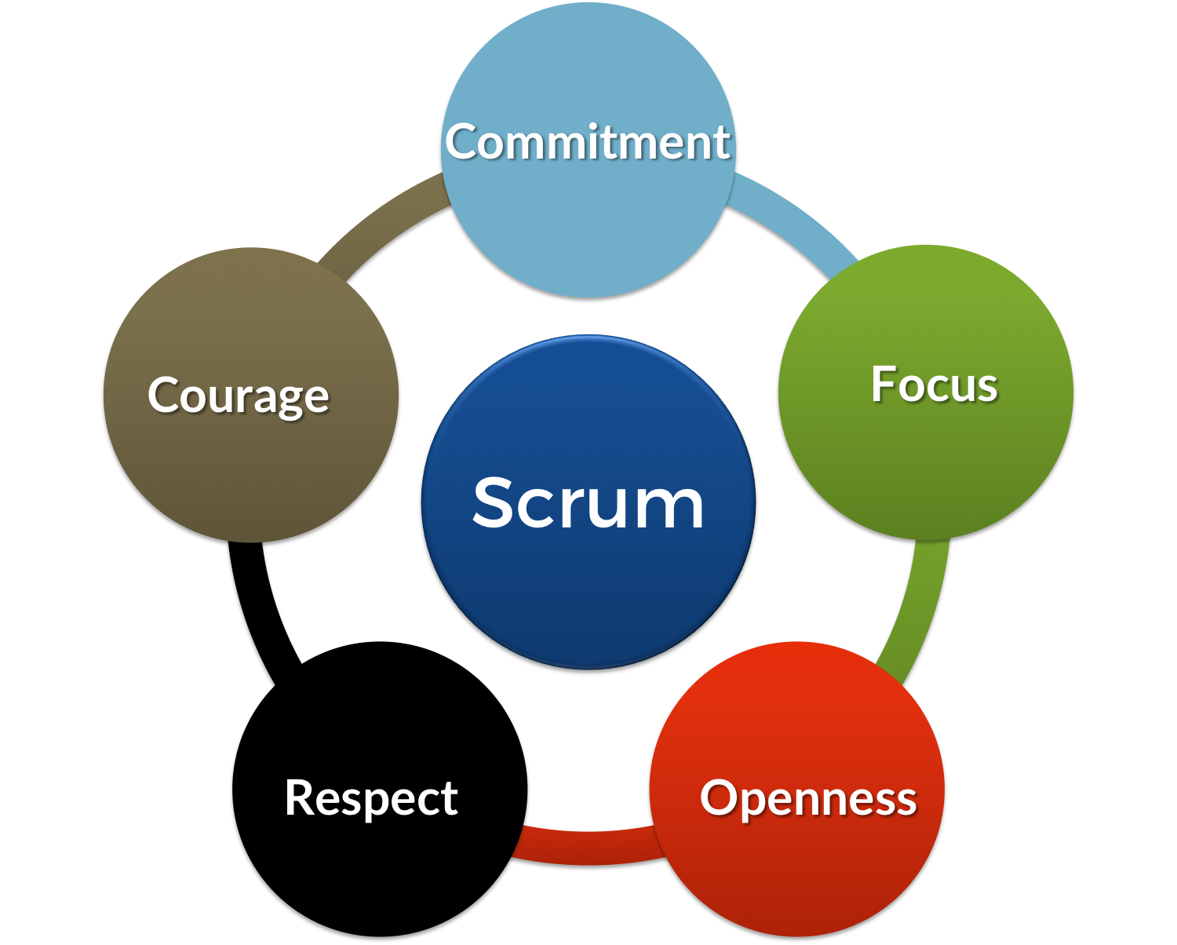
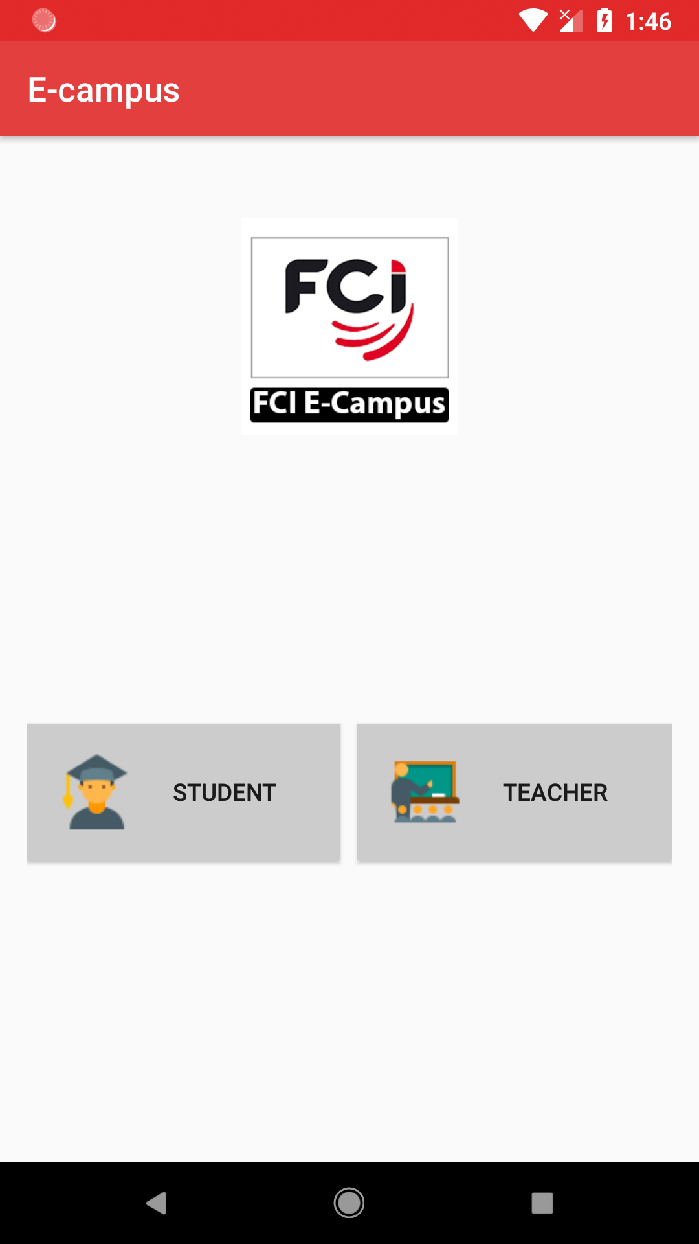

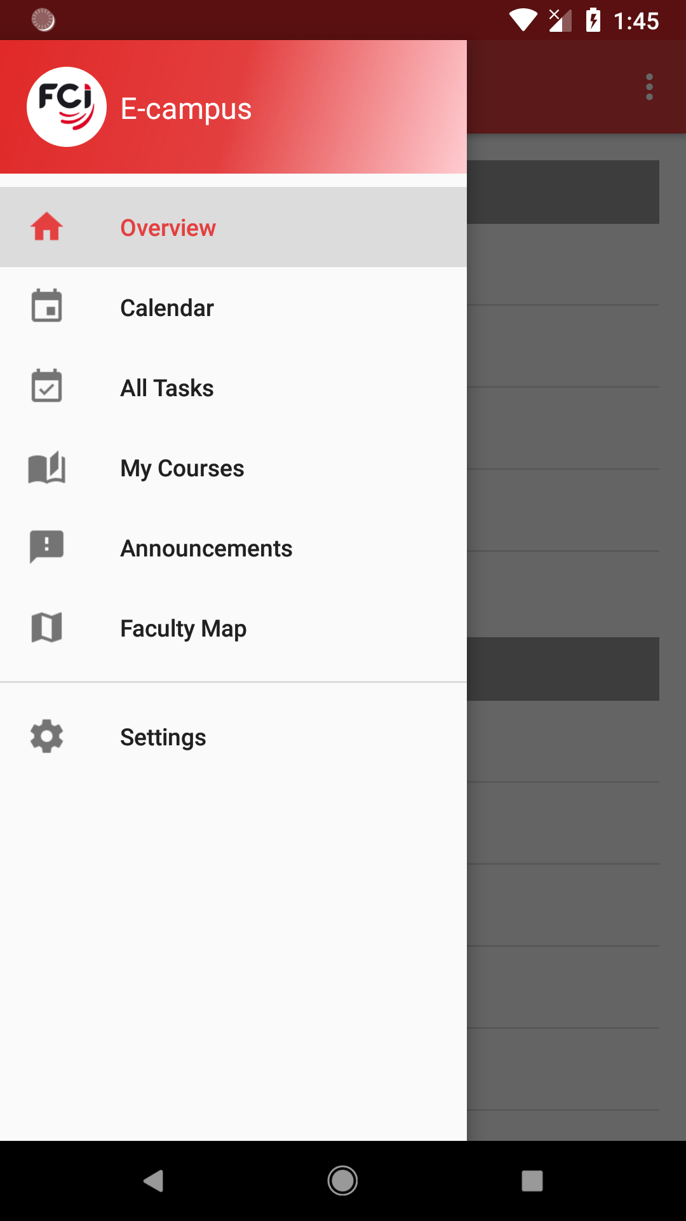

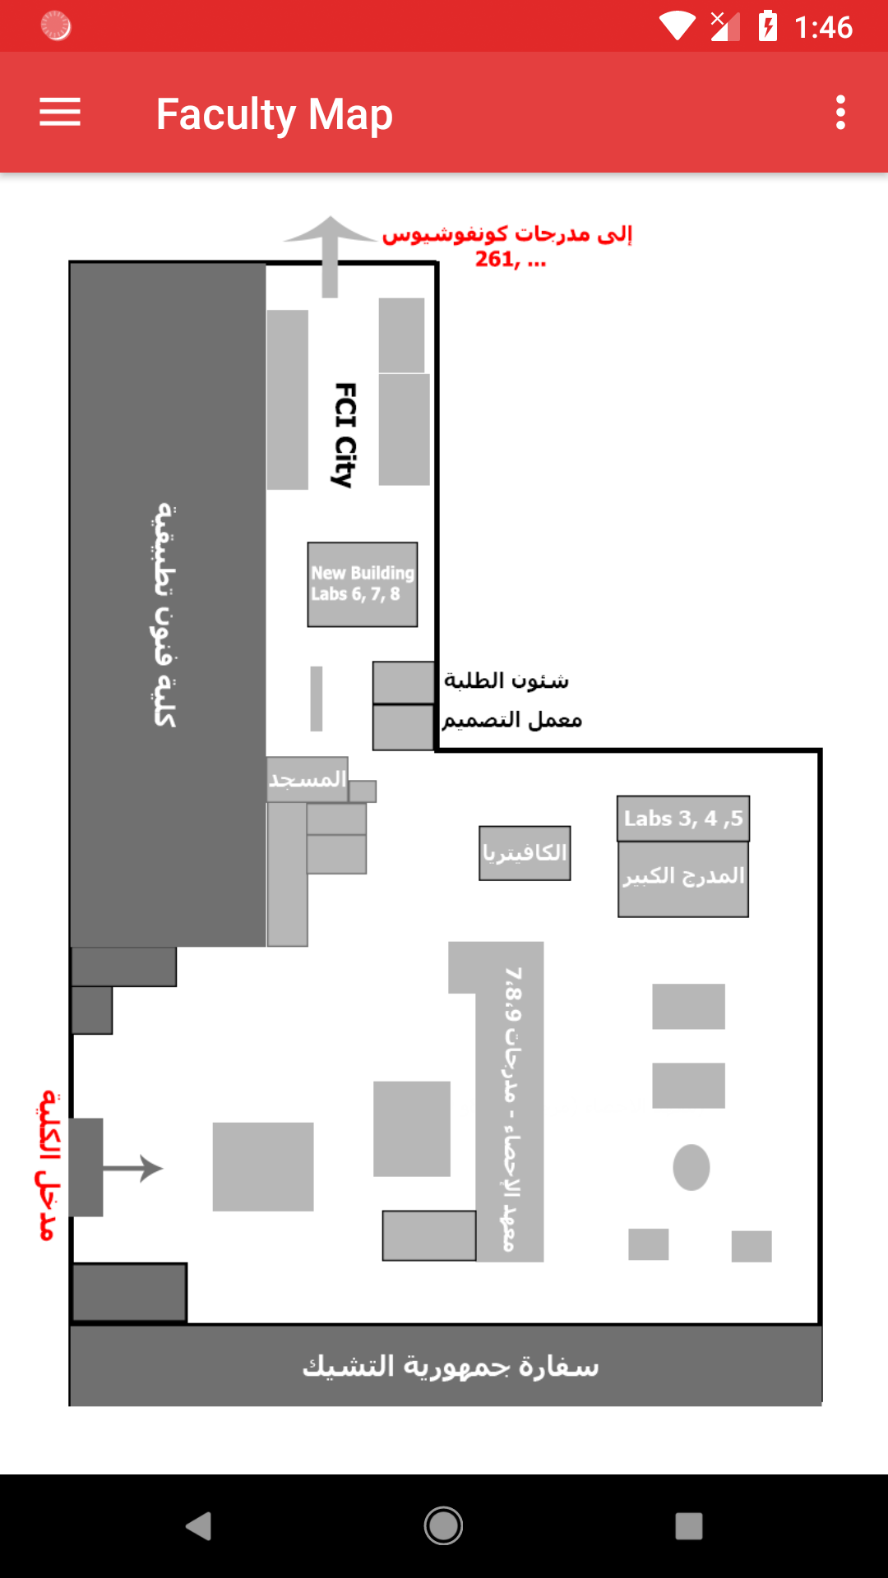
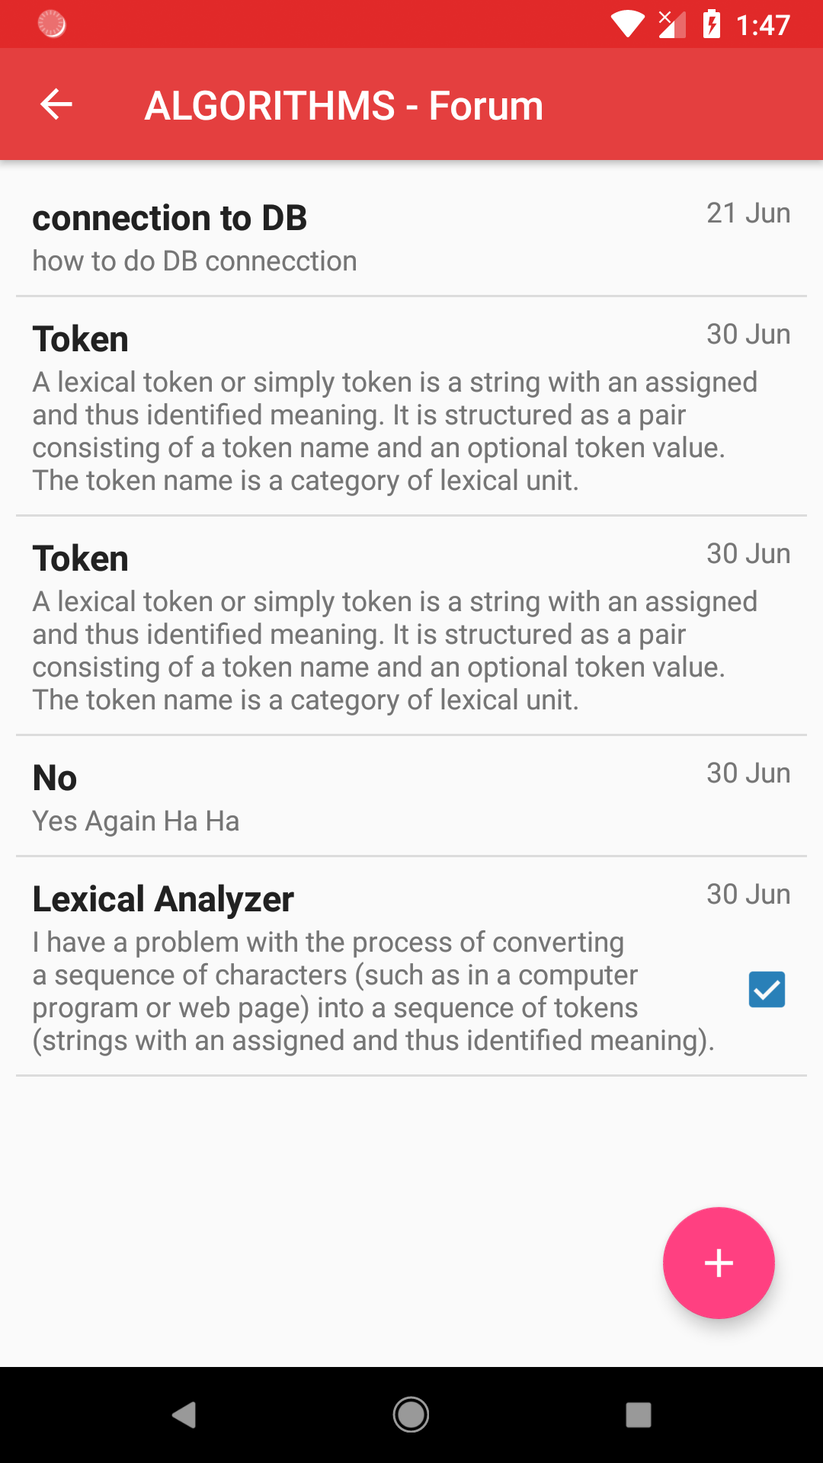

75 cm
FCI E-campus
24 cm
Amr, Abdelrahman, Ahmed, Abdelaziz and Abdallah
Supervisor: Dr. Mohammed Nassef
Abstract
Methods
In this project we used Scrum Methodology. Scrum is an agile method for project management.
In the backend:
• Developed using the Laravel PHP framework alongside with MySQL DBMS.
• Developed with Jetbrains PhpStorm IDE and XAMPP stack.
• Deployed on Heroku which is a cloud platform-as-a-service (PAAS).
In the frontend (client):
• Android application developed using the native Android framework with Java.
• Developed with Android Studio IDE and Virtual Emulators to test our app.
• Published with the Google PlayStore console.
Organizing time for a faculty student is an essential part of his success. This has been always a problem with no definite solution.
The students at Faculty of Computer and Information, Cairo University are heavily distracted between many online places.
Facebook groups, E-com, Acadox, GDrive and a lot more. Cluttered and unorganized, theses websites do bad to students more than they do them good.
Our app is an effective solution for all the problems facing students at FCI. It combines all what they will need in a single place saving them from distraction and ad-flooded websites. Targeted for their needs, it facilitates learning and helps them focus on the more important things, i.e. learning.
Design and format details are up the students creativity
Scrum Values
Login or sign up as Student, Professor or Teacher Assistant
Introduction
Save and submit 3 copies of the poster:
1. The poster in a “PDF” format, use the following name scheme:
<year>-<semester>-<dept.init>-GP2-<project number>-<project name>-Poster.pdf
2. The poster in a “png” format, use the following name scheme:
<year>-<semester>-<dept.init>-GP2-<project number>-<project name>-Poster.png
3. The poster page in the graduation project book.
Complete your project information in the “Template(6)-Graduation Project II - PosterPage.docx” file, add the image of the poster and scale it to 14% for both height and width.
use the following name scheme:
<year>-<semester>-<dept.init>-GP2-<project number>-<project name>-PosterPage.docx
98.5 cm
This project aims to create a mobile application that will help students & staff at FCI stay organized. The app will provide students, teacher assistants & professors with their schedule, depending on the courses they have registered. If the student doesn’t know the location of his lecture or lab the app will help him and show him a map to where the lecture/section hall or lab is in the faculty.
Also, users receive new announcements from the faculty notifying them with important events happening at the faculty. To help students keep track with their courses, our app gives an overview of what is due this day and the next. It also gives them a list combining all tasks from all the courses they are registered in. The app will organize downloading and uploading materials. The app will provide a forum for the students to communicate with each other as well as with TAs and professors.
All in one place.
Never be lost
Ask questions & get help
PlayStore: @FCI E-campus
GitHub: https://github.com/FCI-E-campus
Contact us:
Email: fci_e_campus@gmail.com
Mobile: 01110095611
15 cm
For all soft copy formats
For print use only
24 cm

