Slide 1
Monqez
Graduation Project

Slide 2
What is Monqez?
Monqez is a mobile application that matches and connects between the user calling for help and the nearest available first-aider (Monqez) as well as provide some basic first aid help either via pictures or calls. The software aims to provide a quick help for the user in need until the ambulance arrives or the user gets well.

Slide 3
Why Monqez?
On the 12th of April of 2010, The Guardian magazine stated that over 150,000 people are dying unnecessarily due to the lack of correct first-aid.
The university of Manchester stated in its magazine that Up to 59% of ‘pre-hospital’ deaths from injury could potentially be prevented if more people stepped in with some simple first aid, according to new research commissioned by the British Red Cross and conducted by the University of Manchester.

Slide 4
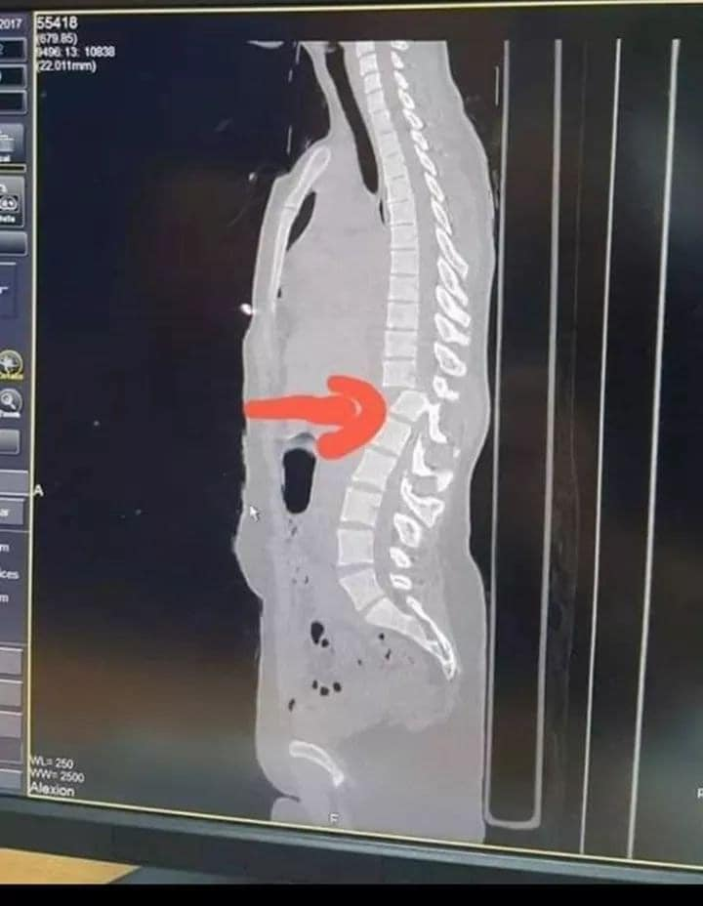
Why Monqez?
A 27 year-old girl had an accident on the highway. Everyone around got the girl to sit on a chair thinking that this is the right thing to do. This simple action resulted in cut in the spinal cord as the attached picture shows making this girl paralyzed for the rest of her life. If any person with first-aid was near the accident, this could have been easily handled and the girl would have been still able to move and walk.

Slide 5
Why Monqez?
Even on the social media, we keep reading articles about people that had a minor accident but couldn’t make it because the ambulance arrived late or because they didn’t get correct first-aids.
Wrong first-aid steps could make a condition worse, that’s why only people with enough training should only perform the first aid.
That’s why we though about Monqez, because Monqez aims to save souls. The application helps the community by saving their lives by providing first aid to people in need by qualified people as soon as possible.

Slide 6

Similar Applications
New Zealand Red Cross First Aid
It contains step-by-step instructions for many emergencies, including CPR, what to do about a burn injury, and many other medical emergencies like heart attacks, open wounds, and more.
Doesn't send a medic

Slide 7

Similar Applications
The E-Medic (المسعف الالكترونى)
The application allows receiving any new communication, as well as accepting or canceling the report, drawing the best paths to the location of the report and determining it, recording all notes on it, as well as receiving any amendment to the report from the operating room so that the operating room is aware of the emergency teams and following them on an ongoing basis.
The application also allows emergency teams to communicate emergency cases with hospitals and choose the most appropriate hospital for the case.
It does not send a paramedic to do first aid, rather it sends an ambulance.

Slide 8
Similar Applications
There is no similar application that provides a first-aider in Egypt!

Slide 9
references
https://www.theguardian.com/society/2010/apr/12/first-aid-skills-deaths#:~:text=Meanwhile%2C%20almost%20a%20quarter%20(24,a%20passerby%20knew%20first%20aid.
https://www.manchester.ac.uk/discover/news/over-half-of-deaths-from-injury-could-be-prevented-if-public-knew-first-aid/
https://www.facebook.com/photo?fbid=10218004884817896&set=a.3401137471412
https://play.google.com/store/apps/details?id=com.cube.gdpc.nzl&hl=en&gl=US
https://www.hiamag.com/%D9%85%D9%86%D9%88%D8%B9%D8%A7%D8%AA/%D8%A7%D8%AE%D8%A8%D8%A7%D8%B1/848121-%D8%A7%D9%84%D9%87%D9%84%D8%A7%D9%84-%D8%A7%D9%84%D8%A3%D8%AD%D9%85%D8%B1-%D8%A7%D9%84%D8%B3%D8%B9%D9%88%D8%AF%D9%8A-%D9%8A%D8%AF%D8%B4%D9%86-%D8%A7%D9%84%D9%85%D8%B1%D8%AD%D9%84%D8%A9-%D8%A7%D9%84%D8%AB%D8%A7%D9%86%D9%8A%D8%A9-%D9%85%D9%86-%D8%AA%D8%B7%D8%A8%D9%8A%D9%82-%D8%A7%D9%84%D9%85%D8%B3%D8%B9%D9%81-%D8%A7%D9%84%D8%A5%D9%84%D9%83%D8%AA%D8%B1%D9%88%D9%86%D9%8A

