Slide 1
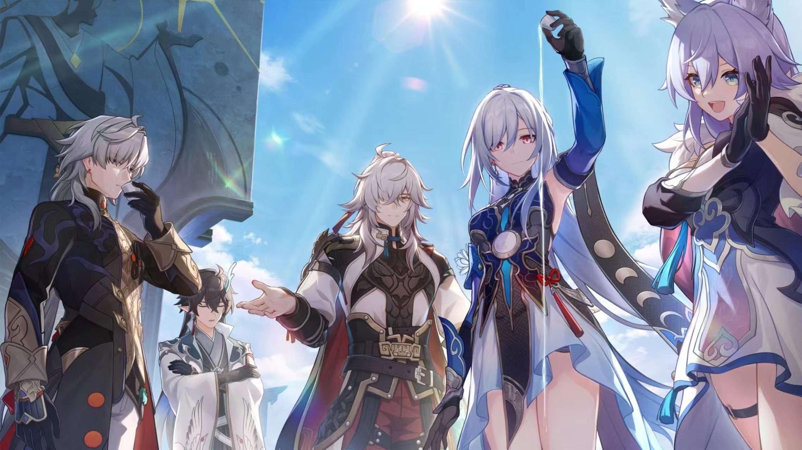
RDBMS Designed for Beginners about
Hongkai: Star Rail
by Group 7

Slide 2
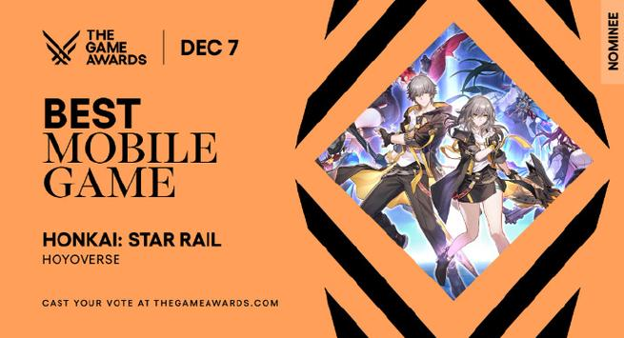
Background: what is Hongkai: Star Rail
2023 TGA best mobile game nomination
A turn-based role-playing game

Slide 3
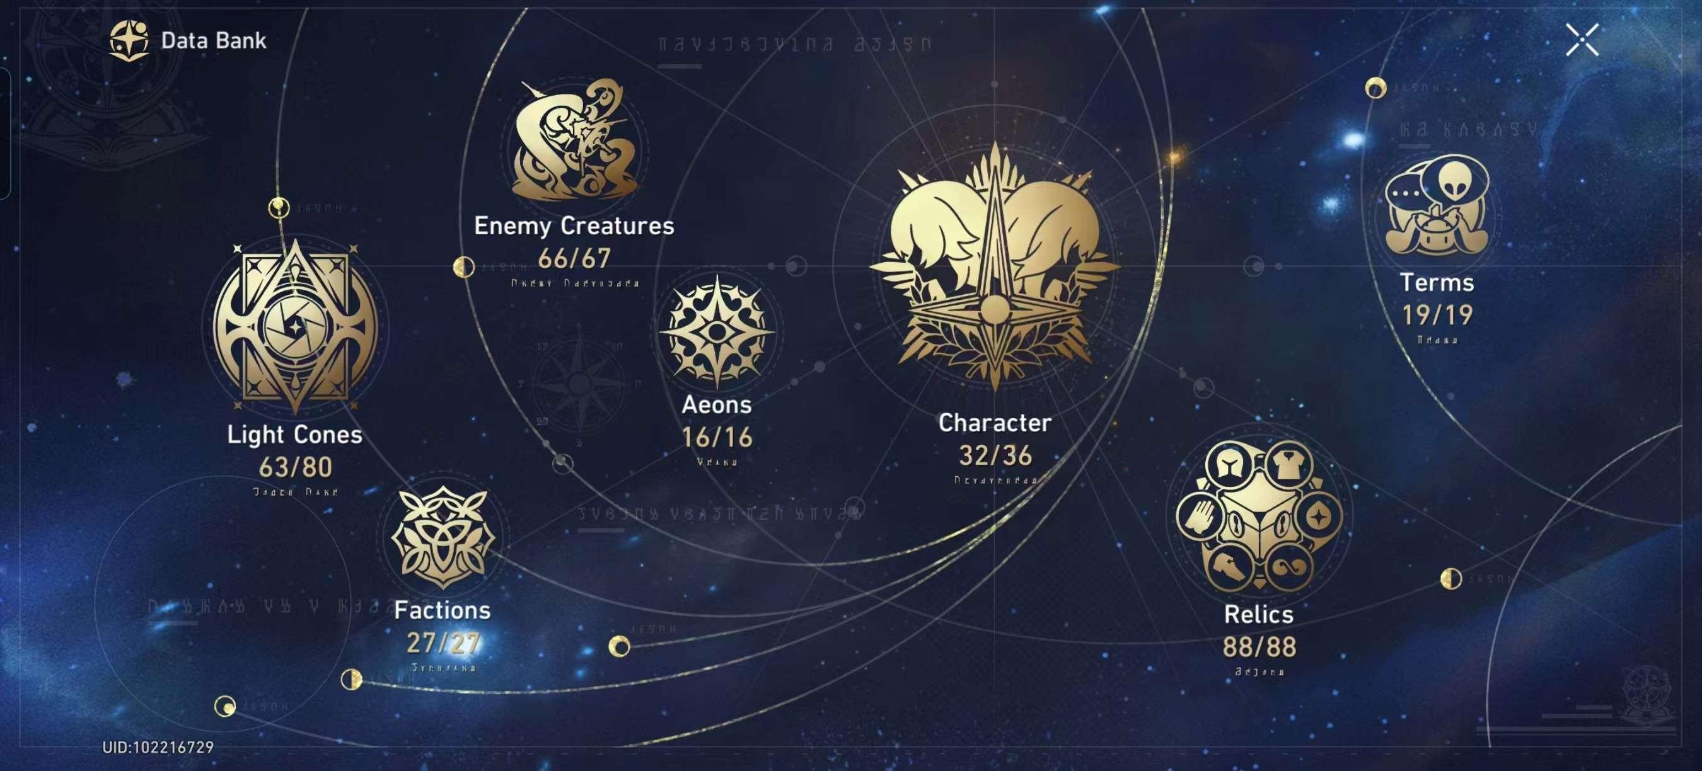
Background: why this topic?
Initially, we are inspired by the ‘Data Bank’ in the game.

Slide 4
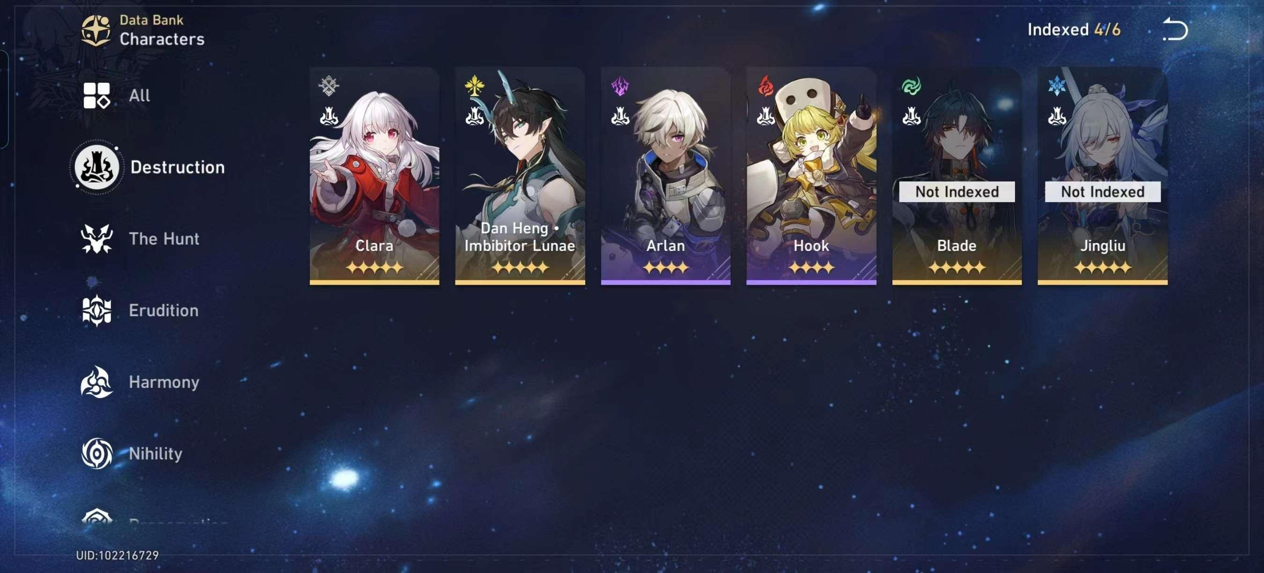
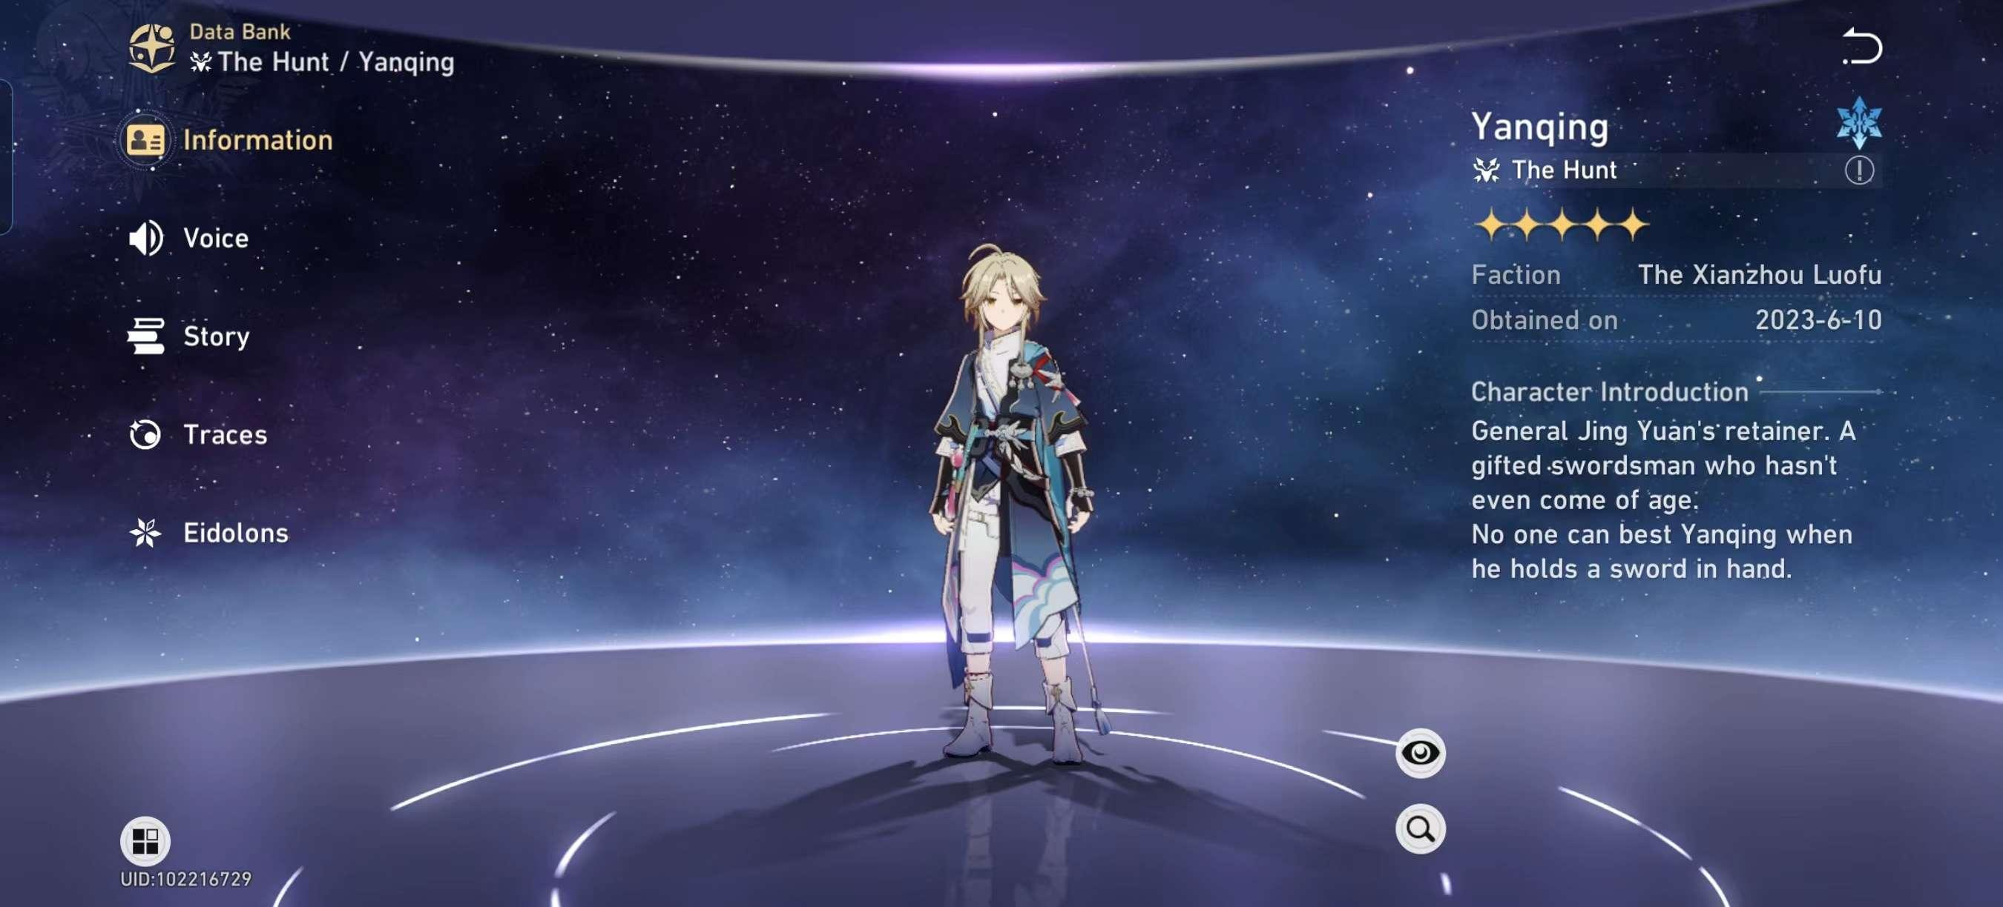
Background: why this topic?
The information is not enough!
Data Bank is story-biased.

Slide 5
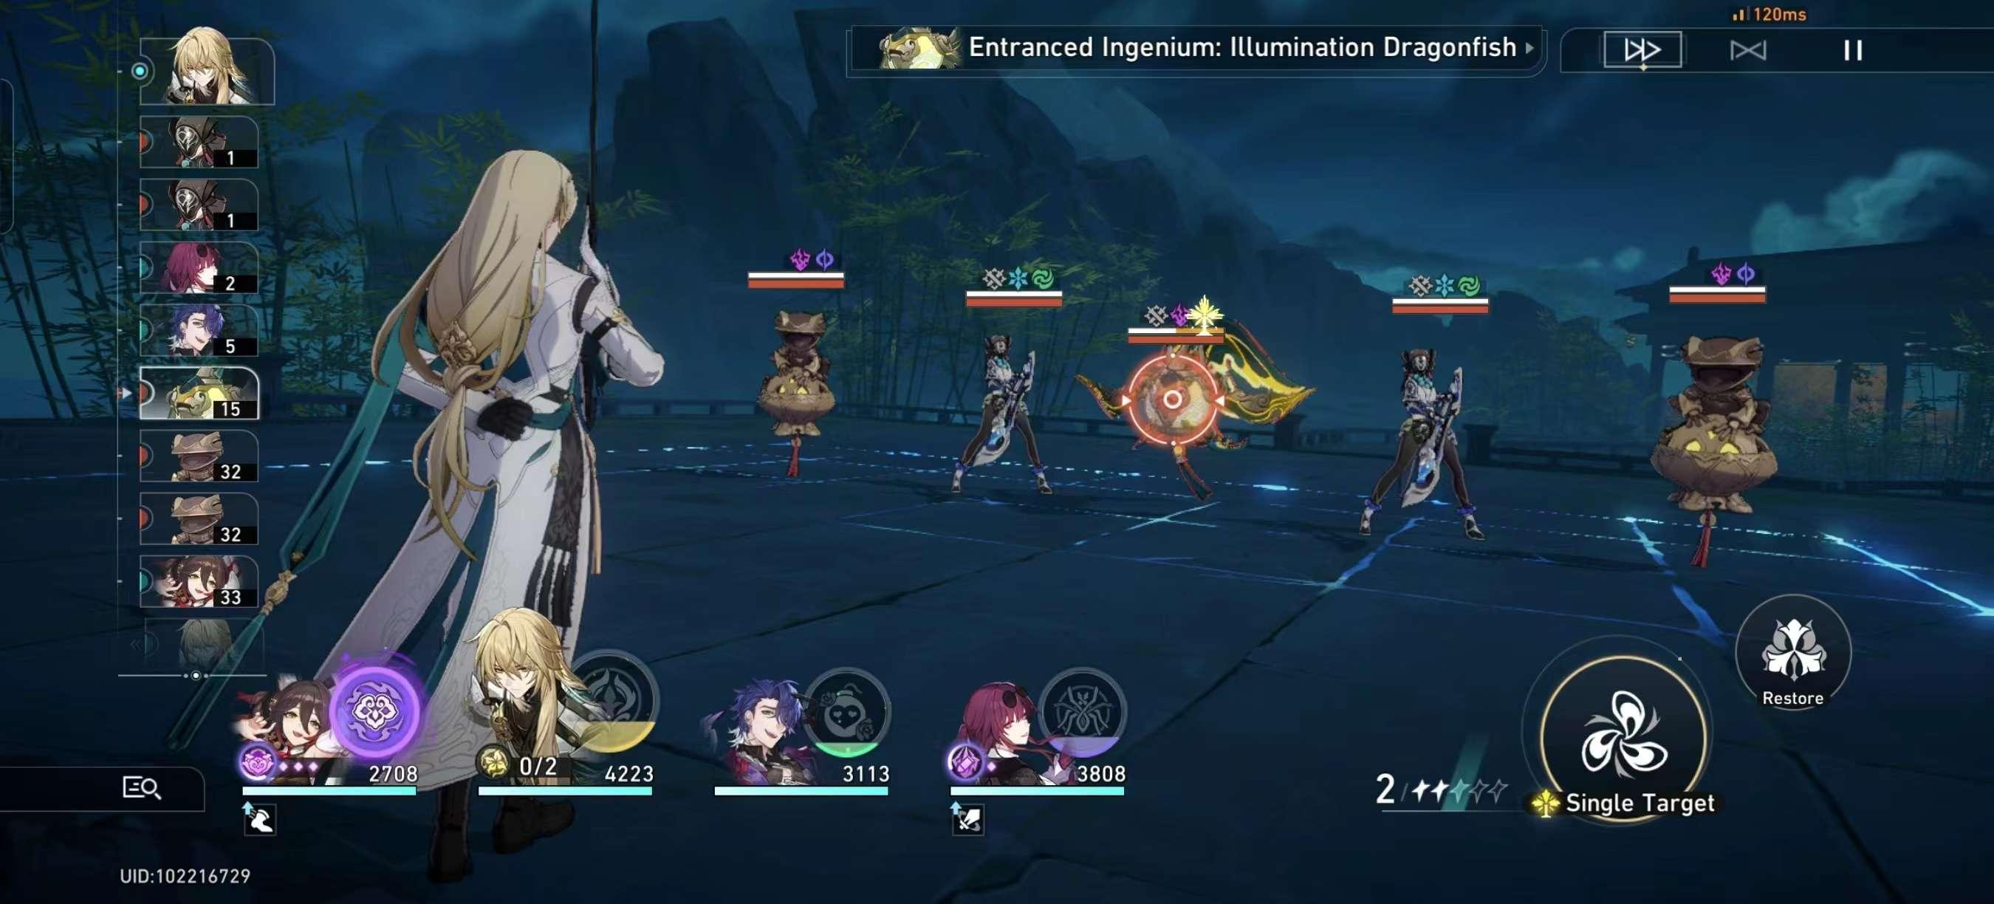
Background: why this topic?
What do we need? Combat-related data!

Slide 6
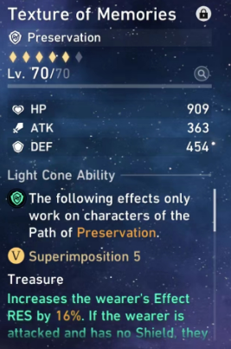
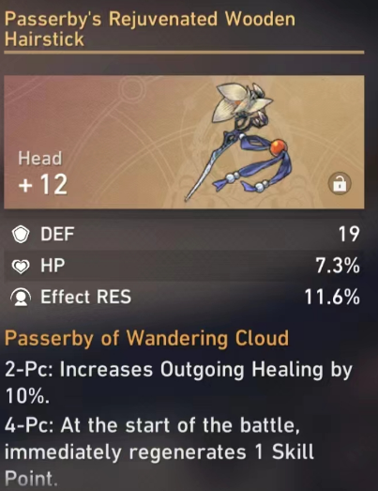
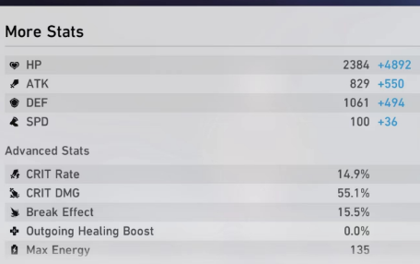
Background: why this topic is worth exploring?
Why it can be done with RDBMS?
In order to advance the game process, we should focus on the static data out of the combat, especially suit-matching.
=> Only fixed panel data is considered.

Slide 7
ER & EER

Slide 8
ER & EER

Slide 9
Logical Design: Character

Slide 10
Logical Design: Lightcone

Slide 11
Logical Design: Relics & Ornaments

Slide 12
Data Sources

