Slide 1
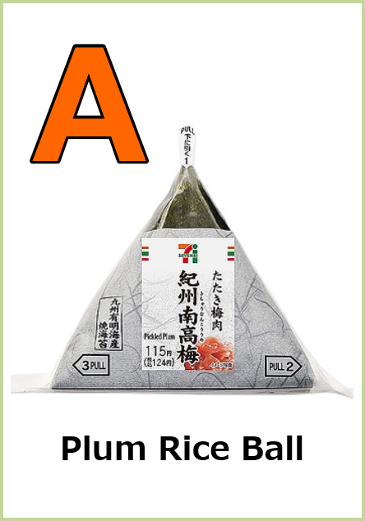
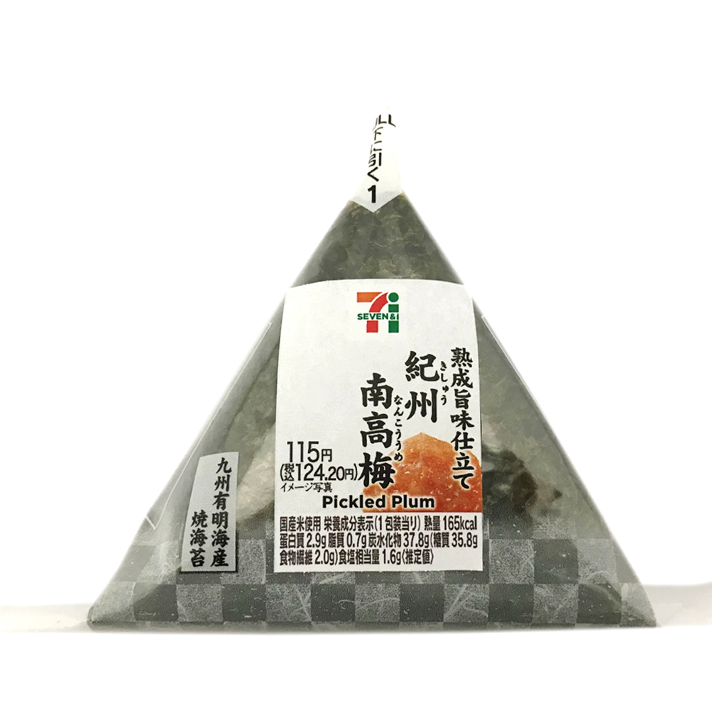
A
Plum Rice Ball

Slide 2
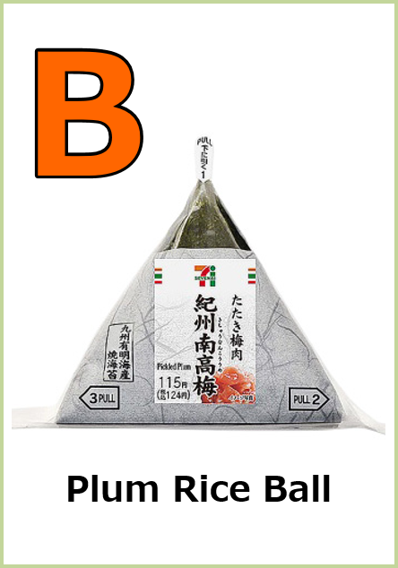
B
Plum Rice Ball

Slide 3
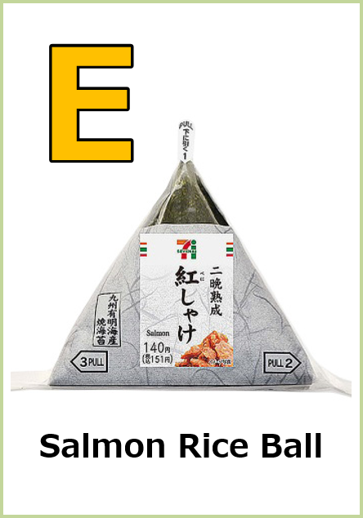
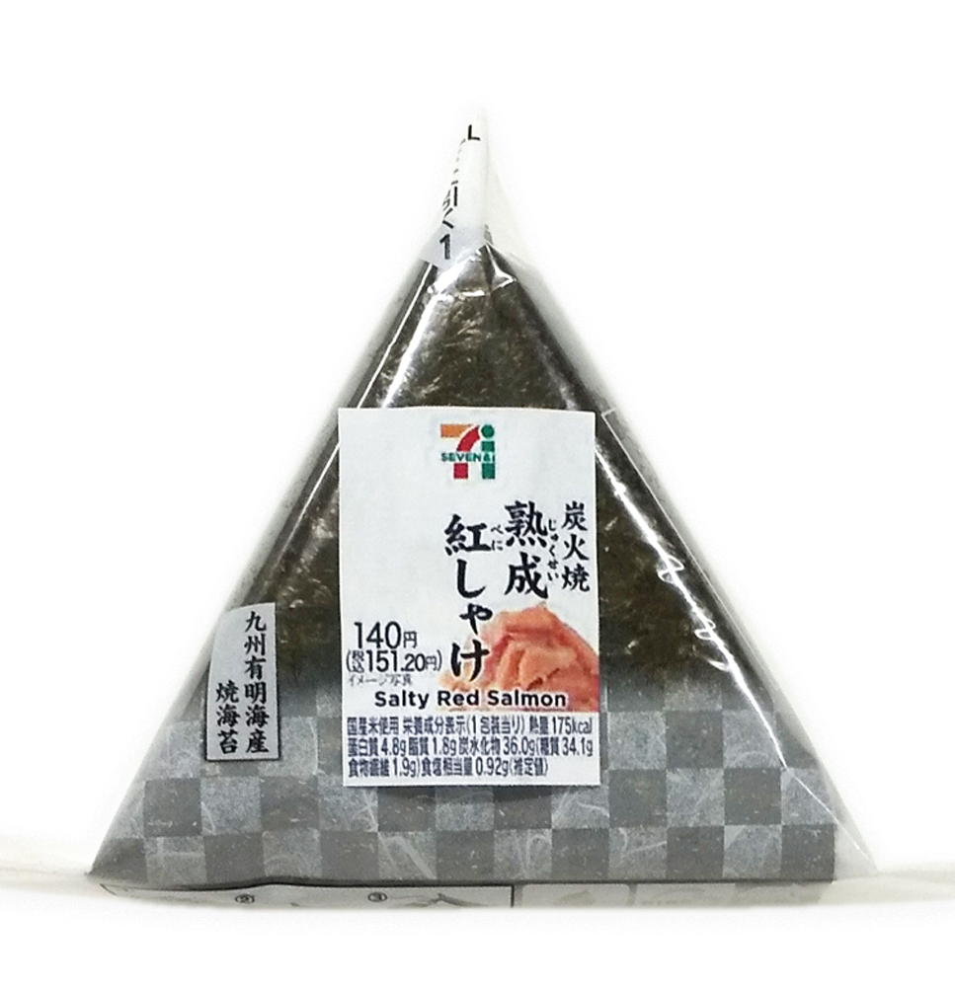
E
Salmon Rice Ball

Slide 4
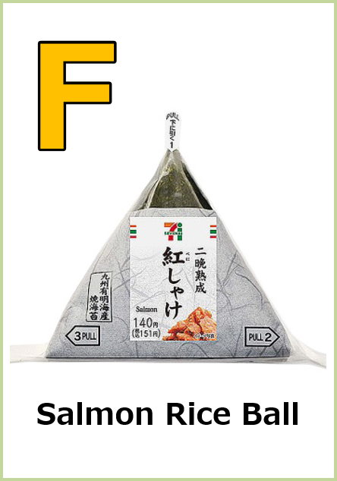
F
Salmon Rice Ball

Slide 5


I
Egg Sandwiches

Slide 6

J
Egg Sandwiches

Slide 7
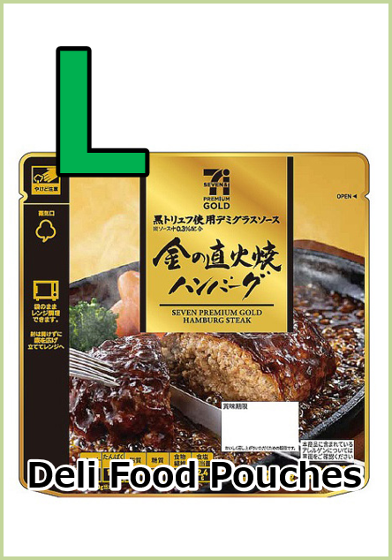
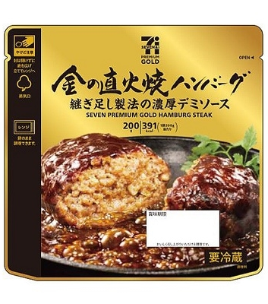
L
Deli Food Pouches
Deli Food Pouches

Slide 8

M
Deli Food Pouches
Deli Food Pouches

Slide 9


O
Drink
Drink

Slide 10

P
Drink
Drink

Slide 11
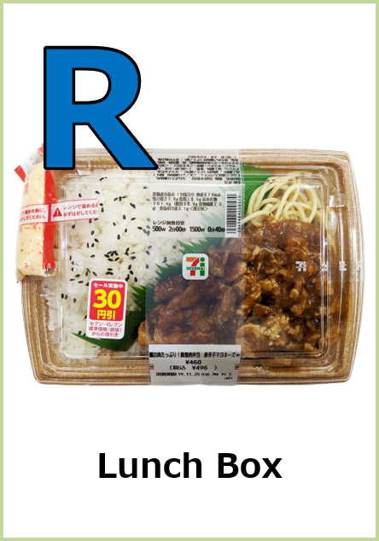
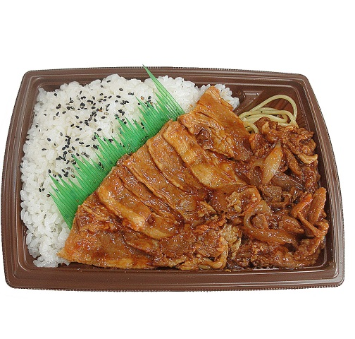
R
Lunch Box

Slide 12
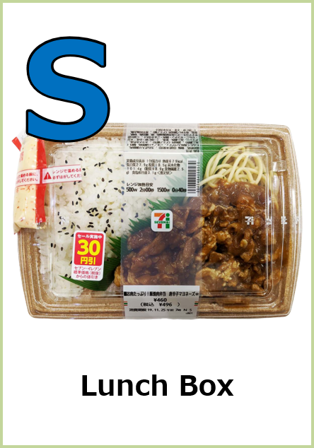
S
Lunch Box

