Slide 1
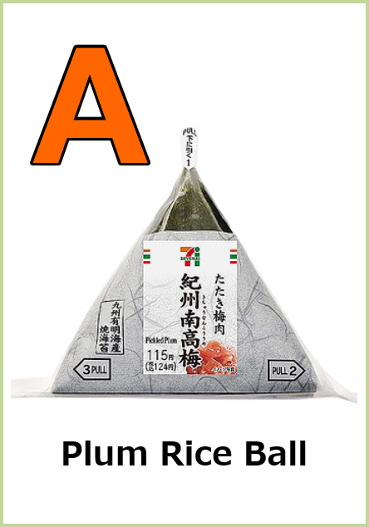
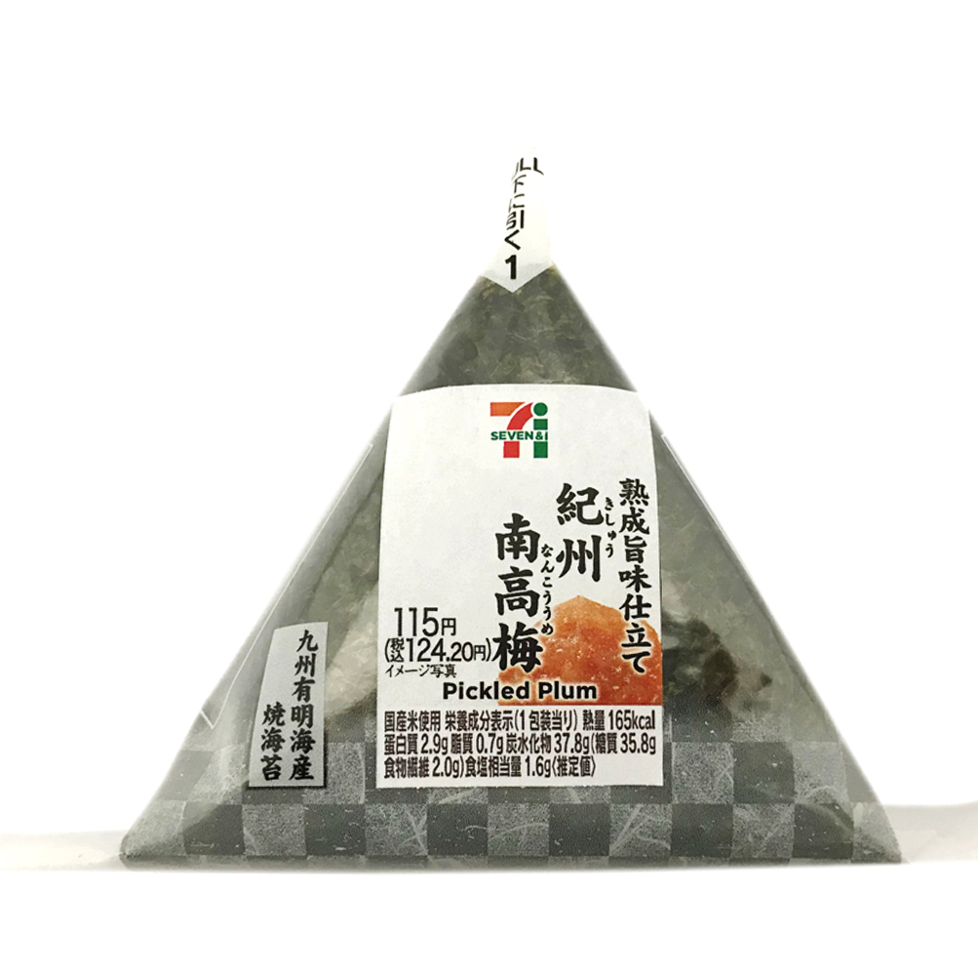
A
Plum Rice Ball
Plum Rice Ball

Slide 2

?

Slide 3
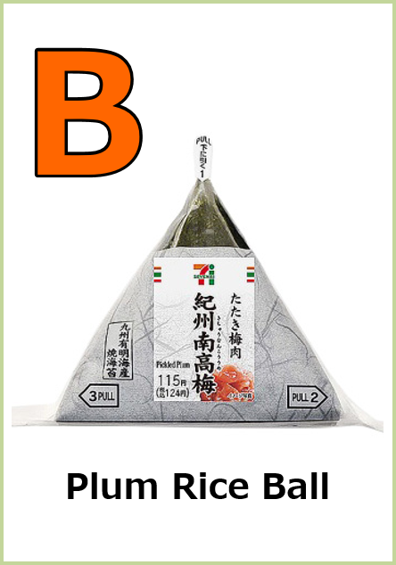
B
Plum Rice Ball
Plum Rice Ball

Slide 4
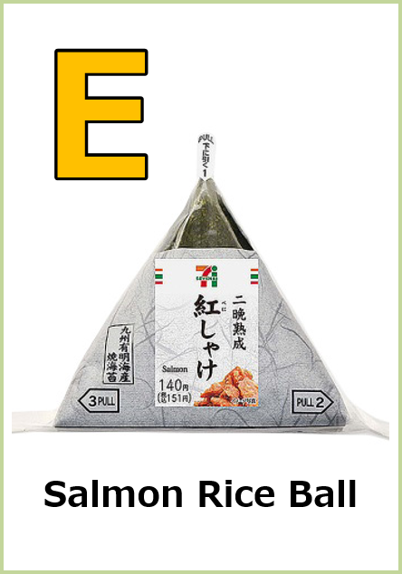
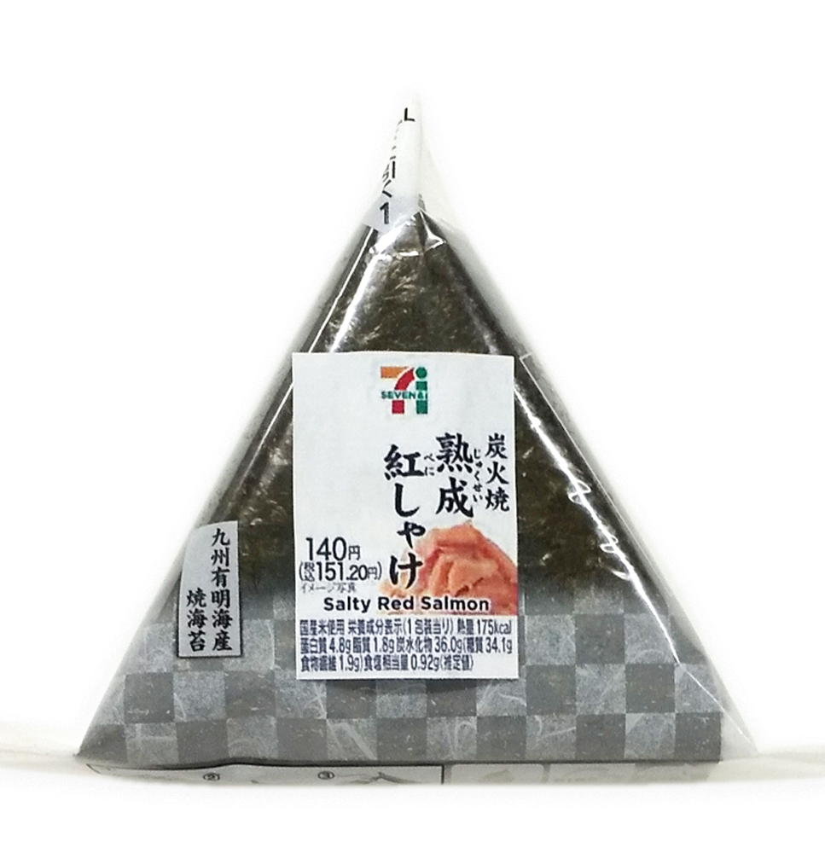
E
Salmon Rice Ball
Salmon Rice Ball

Slide 5
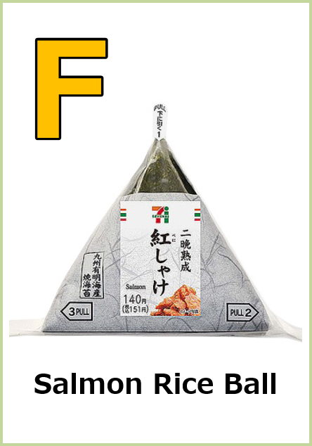
F
Salmon Rice Ball
Salmon Rice Ball

Slide 6

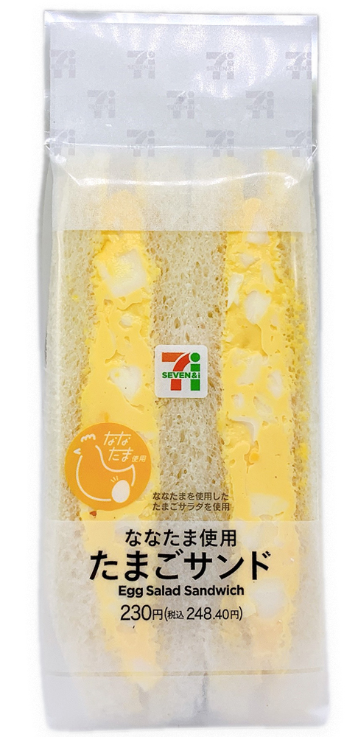
I
Egg Sandwiches
Egg Sandwiches

Slide 7

J
Egg Sandwiches
Egg Sandwiches

Slide 8
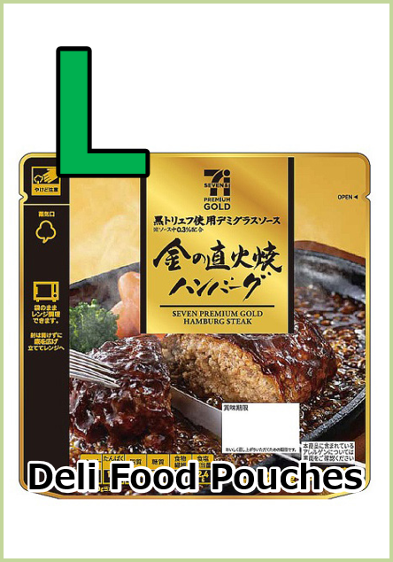
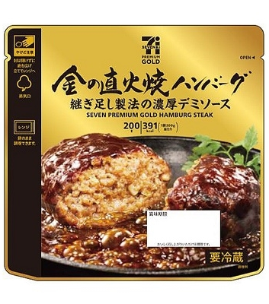
L
Deli Food Pouches
Deli Food Pouches

Slide 9

M
Deli Food Pouches
Deli Food Pouches

Slide 10


O
Drink
Drink

Slide 11

P
Drink
Drink

Slide 12
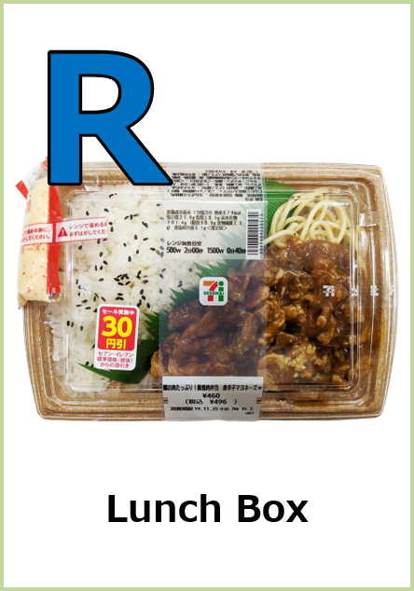
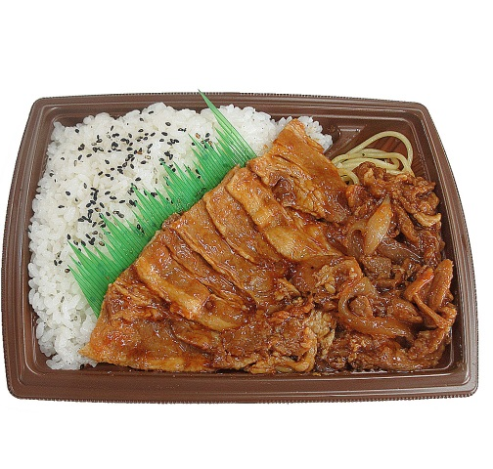
R
Lunch Box
Lunch Box

Slide 13
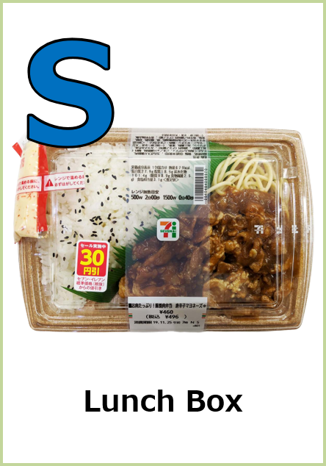
S
Lunch Box
Lunch Box

