Slide 1
ID label for products
Each product has an alphabetic ID: from A to Z and a.
Plum rice balls: (A, B), C
Salmon rice balls: (D, E), F
Tuna rice balls: (G, H), I
Sandwiches A: (J, K), L
Sandwiches B: (M, N), O
Deli Food Pouches: (P, Q), R
Drinks: (S, T), U
Lunch Boxes A: (V, W), X
Lunch Boxes B: (Y, Z), a
The ID is printed on a 30mm x 30mm label.
The font is ”Arial Black” and font size is “80”
The ID label is placed on the barcode.

Slide 2

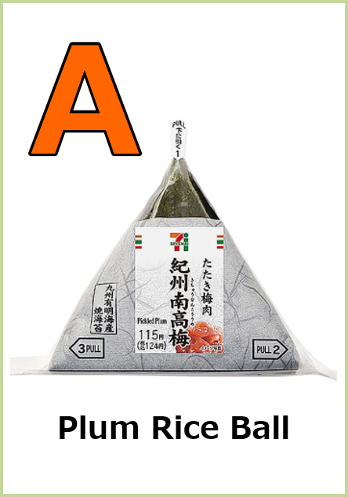
?

Slide 3
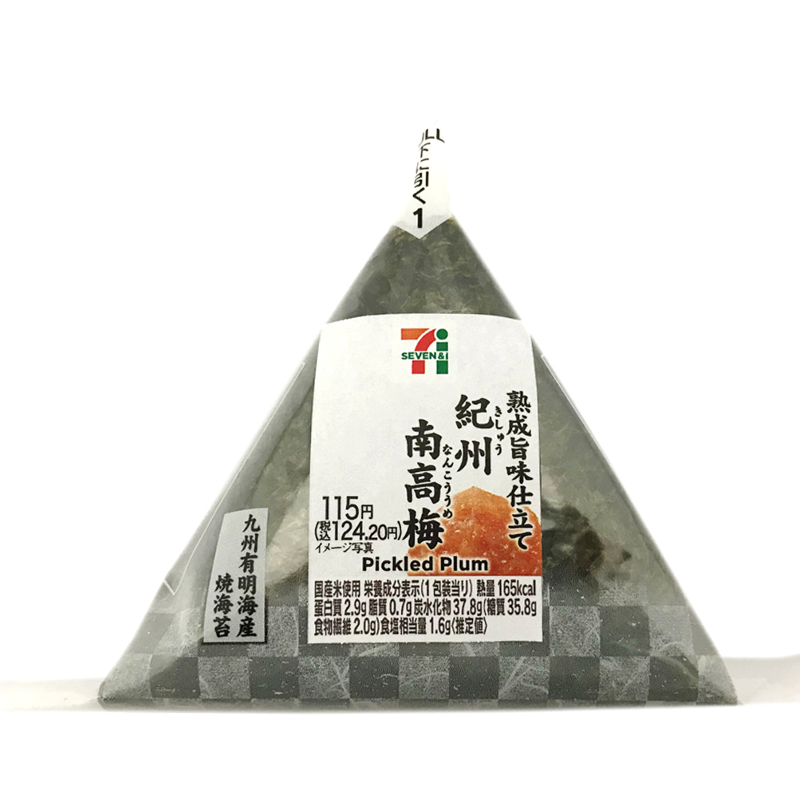
A
B
Plum Rice Ball
Plum Rice Ball
Plum Rice Ball
Plum Rice Ball

Slide 4
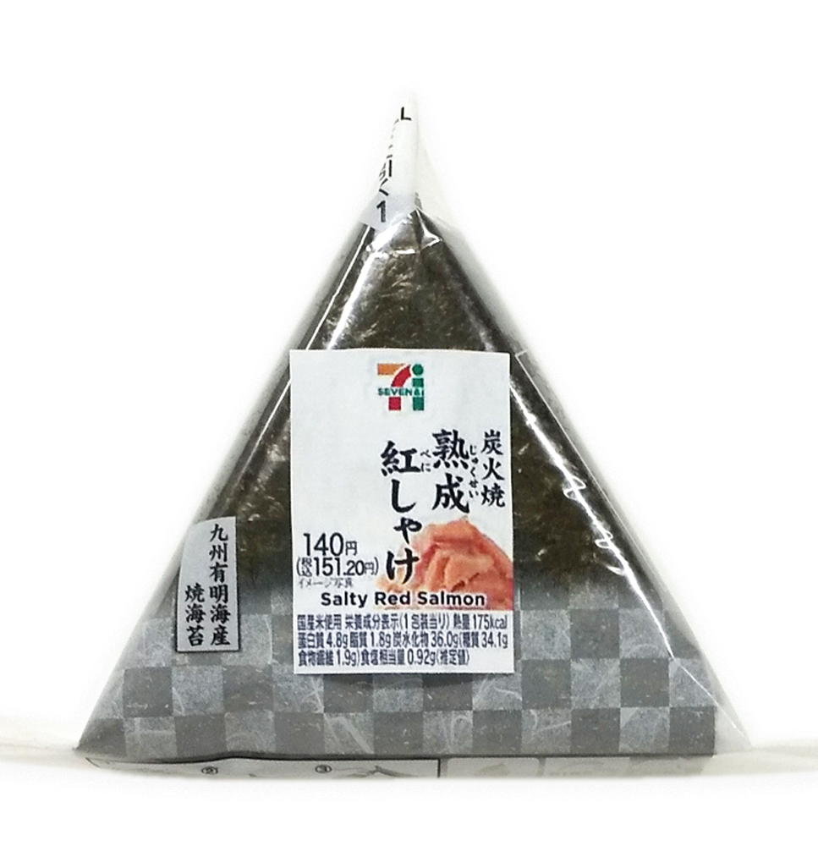
D
E
Salmon Rice Ball
Salmon Rice Ball
Salmon Rice Ball
Salmon Rice Ball

Slide 5
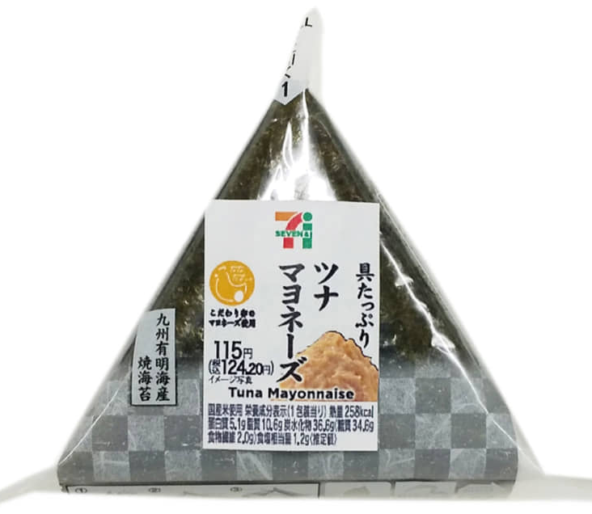
G
H
Tuna Rice Ball
Tuna Rice Ball
Tuna Rice Ball
Tuna Rice Ball

Slide 6
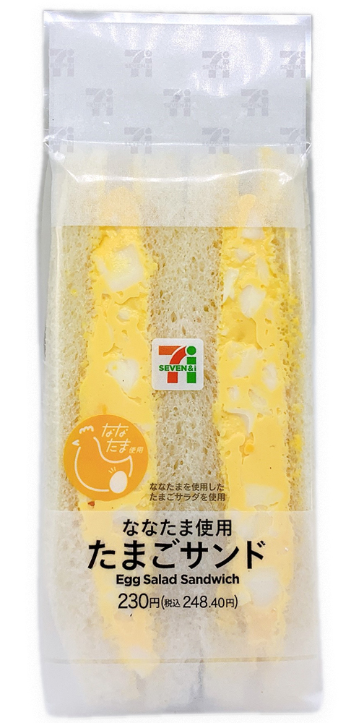
J
K
Sandwiches A
Sandwiches A
Sandwiches A
Sandwiches A

Slide 7
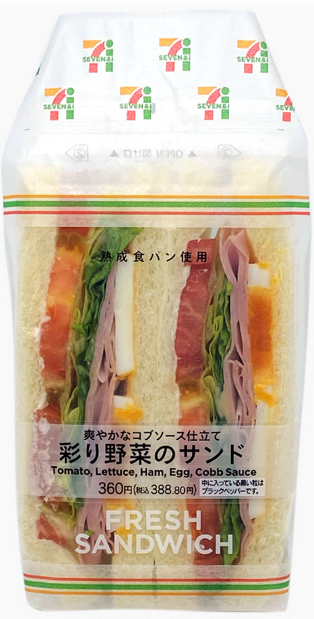
M
N
Sandwiches B
Sandwiches B
Sandwiches B
Sandwiches B

Slide 8
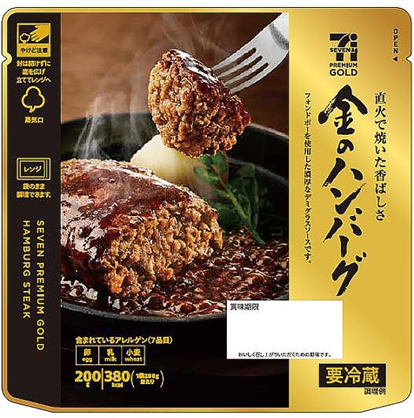
P
Q
Deli Food Pouches
Deli Food Pouches
Deli Food Pouches
Deli Food Pouches

Slide 9

S
T
Drink
Drink
Drink
Drink

Slide 10
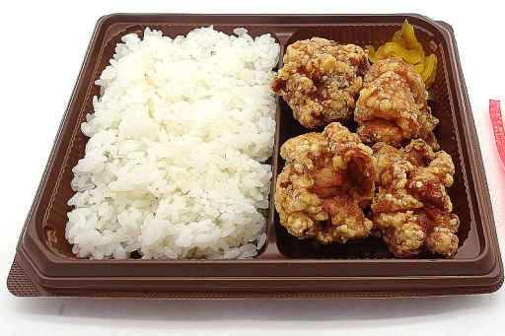
V
W
Lunch Box A
Lunch Box A
Lunch Box A
Lunch Box A

Slide 11
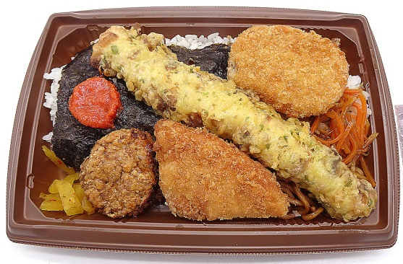
Y
Z
Lunch Box B
Lunch Box B
Lunch Box B
Lunch Box B

