Slide 1
PACKT · CLAUDE CODE BOOTCAMP COHORT 2 · LUCA BERTON
PACKT LIVE WORKSHOP · 7.5 HOURS
CLAUDE CODE BOOTCAMP
COHORT 2
Build. Orchestrate. Verify. Ship.
10 connected hands-on projects · Luca Berton
001 / 198
Notes:
Welcome to Cohort 2. I'm Luca Berton. Today we build one real product, Shipyard, across ten connected projects, and every step ends with evidence, not a claim. Build faster, orchestrate smarter, verify everything, ship with confidence.

Slide 2
PACKT · CLAUDE CODE BOOTCAMP COHORT 2 · LUCA BERTON
THE PROMISE OF TODAY
From an engineering brief to a production readiness decision.
Working applications · safer Git and sandbox workflows · a reusable Skills Pack · a repeatable process
002 / 198
Notes:
By 4:30 you will have working software, a safer way of working with Git and sandboxes, your own Skills Pack and plugin, and a process you can repeat on Monday: brief, plan, build, verify, review, decide.

Slide 3
PACKT · CLAUDE CODE BOOTCAMP COHORT 2 · LUCA BERTON
THE DAY AT A GLANCE
14 parts · 10 projects · 450 minutes
Block | Parts | Projects
Foundations | 1–3 · workspace, briefs, project brain | 1–3
Better code | 4–6 · Best-of-N, debugging, worktrees | 4–6
Beyond the terminal | 7–8 · wireframe to UI, Chrome, refactor | 7–8
Scale and reuse | 9–11 · Skills, hooks, plugins, Agent Teams | 9A–9C
Ship | 12–14 · production review, Cowork, Remote Control | 10A–10C
Close | Q&A, assessment, certification briefing | –
003 / 198
Notes:
Here is the shape of the day. Foundations first, then better code, then beyond the terminal, then scale and reuse, then we ship. Breaks at 10:10, 11:45, lunch at 12:20, and 2:50.

Slide 4
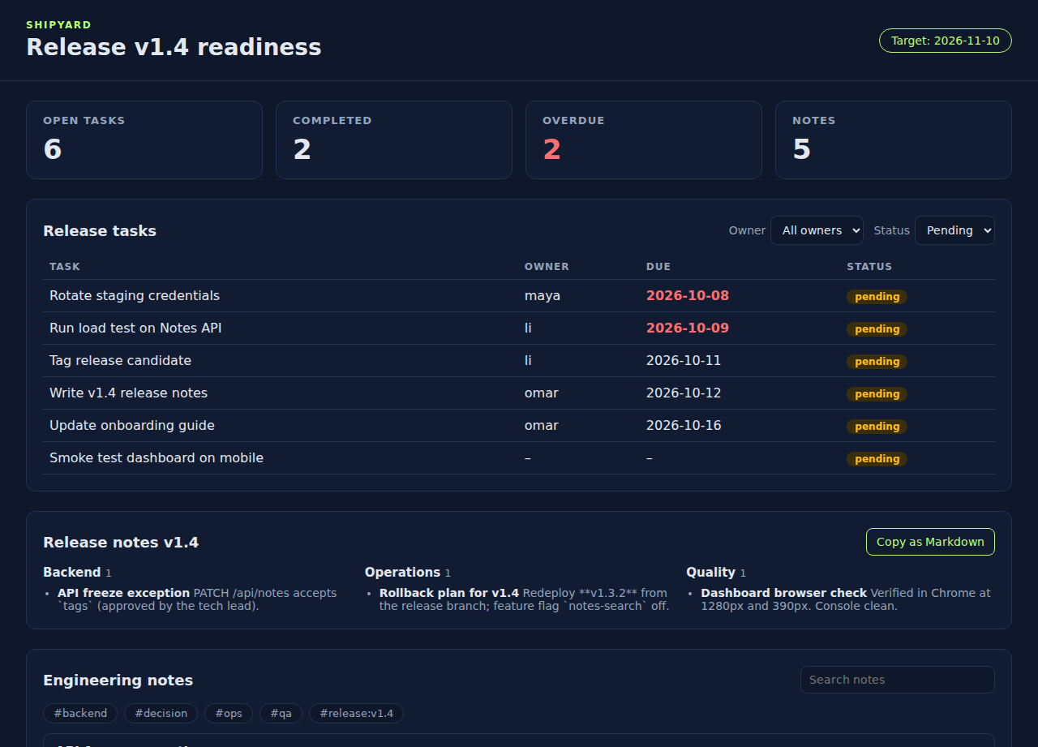
PACKT · CLAUDE CODE BOOTCAMP COHORT 2 · LUCA BERTON
THE PRODUCT WE BUILD ALL DAY
Shipyard: release readiness in one page
Where we end up: shipctl CLI → Notes API → release dashboard → release notes, reviewed and production-checked.
004 / 198
Notes:
This is where we land at the end of the day. A release dashboard fed by a CLI and an API, with release notes generated by an Agent Team. Every pixel on this screen comes from a project you will do.

Slide 5
PACKT · CLAUDE CODE BOOTCAMP COHORT 2 · LUCA BERTON
THE LOOP WE REPEAT IN EVERY PART
Plan → Implement → Verify → Review → Commit
Plan
Implement
Verify
Review
Commit
Claude proposes. Tests, browsers and reviewers produce evidence. The human — the engineer of record — decides.
005 / 198
Notes:
Every part follows this loop. Claude can plan and implement fast. Verification and review are where evidence comes from. Commit is a human decision. Keep this loop in your head all day.

Slide 6
PACKT · CLAUDE CODE BOOTCAMP COHORT 2 · LUCA BERTON
HOW EACH PART RUNS
Same rhythm, every time
Step | What happens | Who
Topic | Concepts and the brief | Luca
Video / live demo | A real recorded Claude Code run of the exact prompts | Claude + Luca
Explain + discuss | What the evidence shows; your questions | Everyone
Lab | You run it: bin/bootcamp stage NN, then the prompts | You
Checkpoint | bin/bootcamp verify · fallback bin/bootcamp fallback NN | You
006 / 198
Notes:
Each part has the same rhythm. I introduce the topic, we watch a real recorded run so timing and output are predictable, I explain what the evidence shows, we discuss, and then you do the lab. If anything breaks, one command loads the checkpoint so nobody falls behind.

Slide 7
PACKT · CLAUDE CODE BOOTCAMP COHORT 2 · LUCA BERTON
SETUP CHECK · 2 MINUTES
Everything you need, verified
git clone <your copy of the bootcamp repo> && cd claude-code-bootcamp-cohort-2
bin/bootcamp preflight # tools + all 14 reference checkpoints
bin/bootcamp stage 01 # your Shipyard repo at ~/shipyard-stage
claude --version # Claude Code installed and logged in
Python 3.10+ · Git · Node.js 18+ (dashboard tests) · Chrome for Part 7 · GitHub for selected workflows
007 / 198
Notes:
Let's verify the setup together. Preflight checks your tools and builds every reference checkpoint and runs its tests. If it says PREFLIGHT PASSED, you are ready for the whole day.

Slide 8
PACKT · CLAUDE CODE BOOTCAMP COHORT 2 · LUCA BERTON
EXACT SCHEDULE · MORNING
Today, minute by minute
Time | Session | Length
09:00–09:20 | Part 01 · Welcome, setup, AI-first mindset and safe delegation | 20 min
09:20–09:45 | Part 02 · Prompting Claude Code like a tech lead | 25 min
09:45–10:10 | Part 03 · CLAUDE.md, scoped rules and auto memory | 25 min
10:10–10:20 | Break | 10 min
10:20–10:50 | Part 04 · Best-of-N and better engineering decisions | 30 min
10:50–11:20 | Part 05 · Testing, debugging, checkpoints and /goal | 30 min
11:20–11:45 | Part 06 · Git workflows, worktrees, permissions and sandboxing | 25 min
11:45–11:55 | Break | 10 min
11:55–12:20 | Part 07 · Multimodal building and Chrome verification | 25 min
12:20–13:00 | Lunch | 40 min
008 / 198
Notes:
This is the exact morning schedule from the brief. The whole day is 450 minutes including breaks and lunch.

Slide 9
PACKT · CLAUDE CODE BOOTCAMP COHORT 2 · LUCA BERTON
EXACT SCHEDULE · AFTERNOON
Today, minute by minute
Time | Session | Length
13:00–13:20 | Part 08 · Refactor, document and create a maintainer handoff | 20 min
13:20–13:55 | Part 09 · Skills, hooks and specialist subagents | 35 min
13:55–14:20 | Part 10 · Plugins and marketplace distribution | 25 min
14:20–14:50 | Part 11 · Agent Teams: ship a feature in parallel | 30 min
14:50–15:00 | Break | 10 min
15:00–15:25 | Part 12 · Production readiness, security and code review | 25 min
15:25–15:45 | Part 13 · Claude Cowork: engineering output to stakeholder update | 20 min
15:45–16:05 | Part 14 · Web, mobile, Remote Control and work that continues | 20 min
16:05–16:30 | Final Q&A and exam briefing | 25 min
009 / 198
Notes:
This is the exact afternoon schedule from the brief. The whole day is 450 minutes including breaks and lunch.

Slide 10
PACKT · CLAUDE CODE BOOTCAMP COHORT 2 · LUCA BERTON
PART 01 · 09:00–09:20 · 20 MIN
Welcome, setup, AI-first mindset and safe delegation
Project 1: AI-Ready Engineering Workspace
010 / 198
Notes:
09:00–09:20. Part 01: Welcome, setup, AI-first mindset and safe delegation. Project 1: AI-Ready Engineering Workspace. By the end of this part you leave with: Working Claude Code environment; Trusted starter repository; Written permission and safety boundary (SAFETY.md + .claude/settings.json); Baseline Git commit and recovery point.

Slide 11
PACKT · CLAUDE CODE BOOTCAMP COHORT 2 · LUCA BERTON
PART 01 · GOALS
What you will be able to do
• Map what Claude Code can do across CLI, IDE, desktop, web and mobile
• Run the lifecycle: plan → implement → verify → review → commit
• Choose model, context and effort for a task
• Pick a permission mode and accept workspace trust deliberately
• Separate reversible from irreversible actions; create a recovery point first
011 / 198
Notes:
These are the goals for this part. Map what Claude Code can do across CLI, IDE, desktop, web and mobile Run the lifecycle: plan → implement → verify → review → commit Choose model, context and effort for a task Pick a permission mode and accept workspace trust deliberately Separate reversible from irreversible actions; create a recovery point first.

Slide 12
PACKT · CLAUDE CODE BOOTCAMP COHORT 2 · LUCA BERTON
WHERE CLAUDE CODE RUNS
One agent, many surfaces
Surface | Best for | Today
Terminal (CLI) | Full control, scripting, -p automation | Parts 1–12
IDE (VS Code, JetBrains) | Diffs inline with your editor | Optional
Desktop app | Sessions side by side, Cowork | Part 13
Web (claude.ai/code) | Cloud sessions, routines | Part 14
Mobile | Monitor and steer via Remote Control | Part 14
012 / 198
Notes:
Claude Code is not only a terminal tool any more. Same agent, different surfaces. We start in the terminal because it gives us the most control and the clearest evidence, and we finish on the phone.

Slide 13
PACKT · CLAUDE CODE BOOTCAMP COHORT 2 · LUCA BERTON
CHOOSE BEFORE YOU TYPE
Model, context and effort
Knob | How | Rule of thumb
Model | /model, --model sonnet | Sonnet for most work; Opus for hard design; Haiku for quick, cheap tasks
Effort | /effort low…max, --effort | Raise for ambiguous problems; lower for mechanical edits
Context | /context, /compact, @file | Give the brief and the files, not your whole disk
013 / 198
Notes:
Three knobs before you even type. The model, the effort, and the context. Most failures I see come from the wrong context, not the wrong model.

Slide 14
PACKT · CLAUDE CODE BOOTCAMP COHORT 2 · LUCA BERTON
PERMISSION MODES
Autonomy is a setting, not a mood
Mode | Behaviour | Use when
Manual (default) | Asks before edits and commands | Learning, risky areas
acceptEdits | Auto-accepts edits and common file commands | Focused edit loops
plan | Read-only until you approve a plan | New designs, multi-file changes
auto | A classifier reviews actions instead of prompting | Staged copies with a recovery point
bypassPermissions | No checks | Disposable containers only
014 / 198
Notes:
Shift+Tab cycles through modes. Pick the mode that matches the consequence of a mistake. Workspace trust matters too: project allow rules only apply after you accept the trust dialog, so read the folder before you trust it.

Slide 15
PACKT · CLAUDE CODE BOOTCAMP COHORT 2 · LUCA BERTON
SAFE DELEGATION
Blind trust vs safe delegation
BLIND TRUST
SAFE DELEGATION
• “Update every dependency, fix whatever breaks, and deploy the application.”
• Inspect dependencies and propose an upgrade plan
• Don't touch deployment config or credentials
• Update approved packages in an isolated branch
• Run the full suite; document breaking changes
• Stop for review before merging
015 / 198
Notes:
This is the slide I want you to remember. Same goal, two prompts. The safe one names the scope, the protected areas, the isolation, the evidence and the stop point.

Slide 16
PACKT · CLAUDE CODE BOOTCAMP COHORT 2 · LUCA BERTON
REVERSIBILITY
Autonomy proportional to reversibility
REVERSIBLE: DELEGATE
IRREVERSIBLE: HUMAN APPROVAL
• File edits (git, /rewind)
• Local test runs
• Branches and worktrees
• Drafts and previews
• git push / force push
• Deleting outside git
• Deployments, sent messages
• Credential and permission changes
016 / 198
Notes:
The rule of the day: the more irreversible an action, the closer a human must be. Before any autonomous work, create a recovery point: a baseline commit.

Slide 17
PACKT · CLAUDE CODE BOOTCAMP COHORT 2 · LUCA BERTON
PART 01 · PROMPT 1 OF 1
Safety boundary (Manual mode)
Read README.md. Draft SAFETY.md for this repository: the permission
mode we use and when, actions allowed without asking, actions that
must ask first, blocked actions, which actions are reversible versus
irreversible, and how we recover (baseline commit). Then show me a
matching .claude/settings.json permissions block (allow / ask /
deny) in your reply, but do not create that file: I will review it
and save it myself. Do not commit.
Copy from parts/01-workspace/PROMPTS.md
017 / 198
Notes:
This is the exact prompt 1. Read it with me: notice the scope, the constraints and the evidence it asks for. Read README.md. Draft SAFETY.md for this repository: the permission mode we use and when, actions allowed without asking, actions that must ask first, blocked actions, which actions are reversible versus irreversible, and how we recover (baseline commit). Then show me a matching .claude/settings.json permissions block (allow / ask / deny) in your reply, but do not create that file: I will review it and save it myself. Do not commit.

Slide 18
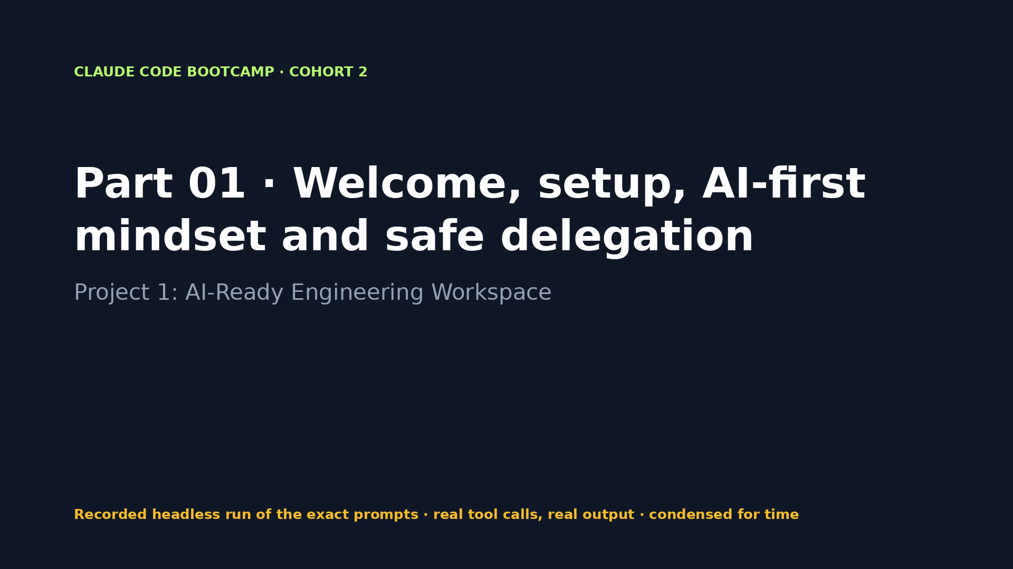
Notes:
VIDEO · Part 01 · Claude drafts the safety boundary from the README; the human saves the settings and commits the baseline.
Say first: “This is a recording of a real run of the exact prompts on the previous slide. Tool calls and output are real; long runs are condensed.”
CLICK THE VIDEO to play. Click again to pause for questions. Then → for what the evidence shows.
Fallback if playback fails: open videos/01-workspace.mp4 in VLC or a browser.

Slide 19
PACKT · CLAUDE CODE BOOTCAMP COHORT 2 · LUCA BERTON
PART 01 · EVIDENCE, NOT CLAIMS
What the run proved
WHAT TO LOOK FOR
WHAT THE RECORDED RUN PRODUCED
• claude --version and /status
• git log --oneline -1 → baseline commit
• SAFETY.md reviewed by a human
• /permissions shows the saved rules
• 1 prompt(s) · 1 min 29 s · $0.10 · 5 tool calls
• bin/bootcamp verify: 3 PASS · 0 FAIL
• Changed: ?? SAFETY.md
019 / 198
Notes:
Now let's look at what we actually saw. Each line on the right comes from the recorded run, not from me. The run took 1 minutes 29 seconds and cost 0.10 dollars.

Slide 20
PACKT · CLAUDE CODE BOOTCAMP COHORT 2 · LUCA BERTON
PART 01 · DISCUSS
Your turn to think
• Which of your daily tasks are reversible, and which are not?
• Rewrite "Update every dependency, fix whatever breaks, and deploy" as a safe delegation.
• When would you choose plan mode over auto mode?
020 / 198
Notes:
Discussion. Take one of these questions. I'll take two or three answers before the lab.

Slide 21
PACKT · CLAUDE CODE BOOTCAMP COHORT 2 · LUCA BERTON
PART 01 · LAB
Hands-on
• Stage part 01, start Claude Code, accept trust only after reading the folder, choose Manual mode, draft SAFETY.md with the prompt, save the settings yourself, commit the baseline.
• Start: bin/bootcamp stage 01
• Prompts: parts/01-workspace/PROMPTS.md
• Check: bin/bootcamp verify
021 / 198
Notes:
Lab time. Stage the part, run the prompts, and check with verify. If you get stuck, fallback loads the reference.

Slide 22
PACKT · CLAUDE CODE BOOTCAMP COHORT 2 · LUCA BERTON
PART 01 · CHECKPOINT
You now have
✓ Working Claude Code environment
✓ Trusted starter repository
✓ Written permission and safety boundary (SAFETY.md + .claude/settings.json)
✓ Baseline Git commit and recovery point
• Behind? bin/bootcamp checkpoint 01 --force
022 / 198
Notes:
Checkpoint. If you have all of these, you're ready for the next part. If not, checkpoint gets you there in one command.

Slide 23
PACKT · CLAUDE CODE BOOTCAMP COHORT 2 · LUCA BERTON
PART 02 · 09:20–09:45 · 25 MIN
Prompting Claude Code like a tech lead
Project 2: CLI Release Task Manager
023 / 198
Notes:
09:20–09:45. Part 02: Prompting Claude Code like a tech lead. Project 2: CLI Release Task Manager. By the end of this part you leave with: Working CLI application (`shipctl.py`); Structured engineering brief; Test suite; Acceptance evidence table; README with usage examples.

Slide 24
PACKT · CLAUDE CODE BOOTCAMP COHORT 2 · LUCA BERTON
PART 02 · GOALS
What you will be able to do
• Replace small prompts with a complete engineering brief
• State outcome, context, constraints, protected areas and acceptance criteria
• Require proof instead of accepting completion claims
• Ask for a plan first; review and challenge it; intervene only at decision points
024 / 198
Notes:
These are the goals for this part. Replace small prompts with a complete engineering brief State outcome, context, constraints, protected areas and acceptance criteria Require proof instead of accepting completion claims Ask for a plan first; review and challenge it; intervene only at decision points.

Slide 25
PACKT · CLAUDE CODE BOOTCAMP COHORT 2 · LUCA BERTON
FROM PROMPT TO BRIEF
Small prompt vs engineering brief
SMALL PROMPT
ENGINEERING BRIEF
• “Write a task manager CLI.”
• No scope, no constraints
• No definition of done
• You get a guess
• Outcome and context
• Constraints and protected areas
• Acceptance criteria AC1–AC8
• Required evidence
• Plan first, then stop
025 / 198
Notes:
A tech lead doesn't say 'write a task manager'. A tech lead writes a brief: what outcome, what context, what must not change, what done means, and what proof is required.

Slide 26
PACKT · CLAUDE CODE BOOTCAMP COHORT 2 · LUCA BERTON
THE BRIEF, ABRIDGED
briefs/cli-release-task-manager.md
## Constraints
- Python stdlib only; storage ./tasks.json, override with SHIPCTL_DB
- Exit codes: 0 ok · 1 user error · 2 storage error
## Protected areas
- SAFETY.md, .claude/, briefs/ · no commits
## Acceptance criteria
AC1 add prints `Added #<id>: <title>` AC4 pending list sorted by due date
AC5 owner + status filters combine AC7 corrupt tasks.json exits 2
## Required evidence
- plan · raw test output · AC→test table · real CLI session
Full brief in parts/02-task-manager/start/briefs/
026 / 198
Notes:
Here is the brief we use. Notice the required evidence section. We don't ask Claude whether it's done; we ask for the command, the output, and a mapping from every criterion to a test.

Slide 27
PACKT · CLAUDE CODE BOOTCAMP COHORT 2 · LUCA BERTON
PLAN MODE
Review the plan like a pull request
• Shift+Tab to plan mode: Claude reads and proposes, edits nothing
• Challenge storage, error handling, test strategy, edge cases
• Reject once with a concrete objection; approve explicitly
• Intervene at decision points, not on every line
027 / 198
Notes:
Plan mode is where you get leverage. Reading a plan takes two minutes; reading a wrong implementation takes twenty. Challenge it once, with something specific.

Slide 28
PACKT · CLAUDE CODE BOOTCAMP COHORT 2 · LUCA BERTON
PROOF, NOT CLAIMS
“Tests pass” is a claim.
“Ran 15 tests … OK” is evidence.
Ask for the command, the raw output, and the criterion each test proves.
028 / 198
Notes:
This is the habit that separates teams that trust AI output from teams that get burned by it. Always ask for the command and its raw output.

Slide 29
PACKT · CLAUDE CODE BOOTCAMP COHORT 2 · LUCA BERTON
PART 02 · PROMPT 1 OF 2
Plan first (plan mode)
Read briefs/cli-release-task-manager.md and SAFETY.md. Propose an
implementation plan for shipctl: files, functions, storage format,
how each acceptance criterion will be tested, and the risks. Do not
write code yet.
Copy from parts/02-task-manager/PROMPTS.md
029 / 198
Notes:
This is the exact prompt 1. Read it with me: notice the scope, the constraints and the evidence it asks for. Read briefs/cli-release-task-manager.md and SAFETY.md. Propose an implementation plan for shipctl: files, functions, storage format, how each acceptance criterion will be tested, and the risks. Do not write code yet.

Slide 30
PACKT · CLAUDE CODE BOOTCAMP COHORT 2 · LUCA BERTON
PART 02 · PROMPT 2 OF 2
Implement after approval
Plan approved. Implement shipctl.py, tests/test_shipctl.py and the
README section exactly as planned. Run python3 -m unittest discover
-s tests -v and show the raw output. Then give me a table mapping
every acceptance criterion (AC1-AC8) to the test that proves it, and
a short terminal session with real CLI output for AC1, AC4 and AC5
using SHIPCTL_DB=./demo-tasks.json. Do not commit.
Copy from parts/02-task-manager/PROMPTS.md
030 / 198
Notes:
This is the exact prompt 2. Read it with me: notice the scope, the constraints and the evidence it asks for. Plan approved. Implement shipctl.py, tests/test_shipctl.py and the README section exactly as planned. Run python3 -m unittest discover -s tests -v and show the raw output. Then give me a table mapping every acceptance criterion (AC1-AC8) to the test that proves it, and a short terminal session with real CLI output for AC1, AC4 and AC5 using SHIPCTL_DB=./demo-tasks.json. Do not commit.

Slide 31
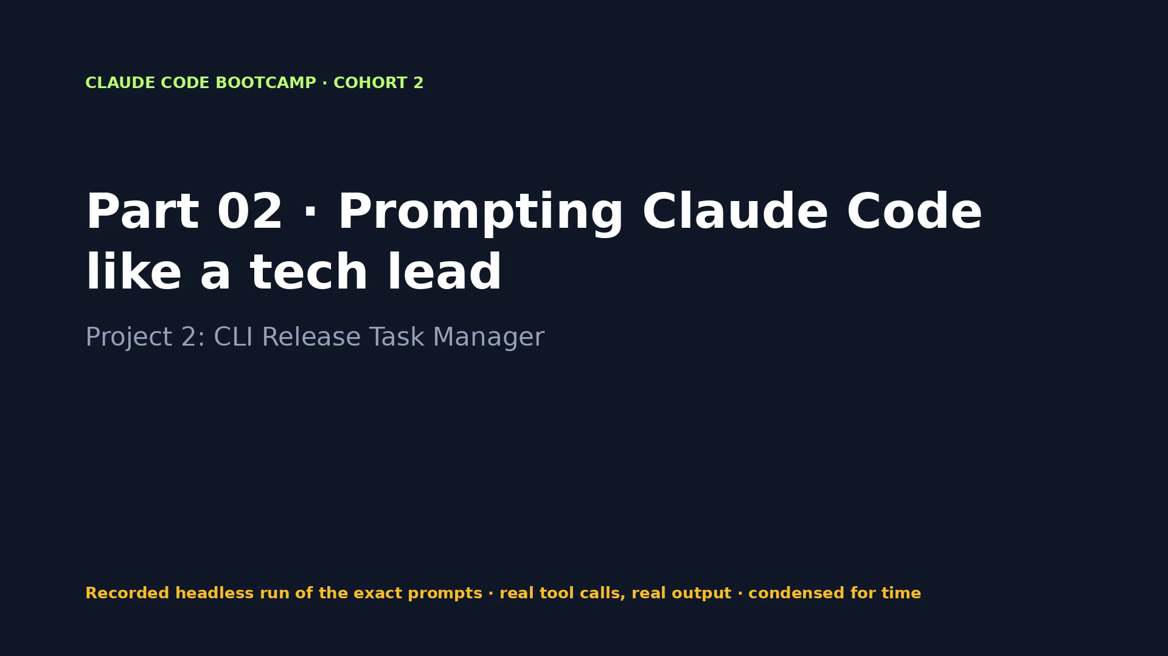
Notes:
VIDEO · Part 02 · Plan mode proposal, approval, implementation, 15 passing tests and the AC evidence table.
Say first: “This is a recording of a real run of the exact prompts on the previous slide. Tool calls and output are real; long runs are condensed.”
CLICK THE VIDEO to play. Click again to pause for questions. Then → for what the evidence shows.
Fallback if playback fails: open videos/02-task-manager.mp4 in VLC or a browser.

Slide 32
PACKT · CLAUDE CODE BOOTCAMP COHORT 2 · LUCA BERTON
PART 02 · EVIDENCE, NOT CLAIMS
What the run proved
WHAT TO LOOK FOR
WHAT THE RECORDED RUN PRODUCED
• The approved plan
• Raw unittest -v output
• AC → test table
• Real CLI session for AC1, AC4, AC5
• 2 prompt(s) · 3 min 17 s · $0.50 · 18 tool calls
• Tests seen in the run: Ran 33 tests in 4.279s
• bin/bootcamp verify: 5 PASS · 0 FAIL
• Changed: M README.md, ?? shipctl.py, ?? tests/
032 / 198
Notes:
Now let's look at what we actually saw. Each line on the right comes from the recorded run, not from me. The run took 3 minutes 17 seconds and cost 0.50 dollars. In the first recording Claude refused to invent CLI output when the scratch path was blocked. Remember that: no evidence, no claim.

Slide 33
PACKT · CLAUDE CODE BOOTCAMP COHORT 2 · LUCA BERTON
PART 02 · DISCUSS
Your turn to think
• Which acceptance criterion was the hardest to prove, and why?
• What would you have challenged in the plan?
• What is the difference between "tests pass" and "here is the command and its output"?
033 / 198
Notes:
Discussion. Take one of these questions. I'll take two or three answers before the lab.

Slide 34
PACKT · CLAUDE CODE BOOTCAMP COHORT 2 · LUCA BERTON
PART 02 · LAB
Hands-on
• Run the two prompts. Reject the first plan once with a concrete objection (for example: atomic writes). Check the evidence table against the brief yourself.
• Start: bin/bootcamp stage 02
• Prompts: parts/02-task-manager/PROMPTS.md
• Check: bin/bootcamp verify
034 / 198
Notes:
Lab time. Stage the part, run the prompts, and check with verify. If you get stuck, fallback loads the reference.

Slide 35
PACKT · CLAUDE CODE BOOTCAMP COHORT 2 · LUCA BERTON
PART 02 · CHECKPOINT
You now have
✓ Working CLI application (shipctl.py)
✓ Structured engineering brief
✓ Test suite
✓ Acceptance evidence table
✓ README with usage examples
• Behind? bin/bootcamp checkpoint 02 --force
035 / 198
Notes:
Checkpoint. If you have all of these, you're ready for the next part. If not, checkpoint gets you there in one command.

Slide 36
PACKT · CLAUDE CODE BOOTCAMP COHORT 2 · LUCA BERTON
PART 03 · 09:45–10:10 · 25 MIN
CLAUDE.md, scoped rules and auto memory
Project 3: Project Brain
036 / 198
Notes:
09:45–10:10. Part 03: CLAUDE.md, scoped rules and auto memory. Project 3: Project Brain. By the end of this part you leave with: Reusable CLAUDE.md (under 60 lines); Path-scoped rules (`tests/**`, `shipctl.py`); Documented conventions; Reviewed auto-memory entry; Evidence that Claude followed the context (`shipctl stats`).

Slide 37
PACKT · CLAUDE CODE BOOTCAMP COHORT 2 · LUCA BERTON
PART 03 · GOALS
What you will be able to do
• Decide what belongs in CLAUDE.md, and what does not
• Record build/test commands, conventions, security rules and do-not-touch areas concisely
• Use .claude/rules with paths: for directory- or language-specific instructions
• Move occasional reference material into Skills
• Review, correct and remove stale auto memory
037 / 198
Notes:
These are the goals for this part. Decide what belongs in CLAUDE.md, and what does not Record build/test commands, conventions, security rules and do-not-touch areas concisely Use .claude/rules with `paths:` for directory- or language-specific instructions Move occasional reference material into Skills Review, correct and remove stale auto memory.

Slide 38
PACKT · CLAUDE CODE BOOTCAMP COHORT 2 · LUCA BERTON
CLAUDE.MD
What belongs in CLAUDE.md
IN
OUT
• Stack and exact commands
• Conventions Claude can't infer
• Exit-code and API contracts
• Protected files, do-not rules
• Pointers: @SAFETY.md
• Long reference material (→ Skills)
• Path-specific rules (→ .claude/rules)
• Things the code already says
• Personal preferences (→ auto memory)
• Secrets, ever
038 / 198
Notes:
CLAUDE.md is loaded every session, so every line costs context. Keep it short, specific and true. If it's occasional, it's a Skill. If it's path-specific, it's a rule.

Slide 39
PACKT · CLAUDE CODE BOOTCAMP COHORT 2 · LUCA BERTON
PATH-SCOPED RULES
.claude/rules/tests.md
---
paths:
- "tests/**/*.py"
---
# Test conventions
- One TestCase class per behaviour: <Behaviour>Tests
- Never touch the real tasks.json: SHIPCTL_DB → temp dir
- Assert exit codes and exact messages
Loaded only when Claude works on matching files. The only frontmatter key is paths:.
039 / 198
Notes:
Rules with a paths frontmatter load only when Claude touches matching files. This keeps the global context small and the local guidance precise.

Slide 40
PACKT · CLAUDE CODE BOOTCAMP COHORT 2 · LUCA BERTON
MEMORY, LAYERED
Who remembers what
Layer | Where | Reviewed by
CLAUDE.md | repo root, versioned | the team, in PRs
Rules | .claude/rules/*.md with paths: | the team
Skills | .claude/skills/<name>/SKILL.md | the team
Auto memory | ~/.claude/projects/<project>/memory/ | you, with /memory
040 / 198
Notes:
Auto memory is on by default and lives outside the repo. It's useful, and it goes stale. Review it with /memory, delete duplicates and anything derivable from code, date the project facts.

Slide 41
PACKT · CLAUDE CODE BOOTCAMP COHORT 2 · LUCA BERTON
HOW WE TEST THE BRAIN
Make a change. Check the diff against the rules.
shipctl stats: cmd_ naming · README table updated · test class conventions · exit codes intact
041 / 198
Notes:
The only way to know context works is to watch it change behaviour. We ask for a small feature and check the diff against every rule.

Slide 42
PACKT · CLAUDE CODE BOOTCAMP COHORT 2 · LUCA BERTON
PART 03 · PROMPT 1 OF 2
Write the project brain
Create a concise CLAUDE.md for this repository (under 60 lines):
stack, exact build and test commands, conventions you can infer from
shipctl.py and tests/, the exit-code contract, protected files
(SAFETY.md, .claude/settings.json, briefs/), and do-not rules. Then
create two path-scoped rules with `paths:` frontmatter:
.claude/rules/tests.md for tests/**/*.py and .claude/rules/cli.md
for shipctl.py. Keep anything occasional out of CLAUDE.md. Do not
commit.
Copy from parts/03-project-brain/PROMPTS.md
042 / 198
Notes:
This is the exact prompt 1. Read it with me: notice the scope, the constraints and the evidence it asks for. Create a concise CLAUDE.md for this repository (under 60 lines): stack, exact build and test commands, conventions you can infer from shipctl.py and tests/, the exit-code contract, protected files (SAFETY.md, .claude/settings.json, briefs/), and do-not rules. Then create two path-scoped rules with `paths:` frontmatter: .claude/rules/tests.md for tests/**/*.py and .claude/rules/cli.md for shipctl.py. Keep anything occasional out of CLAUDE.md. Do not commit.

Slide 43
PACKT · CLAUDE CODE BOOTCAMP COHORT 2 · LUCA BERTON
PART 03 · PROMPT 2 OF 2
Prove the context is applied
Add a `shipctl stats` command that prints pending, done and overdue
counts per owner. Follow CLAUDE.md and the rules in .claude/rules.
When done, list which specific rules you applied and where, run the
full test suite and show the raw output. Do not commit.
Copy from parts/03-project-brain/PROMPTS.md
043 / 198
Notes:
This is the exact prompt 2. Read it with me: notice the scope, the constraints and the evidence it asks for. Add a `shipctl stats` command that prints pending, done and overdue counts per owner. Follow CLAUDE.md and the rules in .claude/rules. When done, list which specific rules you applied and where, run the full test suite and show the raw output. Do not commit.

Slide 44
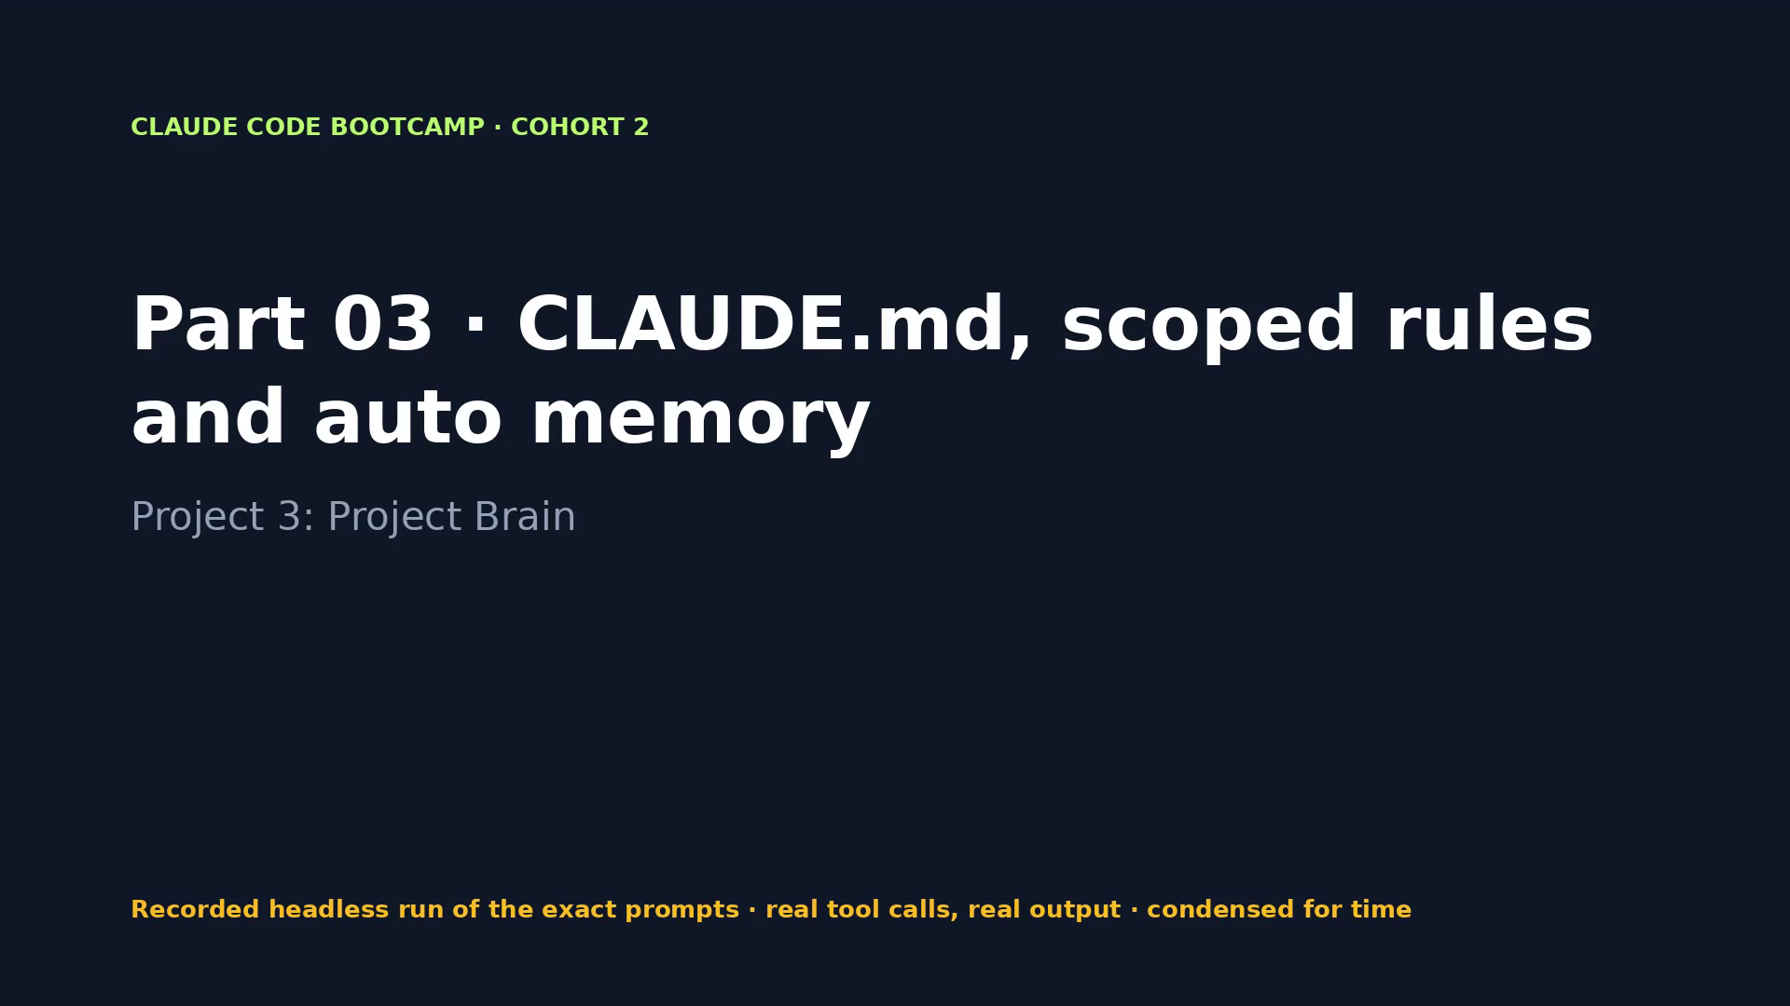
Notes:
VIDEO · Part 03 · Claude writes CLAUDE.md and two scoped rules, then implements `stats` and cites the rules it applied.
Say first: “This is a recording of a real run of the exact prompts on the previous slide. Tool calls and output are real; long runs are condensed.”
CLICK THE VIDEO to play. Click again to pause for questions. Then → for what the evidence shows.
Fallback if playback fails: open videos/03-project-brain.mp4 in VLC or a browser.

Slide 45
PACKT · CLAUDE CODE BOOTCAMP COHORT 2 · LUCA BERTON
PART 03 · EVIDENCE, NOT CLAIMS
What the run proved
WHAT TO LOOK FOR
WHAT THE RECORDED RUN PRODUCED
• /memory shows CLAUDE.md, rules and auto memory
• /context shows what loaded
• Diff of stats follows cmd_ naming, README table, test class conventions
• Reviewed memory entries in docs/memory-review.md
• 2 prompt(s) · 3 min 04 s · $0.40 · 15 tool calls
• Tests seen in the run: Ran 18 tests in 2.705s
• bin/bootcamp verify: 5 PASS · 0 FAIL
• Changed: M README.md, M shipctl.py, M tests/test_shipctl.py, ?? .claude/rules/ … (+1)
045 / 198
Notes:
Now let's look at what we actually saw. Each line on the right comes from the recorded run, not from me. The run took 3 minutes 4 seconds and cost 0.40 dollars. Headless runs cannot approve edits under .claude/, so the rules were installed by a labelled human step. Live, you approve them.

Slide 46
PACKT · CLAUDE CODE BOOTCAMP COHORT 2 · LUCA BERTON
PART 03 · DISCUSS
Your turn to think
• What did you delete from your first CLAUDE.md draft, and why?
• When is a path-scoped rule better than a line in CLAUDE.md?
• Which auto-memory entries would you never keep?
046 / 198
Notes:
Discussion. Take one of these questions. I'll take two or three answers before the lab.

Slide 47
PACKT · CLAUDE CODE BOOTCAMP COHORT 2 · LUCA BERTON
PART 03 · LAB
Hands-on
• Write CLAUDE.md and the rules (Claude Code asks you to approve edits under .claude/: read them, then approve), start a fresh session, request the stats change, and check the diff against the rules. Open /memory and remove one stale entry.
• Start: bin/bootcamp stage 03
• Prompts: parts/03-project-brain/PROMPTS.md
• Check: bin/bootcamp verify
047 / 198
Notes:
Lab time. Stage the part, run the prompts, and check with verify. If you get stuck, fallback loads the reference.

Slide 48
PACKT · CLAUDE CODE BOOTCAMP COHORT 2 · LUCA BERTON
PART 03 · CHECKPOINT
You now have
✓ Reusable CLAUDE.md (under 60 lines)
✓ Path-scoped rules (tests/**, shipctl.py)
✓ Documented conventions
✓ Reviewed auto-memory entry
✓ Evidence that Claude followed the context (shipctl stats)
• Behind? bin/bootcamp checkpoint 03 --force
048 / 198
Notes:
Checkpoint. If you have all of these, you're ready for the next part. If not, checkpoint gets you there in one command.

Slide 49
PACKT · CLAUDE CODE BOOTCAMP COHORT 2 · LUCA BERTON
10:10–10:20
Break · 10 minutes
Behind? bin/bootcamp checkpoint 03 --force · next: Part 04
049 / 198
Notes:
Ten-minute break. Use it to run bin/bootcamp verify on your stage, or bin/bootcamp checkpoint for the next part if you fell behind.

Slide 50
PACKT · CLAUDE CODE BOOTCAMP COHORT 2 · LUCA BERTON
PART 04 · 10:20–10:50 · 30 MIN
Best-of-N and better engineering decisions
Project 4: Notes API Design Tournament
050 / 198
Notes:
10:20–10:50. Part 04: Best-of-N and better engineering decisions. Project 4: Notes API Design Tournament. By the end of this part you leave with: Working Notes API; Three-option decision matrix; Selected architecture with reasoning; Rejected Options Log.

Slide 51
PACKT · CLAUDE CODE BOOTCAMP COHORT 2 · LUCA BERTON
PART 04 · GOALS
What you will be able to do
• Ask for genuinely different approaches, not cosmetic variants
• Score them on a fixed matrix: simplicity, testability, security, scalability, maintenance
• Avoid the first-answer-wins trap and incoherent hybrids
• Record the chosen and rejected approaches
051 / 198
Notes:
These are the goals for this part. Ask for genuinely different approaches, not cosmetic variants Score them on a fixed matrix: simplicity, testability, security, scalability, maintenance Avoid the first-answer-wins trap and incoherent hybrids Record the chosen and rejected approaches.

Slide 52
PACKT · CLAUDE CODE BOOTCAMP COHORT 2 · LUCA BERTON
BEST-OF-N
Don't let the first answer win
• Ask for N genuinely different shapes of the system
• Cosmetic variants (renamed files, same design) don't count
• Score on a fixed matrix before anyone gets attached
• Pick one; hybrid only if it is coherent and explained
• Record what you rejected and when it would win
052 / 198
Notes:
The first answer is usually reasonable, which is exactly why it's dangerous. Best-of-N forces real alternatives and makes the decision explicit.

Slide 53
PACKT · CLAUDE CODE BOOTCAMP COHORT 2 · LUCA BERTON
THE THREE OPTIONS
Notes API: three shapes
Option | Shape | Key risk
A | Single module + JSON file | Rules tangled with HTTP; full rewrites
B | Router / service / SQLite repository | Three files; SQLite write locking
C | Event-sourced append-only log | Most moving parts; replay cost
053 / 198
Notes:
Three designs that differ in structure, persistence and consistency, not in naming.

Slide 54
PACKT · CLAUDE CODE BOOTCAMP COHORT 2 · LUCA BERTON
FIXED, WEIGHTED CRITERIA
Decision matrix
Criterion (weight) | A | B | C
Simplicity (×2) | 10 | 8 | 4
Testability (×3) | 6 | 15 | 12
Security (×2) | 6 | 8 | 6
Scalability (×1) | 1 | 3 | 3
Maintenance (×2) | 4 | 10 | 4
Total / 50 | 27 | 44 | 29
Reference tournament. In the recorded run Claude labelled the options differently (A = layered) and scored them 40 / 35 / 34: same winner.
054 / 198
Notes:
Weights are decided before scoring. Testability is weighted highest because the next part depends on it. B wins clearly.

Slide 55
PACKT · CLAUDE CODE BOOTCAMP COHORT 2 · LUCA BERTON
REJECTED OPTIONS LOG
Why C lost, and when it would win
## Option C: event-sourced append-only log
- Main advantages: full audit trail, time travel
- Main disadvantages: most moving parts, replay cost, privacy deletion
- Primary reason for rejection: complexity without a requirement
- Could become appropriate if: compliance needs an immutable
history, or the dashboard needs a 'what changed' feed
decision/rejected-options-log.md
055 / 198
Notes:
The most valuable line in this document is the last one: under what conditions the rejected option becomes right. That's what your future self needs.

Slide 56
PACKT · CLAUDE CODE BOOTCAMP COHORT 2 · LUCA BERTON
PART 04 · PROMPT 1 OF 2
Tournament (no code)
Read briefs/notes-api.md. Follow the tournament rules exactly: write
three genuinely different designs to designs/option-a-*.md,
option-b-*.md and option-c-*.md, score them in decision/decision-
matrix.md with the fixed weighted criteria, recommend a winner, and
write decision/rejected-options-log.md with every required field. Do
not write any implementation code. Stop and wait for my approval.
Copy from parts/04-notes-tournament/PROMPTS.md
056 / 198
Notes:
This is the exact prompt 1. Read it with me: notice the scope, the constraints and the evidence it asks for. Read briefs/notes-api.md. Follow the tournament rules exactly: write three genuinely different designs to designs/option-a-*.md, option-b-*.md and option-c-*.md, score them in decision/decision-matrix.md with the fixed weighted criteria, recommend a winner, and write decision/rejected-options-log.md with every required field. Do not write any implementation code. Stop and wait for my approval.

Slide 57
PACKT · CLAUDE CODE BOOTCAMP COHORT 2 · LUCA BERTON
PART 04 · PROMPT 2 OF 2
Implement the approved design
I approve your recommended design. Implement it in notes_api/ with
end-to-end tests in tests/test_notes_api.py that run a real server
on an ephemeral port. Run the full test suite and show the raw
output. Do not commit.
Copy from parts/04-notes-tournament/PROMPTS.md
057 / 198
Notes:
This is the exact prompt 2. Read it with me: notice the scope, the constraints and the evidence it asks for. I approve your recommended design. Implement it in notes_api/ with end-to-end tests in tests/test_notes_api.py that run a real server on an ephemeral port. Run the full test suite and show the raw output. Do not commit.

Slide 58
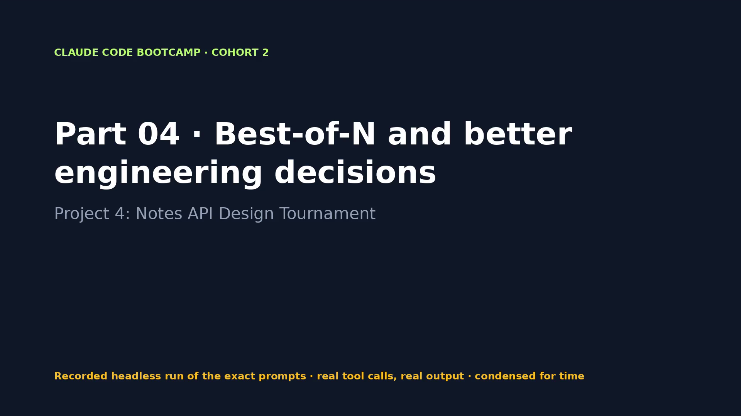
Notes:
VIDEO · Part 04 · Three designs, the weighted matrix, the Rejected Options Log, then the approved implementation with tests.
Say first: “This is a recording of a real run of the exact prompts on the previous slide. Tool calls and output are real; long runs are condensed.”
CLICK THE VIDEO to play. Click again to pause for questions. Then → for what the evidence shows.
Fallback if playback fails: open videos/04-notes-tournament.mp4 in VLC or a browser.

Slide 59
PACKT · CLAUDE CODE BOOTCAMP COHORT 2 · LUCA BERTON
PART 04 · EVIDENCE, NOT CLAIMS
What the run proved
WHAT TO LOOK FOR
WHAT THE RECORDED RUN PRODUCED
• Three design files that differ in shape
• Filled matrix with totals
• Rejected Options Log with 'could become appropriate if'
• Raw test output
• 2 prompt(s) · 10 min 38 s · $0.58 · 24 tool calls
• Tests seen in the run: Ran 42 tests in 1.806s
• bin/bootcamp verify: 7 PASS · 0 FAIL
• Changed: ?? decision/, ?? designs/, ?? notes_api/, ?? tests/test_notes_api.py
059 / 198
Notes:
Now let's look at what we actually saw. Each line on the right comes from the recorded run, not from me. The run took 10 minutes 38 seconds and cost 0.58 dollars.

Slide 60
PACKT · CLAUDE CODE BOOTCAMP COHORT 2 · LUCA BERTON
PART 04 · DISCUSS
Your turn to think
• Were the three designs genuinely different? How can you tell?
• Which criterion weight would you change for your team?
• Under what conditions would the rejected option win?
060 / 198
Notes:
Discussion. Take one of these questions. I'll take two or three answers before the lab.

Slide 61
PACKT · CLAUDE CODE BOOTCAMP COHORT 2 · LUCA BERTON
PART 04 · LAB
Hands-on
• Run the tournament prompt. Before approving, push back once: ask Claude to defend the scores of the loser it ranked second.
• Start: bin/bootcamp stage 04
• Prompts: parts/04-notes-tournament/PROMPTS.md
• Check: bin/bootcamp verify
061 / 198
Notes:
Lab time. Stage the part, run the prompts, and check with verify. If you get stuck, fallback loads the reference.

Slide 62
PACKT · CLAUDE CODE BOOTCAMP COHORT 2 · LUCA BERTON
PART 04 · CHECKPOINT
You now have
✓ Working Notes API
✓ Three-option decision matrix
✓ Selected architecture with reasoning
✓ Rejected Options Log
• Behind? bin/bootcamp checkpoint 04 --force
062 / 198
Notes:
Checkpoint. If you have all of these, you're ready for the next part. If not, checkpoint gets you there in one command.

Slide 63
PACKT · CLAUDE CODE BOOTCAMP COHORT 2 · LUCA BERTON
PART 05 · 10:50–11:20 · 30 MIN
Testing, debugging, checkpoints and /goal
Project 5: Resilient Notes API
063 / 198
Notes:
10:50–11:20. Part 05: Testing, debugging, checkpoints and /goal. Project 5: Resilient Notes API. By the end of this part you leave with: Expanded test suite; Documented diagnosis; Verified bug fix; Successful checkpoint restore; Completed Review Before Merge checklist.

Slide 64
PACKT · CLAUDE CODE BOOTCAMP COHORT 2 · LUCA BERTON
PART 05 · GOALS
What you will be able to do
• Generate meaningful tests and find missing edge cases
• Use a failing test as the debugging contract; investigate before editing
• Use checkpoints: /rewind → restore code without losing the conversation
• Use /goal for a measurable completion condition
• Separate test evidence from Claude's own completion claim
064 / 198
Notes:
These are the goals for this part. Generate meaningful tests and find missing edge cases Use a failing test as the debugging contract; investigate before editing Use checkpoints: /rewind → restore code without losing the conversation Use /goal for a measurable completion condition Separate test evidence from Claude's own completion claim.

Slide 65
PACKT · CLAUDE CODE BOOTCAMP COHORT 2 · LUCA BERTON
THE DEBUGGING CONTRACT
Reproduce → explain → failing test → bounded fix → evidence
Reproduce
Explain
Failing test
Bounded fix
Evidence
Investigate before editing. The failing test is the contract the fix must satisfy.
065 / 198
Notes:
We don't let Claude edit first. It reproduces, explains with file and line, writes a failing regression test, and only then fixes — the smallest fix that turns that test green.

Slide 66
PACKT · CLAUDE CODE BOOTCAMP COHORT 2 · LUCA BERTON
THE SEEDED DEFECT
BUG-101: renaming a note erases its content
def update(self, note_id, data):
current = self.get(note_id)
title = _title(data["title"]) if "title" in data else current["title"]
- body = _body(data.get("body")) # missing key → None → ""
+ body = _body(data["body"]) if "body" in data else current["body"]
One line. Green suite before and after — until the regression test exists.
066 / 198
Notes:
This is a real-world kind of bug: the title is merged correctly, the body is not. The original suite is green, because nobody ever sent a partial PATCH.

Slide 67
PACKT · CLAUDE CODE BOOTCAMP COHORT 2 · LUCA BERTON
CHECKPOINTS
/rewind: what comes back
Option | Restores
Restore code and conversation | Files + chat to that prompt
Restore code | Files only; keep the conversation and what you learned
Restore conversation | Chat only
Not restored | Bash changes (rm, mv, cp), external edits, most subagent edits
067 / 198
Notes:
Esc Esc or /rewind. Restore code is the gem: you keep the lesson of the failed attempt and lose its edits. It's not a replacement for git — Bash changes are not tracked.

Slide 68
PACKT · CLAUDE CODE BOOTCAMP COHORT 2 · LUCA BERTON
MEASURABLE COMPLETION
/goal turns 'done' into a condition
/goal BUG-101 is fixed with the smallest change in notes_api/service.py,
python3 -m unittest discover -s tests -q exits 0 with the raw output shown,
docs/diagnosis-bug-101.md records reproduce/cause/fix/evidence,
and the Review Before Merge checklist is complete with evidence.
Evaluated after each turn from the transcript: not yet met · met · impossible. Phrase it so Claude can demonstrate it.
068 / 198
Notes:
The goal evaluator reads the transcript and doesn't run tools, so the condition must be something Claude can show: a command and its exit code.

Slide 69
PACKT · CLAUDE CODE BOOTCAMP COHORT 2 · LUCA BERTON
REVIEW BEFORE MERGE
Seven points, each with evidence
# | Check
1 | Scope: stayed within approved files and criteria?
2 | Diff: can I explain every material line?
3 | Tests: relevant tests pass, including new edge cases?
4 | Security: secrets, dependencies, permissions, unsafe inputs?
5 | Runtime: verified in the real interface?
6 | Rollback: clean checkpoint, branch or commit?
7 | Handoff: risks, docs, ownership, next steps clear?
069 / 198
Notes:
This checklist comes back in Part 9 as a Skill and in Part 10 as a plugin. Learn it here by hand.

Slide 70
PACKT · CLAUDE CODE BOOTCAMP COHORT 2 · LUCA BERTON
PART 05 · PROMPT 1 OF 2
Investigate before editing
Read BUG-REPORT.md. Do not change any code yet. Reproduce BUG-101
with a failing regression test in tests/test_partial_update.py
(title-only PATCH must keep the body; also cover body-only, explicit
empty body and empty patch). Run it and show the failure. Then
explain the most likely cause with file and line.
Copy from parts/05-resilient-notes/PROMPTS.md
070 / 198
Notes:
This is the exact prompt 1. Read it with me: notice the scope, the constraints and the evidence it asks for. Read BUG-REPORT.md. Do not change any code yet. Reproduce BUG-101 with a failing regression test in tests/test_partial_update.py (title-only PATCH must keep the body; also cover body-only, explicit empty body and empty patch). Run it and show the failure. Then explain the most likely cause with file and line.

Slide 71
PACKT · CLAUDE CODE BOOTCAMP COHORT 2 · LUCA BERTON
PART 05 · PROMPT 2 OF 2
Measurable completion with /goal
/goal BUG-101 is fixed with the smallest change in
notes_api/service.py, python3 -m unittest discover -s tests -q exits
0 with the raw output shown, docs/diagnosis-bug-101.md records
reproduce/cause/fix/evidence, and reviews/review-before-merge-
bug-101.md completes all seven points of templates/review-before-
merge-checklist.md with evidence. Do not commit.
Copy from parts/05-resilient-notes/PROMPTS.md
071 / 198
Notes:
This is the exact prompt 2. Read it with me: notice the scope, the constraints and the evidence it asks for. /goal BUG-101 is fixed with the smallest change in notes_api/service.py, python3 -m unittest discover -s tests -q exits 0 with the raw output shown, docs/diagnosis-bug-101.md records reproduce/cause/fix/evidence, and reviews/review-before-merge-bug-101.md completes all seven points of templates/review-before-merge-checklist.md with evidence. Do not commit.

Slide 72
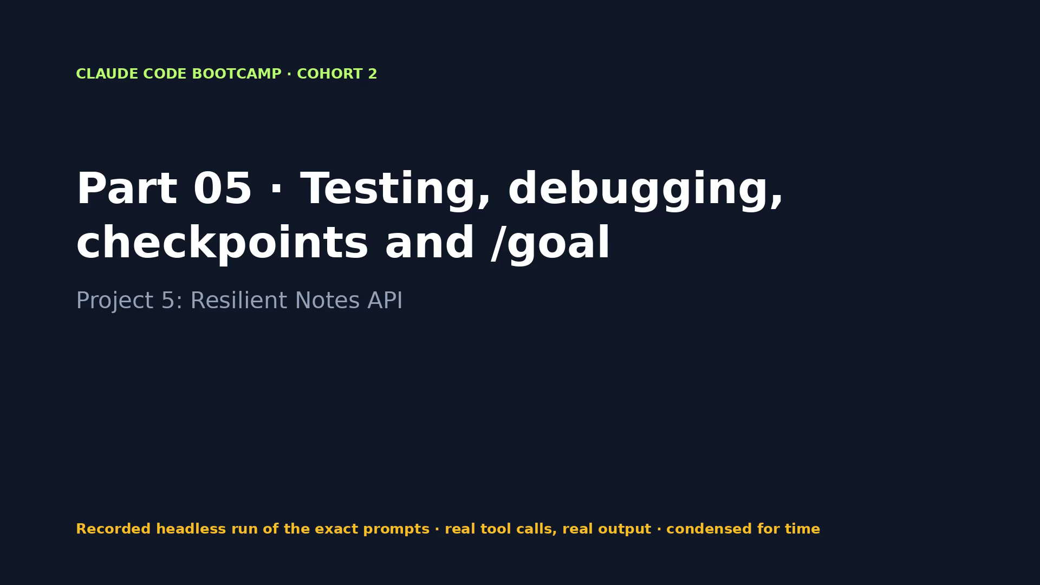
Notes:
VIDEO · Part 05 · Failing regression test, diagnosis to the exact line, /goal-driven fix, green suite and the completed checklist.
Say first: “This is a recording of a real run of the exact prompts on the previous slide. Tool calls and output are real; long runs are condensed.”
CLICK THE VIDEO to play. Click again to pause for questions. Then → for what the evidence shows.
Fallback if playback fails: open videos/05-resilient-notes.mp4 in VLC or a browser.

Slide 73
PACKT · CLAUDE CODE BOOTCAMP COHORT 2 · LUCA BERTON
PART 05 · EVIDENCE, NOT CLAIMS
What the run proved
WHAT TO LOOK FOR
WHAT THE RECORDED RUN PRODUCED
• Failing test output before the fix
• One-line diff in service.py
• Passing full suite
• /rewind restore of the deliberately bad attempt
• Seven-point checklist with evidence
• 2 prompt(s) · 3 min 57 s · $0.41 · 22 tool calls
• Tests seen in the run: Ran 31 tests in 1.644s
• bin/bootcamp verify: 8 PASS · 0 FAIL
• Changed: M notes_api/service.py, ?? docs/diagnosis-bug-101.md, ?? reviews/, ?? tests/test_partial_update.py
073 / 198
Notes:
Now let's look at what we actually saw. Each line on the right comes from the recorded run, not from me. The run took 3 minutes 57 seconds and cost 0.41 dollars. Watch how /goal kept the turn going until the checklist had real evidence.

Slide 74
PACKT · CLAUDE CODE BOOTCAMP COHORT 2 · LUCA BERTON
PART 05 · DISCUSS
Your turn to think
• Why write the failing test before reading the code?
• What does /rewind restore, and what does it not restore?
• What makes a /goal condition checkable from the transcript?
074 / 198
Notes:
Discussion. Take one of these questions. I'll take two or three answers before the lab.

Slide 75
PACKT · CLAUDE CODE BOOTCAMP COHORT 2 · LUCA BERTON
PART 05 · LAB
Hands-on
• Try the deliberately heavy approach first (rewrite the repository update), then /rewind → Restore code, and apply the bounded fix.
• Start: bin/bootcamp stage 05
• Prompts: parts/05-resilient-notes/PROMPTS.md
• Check: bin/bootcamp verify
075 / 198
Notes:
Lab time. Stage the part, run the prompts, and check with verify. If you get stuck, fallback loads the reference.

Slide 76
PACKT · CLAUDE CODE BOOTCAMP COHORT 2 · LUCA BERTON
PART 05 · CHECKPOINT
You now have
✓ Expanded test suite
✓ Documented diagnosis
✓ Verified bug fix
✓ Successful checkpoint restore
✓ Completed Review Before Merge checklist
• Behind? bin/bootcamp checkpoint 05 --force
076 / 198
Notes:
Checkpoint. If you have all of these, you're ready for the next part. If not, checkpoint gets you there in one command.

Slide 77
PACKT · CLAUDE CODE BOOTCAMP COHORT 2 · LUCA BERTON
PART 06 · 11:20–11:45 · 25 MIN
Git workflows, worktrees, permissions and sandboxing
Project 6: Isolated Search Feature
077 / 198
Notes:
11:20–11:45. Part 06: Git workflows, worktrees, permissions and sandboxing. Project 6: Isolated Search Feature. By the end of this part you leave with: Isolated worktree; Feature branch; Search and tagging functionality; Reviewed diff; Passing test suite; Clean merge and commit history.

Slide 78
PACKT · CLAUDE CODE BOOTCAMP COHORT 2 · LUCA BERTON
PART 06 · GOALS
What you will be able to do
• Use feature branches and focused commits; review Claude-generated diffs
• Isolate experiments with claude --worktree
• Run parallel sessions without contaminating the main checkout
• Set filesystem and network boundaries with /sandbox
• Match autonomy to consequence and reversibility
078 / 198
Notes:
These are the goals for this part. Use feature branches and focused commits; review Claude-generated diffs Isolate experiments with `claude --worktree` Run parallel sessions without contaminating the main checkout Set filesystem and network boundaries with /sandbox Match autonomy to consequence and reversibility.

Slide 79
PACKT · CLAUDE CODE BOOTCAMP COHORT 2 · LUCA BERTON
WHY GIT MATTERS MORE NOW
Agents make many changes, fast
• Feature branch per change; focused commits
• Review every Claude-generated diff before merge
• Rollback must be one command away
• Parallel work needs isolation, not discipline
079 / 198
Notes:
When an agent can change twenty files in a minute, Git stops being bookkeeping and becomes your safety system.

Slide 80
PACKT · CLAUDE CODE BOOTCAMP COHORT 2 · LUCA BERTON
WORKTREES
claude --worktree search-tags
claude --worktree search-tags # .claude/worktrees/search-tags on branch worktree-search-tags
# ... build the feature in isolation; main stays runnable ...
git -C .claude/worktrees/search-tags diff --stat main...HEAD
python3 -m unittest discover -s tests -q # run in the worktree
git merge --no-ff worktree-search-tags
git worktree remove .claude/worktrees/search-tags
Add .claude/worktrees/ to .gitignore. -p runs are never auto-cleaned.
080 / 198
Notes:
A worktree is a second checkout on its own branch. Claude works there; your main checkout keeps running. That's how you run parallel sessions without contaminating main.

Slide 81
PACKT · CLAUDE CODE BOOTCAMP COHORT 2 · LUCA BERTON
BOUNDARIES
Permissions vs sandbox
Layer | Controls | Example
Permission rules | Which tools Claude may call | deny: Bash(git push *)
Hooks | Deterministic checks on events | Block force push (Part 9)
Sandbox (/sandbox) | OS-level filesystem + network for Bash | allowWrite: repo · allowedDomains: pypi.org
Worktree | Which files a session changes | .claude/worktrees/<name>
081 / 198
Notes:
These layers are complementary. Permission rules decide what Claude may call. The sandbox restricts what commands can touch at the OS level, on macOS and Linux. Worktrees decide where the changes land.

Slide 82
PACKT · CLAUDE CODE BOOTCAMP COHORT 2 · LUCA BERTON
MATCH AUTONOMY TO CONSEQUENCE
Worktree + sandbox + tests = room to be autonomous.
Main checkout + credentials + production = a human at every step.
082 / 198
Notes:
Isolation is what buys autonomy. The safer the box, the more you can let Claude run.

Slide 83
PACKT · CLAUDE CODE BOOTCAMP COHORT 2 · LUCA BERTON
PART 06 · PROMPT 1 OF 1
Build inside the worktree (claude --worktree search-tags)
Read briefs/search-and-tags.md. Implement search and tags exactly as
specified, keeping the layering (SQL only in repository.py, rules
only in service.py). Add tests in tests/test_search_tags.py,
including literal % and _ in search. Run the full suite and show the
raw output. Then show git diff --stat against main. Do not commit
and do not touch files outside notes_api/ and tests/.
Copy from parts/06-isolated-search/PROMPTS.md
083 / 198
Notes:
This is the exact prompt 1. Read it with me: notice the scope, the constraints and the evidence it asks for. Read briefs/search-and-tags.md. Implement search and tags exactly as specified, keeping the layering (SQL only in repository.py, rules only in service.py). Add tests in tests/test_search_tags.py, including literal % and _ in search. Run the full suite and show the raw output. Then show git diff --stat against main. Do not commit and do not touch files outside notes_api/ and tests/.

Slide 84
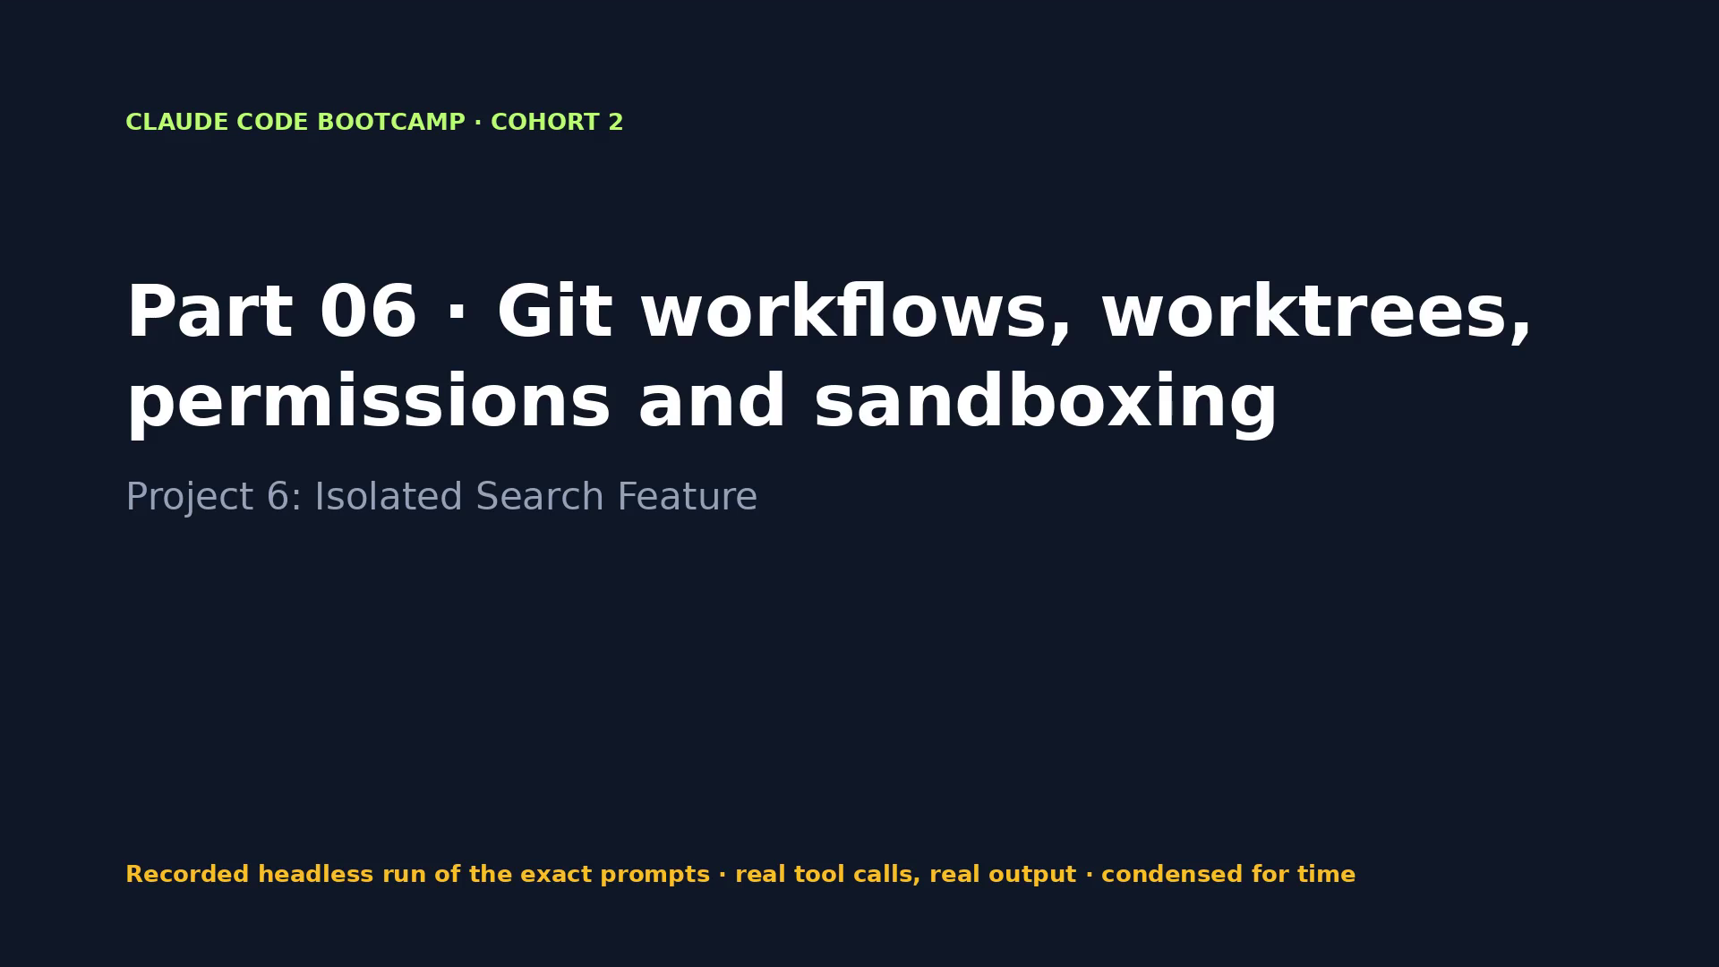
Notes:
VIDEO · Part 06 · A real worktree session builds search and tags; review the diff from main, then merge.
Say first: “This is a recording of a real run of the exact prompts on the previous slide. Tool calls and output are real; long runs are condensed.”
CLICK THE VIDEO to play. Click again to pause for questions. Then → for what the evidence shows.
Fallback if playback fails: open videos/06-isolated-search.mp4 in VLC or a browser.

Slide 85
PACKT · CLAUDE CODE BOOTCAMP COHORT 2 · LUCA BERTON
PART 06 · EVIDENCE, NOT CLAIMS
What the run proved
WHAT TO LOOK FOR
WHAT THE RECORDED RUN PRODUCED
• git worktree list shows .claude/worktrees/search-tags
• git diff --stat main...
• Full suite green inside the worktree
• main untouched while the feature was built
• Merge commit + worktree removed
• 1 prompt(s) · 6 min 18 s · $0.25 · 9 tool calls
• Tests seen in the run: Ran 51 tests in 9.674s
• bin/bootcamp verify: 9 PASS · 0 FAIL
• Changed: M notes_api/repository.py, M notes_api/server.py, M notes_api/service.py, ?? tests/test_search_tags.py
085 / 198
Notes:
Now let's look at what we actually saw. Each line on the right comes from the recorded run, not from me. The run took 6 minutes 18 seconds and cost 0.25 dollars. main stayed untouched: every change is on the worktree branch.

Slide 86
PACKT · CLAUDE CODE BOOTCAMP COHORT 2 · LUCA BERTON
PART 06 · DISCUSS
Your turn to think
• What would have happened without the worktree?
• Which commands would you allow in a sandbox, and which network domains?
• When is a branch enough, and when do you want a worktree?
086 / 198
Notes:
Discussion. Take one of these questions. I'll take two or three answers before the lab.

Slide 87
PACKT · CLAUDE CODE BOOTCAMP COHORT 2 · LUCA BERTON
PART 06 · LAB
Hands-on
• Start claude --worktree search-tags, run the prompt, review the diff from main, run the tests yourself in the worktree, then merge and remove the worktree.
• Start: bin/bootcamp stage 06
• Prompts: parts/06-isolated-search/PROMPTS.md
• Check: bin/bootcamp verify
087 / 198
Notes:
Lab time. Stage the part, run the prompts, and check with verify. If you get stuck, fallback loads the reference.

Slide 88
PACKT · CLAUDE CODE BOOTCAMP COHORT 2 · LUCA BERTON
PART 06 · CHECKPOINT
You now have
✓ Isolated worktree
✓ Feature branch
✓ Search and tagging functionality
✓ Reviewed diff
✓ Passing test suite
✓ Clean merge and commit history
• Behind? bin/bootcamp checkpoint 06 --force
088 / 198
Notes:
Checkpoint. If you have all of these, you're ready for the next part. If not, checkpoint gets you there in one command.

Slide 89
PACKT · CLAUDE CODE BOOTCAMP COHORT 2 · LUCA BERTON
11:45–11:55
Break · 10 minutes
Behind? bin/bootcamp checkpoint 06 --force · next: Part 07
089 / 198
Notes:
Ten-minute break. Use it to run bin/bootcamp verify on your stage, or bin/bootcamp checkpoint for the next part if you fell behind.

Slide 90
PACKT · CLAUDE CODE BOOTCAMP COHORT 2 · LUCA BERTON
PART 07 · 11:55–12:20 · 25 MIN
Multimodal building and Chrome verification
Project 7: Dashboard from a Wireframe
090 / 198
Notes:
11:55–12:20. Part 07: Multimodal building and Chrome verification. Project 7: Dashboard from a Wireframe. By the end of this part you leave with: Working dashboard; Componentized frontend; Browser verification evidence; Console and interaction issue log; Before-and-after status for identified issues.

Slide 91
PACKT · CLAUDE CODE BOOTCAMP COHORT 2 · LUCA BERTON
PART 07 · GOALS
What you will be able to do
• Turn a wireframe into components, states and interaction requirements
• Improve the prompt before patching generated UI by hand
• Connect Claude Code to Chrome (claude --chrome, /chrome)
• Test navigation and forms, inspect the console, check responsive layouts, capture evidence
• Convert findings into focused fixes
091 / 198
Notes:
These are the goals for this part. Turn a wireframe into components, states and interaction requirements Improve the prompt before patching generated UI by hand Connect Claude Code to Chrome (`claude --chrome`, /chrome) Test navigation and forms, inspect the console, check responsive layouts, capture evidence Convert findings into focused fixes.

Slide 92
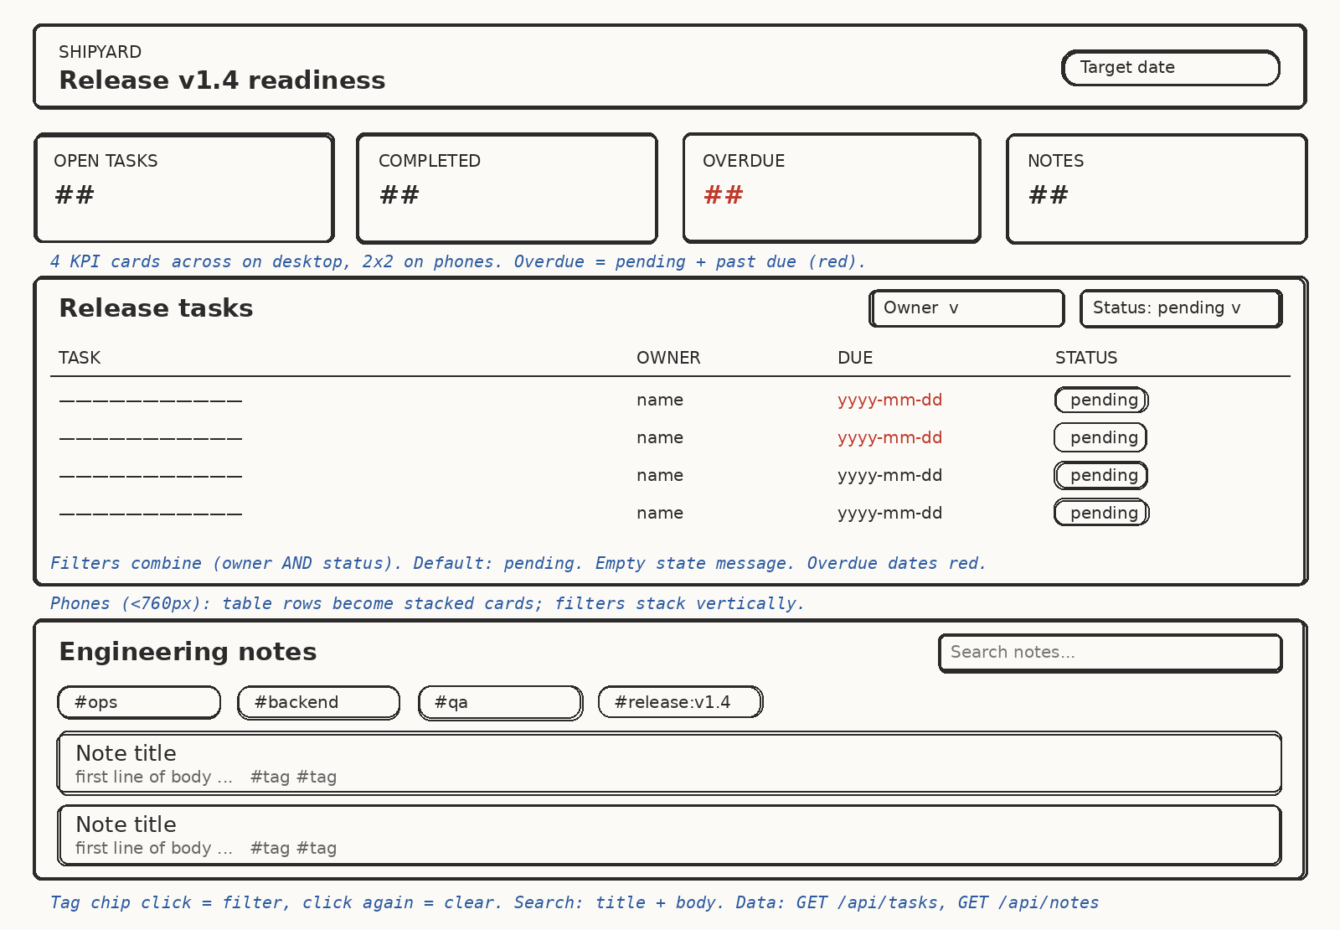
PACKT · CLAUDE CODE BOOTCAMP COHORT 2 · LUCA BERTON
THE INPUT
A hand-drawn wireframe with annotations
Annotations are requirements: overdue in red, filters combine, 2×2 cards on phones, chip toggles.
092 / 198
Notes:
This is the only design input. Notice the blue annotations. We ask Claude to extract components, states and interactions from the image first, before any code.

Slide 93
PACKT · CLAUDE CODE BOOTCAMP COHORT 2 · LUCA BERTON
FROM PIXELS TO REQUIREMENTS
Extract before you build
• Components: header, KPI cards, tasks table, notes panel, chips
• States: loading, empty, overdue, active filter, active chip
• Interactions: owner × status filters, debounced search, chip toggle
• Responsive rules from the annotations
• If the UI is wrong, improve the prompt before patching by hand
093 / 198
Notes:
The extraction step is where you catch misunderstandings cheaply. If the generated UI is wrong, fix the prompt and regenerate; hand patches don't scale.

Slide 94
PACKT · CLAUDE CODE BOOTCAMP COHORT 2 · LUCA BERTON
CLAUDE IN CHROME
Real browser evidence
Need | How
Connect | claude --chrome or /chrome (extension ≥ 1.0.36, claude.ai login)
Exercise flows | Navigate, click, type, fill forms
Console | Read errors and logs
Responsive | Resize to 390 px; screenshots
Limits | Pauses on logins/CAPTCHAs; no WSL; JS dialogs block
094 / 198
Notes:
Claude in Chrome lets Claude test what it built in a real browser, read the console and capture screenshots. That's runtime evidence — point 5 of the checklist.

Slide 95
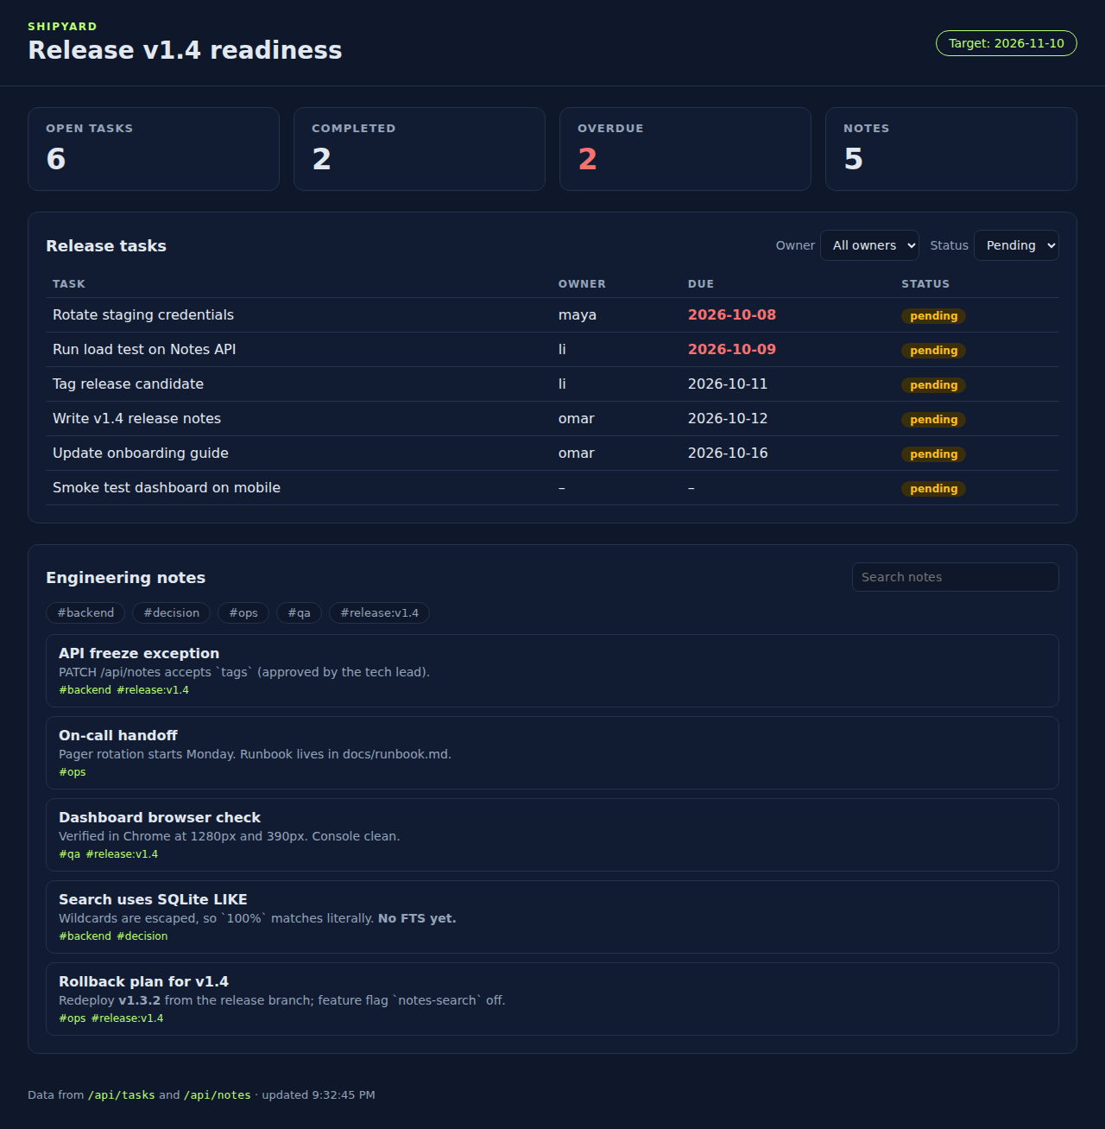
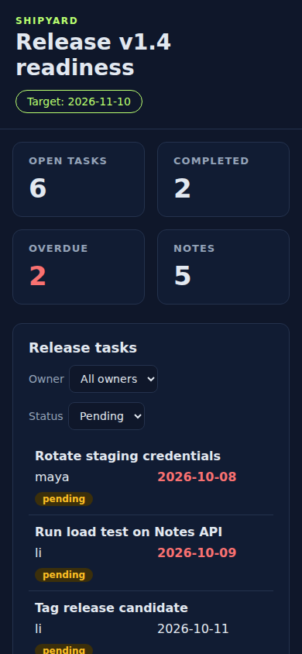
PACKT · CLAUDE CODE BOOTCAMP COHORT 2 · LUCA BERTON
CAPTURED EVIDENCE
1280 px and 390 px, console clean
Fallback path for learners without Chrome: these screenshots + the manual browser verification checklist.
095 / 198
Notes:
These are real captures of the reference checkpoint: desktop and phone, no console messages. Learners without the Chrome integration review these with the manual checklist.

Slide 96
PACKT · CLAUDE CODE BOOTCAMP COHORT 2 · LUCA BERTON
PART 07 · PROMPT 1 OF 2
Build from the wireframe
Look at wireframes/release-dashboard.png and read briefs/release-
dashboard.md. First list the components, states and interactions you
extracted from the image and its annotations. Then build the
dashboard in dashboard/ and add the read-only GET /api/tasks route
and static serving to the existing server, with node --test tests
for the pure logic. Run both test suites and show the raw output. Do
not commit.
Copy from parts/07-dashboard-wireframe/PROMPTS.md
096 / 198
Notes:
This is the exact prompt 1. Read it with me: notice the scope, the constraints and the evidence it asks for. Look at wireframes/release-dashboard.png and read briefs/release-dashboard.md. First list the components, states and interactions you extracted from the image and its annotations. Then build the dashboard in dashboard/ and add the read-only GET /api/tasks route and static serving to the existing server, with node --test tests for the pure logic. Run both test suites and show the raw output. Do not commit.

Slide 97
PACKT · CLAUDE CODE BOOTCAMP COHORT 2 · LUCA BERTON
PART 07 · PROMPT 2 OF 2
Verify in Chrome (claude --chrome)
Start the server with seeded data (python3 seed.py && python3 -m
notes_api.server). Open http://localhost:8000/ in Chrome. Exercise
the owner filter, status filter, both combined, search, and tag
toggle on/off. Read the console. Resize to 390px wide. Record every
issue in docs/browser-issue-log.md with evidence, fix them one by
one, and re-verify each fix.
Copy from parts/07-dashboard-wireframe/PROMPTS.md
097 / 198
Notes:
This is the exact prompt 2. Read it with me: notice the scope, the constraints and the evidence it asks for. Start the server with seeded data (python3 seed.py && python3 -m notes_api.server). Open http://localhost:8000/ in Chrome. Exercise the owner filter, status filter, both combined, search, and tag toggle on/off. Read the console. Resize to 390px wide. Record every issue in docs/browser-issue-log.md with evidence, fix them one by one, and re-verify each fix.

Slide 98
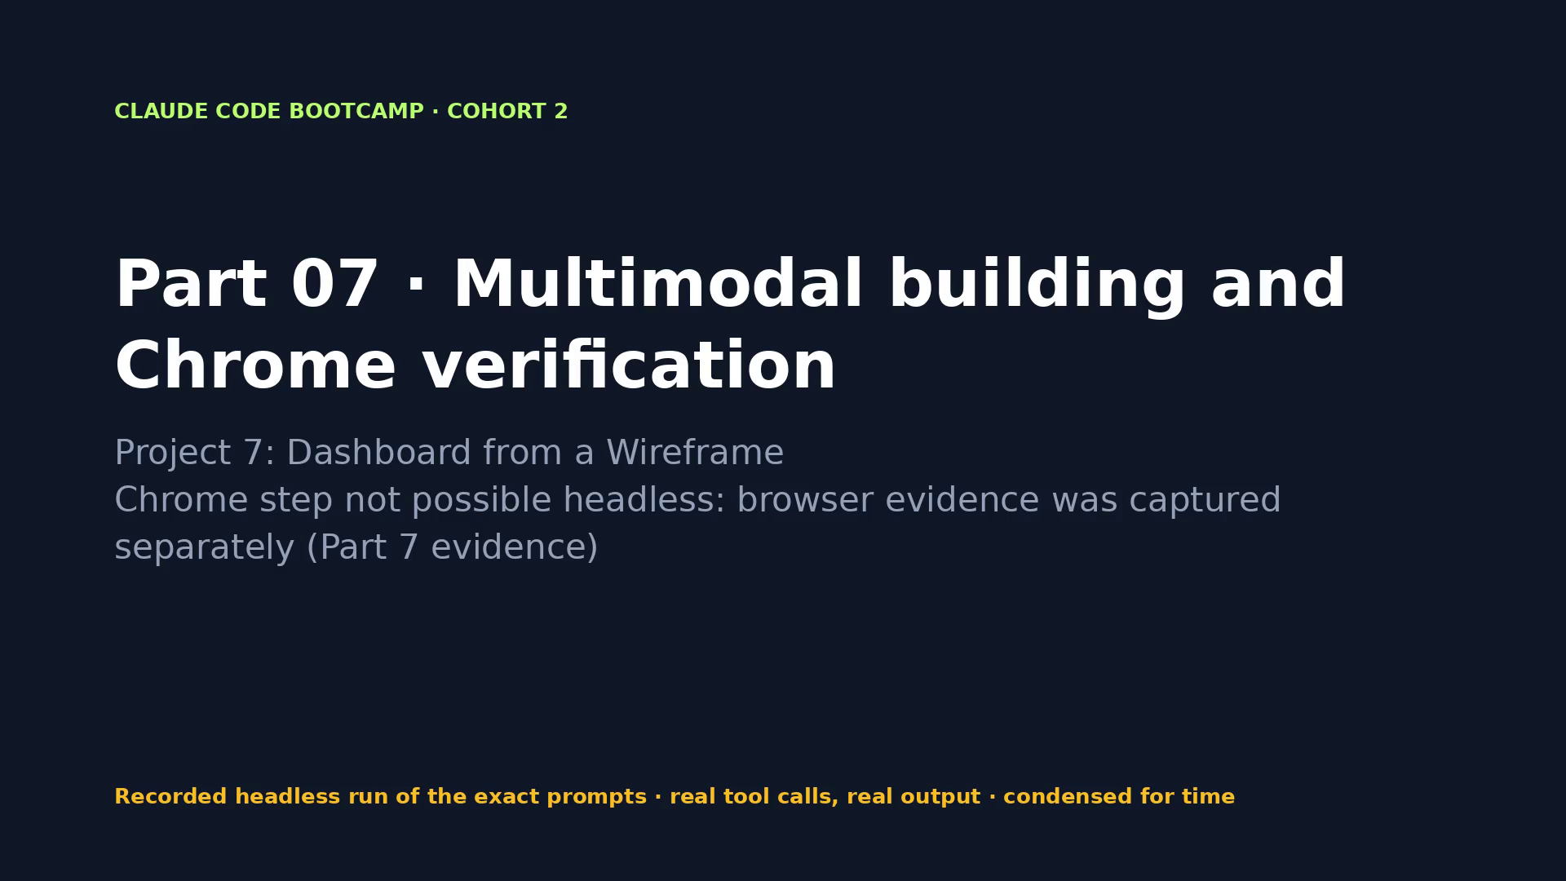
Notes:
VIDEO · Part 07 · Claude reads the wireframe, builds the dashboard and verifies it; real screenshots at 1280 and 390 px.
Say first: “This is a recording of a real run of the exact prompts on the previous slide. Tool calls and output are real; long runs are condensed.”
CLICK THE VIDEO to play. Click again to pause for questions. Then → for what the evidence shows.
Fallback if playback fails: open videos/07-dashboard-wireframe.mp4 in VLC or a browser.
This video covers prompt 1 only: Claude in Chrome cannot run headless. Do prompt 2 live with `claude --chrome`, or show the captured screenshots on the next slides.

Slide 99
PACKT · CLAUDE CODE BOOTCAMP COHORT 2 · LUCA BERTON
PART 07 · EVIDENCE, NOT CLAIMS
What the run proved
WHAT TO LOOK FOR
WHAT THE RECORDED RUN PRODUCED
• Component/state list extracted from the image
• Desktop and 390 px screenshots
• Console: no errors
• Issue log with before/after
• 1 prompt(s) · 6 min 03 s · $0.34 · 20 tool calls
• Tests seen in the run: Ran 54 tests in 13.369s
• bin/bootcamp verify: 11 PASS · 0 FAIL
• Changed: M notes_api/server.py, ?? dashboard/, ?? tests/test_dashboard_server.py
099 / 198
Notes:
Now let's look at what we actually saw. Each line on the right comes from the recorded run, not from me. The run took 6 minutes 3 seconds and cost 0.34 dollars. The Chrome step can't run headless; the browser evidence was captured with the same seeded data.

Slide 100
PACKT · CLAUDE CODE BOOTCAMP COHORT 2 · LUCA BERTON
PART 07 · DISCUSS
Your turn to think
• What did Claude extract from the annotations that you would have missed?
• Which issues can only be found in a real browser?
• When do you fix the prompt instead of patching the UI?
100 / 198
Notes:
Discussion. Take one of these questions. I'll take two or three answers before the lab.

Slide 101
PACKT · CLAUDE CODE BOOTCAMP COHORT 2 · LUCA BERTON
PART 07 · LAB
Hands-on
• Build from the wireframe, then verify with claude --chrome. No Chrome? Use the browser verification checklist and the captured evidence in parts/07/evidence.
• Start: bin/bootcamp stage 07
• Prompts: parts/07-dashboard-wireframe/PROMPTS.md
• Check: bin/bootcamp verify
101 / 198
Notes:
Lab time. Stage the part, run the prompts, and check with verify. If you get stuck, fallback loads the reference.

Slide 102
PACKT · CLAUDE CODE BOOTCAMP COHORT 2 · LUCA BERTON
PART 07 · CHECKPOINT
You now have
✓ Working dashboard
✓ Componentized frontend
✓ Browser verification evidence
✓ Console and interaction issue log
✓ Before-and-after status for identified issues
• Behind? bin/bootcamp checkpoint 07 --force
102 / 198
Notes:
Checkpoint. If you have all of these, you're ready for the next part. If not, checkpoint gets you there in one command.

Slide 103
PACKT · CLAUDE CODE BOOTCAMP COHORT 2 · LUCA BERTON
12:20–13:00
Lunch · 40 minutes
Behind? bin/bootcamp checkpoint 07 --force · next: Part 08
103 / 198
Notes:
Forty minutes for lunch. When we come back: refactoring and the maintainer handoff. If you're behind, bin/bootcamp checkpoint 07 gets you to the start line.

Slide 104
PACKT · CLAUDE CODE BOOTCAMP COHORT 2 · LUCA BERTON
PART 08 · 13:00–13:20 · 20 MIN
Refactor, document and create a maintainer handoff
Project 8: Maintainer-Ready Dashboard
104 / 198
Notes:
13:00–13:20. Part 08: Refactor, document and create a maintainer handoff. Project 8: Maintainer-Ready Dashboard. By the end of this part you leave with: Refactored project structure; Passing tests; Updated README; Architecture note; Maintainer handoff; Known limitations and next steps.

Slide 105
PACKT · CLAUDE CODE BOOTCAMP COHORT 2 · LUCA BERTON
PART 08 · GOALS
What you will be able to do
• Refactor with behaviour-preserving constraints
• Find duplication and unclear responsibilities; improve naming and structure
• Keep tests and browser checks as refactor guardrails
• Generate architecture notes, onboarding docs, known limitations and a handoff
105 / 198
Notes:
These are the goals for this part. Refactor with behaviour-preserving constraints Find duplication and unclear responsibilities; improve naming and structure Keep tests and browser checks as refactor guardrails Generate architecture notes, onboarding docs, known limitations and a handoff.

Slide 106
PACKT · CLAUDE CODE BOOTCAMP COHORT 2 · LUCA BERTON
BEHAVIOUR-PRESERVING REFACTOR
Change the structure, prove nothing else changed
• Bounded plan first: modules, responsibilities, what won't change
• Same HTML ids, same API calls, same rendering
• Tests are the guardrail: assertions unchanged, only imports move
• Browser check before and after
106 / 198
Notes:
A refactor is only safe if you can prove behaviour didn't change. Plan, guardrails, then implement.

Slide 107
PACKT · CLAUDE CODE BOOTCAMP COHORT 2 · LUCA BERTON
FROM ONE FILE TO FOUR
dashboard/app.js → modules
Module | Single responsibility
js/logic.js | Pure rules: overdue, filters, KPIs, escaping (unit-tested)
js/api.js | The only fetch calls
js/render.js | One function per page region
js/main.js | State, events, orchestration
107 / 198
Notes:
Four modules, each with one job. The pure logic is now testable in Node without a browser.

Slide 108

PACKT · CLAUDE CODE BOOTCAMP COHORT 2 · LUCA BERTON
PROOF
Pixel diff: only the timestamp changed
Reference checkpoint, before (left) and after (right) the refactor. Diff bounding box: the footer's 'updated HH:MM:SS' only.
108 / 198
Notes:
We captured the dashboard before and after the refactor and diffed the pixels. The only difference is the clock in the footer. That's what proof of a behaviour-preserving refactor looks like.

Slide 109
PACKT · CLAUDE CODE BOOTCAMP COHORT 2 · LUCA BERTON
THE HANDOFF
What a maintainer needs on day one
Document | Answers
docs/ARCHITECTURE.md | What talks to what, and who owns which rule
docs/HANDOFF.md | Start here in 15 minutes; how to change safely
Known limitations | Stored XSS risk, no auth, hard-coded version, no pagination
README.md | Run, test, layout
109 / 198
Notes:
The known limitations table is the most honest part of a handoff. Notice the first row — we'll come back to it in the production review.

Slide 110
PACKT · CLAUDE CODE BOOTCAMP COHORT 2 · LUCA BERTON
PART 08 · PROMPT 1 OF 2
Bounded refactoring plan (plan mode)
Read REFACTOR-REQUEST.md. Propose a bounded refactoring plan for
dashboard/app.js: target modules and their single responsibility,
what will not change (HTML ids, API calls, rendering, behaviour),
and how the existing tests and a browser check prove behaviour is
preserved. Do not edit yet.
Copy from parts/08-maintainer-dashboard/PROMPTS.md
110 / 198
Notes:
This is the exact prompt 1. Read it with me: notice the scope, the constraints and the evidence it asks for. Read REFACTOR-REQUEST.md. Propose a bounded refactoring plan for dashboard/app.js: target modules and their single responsibility, what will not change (HTML ids, API calls, rendering, behaviour), and how the existing tests and a browser check prove behaviour is preserved. Do not edit yet.

Slide 111
PACKT · CLAUDE CODE BOOTCAMP COHORT 2 · LUCA BERTON
PART 08 · PROMPT 2 OF 2
Implement, re-verify, hand off
Plan approved. Implement it. Keep the existing test assertions (only
import paths may change), run both test suites and show the raw
output. Then write docs/ARCHITECTURE.md (one page), docs/HANDOFF.md
(start here, how to change things safely, known limitations,
ownership) and update README.md. Do not commit.
Copy from parts/08-maintainer-dashboard/PROMPTS.md
111 / 198
Notes:
This is the exact prompt 2. Read it with me: notice the scope, the constraints and the evidence it asks for. Plan approved. Implement it. Keep the existing test assertions (only import paths may change), run both test suites and show the raw output. Then write docs/ARCHITECTURE.md (one page), docs/HANDOFF.md (start here, how to change things safely, known limitations, ownership) and update README.md. Do not commit.

Slide 112
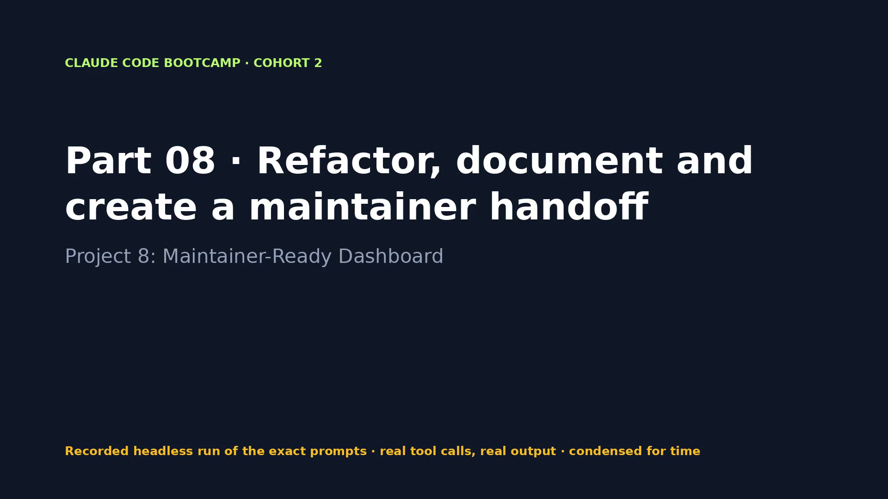
Notes:
VIDEO · Part 08 · Plan, refactor into four modules, tests unchanged and green, pixel-identical screenshots, handoff docs.
Say first: “This is a recording of a real run of the exact prompts on the previous slide. Tool calls and output are real; long runs are condensed.”
CLICK THE VIDEO to play. Click again to pause for questions. Then → for what the evidence shows.
Fallback if playback fails: open videos/08-maintainer-dashboard.mp4 in VLC or a browser.

Slide 113
PACKT · CLAUDE CODE BOOTCAMP COHORT 2 · LUCA BERTON
PART 08 · EVIDENCE, NOT CLAIMS
What the run proved
WHAT TO LOOK FOR
WHAT THE RECORDED RUN PRODUCED
• Plan approved before edits
• Tests green with unchanged assertions
• Screenshot diff before/after: only the timestamp differs
• ARCHITECTURE.md and HANDOFF.md
• 2 prompt(s) · 3 min 38 s · $0.54 · 28 tool calls
• Tests seen in the run: Ran 46 tests in 2.826s
• bin/bootcamp verify: 13 PASS · 0 FAIL
• Changed: M README.md, M dashboard/app.js, M dashboard/tests/app.test.mjs, ?? dashboard/api.js … (+6)
113 / 198
Notes:
Now let's look at what we actually saw. Each line on the right comes from the recorded run, not from me. The run took 3 minutes 38 seconds and cost 0.54 dollars.

Slide 114
PACKT · CLAUDE CODE BOOTCAMP COHORT 2 · LUCA BERTON
PART 08 · DISCUSS
Your turn to think
• How do you prove a refactor changed nothing?
• What belongs in a handoff that a README never says?
• Which known limitation should block the next release?
114 / 198
Notes:
Discussion. Take one of these questions. I'll take two or three answers before the lab.

Slide 115
PACKT · CLAUDE CODE BOOTCAMP COHORT 2 · LUCA BERTON
PART 08 · LAB
Hands-on
• Run the plan prompt, cut one module from the plan, approve, implement, and compare screenshots before and after.
• Start: bin/bootcamp stage 08
• Prompts: parts/08-maintainer-dashboard/PROMPTS.md
• Check: bin/bootcamp verify
115 / 198
Notes:
Lab time. Stage the part, run the prompts, and check with verify. If you get stuck, fallback loads the reference.

Slide 116
PACKT · CLAUDE CODE BOOTCAMP COHORT 2 · LUCA BERTON
PART 08 · CHECKPOINT
You now have
✓ Refactored project structure
✓ Passing tests
✓ Updated README
✓ Architecture note
✓ Maintainer handoff
✓ Known limitations and next steps
• Behind? bin/bootcamp checkpoint 08 --force
116 / 198
Notes:
Checkpoint. If you have all of these, you're ready for the next part. If not, checkpoint gets you there in one command.

Slide 117
PACKT · CLAUDE CODE BOOTCAMP COHORT 2 · LUCA BERTON
PART 09 · 13:20–13:55 · 35 MIN
Skills, hooks and specialist subagents
Project 9A: Engineering Quality Skills Pack
117 / 198
Notes:
13:20–13:55. Part 09: Skills, hooks and specialist subagents. Project 9A: Engineering Quality Skills Pack. By the end of this part you leave with: Customized SKILL.md; Working post-edit validation hook; Specialist subagent definition; Structured review output.

Slide 118
PACKT · CLAUDE CODE BOOTCAMP COHORT 2 · LUCA BERTON
PART 09 · GOALS
What you will be able to do
• Choose between CLAUDE.md, rules, Skills, hooks, MCP, subagents and Agent Teams
• Read SKILL.md structure: description, discovery, arguments, supporting files, forked context
• Use hooks as deterministic controls: post-edit tests, blocking unsafe commands
• Create specialist subagents with restricted tools
118 / 198
Notes:
These are the goals for this part. Choose between CLAUDE.md, rules, Skills, hooks, MCP, subagents and Agent Teams Read SKILL.md structure: description, discovery, arguments, supporting files, forked context Use hooks as deterministic controls: post-edit tests, blocking unsafe commands Create specialist subagents with restricted tools.

Slide 119
PACKT · CLAUDE CODE BOOTCAMP COHORT 2 · LUCA BERTON
PICK THE RIGHT TOOL
Where should this knowledge live?
Need | Use
Always-true project facts | CLAUDE.md
Path-specific conventions | .claude/rules (paths:)
Occasional procedure or reference | Skill (SKILL.md)
Must always happen, no exceptions | Hook
External tool or data | MCP server
Isolated specialist with restricted tools | Subagent
Parallel independent workstreams | Agent Team
Share all of the above | Plugin
119 / 198
Notes:
This is the decision table of the afternoon. If a rule must never be broken, it's a hook, not an instruction. If it's a procedure you use sometimes, it's a Skill.

Slide 120
PACKT · CLAUDE CODE BOOTCAMP COHORT 2 · LUCA BERTON
ANATOMY OF A SKILL
.claude/skills/change-review/SKILL.md
---
name: change-review
description: Review a Shipyard change against the seven-point
Review Before Merge checklist ... Read-only; never commits.
when_to_use: "review this change", "is this ready to merge"
argument-hint: "[brief or files]"
allowed-tools: Read Grep Glob Bash(git diff *) Bash(git status *)
---
# Change Review
Focus: $ARGUMENTS · Checklist: [checklist.md](checklist.md)
Description drives discovery · $ARGUMENTS passes input · supporting files load only when linked
120 / 198
Notes:
Only the description sits in context until the skill fires. The body and supporting files load progressively. Arguments arrive in $ARGUMENTS. context: fork runs it as a subagent.

Slide 121
PACKT · CLAUDE CODE BOOTCAMP COHORT 2 · LUCA BERTON
HOOKS AS ENGINEERING CONTROLS
Block unsafe commands, test after every edit
PreToolUse matcher: Bash
→ .claude/hooks/block-unsafe-commands.sh (exit 2 = block, reason → Claude)
PostToolUse matcher: Edit|Write
→ .claude/hooks/post-edit-validate.sh (runs the tests for the edited file)
# in .claude/settings.json → "hooks": { "PreToolUse": [...], "PostToolUse": [...] }
# command paths start with "$CLAUDE_PROJECT_DIR"/.claude/hooks/
Exit 2 blocks and sends stderr to Claude. Exit 1 does not block.
121 / 198
Notes:
Hooks are deterministic. The PreToolUse hook denies a force push before it runs. The PostToolUse hook runs the relevant tests after every edit and feeds failures back. Exit code 2 is the one that blocks.

Slide 122
PACKT · CLAUDE CODE BOOTCAMP COHORT 2 · LUCA BERTON
SPECIALIST SUBAGENT
.claude/agents/security-reviewer.md
---
name: security-reviewer
description: Read-only application security specialist ...
tools: Read, Grep, Glob
model: sonnet
---
Return severity-ranked findings, each with file:line,
quoted evidence and a concrete fix. Never edit files.
Fresh context · restricted tools · structured output contract
122 / 198
Notes:
A reviewer that cannot edit is a reviewer you can trust not to 'fix' things quietly. Restricting tools is the point.

Slide 123
PACKT · CLAUDE CODE BOOTCAMP COHORT 2 · LUCA BERTON
PART 09 · PROMPT 1 OF 2
Specialist review
Use the security-reviewer subagent to review notes_api/ and
dashboard/js/. It must cite file:line and quoted evidence for every
finding and rank them by severity. Save its report to
reviews/security-review-dashboard.md. Do not change any code.
Copy from parts/09-quality-pack/PROMPTS.md
123 / 198
Notes:
This is the exact prompt 1. Read it with me: notice the scope, the constraints and the evidence it asks for. Use the security-reviewer subagent to review notes_api/ and dashboard/js/. It must cite file:line and quoted evidence for every finding and rank them by severity. Save its report to reviews/security-review-dashboard.md. Do not change any code.

Slide 124
PACKT · CLAUDE CODE BOOTCAMP COHORT 2 · LUCA BERTON
PART 09 · PROMPT 2 OF 2
Hook in action
Make the release target date in dashboard/index.html read 2026-11-12
instead of 2026-11-10 and tell me what the post-edit validation hook
reported. Then test our PreToolUse guardrail: the block-unsafe-
commands hook is expected to stop secret reads before they run.
Attempt exactly `cat .env` once (the file may not even exist) and
report the hook's message word for word. Do not try any workaround.
Copy from parts/09-quality-pack/PROMPTS.md
124 / 198
Notes:
This is the exact prompt 2. Read it with me: notice the scope, the constraints and the evidence it asks for. Make the release target date in dashboard/index.html read 2026-11-12 instead of 2026-11-10 and tell me what the post-edit validation hook reported. Then test our PreToolUse guardrail: the block-unsafe-commands hook is expected to stop secret reads before they run. Attempt exactly `cat .env` once (the file may not even exist) and report the hook's message word for word. Do not try any workaround.

Slide 125
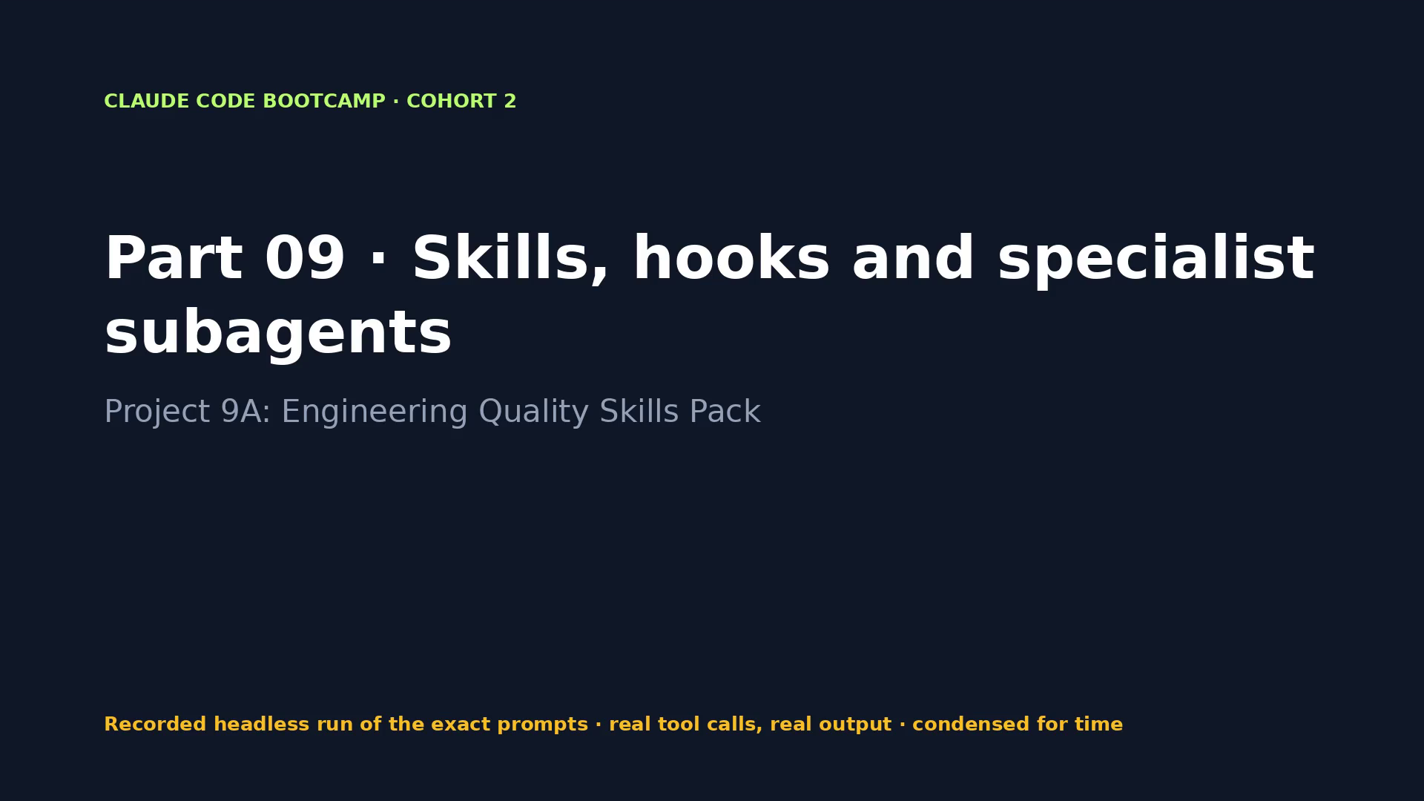
Notes:
VIDEO · Part 09 · Read-only security reviewer finds the stored XSS with file:line; the hook blocks a force push.
Say first: “This is a recording of a real run of the exact prompts on the previous slide. Tool calls and output are real; long runs are condensed.”
CLICK THE VIDEO to play. Click again to pause for questions. Then → for what the evidence shows.
Fallback if playback fails: open videos/09-quality-pack.mp4 in VLC or a browser.

Slide 126
PACKT · CLAUDE CODE BOOTCAMP COHORT 2 · LUCA BERTON
PART 09 · EVIDENCE, NOT CLAIMS
What the run proved
WHAT TO LOOK FOR
WHAT THE RECORDED RUN PRODUCED
• /hooks lists PreToolUse and PostToolUse
• Post-edit tests run automatically
• cat .env blocked by the hook, although permissions allow cat
• Severity-ranked review with file:line
• 2 prompt(s) · 3 min 19 s · $0.54 · 19 tool calls
• bin/bootcamp verify: 16 PASS · 0 FAIL
• Changed: M .claude/settings.json, M dashboard/index.html, ?? reviews/security-review-dashboard.md
126 / 198
Notes:
Now let's look at what we actually saw. Each line on the right comes from the recorded run, not from me. The run took 3 minutes 19 seconds and cost 0.54 dollars. The read-only reviewer found more issues than our reference, including an unescaped status and the test files served publicly.

Slide 127
PACKT · CLAUDE CODE BOOTCAMP COHORT 2 · LUCA BERTON
PART 09 · DISCUSS
Your turn to think
• Which rule in your team should be a hook, not an instruction?
• Why does the security reviewer get only Read, Grep and Glob?
• What would make a skill trigger automatically, and when should it not?
127 / 198
Notes:
Discussion. Take one of these questions. I'll take two or three answers before the lab.

Slide 128
PACKT · CLAUDE CODE BOOTCAMP COHORT 2 · LUCA BERTON
PART 09 · LAB
Hands-on
• Customize the description and add a Shipyard section to change-review/SKILL.md, wire the hooks in settings.json, then run the two prompts.
• Start: bin/bootcamp stage 09
• Prompts: parts/09-quality-pack/PROMPTS.md
• Check: bin/bootcamp verify
128 / 198
Notes:
Lab time. Stage the part, run the prompts, and check with verify. If you get stuck, fallback loads the reference.

Slide 129
PACKT · CLAUDE CODE BOOTCAMP COHORT 2 · LUCA BERTON
PART 09 · CHECKPOINT
You now have
✓ Customized SKILL.md
✓ Working post-edit validation hook
✓ Specialist subagent definition
✓ Structured review output
• Behind? bin/bootcamp checkpoint 09 --force
129 / 198
Notes:
Checkpoint. If you have all of these, you're ready for the next part. If not, checkpoint gets you there in one command.

Slide 130
PACKT · CLAUDE CODE BOOTCAMP COHORT 2 · LUCA BERTON
PART 10 · 13:55–14:20 · 25 MIN
Plugins and marketplace distribution
Project 9B: Package the Engineering Quality Plugin
130 / 198
Notes:
13:55–14:20. Part 10: Plugins and marketplace distribution. Project 9B: Package the Engineering Quality Plugin. By the end of this part you leave with: Validated Claude Code plugin; Local plugin installation; Successful namespaced invocation; Distribution README.

Slide 131
PACKT · CLAUDE CODE BOOTCAMP COHORT 2 · LUCA BERTON
PART 10 · GOALS
What you will be able to do
• Package Skills, hooks, subagents and MCP configuration as one plugin
• Write the manifest; understand namespacing
• Validate (claude plugin validate --strict), install and test locally
• Distribute through a marketplace; version, trust and maintain
131 / 198
Notes:
These are the goals for this part. Package Skills, hooks, subagents and MCP configuration as one plugin Write the manifest; understand namespacing Validate (`claude plugin validate --strict`), install and test locally Distribute through a marketplace; version, trust and maintain.

Slide 132
PACKT · CLAUDE CODE BOOTCAMP COHORT 2 · LUCA BERTON
PLUGINS PACKAGE EVERYTHING
plugins/engineering-quality/
.claude-plugin/plugin.json # name, version 1.0.0, description, author
skills/change-review/SKILL.md # → /engineering-quality:change-review
skills/security-review/SKILL.md
agents/security-reviewer.md
hooks/hooks.json # ${CLAUDE_PLUGIN_ROOT}/hooks/*.sh
hooks/post-edit-validate.sh
hooks/block-unsafe-commands.sh
README.md
Only the manifest lives in .claude-plugin/. Components sit at the plugin root.
132 / 198
Notes:
A plugin is the packaging layer. Everything we built in Part 9 goes into one folder with a manifest. Names are namespaced, so they never collide with yours.

Slide 133
PACKT · CLAUDE CODE BOOTCAMP COHORT 2 · LUCA BERTON
VALIDATE, INSTALL, INSPECT
Real output from our run
$ claude plugin validate ./plugins/engineering-quality --strict
✔ Validation passed
$ claude plugin marketplace add ./
✔ Successfully added marketplace: shipyard-tools
$ claude plugin install engineering-quality@shipyard-tools
✔ Successfully installed plugin: engineering-quality@shipyard-tools
$ claude plugin details engineering-quality@shipyard-tools
Skills (2) change-review, security-review · Agents (1) · Hooks (2)
Always-on: ~398 tok added to every session
parts/10-plugin/solution/evidence/
133 / 198
Notes:
This is the real output from our validation and install. Look at the last line: every installed plugin costs context in every session. That's the maintenance cost of distribution.

Slide 134
PACKT · CLAUDE CODE BOOTCAMP COHORT 2 · LUCA BERTON
DISTRIBUTION
Marketplaces, versions, trust
Topic | Practice
Marketplace | .claude-plugin/marketplace.json: name, owner, plugins[]
Install | /plugin marketplace add <repo> · /plugin install name@marketplace
Versioning | A version in plugin.json pins users until you bump it
Dependencies | "dependencies": name, name@marketplace, or a version range
Trust | Read hooks and scripts before installing; plugins run as you
134 / 198
Notes:
Distribution is easy; trust is the hard part. A plugin's hooks run on your machine as you. Review them like any third-party code.

Slide 135
PACKT · CLAUDE CODE BOOTCAMP COHORT 2 · LUCA BERTON
PART 10 · PROMPT 1 OF 2
Package
Read briefs/package-plugin.md. Package our .claude/ change-review
skill, a security-review skill, the security-reviewer agent and both
hooks into plugins/engineering-quality/ with a valid .claude-
plugin/plugin.json and hooks/hooks.json using ${CLAUDE_PLUGIN_ROOT}.
Add the marketplace file .claude-plugin/marketplace.json named
shipyard-tools. Run claude plugin validate on both with --strict and
show the output. Do not commit.
Copy from parts/10-plugin/PROMPTS.md
135 / 198
Notes:
This is the exact prompt 1. Read it with me: notice the scope, the constraints and the evidence it asks for. Read briefs/package-plugin.md. Package our .claude/ change-review skill, a security-review skill, the security-reviewer agent and both hooks into plugins/engineering-quality/ with a valid .claude-plugin/plugin.json and hooks/hooks.json using ${CLAUDE_PLUGIN_ROOT}. Add the marketplace file .claude-plugin/marketplace.json named shipyard-tools. Run claude plugin validate on both with --strict and show the output. Do not commit.

Slide 136
PACKT · CLAUDE CODE BOOTCAMP COHORT 2 · LUCA BERTON
PART 10 · PROMPT 2 OF 2
Namespaced invocation (claude --plugin-dir ./plugins/engineering-quality)
/engineering-quality:change-review briefs/package-plugin.md
Copy from parts/10-plugin/PROMPTS.md
136 / 198
Notes:
This is the exact prompt 2. Read it with me: notice the scope, the constraints and the evidence it asks for. /engineering-quality:change-review briefs/package-plugin.md

Slide 137
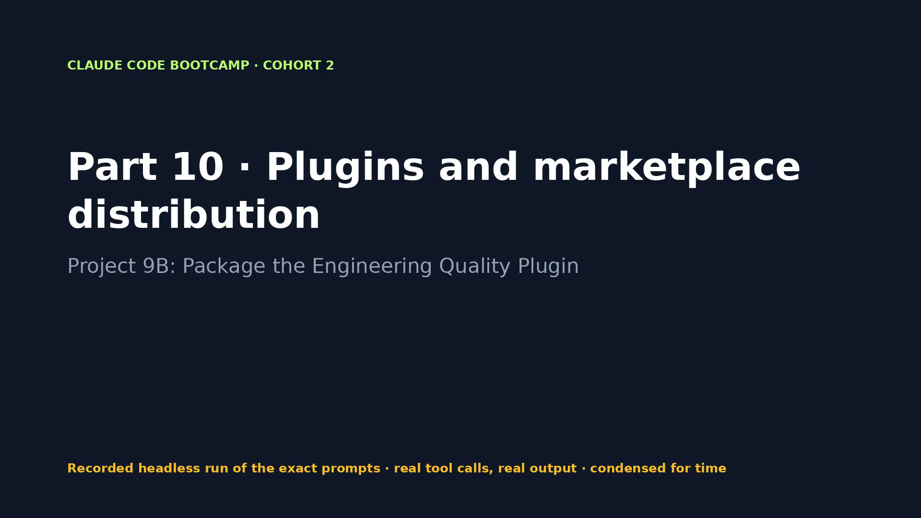
Notes:
VIDEO · Part 10 · Plugin packaged and validated, installed from a local marketplace, invoked by its namespaced name.
Say first: “This is a recording of a real run of the exact prompts on the previous slide. Tool calls and output are real; long runs are condensed.”
CLICK THE VIDEO to play. Click again to pause for questions. Then → for what the evidence shows.
Fallback if playback fails: open videos/10-plugin.mp4 in VLC or a browser.

Slide 138
PACKT · CLAUDE CODE BOOTCAMP COHORT 2 · LUCA BERTON
PART 10 · EVIDENCE, NOT CLAIMS
What the run proved
WHAT TO LOOK FOR
WHAT THE RECORDED RUN PRODUCED
• claude plugin validate … --strict → Validation passed
• claude plugin install engineering-quality@shipyard-tools
• claude plugin details inventory and token cost
• Namespaced skill output
• 2 prompt(s) · 10 min 44 s · $0.86 · 41 tool calls
• Tests seen in the run: Ran 46 tests in 2.614s
• bin/bootcamp verify: 18 PASS · 1 FAIL (Plugin hook scripts executable)
• Changed: ?? .claude-plugin/, ?? plugins/
138 / 198
Notes:
Now let's look at what we actually saw. Each line on the right comes from the recorded run, not from me. The run took 10 minutes 44 seconds and cost 0.86 dollars. Note the failing check: Plugin hook scripts executable. We discuss why rather than hide it. The plugin's own change-review caught that the hook scripts were not executable. The one failing check is that real gap.

Slide 139
PACKT · CLAUDE CODE BOOTCAMP COHORT 2 · LUCA BERTON
PART 10 · DISCUSS
Your turn to think
• What would you put in a plugin, and what stays in CLAUDE.md?
• How do you trust a plugin from another team?
• When do you bump the version?
139 / 198
Notes:
Discussion. Take one of these questions. I'll take two or three answers before the lab.

Slide 140
PACKT · CLAUDE CODE BOOTCAMP COHORT 2 · LUCA BERTON
PART 10 · LAB
Hands-on
• Package, validate with --strict, install from the local marketplace, run /engineering-quality:change-review.
• Start: bin/bootcamp stage 10
• Prompts: parts/10-plugin/PROMPTS.md
• Check: bin/bootcamp verify
140 / 198
Notes:
Lab time. Stage the part, run the prompts, and check with verify. If you get stuck, fallback loads the reference.

Slide 141
PACKT · CLAUDE CODE BOOTCAMP COHORT 2 · LUCA BERTON
PART 10 · CHECKPOINT
You now have
✓ Validated Claude Code plugin
✓ Local plugin installation
✓ Successful namespaced invocation
✓ Distribution README
• Behind? bin/bootcamp checkpoint 10 --force
141 / 198
Notes:
Checkpoint. If you have all of these, you're ready for the next part. If not, checkpoint gets you there in one command.

Slide 142
PACKT · CLAUDE CODE BOOTCAMP COHORT 2 · LUCA BERTON
PART 11 · 14:20–14:50 · 30 MIN
Agent Teams: ship a feature in parallel
Project 9C: Parallel Feature Sprint
142 / 198
Notes:
14:20–14:50. Part 11: Agent Teams: ship a feature in parallel. Project 9C: Parallel Feature Sprint. By the end of this part you leave with: Parallel task plan; Explicit role and file ownership; Integrated feature; Passing tests; Team review and retrospective; Documented coordination risks.

Slide 143
PACKT · CLAUDE CODE BOOTCAMP COHORT 2 · LUCA BERTON
PART 11 · GOALS
What you will be able to do
• Choose between subagents and Agent Teams; background sessions and agent view
• Lead and teammate roles, shared task list, direct messages, plan approval
• Avoid file conflicts with explicit ownership; quality gates for parallel work
• Monitor token and coordination cost
143 / 198
Notes:
These are the goals for this part. Choose between subagents and Agent Teams; background sessions and agent view Lead and teammate roles, shared task list, direct messages, plan approval Avoid file conflicts with explicit ownership; quality gates for parallel work Monitor token and coordination cost.

Slide 144
PACKT · CLAUDE CODE BOOTCAMP COHORT 2 · LUCA BERTON
SUBAGENTS VS AGENT TEAMS
Delegate a task, or run a team
SUBAGENTS
AGENT TEAMS (EXPERIMENTAL)
• Work inside one session
• Report back to the main agent
• Cheaper, simpler
• Great for review, research, tests
• Separate Claude instances
• Shared task list + direct messages
• More tokens, real parallelism
• Lead coordinates; teammates own files
144 / 198
Notes:
Subagents are delegates. A team is a set of peers with a lead, a shared task list and a mailbox. Teams cost significantly more tokens, so use them when the work genuinely splits.

Slide 145
PACKT · CLAUDE CODE BOOTCAMP COHORT 2 · LUCA BERTON
OWNERSHIP PREVENTS CONFLICTS
Release notes sprint
Role | Owns | Done when
Backend | notes_api/releases.py, route in server.py | Contract returned
Frontend | index.html, styles.css, js/release-notes.js, main.js | Panel + copy
Test & verify | tests/test_release_notes.py, dashboard tests, browser | Suites green + evidence
145 / 198
Notes:
Disjoint file ownership plus a frozen API contract is what makes parallel work safe. Put the ownership in each teammate's spawn prompt and check the diff per file: the plan approval step will not enforce it for you, as the next slide shows.

Slide 146
PACKT · CLAUDE CODE BOOTCAMP COHORT 2 · LUCA BERTON
RUNNING A TEAM
Controls you actually use
Control | How
Enable | CLAUDE_CODE_EXPERIMENTAL_AGENT_TEAMS=1
Plan first | Teammates plan read-only; the lead session auto-approves the plan (no review): read plans yourself, steer by message
Steer | Message a teammate directly; Ctrl+T task list
Quality gates | TaskCompleted / TeammateIdle hooks; plugin review
Display | in-process (default) or --teammate-mode tmux
Cost | Fewer, focused teammates; stop idle ones
146 / 198
Notes:
These are the controls you'll touch. One surprise from the docs: when a teammate finishes planning, Claude Code approves the plan in the lead's session without the lead reviewing it. So the human gate is you: read the plans, message a teammate that strays, and use TaskCompleted hooks as the quality gate. Watch the token cost — it scales with teammates.

Slide 147
PACKT · CLAUDE CODE BOOTCAMP COHORT 2 · LUCA BERTON
THE INTEGRATED FEATURE
Release notes, generated and copyable
Reference checkpoint: 54 Python tests + 10 node tests green after integration.
147 / 198
Notes:
Here's the integrated feature: grouped release notes and a Copy as Markdown button, with both suites green.

Slide 148
PACKT · CLAUDE CODE BOOTCAMP COHORT 2 · LUCA BERTON
PART 11 · PROMPT 1 OF 2
Launch the team (CLAUDE_CODE_EXPERIMENTAL_AGENT_TEAMS=1)
Read briefs/release-notes-team.md. Create an agent team with three
teammates: backend owner, frontend owner, and test and verification
owner, each restricted to the files listed in the brief. Require
plan approval before any teammate edits. Freeze the API contract
from the brief first, write the task list with dependencies to
docs/team-plan.md, then let the teammates work in parallel. When all
tasks are done, run both test suites, show the raw output, and
summarise what each teammate changed. Do not commit.
Copy from parts/11-agent-team/PROMPTS.md
148 / 198
Notes:
This is the exact prompt 1. Read it with me: notice the scope, the constraints and the evidence it asks for. Read briefs/release-notes-team.md. Create an agent team with three teammates: backend owner, frontend owner, and test and verification owner, each restricted to the files listed in the brief. Require plan approval before any teammate edits. Freeze the API contract from the brief first, write the task list with dependencies to docs/team-plan.md, then let the teammates work in parallel. When all tasks are done, run both test suites, show the raw output, and summarise what each teammate changed. Do not commit.

Slide 149
PACKT · CLAUDE CODE BOOTCAMP COHORT 2 · LUCA BERTON
PART 11 · PROMPT 2 OF 2
Steer one teammate
Message the frontend owner: the panel must show an empty-state
message when the release has no notes, and the Copy button must say
"Copied" for 1.5 seconds.
Copy from parts/11-agent-team/PROMPTS.md
149 / 198
Notes:
This is the exact prompt 2. Read it with me: notice the scope, the constraints and the evidence it asks for. Message the frontend owner: the panel must show an empty-state message when the release has no notes, and the Copy button must say "Copied" for 1.5 seconds.

Slide 150
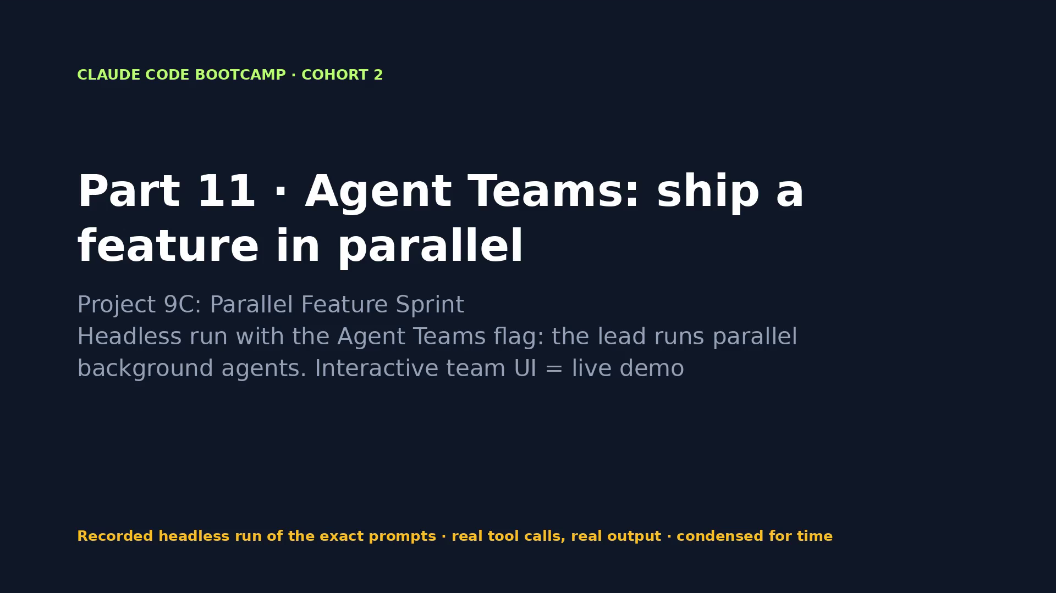
Notes:
VIDEO · Part 11 · The team builds release notes in parallel: backend endpoint, frontend panel, tests, integrated and green.
Say first: “This is a recording of a real run of the exact prompts on the previous slide. Tool calls and output are real; long runs are condensed.”
CLICK THE VIDEO to play. Click again to pause for questions. Then → for what the evidence shows.
Fallback if playback fails: open videos/11-agent-team.mp4 in VLC or a browser.

Slide 151
PACKT · CLAUDE CODE BOOTCAMP COHORT 2 · LUCA BERTON
PART 11 · EVIDENCE, NOT CLAIMS
What the run proved
WHAT TO LOOK FOR
WHAT THE RECORDED RUN PRODUCED
• Task list with owners and dependencies
• No file edited by two teammates
• Both suites green after integration
• /engineering-quality:change-review before acceptance
• Retrospective + token cost
• 2 prompt(s) · 14 min 11 s · $2.21 · 70 tool calls
• Tests seen in the run: # pass 21
• bin/bootcamp verify: 20 PASS · 0 FAIL
• Changed: M dashboard/index.html, M dashboard/js/main.js, M dashboard/styles.css, M notes_api/server.py … (+5)
151 / 198
Notes:
Now let's look at what we actually saw. Each line on the right comes from the recorded run, not from me. The run took 14 minutes 11 seconds and cost 2.21 dollars. Headless mode coordinated parallel background agents with plan approval and SendMessage steering. The interactive team UI is the live demo.

Slide 152
PACKT · CLAUDE CODE BOOTCAMP COHORT 2 · LUCA BERTON
PART 11 · DISCUSS
Your turn to think
• When is an Agent Team worth the extra tokens?
• What made parallel work safe here?
• What would you change in the plan approval step?
152 / 198
Notes:
Discussion. Take one of these questions. I'll take two or three answers before the lab.

Slide 153
PACKT · CLAUDE CODE BOOTCAMP COHORT 2 · LUCA BERTON
PART 11 · LAB
Hands-on
• Watch the instructor's team, steer one teammate, then review the integrated diff with the plugin. No access? Use the transcript, task board and checkpoint in parts/11.
• Start: bin/bootcamp stage 11
• Prompts: parts/11-agent-team/PROMPTS.md
• Check: bin/bootcamp verify
153 / 198
Notes:
Lab time. Stage the part, run the prompts, and check with verify. If you get stuck, fallback loads the reference.

Slide 154
PACKT · CLAUDE CODE BOOTCAMP COHORT 2 · LUCA BERTON
PART 11 · CHECKPOINT
You now have
✓ Parallel task plan
✓ Explicit role and file ownership
✓ Integrated feature
✓ Passing tests
✓ Team review and retrospective
✓ Documented coordination risks
• Behind? bin/bootcamp checkpoint 11 --force
154 / 198
Notes:
Checkpoint. If you have all of these, you're ready for the next part. If not, checkpoint gets you there in one command.

Slide 155
PACKT · CLAUDE CODE BOOTCAMP COHORT 2 · LUCA BERTON
14:50–15:00
Break · 10 minutes
Behind? bin/bootcamp checkpoint 11 --force · next: Part 12
155 / 198
Notes:
Ten-minute break. Use it to run bin/bootcamp verify on your stage, or bin/bootcamp checkpoint for the next part if you fell behind.

Slide 156
PACKT · CLAUDE CODE BOOTCAMP COHORT 2 · LUCA BERTON
PART 12 · 15:00–15:25 · 25 MIN
Production readiness, security and code review
Project 10A: Production Readiness Review
156 / 198
Notes:
15:00–15:25. Part 12: Production readiness, security and code review. Project 10A: Production Readiness Review. By the end of this part you leave with: Security review; Code review findings; Top three prioritized fixes; Named owner; Verification plan; Production readiness decision.

Slide 157
PACKT · CLAUDE CODE BOOTCAMP COHORT 2 · LUCA BERTON
PART 12 · GOALS
What you will be able to do
• Prototype versus production expectations
• Review dependencies, secrets, input validation, authN/authZ, permissions, errors, performance, rollback
• Use /security-review, /code-review and ultrareview (/code-review ultra)
• Separate verified findings from speculative concerns; prioritise by severity, effort and impact
157 / 198
Notes:
These are the goals for this part. Prototype versus production expectations Review dependencies, secrets, input validation, authN/authZ, permissions, errors, performance, rollback Use /security-review, /code-review and ultrareview (`/code-review ultra`) Separate verified findings from speculative concerns; prioritise by severity, effort and impact.

Slide 158
PACKT · CLAUDE CODE BOOTCAMP COHORT 2 · LUCA BERTON
PROTOTYPE VS PRODUCTION
The bar moves
PROTOTYPE
PRODUCTION
• Works on my machine
• Happy path
• Trusted users
• Restart fixes it
• Secrets, inputs, authN/authZ
• Errors and limits
• Untrusted network
• Rollback and observability
158 / 198
Notes:
Shipyard works and is well tested. Production asks different questions: who can reach it, what can they send, what happens when it fails.

Slide 159
PACKT · CLAUDE CODE BOOTCAMP COHORT 2 · LUCA BERTON
VERIFIED FINDINGS
Every finding has evidence
Sev | Finding | Evidence
High | Stored XSS in note bodies | render.js:46 · formatBody('<img onerror>') unchanged
High | No auth, bind 0.0.0.0, CORS * | server.py:128, :37 · probe output
Medium | Unbounded request body | server.py:64 · 5 MB header blocks a worker
Low | Exception details leaked | server.py:111 repr(exc)
159 / 198
Notes:
Every row here was proven: file and line, plus a command we actually ran. Speculative concerns go in a separate list and don't block.

Slide 160
PACKT · CLAUDE CODE BOOTCAMP COHORT 2 · LUCA BERTON
REVIEW TOOLS
Which review, when
Tool | What it is
/security-review | Security review of the branch diff (needs an origin remote)
/code-review (alias /review) | Local multi-agent review: low…max, --fix, --comment
/code-review ultra · claude ultrareview | Cloud multi-agent deep review (claude.ai login)
Code Review GitHub app | Managed PR reviews (Team/Enterprise, research preview)
Our plugin | /engineering-quality:security-review + read-only reviewer
160 / 198
Notes:
Several review tools, different depths and costs. Ultrareview runs in the cloud with many agents; it's for the changes that really matter.

Slide 161
PACKT · CLAUDE CODE BOOTCAMP COHORT 2 · LUCA BERTON
THE DECISION
Conditional go.
Reference report: internal rollout only after the top three fixes pass verification. The recorded review said No-go for the org-wide rollout. Which would you sign?
161 / 198
Notes:
A readiness report ends with a decision someone can act on. Conditional go, with named owners and verification actions.

Slide 162
PACKT · CLAUDE CODE BOOTCAMP COHORT 2 · LUCA BERTON
PART 12 · PROMPT 1 OF 1
Production review
Read briefs/production-review.md. Run /engineering-quality:security-
review on notes_api/ and dashboard/js/, then review the rest
yourself. Write reports/production-readiness.md with: risk summary,
severity-ranked findings each with evidence (file:line, config, test
or runtime output you actually ran), a separate list of speculative
concerns, top three fixes with owner and verification action, and a
Go / Conditional go / No-go recommendation. Do not fix anything.
Copy from parts/12-production-readiness/PROMPTS.md
162 / 198
Notes:
This is the exact prompt 1. Read it with me: notice the scope, the constraints and the evidence it asks for. Read briefs/production-review.md. Run /engineering-quality:security-review on notes_api/ and dashboard/js/, then review the rest yourself. Write reports/production-readiness.md with: risk summary, severity-ranked findings each with evidence (file:line, config, test or runtime output you actually ran), a separate list of speculative concerns, top three fixes with owner and verification action, and a Go / Conditional go / No-go recommendation. Do not fix anything.

Slide 163
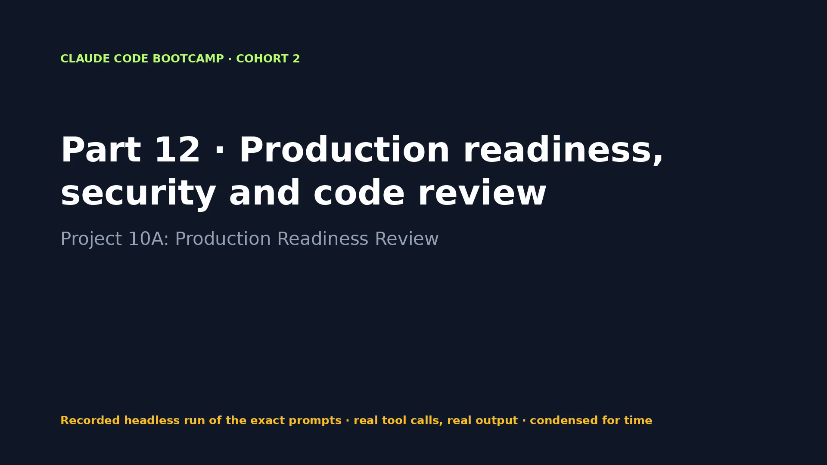
Notes:
VIDEO · Part 12 · Security review with file:line evidence, runtime proof, top three fixes and a conditional go.
Say first: “This is a recording of a real run of the exact prompts on the previous slide. Tool calls and output are real; long runs are condensed.”
CLICK THE VIDEO to play. Click again to pause for questions. Then → for what the evidence shows.
Fallback if playback fails: open videos/12-production-readiness.mp4 in VLC or a browser.

Slide 164
PACKT · CLAUDE CODE BOOTCAMP COHORT 2 · LUCA BERTON
PART 12 · EVIDENCE, NOT CLAIMS
What the run proved
WHAT TO LOOK FOR
WHAT THE RECORDED RUN PRODUCED
• Stored XSS proven at runtime
• Bind 0.0.0.0 + CORS * proven by the probe
• Oversized request blocks a worker
• Top 3 fixes with owners and verification
• A Go / Conditional go / No-go decision with reasons
• 1 prompt(s) · 2 min 57 s · $0.47 · 39 tool calls
• Tests seen in the run: Ran 54 tests in 3.650s · # pass 10
• bin/bootcamp verify: 21 PASS · 0 FAIL
• Changed: ?? reports/
164 / 198
Notes:
Now let's look at what we actually saw. Each line on the right comes from the recorded run, not from me. The run took 2 minutes 57 seconds and cost 0.47 dollars. Our reference says conditional go; the recorded review said no-go for the org-wide rollout. Two reviewers, two decisions: which would you sign?

Slide 165
PACKT · CLAUDE CODE BOOTCAMP COHORT 2 · LUCA BERTON
PART 12 · DISCUSS
Your turn to think
• Which finding would you have missed without runtime evidence?
• What turns a speculative concern into a verified finding?
• Would you sign the conditional go?
165 / 198
Notes:
Discussion. Take one of these questions. I'll take two or three answers before the lab.

Slide 166
PACKT · CLAUDE CODE BOOTCAMP COHORT 2 · LUCA BERTON
PART 12 · LAB
Hands-on
• Run the review on your own project. Every High finding needs a command and its output.
• Start: bin/bootcamp stage 12
• Prompts: parts/12-production-readiness/PROMPTS.md
• Check: bin/bootcamp verify
166 / 198
Notes:
Lab time. Stage the part, run the prompts, and check with verify. If you get stuck, fallback loads the reference.

Slide 167
PACKT · CLAUDE CODE BOOTCAMP COHORT 2 · LUCA BERTON
PART 12 · CHECKPOINT
You now have
✓ Security review
✓ Code review findings
✓ Top three prioritized fixes
✓ Named owner
✓ Verification plan
✓ Production readiness decision
• Behind? bin/bootcamp checkpoint 12 --force
167 / 198
Notes:
Checkpoint. If you have all of these, you're ready for the next part. If not, checkpoint gets you there in one command.

Slide 168
PACKT · CLAUDE CODE BOOTCAMP COHORT 2 · LUCA BERTON
PART 13 · 15:25–15:45 · 20 MIN
Claude Cowork: engineering output to stakeholder update
Project 10B: Stakeholder Handoff
168 / 198
Notes:
15:25–15:45. Part 13: Claude Cowork: engineering output to stakeholder update. Project 10B: Stakeholder Handoff. By the end of this part you leave with: Stakeholder-ready release update; Risk and decision summary; Follow-up action list; Named owners and next steps.

Slide 169
PACKT · CLAUDE CODE BOOTCAMP COHORT 2 · LUCA BERTON
PART 13 · GOALS
What you will be able to do
• Extend agentic work beyond code: reports, spreadsheets, presentations, documents
• Keep technical accuracy while translating risk into business impact
• Cowork permissions, local file access, reviewing browser and connector actions
• Manual, automatic and skipped approval modes
169 / 198
Notes:
These are the goals for this part. Extend agentic work beyond code: reports, spreadsheets, presentations, documents Keep technical accuracy while translating risk into business impact Cowork permissions, local file access, reviewing browser and connector actions Manual, automatic and skipped approval modes.

Slide 170
PACKT · CLAUDE CODE BOOTCAMP COHORT 2 · LUCA BERTON
COWORK
Agentic work beyond code
• Agentic workspace in Claude Desktop, built on the Claude Code architecture
• Reads local files you grant; produces documents, spreadsheets, presentations
• Uses the skills and plugins enabled on your claude.ai account
• Review every browser and connector action; choose the approval mode
170 / 198
Notes:
Cowork takes the same agentic loop to business documents. Same discipline: grant only the folder it needs and review its actions.

Slide 171
PACKT · CLAUDE CODE BOOTCAMP COHORT 2 · LUCA BERTON
TRANSLATE, DON'T SOFTEN
Technical risk → business impact
Engineering finding | Stakeholder language
Stored XSS (High) | A note with hidden script could run in every colleague's browser
No auth, bind 0.0.0.0 (High) | Anyone on the network can edit or delete notes
Unbounded body (Medium) | One malformed request can slow the service for everyone
171 / 198
Notes:
The severity doesn't change in translation. Only the words do. That's the bar for a stakeholder update.

Slide 172
PACKT · CLAUDE CODE BOOTCAMP COHORT 2 · LUCA BERTON
ONE PAGE
The stakeholder update
Section | Rule
Status | Conditional go, one sentence
Completed | Features, not tickets
Impact | For customers or the business
Risks | Plain language, same severity
Decisions | Who decides what, by when
Fixes + owners | No invented dates
Next step | One action
172 / 198
Notes:
Eight sections, one page, readable on a phone. No invented dates: if the date depends on an approval, say so.

Slide 173
PACKT · CLAUDE CODE BOOTCAMP COHORT 2 · LUCA BERTON
PART 13 · PROMPT 1 OF 1
Cowork (or the stakeholder-update skill)
Read reports/production-readiness.md, docs/HANDOFF.md and docs/team-
plan.md. Write reports/stakeholder-update.md: one page for a VP of
Engineering reading on a phone, with exactly these sections: current
release status, features completed, customer or business impact,
major risks (plain language, severities unchanged), decisions
required, top three fixes, owners and deadlines (no invented dates),
recommended next step.
Copy from parts/13-cowork-handoff/PROMPTS.md
173 / 198
Notes:
This is the exact prompt 1. Read it with me: notice the scope, the constraints and the evidence it asks for. Read reports/production-readiness.md, docs/HANDOFF.md and docs/team-plan.md. Write reports/stakeholder-update.md: one page for a VP of Engineering reading on a phone, with exactly these sections: current release status, features completed, customer or business impact, major risks (plain language, severities unchanged), decisions required, top three fixes, owners and deadlines (no invented dates), recommended next step.

Slide 174
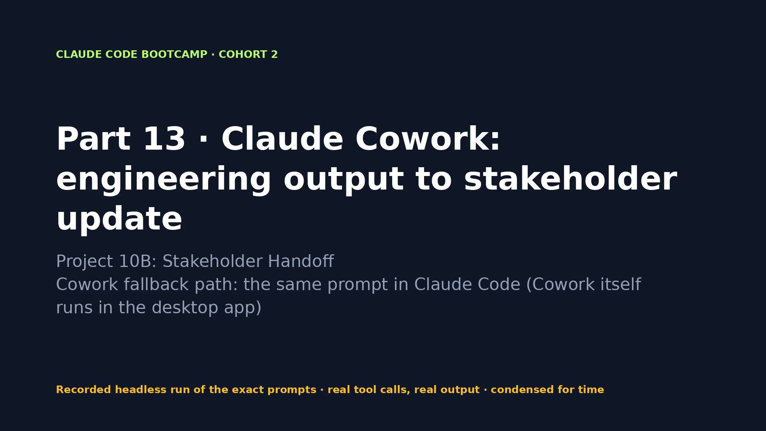
Notes:
VIDEO · Part 13 · The readiness report becomes a one-page stakeholder update with honest severities and owners.
Say first: “This is a recording of a real run of the exact prompts on the previous slide. Tool calls and output are real; long runs are condensed.”
CLICK THE VIDEO to play. Click again to pause for questions. Then → for what the evidence shows.
Fallback if playback fails: open videos/13-cowork-handoff.mp4 in VLC or a browser.

Slide 175
PACKT · CLAUDE CODE BOOTCAMP COHORT 2 · LUCA BERTON
PART 13 · EVIDENCE, NOT CLAIMS
What the run proved
WHAT TO LOOK FOR
WHAT THE RECORDED RUN PRODUCED
• One page, eight sections
• Severities match the readiness report
• No invented dates
• Every connector/browser action reviewed before approval
• 1 prompt(s) · 1 min 11 s · $0.10 · 4 tool calls
• bin/bootcamp verify: 21 PASS · 0 FAIL
• Changed: ?? reports/stakeholder-update.md
175 / 198
Notes:
Now let's look at what we actually saw. Each line on the right comes from the recorded run, not from me. The run took 1 minutes 11 seconds and cost 0.10 dollars. No invented deadlines: the run wrote 'not set' because the sources give none.

Slide 176
PACKT · CLAUDE CODE BOOTCAMP COHORT 2 · LUCA BERTON
PART 13 · DISCUSS
Your turn to think
• What did the update leave out on purpose?
• How do you keep severity honest in business language?
• Which approval mode would you use for Cowork in your company?
176 / 198
Notes:
Discussion. Take one of these questions. I'll take two or three answers before the lab.

Slide 177
PACKT · CLAUDE CODE BOOTCAMP COHORT 2 · LUCA BERTON
PART 13 · LAB
Hands-on
• Give Cowork the folder and the prompt. No Cowork? Run /stakeholder-update from the Skills Pack with the same inputs.
• Start: bin/bootcamp stage 13
• Prompts: parts/13-cowork-handoff/PROMPTS.md
• Check: bin/bootcamp verify
177 / 198
Notes:
Lab time. Stage the part, run the prompts, and check with verify. If you get stuck, fallback loads the reference.

Slide 178
PACKT · CLAUDE CODE BOOTCAMP COHORT 2 · LUCA BERTON
PART 13 · CHECKPOINT
You now have
✓ Stakeholder-ready release update
✓ Risk and decision summary
✓ Follow-up action list
✓ Named owners and next steps
• Behind? bin/bootcamp checkpoint 13 --force
178 / 198
Notes:
Checkpoint. If you have all of these, you're ready for the next part. If not, checkpoint gets you there in one command.

Slide 179
PACKT · CLAUDE CODE BOOTCAMP COHORT 2 · LUCA BERTON
PART 14 · 15:45–16:05 · 20 MIN
Web, mobile, Remote Control and work that continues
Project 10C: Cross-Device Continuation
179 / 198
Notes:
15:45–16:05. Part 14: Web, mobile, Remote Control and work that continues. Project 10C: Cross-Device Continuation. By the end of this part you leave with: Cross-device continuation checklist; Remote verification status update; Post-release routine brief.

Slide 180
PACKT · CLAUDE CODE BOOTCAMP COHORT 2 · LUCA BERTON
PART 14 · GOALS
What you will be able to do
• Move between terminal, desktop, web and mobile
• Continue a local session with Remote Control; monitor and steer from another device
• Local sessions versus cloud sessions; when local context or credentials are required
• Routines and scheduled work; safe automation with clear stop conditions
180 / 198
Notes:
These are the goals for this part. Move between terminal, desktop, web and mobile Continue a local session with Remote Control; monitor and steer from another device Local sessions versus cloud sessions; when local context or credentials are required Routines and scheduled work; safe automation with clear stop conditions.

Slide 181
PACKT · CLAUDE CODE BOOTCAMP COHORT 2 · LUCA BERTON
LOCAL VS CLOUD
Where should this session run?
 | Remote Control (local) | Cloud session / routine
Runs on | Your machine | Anthropic cloud, fresh clone
Has | Local files, credentials, VPN | Only the GitHub repo
Start | claude --remote-control / /rc | claude --cloud · /schedule
Steer from | claude.ai/code, mobile app | claude.ai/code
Needs | The claude process alive | A pushed branch
181 / 198
Notes:
Remote Control keeps the session on your laptop and lets you steer it from the phone. Cloud sessions and routines run without your machine but only see what's in the repo.

Slide 182
PACKT · CLAUDE CODE BOOTCAMP COHORT 2 · LUCA BERTON
CONTINUE ANYWHERE
Start locally, steer from the phone
claude --remote-control "Shipyard v1.4 verification"
# or inside a running session:
/remote-control
# → open the session URL or scan the QR code (spacebar)
# → claude.ai/code or the Claude app's Code tab
Pro/Max/Team/Enterprise with a claude.ai login; Team/Enterprise owners enable it in admin settings.
182 / 198
Notes:
I start the verification here, then pick it up on my phone and steer it once. It keeps using my local files and tools.

Slide 183
PACKT · CLAUDE CODE BOOTCAMP COHORT 2 · LUCA BERTON
SAFE AUTOMATION
Every routine needs these six answers
Field | Shipyard routine
Trigger | Daily 08:45 for 7 days post-release; on merge to main
Scope | Repo shipyard, branch main, read-only
Permissions | Run tests and probe; draft issue/PR only
Output | Totals + probe + GREEN/YELLOW/RED
Approval point | Engineer of record on any proposed fix
Stop | After 7 GREEN, or first RED → issue + disable
183 / 198
Notes:
Routines run without permission prompts, so the safety has to be in the design: least privilege, draft-only output, and a stop condition that hands control back to a human.

Slide 184
PACKT · CLAUDE CODE BOOTCAMP COHORT 2 · LUCA BERTON
PART 14 · PROMPT 1 OF 2
Remote Control (claude --remote-control "Shipyard v1.4 verification")
Run both test suites and python3 scripts/readiness_probe.py (it
starts its own server), then write a five-line verification status
to ops/remote-verification-status.md: test totals with the raw
summary lines, probe results, verdict GREEN/YELLOW/RED and the next
step. Stop after writing the file; do not edit anything else.
Copy from parts/14-remote-routine/PROMPTS.md
184 / 198
Notes:
This is the exact prompt 1. Read it with me: notice the scope, the constraints and the evidence it asks for. Run both test suites and python3 scripts/readiness_probe.py (it starts its own server), then write a five-line verification status to ops/remote-verification-status.md: test totals with the raw summary lines, probe results, verdict GREEN/YELLOW/RED and the next step. Stop after writing the file; do not edit anything else.

Slide 185
PACKT · CLAUDE CODE BOOTCAMP COHORT 2 · LUCA BERTON
PART 14 · PROMPT 2 OF 2
Design the routine
Write ops/post-release-routine.md using templates/post-release-
routine-brief.md: a recurring post-release check for this repository
with trigger, repository scope, required permissions (least
privilege), expected output, the human approval point, and the
completion or stop condition. Say what must stay local and what can
run as a cloud routine.
Copy from parts/14-remote-routine/PROMPTS.md
185 / 198
Notes:
This is the exact prompt 2. Read it with me: notice the scope, the constraints and the evidence it asks for. Write ops/post-release-routine.md using templates/post-release-routine-brief.md: a recurring post-release check for this repository with trigger, repository scope, required permissions (least privilege), expected output, the human approval point, and the completion or stop condition. Say what must stay local and what can run as a cloud routine.

Slide 186
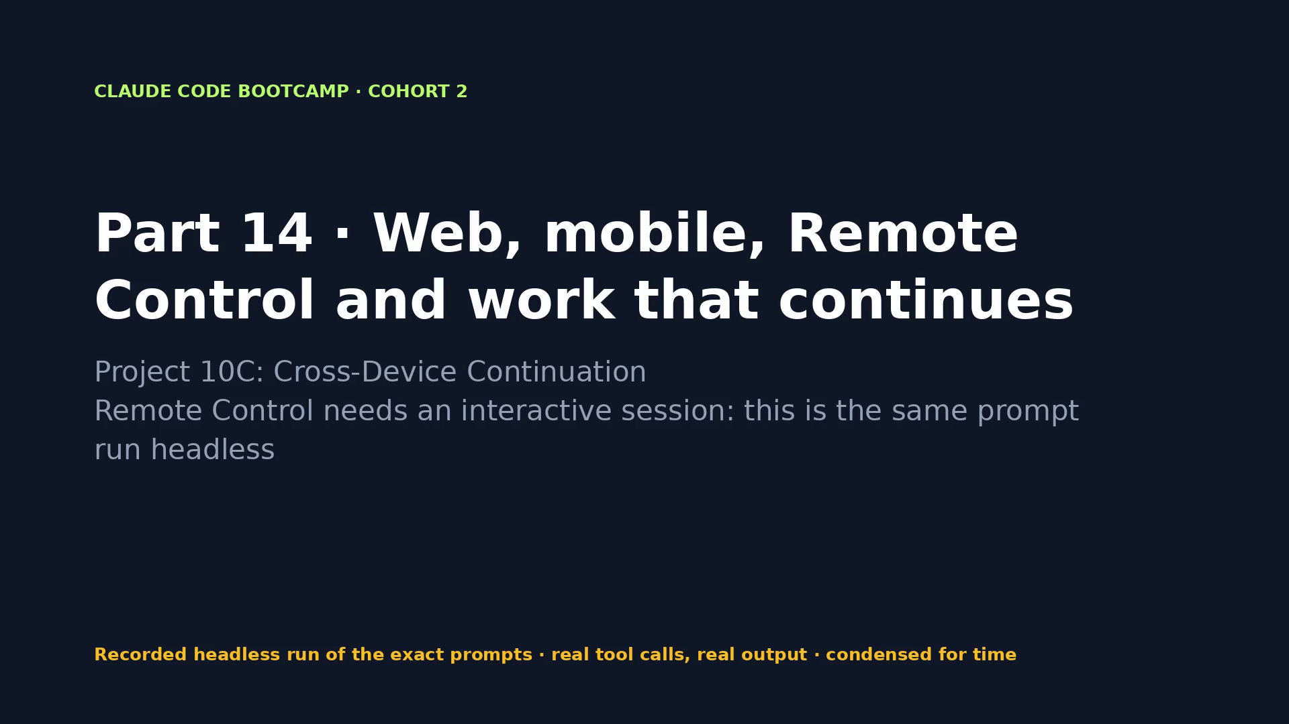
Notes:
VIDEO · Part 14 · Verification runs, a status file is written, and a post-release routine brief with stop conditions is designed.
Say first: “This is a recording of a real run of the exact prompts on the previous slide. Tool calls and output are real; long runs are condensed.”
CLICK THE VIDEO to play. Click again to pause for questions. Then → for what the evidence shows.
Fallback if playback fails: open videos/14-remote-routine.mp4 in VLC or a browser.

Slide 187
PACKT · CLAUDE CODE BOOTCAMP COHORT 2 · LUCA BERTON
PART 14 · EVIDENCE, NOT CLAIMS
What the run proved
WHAT TO LOOK FOR
WHAT THE RECORDED RUN PRODUCED
• Session visible on claude.ai/code and the mobile app
• Steered once from the phone
• Status file written by the remote session
• Routine brief with stop conditions
• 2 prompt(s) · 4 min 12 s · $0.25 · 8 tool calls
• Tests seen in the run: Ran 54 tests in 1.904s
• bin/bootcamp verify: 21 PASS · 0 FAIL
• Changed: ?? ops/
187 / 198
Notes:
Now let's look at what we actually saw. Each line on the right comes from the recorded run, not from me. The run took 4 minutes 12 seconds and cost 0.25 dollars.

Slide 188
PACKT · CLAUDE CODE BOOTCAMP COHORT 2 · LUCA BERTON
PART 14 · DISCUSS
Your turn to think
• What must never run unattended?
• What stays local, and why?
• What is your stop condition for a routine that fails twice?
188 / 198
Notes:
Discussion. Take one of these questions. I'll take two or three answers before the lab.

Slide 189
PACKT · CLAUDE CODE BOOTCAMP COHORT 2 · LUCA BERTON
PART 14 · LAB
Hands-on
• Design your own post-release routine with the template; trade it with a neighbour and find one missing stop condition.
• Start: bin/bootcamp stage 14
• Prompts: parts/14-remote-routine/PROMPTS.md
• Check: bin/bootcamp verify
189 / 198
Notes:
Lab time. Stage the part, run the prompts, and check with verify. If you get stuck, fallback loads the reference.

Slide 190
PACKT · CLAUDE CODE BOOTCAMP COHORT 2 · LUCA BERTON
PART 14 · CHECKPOINT
You now have
✓ Cross-device continuation checklist
✓ Remote verification status update
✓ Post-release routine brief
• Behind? bin/bootcamp checkpoint 14 --force
190 / 198
Notes:
Checkpoint. If you have all of these, you're ready for the next part. If not, checkpoint gets you there in one command.

Slide 191
PACKT · CLAUDE CODE BOOTCAMP COHORT 2 · LUCA BERTON
16:05–16:30
Final Q&A and exam briefing
191 / 198
Notes:
We're at the final block. Common mistakes, assessment, certification, and your questions.

Slide 192
PACKT · CLAUDE CODE BOOTCAMP COHORT 2 · LUCA BERTON
COMMON MISTAKES
Anti-patterns we avoided today
Anti-pattern | Instead
Accepting 'done' | Command + raw output
Huge CLAUDE.md | Rules, Skills, auto memory
First answer wins | Best-of-N with a fixed matrix
Editing before reproducing | Failing test first
Agent Team for a small change | One session + subagent
Instruction for a hard rule | A hook
Autonomy on main | Worktree + sandbox + recovery point
192 / 198
Notes:
If you remember one slide from today, make it this one.

Slide 193
PACKT · CLAUDE CODE BOOTCAMP COHORT 2 · LUCA BERTON
ASSESSMENT
How you are assessed
Component | Evidence | Weight
Scenario-based knowledge quiz | Permissions, feature selection, context, security, workflow | 30%
Practical capstone | Working change, tests, diff, verification, readiness report | 50%
Engineering reflection | Rejected approach, human checkpoint, unresolved risk | 20%
193 / 198
Notes:
Thirty percent quiz, fifty percent capstone, twenty percent reflection. Details in the assessment folder.

Slide 194
PACKT · CLAUDE CODE BOOTCAMP COHORT 2 · LUCA BERTON
PASSING CRITERIA
What it takes to pass
• 70% or higher overall; at least 60% on the practical capstone
• Genuine test or runtime evidence
• Risk summary, top three fixes, named owner, verification step
• Automatic fail: exposed credentials, fabricated test results, unsafe irreversible actions
194 / 198
Notes:
Note the automatic-fail conditions. Fabricated test results fail the assessment, no matter how good the rest is.

Slide 195
PACKT · CLAUDE CODE BOOTCAMP COHORT 2 · LUCA BERTON
CERTIFICATION READINESS
Free mock test: 60 questions, 7 domains
Domain | Weight | Q
Prompting and Task Execution | 14% | 8
Output Evaluation and Validation | 21% | 13
Product and Model Selection | 12% | 7
Workflow Integration and Solution Design | 16% | 10
Configuration and Knowledge Management | 12% | 7
Governance, Risk, and Responsible Use | 15% | 9
Troubleshooting and Optimization | 10% | 6
195 / 198
Notes:
The mock test mirrors the seven domains of the Claude Certified Associate – Foundations exam. Run it with python3 mock-test/run.py. It writes a readiness report with a seven-day revision plan.

Slide 196
PACKT · CLAUDE CODE BOOTCAMP COHORT 2 · LUCA BERTON
IMPORTANT DISCLAIMER
Independent preparation material
• This workshop and mock test are independently created by Packt
• Not official Anthropic training, not endorsed by Anthropic
• No official examination questions
• Completing them does not guarantee success in the official exam
196 / 198
Notes:
I'll read this exactly: these materials are independent, not endorsed by Anthropic, and contain no official exam questions.

Slide 197
PACKT · CLAUDE CODE BOOTCAMP COHORT 2 · LUCA BERTON
TAKE IT HOME
Your Skills Pack and repository
Asset | Where
8 Skills | skills-pack/skills/
Hooks + subagents | skills-pack/hooks, skills-pack/agents
Engineering Quality plugin | plugins/engineering-quality + marketplace
Templates | templates/
Checkpoints for every project | bin/bootcamp checkpoint NN
Assessment + mock test | assessment/, mock-test/
197 / 198
Notes:
Everything we used today is in your repository. Install the Skills Pack into your own repos with skills-pack/install.sh.

Slide 198
PACKT · CLAUDE CODE BOOTCAMP COHORT 2 · LUCA BERTON
THANK YOU
VERIFY EVERYTHING.
SHIP WITH CONFIDENCE.
Questions?
Luca Berton · Claude Code Bootcamp Cohort 2
198 / 198
Notes:
Thank you. Build faster, orchestrate smarter, verify everything, ship with confidence. Questions?

