Slide 1
REPO’s
Data Engineer
Data Scientist
Azure DevOps
GitHub
Action
Data Wrangler
Featue Engineering
ETL [python]
Pipelines [ADF]
ML Enginieer
DevOps
Build Azure Resources
CICD
MLOps
Data Analyst

Slide 2
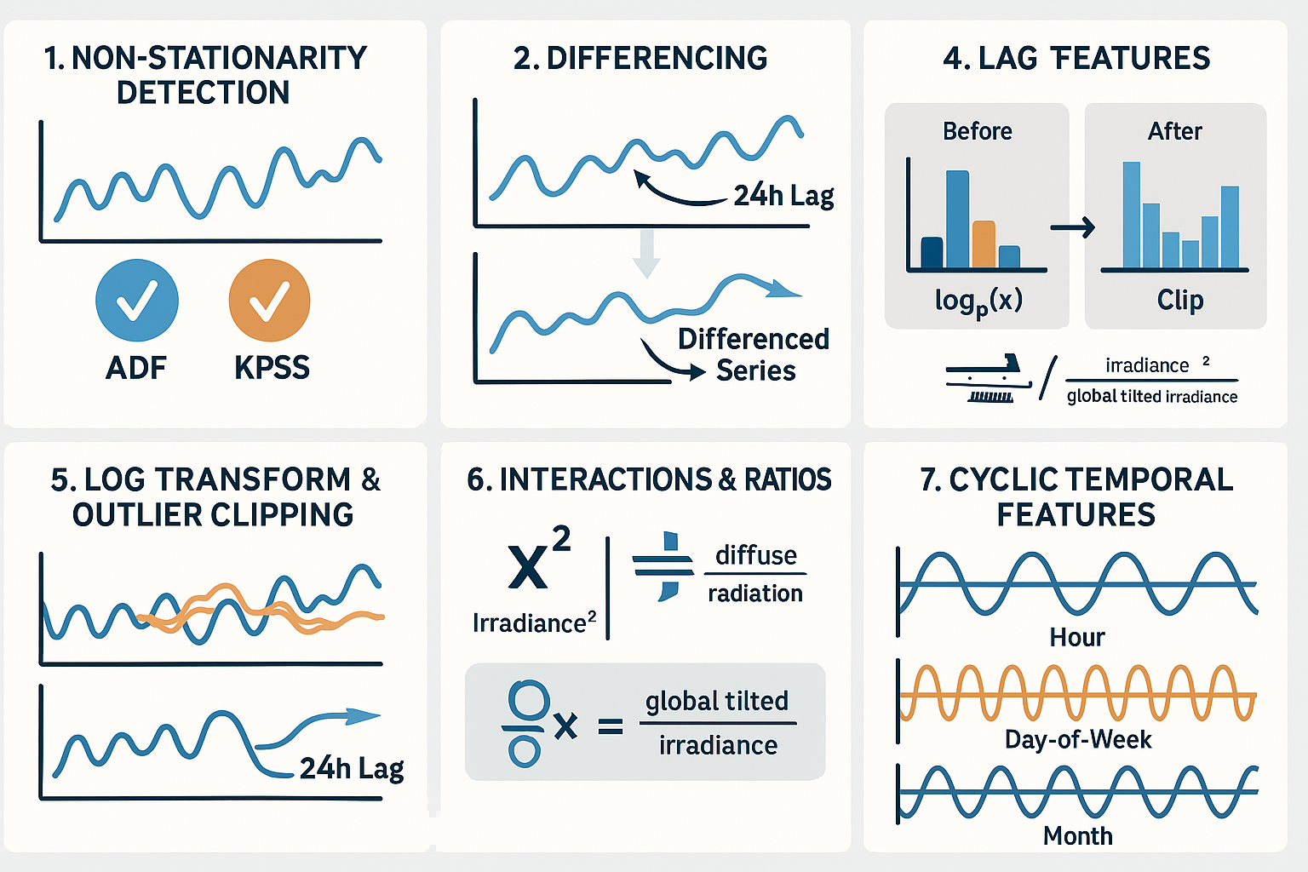

Slide 3
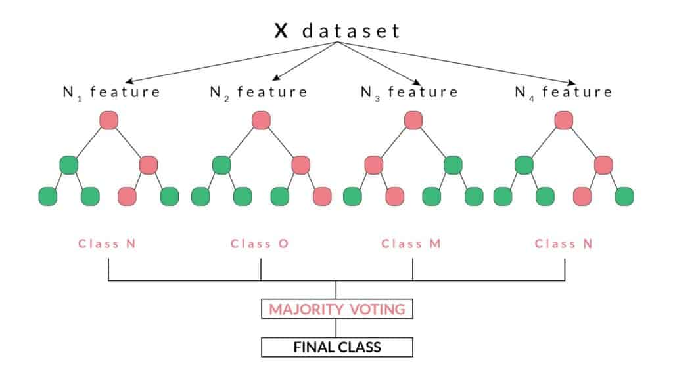
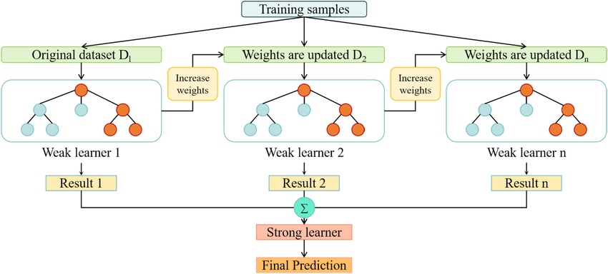
RandomForestRegressor
XGBRegressor

Slide 4
Since the location (18.2158, -71.0998) is in the Caribbean, Open-Meteo typically uses global models like GFS (Global Forecast System) from NOAA, or sometimes ICON (Icosahedral Nonhydrostatic Model) from the DWD, for their "best_match" forecasts in regions not covered by very high-resolution local models. Given the global nature and forecast length (up to 16 days), GFS is a very strong candidate.

Slide 5
