Slide 1

input
Conditional expressions if,elsif,else and ifelse()
If(condition 1)
TRUE
FALSE
Then
Else, if
Instructions
elseif (condition 2)
TRUE
FALSE
Then
Else
instructions
else()
instructions
output

Slide 2
Switch
input
x
= x1,x2…xn
x
x
Element 1
Expresion
Elemento n
Element 1
Element 3
Element 2
Element 2
Element 1
Element 2
Element 3
Element 3
x̄(x)
Md(x)
s(x)
x̄
Md
s
Action
output

Slide 3

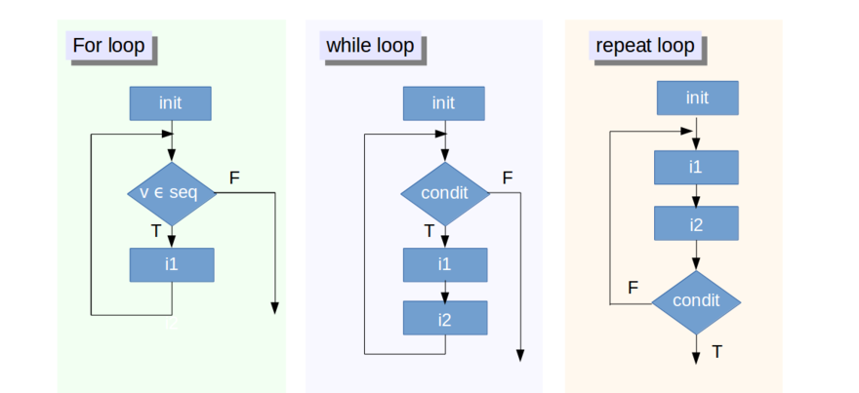
Loops
x
= 1,2,3,4,5
= 1
= 1
x
x
x
x
x
i in x
x<6
print(x)
Skip x=3
x = x+1
T
if (val == 3)
{next}
print(i)
print(i)
if(x == 6)
{break}
F
i = i+1
print(i)
End of loop
[1]1
[1]2
[1]3
[1]4
[1]5
[1]1
[1]2
[1]3
[1]4
[1]5
[1]1
[1]2
[1]4
[1]5
End of loop
[1]1
[1]2
[1]3
[1]4
[1]5
End of loop

Slide 4
Nested FOR loop
i = 2
For (i in 1:2)
i = 1
i = 0
j = 3
j = 2
j = 1
For (j in 1:3)
j = 0

Slide 5
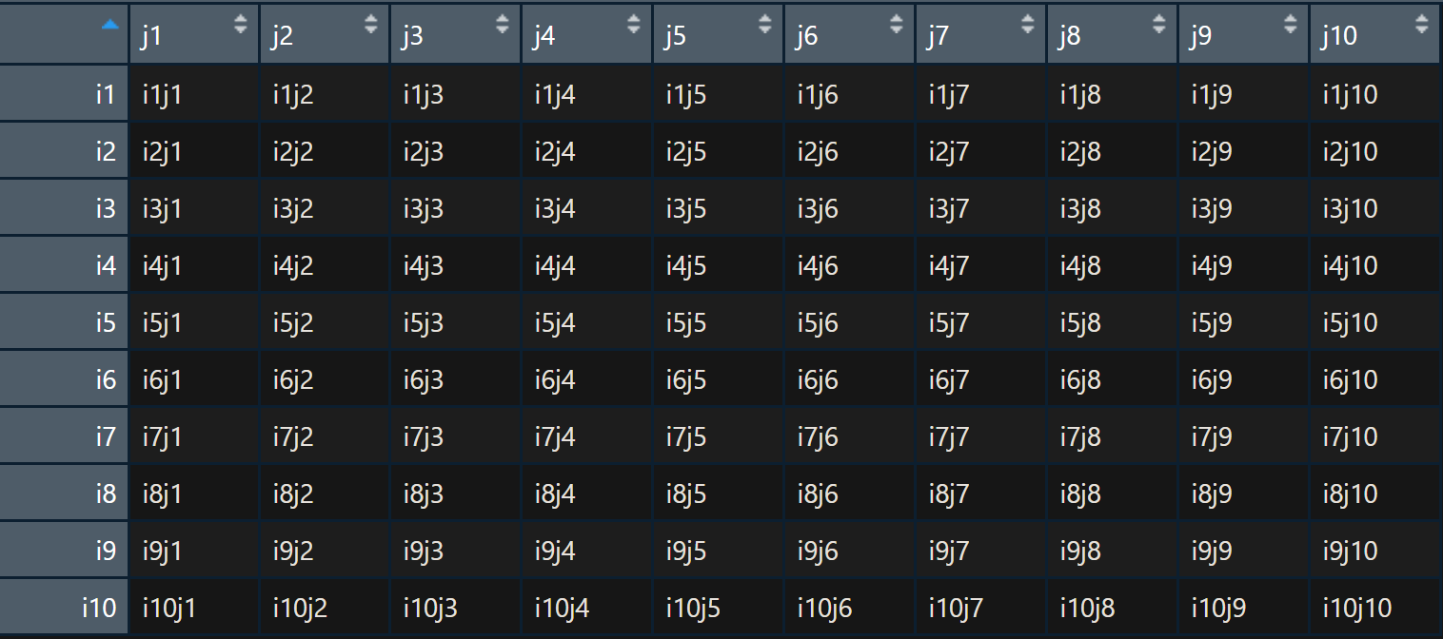

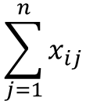
apply()
2
MARGIN
X
> apply(x,1,sum)
1
$$\sum_{j=1}^{n}{x_{ij}}$$
> apply(x, 2, mean)
$$\overline{X_{jn}}=\frac{\sum_{i=1}^{n}{X_{ij}}}{n}$$

Slide 6
lapply()
mat.l
1 2 3
2
A
A
result
1 2 3
2
B
lapply(mat.l,function(x) x[,2])
B
1 2 3
C
2
C

Slide 7
sapply()
mat.l
2 3
4 5 6
A
2 3
7 8 9
B
sapply(mat.l,function(x) x[2,2])
C(5,8,11)
2 3
10 11 12
C

Slide 8
mapply()
1 2 3
x
result
TRUE, TRUE, FALSE
mapply(identical,x,y)
1 2 4
y

