Slide 1

ML in Applications
Dipartimento di Automatica e Informatica
Politecnico di Torino, Torino, ITALY

Slide 2
Transformers

Slide 3
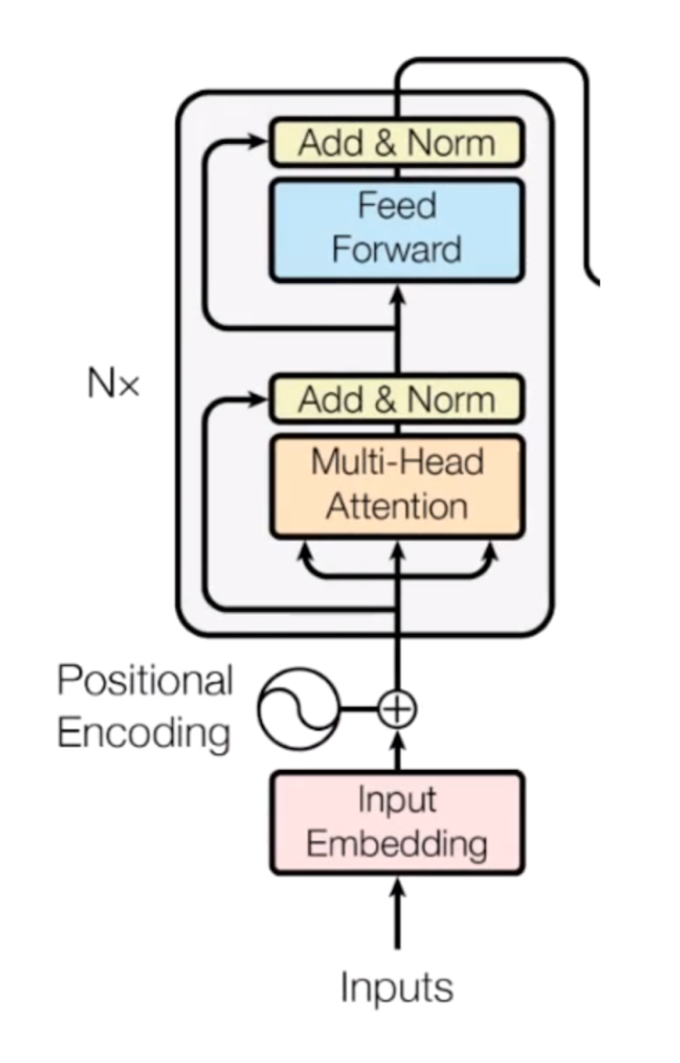
Transformers
A transformer is a type of artificial neural network architecture introduced in the landmark paper “Attention is all you need”.
It revolutionized the field of natural language processing by enabling state-of-the-art performance on various tasks. Transformers are designed to handle sequential data efficiently and have since been applied to almost every type of problem in machine learning

Slide 4
Why?
Recurrent and Convolutional layers reduce the number of parameters of Fully Connected layers but both make compromises with context range.
Transformer layers use less parameters than FC architectures yet retain the ability to model arbitrarily long range dependencies in the data

Slide 5
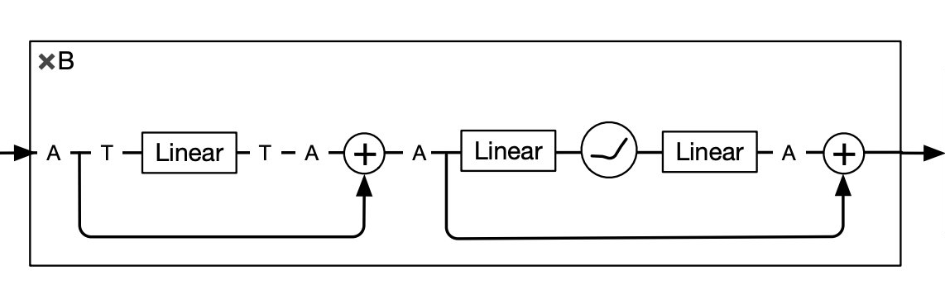
The idea behind Transformers
The idea is simple, let’s separate the spatial dimension from the feature dimension and process them in separate steps. Let’s assume we only use FC layers.
Imagine you have 1000 samples from 40 sensors.
A single FC layer would require (1000*40)^2=1,6B parameters
By separating the two dimensions and assigning a layer to each we only need 1000^2+40^2=1,16M parameters

Slide 6
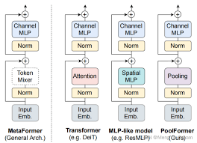
The idea behind Transformers
Countless architectures have been build from this idea, inspired by the success of the Transformer.
It’s powerful enough that all these techniques work well, regardless of what’s used on the spatial dimension

Slide 7
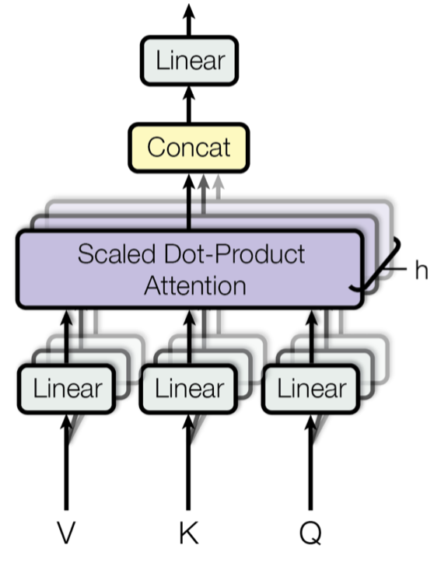
Attention as token mixer
The best accuracy is still given by the original Transformer, which introduces a mechanism named «Attention» to process the spatial dimension

Slide 8
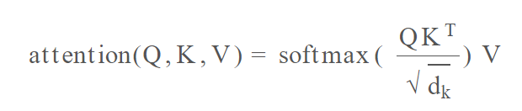
What is self attention
The original data is projected into three vectors using linear projection: Query, Key and Value though key and value can also be the same vector.
Query represents what the network is looking for, Key represents what each data point is. The final output is a weighted combination of the samples which are most similar to the query.

Slide 9
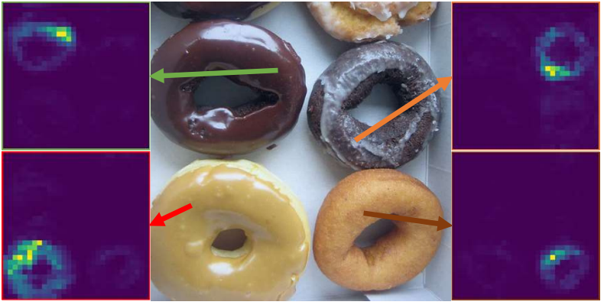
Multi Head attention
Multi-head attention is an extension of the self-attention mechanism, where the model uses multiple sets of query, key, and value projections to perform parallel attention computations. The results of the different attention heads are concatenated along the feature dimension and then passed through a linear layer to produce the final output.
The main advantage of multi-head attention is that it enables the model to simultaneously focus on different aspects of the input data, capturing a more diverse range of relationships and dependencies.

Slide 10
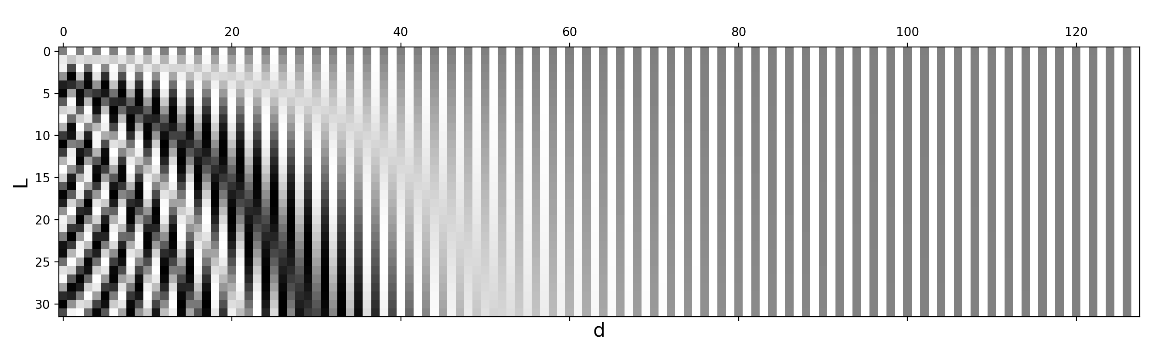
Attention and positional encoding
The attention mechanism has a flaw: it does not have any idea whether a sample is close or far in the spatial dimension.
This is because the self-attention mechanism processes the input data independently and does not consider the order or position of the input data. To overcome this limitation, positional encoding is used in transformers.
Positional encoding adds information about the position of each token in the sequence to the input embeddings before they are processed by the transformer layers. This allows the transformer to learn and maintain the order of the input sequence and recognize patterns that depend on the position of tokens in the sequence..

Slide 11
Attention and positional encoding
There are various ways to implement positional encoding, but the most common method involves adding sine and cosine functions with different frequencies to the input embeddings. These functions produce unique values for each position, ensuring that the transformer can accurately identify the position of tokens in the input sequence.

Slide 12
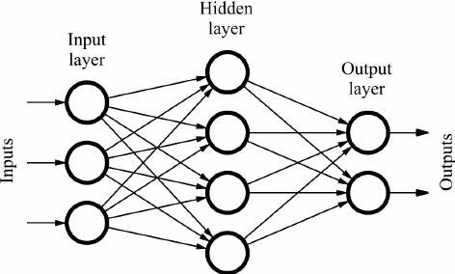
Features
In the transformer architecture, the features are handled by two FC layers with the first having 4x as many neurons as the second and a non linear activation function in between. These layers are applied on each position (token) independently, performing the same operation for each token. This is also known as position-wise feedforward layers.

Slide 13
Normalization
Layer Normalization is applied after the self-attention mechanism and the FC part within each layer of the transformer. It works by normalizing the input data across the feature dimension (instead of the batch dimension as in Batch Normalization). This means that for each sample in the sequence, the mean and standard deviation are computed across its features, and then the data is normalized using these statistics.
Normalization in transformers serves several purposes:
1. It helps in stabilizing the training process by ensuring that the inputs to each layer have a consistent mean and variance, thus preventing the vanishing or exploding gradients problem.
2. It can improve the convergence speed of the model, as the optimizer has to deal with a more well-conditioned optimization landscape.
3. It can also act as a form of regularization, reducing overfitting and improving generalization.

