Slide 1

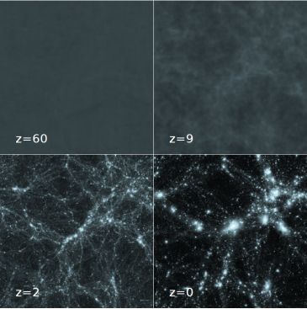
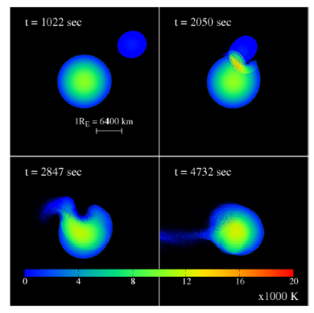
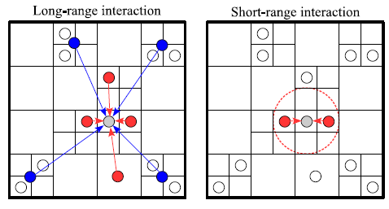
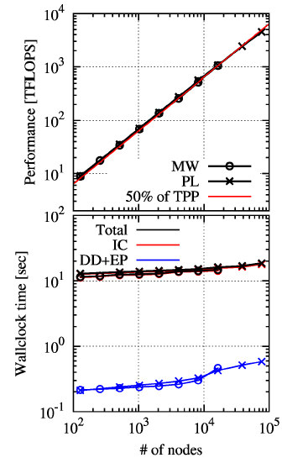
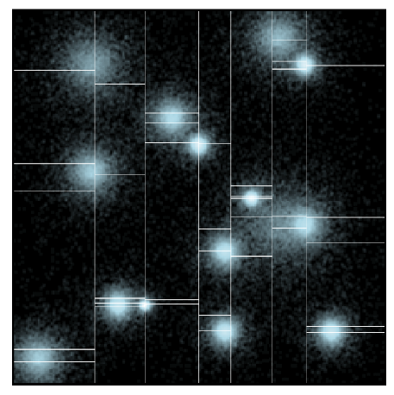
Particle Simulator
Research Team
Team Leader
Junichiro Makino
jmakino@riken.jp
We have developed FDPS (Framework for Developing Particle Simulator), a universal software application that can be used to write high-performance, particle-based simulations.
AAAAAAAAAAAAAAAAA
https://github.com/FDPS/FDPS
The Design
Applications
FDPS is a C++ header library. A user of FDPS can develop the simulation code in the following three steps:
Below are visualizations of cosmological structure formation simulations with gravity code (left) and planet collision simulations with smoothed-particle hydrodynamics code (right), both implemented using FDPS:
Define the data structure for the single particle, as a class in C++ language.
Define the interaction function f, that receives arrays of interacting particles, and calculates and accumulates the force on the particles.
Write the main program using the data class and functions provided by FDPS.
The Implementation
Performance
The right figures show the performance of the gravity code, measured in the flops (top) and wall-clock-per-timestep (bottom), as functions of the number of nodes. The code scales up to 76,544 nodes while keeping 50% of the theoretical peak performance, on the K computer.
FDPS handles long-range interactions by Burnes-Hut algorithm, and short-range interactions by tree-search based neighbor list. FDPS takes care of inter-node (MPI) and intra-node (OpenMP) communications, and load balancing. FDPS adopts three-dimensional multi-section domain decomposition, that is used in Gordon-Bell-prize-winning particle simulator GreeM.
The user code computes over small, local subset of particles that FDPS prepares for you. The user still have to SIMD-ize their codes, but auto-vectorization are often good enough for such small codes.
Getting Started
FDPS is open-sourced under MIT license at
https://github.com/FDPS/FDPS
Tutorials, specifications, and ready-to-run example programs are found in the above URL.
With FDPS, our dream of letting one-core programmers to utilize large-scale supercomputers had come true, for particle simulation applications.
Figure: An Example of 7x6 domain decomposition.

Slide 2
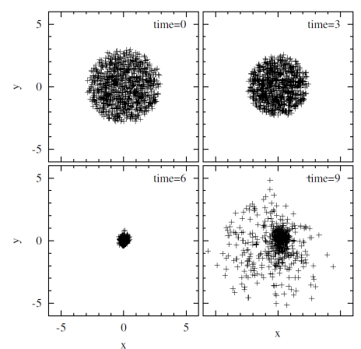
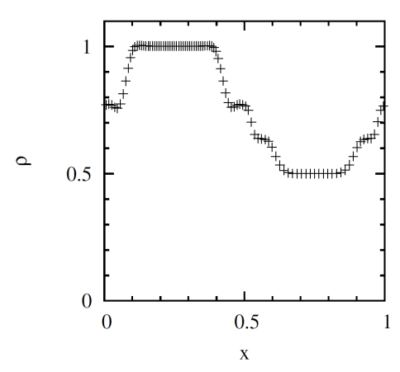
Getting Started with FDPS
c.f. The FDPS tutorial available from https://github.com/FDPS/FDPS: https://github.com/FDPS/FDPS/blob/master/doc/doc_tutorial_e.pdf
# Download FDPS via Git
$ git clone git://github.com/FDPS/FDPS.git
-- or --
# Download FDPS via SVN
$ svn co --depth empty https://github.com/FDPS/FDPS
$ cd FDPS
$ svn up trunk
# Build and Run the N-body example
$ cd $(FDPS)/sample/nbody/
$ make
$ ./nbody.out
$ gnuplot
> plot “result/0009.dat” using 3:4
Here, $(FDPS) is the directory where you have downloaded FDPS.
# Build and Run the Smoothed Particle Hydro example
$ cd $(FDPS)/sample/sph/
$ make
$ ./sph.out
$ gnuplot
> plot “result/0040.dat” using 3:9
# N-body example with OpenMP & MPI
Edit the Makefile :
Set the variable CC to your MPI C++ compiler
Uncomment the line CFLAGS += -DPARTICLE_SIMULATOR_THREAD_PARALLEL -fopenmp
Uncomment the line CFLAGS += -DPARTICLE_SIMULATOR_MPI_PARALLEL
Then
$ make
$ $(MPIRUN) –np $(NPROC) ./nbody.out
Here, $(MPIRUN) is the name of your MPI job launcher (mpirun or mpiexec depending on your MPI configuration), and $(NPROC) is the number of processes you want to use.

