Slide 1
Topic mODELING
lAtent Dirichlet ALLOCATION

Slide 2
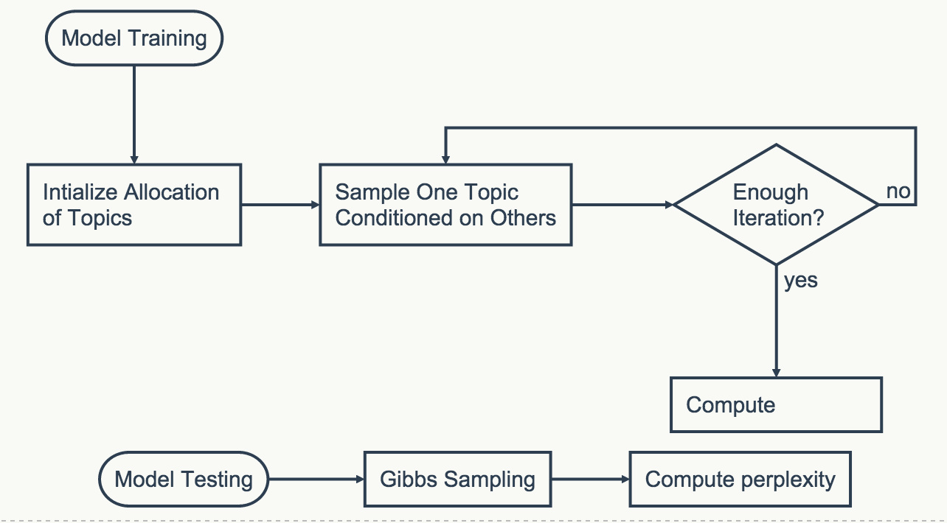

Implement via gibbs sampling
Why Gibbs Sampling instead of Variational Bayes?
The main procedure:
$φ$, Save z

Slide 3
Collaborative FILTERING
Recommendation Systems
Using Predictive Perplexity to conduct model selection
Using data from MovieLens
2000 entries, 1800 for training, 200 for testing

Slide 4
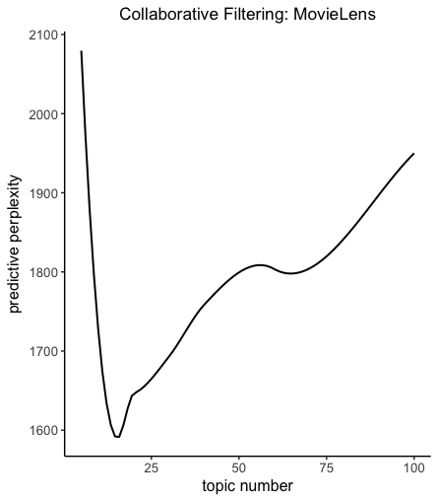
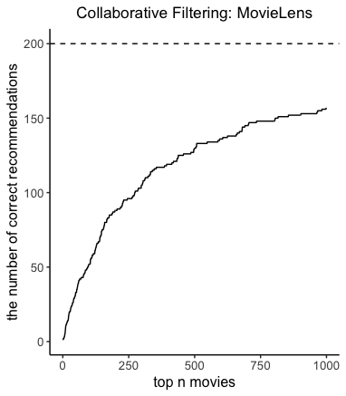
Collaborative FILTERING

Slide 5
Collaborative FILTERING
Other things need to be done:
More Reliable metrics
Usage of Collaborative filtering

