Slide 1
Bilinear Attention Networks
Jin-Hwa Kim, Jaehyun Jun, Byoung-Tak Zhang
Seoul National University
Reporter
Zheng Wang
17110240005@fudan.edu.cn

Slide 2
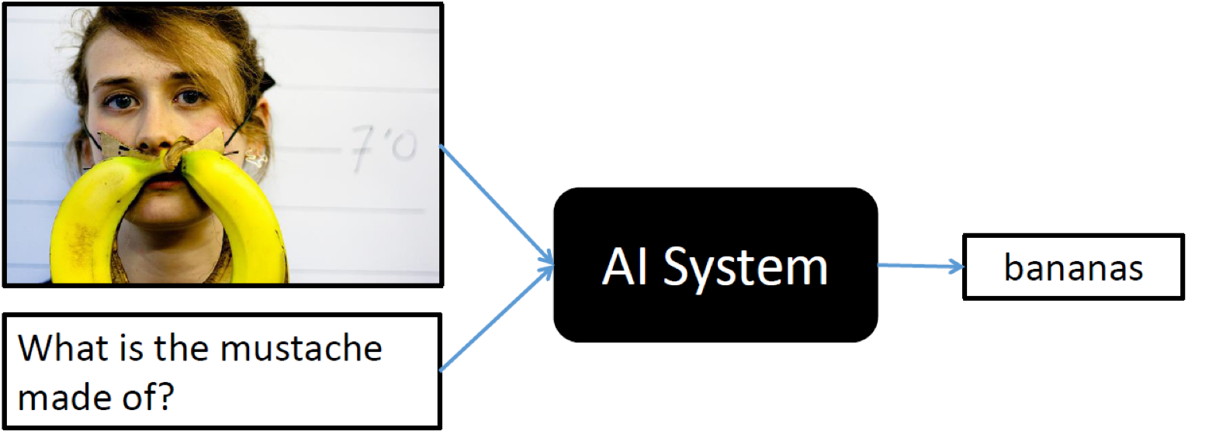
Visual Question Answering
Learning joint representation of multiple modalities
Linguistic and visual information

Slide 3
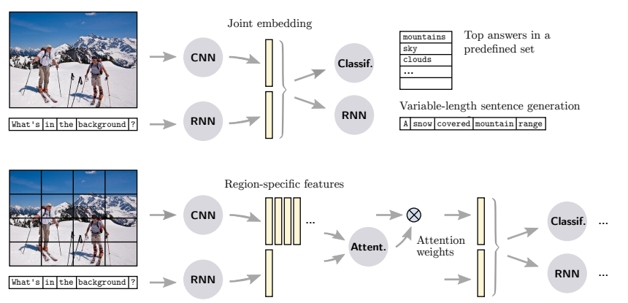
Visual Question Answering

Slide 4
Objective
Introducing bilinear attention
Interactions between words and visual concepts are meaningful
Proposing an efficient method (with the same time complexity) on top of low-rank bilinear pooling
Residual learning of attention
- Residual learning with attention mechanism for incremental inference

Slide 5
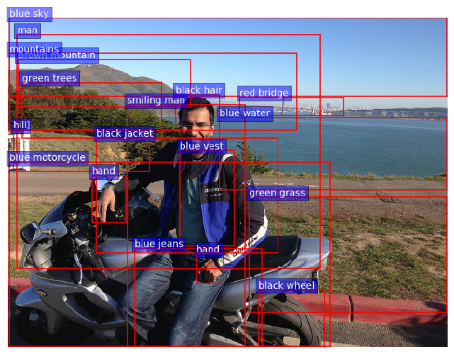
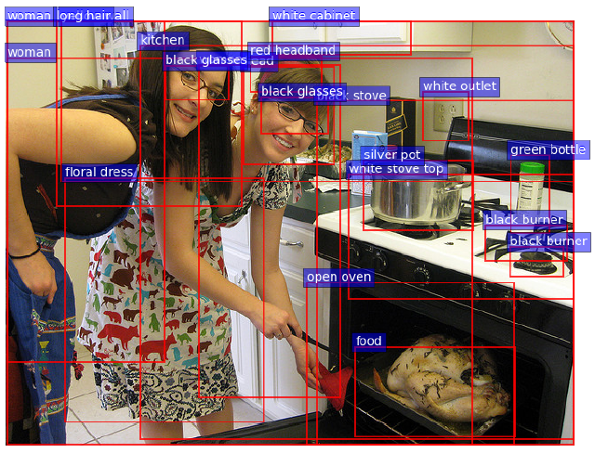

Preliminary
Question embedding (fine-tuning)
Use the all outputs of GRU (every time steps)
- $X∈R^{N×ρ}$where N is hidden dim., and $ρ=\left|{\{X}_{i}\}\right|$is # of tokens
Image embedding (fixed bottom-up-attention)

Slide 6
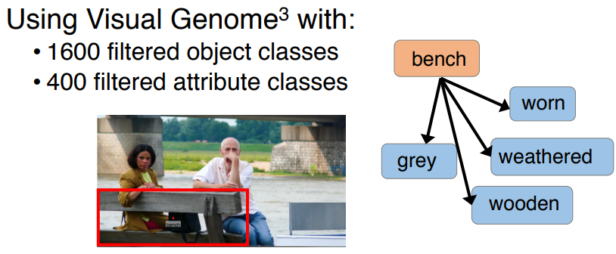
Preliminary
Question embedding (fine-tuning)
Use the all outputs of GRU (every time steps)
- $X∈R^{N×ρ}$where N is hidden dim., and $ρ=\left|{\{X}_{i}\}\right|$is # of tokens
Image embedding (fixed bottom-up-attention)

Slide 7
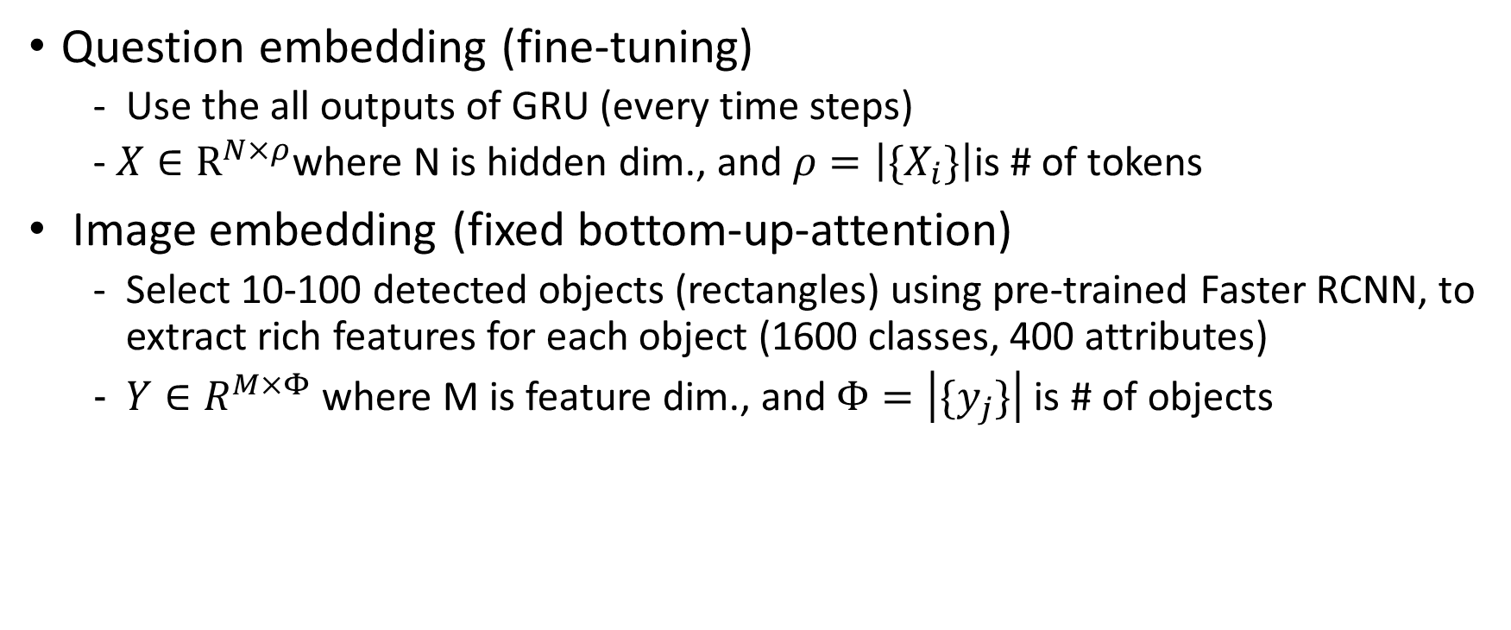
Preliminary
Question embedding (fine-tuning)
Use the all outputs of GRU (every time steps)
- $X∈R^{N×ρ}$where N is hidden dim., and $ρ=\left|{\{X}_{i}\}\right|$is # of tokens
Image embedding (fixed bottom-up-attention)
Select 10-100 detected objects (rectangles) using pre-trained Faster RCNN, to extract rich features for each object (1600 classes, 400 attributes)
$Y∈R^{M×Φ}$ where M is feature dim., and $Φ=\left|\{y_{j}\}\right|$is # of objects

Slide 8


Low-rank Bilinear Pooling
Bilinear model and its approximation (Wolf et al., 2007, Pirsiavash et al., 2009)
Low-rank bilinear pooling (Kim et al., 2017)
For vector output, instead of using three-dimensional tensors U and V, replace the vector of ones with a pooling matrix P (use three two-dimensional tensors).

Slide 9
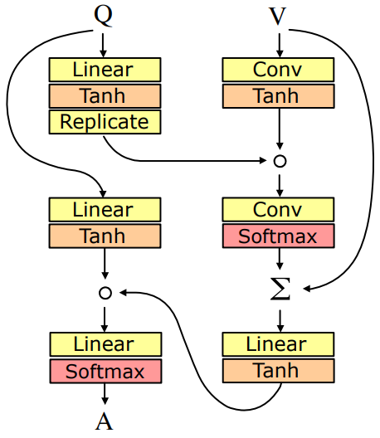

Unitary Attention
This pooling is used to get attention weights with a question embedding (single-channel) vector and visual feature vectors (multi-channel) as the two inputs.
We call it unitary attention since a question embedding vector queried the feature vectors, unidirectionally.

Slide 10
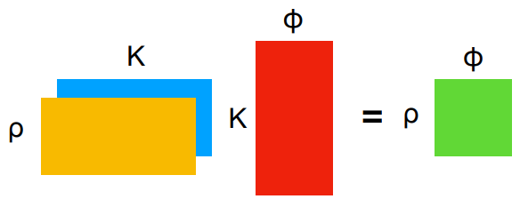
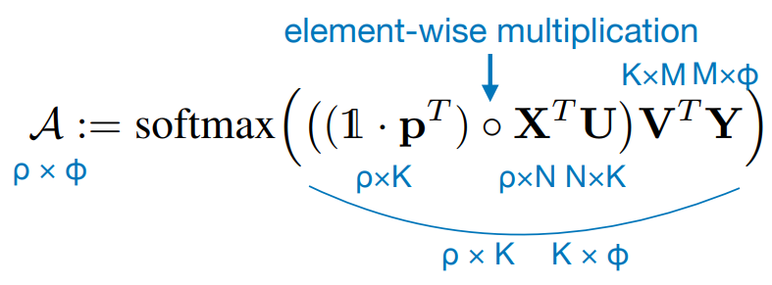
Bilinear Attention Maps
U and V are linear embeddings
p is a learnable projection vector

Slide 11
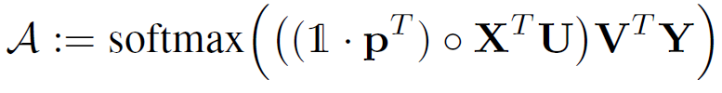

Bilinear Attention Maps
Exactly the same approach with low-rank bilinear pooling

Slide 12
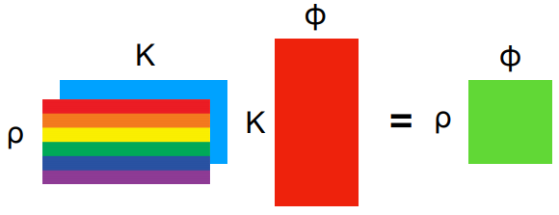

Multiple Bilinear Attention Maps
Exactly the same approach with low-rank bilinear pooling

Slide 13
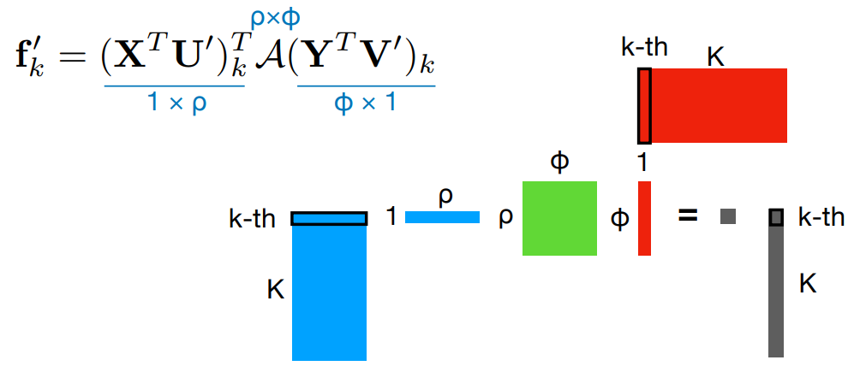
Bilinear Attention Networks
Each multimodal joint feature is filled with following equation (k is the index of K):

Slide 14
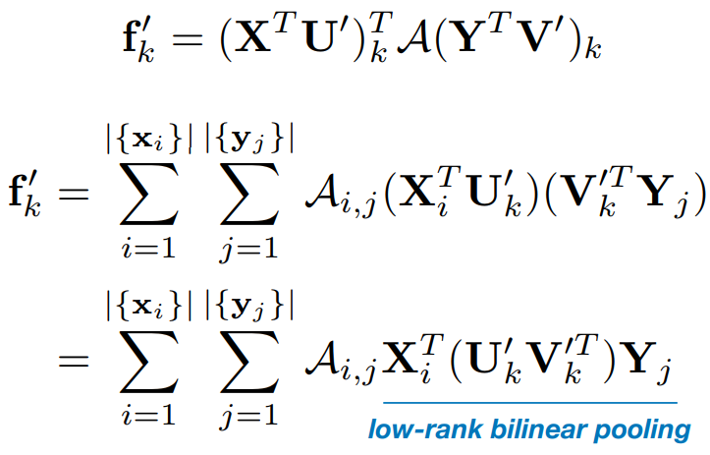
Bilinear Attention Networks
One can show that this is equivalent to a bilinear attention model where each feature is pooled by low-rank bilinear approximation

Slide 15
Bilinear Attention Networks
One can show that this is equivalent to a bilinear attention model where each feature is pooled by low-rank bilinear approximation
Low-rank bilinear feature learning inside bilinear attention

Slide 16
Bilinear Attention Networks
One can show that this is equivalent to a bilinear attention model where each feature is pooled by low-rank bilinear approximation
Low-rank bilinear feature learning inside bilinear attention
Similarly to MLB (Kim et al., ICLR 2017), activation functions can be applied

Slide 17
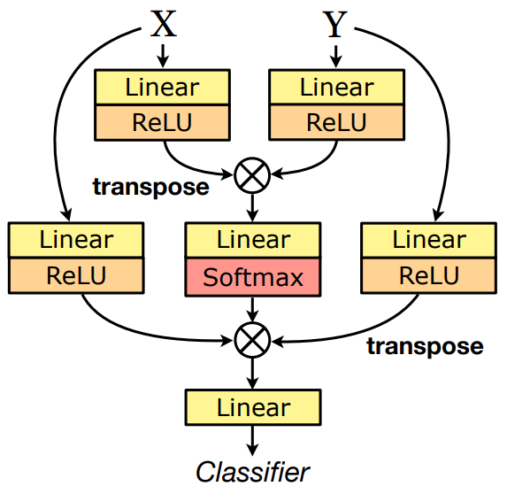
Bilinear Attention Networks

Slide 18
Bilinear Attention Networks

Slide 19
Time Complexity
Assuming that M ≥ N > K > φ ≥ ρ, the time complexity of bilinear attention networks is O(KMφ) where K denotes hidden size, since BAN consists of matrix chain multiplication
Empirically, BAN takes 284s/epoch while unitary attention control takes 190s/epoch
Largely due to the increment of input size for Softmax function, φ to φ × ρ

Slide 20
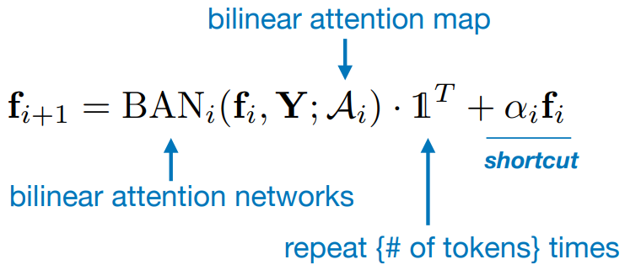

Residual Learning of Attention
Residual learning exploits multiple attention maps ($f_{0}$is X and {$α_{i}$} is fixed to ones):

Slide 21
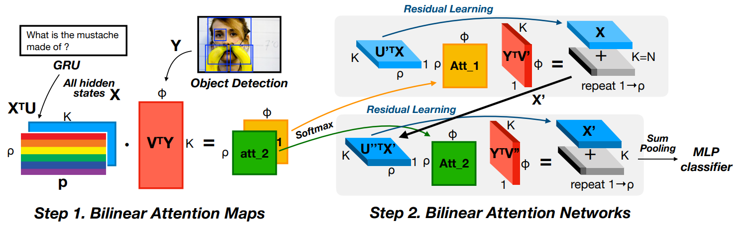
Overview
After getting bilinear attention maps, we can stack multiple BANs.

Slide 22
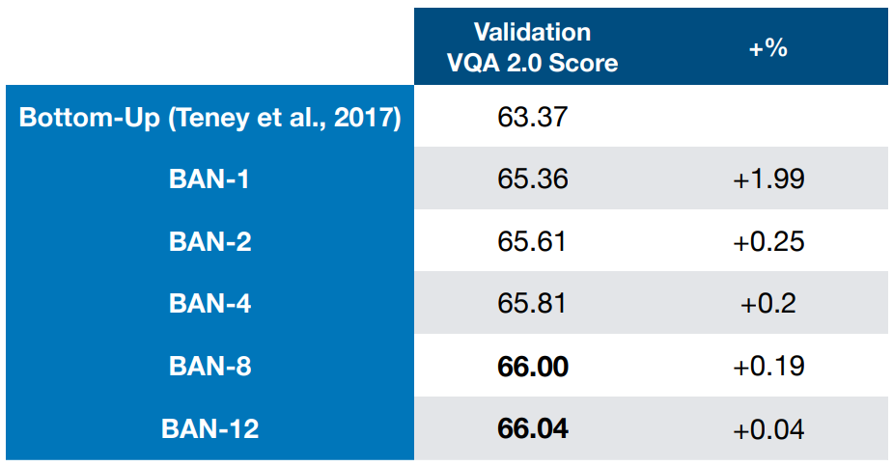
Multiple Attention Maps
Single model on validation score

Slide 23
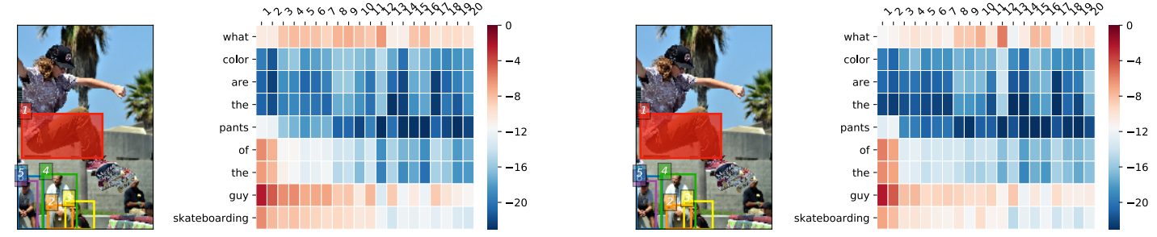
Visualization

Slide 24
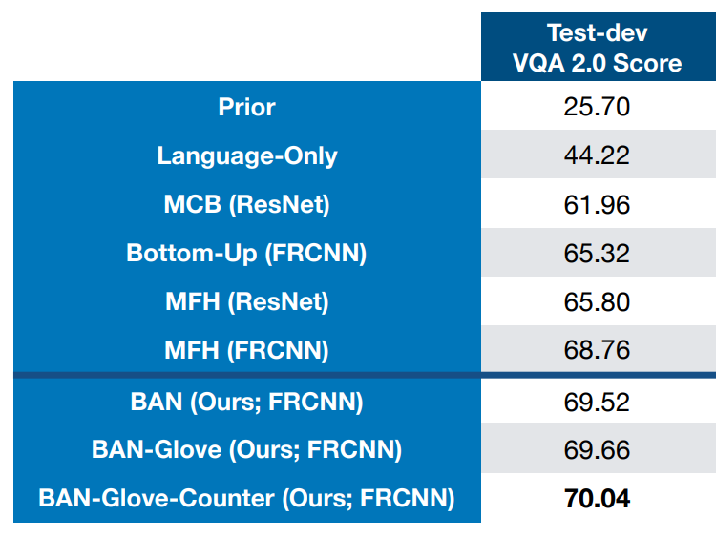
Comparison with State-of-the-arts
Single model on test-dev score

Slide 25
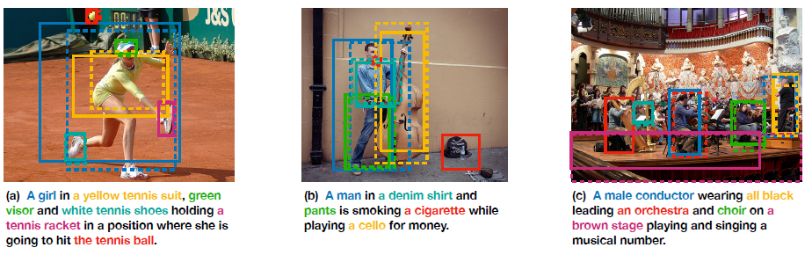
Flickr30k Entities
Visual grounding task — mapping entity phrases to regions in an image

Slide 26
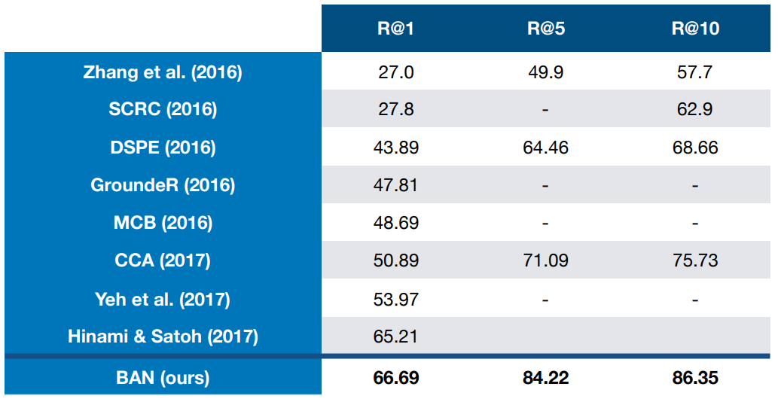
Flickr30k Entities Recall@1,5,10

Slide 27
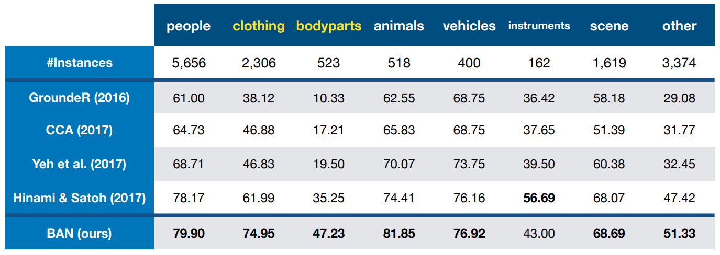
Flickr30k Entities Recall@1,5,10

Slide 28
Conclusions
Bilinear attention networks gracefully extends unitary attention networks,
as low-rank bilinear pooling inside bilinear attention.
Furthermore, residual learning of attention efficiently uses multiple attention maps.

