Slide 1

Relational inductive biases, deep learning, and graph networks
Peter W. Battaglia^{1*} , Jessica B. Hamrick¹ , Victor Bapst¹ ,
Alvaro Sanchez-Gonzalez¹ , Vinicius Zambaldi¹ , Mateusz Malinowski¹ , Andrea Tacchetti¹ , David Raposo¹ , Adam Santoro¹ , Ryan Faulkner¹ , Caglar Gulcehre¹ , Francis Song¹ , Andrew Ballard¹ , Justin Gilmer² , George Dahl² , Ashish Vaswani² , Kelsey Allen³ , Charles Nash⁴ , Victoria Langston¹ , Chris Dyer¹ , Nicolas Heess¹ , Daan Wierstra¹ , Pushmeet Kohli¹ , Matt Botvinick¹ , Oriol Vinyals¹ , Yujia Li¹ ,
Razvan Pascanu¹
¹DeepMind; ²Google Brain; ³MIT; ⁴University of Edinburgh
11 Jun 2018
魏彤18210240206

Slide 2


Introduction
Relational inductive biases
Graph networks
Design principles for GN
content
Discussion

Slide 3
Introduction
A key signature of human intelligence is the ability to make “infinite use of finite means”, in which a small set of elements (such as words) can be productively composed in limitless ways (such as into new sentences).
Notes:
the principle of combinatorial generalization

Slide 4
Introduction
Build artificial systems which exhibit combinatorial generalization
Example for past approaches
relational reinforcement learning
statistical relational learning
Notes:
data and computing resources were expensive

Slide 5
Introduction
modern deep learning methods
end-to-end
avoid explicit structure and “hand-engineering”
challenges of modern deep learning methods
complex language and scene understanding
reasoning about structured data
learning from small amounts of experience
Notes:
cheap data and cheap computing resources
combinatorial generalization
why

Slide 6
Introduction
Humans’ capacity for combinatorial generalization depends critically on our cognitive mechanisms for representing structure and reasoning about relations.
Here we explore how to improve modern AI’s capacity for combinatorial generalization by biasing learning towards structured representations and computations, and in particular, systems that operate on graphs.
Notes:
cheap data and cheap computing resources
combinatorial generalization
why

Slide 7
Introduction
Relational inductive biases
Graph networks
Design principles for GN
content
Discussion
Notes:
Relational reasoning

Slide 8
Relational
Inductive
biases
entity
An entity is an element with attributes.
Relational reasoning
relation
A relation is a property between entities.
rule
A rule is a function that maps entities and relations to other entities and relations
Notes:
product of composing a set of known building blocks

Slide 9
Relational
Inductive
biases
Above
Top
Middle
Bottom
Above
Above
Taller
Taller
Bob
Tom
Peter
Taller
Structured representations
Structured computations
Notes:
product of composing a set of known building blocks

Slide 10
Relational
Inductive
biases
Inductive biases
An inductive bias allows a learning algorithm to prioritize one solution (or interpretation) over another, independent of the observed data.
Example
choice and parameterization of module
regularization to avoid overfitting
Notes:
人为强加的

Slide 11
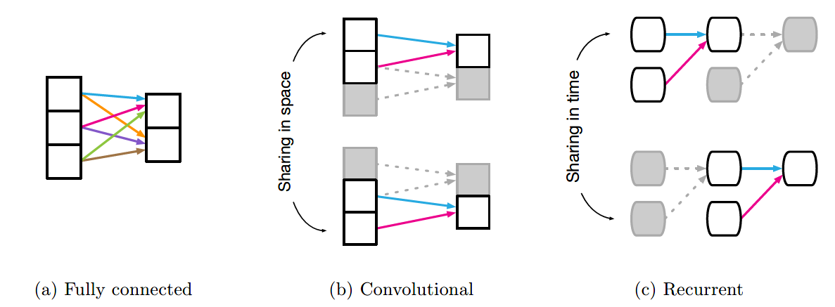
Relational
Inductive
biases
Relational inductive biases in standard deep learning building blocks
Component | Entities | Relations | Rel. inductive bias | Invariance
Fully connected | Units | All-to-all | Weak | -
Convolutional | Grid elements | Local | Locality | Spatial translation
Recurrent | Timesteps | Sequential | Sequentiality | Time translation
Graph network | Nodes | Edge | Arbitrary | Node, edge permutations

Slide 12
Introduction
Relational inductive biases
Graph networks
Design principles for GN
content
Discussion
Notes:
Relational reasoning

Slide 13
Graph
networks
Background
Neural networks that operate on graphs, and structure their computations accordingly, have been developed and explored extensively for more than a decade under the umbrella of “graph neural networks” , but have grown rapidly in scope and popularity in recent years.
application
visual scene understanding tasks
few-shot learning
predict the chemical properties of molecules
Notes:
under the umbrella of “graph neural networks” 2005
the breadth of domains

Slide 14
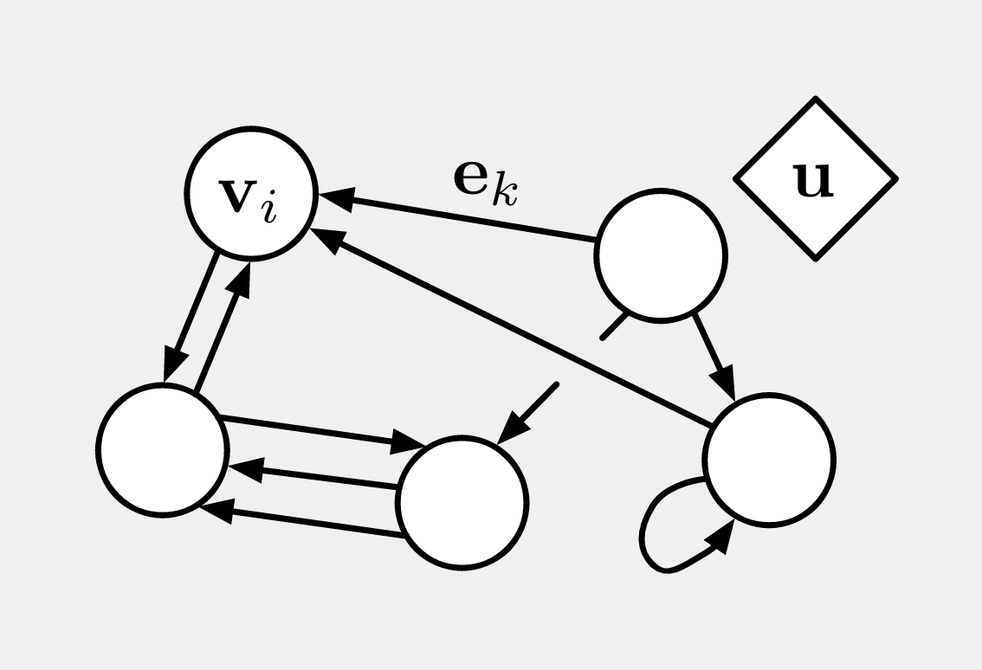
Graph
networks
Graph network (GN) block
graph-to-graph
customizability
Entities
nodes
Relations
edges
Rule
function

Slide 15
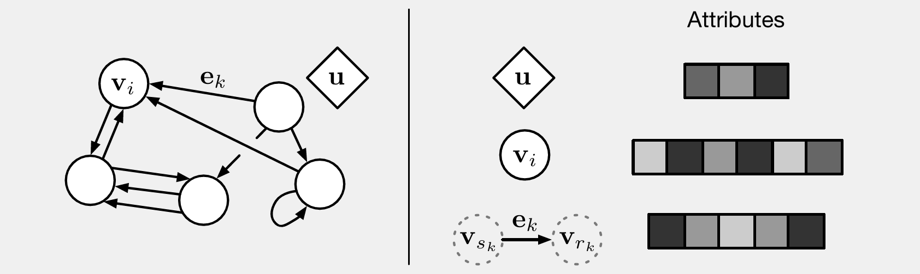
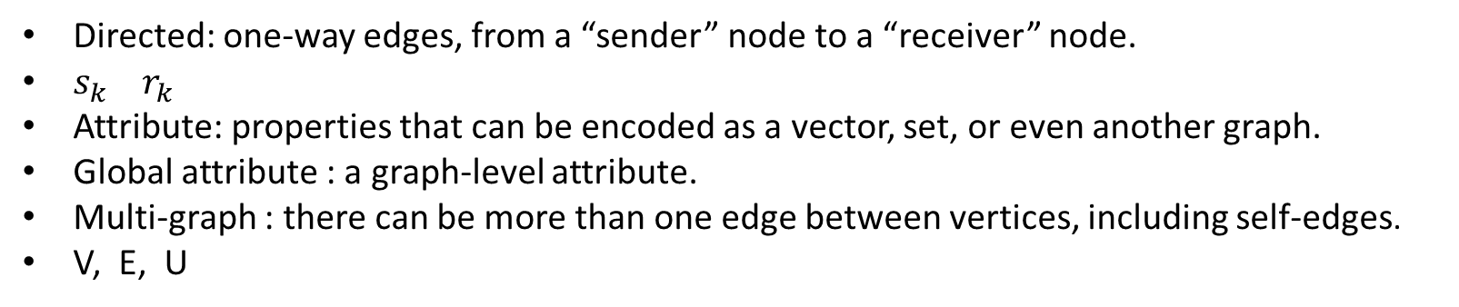
Graph
networks
Directed: one-way edges, from a “sender” node to a “receiver” node.
$s_{k} r_{k}$
Attribute: properties that can be encoded as a vector, set, or even another graph.
Global attribute : a graph-level attribute.
Multi-graph : there can be more than one edge between vertices, including self-edges.
V, E, U

Slide 16
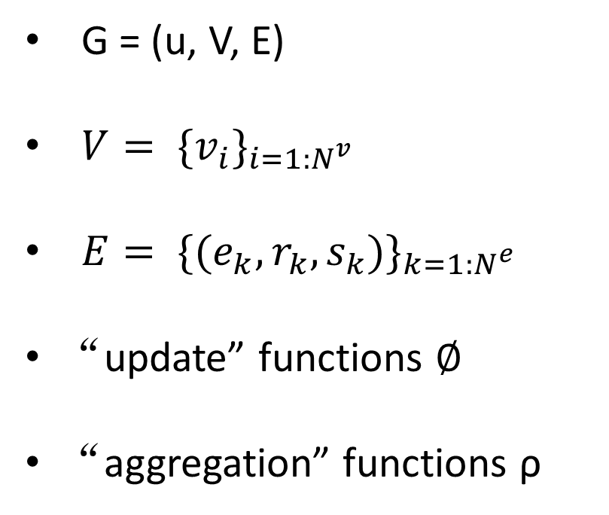
Graph
networks
Steps of computation in a full GN block.
G = (u, V, E)
$V= {\{v_{i}\}}_{i=1:N^{v}}$
$E= {\{(e_{k},r_{k},s_{k})\}}_{k=1:N^{e}}$
“update” functions $∅$
“aggregation” functions ρ
Notes:
重力

Slide 17
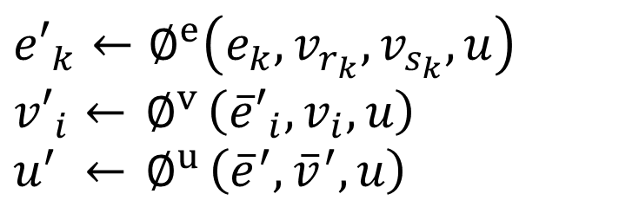
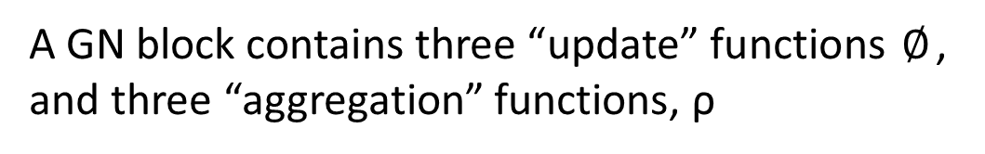
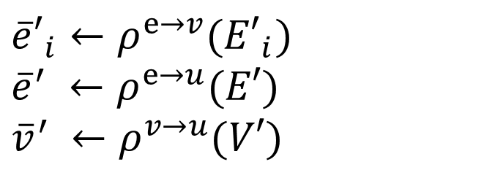
Graph
networks
Steps of computation in a full GN block.
A GN block contains three “update” functions $∅$, and three “aggregation” functions, ρ
$${e′}_{k}←∅^{e}\left(e_{k},v_{r_{k}},v_{s_{k}},u\right)$$
$${v′}_{i}←{ ∅}^{v}\left({\overline{e}′}_{i},v_{i},u\right)$$
$$u^{′} ←{ ∅}^{u}\left({\overline{e}}^{′},{\overline{v}}^{′},u\right)$$
$${\overline{e}′}_{i}←ρ^{e→v}({E′}_{i})$$
$${\overline{e}}^{′} ←ρ^{e→u}(E′)$$
$${\overline{v}}^{′} ←ρ^{v→u}(V′)$$
Crucially, the ρ functions must be invariant to permutations of their inputs, and should take variable numbers of arguments (e.g., elementwise summation, mean, maximum, etc.).

Slide 18
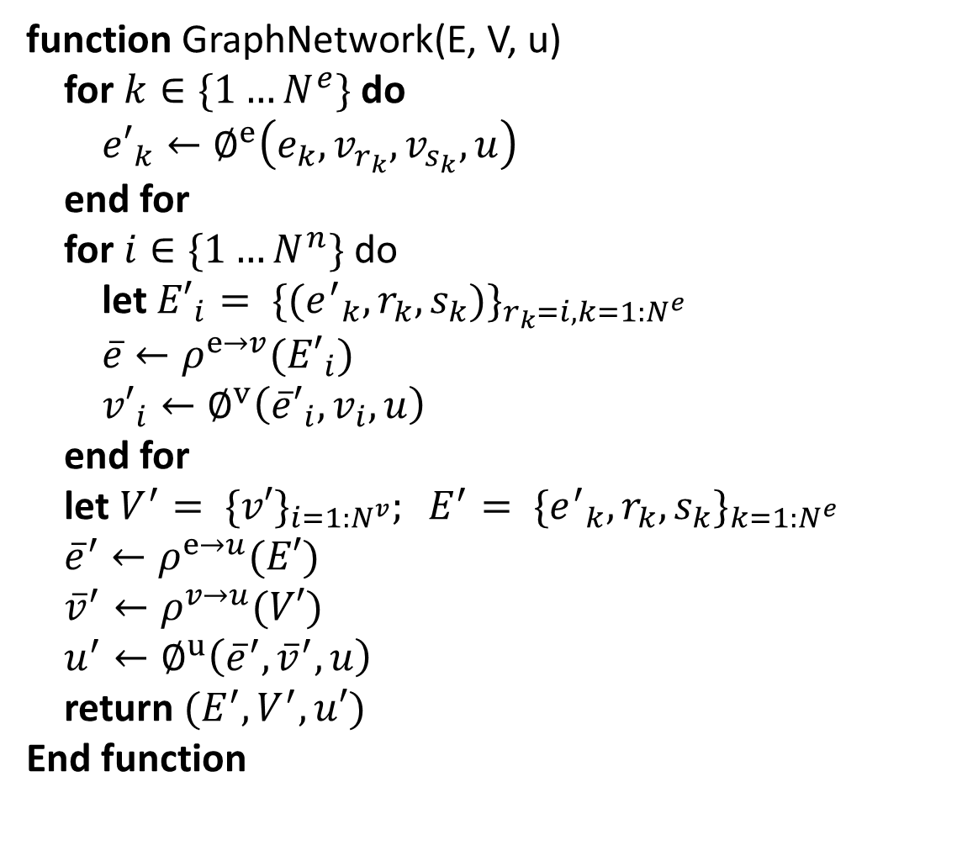
Steps of computation in a full GN block.
Graph
networks
function GraphNetwork(E, V, u)
for $k∈\{1…N^{e}\}$ do
${e′}_{k}←∅^{e}\left(e_{k},v_{r_{k}},v_{s_{k}},u\right)$
end for
for $i∈\{1…N^{n}\}$ do
let ${E′}_{i}= {\{({e^{′}}_{k},r_{k},s_{k})\}}_{r_{k}=i,k=1:N^{e}}$
$\overline{e}←ρ^{e→v}({E′}_{i})$
${v′}_{i}←∅^{v}\left({\overline{e}′}_{i},v_{i},u\right)$
end for
let $V^{′}= {\{v′\}}_{i=1:N^{v}}; E^{′}= {\{{e^{′}}_{k},r_{k},s_{k}\}}_{k=1:N^{e}}$
${\overline{e}}^{′}←ρ^{e→u}(E′)$
${\overline{v}}^{′}←ρ^{v→u}(V′)$
$u^{′}←∅^{u}\left({\overline{e}}^{′},{\overline{v}}^{′},u\right)$
return $(E^{′},V^{′},u′)$
End function
→1. Compute updated edge attributes
→2. Aggregate edge attributes per node
→3. Compute updated node attributes
→4. Aggregate edge attributes globally
→5. Aggregate node attributes globally
→6. Compute updated global attribute

Slide 19
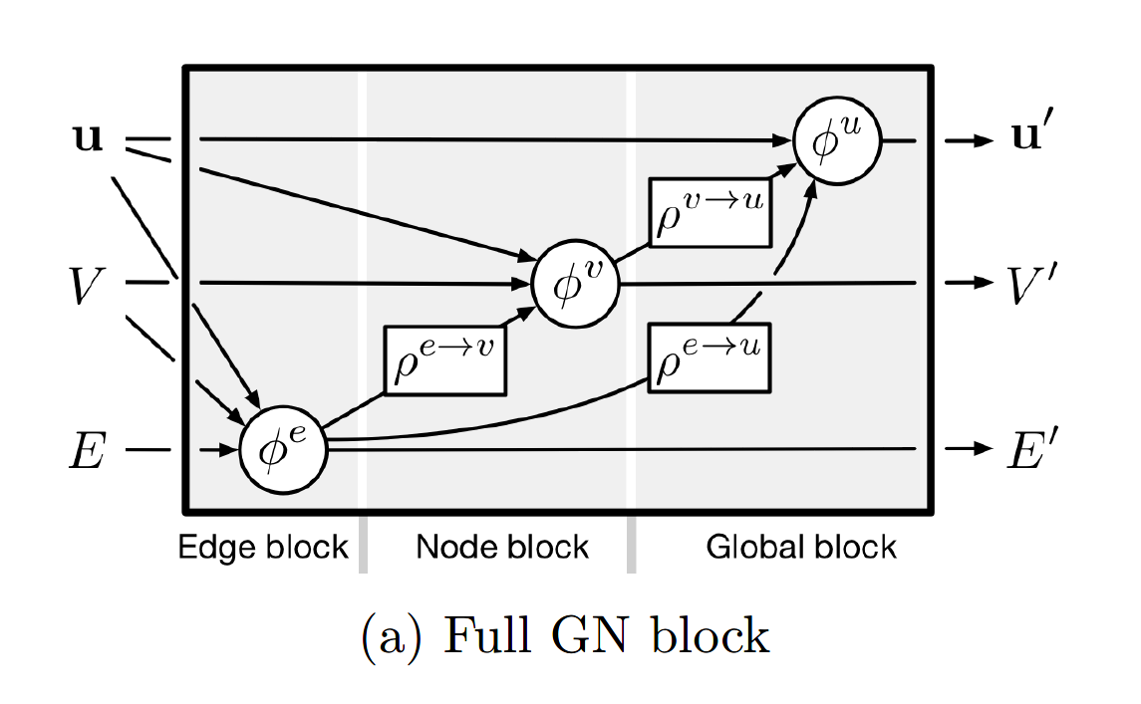
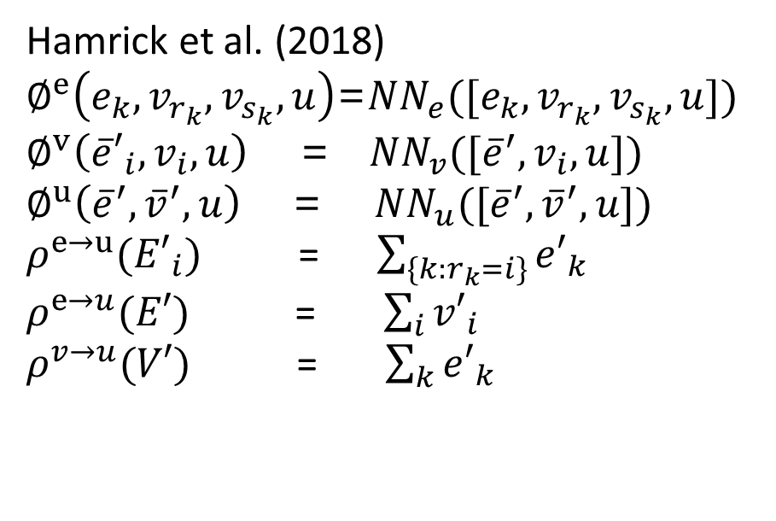
Graph
networks
Configurable within-block structure
Hamrick et al. (2018)
$∅^{e}\left(e_{k},v_{r_{k}},v_{s_{k}},u\right)$=${NN}_{e}([e_{k},v_{r_{k}},v_{s_{k}},u])$
$∅^{v}\left({\overline{e}′}_{i},v_{i},u\right)$ = ${NN}_{v}([{\overline{e}}^{′},v_{i}, u])$
$∅^{u}\left({\overline{e}}^{′},{\overline{v}}^{′},u\right)$ = ${NN}_{u}([{\overline{e}}^{′},{\overline{v}}^{′},u])$
$ρ^{e→u}({E′}_{i})$ = $\sum_{\{k:r_{k}=i\}}{{e′}_{k}}$
$ρ^{e→u}(E′)$ = $\sum_{i}{{v′}_{i}}$
$ρ^{v→u}(V′)$ = $\sum_{k}{{e′}_{k}}$

Slide 20
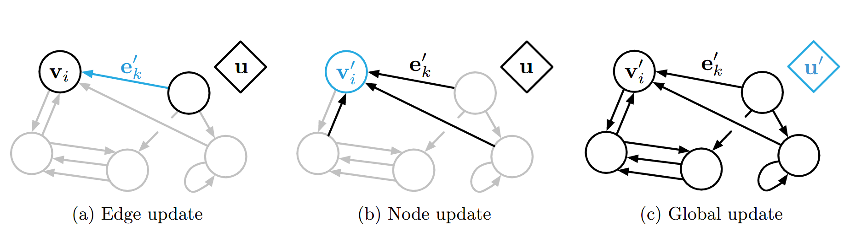
Graph
networks
Steps of computation in a full GN block.
Note, though we assume this sequence of steps here, the order is not strictly enforced: it is possible to reverse the update functions to proceed from global, to per-node, to per-edge updates.

Slide 21
Graph
networks
Relational inductive biases in graph networks
graphs can express arbitrary relationships among entities.
graphs represent entities and their relations as sets, which are invariant to permutations.
a GN’s per-edge and per-node functions are reused across all edges and nodes, respectively.

Slide 22
Introduction
Relational inductive biases
Graph networks
Design principles for GN
content
Discussion
Notes:
Relational reasoning

Slide 23
Design
principles
Design principles for GN
flexible representations
configurable within-block structure
composable multi-block architectures
Notes:
make decisions about interactions among entities
or example to reason about physical systems
predict the potential energy of a physical system
chemical road physical physical
systems systems

Slide 24
Design
principles
Flexible representations
Attributes
arbitrary representational formats
The output of a GN block can also be tailored to the demands of the task.
edge-focused
node-focused
graph-focused
mixed-and-matched
Notes:
make decisions about interactions among entities
example to reason about physical systems
predict the potential energy of a physical system
chemical road physical systems

Slide 25
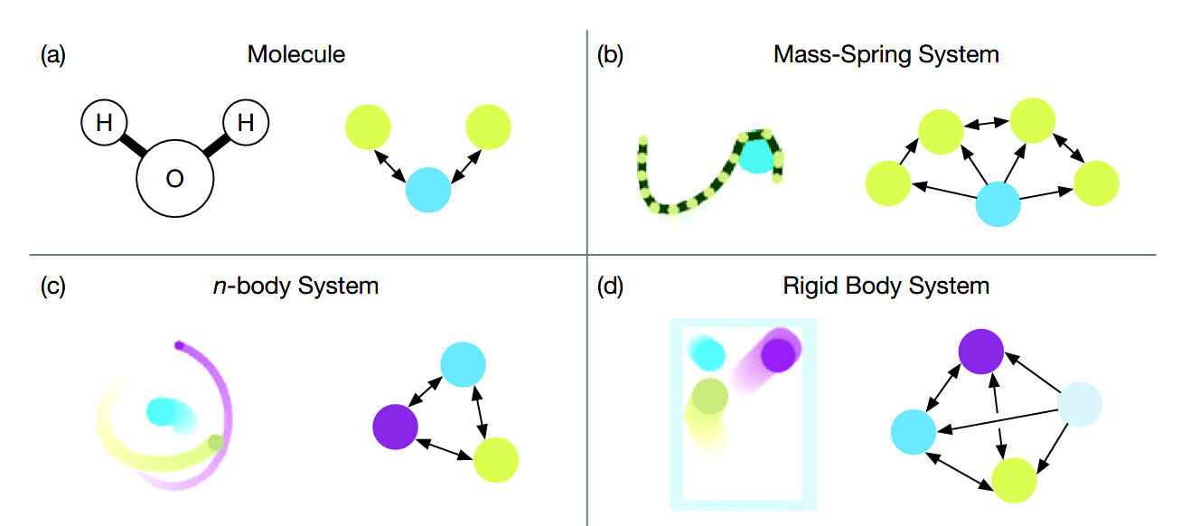
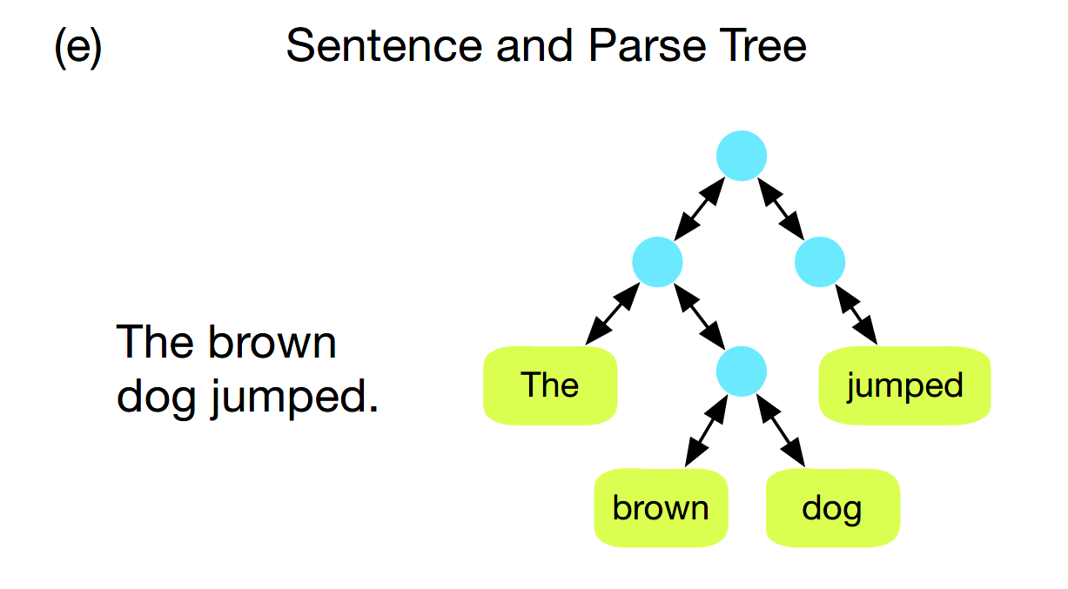
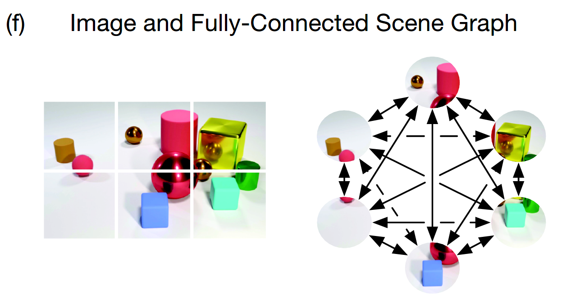
Design
principles
Flexible representations
Graph structure
explicit relational structure
the relational structure must be inferred or assumed
Notes:
make decisions about interactions among entities
example to reason about physical systems
predict the potential energy of a physical system
chemical road physical systems

Slide 26
Design
principles
Design principles for GN
flexible representations
configurable within-block structure
composable multi-block architectures

Slide 27
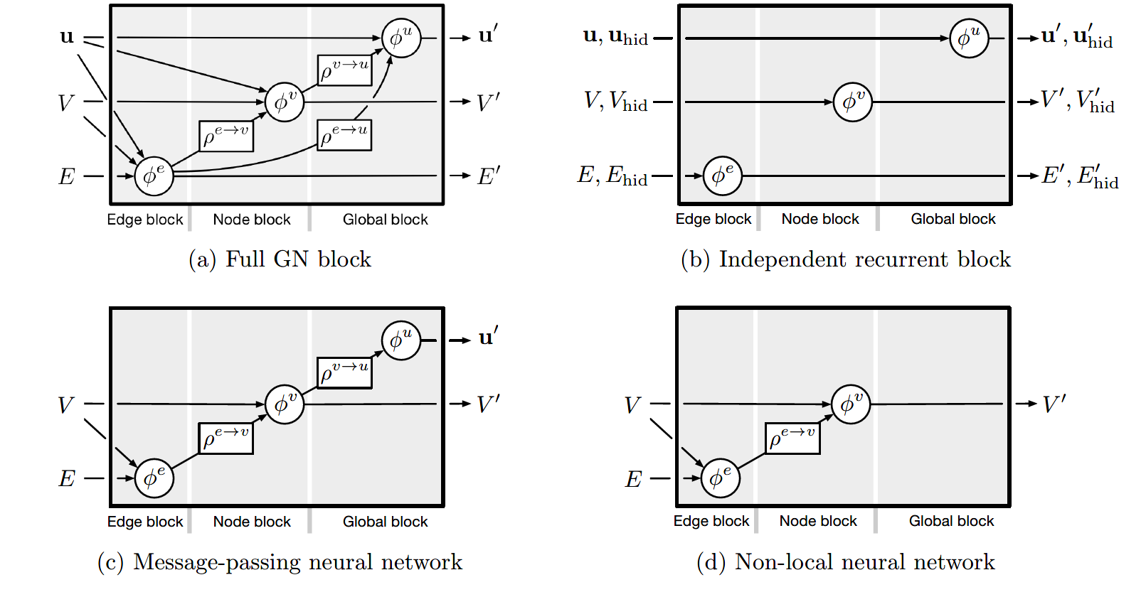
Design
principles
Configurable within-block structure

Slide 28
Design
principles
Design principles for GN
flexible representations
configurable within-block structure
composable multi-block architectures
Notes:
make decisions about interactions among entities
or example to reason about physical systems
predict the potential energy of a physical system
chemical road physical physical
systems systems

Slide 29
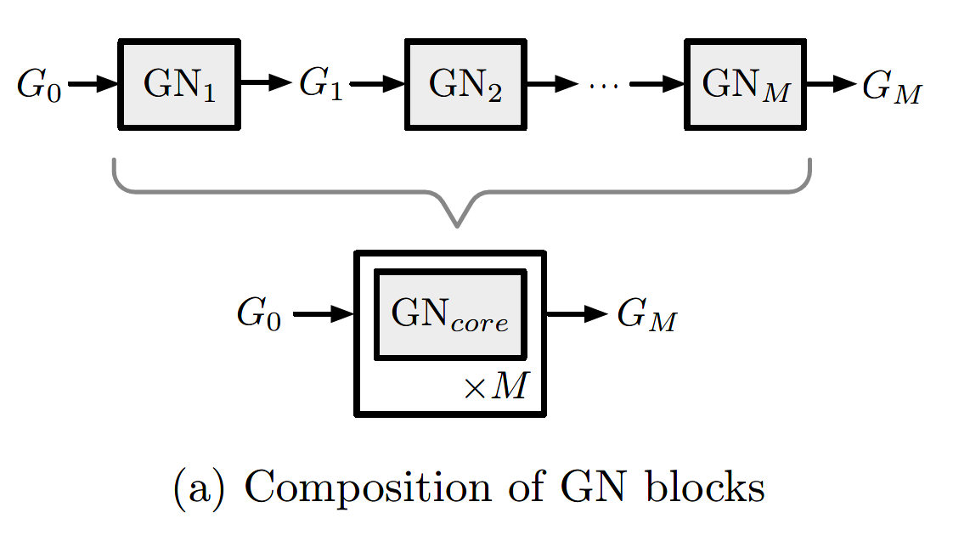
Design
principles
Composable multi-block architectures
message-passing

Slide 30
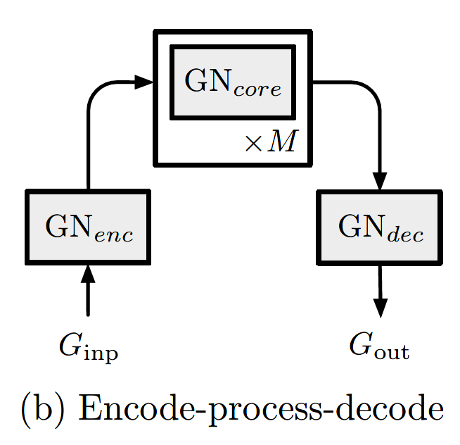
Design
principles
Composable multi-block architectures
Notes:
initial forces and interaction energies between the balls

Slide 31
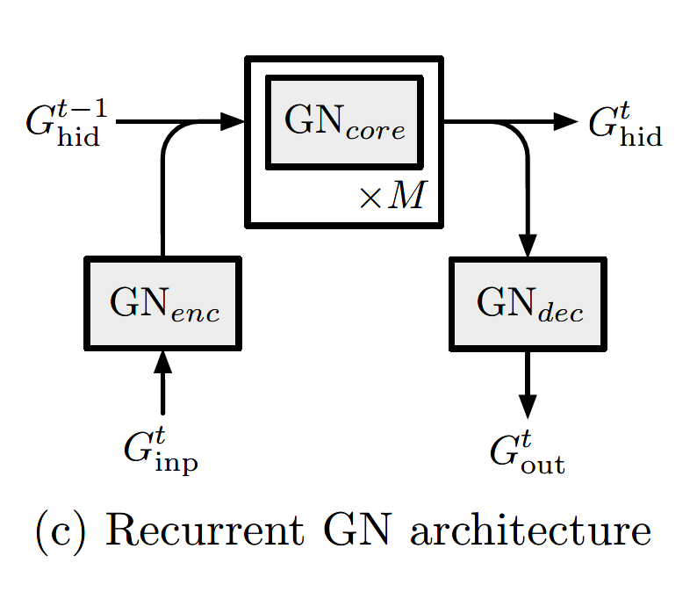
Design
principles
Composable multi-block architectures
predicting the trajectory of a dynamical system

Slide 32
Introduction
Relational inductive biases
Graph networks
Design principles for GN
content
Discussion

Slide 33
Discussion
In this paper, we analyzed the extent to which relational inductive bias exists in deep learning architectures like MLPs, CNNs, and RNNs, and concluded that while CNNs and RNNs do contain relational inductive biases, they cannot naturally handle more structured representations such as sets or graphs. We advocated for building stronger relational inductive biases into deep learning architectures by highlighting an underused deep learning building block called a graph network, which performs computations over graph-structured data. Our graph network framework unifies existing approaches that also operate over graphs, and provides a straightforward interface for assembling graph networks into complex, sophisticated architectures.
Notes:
MLPs, CNNs, and RNNs
sets or graphs

Slide 34
Discussion
Combinatorial generalization in graph networks
“infinite use of finite means”
one-step physical state predictions
zero-shot
GN-based decision-making policies
Embracing explicit structure and flexible learning is a viable approach toward realizing better sample efficiency and generalization in modern AI.
Notes:
MLPs, CNNs, and RNNs
sets or graphs

Slide 35
Discussion
Limitations of graph networks
While graphs are a powerful way of representing structure information, they have limits.
Recursion
control flow
conditional iteration
Notes:
Programs and more “computer-like” processing can offer greater representational and computational expressivity with respect to these notions, and some have argued they are an important component of human cognition.

Slide 36
Discussion
Open questions
Although we are excited about the potential impacts that graph networks can have, we caution that these models are only one step forward.
where do the graphs come from that graph networks operate over?
how to adaptively modify graph structures during the course of computation?
An interesting direction for future work is to further explore the interpretability of the behavior of graph networks.
Notes:
the best ways to use graph networks.

Slide 37
Discussion
Integrative approaches for learning and structure
Notes:
the best ways to use graph networks.

Slide 38
Discussion
Conclusion
Recent advances in AI, propelled by deep learning, have been transformative across many important domains. Despite this, a vast gap between human and machine intelligence remains, especially with respect to efficient, generalizable learning. We argue for making combinatorial generalization a top priority for AI, and advocate for embracing integrative approaches which draw on ideas from human cognition, traditional computer science, standard engineering practice, and modern deep learning.
graph networks
Just only a stepping stone on the path toward human-like intelligence
other relevant, and perhaps underappreciated, research directions
Notes:
the best ways to use graph networks.
graph-to-graph
generalize and extend various recent approaches
relational inductive biases promote combinatorial generalization

Slide 39
THANKS!

