Slide 1
Assisting Developers of Big Data Analytics Applications When Deploying on Hadoop Clouds Weiyi Shang, Zhen Ming Jiang, Hadi Hemmati, Bram Adams, Ahmed E. Hassan, Patrick Martin: ICSE 2013: 402-411

Slide 2
BDA
Big Data Analytics Applications (BDA Apps) are a new type of software applications, which analyze big data using massive parallel processing frameworks (e.g., Hadoop).
Developers of such applications typically develop them using a small sample of data in a pseudo-cloud environment. Afterwards, they deploy the applications in a large-scale cloud environment with considerably more processing power and larger input data (reminiscent of the mainframe days).
Notes:
介绍BDA软件的开发和部署步骤

Slide 3
BDA
Deployment steps:
1. Developers implement and test the BDA App in a small or pseudo cloud (using virtual or physical machines) environment using a small data sample
2. Developers deploy the application on a larger cloud with a considerably larger data set and processing power to test the application in a real-life setting
3. Developers verify the execution of the application to make sure all data are processed and all jobs are successful.
Notes:
介绍BDA软件的开发和部署步骤
本文主要涉及验证部署状态和定位故障
verifying the deployment of BDA Apps in a cloud environment with largescale data
locate possible troublesome instrumentation logs, uncovering the related context of the troublesome logs

Slide 4
The runtime analysis and debugging
Traditional: ineffective, false positive
The traditional approach for deployment verification is to simply search for known error keywords related to unusual executions
New:
Abstract the execution logs from both the small and large scale cloud.
Groups the related abstracted log lines into execution sequences for both.
examines and reports the differences between the two sets of execution sequences
Notes:
介绍大数据应用运行时分析和debug的传统方法，提出本文的解决思路
false positive results since a platform such as Hadoop may intervene in the execution of a job, kill it and restart it elsewhere to achieve better performance, or it might start and kill speculative jobs

Slide 5
The prototype tool on Hadoop BDA Apps
Components of Hadoop: Job, Task, Attempt
Job: A Hadoop program consists of one or multiple MapReduce steps running as a pipeline. Each MapReduce step is a Job in Hadoop.
Task: The execution of a Job is divided into multiple Tasks based on the MapReduce programming model. Therefore, a Task can be either a Map Task that corresponds to the Map in the MapReduce programming model, or a Reduce Task.
Attempt: To support fault tolerance, the Hadoop platform allows each Task to have multiple trials of execution. Each execution is an Attempt.
Notes:
介绍本文涉及Hadoop log抽象过程中涉及的概念

Slide 6
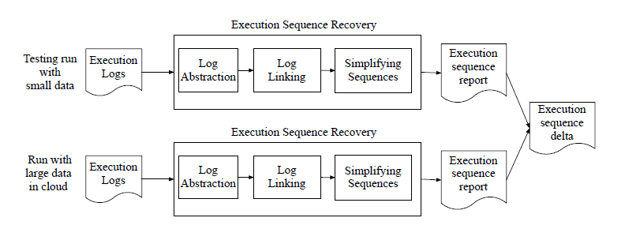
The prototype tool on Hadoop BDA Apps
Execution Sequence Recovery:
Log Abstraction, Log Linking, Simplifying Sequences
Notes:
介绍根据log恢复执行序列的三个过程

Slide 7
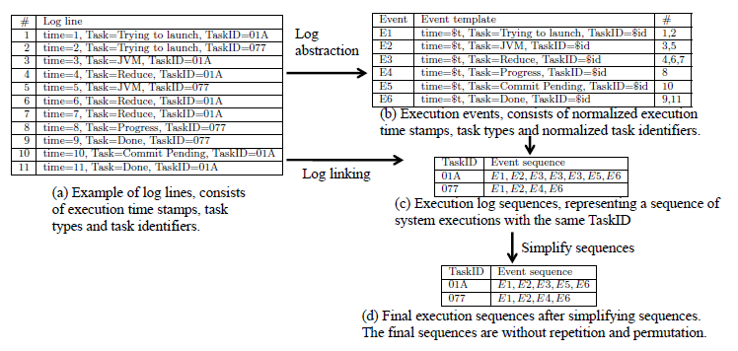
Execution Sequence Recovery:
Notes:
描述执行序列恢复的过程
Log Abstraction, Log Linking, Simplifying Sequences
1. identify the static and dynamic values of the logs based on a small sample of logs. Then we apply the identified static and dynamic parts on full logs to abstract the logs
2. uses dynamic values, such as “$id”, to link log lines into a sequence
3. repetition, regular expression techniques to detect and suppress the repetitions

Slide 8
Case Study
Cases:
WordCount: released with Hadoop as one of the examples of MapReduce programming. The WordCount application analyzes the input files and counts the number of occurrences of each word in the input files.
PageRank: PageRank is a program used by the Google Internet search engine for rating Web pages. Two social-network datasets from the Stanford Large Network Dataset Collection.
JACK: JACK is an industrial application that uses data mining techniques to identify problems in load tests. This tool is used in practice on a daily basis.

Slide 9
Verifying the Deployment:
Due to the decision by underlying platform (e.g. algorithms that Hadoop uses for assigning tasks to machines), a problematic event might be caused by some other reasons than an actual deployment failure.
Task exceptions:
When there is an exception during the execution of a Hadoop task, the task will be killed and restarted on another cloud node.
Notes:
验证部署状态的时候，即查看哪些程序挂掉了，由于底层平台差异, 容易遇到非常多的两种类型假故障，这种假故障不应该被开发者关注
Verifying the Deployment: Developers often use simple text search techniques to identify troublesome events when deploying BDA Apps.
For example, keywords such as “kill” and “fail” are often used to find problematic tasks in Hadoop. Due to the decision by underlying platform (e.g. algorithms that Hadoop uses for assigning tasks to machines), a problematic event might be caused by some other reasons than an actual deployment failure.
介绍Hadoop中最常见的两类非实际部署故障：
Two commonly seen examples of such reasons on Hadoop platform are “Task exceptions” and “Speculative execution”:
Task exceptions+Speculative execution:

Slide 10
Verifying the Deployment:
Speculative execution:
The overall performance of a Hadoop Job may slow down because of some slow running tasks. To optimize the performance, Hadoop replicates the unfinished tasks on idle machines. When one of the replicated tasks, or the original task, is finished, Hadoop commits the results from the task and kills other replicas. This mechanism is similar to the Backup Task in Google’s MapReduce platform. The replication and killing are decided at run-time and are not signs of deployment failures.
Notes:
验证部署状态的时候，即查看哪些程序挂掉了，由于底层平台差异, 容易遇到非常多的两种类型假故障，这种假故障不应该被开发者关注
Verifying the Deployment: Developers often use simple text search techniques to identify troublesome events when deploying BDA Apps.
For example, keywords such as “kill” and “fail” are often used to find problematic tasks in Hadoop. Due to the decision by underlying platform (e.g. algorithms that Hadoop uses for assigning tasks to machines), a problematic event might be caused by some other reasons than an actual deployment failure.
介绍Hadoop中最常见的两类非实际部署故障：
Two commonly seen examples of such reasons on Hadoop platform are “Task exceptions” and “Speculative execution”:
Task exceptions+Speculative execution:

Slide 11
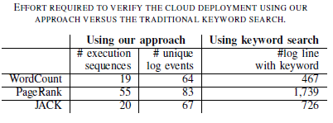
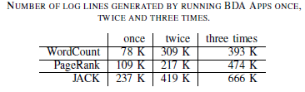
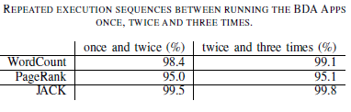
Case Study
Cases: WordCount, PageRank, JACK
Effort reduction: the amount of log lines that must be examined
Reduce 86%, 95%, and 97% effort over the traditional approach
When moving to bigger runs, the size of the final sequences to verify will show very minor increases
Notes:
表1.减少故障查找范围：
表2.伴随数据量增长，执行序列仍然与小数据量下有较大重合
Our approach reduces the verification effort by between 86% to 97% when verifying the cloud deployment of BDA Apps

Slide 12
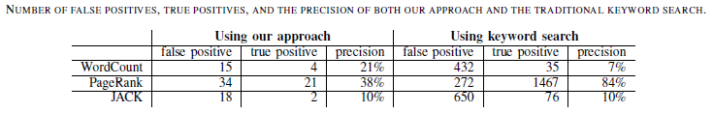
Precise and Informative
Three injected failures: machine failure, missing supporting library, lack of disk space
Machine failure. Machine failure is one of the common system errors in distributed computing. To inject this failure, we manually turn off one machine in the cluster.
Missing supporting library. A cluster administrator may decide to expand the size of the cluster. However, the new machines in the cluster may miss supporting libraries or the versions of the supporting libraries may be outdated. We inject this failure by removing one required library of the analysis.
Lack of disk space. Disks often run out of space while a BDA App is running on the platform due to the large amount of generated intermediate data. We manually fill up one of the machine’s disks to inject this failure.
Notes:
定位故障相关案例分析
本文方法按照故障的类型做了抽象提取，需要验证的范围大大缩小，并且可以提供故障上下文
The precision of our approach for assisting deployment verification of BDA Apps in the cloud is comparable with the precision of the traditional approach. However, our approach provides additional context information (execution sequences) that is essential in speeding up the manual investigation of flagged
problems.

Slide 13
Precise and Informative
However, there are cases that deployment failure might not be possible to catch by a keyword search.
For example, a temporary network congestion may cause the pending queue to be very long, but logs may record that the pending queue is too long without making use of an “error” like string in the log line.
In some cases, a node in the cloud may even fail without recording any error message.
Extra information (context of a log line) that our approach provides for deployment verification.
The precision of our approach for assisting deployment verification of BDA Apps in the cloud is comparable with the precision of the traditional approach. However, our approach provides additional context information (execution sequences) that is essential in speeding up the manual investigation of flagged problems.
Notes:
发现更多的额外故障，可以提供相关上下文，总结

Slide 14
Limitation
Additional case studies are needed to better understand the strengths and limitations of our approach
Additional studies on other open source and commercial platforms with other types of failures are needed to study the generalizability of our approach.
The execution logs may not contain all the information of the runtime behaviour. Other types of dynamic information, such as execution tracing, may have more details about the execution of the BDA Apps.
Notes:
讲一讲局限性

Slide 15
Thanks
Notes:
讲一讲局限性

