Slide 1
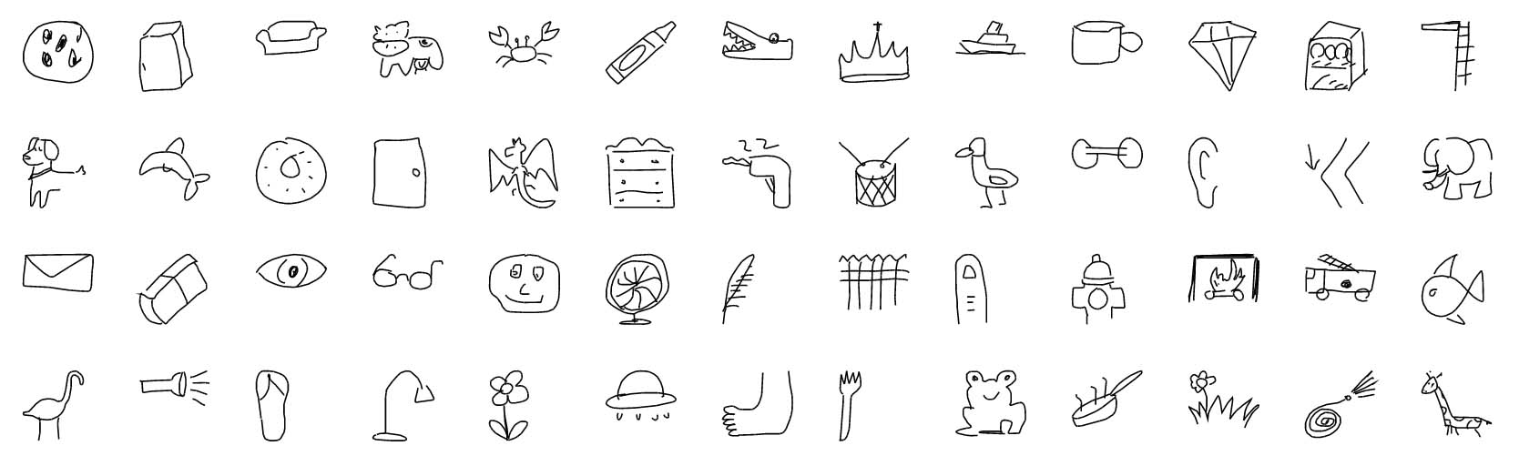
Sketch
18210240044
张兆龙

Slide 2
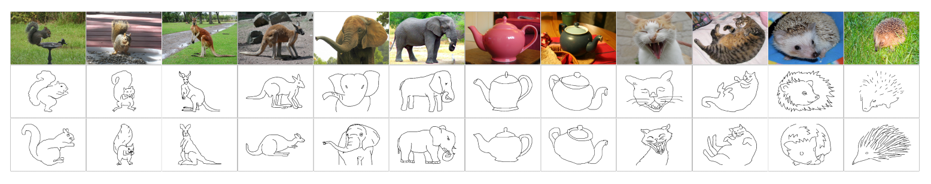
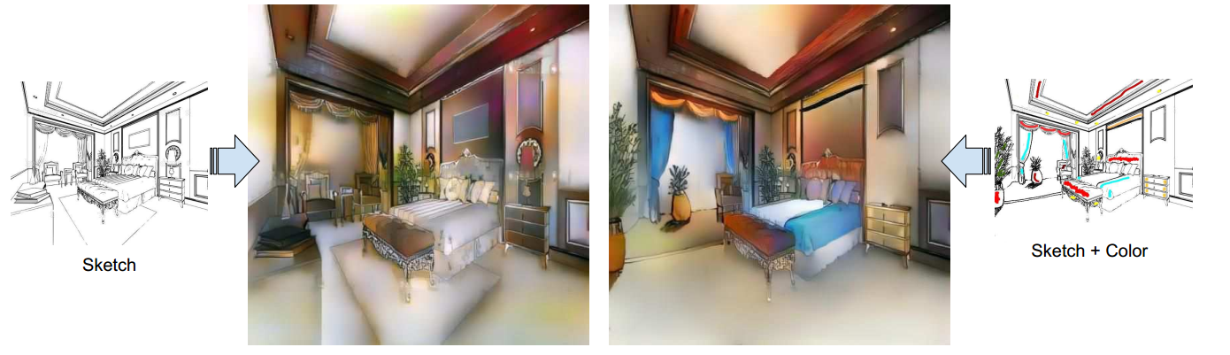
Research on sketches
Sketch-based image retrieval (SBIR)
The Sketchy Database: Learning to Retrieve Badly Drawn Bunnies
Sketch Me That Shoe
Sketch to Image generation
SketchyGAN: Towards Diverse and Realistic Sketch to Image Synthesis
Scribbler: Controlling Deep Image Synthesis with Sketch and Color

Slide 3
Sketch-based Image Retrieval (SBIR)
The Sketchy Database: Learning to Retrieve Badly Drawn Bunnies
Patsorn Sangkloy, Nathan Burnell, Cusuh Ham, James Hays
Georgia Institute of Technology Brown University
ACM Transactions on Graphics (proceedings of SIGGRAPH) 2016

Slide 4
Motivation
The goal of Sketch-based image retrieval is to allow non-artist users to draw visual content and then find matching examples in an image collection. Sketch-based image retrieval is an alternative or a complement to widely used language-based image querying.
Sketch-based image retrieval vs. Text-based image retrieval
Draw one specific item vs. describe it
“office chair with no arms viewed from slightly above and to this side”
“castle with two pointy towers and a crenelated battlement joining them”
The appeal of sketching is that it allows us to specify fine-grained aspects of an object – pose, parts, sub-type
Notes:
没有扶手的办公椅，从稍高的位置向这边看
有两座尖塔的城堡和连接着它们的锯齿状城垛

Slide 5
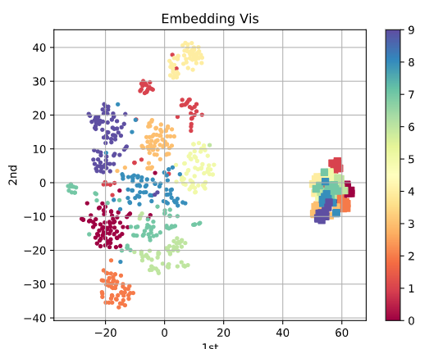
Cross-domain embedding
Semantic gap
How to bridge the distance?

Slide 6
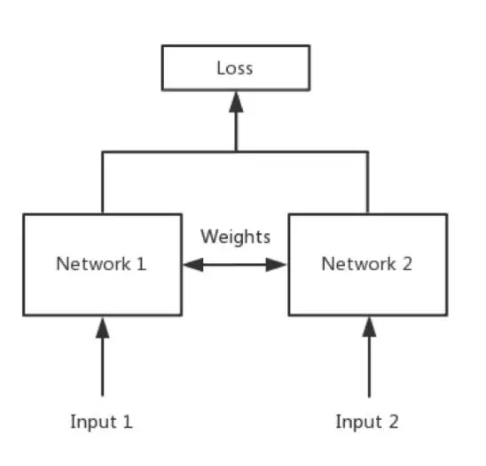
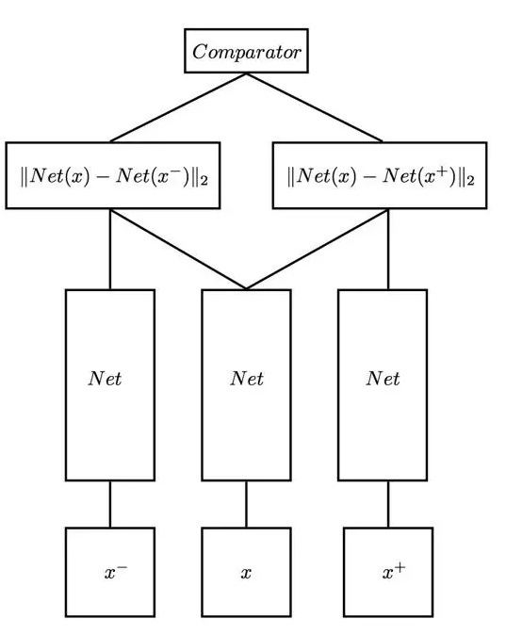
Bridge the distance
Siamese Network
Triplet Network
$$L=l∗d\left(S,I+\right)+\left(1−l\right)∗max⁡(0,m−d\left(S,I−\right))$$
$$L=max⁡(0, m+d\left(S, I+\right)−d\left(S,I−\right))$$

Slide 7
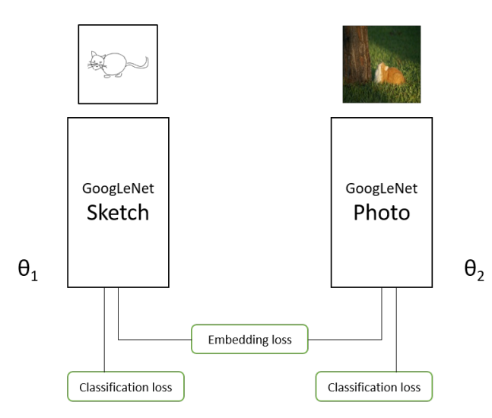
Network Architecture

Slide 8
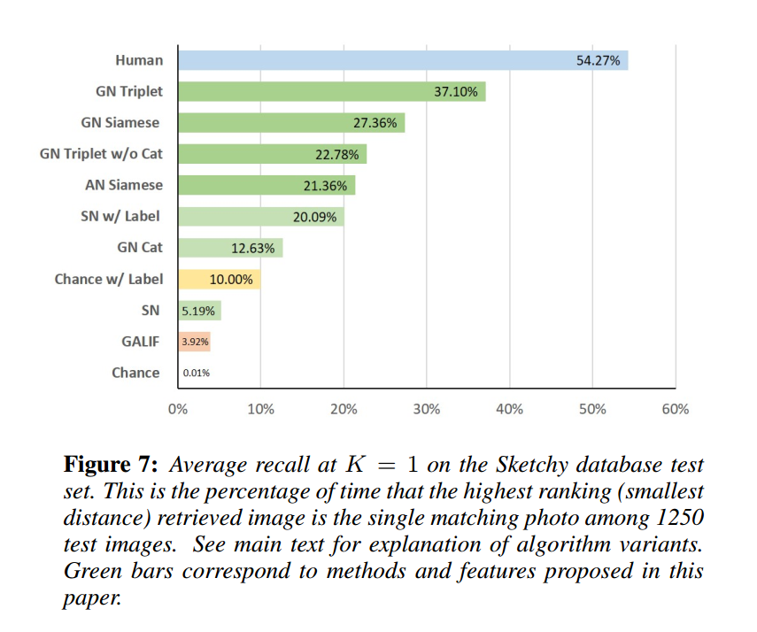
Experiment
Data set : SketchyDataset
125 categories sketches & photos
Test set:
6312 query sketches and
1250 photos spanning 125 categories
Notes:
GN Triplet. This is our top-performing model, GoogLeNet trained with Triplet and classification loss. GN Siamese. GoogLeNet trained with Siamese and classification loss. GN Triplet w/o Cat. GoogLeNet trained exclusively with the Triplet loss. AN Siamese. AlexNet trained with Siamese and classification loss. GN Cat. GoogLeNet trained exclusively with the classification loss on the Sketchy database. The sketch and photo networks are trained independently, but as they predict the same 125 categories their final layer outputs are comparable. GN Cat is meant to represent a “retrieval by categorization” method. Chance. Photos are retrieved in random order. Chance w/ Label. This represents a hypothetical algorithm which can achieve perfect category recognition but ranks the results within that category randomly. This is a strong baseline for our test set – with 125 categories and 10 images per category, this baseline will always find the matching photo within the top 10 out of 1250 retrieved photos GALIF. Gabor local line based feature [Eitz et al. 2012b]. This feature describes sketches using a bank of Gabor filters. It was used for sketch-based shape retrieval by rendering 3D objects as sketches. We apply it to sketch-based image retrieval by performing Canny edge detection on the photos before computing the feature. SN. For another “retrieval by categorization” baseline, we fine-tune GoogLeNet with the 250 category Eitz 2012 dataset and then use the network as a feature extractor. Similar to GALIF approach, we first use edge detection on photos then extract features from both sketch and edge images. We use the 1024 dimensional penultimate network layer activations as the feature. SN w/ Label. Same as SN, except that we assume category recognition is perfect as in the Chance w/ Label baseline. The SN representation outperforms that baseline because it can still sort results within class. Even though this method has an oracle telling it ground truth sketch and photo category, it still performs worse than networks trained on fine-grained sketch-photo pairs for small values of K

Slide 9
Sketch to Image generation
SketchyGAN: Towards Diverse and Realistic Sketch to Image Synthesis
Wengling chen
Georgia Institute of Technology
wchen342@gatech.edu
James Hays
Georgia Institute of Technology,Argo AI
hays@gatech.edu
CVPR 2018

Slide 10
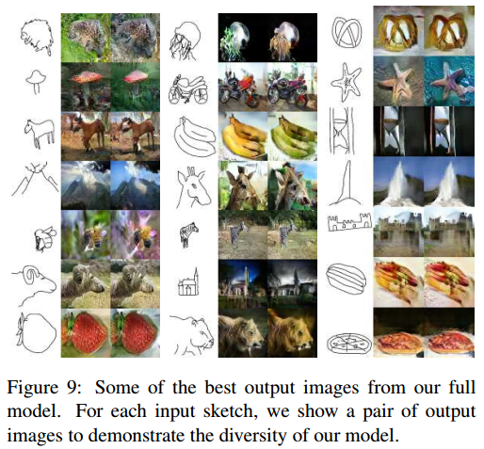

Slide 11
Introduction
There exist several methods that use GANs to translate images from one domain to another. However, none of them is specifically designed for images synthesis from sketches.
SkecthyGAN is proposed in this paper which can generate objects from 50 classes. The input is a sketch illustrating an object and the output is a realistic image containing that object in a similar pose.
Challenges:
Paired photos and sketches are difficult to acquire so there is no massive database to learn from
There is no established neural network method for sketch to image synthesis for diverse categories.
Solutions:
Augmenting the Sketchy database by collecting 2,299,144 Flickr images from 50 categories and synthesizing edge maps from them.
Building a GAN-based model with a new building block, Masked Residual Unit(MRU)

Slide 12
Contributions:
Present SketchyGAN
Demonstrate a data augmentation technique
Formulate a GAN model with additional objective functions and a new network building block

Slide 13
Related Work
Sketch-Based Image Retrieval and Synthesis From category-level retrieval to instance-level retrieval. Sketch2Photo and PhotoSketcher synthesize realistic images by compositing objects and backgrounds retrieved from a given sketch.
Sketch-Based Datasets There are only a few datasets of human-drawn sketches and they are generally small due to the effort needed to collect drawings. TU-Berlin dataset: 20,000 human sketches spanning 250 categories Sketch me that shoe only contains two categories CUHK Face Sketches: 606 face sketches QuickDraw dataset : 50 million sketches
Image-to-Image Translation with GANs pix2pix Image-image translation with conditional adversarial networks sketch coloring, style transformation, domain adaptation cycleGAN

Slide 14
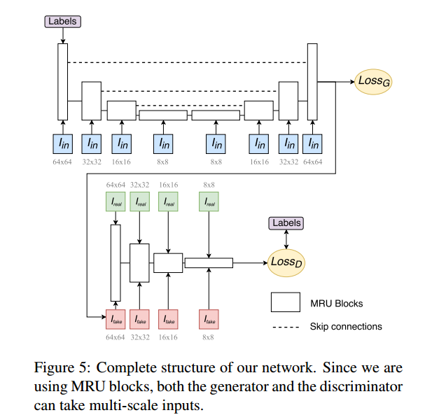
SketchyGAN

Slide 15
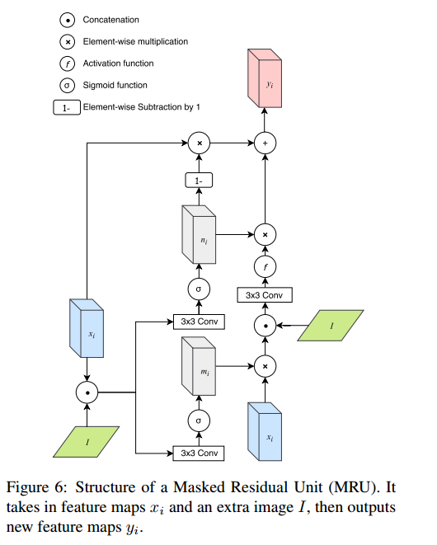
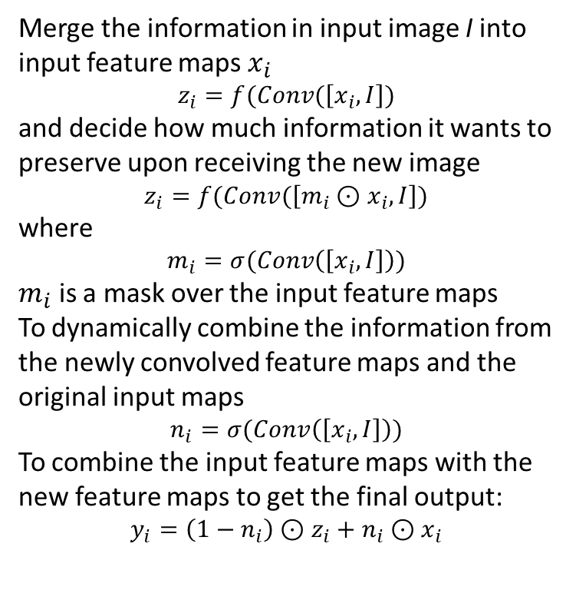
Masked Residual Unit(MRU)
Merge the information in input image I into input feature maps $x_{i}$
$$z_{i}=f(Conv(\left[x_{i},I\right])$$
and decide how much information it wants to preserve upon receiving the new image
$$z_{i}=f(Conv(\left[{m_{i}⊙x}_{i},I\right])$$
where
$$m_{i}=σ(Conv\left(\left[x_{i},I\right]\right))$$
$m_{i}$ is a mask over the input feature maps
To dynamically combine the information from the newly convolved feature maps and the original input maps
$$n_{i}=σ(Conv\left(\left[x_{i},I\right]\right))$$
To combine the input feature maps with the new feature maps to get the final output:
$$y_{i}=\left(1−n_{i}\right)⊙z_{i}+n_{i}⊙x_{i}$$

Slide 16
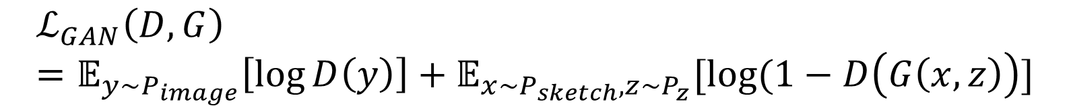
Objective Function
$$ℒ_{GAN}\left(D,G\right)=𝔼_{y\sim P_{image}}\left[\log{D\left(y\right)}\right]+𝔼_{x\sim P_{sketch},z\sim P_{z}}[log⁡(1−D\left(G\left(x,z\right)\right)]$$
Conditional instance normalization in the generator and pass in labels of input sketches.
In addition, we let the discriminator predict class labels out of the images it sees.

Slide 17
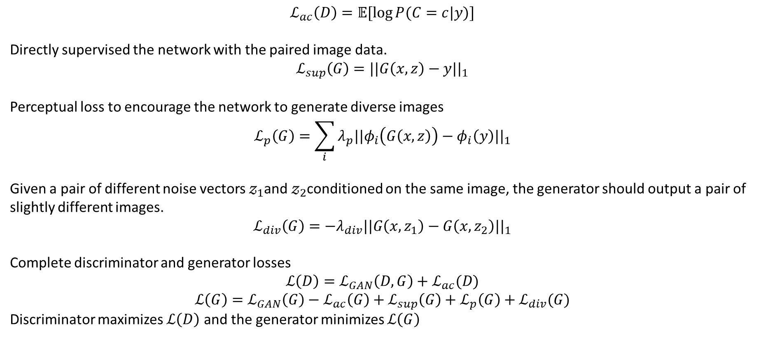
$$ℒ_{ac}\left(D\right)=𝔼[\log{P(C=c|y)}]$$
Directly supervised the network with the paired image data.
$$ℒ_{sup}\left(G\right)=||G\left(x,z\right)−y{||}_{1}$$
Perceptual loss to encourage the network to generate diverse images
$$ℒ_{p}\left(G\right)=\sum_{i}{λ_{p}||φ_{i}\left(G\left(x,z\right)\right)−φ_{i}\left(y\right)||_{1}}$$
Given a pair of different noise vectors $𝓏_{1}$and $𝓏_{2}$conditioned on the same image, the generator should output a pair of slightly different images.
$$ℒ_{div}\left(G\right)=−λ_{div}||G\left(x,z_{1}\right)−G\left(x,z_{2}\right)||_{1}$$
Complete discriminator and generator losses
$$ℒ\left(D\right)=ℒ_{GAN}\left(D,G\right)+ℒ_{ac}(D)$$
$$ℒ\left(G\right)=ℒ_{GAN}\left(G\right)−ℒ_{ac}\left(G\right)+ℒ_{sup}\left(G\right)+ℒ_{p}\left(G\right)+ℒ_{div}(G)$$
Discriminator maximizes $ℒ\left(D\right)$ and the generator minimizes $ℒ\left(G\right)$

Slide 18
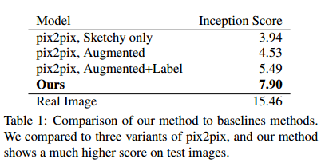
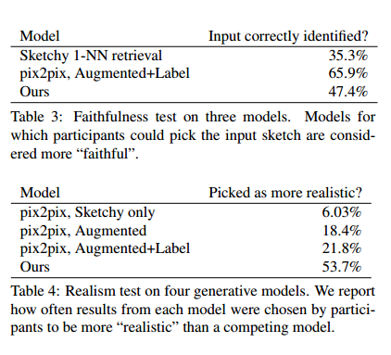
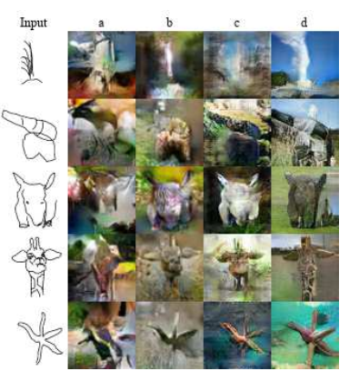
Experiments
Dataset:
sketch-image pairs among 50 categories
edge map-image pairs
Evaluation Metrics:
Inception Scores
Human evaluation of realism and faithfulness
Notes:
Inception Scores
A good synthesized image should have easily recognizable objects by an off-the-shelf recognition system
pix2pix on Sketchy
Pix2pix on Augmented Sketchy
Label-supervised pix2pix on Augmented Sketchy
Our method

Slide 19
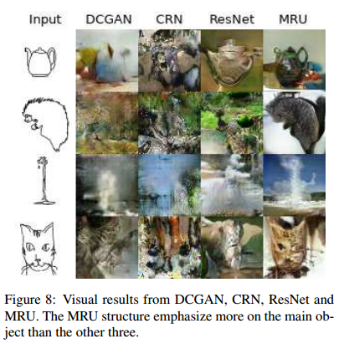
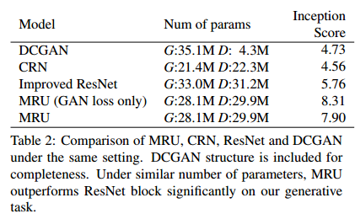
Comparison between MRU and other structures
Notes:
Compare the performance of MRU, ResNet, Cascaded Refinement Network(CRN) and DCGAN
Improved ResNet blocks in both generator and discriminator
DCGAN structure
CRN in generator instead of MRU
MRU model using only GAN loss & ACGAN loss
MRU model tends to produce higher quality foreground objects. This can be due to the internal masks of MRU serving as
an attention mechanism, causing the network to selectively focus on the main object

Slide 20
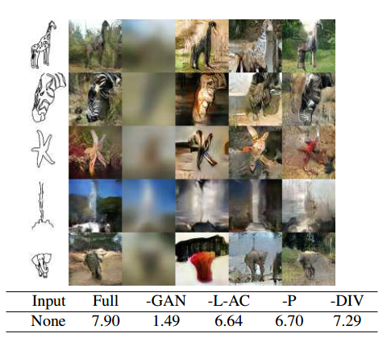
Component Analysis
Decouple the objective function and analyze the influence of each part of it
Class information helps a lot
Diversity loss encourages generator to find a solution to change the unconstrained areas when given different noise vectors
Notes:
“Full” is the full model described in this work
“-GAN” means no GAN loss and no discriminator
“-L-GAN” means no labels-supervision on generator and no auxiliary loss on discriminator
“-P” means no L1 and no perceptual loss
“-DIV” means no diversity loss

