Slide 1

CVPR 2007
葛国胜 18210240079

Slide 2
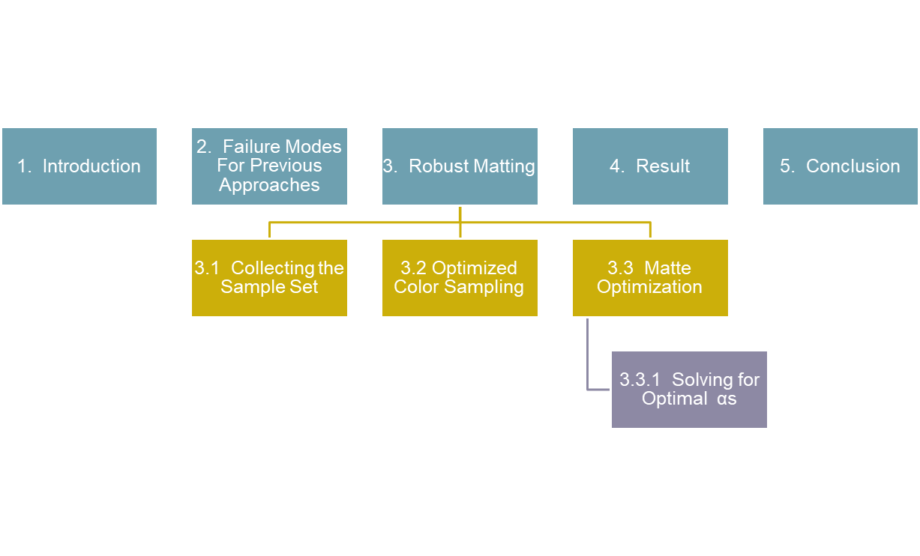
Outline

Slide 3
1. Introduction
Matting refers to the problem of soft and accurate foreground extraction from an image.
C is formulated as a convex combination of a foreground image F and a background image B as
Cz = αzFz + (1 − αz)Bz …………………(1)
*C is input image , F and B are respectively foreground and background image
* z refers to pixel locations, and αz is the foreground opacity of the pixel.

Slide 4
1. Introduction
Roughly speaking, previous matting approaches can be classified into two categories based on how they make use of natural image statistics.
  sampling-based approaches─
  assume that the foreground and background colors of an unknown pixel can be explicitly estimated by examining nearby pixels that have been specified by the user as foreground or background.
  (ex: KnockOut2 matting , Bayesian matting , Belief Propagation matting…etc)
  propagation-based approaches ─
  assume foreground and background colors are locally smooth, for example,that they can be modelled as constant or linearly varying.
  (ex: Poisson matting , Closed-form matting…etc)

Slide 5
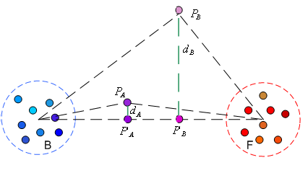
2. Failure Modes For Previous Approaches
For sampling-based approaches
pixel PA fits the linear model very well, thus it has a high probability of being a true mixed pixel between the foreground and background clusters. On the contrary, pixel PB is far away from the interpolation line thus it is very unlikely to be generated by a linear combination of the two clusters.
# previous approaches ignore this fact and simply estimate an alpha value for PB based on its projection to the line P’B

Slide 6
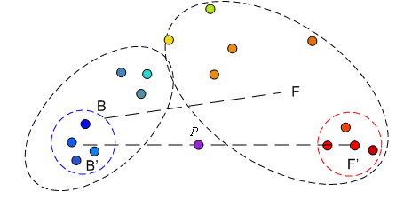
2. Failure Modes For Previous Approaches
For propagation-based approaches
For complex foreground and background patterns, samples collected from local regions do not have a uniform color distribution, as shown in above Figure . In this case, propagation-based approaches will fail (at least partially) since the smoothness assumption is violated.

Slide 7
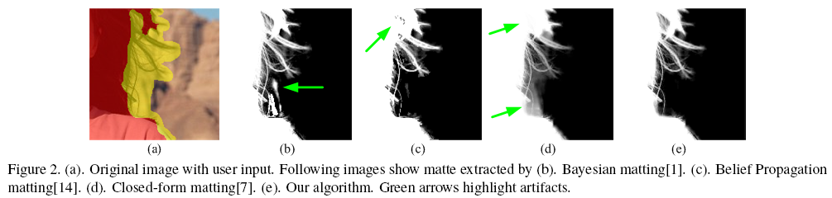
2. Failure Modes For Previous Approaches
Figure 2a shows the original image with the user specified foreground (red) and unknown region (yellow).
Although the foreground color is relatively uniform, the background contains complex patterns, in which dark regions match well with the foreground color.
Figure 2 b, c, and d show that other matting will produce noticeable artifacts due to color sampling errors or assumption violations.

Slide 8
3. Robust Matting
This algorithm is based on an optimized color sampling scheme, and Graph labelling problem is employed to solve for the matte.

Slide 9

3. Robust Matting
Precondition:
Given the input image and a roughly specified trimap.
(trimap can separate from foreground、background and unknow region)
For a pixel z with unknown α assembles a large number of foreground and background samples as candidates for estimating the true foreground and background colors at this location.

Slide 10
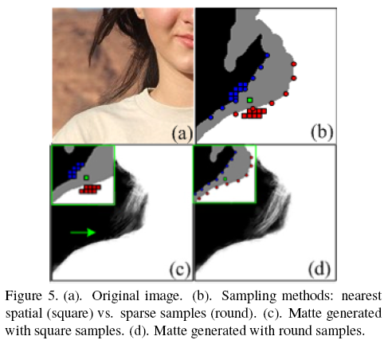
3.1 Collecting the Sample Set
Previous approaches such as Bayesian matting and Belief Propagation matting collect pixels known to be fully foreground or background that have the shortest spatial distances to the target pixel as samples, but may not fully span the variation in foreground and background colors.
In Robust Sampling Method spread the sampling of foreground and background samples along the boundaries of known foreground and background regions. In this way the sample set can better capture the variation of foreground and background colors.

Slide 11
3.2 Optimized Color Sampling
pick out “good” samples from this large candidate set.
=>Good sample pairs should explain any mixed foreground/background pixels as linear combinations of the samples.
Assume that B^{j} is a simple in B, F^{i} is a simple in F.
=>B^{j} and F^{i} in this Figure are good samples for PA , but not for PB.

Slide 12

3.2 Optimized Color Sampling
for a pair of foreground and background colors F^{i} and B^{j} , the estimated alpha value is
…………..(2)

Slide 13


3.2 Optimized Color Sampling
And We define a distance ratio Rd(F^{i},B^{j}), which evaluates this sample pair by examining the ratio of the distances between (1) the pixel color, C, and the color it would have, , predicted by the linear model in Equation 1, and (2) the distance between the foreground/background pair.
……….(3)

Slide 14
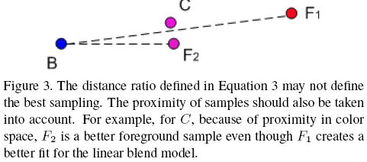
3.2 Optimized Color Sampling
The distance ratio alone will favor sample pairs that are widely spread in color space since the denominator ||F^{i}−B^{j}|| will be large.

Slide 15
3.2 Optimized Color Sampling
define two more weights w(Fi) and w(Bj) as
W(F^{i}) = exp { ─ || F^{i} – C ||² / D²F }……………(4)
and
W(B^{j}) = exp { ─ || B^{j} – C ||² / D²B }…………...(5)
** where DF and DB are the minimum distances between foreground/background sample and the current pixel,(i.e, mini ( || F^{i} – C || ) and minj ( || B^{j} – C || ).

Slide 16
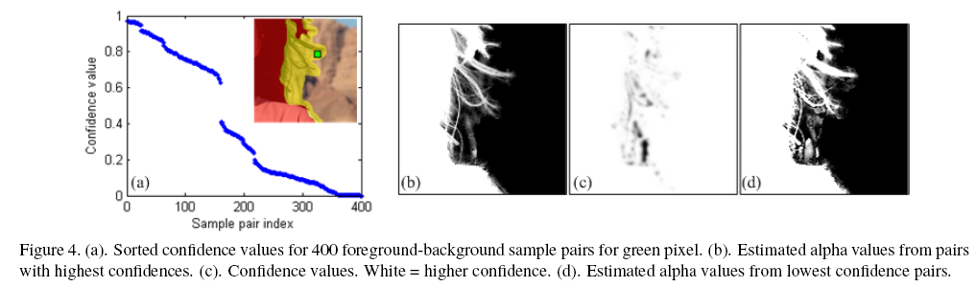

3.2 Optimized Color Sampling
Combining these factors( i.e Rd(F^{i},B^{j}) 、 W(F^{i}) 、 W(B^{j})), we calculate a final confidence value f(F^{i},B^{j}) for a sample pair as
…..(6)
**where σ=0.1 in this system.
We examine the confidence of every pair of foreground and background samples. Finally, we select a small number of pairs (3 in our system) with the highest confidences. The average estimated alpha value and confidence of these three sample pairs are taken as the final values in the color sampling step.

Slide 17
3.3 Matte Optimization
sampling process leads to a good initial alpha estimate and a confidence value for each pixel,and this initial estimate can be further improved by leveraging a priori expectations about more global aspects of the alpha matte.
  In particular , we expect the matte to exhibit local smoothness.
  We also expect alpha values of one or zero (fully foreground or background) to be much more common than mixed pixels.

Slide 18
3.3 Matte Optimization
Our expectation for the matte is thus two fold: firstly, it should respect the alphas chosen for each individual pixel (data constraint) especially when the confidence value is high; secondly, the matte should be locally smooth (neighborhood constraint).
→ This expectation can be satisfied by solving a graph labelling problem in previous graph-based image labelling approaches.

Slide 19
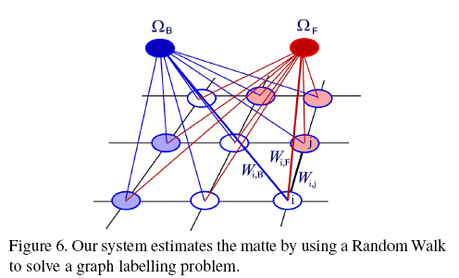
3.3 Matte Optimization
Graph labelling Problem
ΩF 、 ΩB → virtual nodes representing pure foreground and pure background.
white nodes → unknown pixels on the image lattice.
light red and light blue nodes → known pixels marked by the user.
data weight → defined between each pixel and a virtual node to enforce the data constraint. ( ex: Wi,F、Wi,B)
edge weight → defined between two neighboring pixels to enforce the neighborhood constraint. ( ex: Wi,j)

Slide 20





3.3 Matte Optimization
Data weights correspond to relative probabilities of a node being foreground or background.
  For nodes with high confidence values, , we rely on the alpha that fits the linear model from the selected samples.
  For nodes with low confidence , we have a higher expectation that the node is fully foreground or background.
  By above rules ,for an unknown pixel i, two data weights W( i, F) and W( i,B) ,They are defined as
  and ……………(7)
  ** and are estimated alpha and confidence values,and is boolean function returning 0 or 1, is a free parameter in our system which balances the data weight and the edge weight.

Slide 21





3.3 Matte Optimization
  Edge weights between nodes to encourage alpha to have local smoothness.
  They reference the closed-form matting system [A.Levin,et .al 06] sets the weights between neighboring pixels based on their color difference computed from local color distributions.
  the neighborhood term, Wij , is defined by a sum over all 3 × 3 windows that contain pixels i and j.
  …….(8)
  ** represents the set of 3 × 3 windows containing pixels i and j, and k iterates over those windows. and are the color mean and variance in each window. is a regularization coefficient which is set to be 10⁻⁵ in our system.

Slide 22



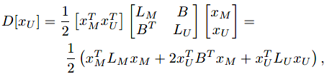

3.3.1 Solving for Optimal αs
  Object Function

Slide 23
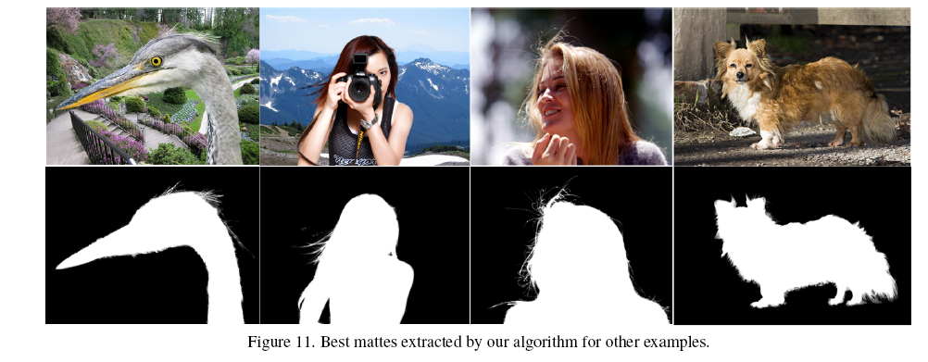
4. Result

Slide 24
5. Conclusion
Robust matting approach that combines the advantages of sampling-based approaches and propagation-based approaches. We propose an optimized color sampling method, which explicitly avoids the weak assumptions of previous approaches, thus enable our algorithm to generate accurate mattes in a robust way for complex images.

