Slide 1
Invariance Matters: Exemplar Memory for Domain Adaptive Person Re-identification
CVPR2019
Zhun Zhong, Liang Zheng, Zhiming Luo, Shaozi Li, Yi Yang
汇报人：沈祥龙

Slide 2
Introduction

Slide 3
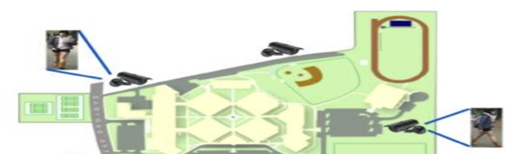
What is Re-ID (Person Re-identification)?
Use computer vision technology to determine whether a particular pedestrian exists in an image or video sequence

Slide 4
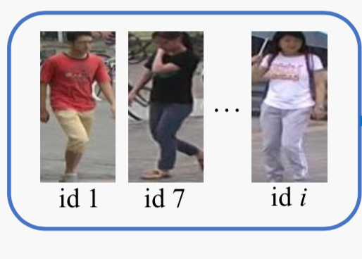
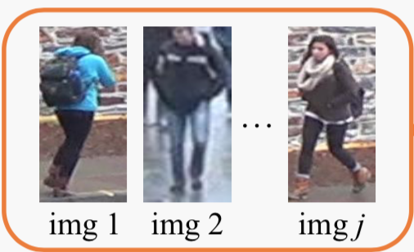
unsupervised domain adaptation (UDA)
labeled source domain
unlabeled target domain
UDA
Notes:
过去的工作可以把监督学习做的很好 但是对无监督域的适应性不好
大部分的UDA目标域都是在闭集合里
人群充实别是开集合问题
目前的工作处理UDA问题都是在照片或者特征图的层面降低差距

Slide 5

Recent advanced methods VS This paper
Recent advanced methods
Image-level
Feature-level
This paper
exemplar-invariance
camera-invariance
neighborhood-invariance
INTER
INTRA

Slide 6
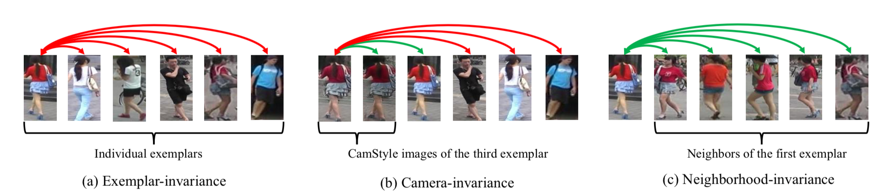
Three underlying invariances
Notes:
首先在过去的高分模型中，发现往往查询的都是表观视觉上差不多的图像，所以学习的是表观信息而不是语义相似性，所以要训练使得与别人不同 而与自己相似。
要排除不同相机风格的影响，同一个对象的不同相机风格应该要相似，
最相近的一个 和 最相近的几个可能都是共享同一身份的，所以要使得最相近的k个对象尽可能相近，模型更加健壮

Slide 7
Framework

Slide 8
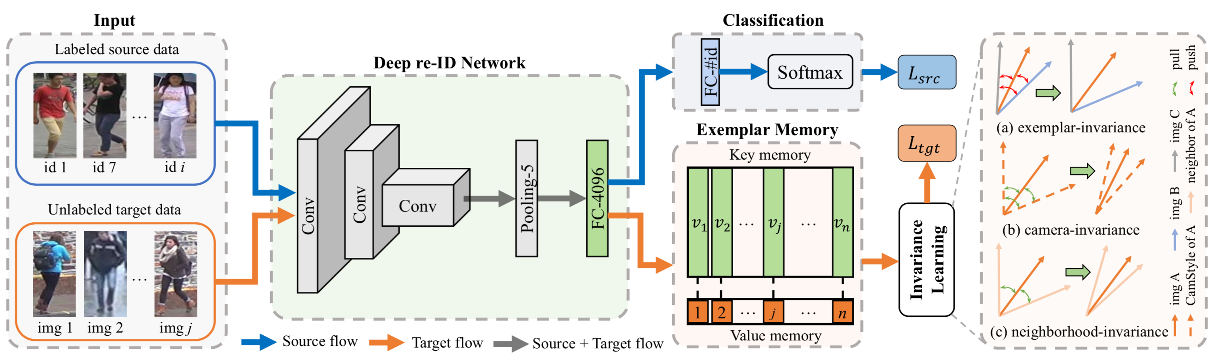
Notes:
使用在ImageNet预先训练的resnet-50作为主体框架，后面接池化和FC bn dropout 和两块部分，首先是分类器部分，针对于有标签样本的，全连接层和softmax激活，使用交叉熵损失来计算源域损失，另一部分是样本记忆器模块针对目标域数据。这是用来存储最新提取的特征。计算一致性学习的损失通过估计输入图片相似度和记忆器中的存储内容。

Slide 9
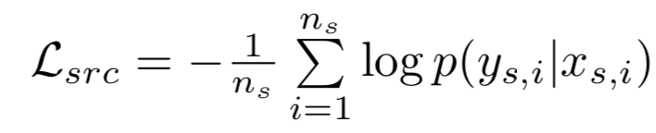
Supervised Learning for Source Domain
LOSS

Slide 10
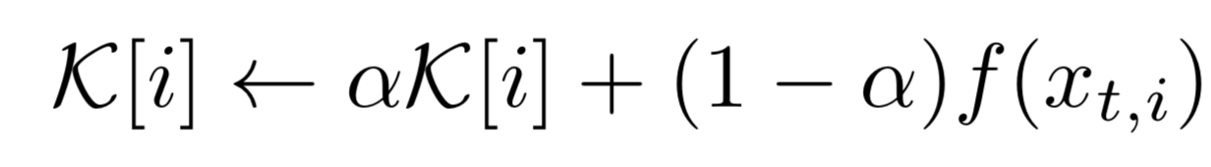

Exemplar Memory
key-value structure
regard each image instance as an individual category
initialize to zeros
Update as:
Then is L2-normalized.

Slide 11
Invariance Learning for Target Domain
Exemplar-invariance
Camera-invariance
Neighborhood-invariance

Slide 12
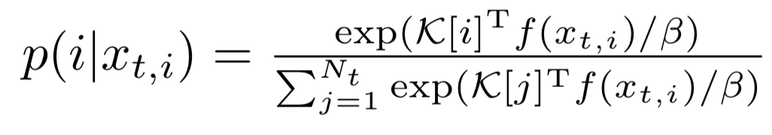
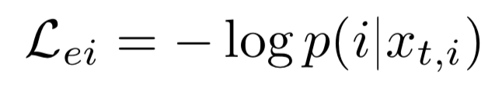
Exemplar-invariance
regard the Nt target images as Nt different classes
first compute the cosine similarities
use softmax to predict P:
Loss:
Notes:
将每个个体尽可能不能有利于模型捕获最明显的特征（防止与他人混淆起来） beta是温度系数来平衡尺度

Slide 13
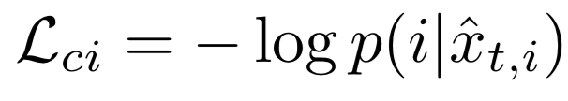
Camera-invariance
consider each camera as a style domain
adopt StarGAN to train a camera style (CamStyle) transfer model
each real target image collected from camera c is augmented with C − 1 images in the styles of other cameras
Loss:
Notes:
X_hat是照相机风格转换副本

Slide 14


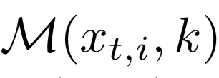
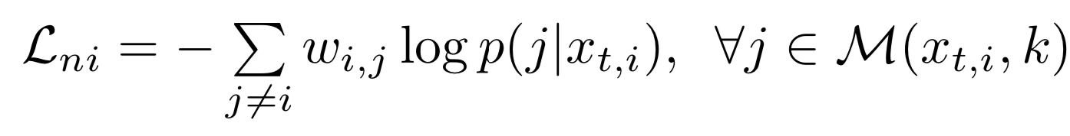
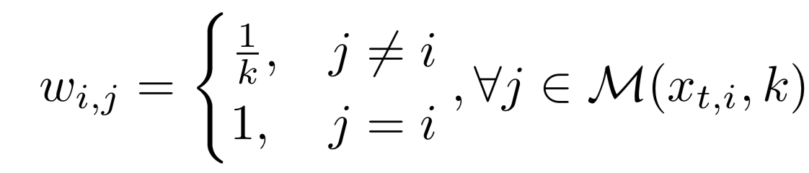
Neighborhood-invariance
find the k-nearest neighbors of in and define the indexes of them as
Loss:
Weight:

Slide 15
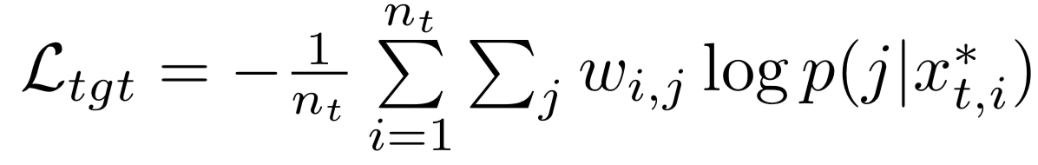
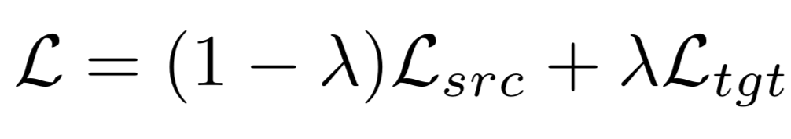
Overall loss of invariance learning
Final Loss for Network
Notes:
J就是前k个个数

Slide 16
Discussion
Exemplar-invariance
If the same identity is not unique?
Neighborhood-invariance
If the neighbors are not the same identity?

Slide 17
Experiment

Slide 18
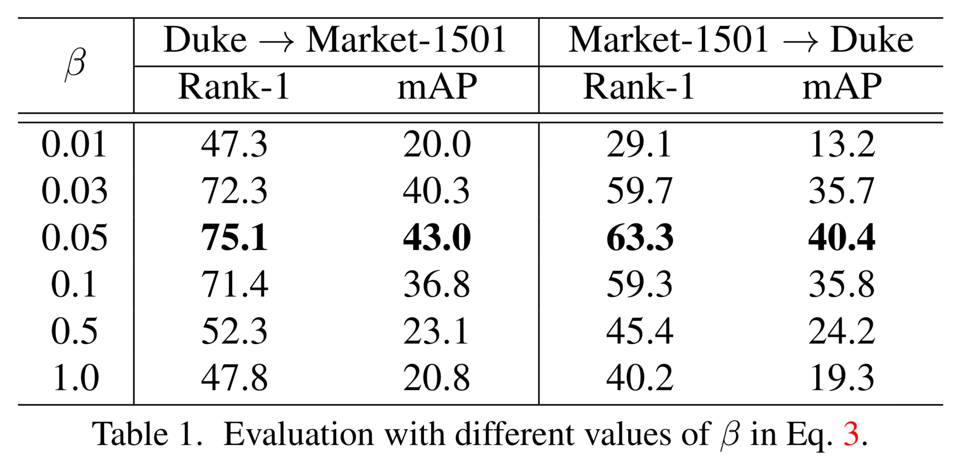
Experiment

Slide 19
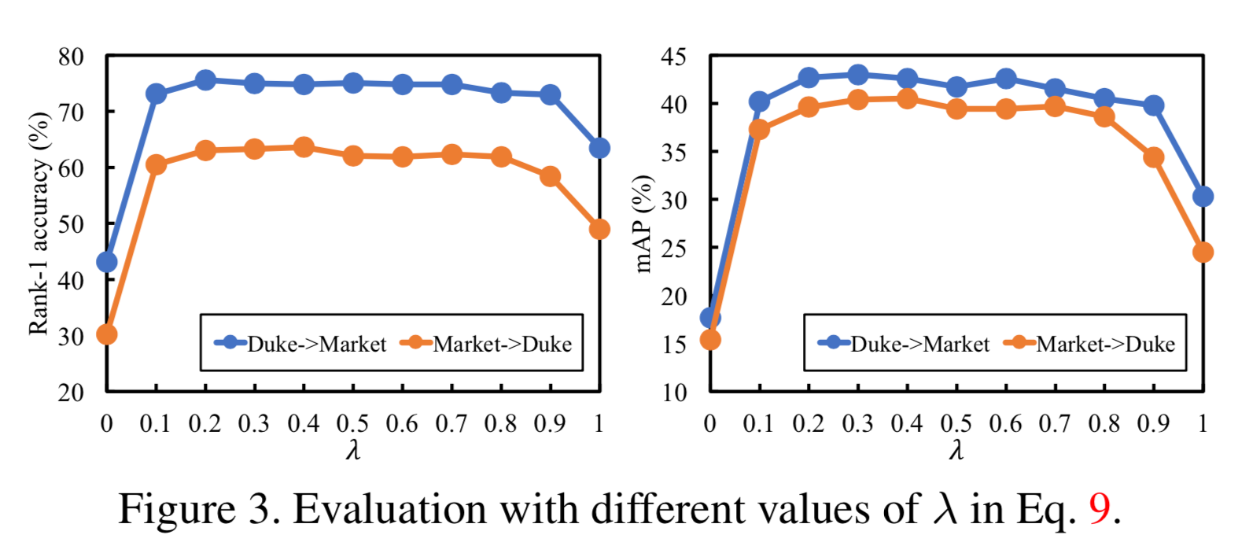
Experiment

Slide 20
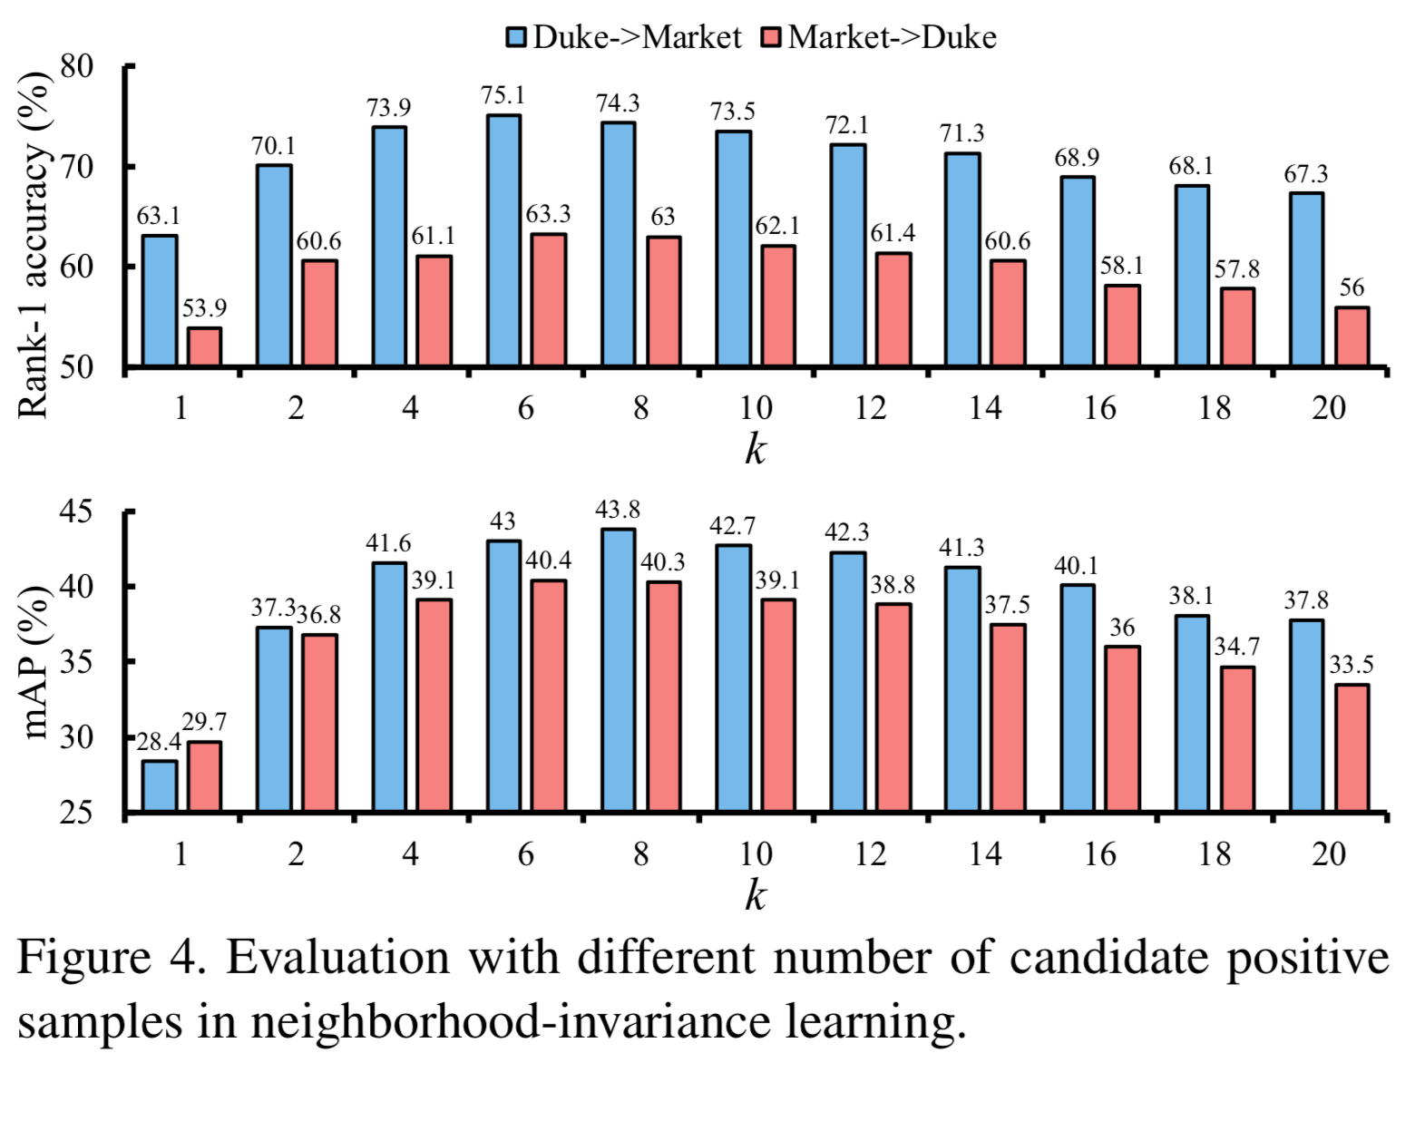
Experiment

Slide 21
Evaluation

Slide 22
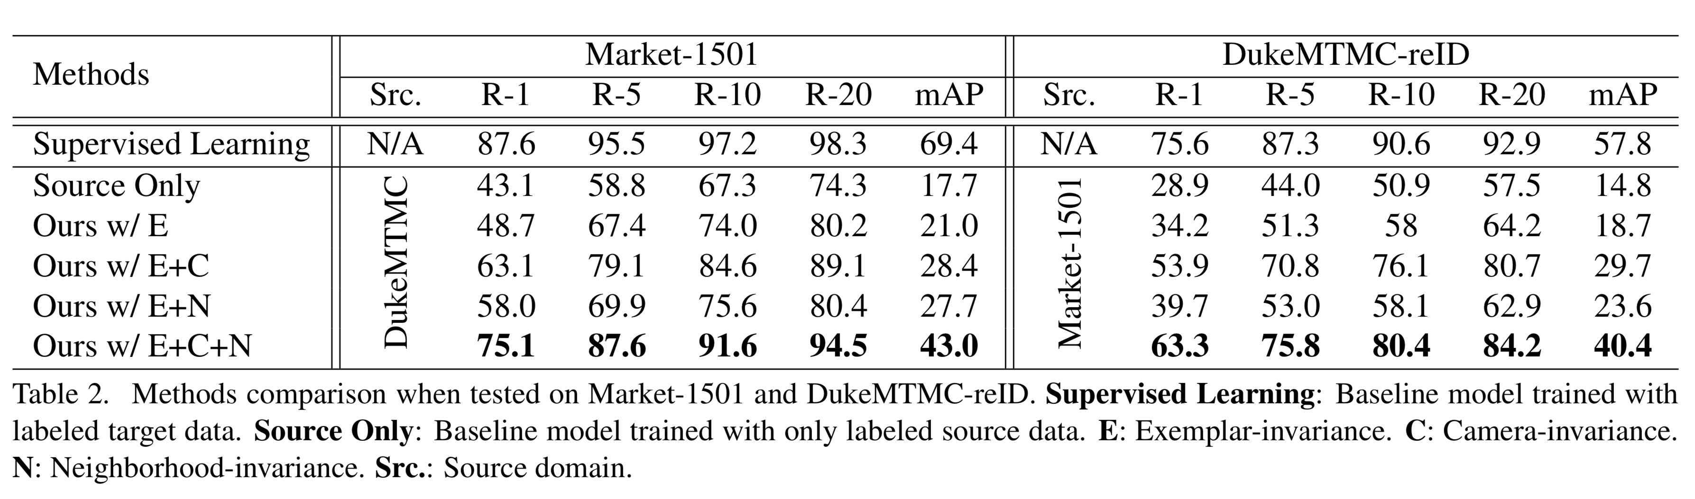
Evaluation

Slide 23
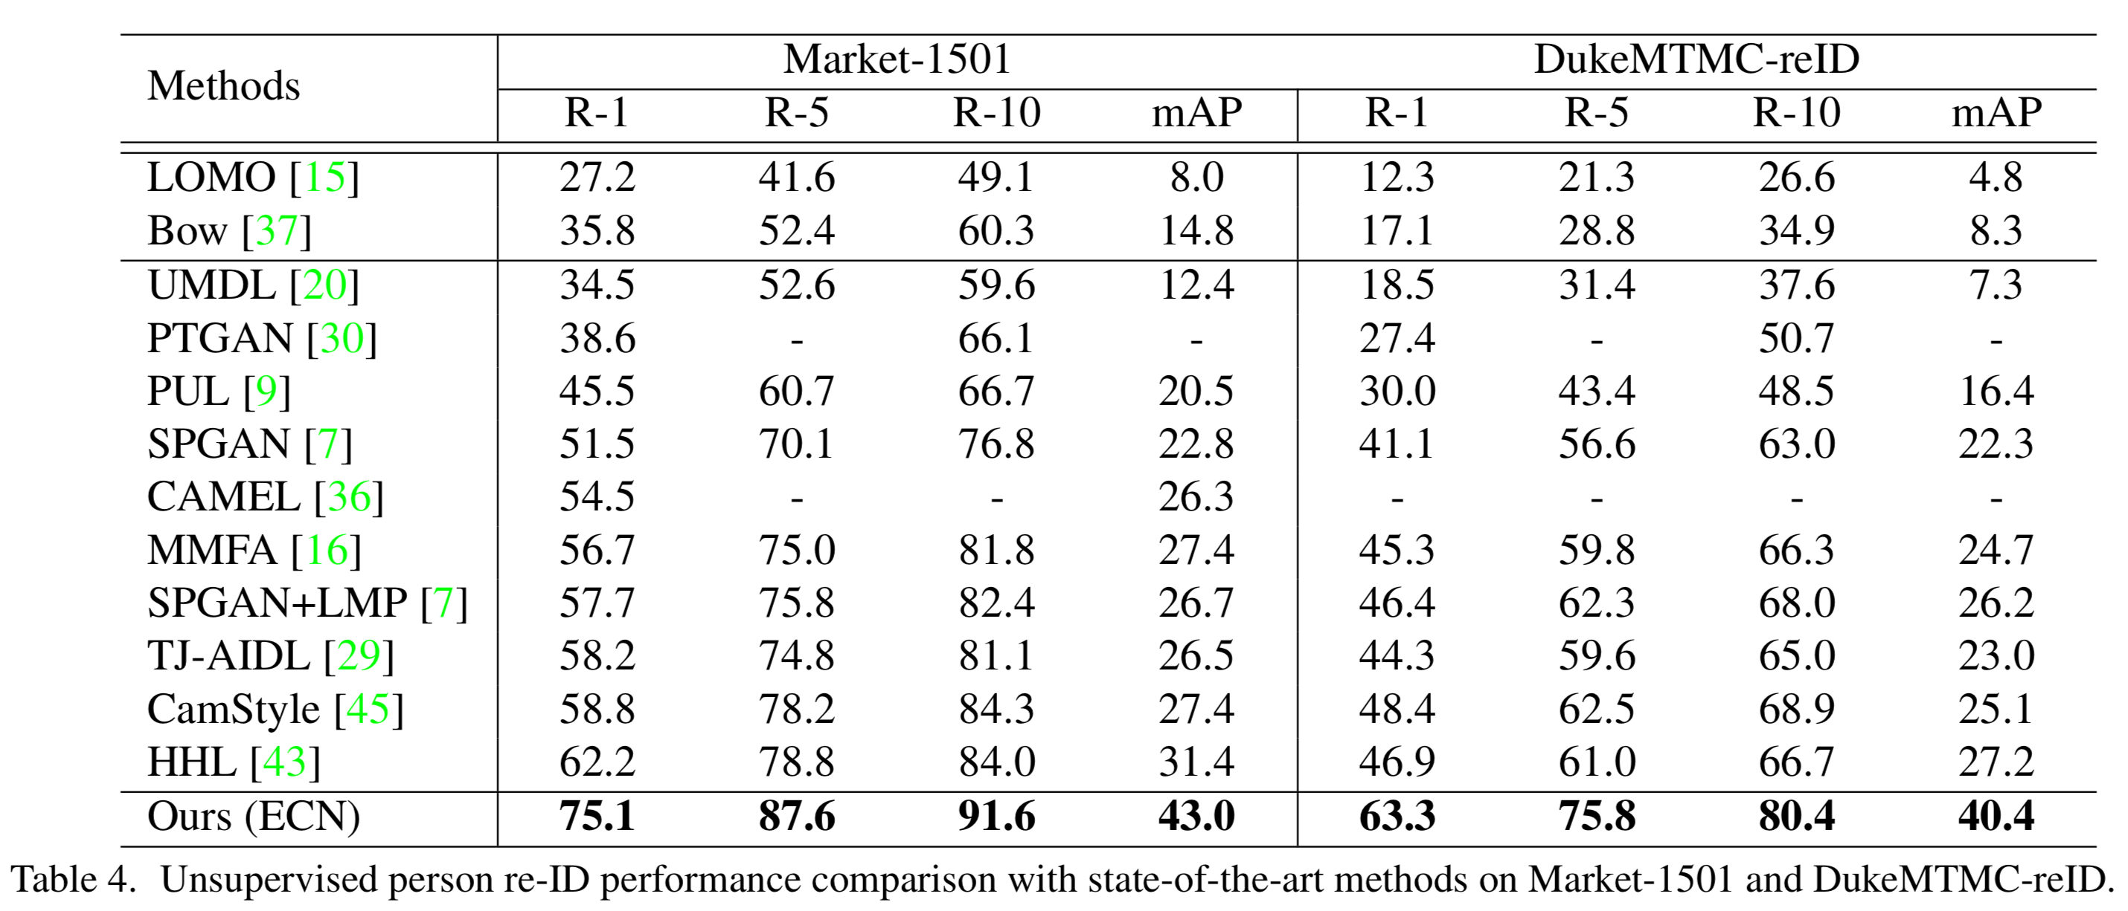
Comparison with State-of-the-art Methods

Slide 24
Conclusion

Slide 25
Advantages
comprehensively study three underlying invariances of the target domain
propose a memory module to effectively enforce the three invariance properties into the system
outperform the state-of-the-art UDA approaches
Disadvantages
When perform Exemplar-invariance , this paper ignored the exemplar shared the same identity
When perform Neighborhood-invariance, this paper will lead the exemplar belong to different identities to be close.

Slide 26
Thanks

