Slide 1
Densely Connected Convolutional Networks CVPR 2017
Gao Huang Cornell University
Zhuang Liu Tsinghua University
Laurens van der Maaten Facebook AI Research
Kilian Q. Weinberger Cornell University
Ren Jing
Feng Rui
18210240159
16/11/2018

Slide 2
Contents
1. Introduction
2. DenseNets
3. Experiments
4. Conclusion
5. References

Slide 3
1. Introduction
Contrast:
ResNet
Inception(GoogleNet)

Slide 4
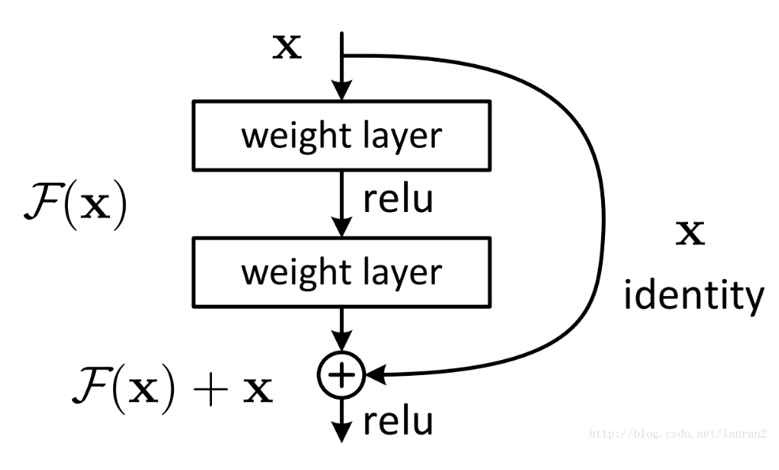
1. Introduction
Contrast:
ResNet

Slide 5
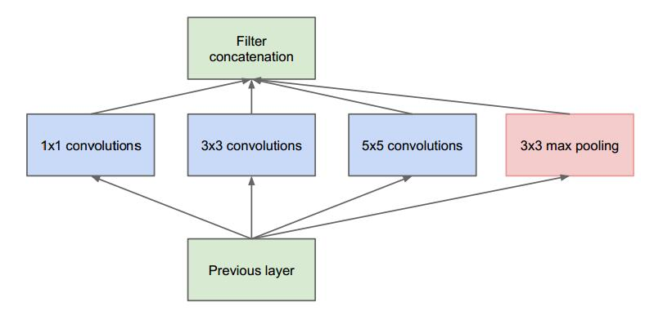
1. Introduction
Contrast:
Inception

Slide 6
1. Introduction
Key Characteristic:
shorten path from early layers to later layers
connect all layers directly

Slide 7
1. Introduction
Advantages:
alleviate the vanishing-gradient problem
strengthen feature propagation
encourage feature reuse
reduce the number of parameters

Slide 8
Contents
1. Introduction
2. DenseNets
3. Experiments
4. Conclusion
5. References

Slide 9
2. DenseNets
Res Block:

Slide 10
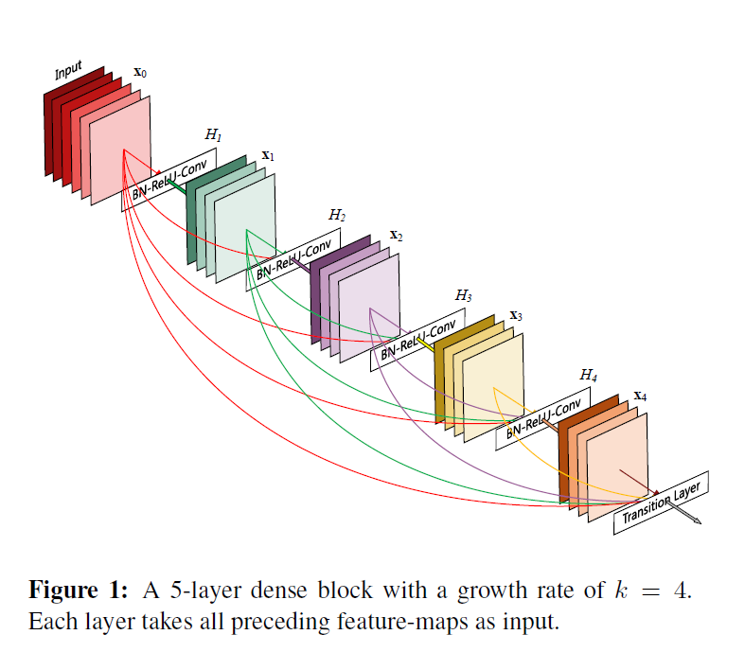
2. DenseNets
Dense Block:

Slide 11


2. DenseNets
Equation:
ResNets
DenseNets
[ · · · ] Concatenation

Slide 12
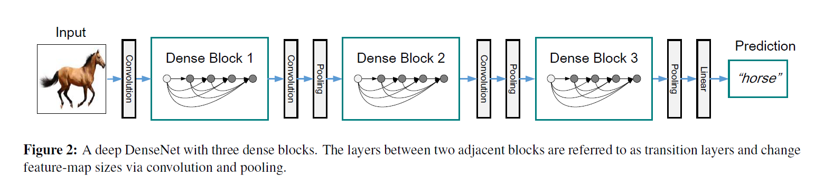
2. DenseNets
DenseNet:

Slide 13
2. DenseNets
DenseNet-BC:
B Bottleneck layer
C Translation layer

Slide 14
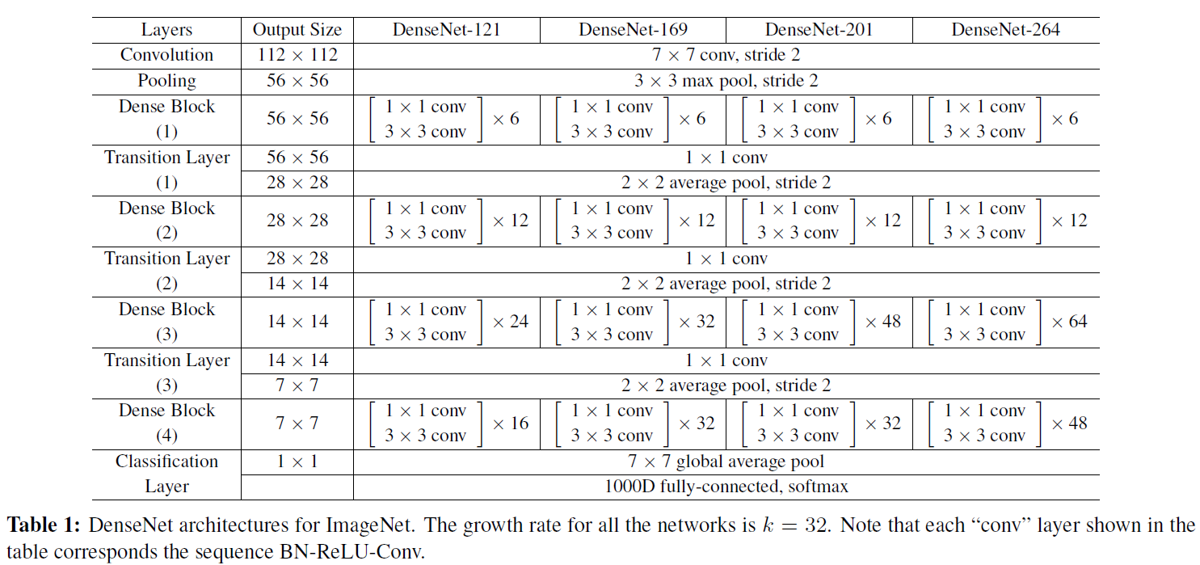
2. DenseNets
DenseNet:

Slide 15
Contents
1. Introduction
2. DenseNets
3. Experiments
4. Conclusion
5. References

Slide 16
3. Experiments
Datasets:
CIFAR (C10, C100)
SVHN
ImageNet

Slide 17
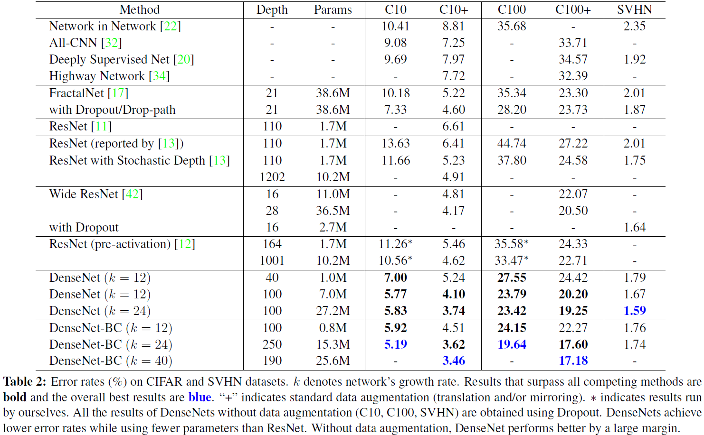
3. Experiments
Results:

Slide 18
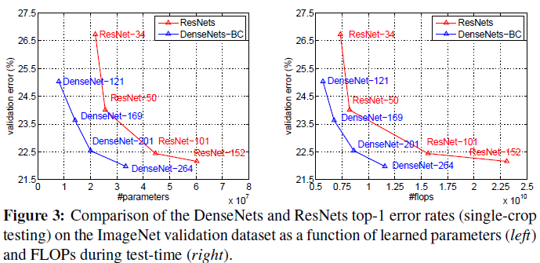
3. Experiments
Results:

Slide 19
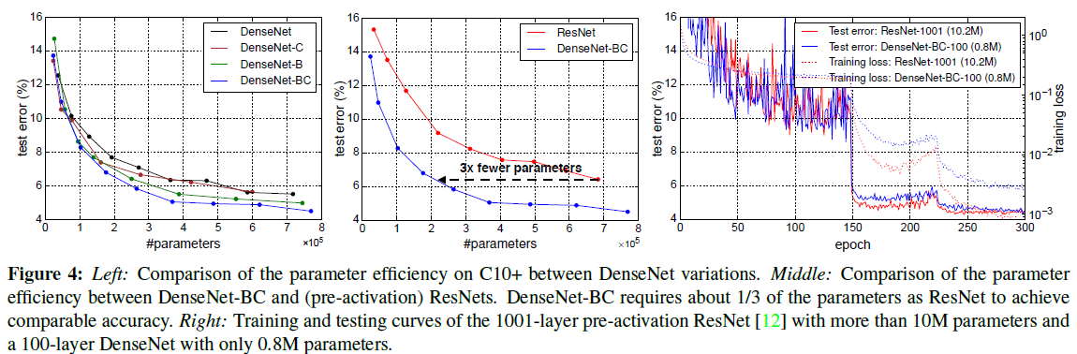
3. Experiments
Results:

Slide 20
Contents
1. Introduction
2. DenseNets
3. Experiments
4. Conclusion
5. References

Slide 21
4. Conclusion
proposed a new convolutional network architecture
direct connections between any two layers
scale to hundreds of layers
improvement in accuracy(lower error rate)
fewer parameters & less computation

Slide 22
Contents
1. Introduction
2. DenseNets
3. Experiments
4. Conclusion
5. References

Slide 23

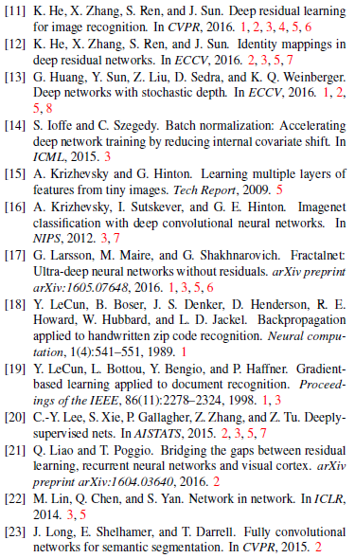
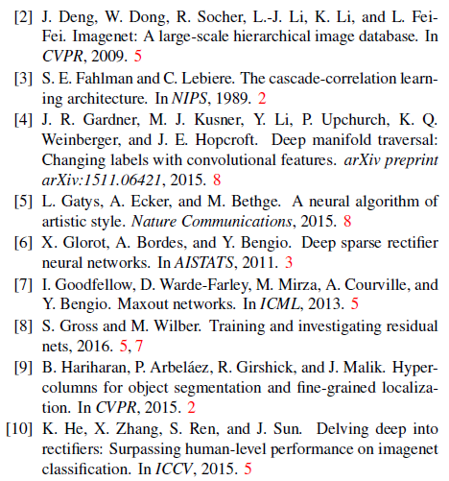
5. References

Slide 24
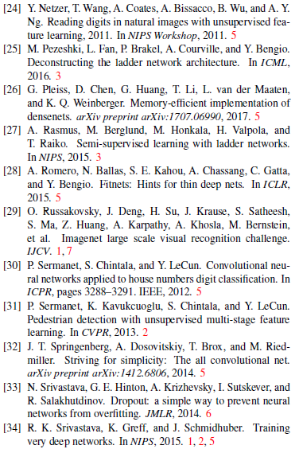
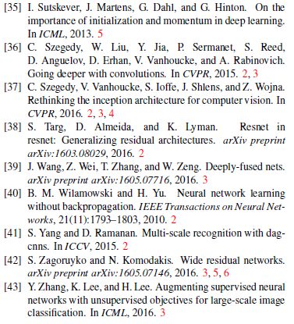
5. References

Slide 25
Thank you for listening!
Ren Jing
Feng Rui
18210240159
16/11/2018

