Slide 1
DetNet:
A Backbone network for Object Detection
Zeming Li¹, Chao Peng², Gang Yu², Xiangyu Zhang², Yangdong Deng¹, Jian Sun²
¹School of Software, Tsinghua University, { lizm15@mails.tsinghua.edu.cn,
dengyd@tsinghua.edu.cn }
² Megvii Inc. (Face++), { pengchao, yugang, zhangxiangyu,
sunjian }@megvii.com
@ECCV:201804
Shuyu Miao
November 2, 2018

Slide 2
Contents
01
02
03
04
Introduction
Motivation
Design
Experiments

Slide 3
01
Introduction

Slide 4
Introduction
Recent CNN based object detectors
one-stage methods: YOLO , SSD , RetinaNet
two-stage detectors: Faster R-CNN , R-FCN , FPN
Directly finetune from ImageNet pre-trained models designed for im-
age classification.

Slide 5
Introduction
image classification VS object detection
Object detection not only needs to recognize the category of the object instances but also spatially locate the position
Large downsampling factor is good for image classification but
compromises the object location ability.
FPN e.g involve extra stages against the task of image classification to handle the objects with various scales.

Slide 6
02
Motivation

Slide 7
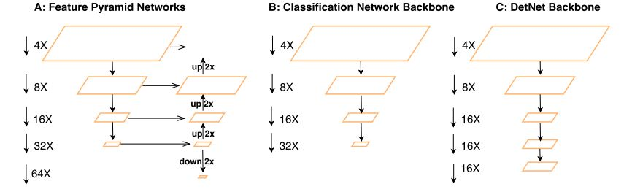
Motivation
The number of network
stages is different
Weak visibility of large
objects
Invisibility of small objects.
How DetNet addresses these problems

Slide 8
Motivation
The number of stages for Object Detection.
Maintain high spatial resolution of the feature maps,
while keeping large receptive field.

Slide 9
Motivation
Contributions of DetNet
First to analyze the inherent drawbacks of traditional ImageNet pre-trained model for fine-tunning recent object detectors.
DetNet is designed for object detection task by maintaining the spatial resolution and enlarging the receptive field.
Achieve new state-of-the-art results on MSCOCO object detection and instance segmentation track

Slide 10
03
Design

Slide 11
Design
Two challenges
keep the spatial resolution
large amount of time and memory
reduce the down-sampling factor
reduce the valid receptive field

Slide 12
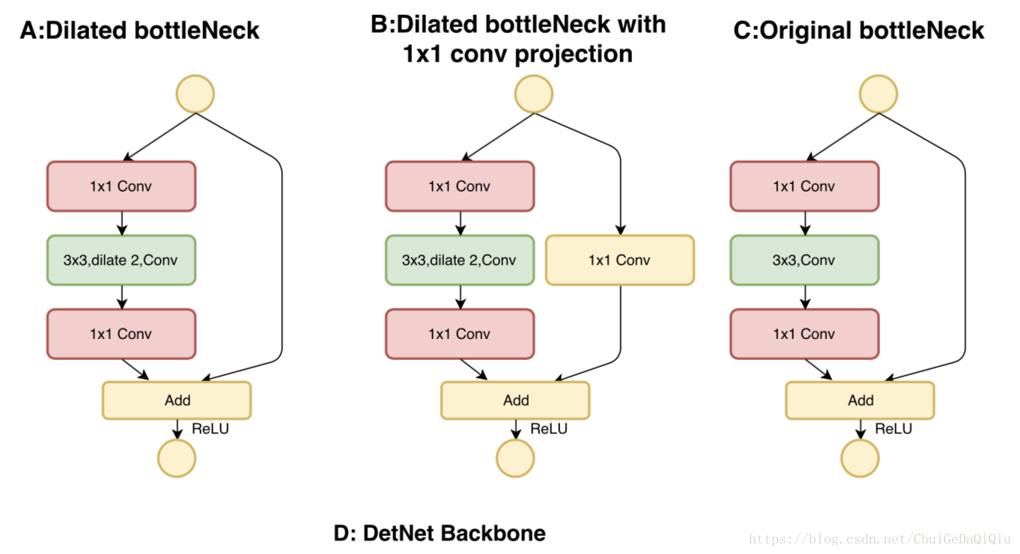
Design

Slide 13
Design
Traditional convolution
Dilated convolution

Slide 14
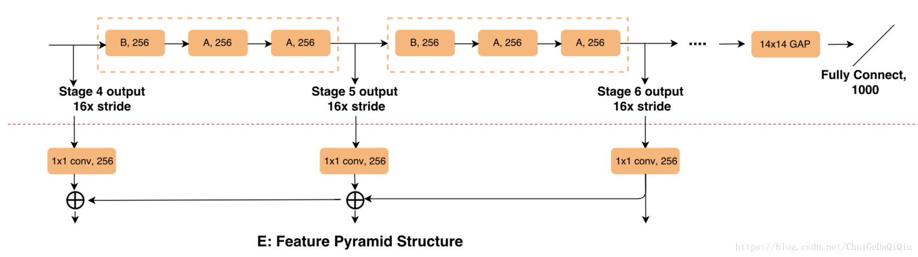
Design
1、Introduce the extra stages, stage 6
2、Fix the spatial resolution as 16x downsampling even after stage 4
3、stage 5 and stage 6 keep the same channels as stage 4
(256 input channels for bottleneck block)

Slide 15
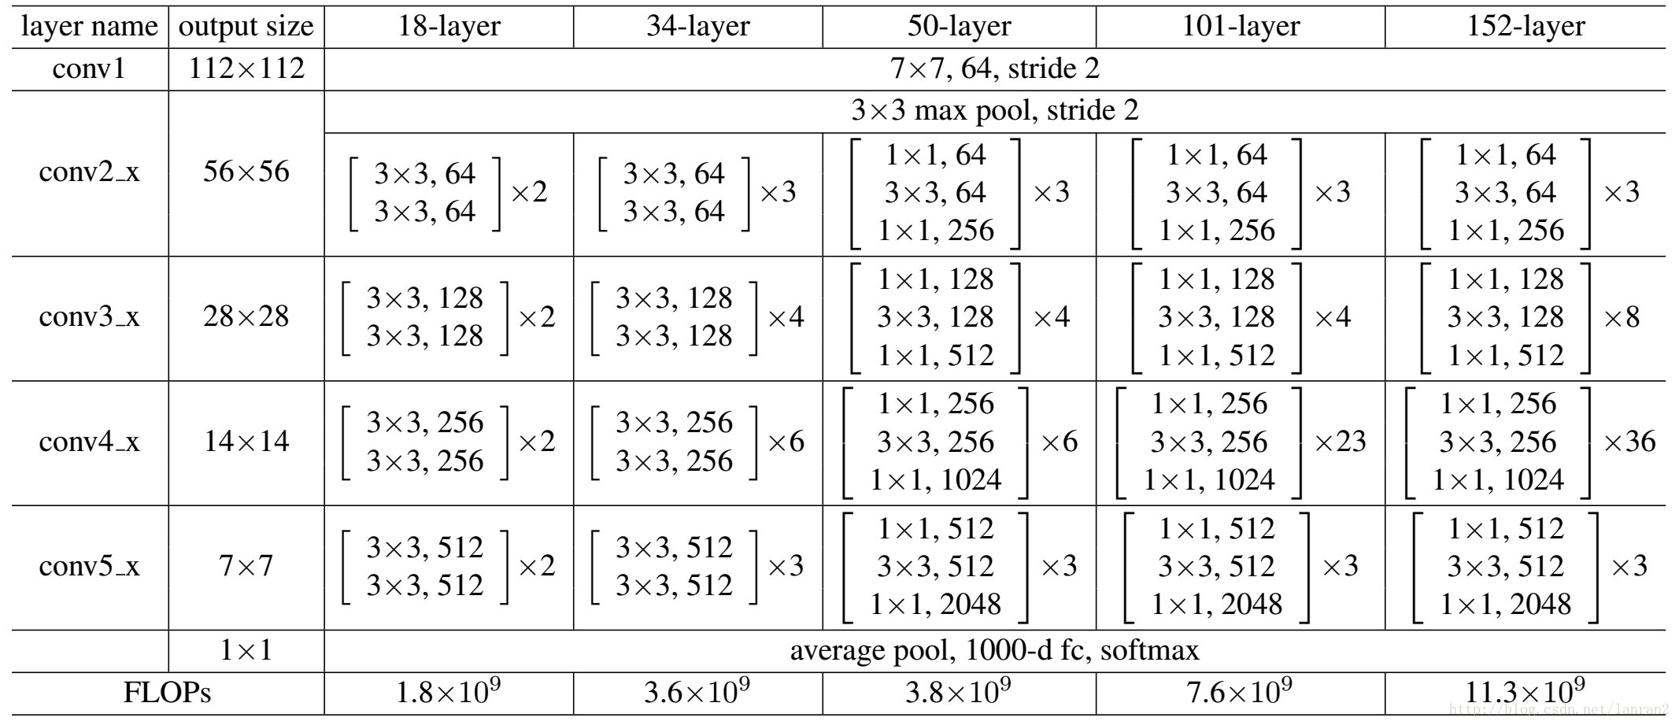

Design
P2
P3
P4
P5
dilated
P6=P5

Slide 16
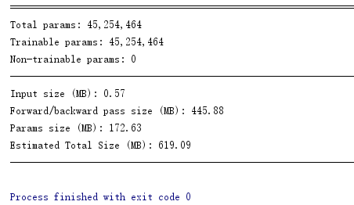
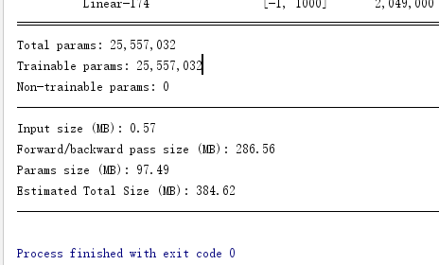
Design
the parameters of detnet59
the parameters of Resnet50

Slide 17
04
Experiments

Slide 18
Experiments
A simple horizontal image flipping data augmentation.
training
mini-batch：2、SGD： weight decay of 0.0001 momentum of 0.9.
MS COCO benchmark、ImageNet pre-trained.

Slide 19
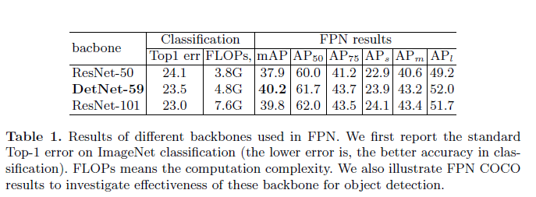
Experiments
Results of different backbones used in FPN

Slide 20
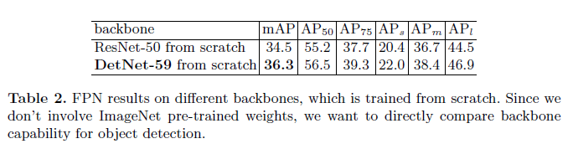
Experiments
FPN results on different backbones which is trained from scratch

Slide 21
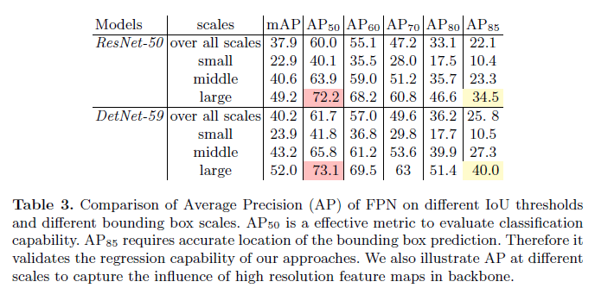
Experiments
AP : how much objects is correctly predicted

Slide 22
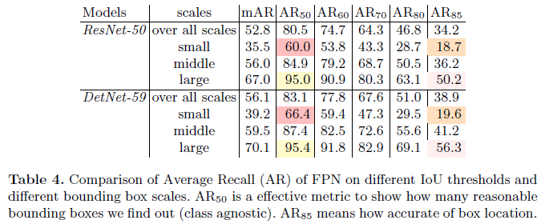
Experiments
AR : how much objects we can find out

Slide 23
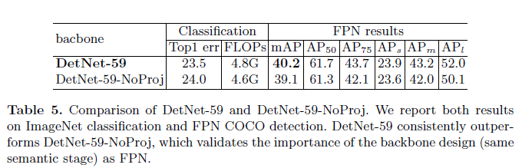
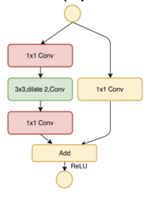
Experiments
Comparison of DetNet-59 and DetNet-59-NoProj

Slide 24
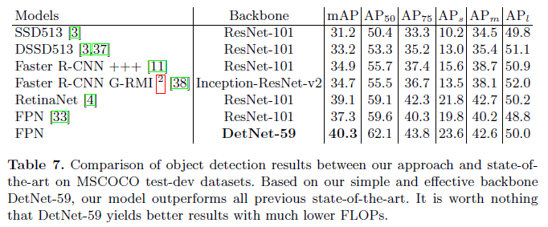
Experiments
Comparison of object detection results

Slide 25
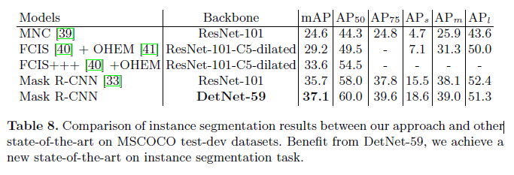
Experiments
Comparison of instance segmentation results

Slide 26
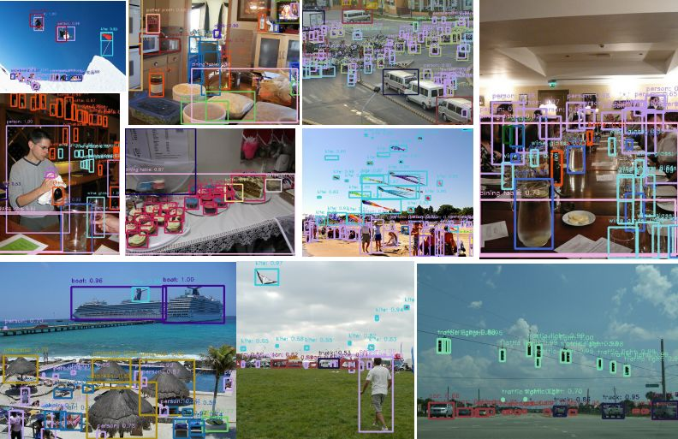
Experiments

Slide 27
THANKS
Q&A

