Slide 1
SuRF: Practical Range Query Filtering with Fast Succinct Tries
2018 SIGMOD Best Paper
Huanchen Zhang，Hyeontaek Lim，Viktor Leis，David G. Andersen，Michael Kaminsky，Kimberly Keeton，Andrew Pavlo
高熙

Slide 2
ABSTRACT
Succinct Range Filter (SuRF), a fast and compact data structure for approximate membership tests
SuRF supports both single-key lookups and common range queries: open-range queries, closed-range queries, and range counts

Slide 3
1 INTRODUCTION
Bloom filters
“Is key 42 in the SSTable?”
“Are there keys between 42 and 1000 in the SSTable?”
B+Tree
The I/O cost of range queries is high enough
Succinct Range Filter
trade between false positive rate and memory consumption
consumes only 10 bits per trie node, which is close to the information-theoretic lower bound
faster

Slide 4
论文中采用字典树为例子

Slide 5
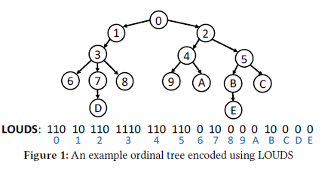
2 FAST SUCCINCT TRIES
Level-Ordered Unary Degree Sequence(LOUDS)
• Position of the i-th node = select0 (i ) + 1
• Position of the k-th child of the node started at p =
select0 (rank1 (p + k)) + 1
• Position of the parent of the node started at p = select1 (rank0 (p))

Slide 6
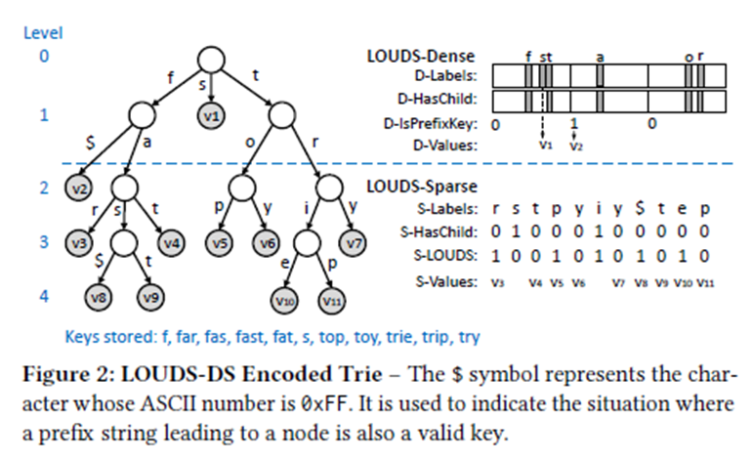
2 FAST SUCCINCT TRIES
LOUDS-Dense
D-ChildNodePos(pos) = 256 ×rank1(D-HasChild, pos)
D-ParentNodePos(pos) = 256 ×select1 (D-HasChild, ⌊pos/256⌋)
D-ValuePos(pos) = rank1(D-Labels,pos) - rank1(D-HasChild, pos) + rank1(D-IsPrefixKey, ⌊pos/256⌋)-1

Slide 7
2 FAST SUCCINCT TRIES
LOUDS-Sparse
S-ChildNodePos(pos) = select1(S-LOUDS, rank1(SHasChild,pos) +1); to move up
S-ParentNodePos(pos) = select1(SHasChild,rank1(S-LOUDS, pos) - 1); to access a value
S-ValuePos(pos) = pos - rank1(S-HasChild, pos) - 1

Slide 8
2 FAST SUCCINCT TRIES
LOUDS-DS and Operations
The cutoff level is defined as the largest l such that
LOUDS-Dense-Size(l) × R ≤ LOUDS-Sparse-Size(l).
R=64 as the default

Slide 9
2 FAST SUCCINCT TRIES
LOUDS-DS and Operations
• ExactKeySearch(key): Return the value of key if key exists (or
NULL otherwise).
• LowerBound(key): Return an iterator pointing to the key-value
pair (k,v) where k is the smallest in lexicographical order satisfying
k ≥ key.
• MoveToNext(iter): Move the iterator to the next key-value.

Slide 10
2 FAST SUCCINCT TRIES
Space and Performance Analysis
n-node LOUDS-Sparse uses 10n bits
Informationtheoretic lower bound (Z) is approximately 9.44n bits
LOUDS-Dense’s size is restricted by the ratio R to ensure that it
does not affect the overall space-efficiency of LOUDS-DS.

Slide 11
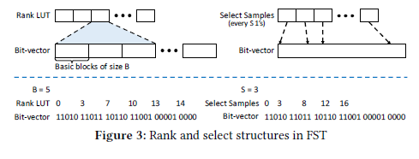
2 FAST SUCCINCT TRIES
Optimizations
rank, select
rank1 (i) = LUT[⌊i/B⌋] + (popcount from bit (⌊i/B⌋ × B) to bit i)
select1 (i ) = LUT[i/S] + (selecting the (i −i/S ×S)th set bit starting from position LUT[i/S] + 1) + 1

Slide 12
2 FAST SUCCINCT TRIES
Optimizations
Label Search
SIMD instructions
Prefetching

Slide 13
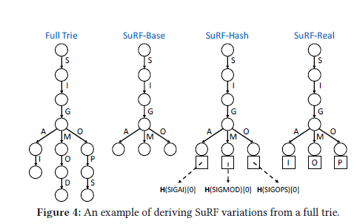
3 SUCCINCT RANGE FILTERS

Slide 14
3 SUCCINCT RANGE FILTERS
SuRF with Mixed Key Suffixes
前面a个字符的前缀用real，再往后b个用hash

Slide 15
3 SUCCINCT RANGE FILTERS
Operations
result = lookup(k)
iter, fp_flag = moveToNext(k)
count, low_fp_flag, high_fp_flag = count(lowKey, highKey)

Slide 16
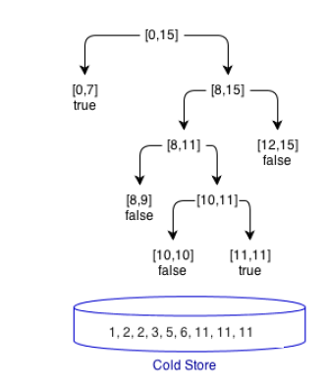
4 FST & SURF MICROBENCHMARKS
ARF

Slide 17
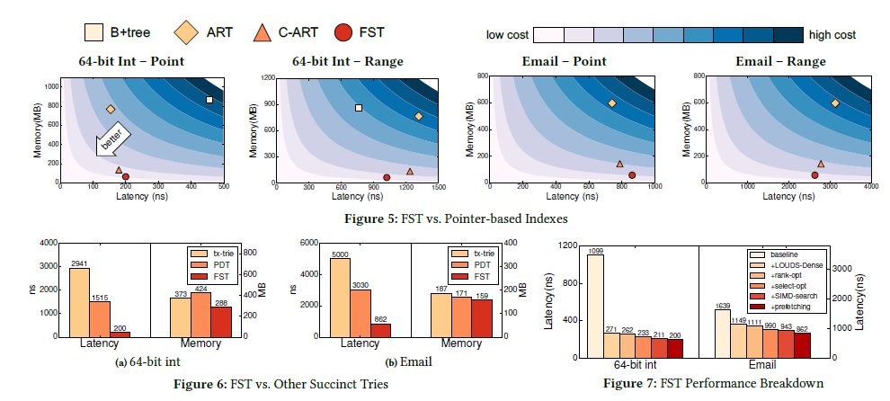
4 FST & SURF MICROBENCHMARKS
Notes:
Baseline 是整个使用裸的LOUDS-Sparse，表中分别是用LOUDS-Dense替代上半部分，以及4个优化

Slide 18
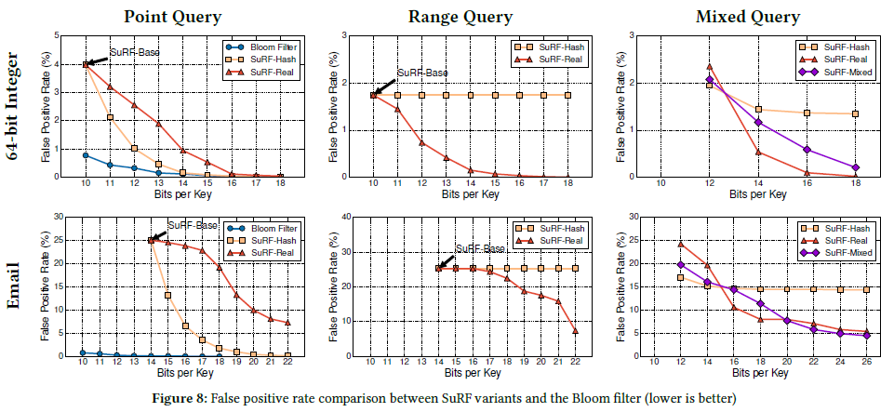
4 FST & SURF MICROBENCHMARKS
mixed (50% point and 50% range, interleaved)

Slide 19
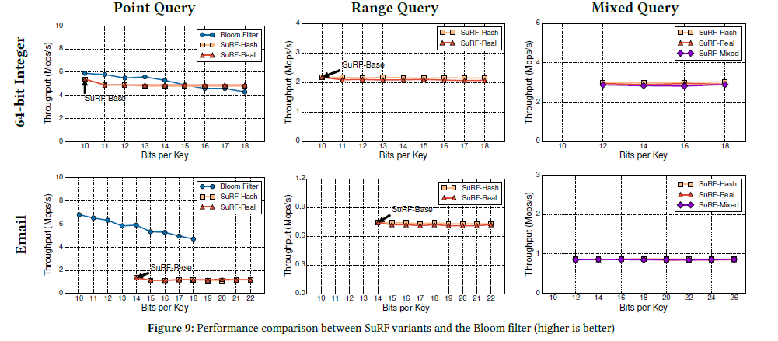
4 FST & SURF MICROBENCHMARKS

Slide 20
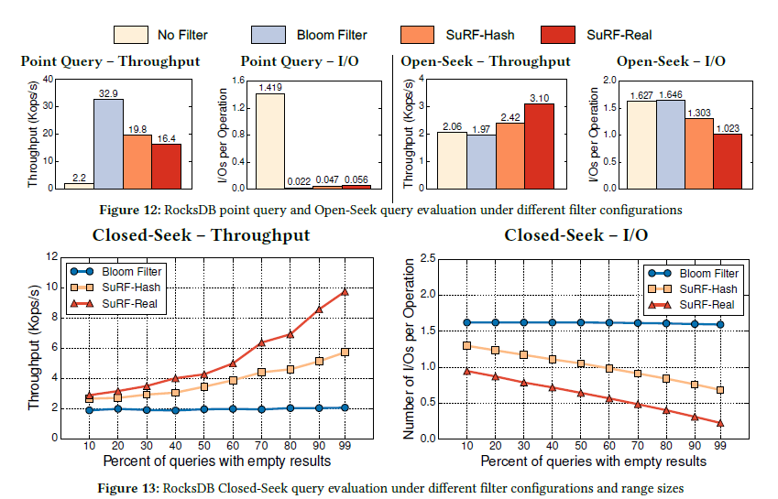
5 EXAMPLE APPLICATION: ROCKSDB

Slide 21
总结
感觉论文核心点是利用了大部分树形存储数据结构（也就和文章强调的range查询息息相关）上半部分稠密，下半部分稀疏的性质分2种存储。
但常常分段存储会带来修改复杂度提高以及结构灵活性下降
为了解决这两个问题，论文采用静态数据结构，同时还强调对于特别长的串采用特殊的截尾方法
值得商榷的是使用静态且长度较固定的邮件和64位整数数据过于迎合这个数据结构，并且实验在内存中进行，而目前先进的数据结构大都是为了平衡磁盘内存读写开销设计的

Slide 22
谢谢大家
高熙

