Slide 1
Generalized End-to-End Loss For Speaker Verification
Authors: Li Wan, Quan Wang, Alan Papir, Ignacio Lopez Moreno
ICASSP 2018
宓仕达

Slide 2
Part 0:
What is speaker verification

Slide 3
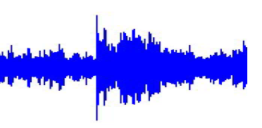
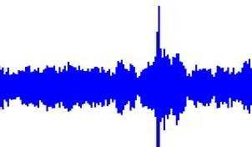
Definition of speaker verification
The process of verifying whether an utterance belongs to a specific speaker, based on that speaker’s known utterances (i.e., enrollment utterances)
Two categories of Speaker verification models:
Text-dependent speaker verification(TD-SV)
Text-independent speaker verification(TI-SV)
utter1
Same Speaker?
utter2

Slide 4
2 stage in speaker verification: Enroll and Verify
Enroll a speaker’ voice:
Record:
Some key word utterance
Several times
Generate:
Embeddings for each utterance
Store:
Averaged embeddings
Verify a speaker’ voice:
Detect:
Voice activity detector
Key word detector
Generate:
Embedding from key word
Compare:
Use cosine similarity to compare the new embedding with the enrolled averaged embeddings.

Slide 5
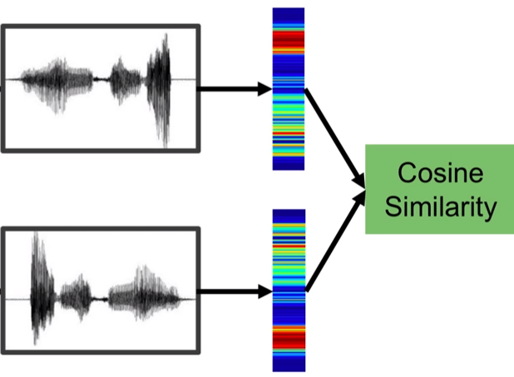
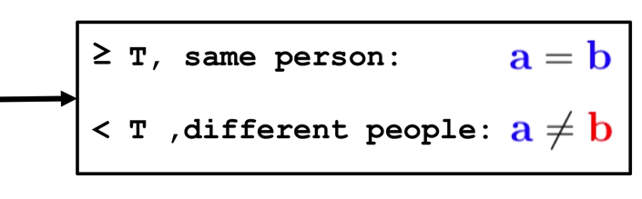

Speaker recognition: Verify
Utter a
Utter b

Slide 6
Categories of speaker verification
Two categories of Speaker verification models:
Text-dependent speaker verification(TD-SV)
Text-independent speaker verification(TI-SV)
utter1
Same Speaker?
utter2

Slide 7
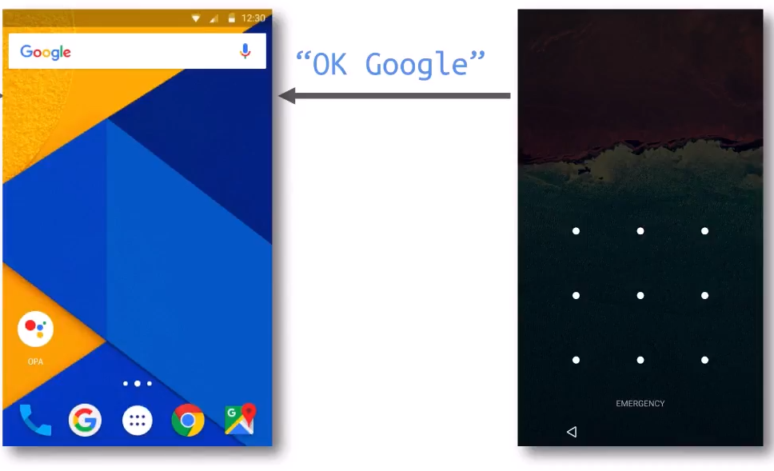
Example applications of speaker verification
Speaker verification at Android Voice Unlock

Slide 8
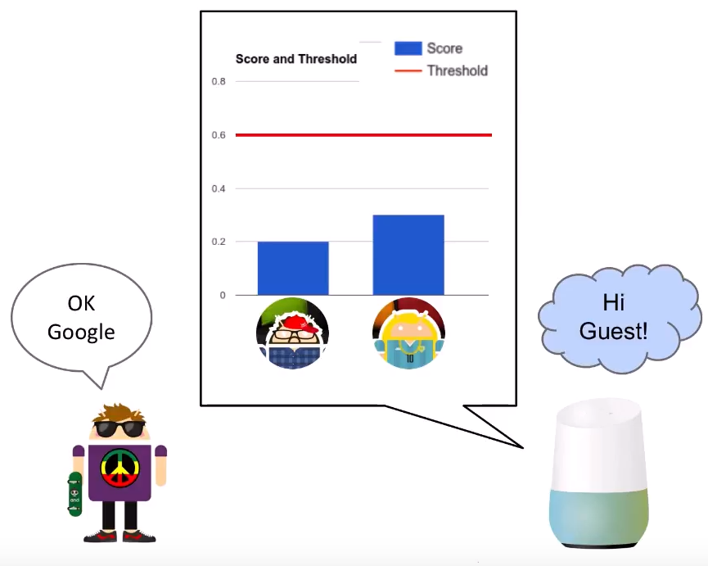
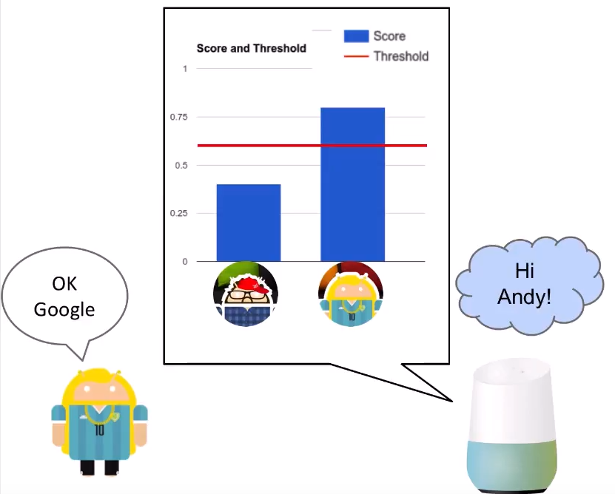
Example applications of speaker verification
Speaker verification at Google-Home Voice Match

Slide 9
Part 1:
Introduction

Slide 10
Speaker embedding
We need to extract fixed dimension speaker discriminative features from audio.
Utterances from same speaker: similar embeddings
Utterances from different speakers: distinct embeddings
Some representative speaker embedding techniques:
I-vector
Najim Dehak, et al.
E2E loss
Georg Heigold, et al.
2011
···
2015
2016
2017
Triplet loss (FaceNet)
Florian Schroff, et al.
GE2E loss
Li Wan, et al.
D-vector

Slide 11
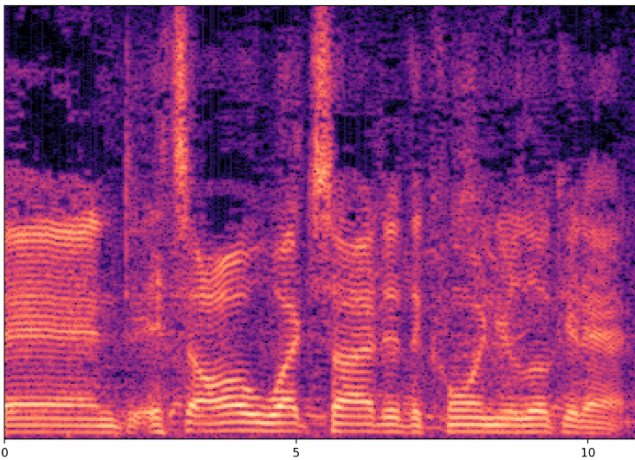
Speaker embedding with LSTM
LSTM
Cell
LSTM
Cell
LSTM
Cell
LSTM
Cell
LSTM
Cell
LSTM
Cell
LSTM
Cell
LSTM
Cell
LSTM
Cell
Evaluation utterance
(fixed-length)
Multi-layer LSTM network
D-vector

Slide 12
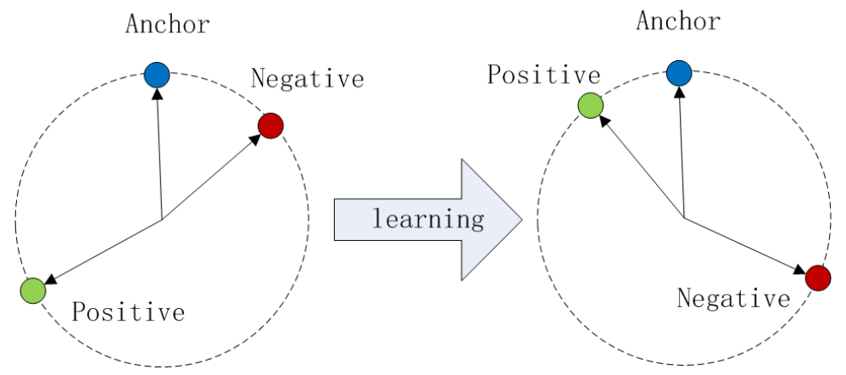
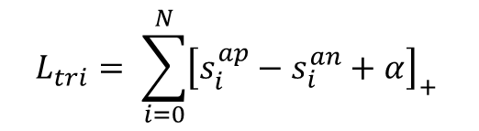
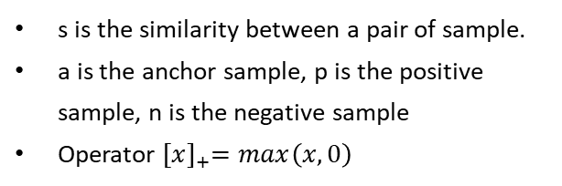
Loss function – Triplet loss
The triplet loss minimizes the distance between an anchor and a positive, both of which have the same identity, and maximizes the distance between the anchor and a negative of different identity.
$$L_{tri}= \sum_{i=0}^{N}{{\left[s_{i}^{ap}−s_{i}^{an}+α\right]}_{+}}$$
s is the similarity between a pair of sample.
a is the anchor sample, p is the positive sample, n is the negative sample
Operator ${[x]}_{+}=max\left(x, 0\right)$
Pros:
Simple and efficient
It models how we want the embedding space to be correctly
Cons:
Does not simulate runtime enrollment behavior(It’s not end-to-end)
Difficult to choose semi-hard pairs to accelerate convergence

Slide 13
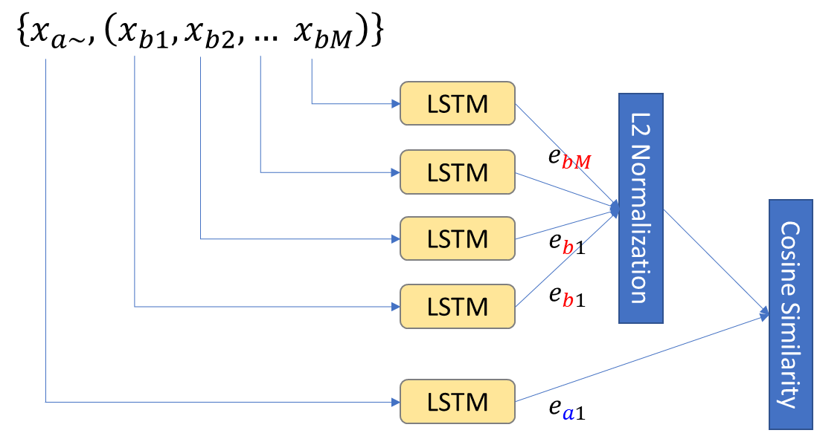
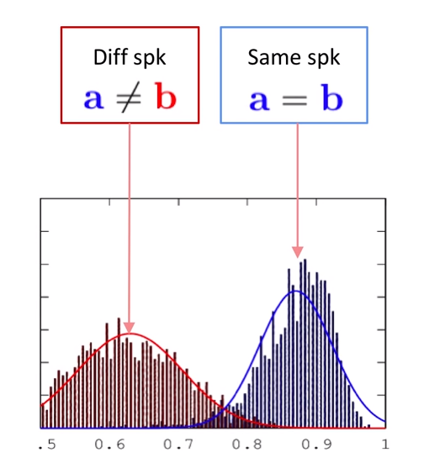
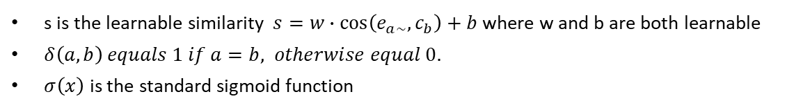

Loss function – Tuple-Based End-to-End loss
TE2E simulates the 2-stage process of runtime enrollment and verification during training.
$$c_{b }$$
$$L_{TE2E}\left(e_{a\sim }, c_{b}\right)=δ\left(a,b\right)σ\left(s\right)+\left(1−δ\left(a,b\right)\right)\left(1−σ\left(s\right)\right)$$
s is the learnable similarity $s=w∙\cos\left(e_{a\sim },c_{b}\right)+b$ where w and b are both learnable
$δ\left(a, b\right) equals 1 if a=b, otherwise equal 0.$
$σ\left(x\right)$ is the standard sigmoid function
TE2E loss encourages a larger value of s when k = j, and a smaller value of s when k ≠ j.

Slide 14
Loss function – Tuple-Based End-to-End loss
Accept/reject
Logistic regression
Pros:
Simulates runtime behavior in the loss function
Each (N+1)-tuple contains all utterance involved in a verification decision
Cons:
Tuples are constructed randomly from training set, so most of them are easy – training is relatively inefficient
Need an initial stage of example selection
Score function
cosine similarity
Speaker Representation
Speaker Model
average
···
LSTM
···
evaluation utterance
enrollment utterance 1
enrollment utterance M

Slide 15
Overview
GE2E loss is a generalization of Google ’s TE2E architecture. This new architecture constructs tuples from input sequences of various lengths in a more efficient way
Model with GE2E learns a better model, by decreasing EER by more than 10%, and reducing the training time by more than 60%
What’s next
The definition of GE2E loss
Why GE2E updates the model parameters more effectively
Experimental results

Slide 16
Part 2:
Generalized End-to-End Loss Model

Slide 17
Generalized End-to-End loss
The GE2E loss is based on processing a large number of utterances at once. It minimizes the distance between the evaluation embedding and its own speaker’s centroids, and maximum the distance between the embeddings and other embeddings, especially the closed false one.
e_{ji}
C_{k’}
C_{j}
C_{k}
For each embedding e_{ji}, we only look at its distance to:
True speaker centroid c_{j}
Closest false speaker centroid c_{k}

Slide 18
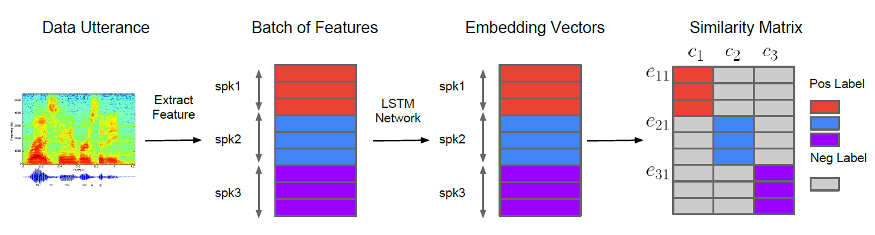
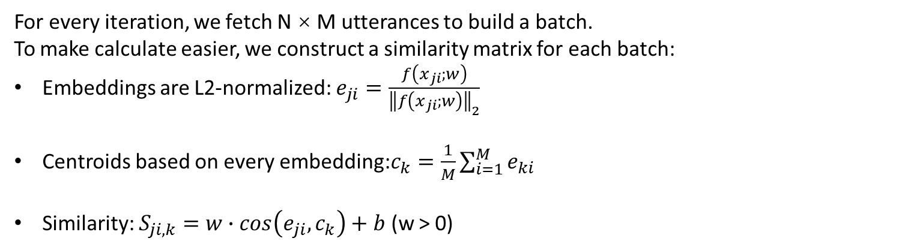
Generalized End-to-End : Similarity matrix
For every iteration, we fetch N × M utterances to build a batch.
To make calculate easier, we construct a similarity matrix for each batch:
Embeddings are L2-normalized: $e_{ji}=\frac{f\left(x_{ji};w\right)}{{\left\|f\left(x_{ji};w\right)\right\|}_{2}}$
Centroids based on every embedding:$c_{k}=\frac{1}{M}\sum_{i=1}^{M}{e_{ki}}$
Similarity: $S_{ji, k}=w∙cos\left(e_{ji}, c_{k}\right)+b$ (w > 0)

Slide 19
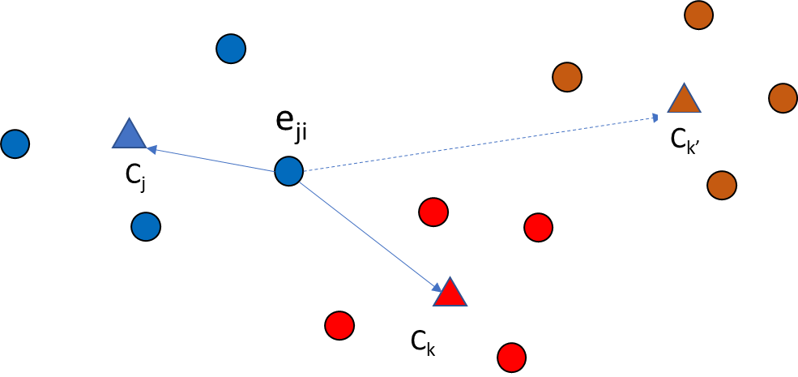
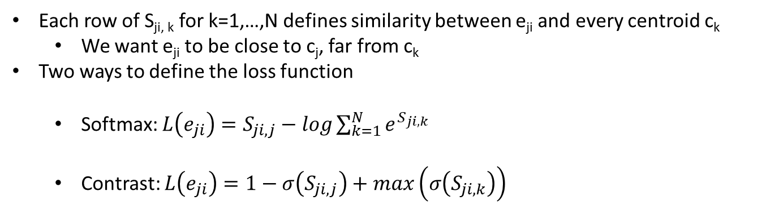
Generalized End-to-End : Loss Function
One Training Batch
Each row of S_{ji, k} for k=1,…,N defines similarity between e_{ji} and every centroid c_{k}
We want e_{ji} to be close to c_{j}, far from c_{k}
Two ways to define the loss function
Softmax: $L\left(e_{ji}\right)=S_{ji,j}−log\sum_{k=1}^{N}{e^{S_{ji,k}}}$
Contrast: $L\left(e_{ji}\right)=1−σ\left(S_{ji, j}\right)+max\left(σ\left(S_{ji,k}\right)\right)$

Slide 20
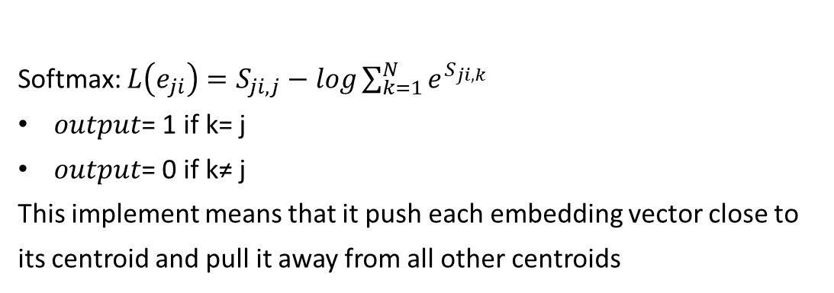
Generalized End-to-End : Loss Function
One Training Batch
Softmax: $L\left(e_{ji}\right)=S_{ji,j}−log\sum_{k=1}^{N}{e^{S_{ji,k}}}$
$output$= 1 if k= j
$output$= 0 if k≠ j
This implement means that it push each embedding vector close to its centroid and pull it away from all other centroids
Good for text-independent applications

Slide 21
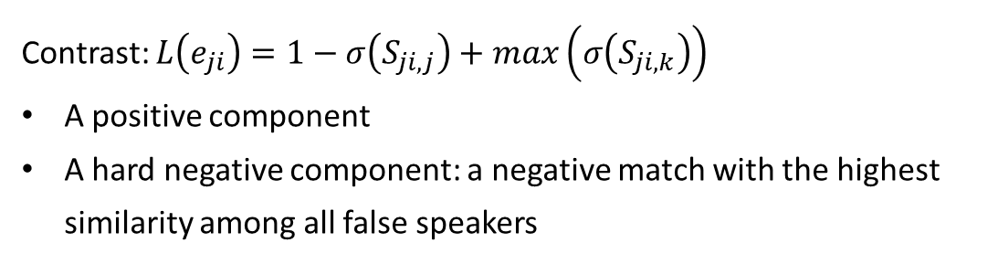
Generalized End-to-End : Loss Function
One Training Batch
Contrast: $L\left(e_{ji}\right)=1−σ\left(S_{ji, j}\right)+max\left(σ\left(S_{ji,k}\right)\right)$
A positive component
A hard negative component: a negative match with the highest similarity among all false speakers
Good for keyword-based applications

Slide 22
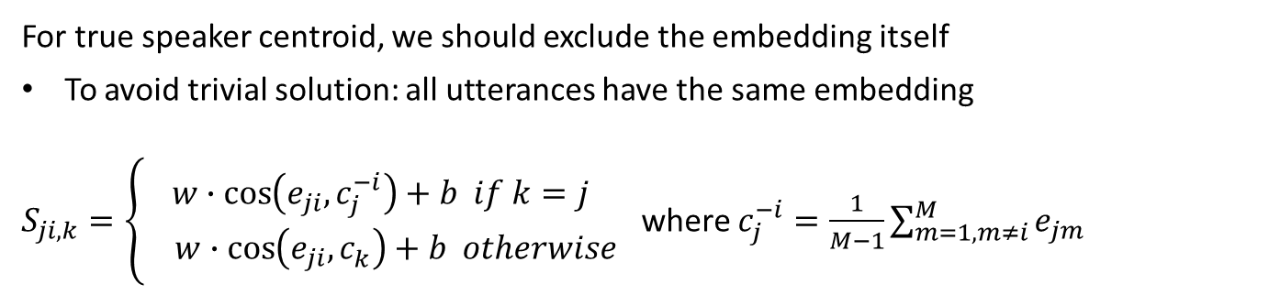
Generalized End-to-End : compute the centroid
One Training Batch
For true speaker centroid, we should exclude the embedding itself
To avoid trivial solution: all utterances have the same embedding
$S_{ji, k}=\left\{\begin{aligned}w∙\cos\left(e_{ji}, c_{j}^{−i}\right)+b if k=j \\ w∙\cos\left(e_{ji}, c_{k}^{ }\right)+b otherwise\end{aligned}\right.$ where $c_{j}^{−i}=\frac{1}{M−1}\sum_{m=1,m≠i}^{M}{e_{jm}}$

Slide 23
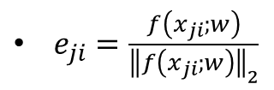
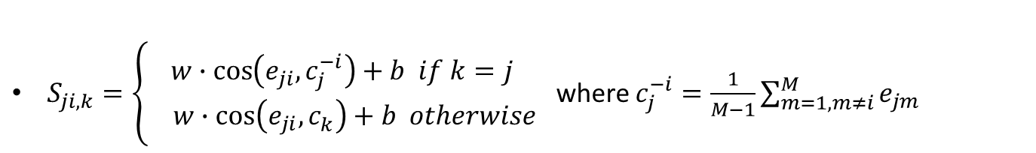


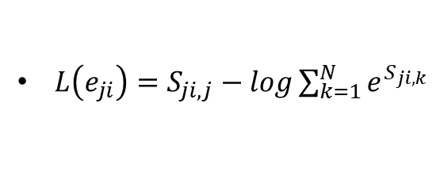
Generalized End-to-End : Final GE2E loss function
$e_{ji}=\frac{f\left(x_{ji};w\right)}{{\left\|f\left(x_{ji};w\right)\right\|}_{2}}$
$L\left(e_{ji}\right)=S_{ji,j}−log\sum_{k=1}^{N}{e^{S_{ji,k}}}$
$L\left(e_{ji}\right)=1−σ\left(S_{ji, j}\right)+max\left(σ\left(S_{ji,k}\right)\right)$
$S_{ji, k}=\left\{\begin{aligned}w∙\cos\left(e_{ji}, c_{j}^{−i}\right)+b if k=j \\ w∙\cos\left(e_{ji}, c_{k}^{ }\right)+b otherwise\end{aligned}\right.$ where $c_{j}^{−i}=\frac{1}{M−1}\sum_{m=1,m≠i}^{M}{e_{jm}}$
$$L_{G}\left(x:w\right)=L_{G}\left(S\right)=\sum_{j, i}{L_{ }\left(e_{ji}\right)}$$

Slide 24
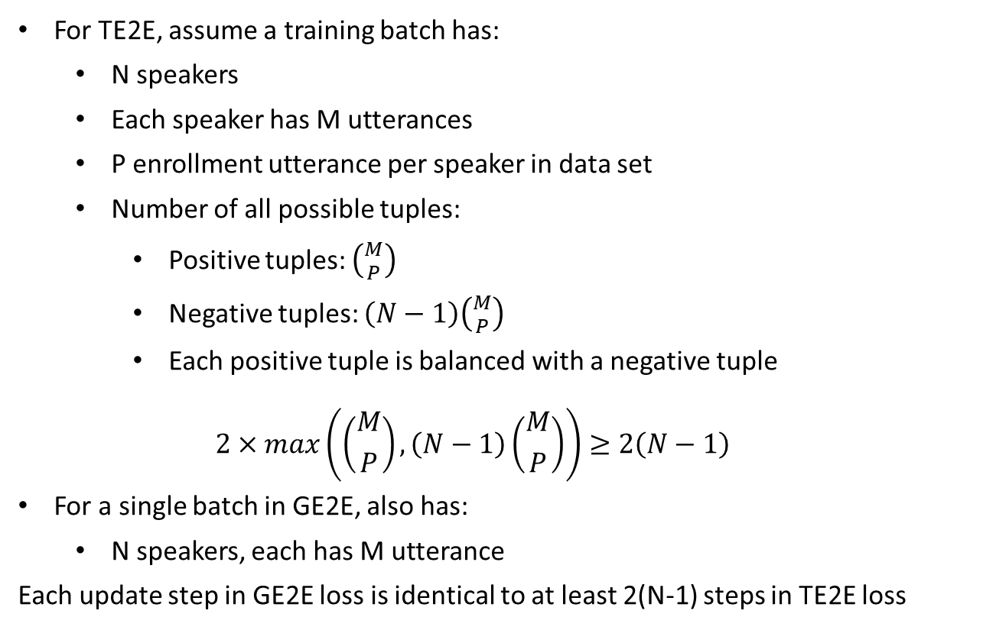
Comparison between TE2E and GE2E
For TE2E, assume a training batch has:
N speakers
Each speaker has M utterances
P enrollment utterance per speaker in data set
Number of all possible tuples:
Positive tuples: $\left({M \atop P}\right)$
Negative tuples: $\left(N−1\right)\left({M \atop P}\right)$
Each positive tuple is balanced with a negative tuple
$$2×max\left(\left({M \atop P}\right), \left(N−1\right)\left({M \atop P}\right)\right)≥2\left(N−1\right)$$
For a single batch in GE2E, also has:
N speakers, each has M utterance
Each update step in GE2E loss is identical to at least 2(N-1) steps in TE2E loss

Slide 25
Part 3:
Text-Independent Speaker
Verification

Slide 26
Text-Independent
Text-independent: identify arbitrary speech
Challenge:
Length of utterance can vary: Unlike keyword based verifying, where we can assume fixed-length for keyword segment
Solution:
Training:
Divide training utterances into partial utterances.
Don’t require all partial utterances to be of the same length, while all partial utterances in a same batch must be of the same length.
Inference:
Apply a sliding window for every utterance
Compute window-level d-vectors for each window
Generate utterance-level d-vectors with L2-normalizing the window-level d-vectors

Slide 27
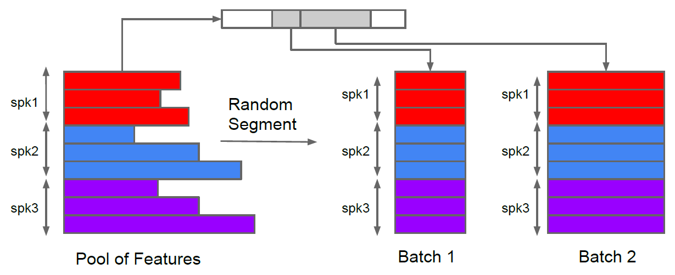
Text-Independent: Training
Training:
Divide training utterances into partial utterances.
Randomly choose a time length t within [lb, ub] = [140, 180] frames
Group utterances by length: every batch contains same length utterances

Slide 28
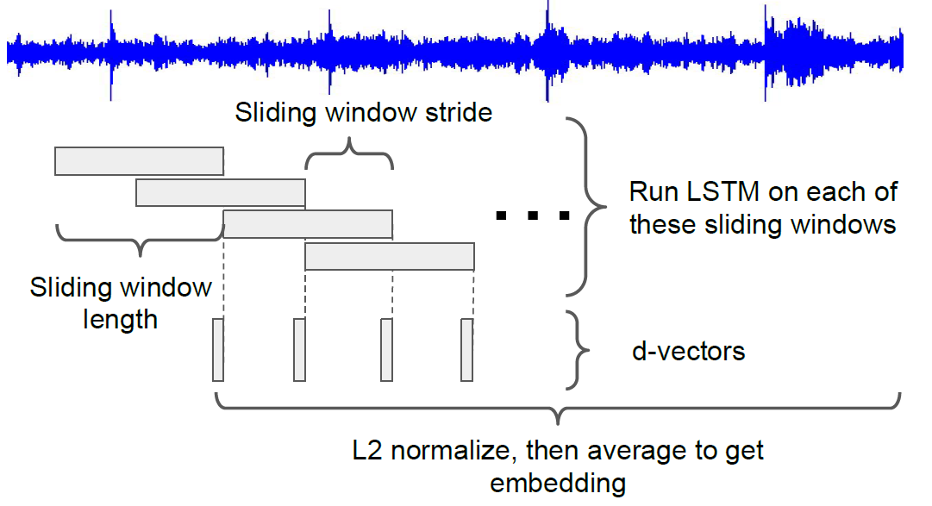
Text-Independent: Sliding window inference
Inference:
Apply a sliding window for every utterance
Compute window-level d-vectors for each window
Generate utterance-level d-vectors with L2-normalizing the window-level d-vectors

Slide 29
Part 4:
Experiment Results

Slide 30
TE2E vs GE2E
Text-dependent experiments:
Model architecture |  | Loss | Average EER(%)
LSTM (cell, proj)*layer | Linear Embedding
(128, 64)*3 | 64 | TE2E | 3.55
(128, 64)*3 | 64 | GE2E | 3.10

Slide 31
TE2E vs GE2E
Text-independent experiments:
Inference | Loss | Other | EER(%)
Full sequence | Softmax | / | 4.06
Sliding window | TE2E | / | 4.06
Sliding window | GE2E | / | 3.55
Sliding window | GE2E | Larger training set Test normalization | 2.75
3 times faster to converge
3 times faster to converge

Slide 32
Thanks for watching

