Slide 1

T-CNN
Tubelets with Convolutional Neural Networks
for Object Detection from Videos
课程：智能视频监控技术
Reporter：邓雪
2018.10.26

Slide 2
1
Introduction
CONTENTS
2
Overall Framework
3
Experiments
4
Conclusion
5
References

Slide 3
Part 1
Introduction
Background
Object Detection from Still images
Object Detection in Videos

Slide 4
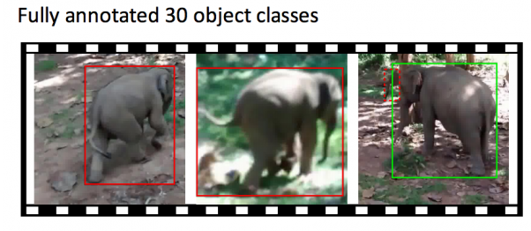
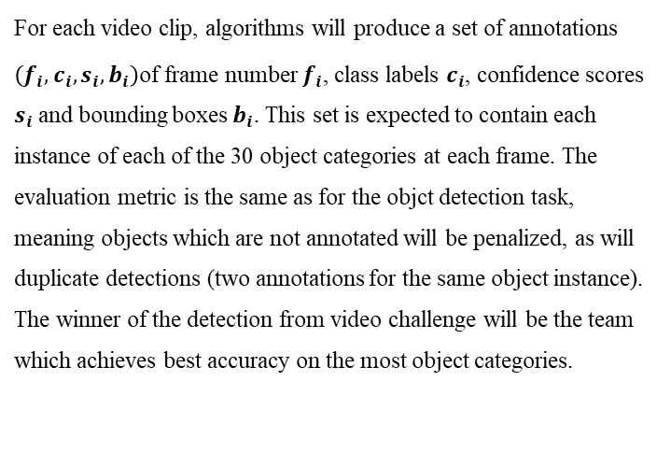
Background
ILSVRC2016
TASK III : Object detection from video(VID)
Fully annotated 30 object classes
There are 30 basic-level categories for this task, which is a subset of the 200 basic-level categories of the object detection task. The categories were carefully chosen considering different factors such as movement type, level of video clutterness, average number of object instance, and several others. All classes are fully labeled for each clip.
For each video clip, algorithms will produce a set of annotations
$\left(f_{i},c_{i},s_{i},b_{i}\right)$of frame number $f_{i}$, class labels $c_{i}$, confidence scores $s_{i}$ and bounding boxes $b_{i}$. This set is expected to contain each instance of each of the 30 object categories at each frame. The evaluation metric is the same as for the objct detection task, meaning objects which are not annotated will be penalized, as will duplicate detections (two annotations for the same object instance). The winner of the detection from video challenge will be the team which achieves best accuracy on the most object categories.

Slide 5
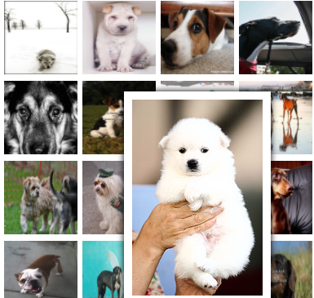
Still Images
Object Detection from Still Images
Detection Algorithm based on deep CNNs
The state-of-the-art frameworks for object detection such as R-CNN and its successors , extract deep convolutional features from region proposals and classify the proposals into different classes.
RCNN
Fast R-CNN
Faster R-CNN

Slide 6
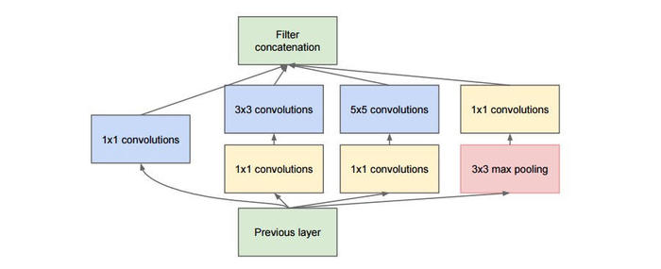
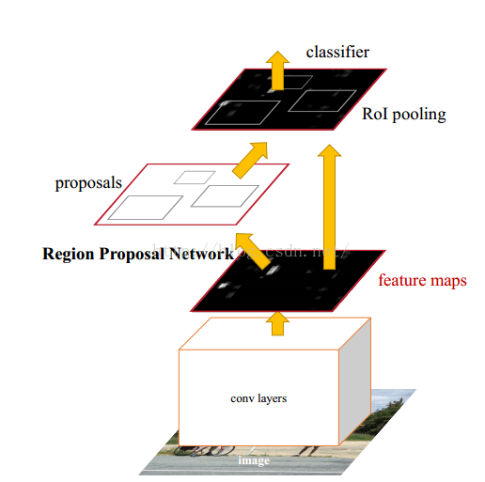
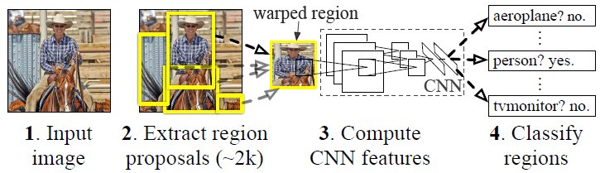
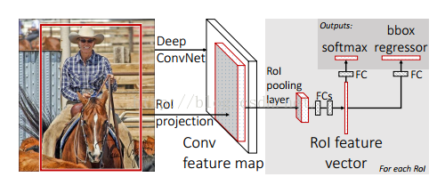
Still Images
R-CNN(Regions with Convolutional Neural Networks)
GoogLeNet
Fast R-CNN
Faster R-CNN

Slide 7
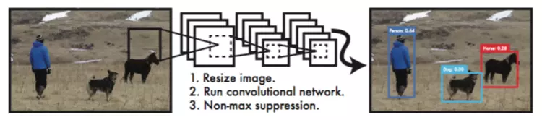
Direct Regression Frameworks
YOLO(You Only Look Once)
YOLO divided the image into even grids and simultaneously predicted the bounding boxes and classification scores.

Slide 8
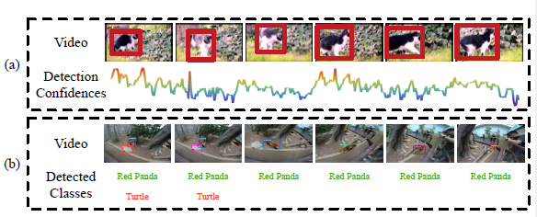
VID
Object Detection in Videos
Key Element
Temporal Information
Detections from still-image detectors contain large temporal fluctuations, because they do not incorporate temporal consistency and constraints.
Contextual Information
Still-image detectors may generate false positives solely based the information on single frames, while these false positives can be distinguished considering the context information of the whole video
Limitations of still-image detectors on videos

Slide 9
Tublet Re-scoring
Part 2
Overall Framework
Still-image object detection
MCS and MGS
Tublet Re-scoring
Model Combination

Slide 10
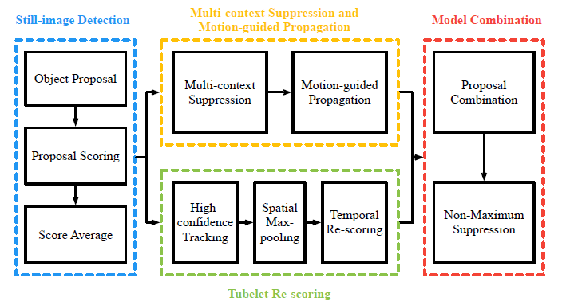
Overall Framework
Overall Framework

Slide 11
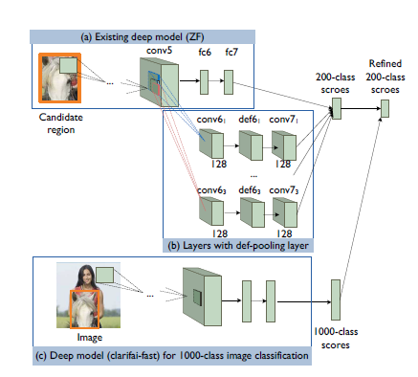
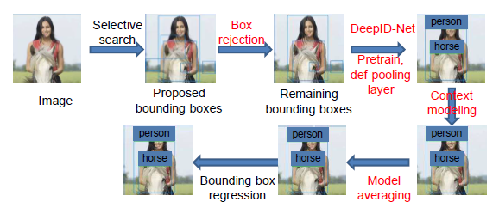
Still-image object Detection
DeepID-Net
Object region proposals
The object region proposals are obtained by selective search (SS) and Edge Boxes (EB) with a cascaded selection process that eliminates easy false positive boxes using an ImageNet pre-trained DeepID-Net.
Model finetuning and SVM training
Finetuned the DET-trained model and retrained the 30 SVMs with combination of DET and VID data.
Score average
Multiple CNN and SVM models are trained separately for the DeepID-Net framework, their results are averaged to generate the detection scores

Slide 12
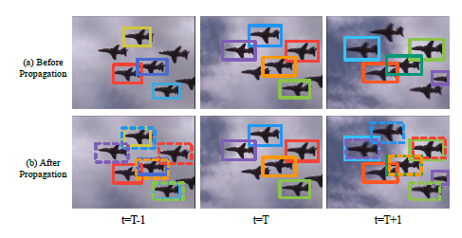
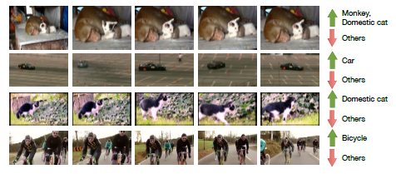
MCS and MGS
Multi-context suppression and motion-guided propagation
Multi-context suppression(MCS)
Sorts all still image detection scores within a video in descending orders
The classes with highly ranked detection scores are treated as high-confidence classes and the rest as low-confidence ones
The detection scores of low-confidence classes are suppressed to reduce false positives.
Motion-guided propagation(MGP)
In still-image object detection, some objects may be missed in certain frames while detected in adjacent frames. MGP propagate boxes and their scores of each frame to its adjacent frame to reduce false negatives.

Slide 13
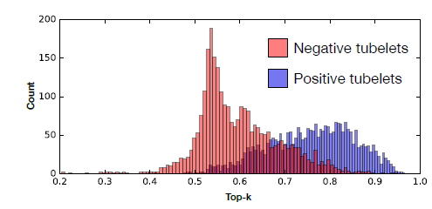
Tubelet Re-scoring
Tubelet Re-scoring
High-confidence tracking
For each object class in a video clip, we track high-confidence detection proposals bi-directionally over the temporal dimension.
The starting bounding boxes of tracking are called “anchors”, which are determined as the most confident detections. Starting from an anchor, we track
bi-directionally to obtain a complete tubelet.
we stop the tracking early when the tracking confidence is below a threshold to reduce false positive tubelets.
Tubelet classification and rescoring
High-confidence tracking and spatial max-pooling generate long sparse tubelets that become candidates for temporal rescoring. The main idea of temporal rescoring is to classify tubelets into positive and negative samples and map the detection scores into different ranges to increase the score margins.
Spatial max-pooling
The spatial max-pooling process is to replace tubelet box proposals with detections of higher confidence by the still-image object detector.

Slide 14
Part 3
Experiments
Parameter Settings
Results
Analysis

Slide 15


Parameter Settings
Data configuration.
Mainly investigate the ratio of training data combination from the DET and VID training sets, and its influence on the still-image object detector DeepID-Net.
Hyperparameter Settings
For motion-guided propagations, mainly investigate the performances of different propagation window sizes.
Network Configurations
The models in DeepID-Net are mainly based on GoogLeNet with batch normalization layers and VGG models.

Slide 16
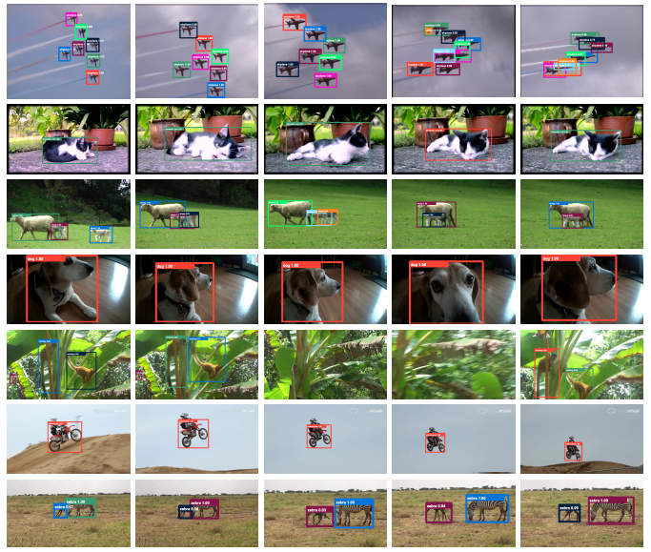
Qualitative Results

Slide 17
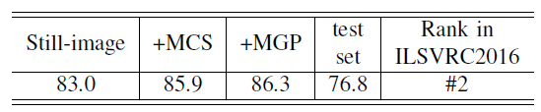
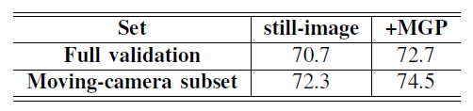
Quantitative results
TABLE I
4-MODEL ENSEMBLE IN ILSVRC 2016 CHALLENGE.
TABLE II
MGP OF DEEPID-NET ON MOVING-CAMERA SUBSET

Slide 18
Part 4
Conclusion

Slide 19
Conclusion
Conclusion
Propose a deep learning framework that incorporates temporal and contextual information into object detection in videos.
This framework achieved the state-of-theart performance on the ImageNet object detection from video task and won the corresponding VID challenge with provided data in ILSVRC2015.
Proposed framework is based on the popular still-image object detection frameworks and adds important components specifically designed for videos.

Slide 20
Part 5
References

Slide 21
References
Kai Kang, Hongsheng Li,Junjie Yan,etc. “T-CNN: Tubelets with Convolutional Neural Networks for Object Detection from Videos”, CVPR 2016
R. Girshick, J. Donahue, T. Darrell, and J. Malik, “Rich feature hierarchies for accurate object detection and semantic segmentation”, CVPR, 2014
R. Girshick, “Fast R-CNN,” ICCV, 2015
S. Ren, K. He, R. Girshick, and J. Sun, “Faster R-CNN: Towards real-time object detection with region proposal networks,” NIPS, 2015
W. Ouyang, X. Wang, X. Zeng, S. Qiu, P. Luo, Y. Tian, H. Li, S. Yang, Z. Wang, C.-C. Loy et al., “DeepID-net: Deformable deep convolutional neural networks for object detection”, CVPR, 2015.

