Slide 1
Efficient Indexing of Billion-Scale datasets of deep descriptors
CVPR2016
汇报人：王丽
18210240036

Slide 2
Backgrounds NO-IMI GNO-IMI Experiments Conclusion
OUTLINES

Slide 3
What we want to do?
search
Query x
Similar images
databases
Modern image retrieval systems have to search through billion-scale databases in several milliseconds to respond to user queries.

Slide 4
Related work
Approximate Nearest Neighbor (ANN) algorithms:
The Inverted File with Asymmetric Distance Computation (IVFADC) indexing system
The Inverted Multi-Index (IMI) system
The system based on the IMI indexing structure and the Product Quantization (PQ) compression
Notes:
ANN avoid exhaustive search by organizing dataset points using an indexing structure

Slide 5

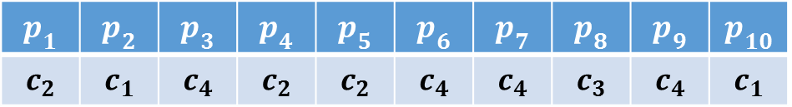


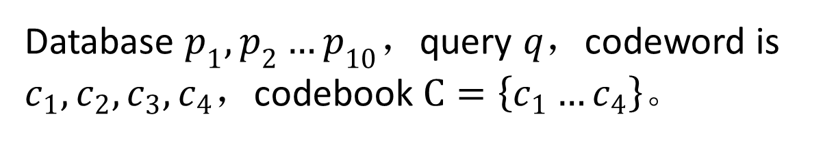

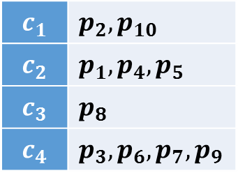

Inverted Index
Database $p_{1},p_{2}…p_{10}$，query $q$，codeword is $c_{1},c_{2},c_{3},c_{4}$，codebook $C=\left\{c_{1}…c_{4}\right\}$。
Index
$$p_{1}$$ | $$p_{2}$$ | $$p_{3}$$ | $$p_{4}$$ | $$p_{5}$$ | $$p_{6}$$ | $$p_{7}$$ | $$p_{8}$$ | $$p_{9}$$ | $$p_{10}$$
$$c_{2}$$ | $$c_{1}$$ | $$c_{4}$$ | $$c_{2}$$ | $$c_{2}$$ | $$c_{4}$$ | $$c_{4}$$ | $$c_{3}$$ | $$c_{4}$$ | $$c_{1}$$
Inverted Index
$$p_{2}$$
$$c_{1}$$ | $$p_{2},p_{10}$$
$$c_{2}$$ | $$p_{1},p_{4},p_{5}$$
$$c_{3}$$ | $$p_{8}$$
$$c_{4}$$ | $$p_{3},p_{6},p_{7},p_{9}$$
$$c_{1}$$
$$q$$
$$p_{1}$$
$$c_{2}$$
Notes:
用k-means将数据库向量量化到对应的码字。
计算$q$和倒排索引中码字的距离，选择1或多个离$q$较近的码字。选中的码字组成短列表，这些码字保存的数据库向量编号组成候选列表，供$q$搜索近似最近邻。
数据库向量为$p_{1},p_{2}…p_{10}$，查询向量为$q$，码字(codeword)为$c_{1},c_{2},c_{3},c_{4}$，码本(codebook)$C=\left\{c_{1}…c_{4}\right\}$。用k-means将数据库向量量化到对应的码字。
查询向量只需在候选列表中搜索近似最近邻，避免了穷举查询向量和所有数据库向量间的近似距离，大大减少搜索时间。
当数据库集很大的时候（1亿或10亿个向量），若码字的数目较少，候选列表太长，搜索时间较长。
增加码字的数目可缩短候选列表，更精确的划分空间，获得较好的搜索效果，但是建立倒排索引的时间较长。

Slide 6
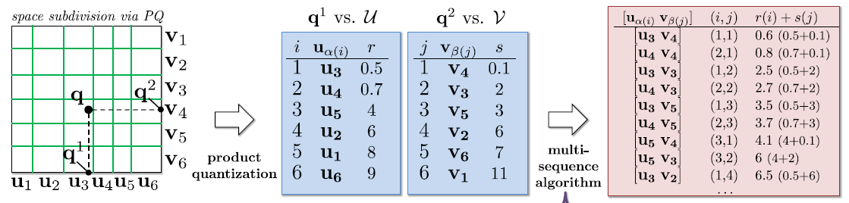
Inverted Multi-Index(IMI)
IMI use product quantization to replace k-means to quantize database vectors
Notes:
1、IMI使用乘积量化替代倒排索引中的k-means量化数据库向量。
2、乘积量化的码本为各组子码本的笛卡尔乘积，码字组成倒排多索引表。
3、倒排多索引表中的每个码字保存被量化到该码字的数据库向量的编号。
4、计算查询向量和码字的距离，依次选出几个较近的码字，这些码字保存的数据库向量编号组成候选列表。

Slide 7
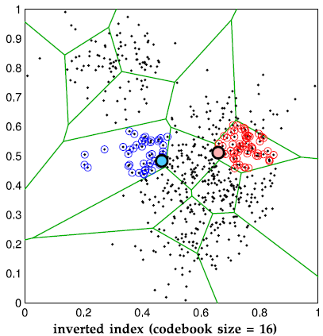
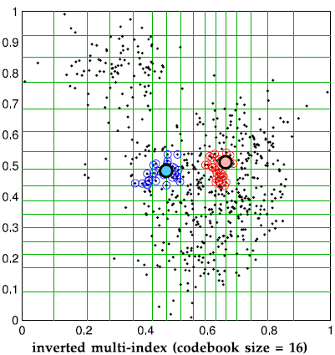
What’s the difference between them?
Notes:
相对于倒排索引，倒排多索引搜索近似最近邻速度更快，效果更好，适用于大规模数据库集。

Slide 8
Challenges
The methods perform on a billion of SIFT vectors.
different halves describe disjoint regions of an image patch.
the correlations between the two halves are small.
SIFT-like descriptors are replaced with deep neural networks (DNN) descriptors.
The methods are not suitable for deep descriptors.
Notes:
DNN provide better performance for many computer vision tasks.
IMI是在SIFT向量（十亿规模）上搜索近似最近邻提出的索引结构。但IMI在深度神经网络向量上的索引性能不好。
IMI适用于SIFT向量的原因是，SIFT向量构造的时候向量的不同部分描述图像块的不相交区域。因此，两组间的相关性较小，IMI的划分合理。但深度向量不同部分间的相关性较大，子空间独立量化不能反映向量集的全局分布。

Slide 9
Backgrounds NO-IMI GNO-IMI Experiments Conclusion
OUTLINES

Slide 10
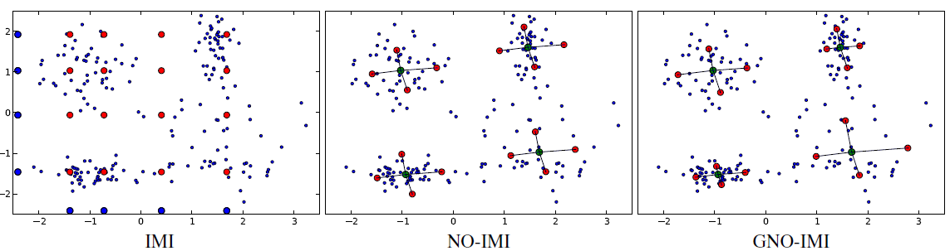
Our Methods
The Non-Orthogonal Inverted Multi-Index (NO-IMI)
The Generalized Non-Orthogonal Inverted Multi-Index (GNO-IMI)
Notes:
3张图的索引结构都产生16个码字。

Slide 11
Non-Orthogonal Inverted Multi-Index(NO-IMI)
database $P=\{p_{1},…,p_{N}\} P⊂R^{D}$
first-order centroids $S=\left\{S_{1},…,S_{K}\right\}$
second-order centroids $T=\left\{T_{1},…,T_{K}\right\} S,T⊂R^{D}$
centroids $c_{i}^{j}=S_{i}+T_{j} i,j=1,…,K$
NO-IMI cells $C_{i}^{j}=\{x∈R^{D}|i,j=arg\min_{k,l}{{||x−(S_{k}+T_{l})||}^{2}}\}$
2K D-dimension vectors represent $K^{2}$ centroids
Notes:
码字$S_{1},…,S_{K}$是在数据库集上聚类生成，称为一阶类中心。
码字$T_{1},…,T_{K}$是所有数据库向量到所属的一阶类中心向量的之间的位移聚类生成，称为二阶类中心。
建立索引：对于每个数据库向量p，将p量化到其对应的类中心向量上（该类中心向量保存p的编号）。

Slide 12

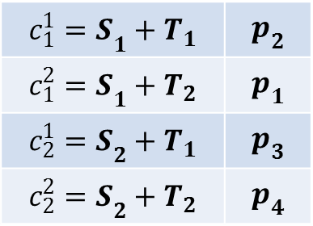
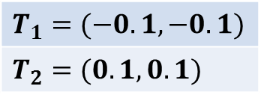


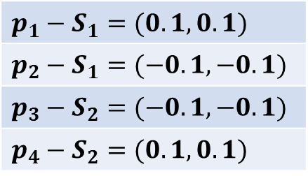
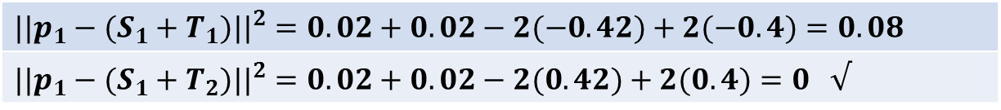
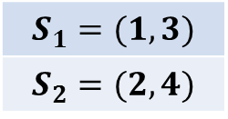
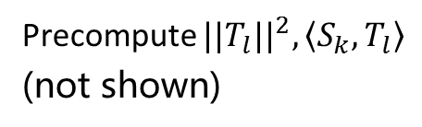
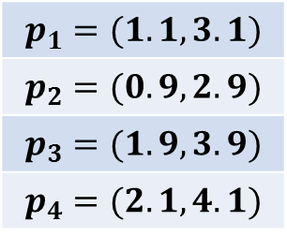
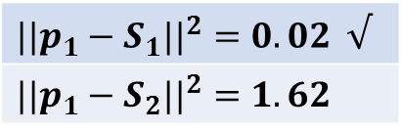

Indexing of NO-IMI
$${||p−\left(S_{k}+T_{l}\right)||}^{2}={||p−S_{k}||}^{2}+{||T_{l}||}^{2}−2\left\langle p,T_{l}\right\rangle +2\left\langle S_{k},T_{l}\right\rangle$$
$$databases$$
$$p_{1}=(1.1,3.1)$$
$$p_{2}=(0.9,2.9)$$
$$p_{3}=(1.9,3.9)$$
$$p_{4}=(2.1,4.1)$$
$$p_{1}−S_{1}=(0.1,0.1)$$
$$p_{2}−S_{1}=(−0.1,−0.1)$$
$$p_{3}−S_{2}=(−0.1,−0.1)$$
$$p_{4}−S_{2}=(0.1,0.1)$$
$$T_{1}=(−0.1,−0.1)$$
$$T_{2}=(0.1,0.1)$$
$$S_{1}=(1,3)$$
$$S_{2}=(2,4)$$
Precompute ${||T_{l}||}^{2},\left\langle S_{k},T_{l}\right\rangle$
(not shown)
K=2
$$p_{1} is assigned to {c_{1}^{2}=S}_{1}+T_{2}$$
calculate ${||p_{1}−S_{k}||}^{2}$
$${{{||p}_{1}−(S}_{1}+T_{1})||}^{2}=0.02+0.02−2(−0.42)+2(−0.4)=0.08$$
${{{||p}_{1}−(S}_{1}+T_{2})||}^{2}=0.02+0.02−2(0.42)+2(0.4)=0 √$
${{{||p}_{1}−S}_{1}||}^{2}=0.02 √$
$${{{||p}_{1}−S}_{2}||}^{2}=1.62$$
r=1
r=1
$${c_{1}^{1}=S}_{1}+T_{1}$$ | $$p_{2}$$
$${c_{1}^{2}=S}_{1}+T_{2}$$ | $$p_{1}$$
$${c_{2}^{1}=S}_{2}+T_{1}$$ | $$p_{3}$$
$${c_{2}^{2}=S}_{2}+T_{2}$$ | $$p_{4}$$
Compute $\left\langle p_{1},T_{l}\right\rangle$(not shown)
$p_{2},p_{3},p_{4}$is the same as $p_{1}$
Notes:
穷举离p最近的类中心向量需要$\text{计算}K^{2}$种情况。论文提出一种不需要穷举计算的方法。

Slide 13
Indexing of NO-IMI
$${||p−\left(S_{k}+T_{l}\right)||}^{2}={||p−S_{k}||}^{2}+{||T_{l}||}^{2}−2\left\langle p,T_{l}\right\rangle +2\left\langle S_{k},T_{l}\right\rangle$$
Precompute ${||T_{l}||}^{2}$ and $\left\langle S_{k},T_{l}\right\rangle$
${||p−S_{k}||}^{2}$ and $\left\langle p,T_{l}\right\rangle$ : O(KD)
Inspect the closest r centroids to p, evaluate rK solutions : O(rK)
The overall complexity is O(DK + rK)
Notes:
O(K^2)
${||p−S_{k}||}^{2}$ : a distance from p to the first-order centroid
$\left\langle p,T_{l}\right\rangle$ : inner product
r is several times smaller than D

Slide 14



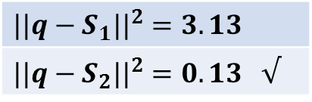


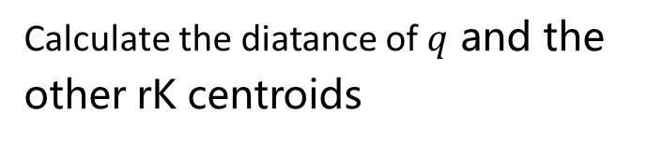

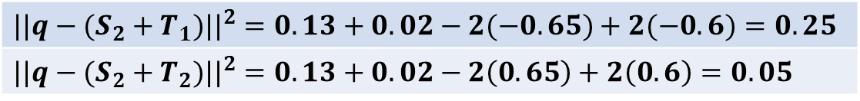
Shortlist extraction of NO-IMI
$q=(2.3,4.2)$。
$${||q−\left(S_{k}+T_{l}\right)||}^{2}={||q−S_{k}||}^{2}+{||T_{l}||}^{2}−2\left\langle q,T_{l}\right\rangle +2\left\langle S_{k},T_{l}\right\rangle$$
${||T_{l}||}^{2},\left\langle S_{k},T_{l}\right\rangle$is saved in table in advance
Calculate the diatance of $q$ and the other rK centroids
$q$，calculate${||q−S_{k}||}^{2}$
${|{|q−S}_{1}||}^{2}=3.13$
$${{||q−S}_{2}||}^{2}=0.13 √$$
$${{||q−(S}_{2}+T_{1})||}^{2}=0.13+0.02−2(−0.65)+2(−0.6)=0.25$$
$${{||q−(S}_{2}+T_{2})||}^{2}=0.13+0.02−2\left(0.65\right)+2\left(0.6\right)=0.05$$
r=1，calculate$\left\langle p_{1},T_{l}\right\rangle$（not shown）
shortlist
L=2
$$p_{3}$$ | $$p_{4}$$
$$c_{2}^{2}=S_{2}+T_{2}$$ | $$c_{2}^{1}=S_{2}+T_{1}$$
若L=1，短列表中为$c_{2}^{2}$，候选列表中为$p_{3}$。
Notes:
对距离排序可得长度为L的短列表（有序）

Slide 15
Backgrounds NO-IMI GNO-IMI Experiments Conclusion
OUTLINES

Slide 16

Generalized Non-Orthogonal Inverted Multi- Index (GNO-IMI)
$c_{i}^{j}=S_{i}+α[i,j]T_{j} i,j=1,…,K$
Indexing:
$i,j=arg\min_{k,l}{||p−(S_{k}+α[k,l]T_{l}){||}^{2}}$
${||p−\left(S_{k}+α\left[k,l\right]T_{l}\right)||}^{2}={||p−S_{k}||}^{2}+α{[k,l]}^{2}{||T_{l}||}^{2}−2α\left[k,l\right]\left\langle p,T_{l}\right\rangle +2α\left[k,l\right]\left\langle S_{k},T_{l}\right\rangle$
Notes:
$α[i,j]$is a factor for the j-th second-order centroid $T_{j}$ in the i-th first-order cluster
NO-IMI假设一阶类中心所在类别内的位移分布是相似的，但不同一阶类别内数据的分布有密集有稀疏，所以GNO-IMI增加了一个$α$矩阵，$α[i,j]$是第i个一阶类别中的第j个二阶类中心的因子。
NO-IMI和GNO-IMI建立索引、找短列表和候选列表的过程类似。

Slide 17
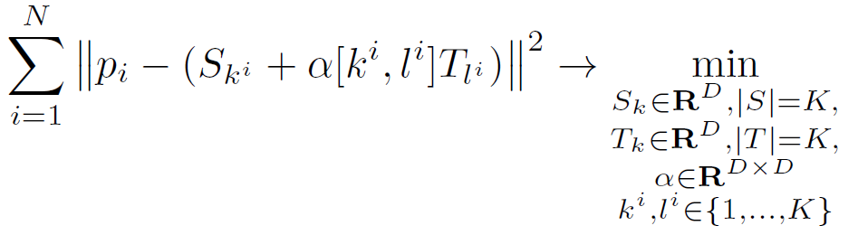
Codebooks learning of GNO-IMI
database $P=\{p_{1},…,p_{N}\}$
minimization of the reconstruction error for all training points

Slide 18
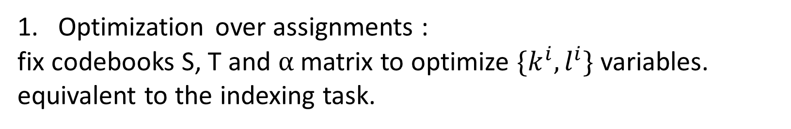
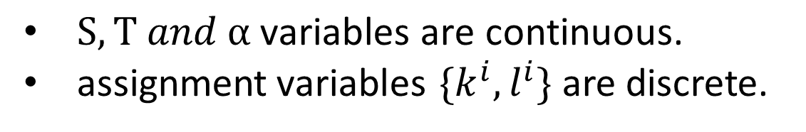
Codebooks learning of GNO-IMI
$S,T and α \text{variables} \text{are} \text{continuous}\text{. }$
assignment$\text{variables}$ $\{k^{i},l^{i}\}$ are discrete.
optimizing over one variable group at a time with the other three groups fixed.
Optimization over assignments :
fix codebooks S, T and $α$matrix to optimize $\{k^{i},l^{i}\}$ variables.
equivalent to the indexing task.

Slide 19
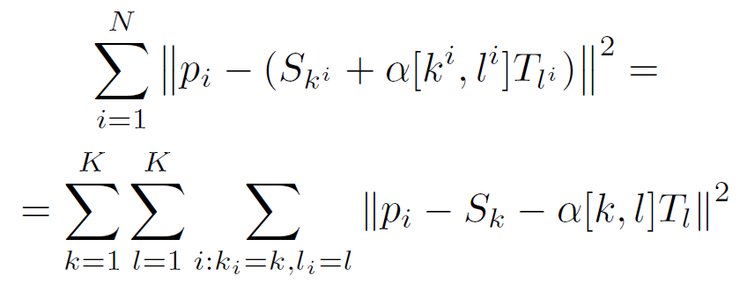
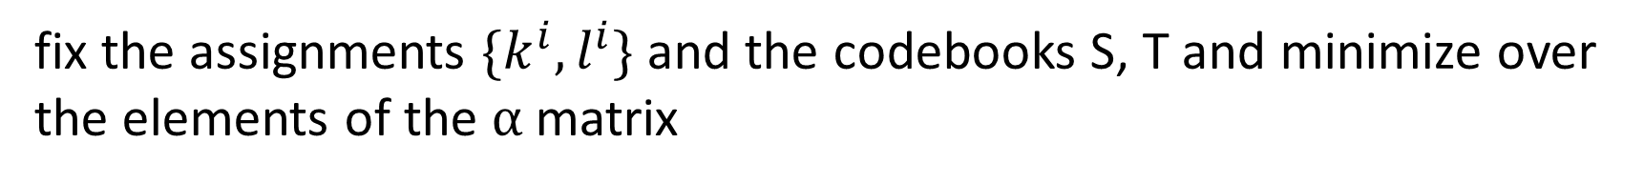
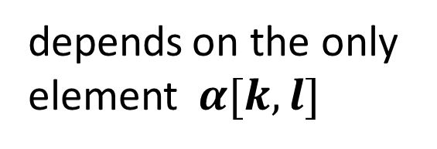
Codebooks learning of GNO-IMI
2. Optimization over $α$ :
fix the assignments $\{k^{i},l^{i}\}$ and the codebooks S, T and minimize over the elements of the $α$matrix
depends on the only element$α[k,l]$

Slide 20
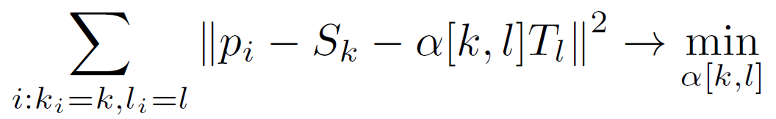
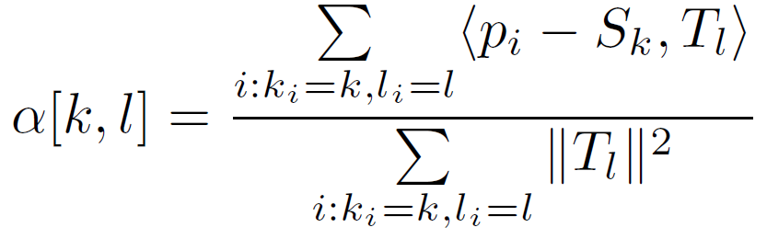
Codebooks learning of GNO-IMI
2. Optimization over $α$ :

Slide 21
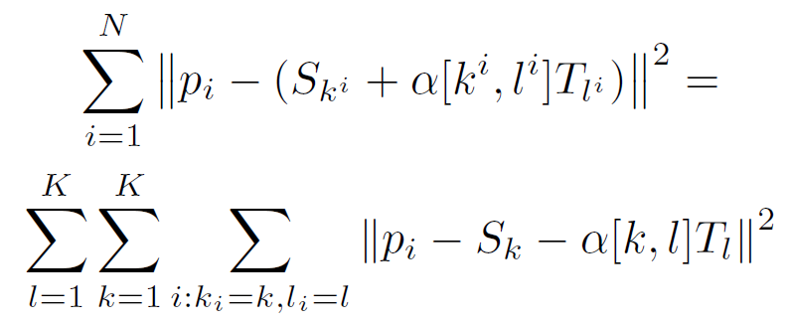
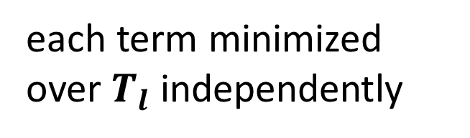
Codebooks learning of GNO-IMI
3. Optimization over second-order codebook T :
each term minimized over $T_{l}$ independently

Slide 22
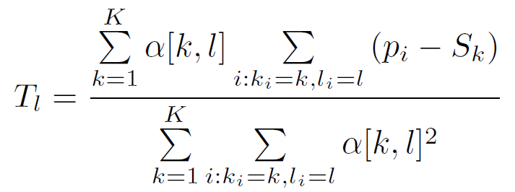
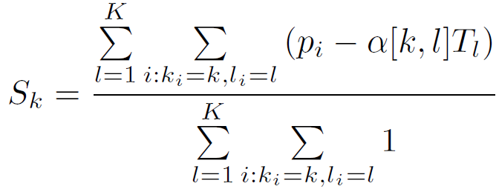
Codebooks learning of GNO-IMI
3. Optimization over second-order codebook T :
4. Optimization over first-order codebook S :

Slide 23
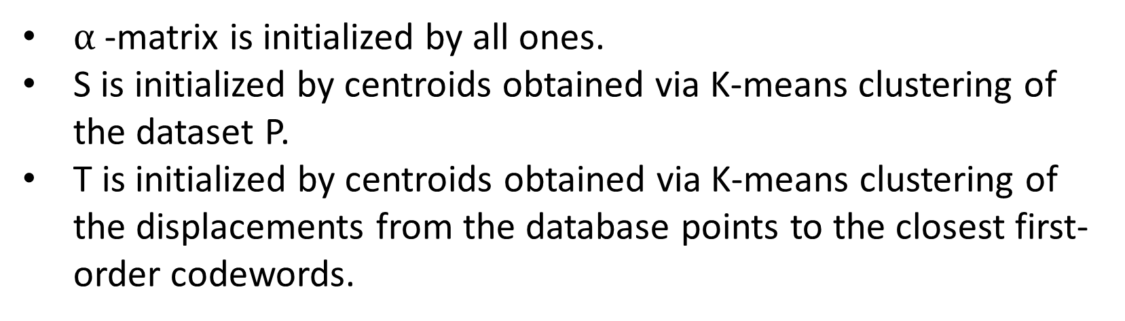
Codebooks learning of GNO-IMI
5. Initialization:
$α$-matrix is initialized by all ones.
S is initialized by centroids obtained via K-means clustering of the dataset P.
T is initialized by centroids obtained via K-means clustering of the displacements from the database points to the closest first-order codewords.

Slide 24
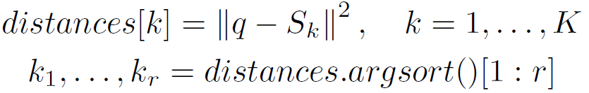
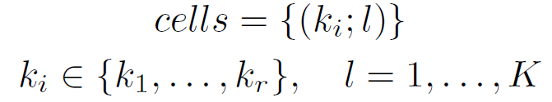
Shortlist extraction of GNO-IMI
1. O(KD + K logK)
Notes:
查询向量q在NO-IMI表中搜索出有序的L个类中心向量（离q较近），组成一个短列表。
1、找出离q较近的前r个一阶类中心向量（用$k_{1},…,k_{r}$表示），

Slide 25
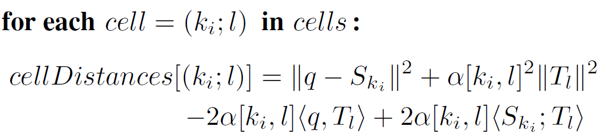
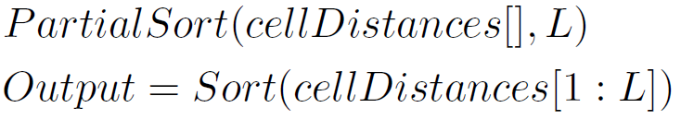
Shortlist extraction of GNO-IMI
2. O(rK)
3. O(rK+LlogL)
Total : O(KD+K logK+rK + Llog L)
Notes:
2、计算q和rK个类中心向量的距离
3、对rK个距离排序获得前L个类中心向量
1std::nth_element from the standard STL library
候选列表由短列表中L个类中心向量保存的数据库向量的编号组成。

Slide 26
Reranking of GNO-IMI
After short-list extraction the (G)NO-IMI performs reranking of candidate points.
Some algorithms such as Asymmetric Distance Computation(ADC) and Optimized Product Quantization (OPQ)
Notes:
候选列表由L个类中心向量保存的数据库向量组成。
在对数据库向量建立索引后，使用Optimized Product Quantization (OPQ)来量化数据库向量和类中心向量间的位移，数据库向量由OPQ编码表示。
用查询向量和OPQ编码的距离近似表示查询向量和候选列表中的数据库向量的距离，对这些距离排序。

Slide 27
Backgrounds NO-IMI GNO-IMI Experiments Conclusion
OUTLINES

Slide 28
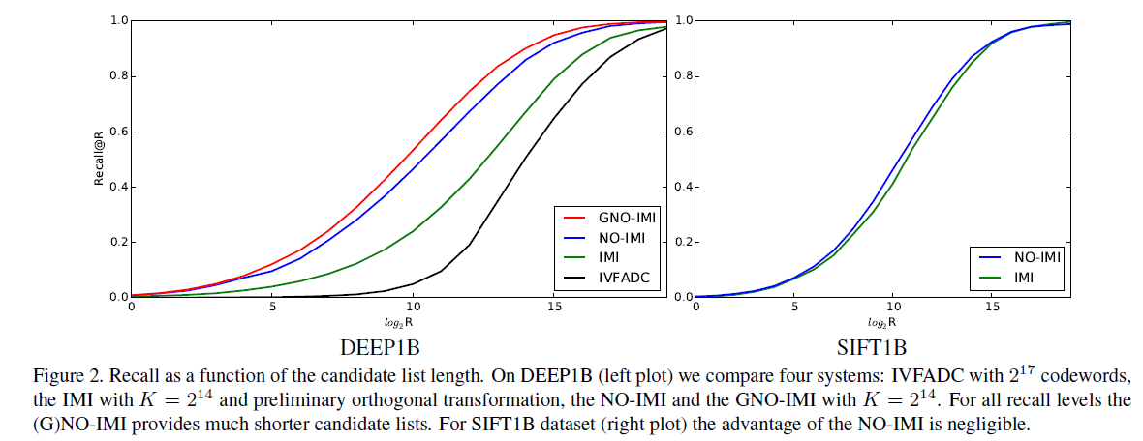
Experiments
Notes:
IVFADC的码字数为$2^{17}$。
其他三种方法的每个码本的码字K为$2^{14}$
recall@R值相同时，(G)NO-IMI提供较短的候选列表。
候选列表长度相同时， (G)NO-IMI的recall@R值较大。

Slide 29
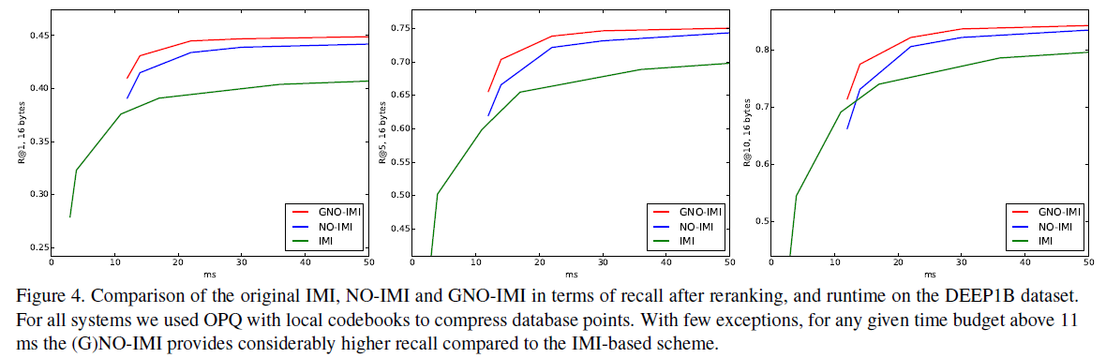
Experiments
Notes:
M=16，recall@R关于在deep1B数据集上运行时间（候选列表长度不同）的函数。

Slide 30
Backgrounds NO-IMI GNO-IMI Experiments Conclusion
OUTLINES

Slide 31
Conclusion
The original Inverted Multi-Index is suboptimal for deep data.
The (G)NO-IMI provide more accurate indexing and more precise candidate lists for deep descriptors (billion-scale indexing).
The advantages of the (G)NO-IMI come at a price of computational overhead, which is small for typical settings.

Slide 32
Thank You!

