Slide 2
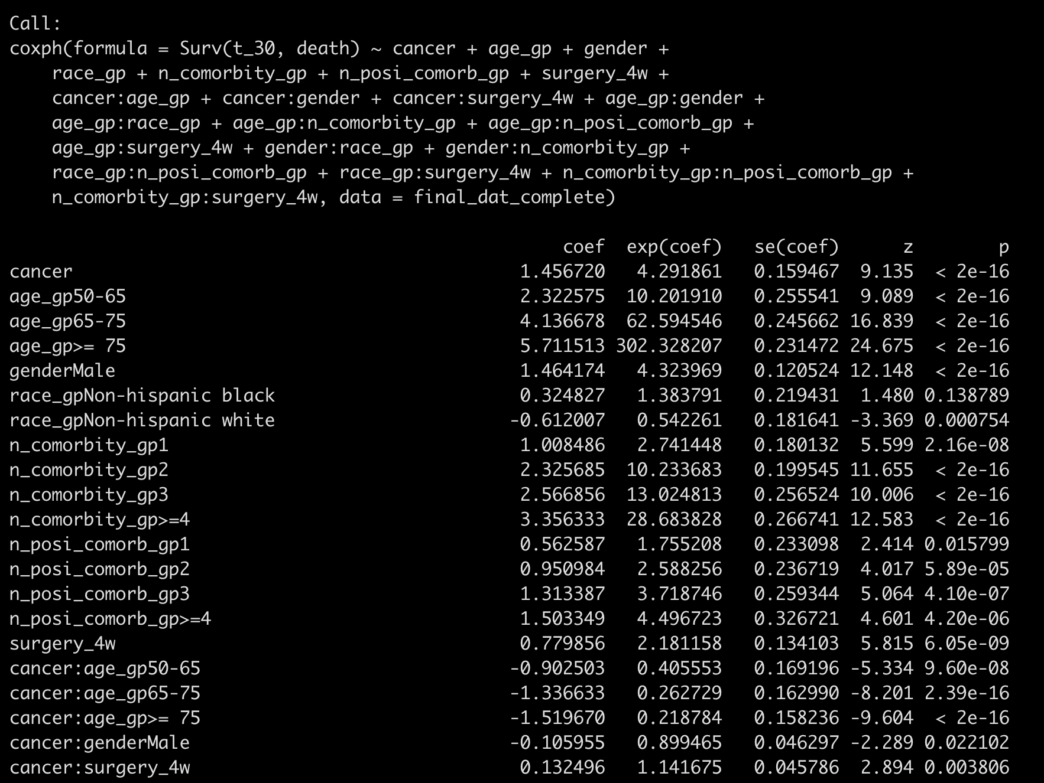
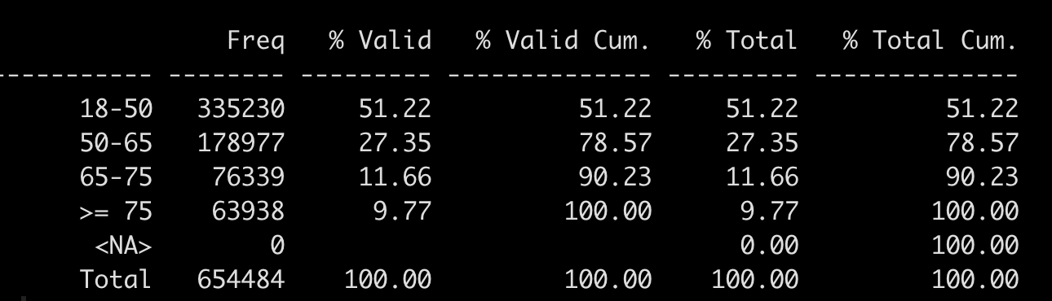
Backward-AIC from all two-way interactions:
50-65: exp(1.457 – 0.903) = 1.74
65-75: exp(1.457 – 1.337) = 1.127
>= 75: exp(1.457 – 1.520) = 1
Maybe remove this one?

Slide 3
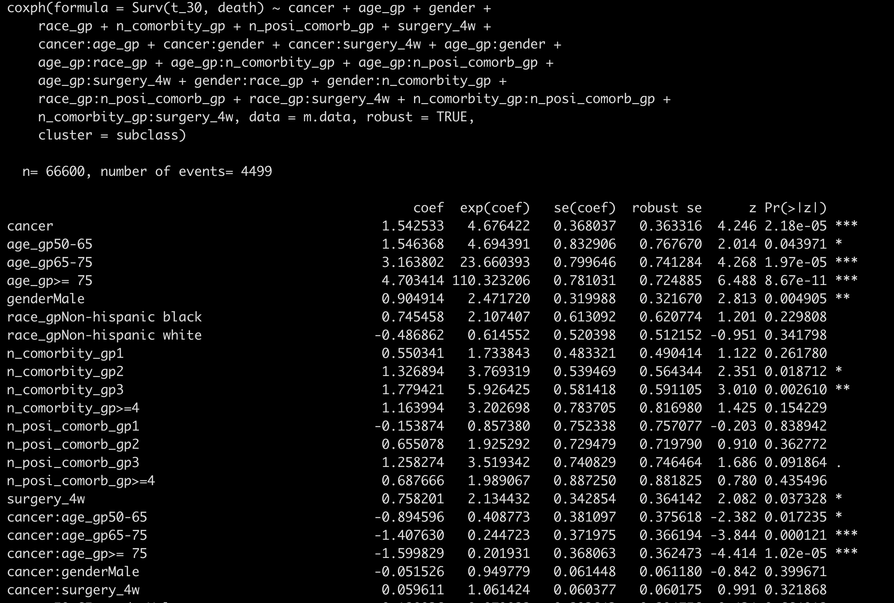
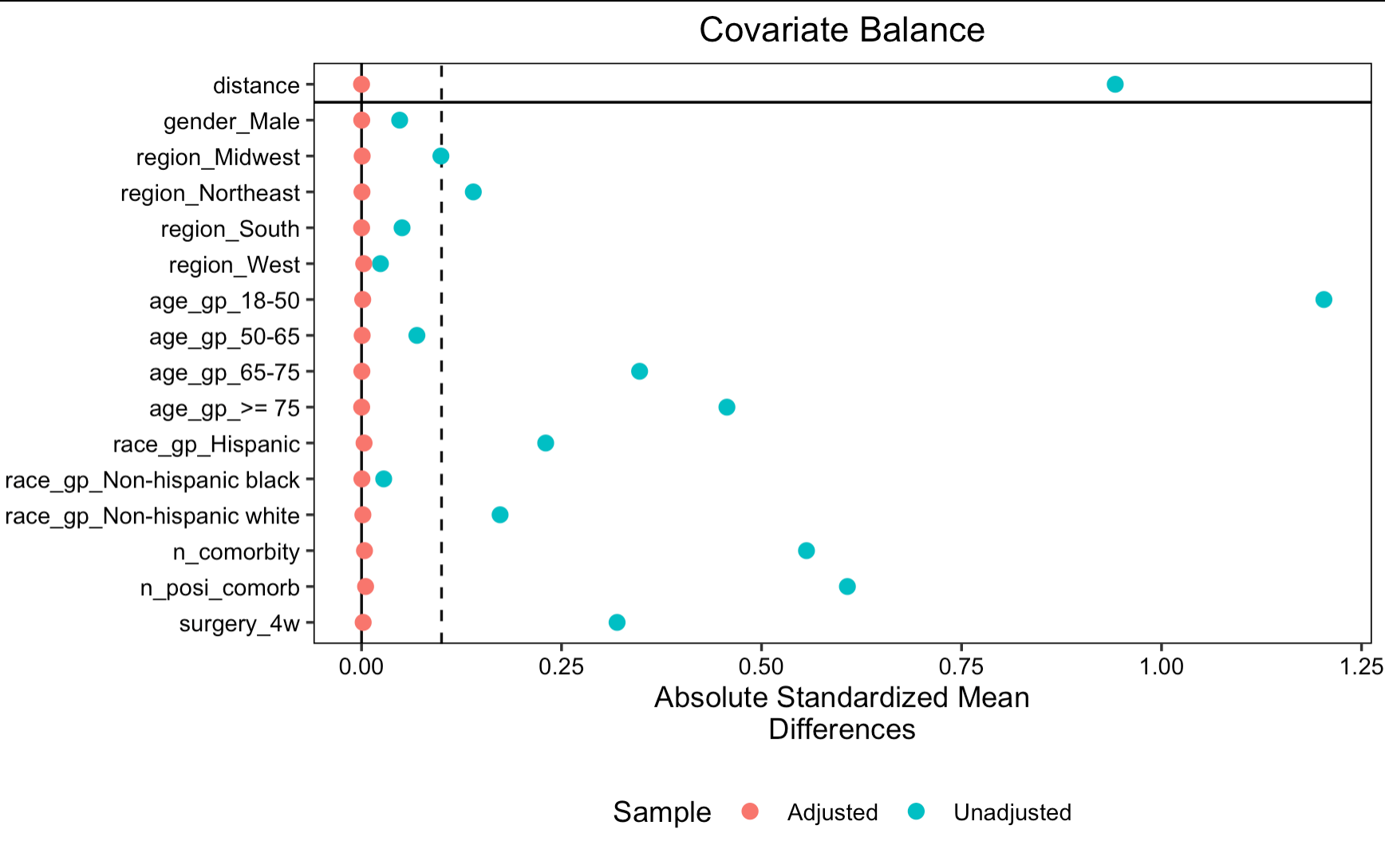
PSM matched on all two-way interactions

Slide 4
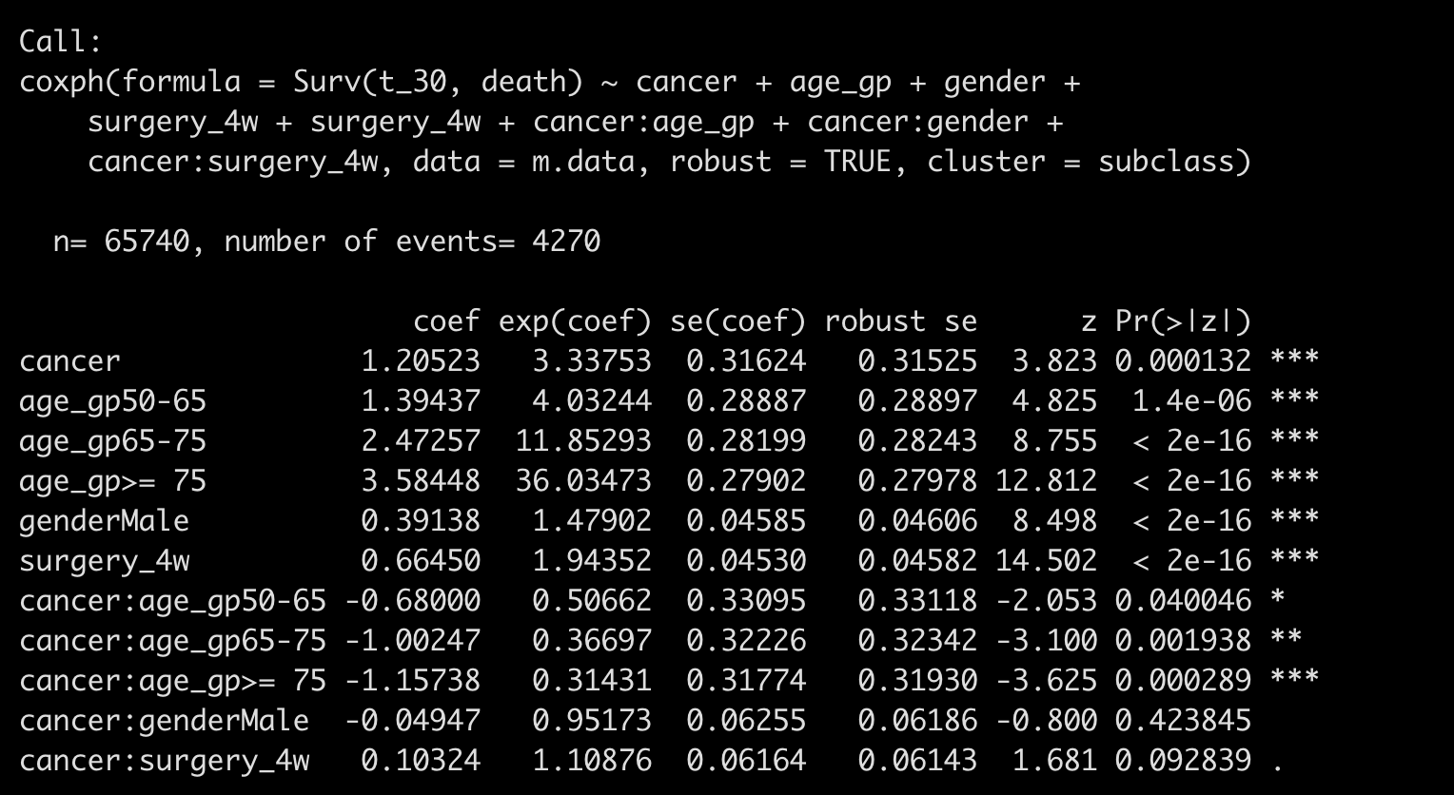
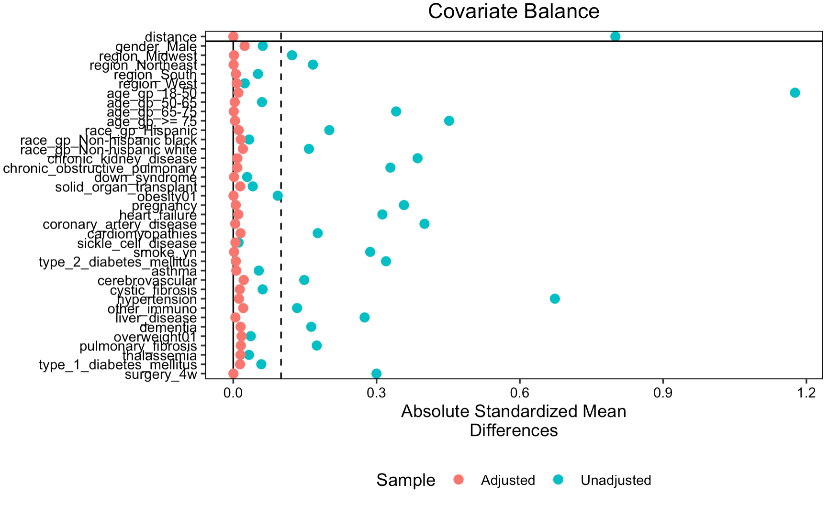
PSM matched on individual comorbidity level

Slide 5
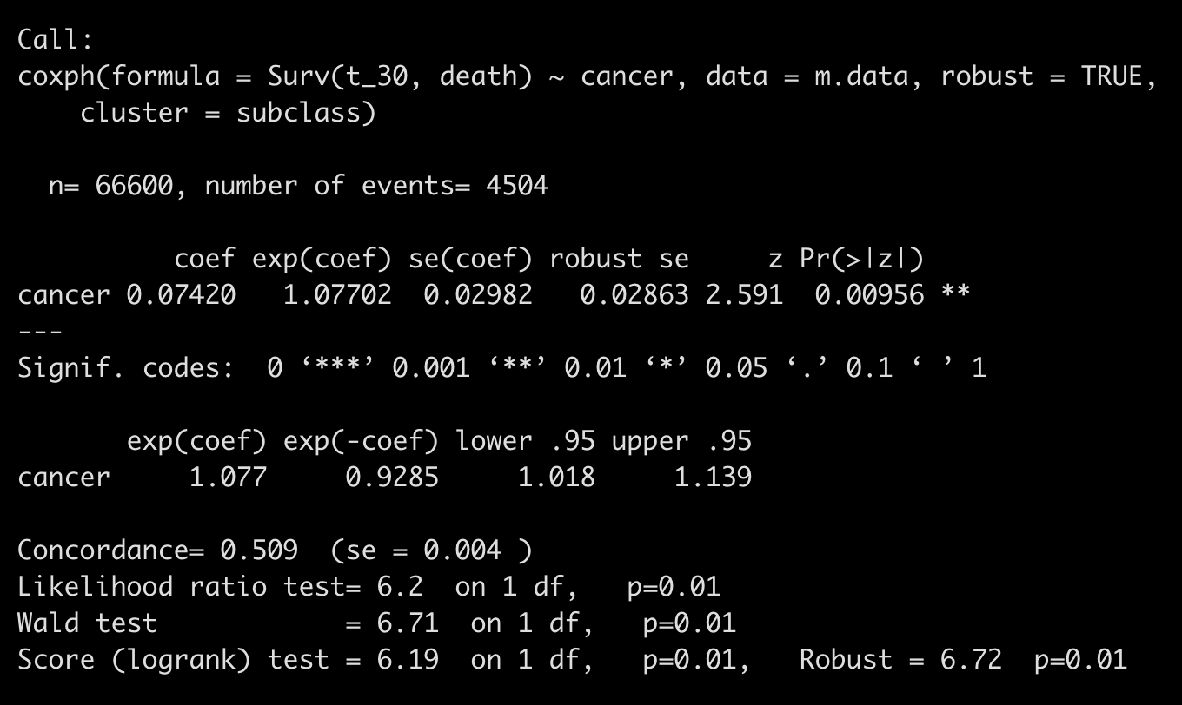
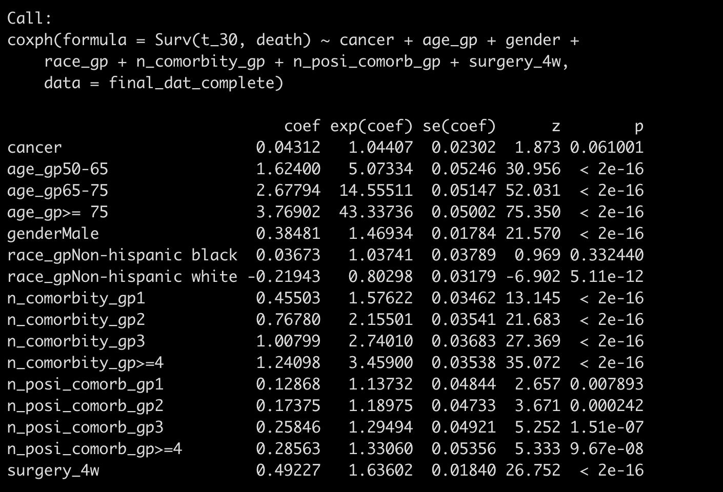
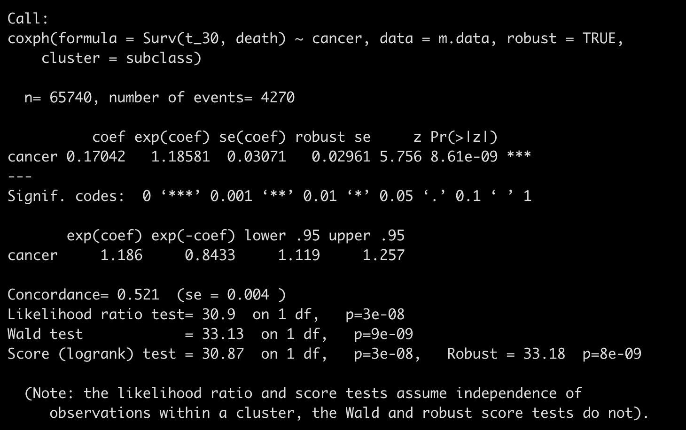
Without consider interaction
Average treatment effect in treated
Average effect in an unknown population

Slide 6
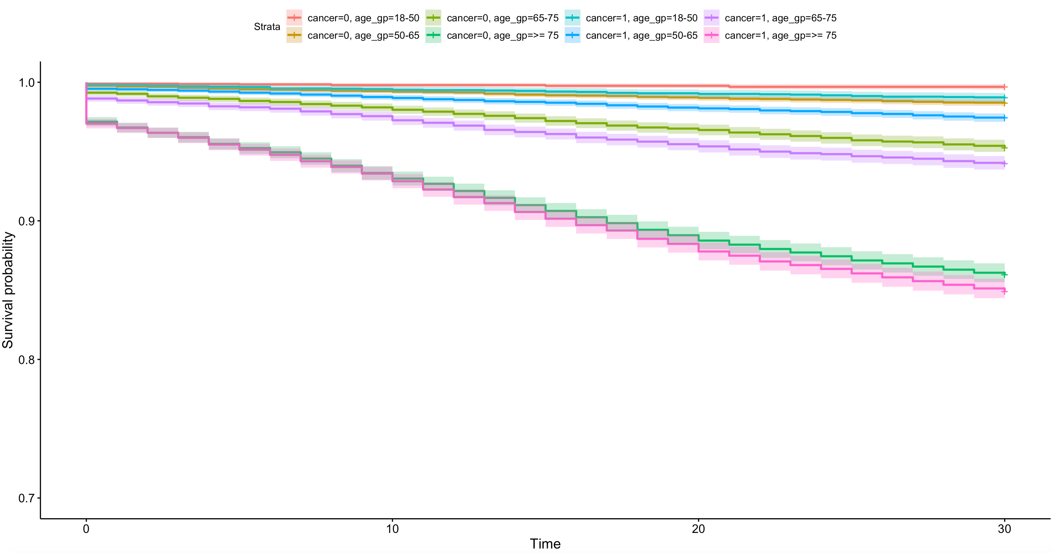

Slide 7
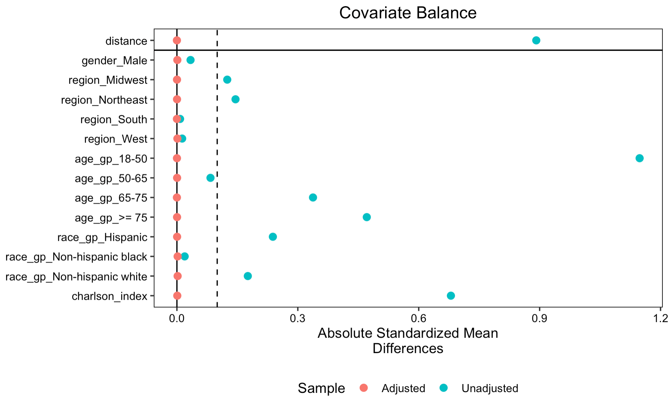
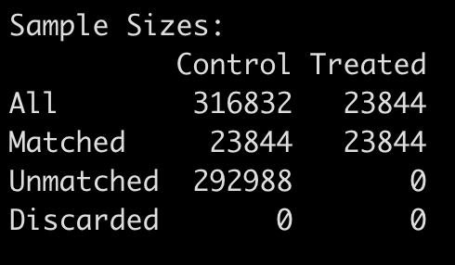

Slide 8
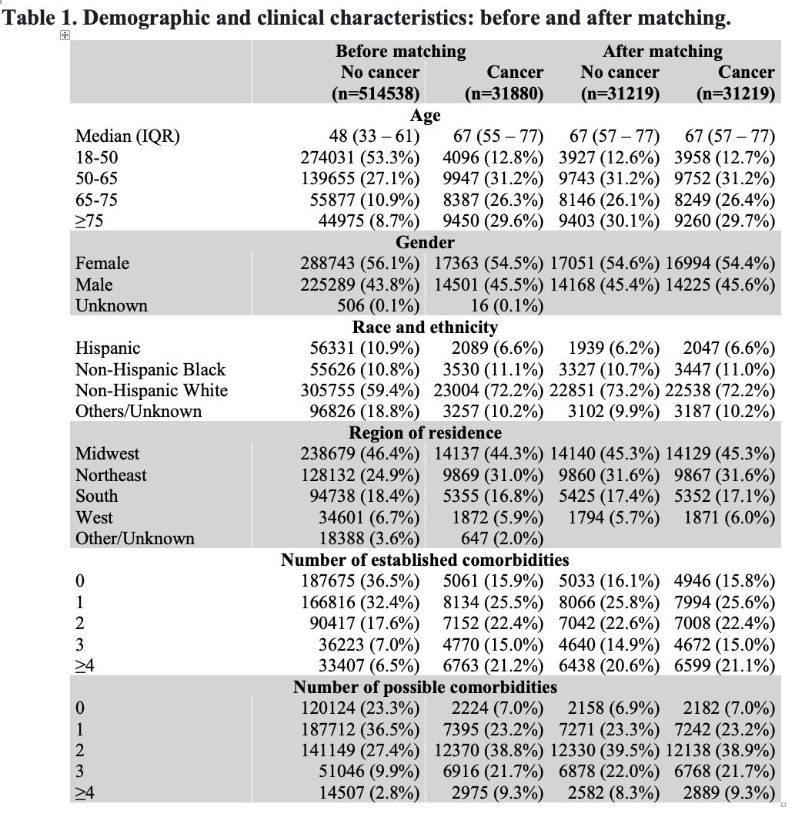
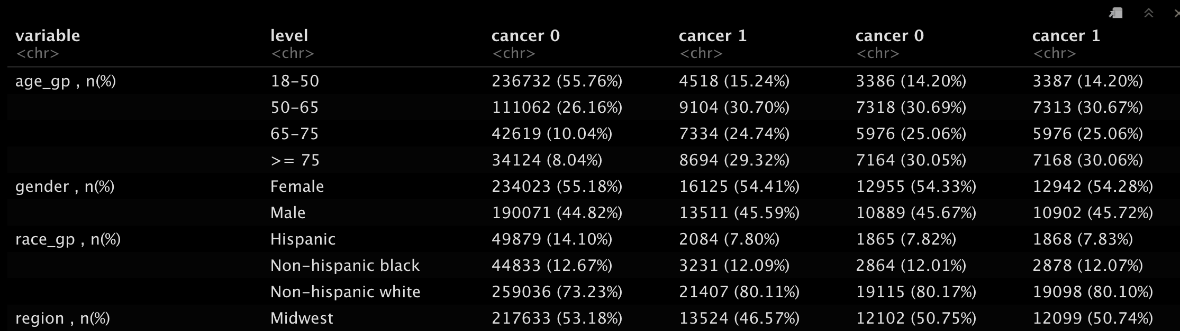
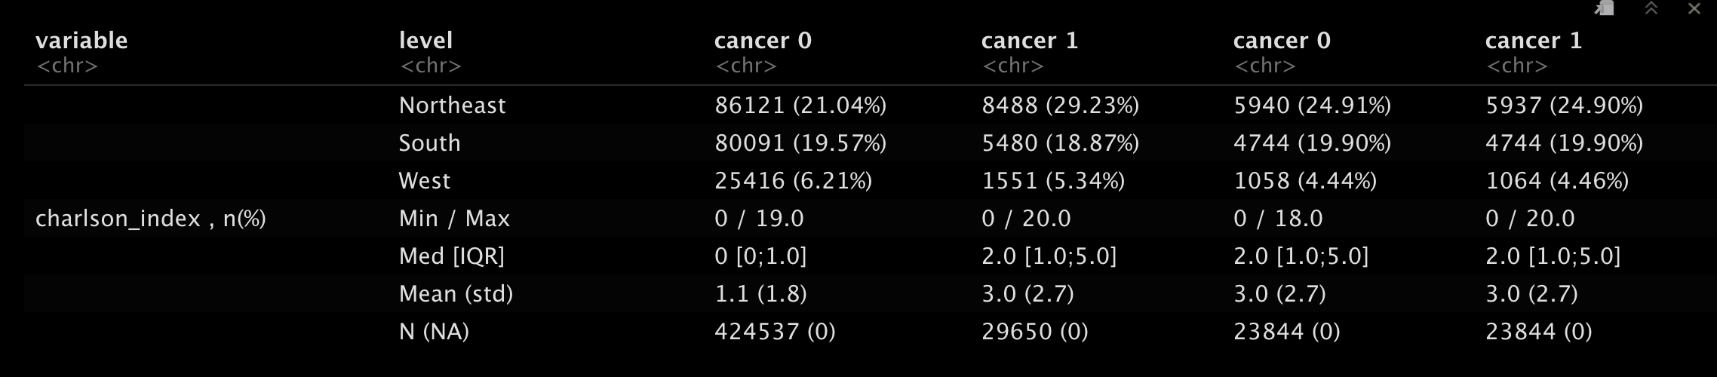
Other/Unknown will be treated as missing
Notes:
Missing whether to present it in the table

Slide 9
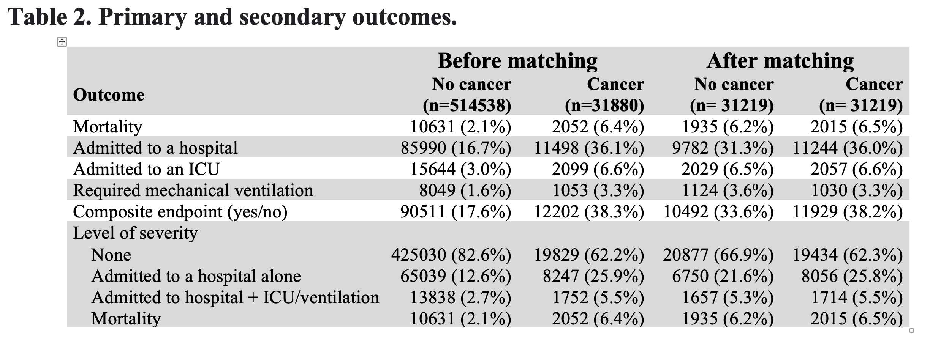
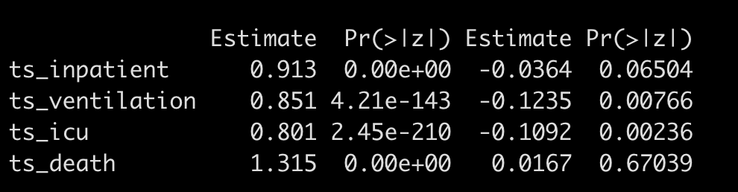
simple logistic regression
logistic regression using PSM

Slide 10
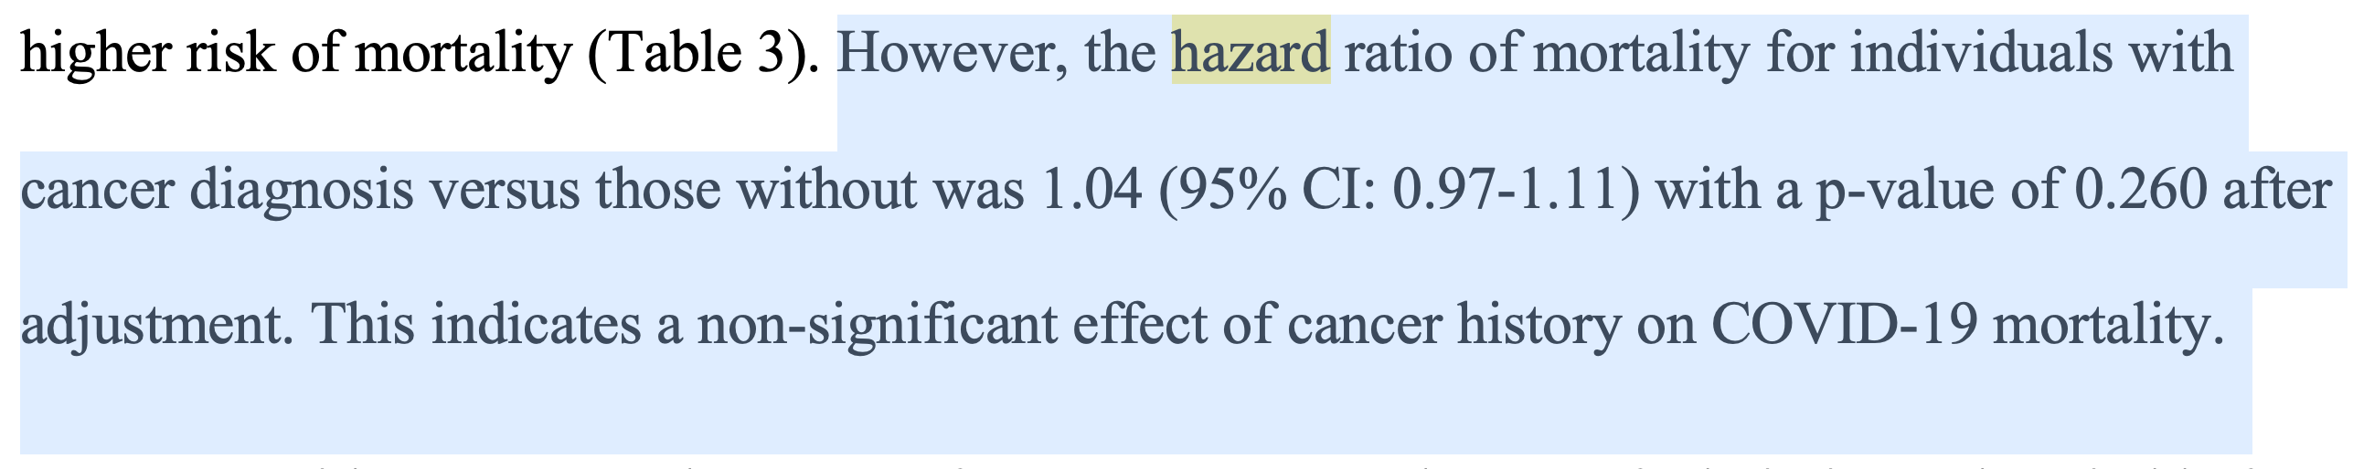
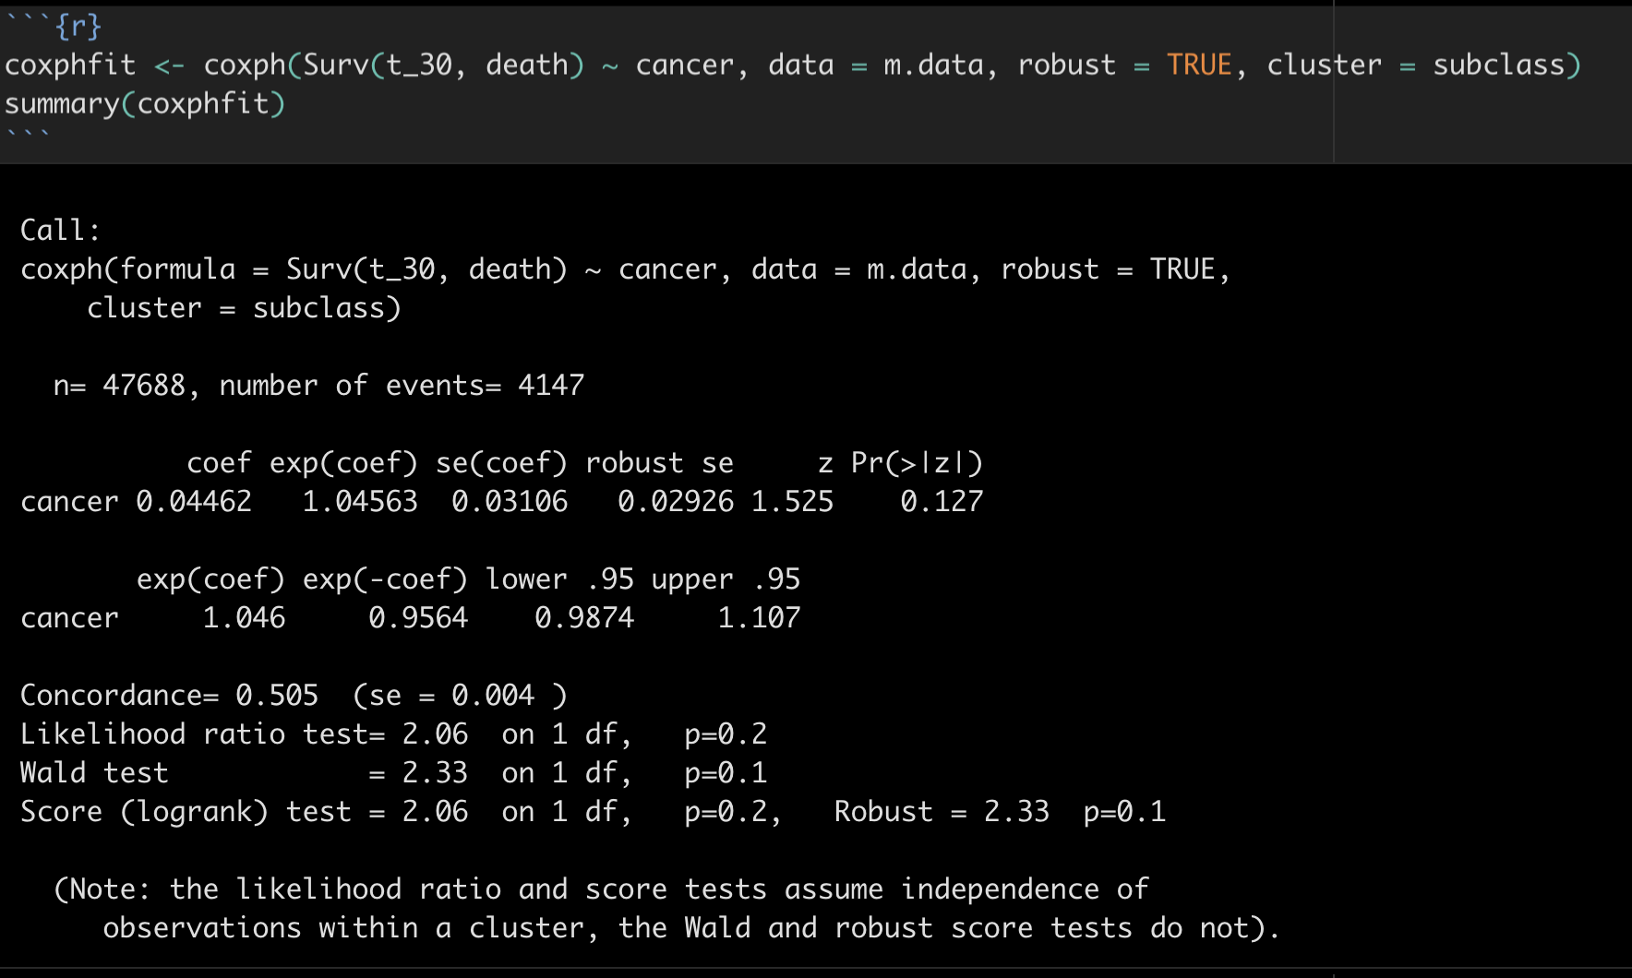
Survival analysis (time-to-event calculation is questionable)

Slide 11
Cancer subgroup analysis
One or two table

Slide 12
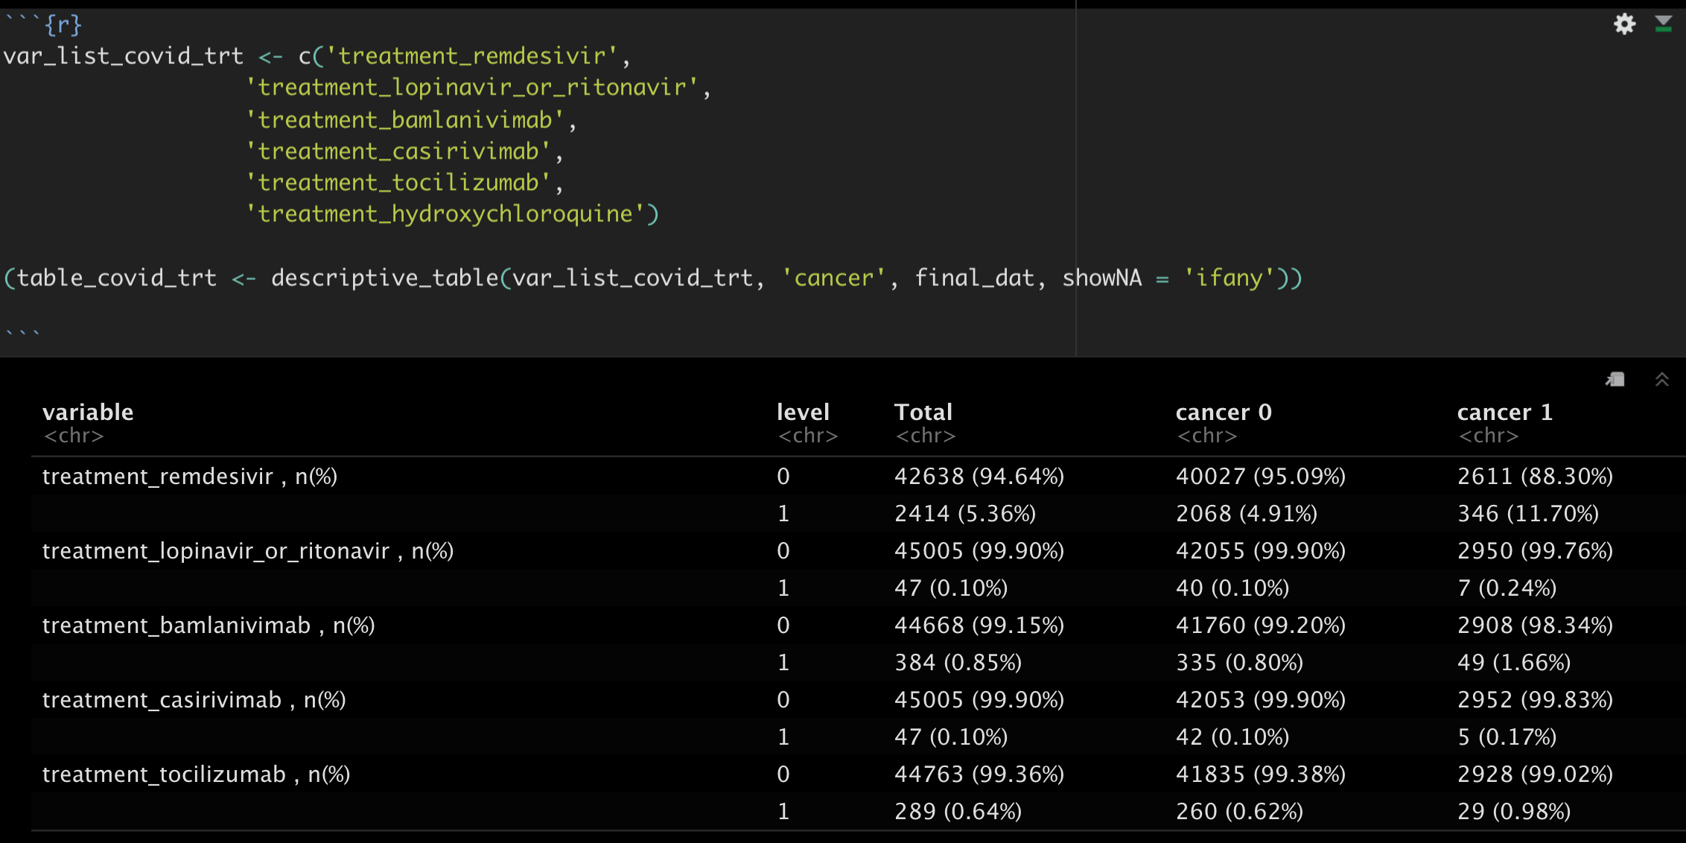

Slide 13
Check list
What comorbidity will be used? Whether to use Charlson comorbidity index.

Slide 14
Few modification
use n_comorbity_gp, n_posi_comorb_gp as categorical variable instead of n_comorbity, n_posi_ comorb as continuous variable
Age_gp was used instead of age as a continuous variable
Surgery_4w was used in matching

