Slide 2
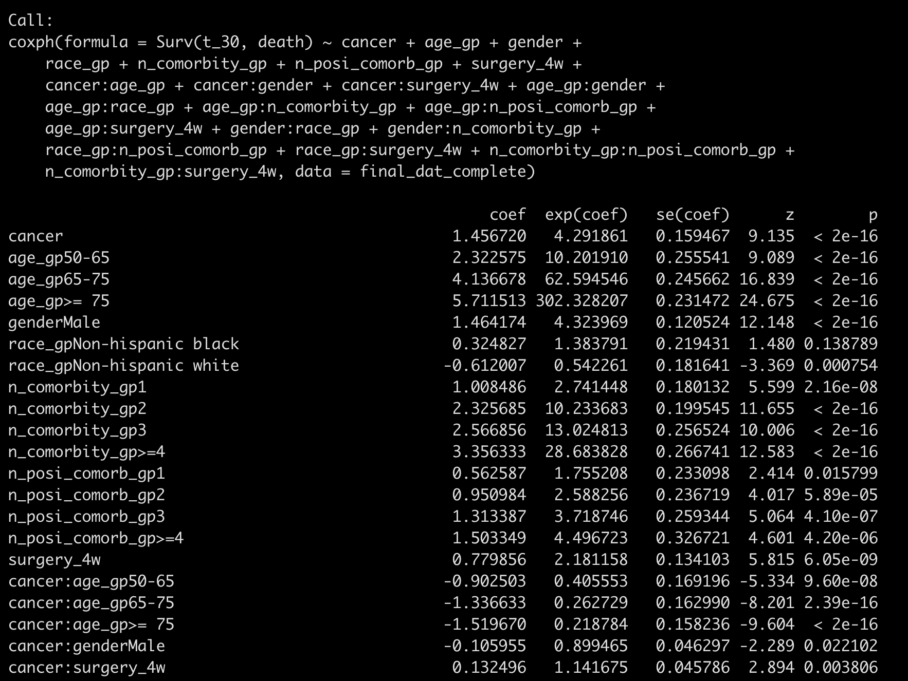
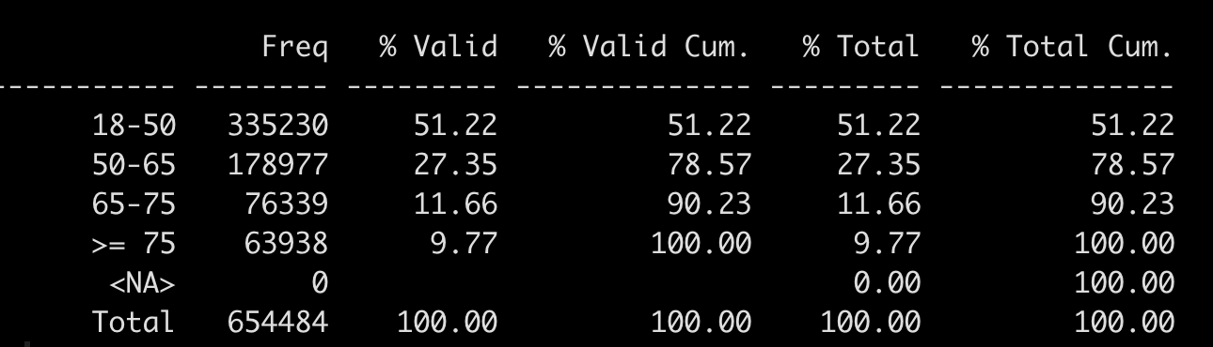
Backward-AIC from all two-way interactions:
50-65: exp(1.457 – 0.903) = 1.74
65-75: exp(1.457 – 1.337) = 1.127
>= 75: exp(1.457 – 1.520) = 1
Maybe remove this one?

Slide 3
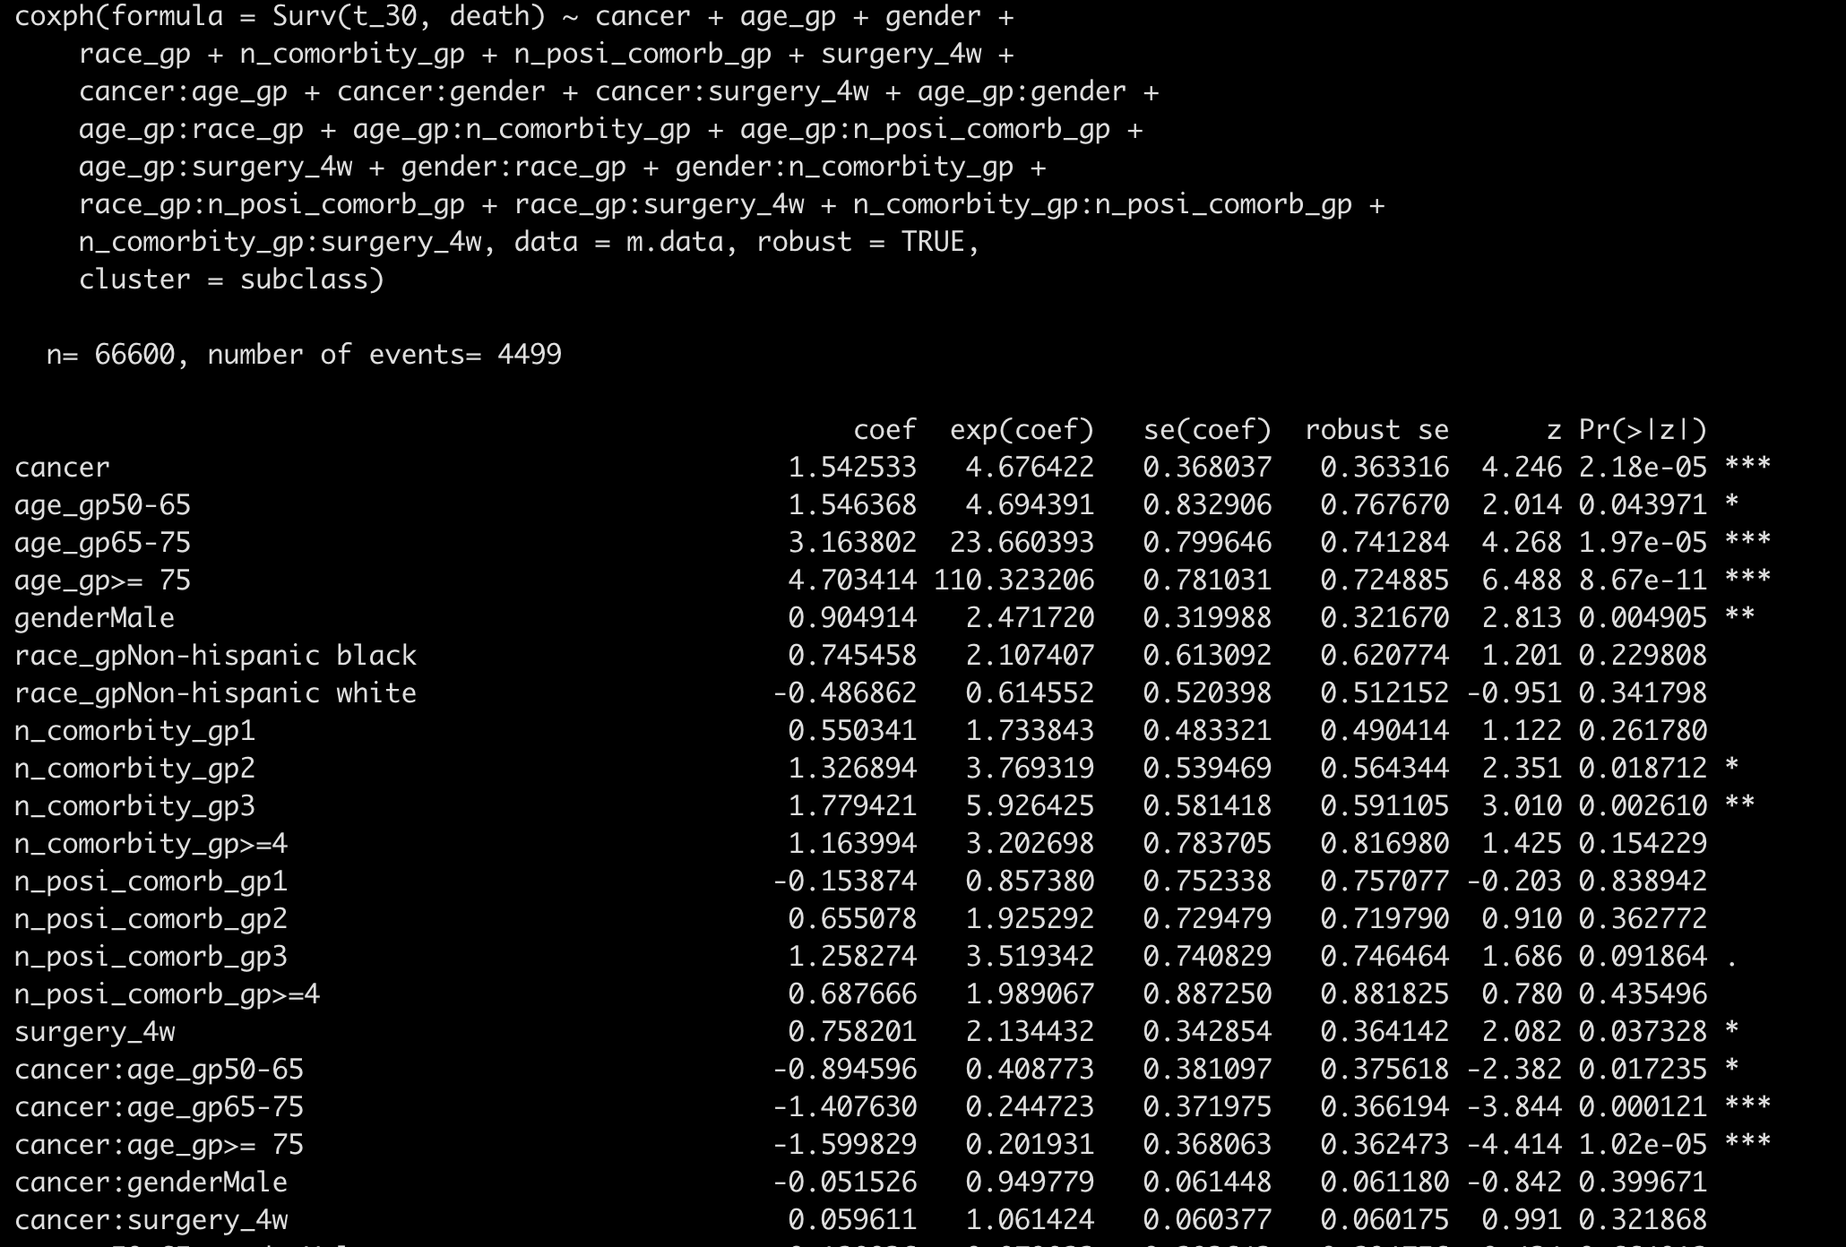
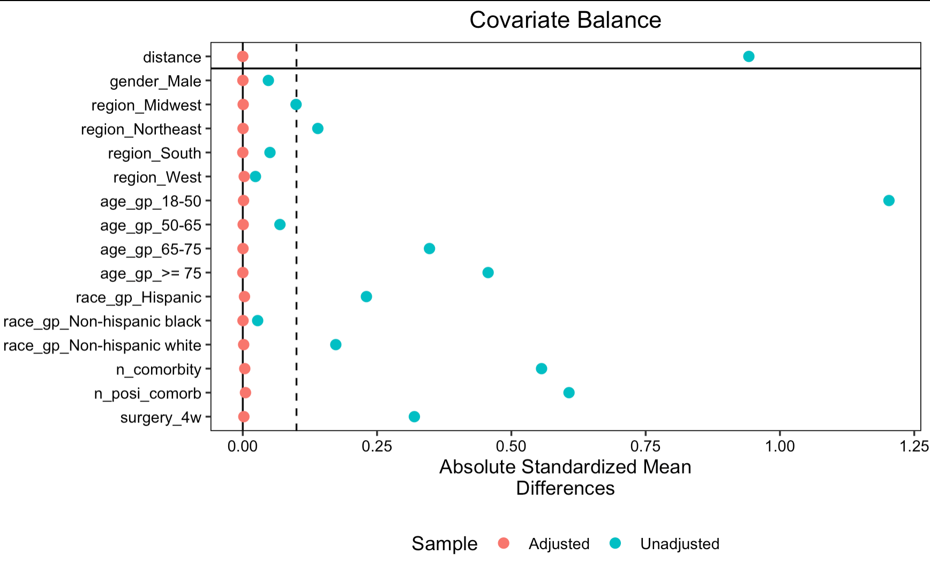
PSM matched on all two-way interactions

Slide 4
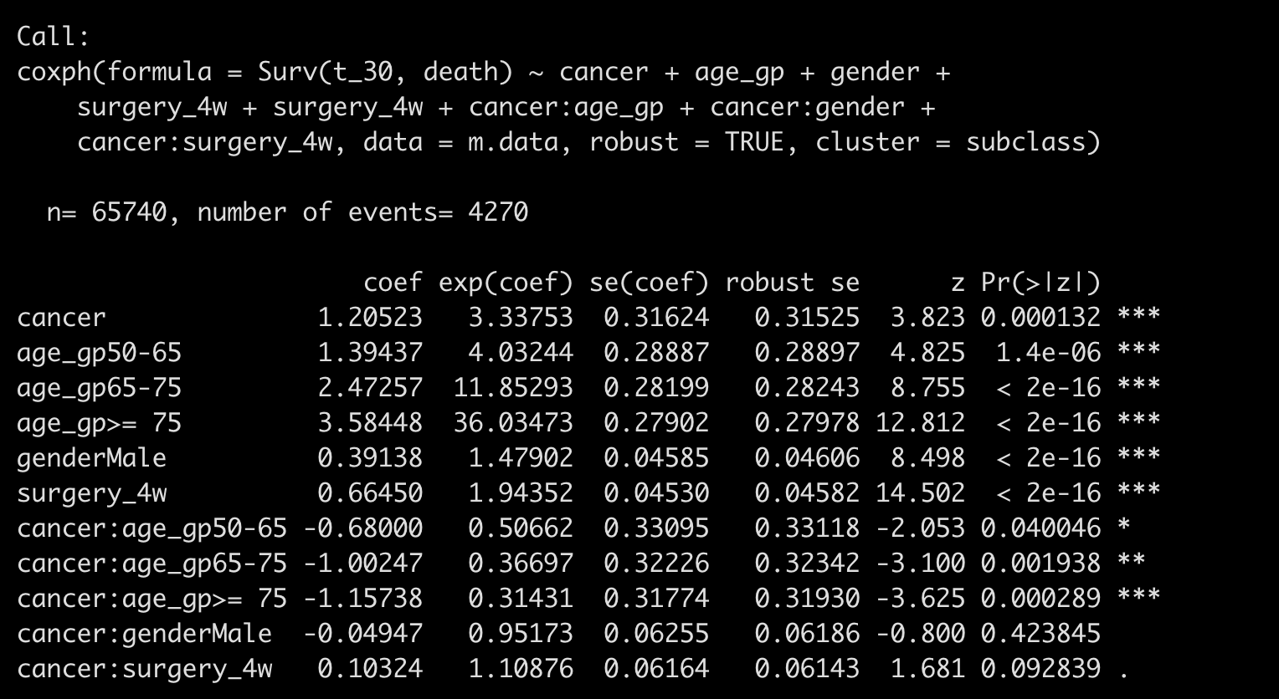
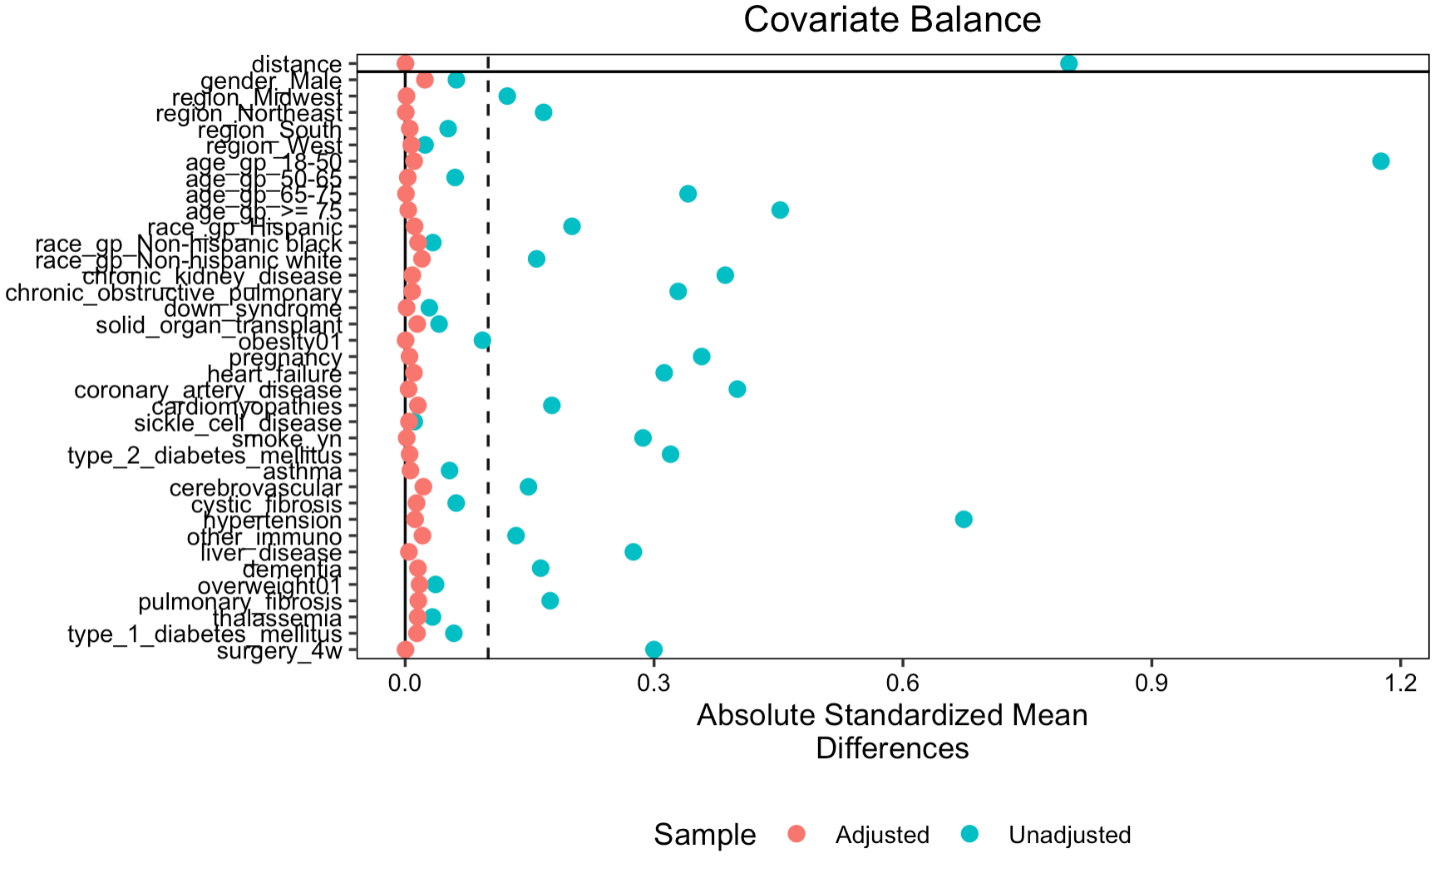
PSM matched on individual comorbidity level

Slide 5
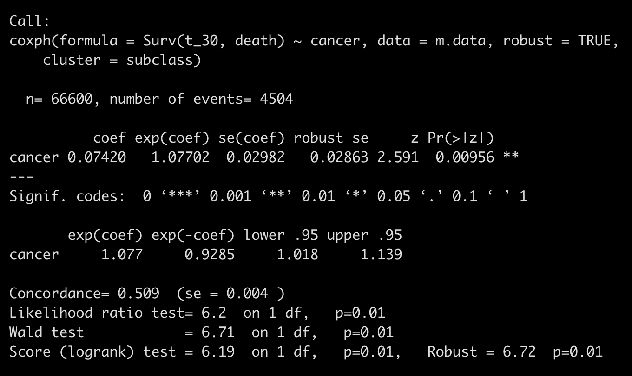
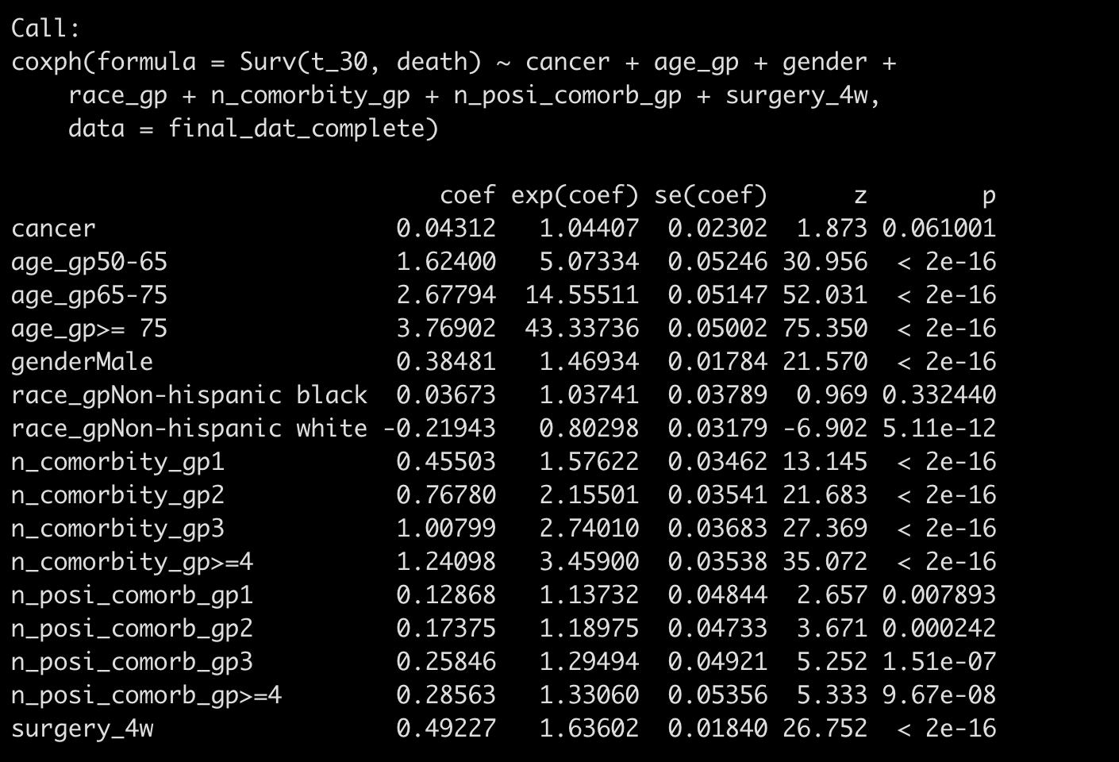
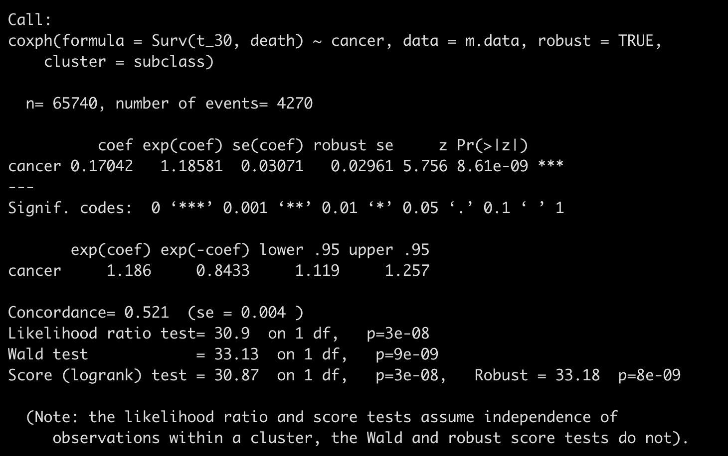
Without consider interaction
Average treatment effect in treated
Average effect in an unknown population

Slide 6
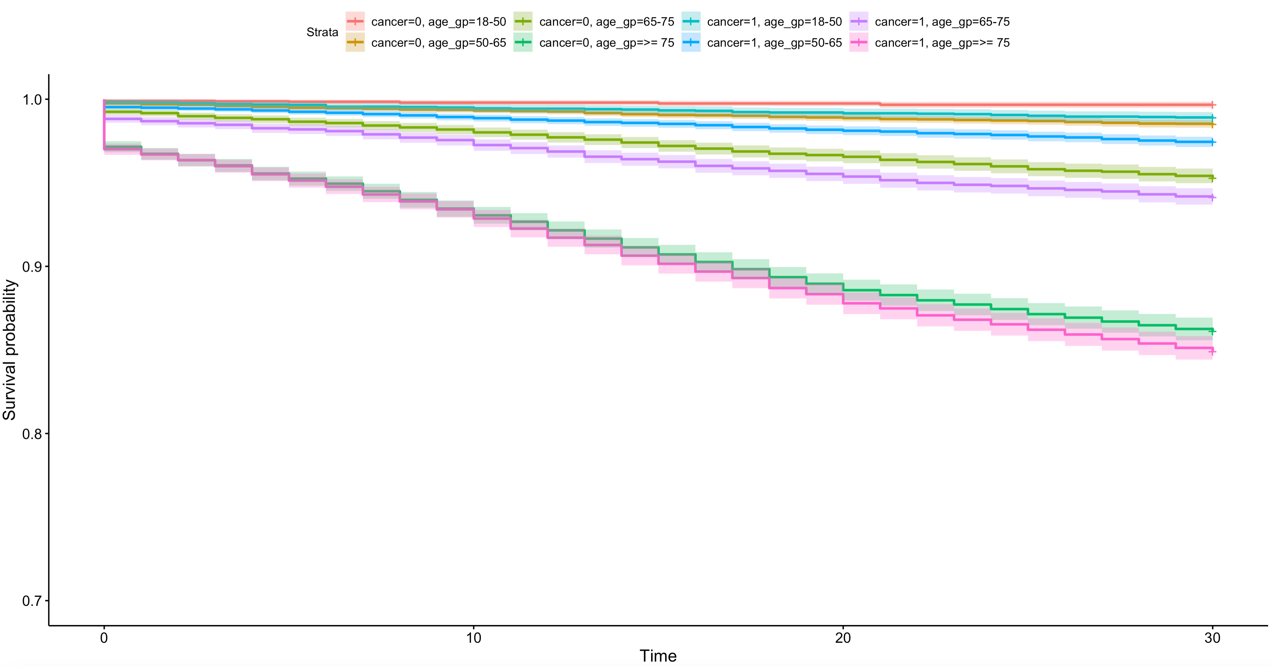

Slide 7
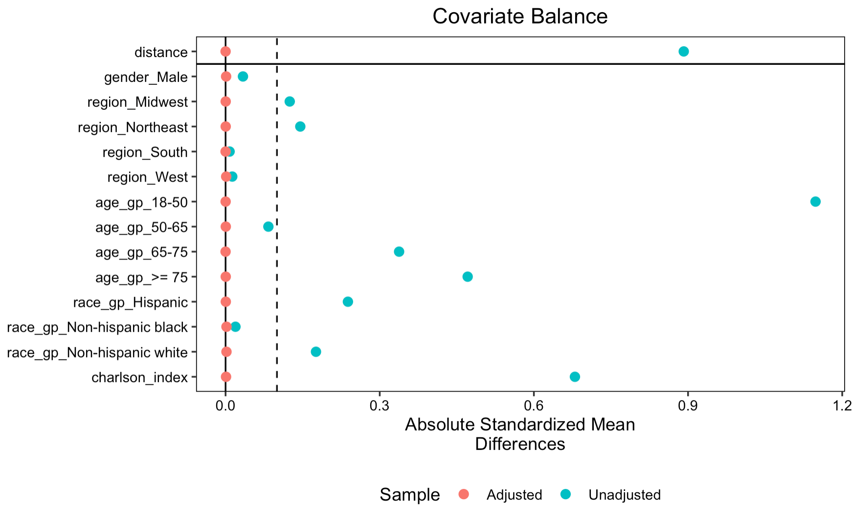
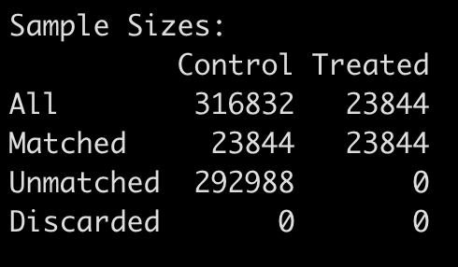

Slide 8
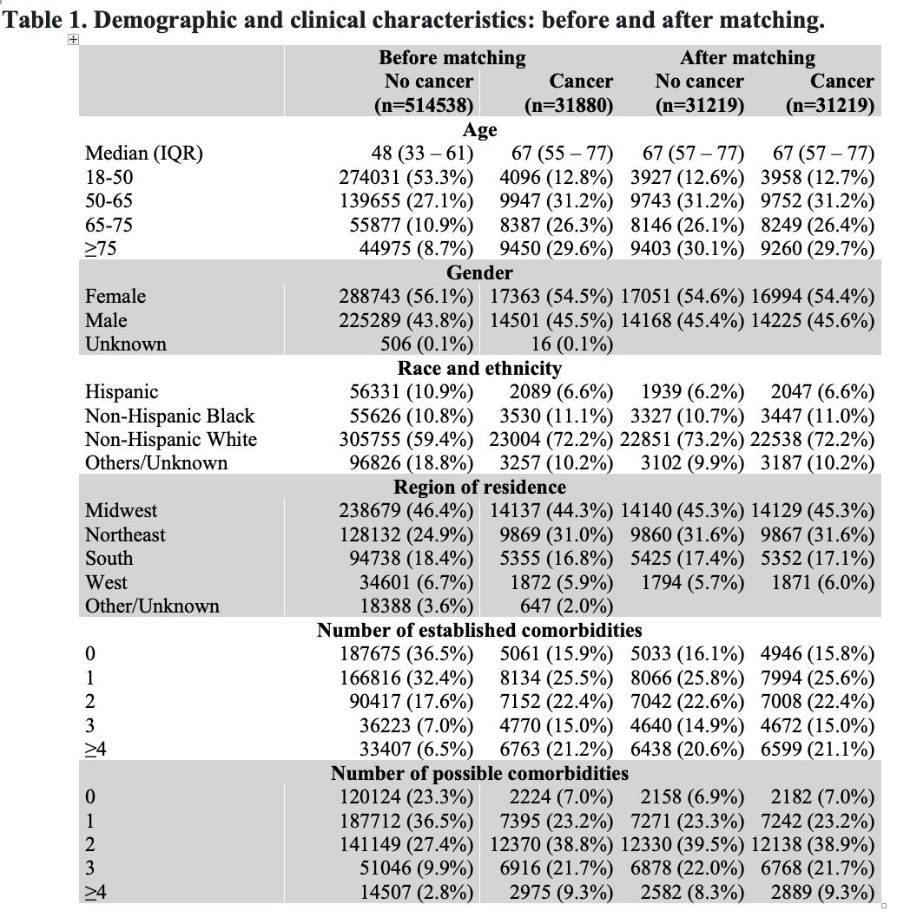
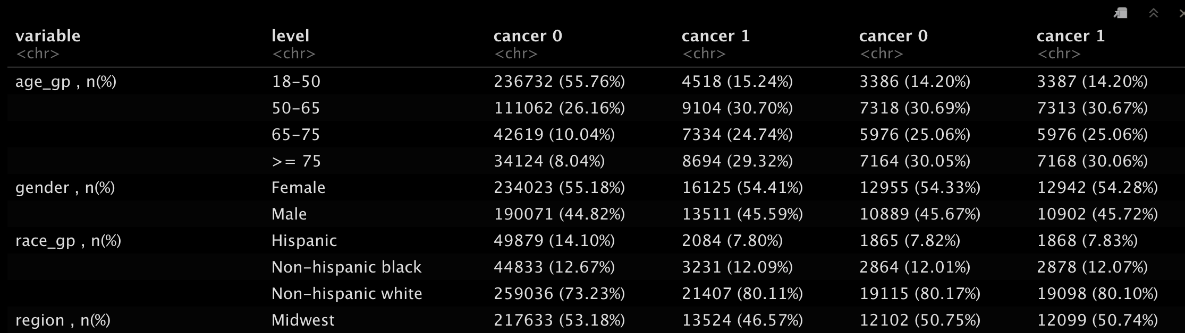
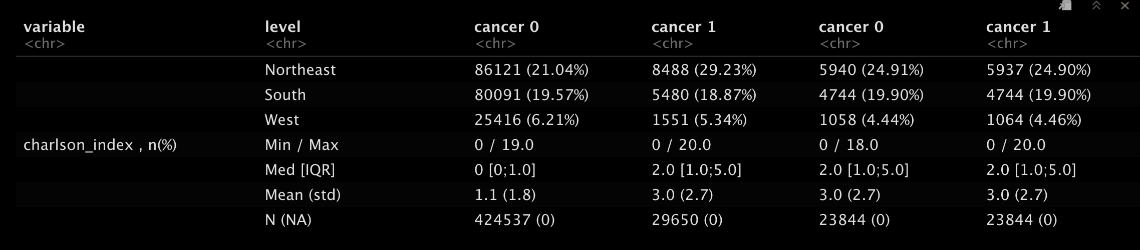
Other/Unknown will be treated as missing
Notes:
Missing whether to present it in the table

Slide 9
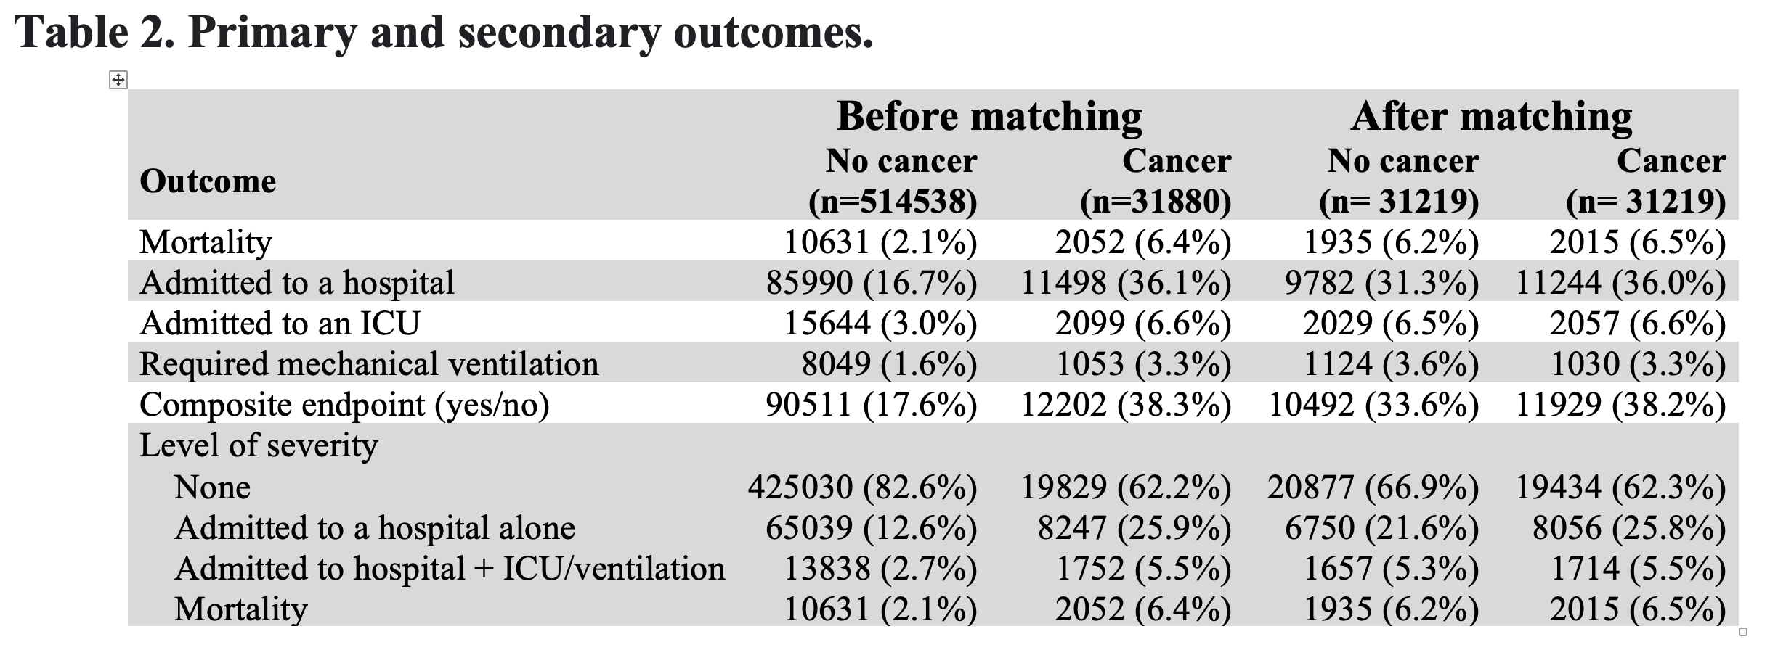
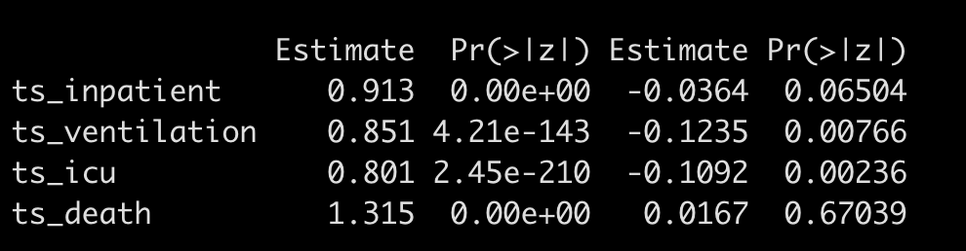
simple logistic regression
logistic regression using PSM

Slide 10
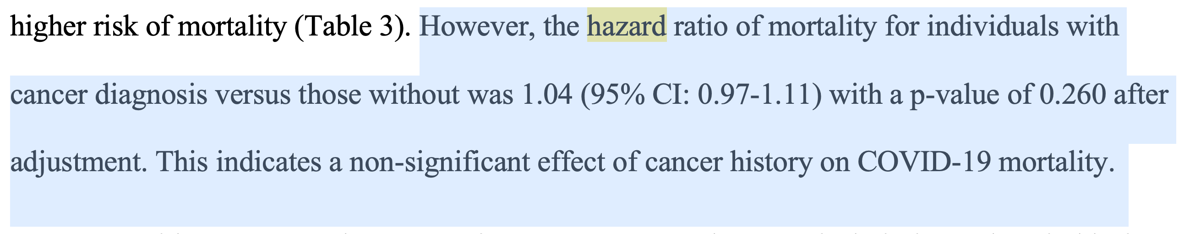
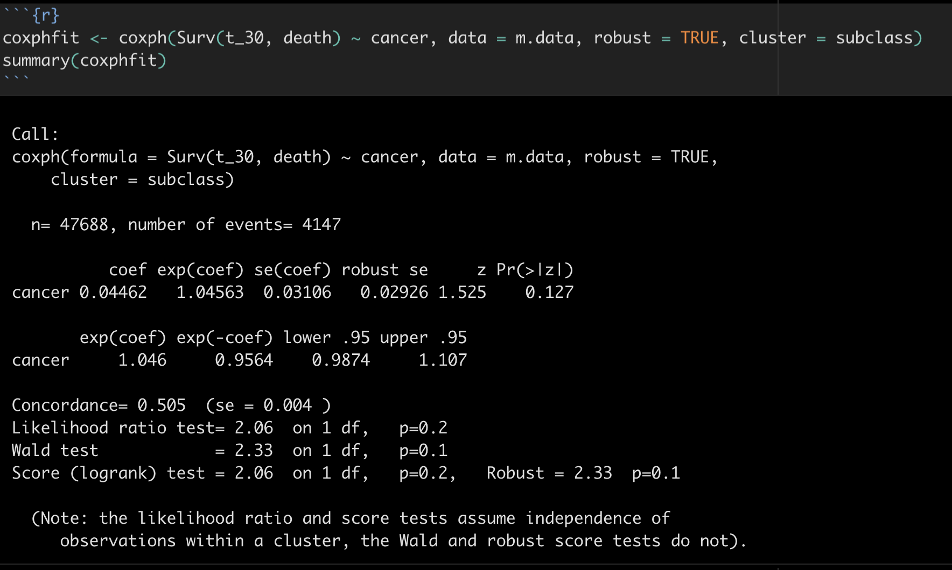
Survival analysis (time-to-event calculation is questionable)

Slide 11
Cancer subgroup analysis
One or two table

Slide 12
Few modification
use n_comorbity_gp, n_posi_comorb_gp as categorical variable instead of n_comorbity, n_posi_ comorb as continuous variable
Age_gp was used instead of age as a continuous variable
Surgery_4w was used in matching

