Slide 2
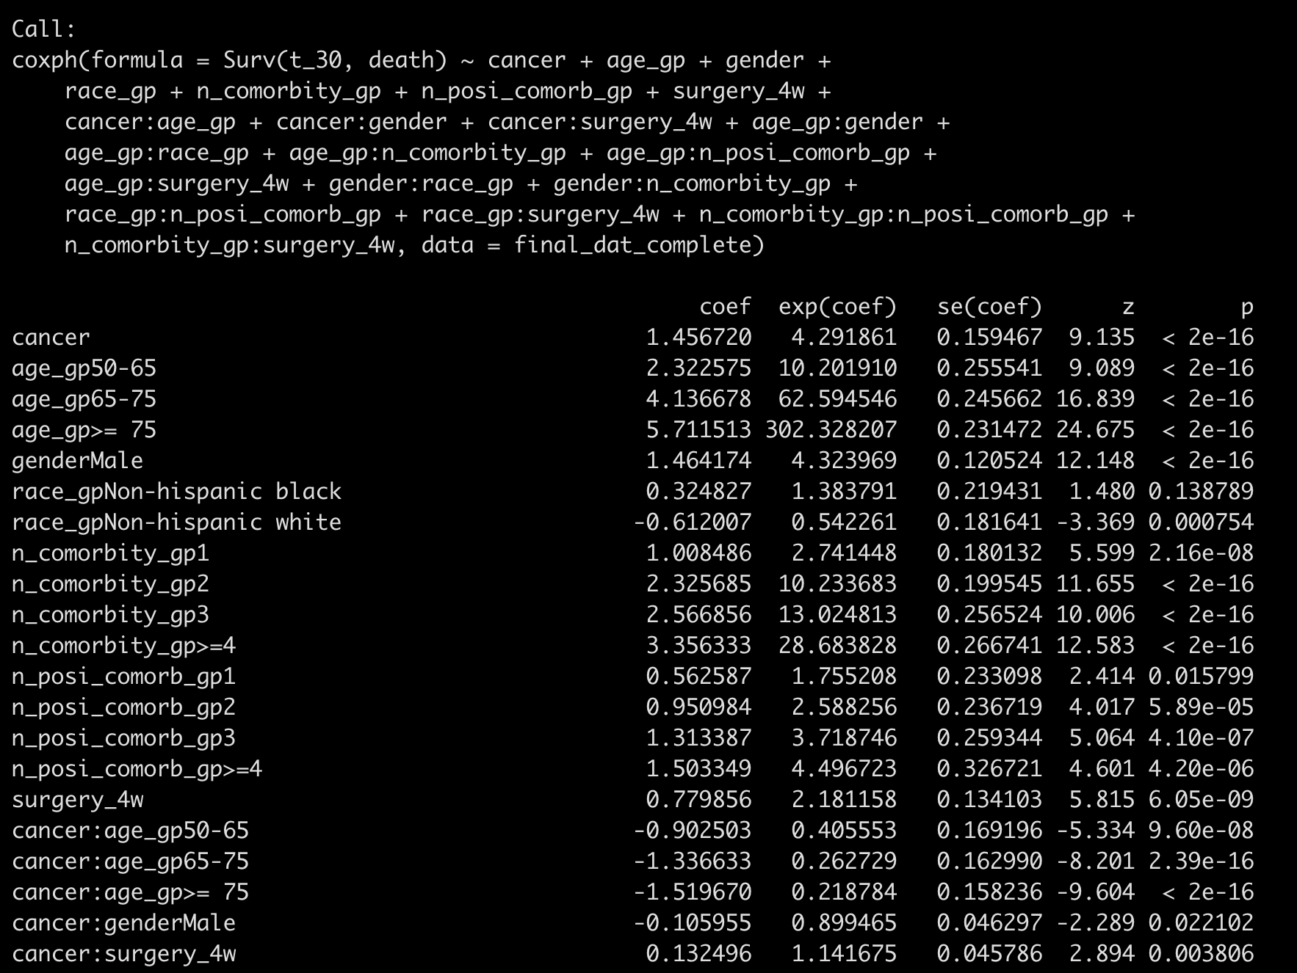
Backward-AIC all two-way interactions

Slide 3
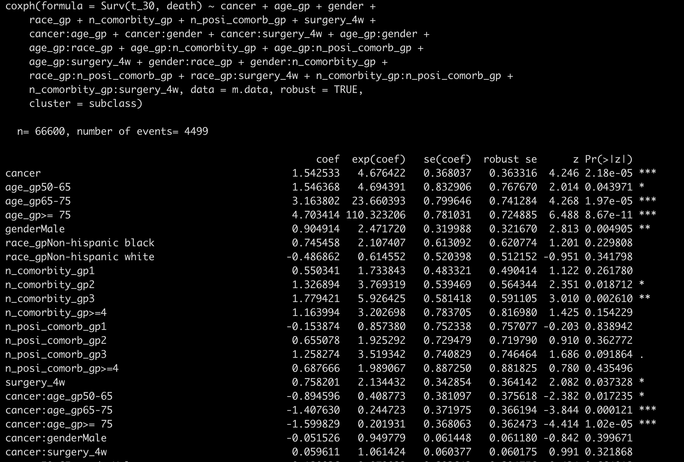
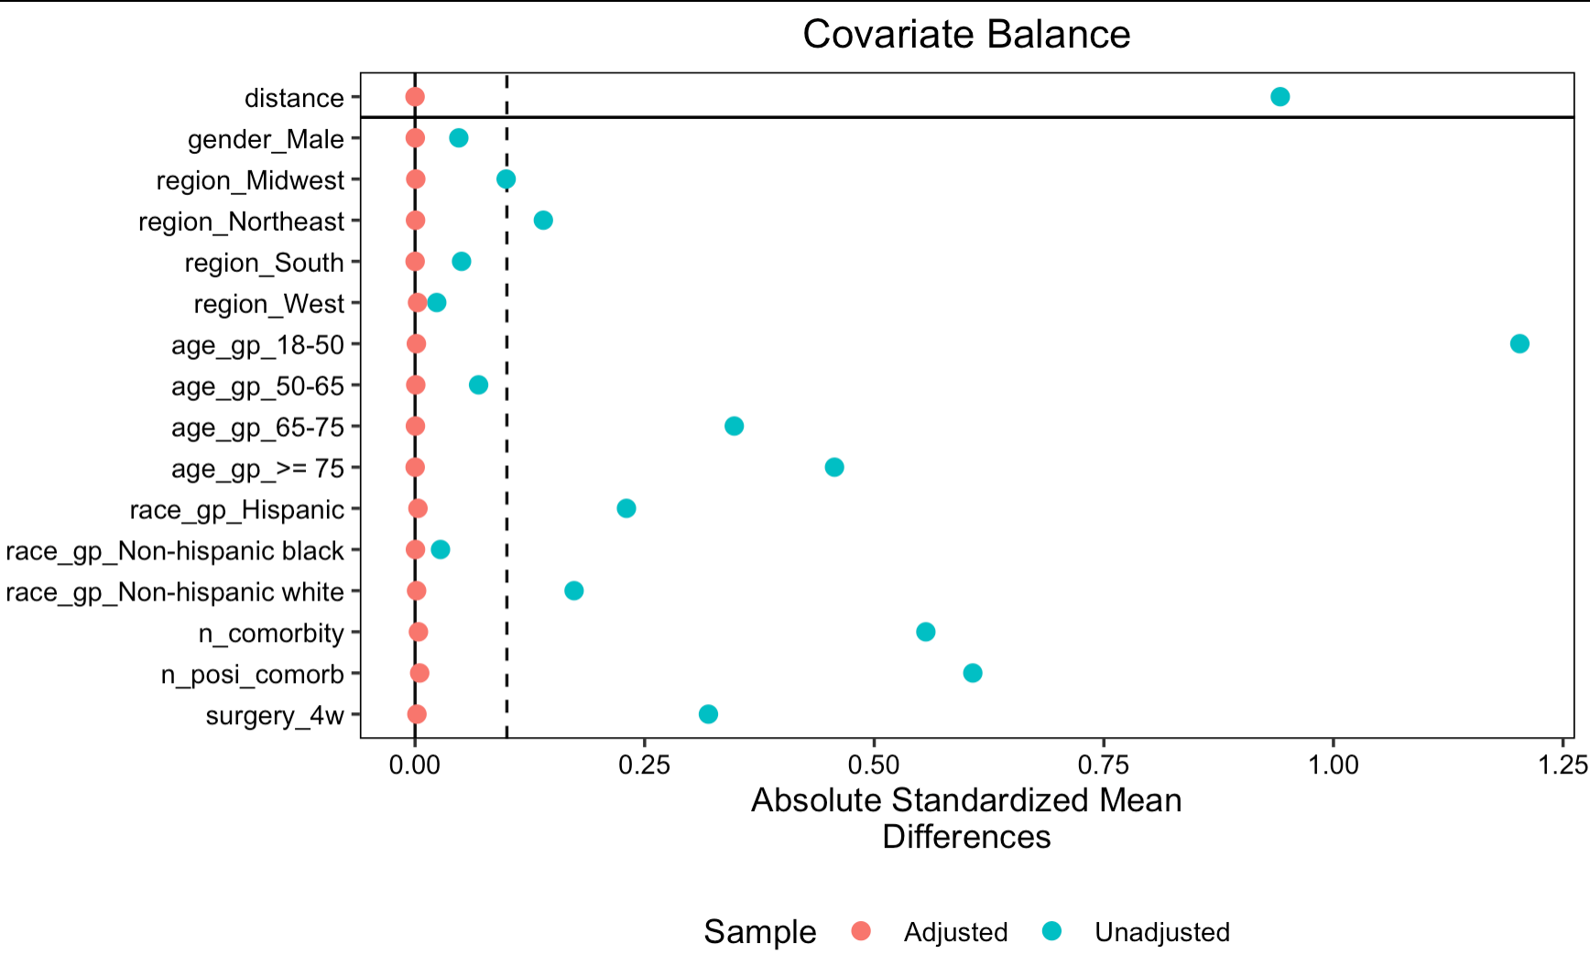
PSM matched on all two-way interactions

Slide 4
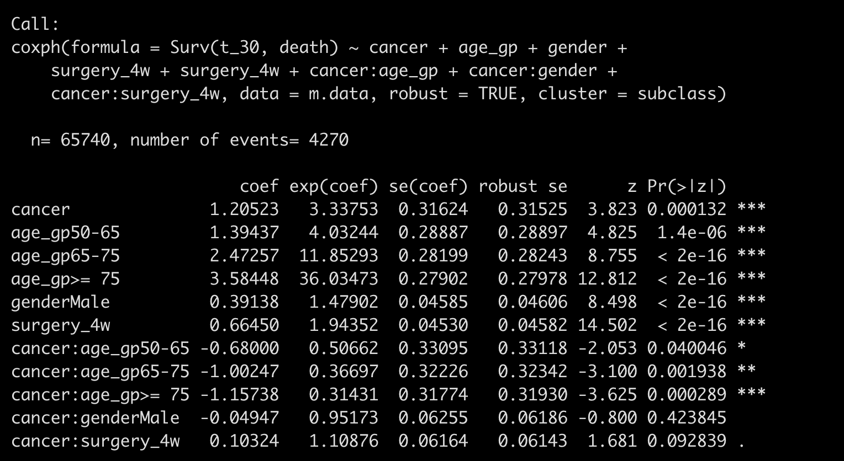
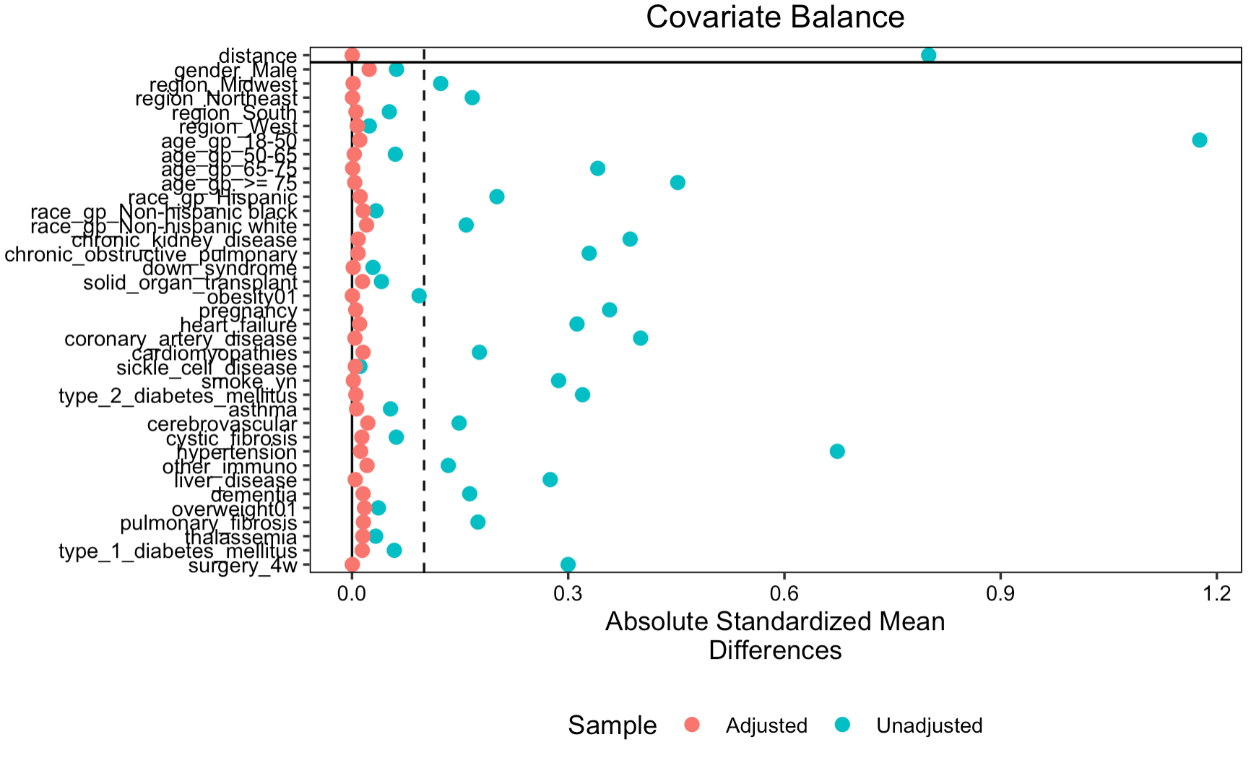
PSM matched on individual comorbidity level

Slide 5
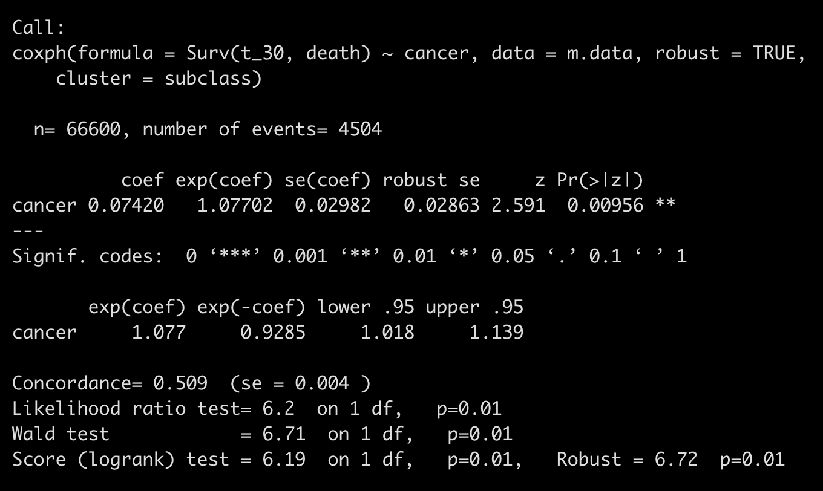
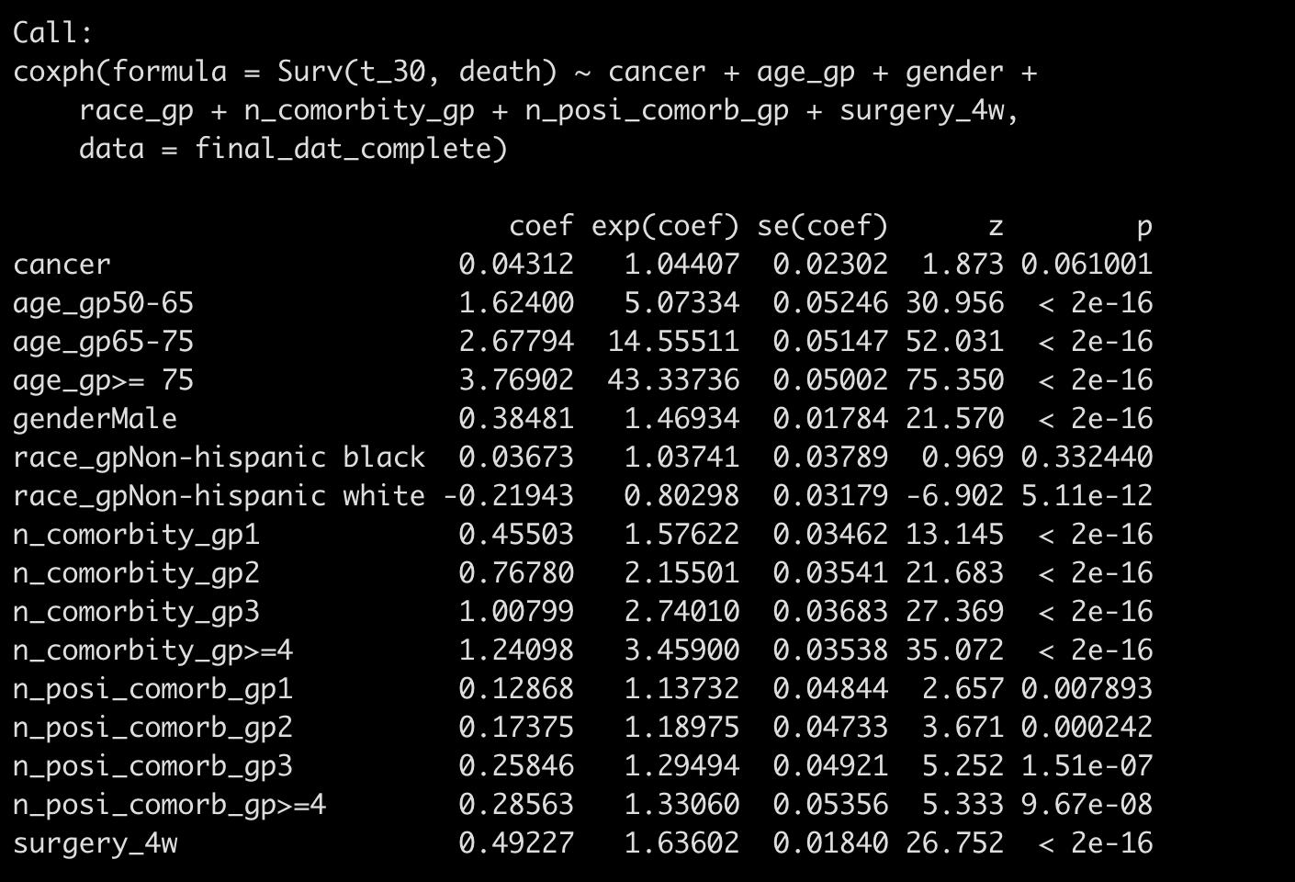
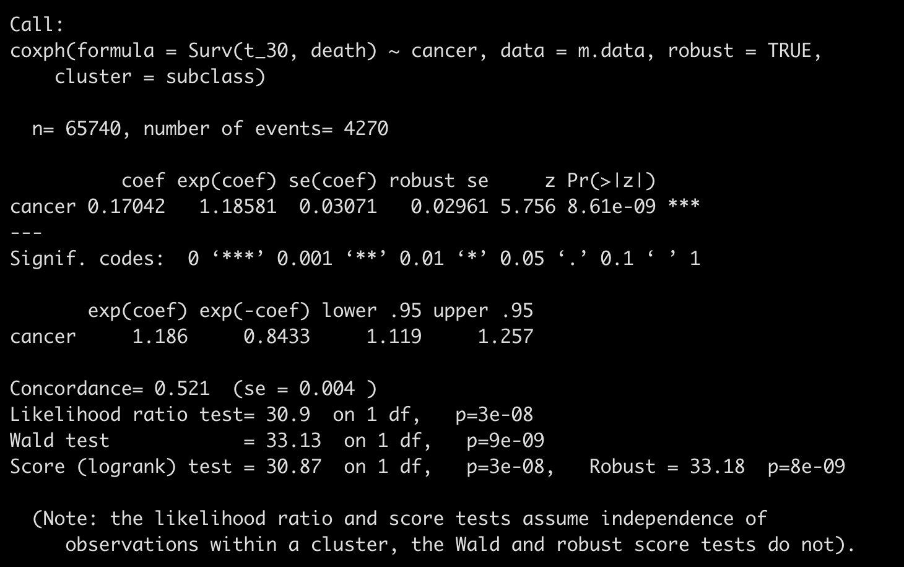
Without consider interaction
Average treatment effect in treated
Average effect in an unknown population

Slide 6
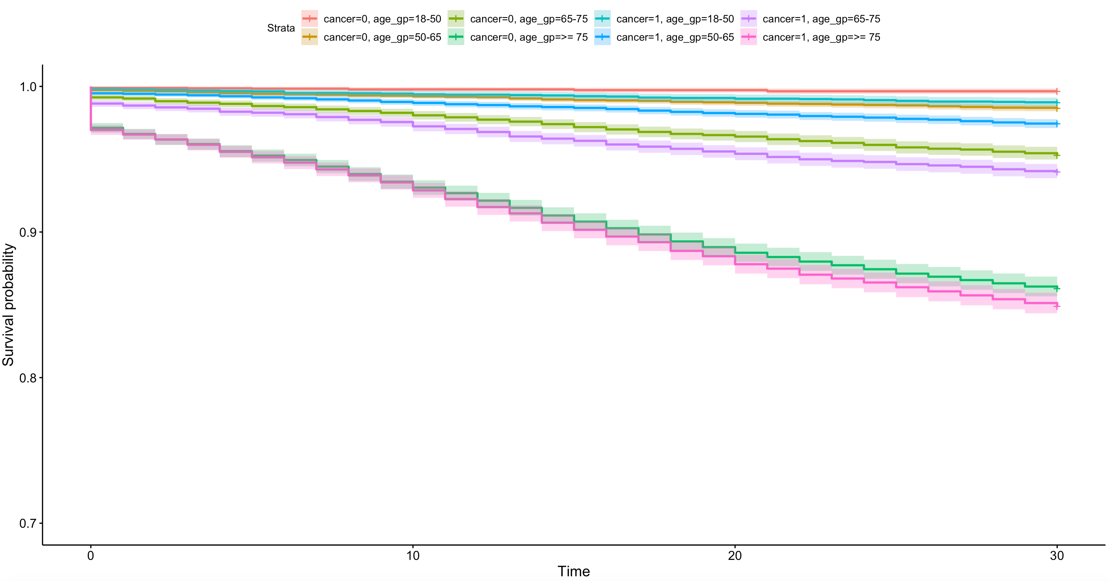

Slide 7
Few modification
use n_comorbity_gp, n_posi_comorb_gp as categorical variable instead of n_comorbity, n_posi_ comorb as continuous variable

