Slide 2
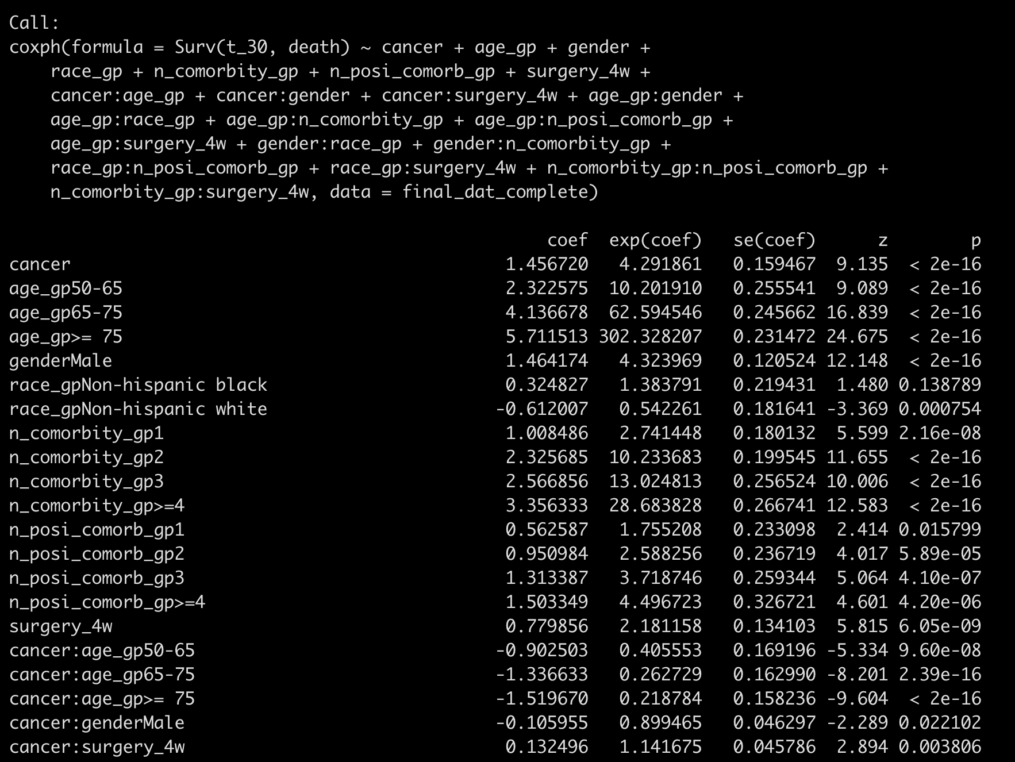
Backward-AIC from all two-way interactions:

Slide 3
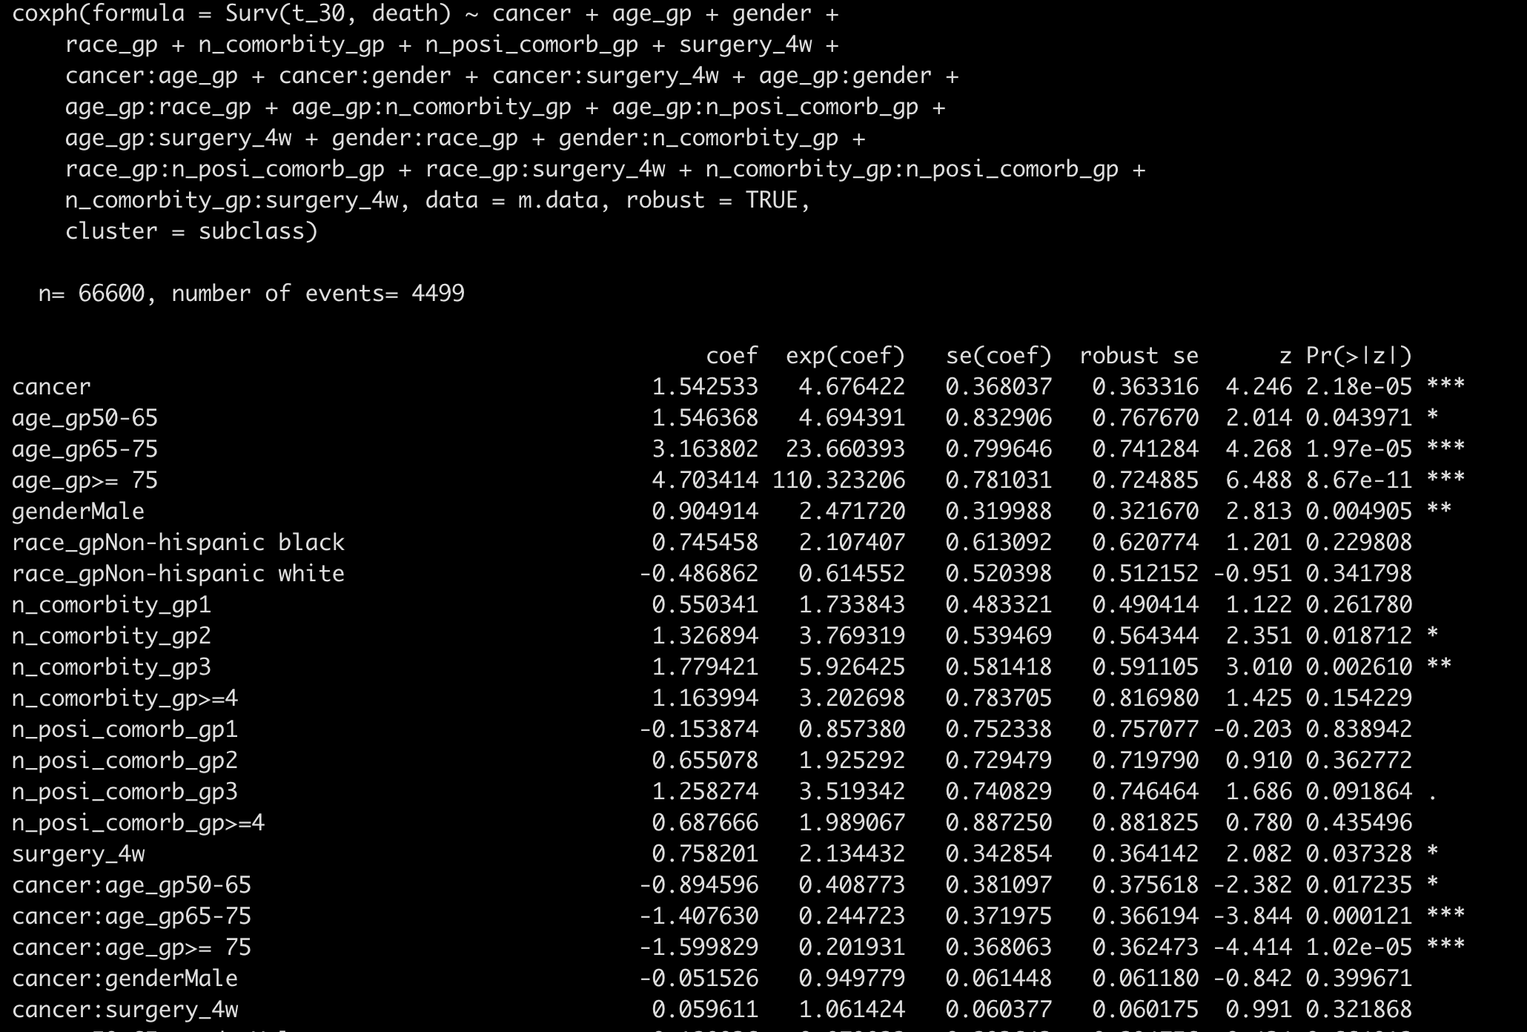
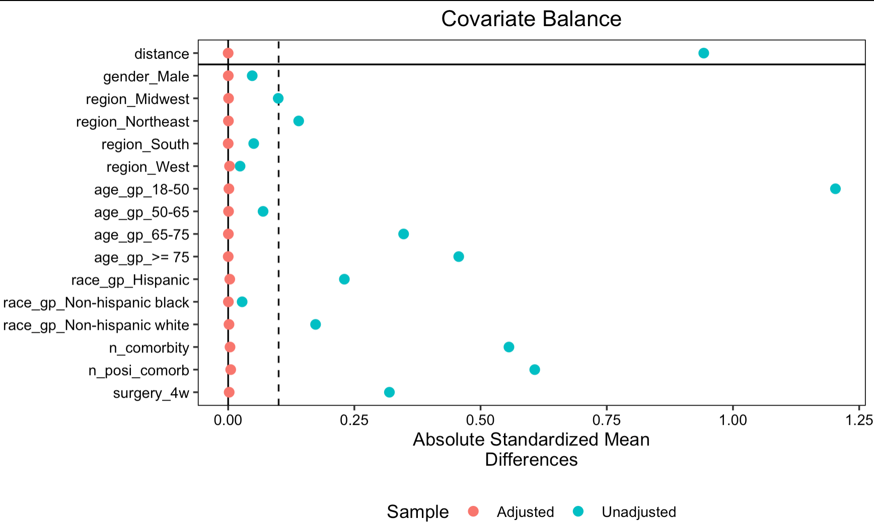
PSM matched on all two-way interactions

Slide 4
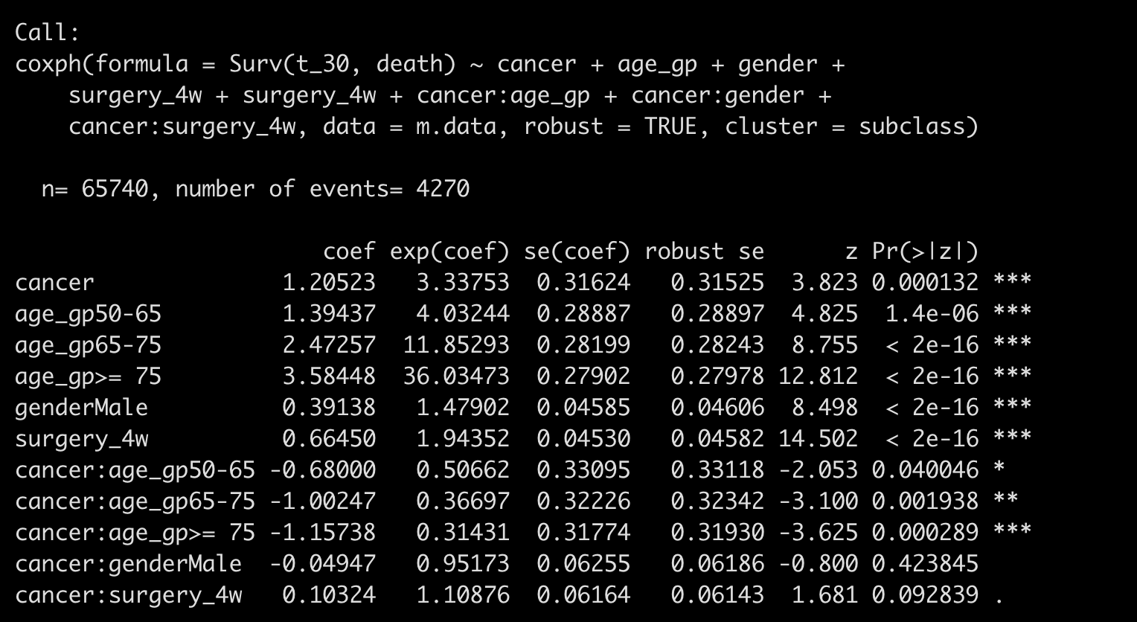
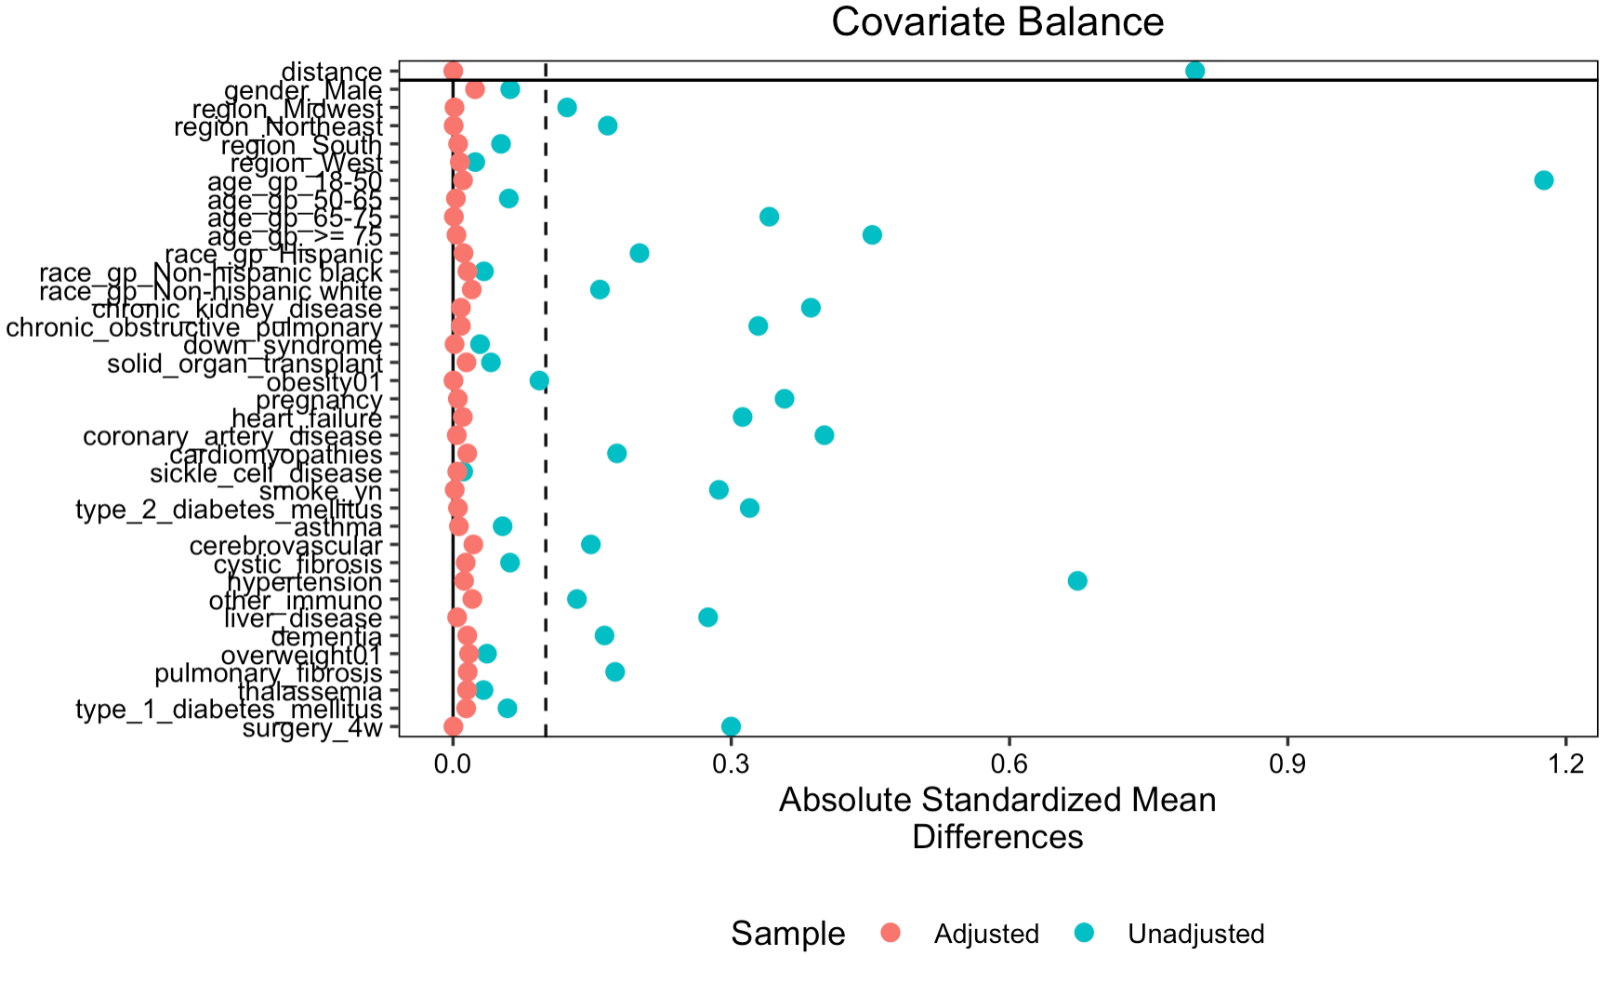
PSM matched on individual comorbidity level

Slide 5
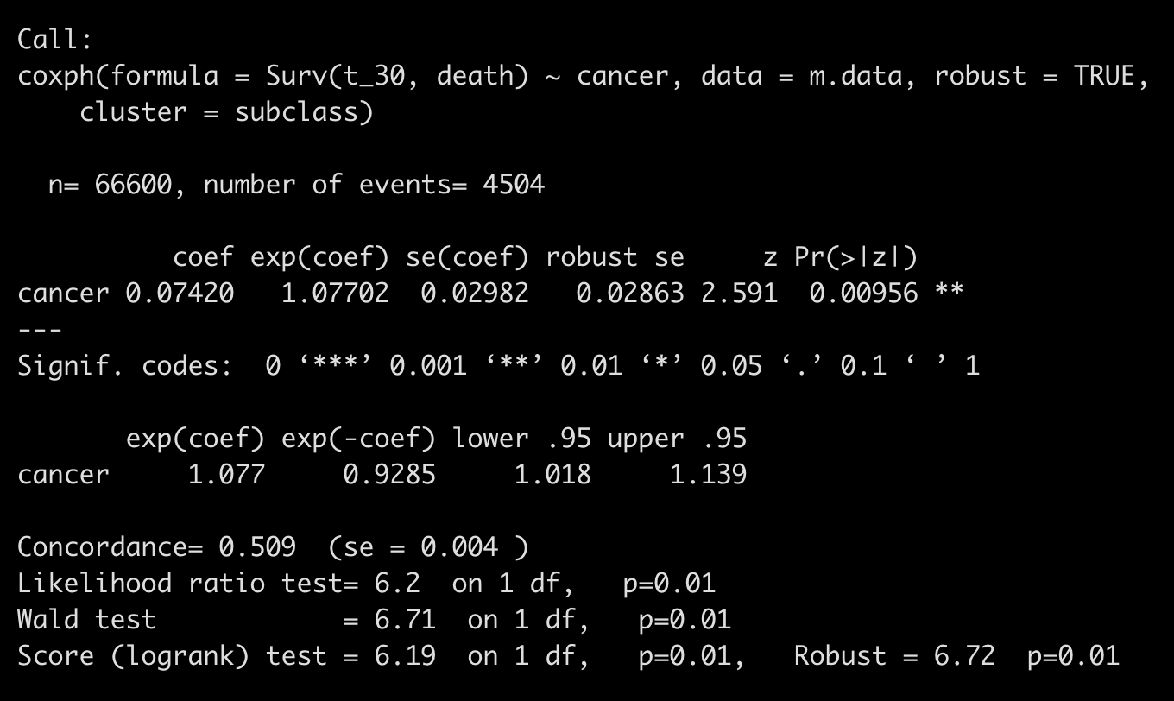
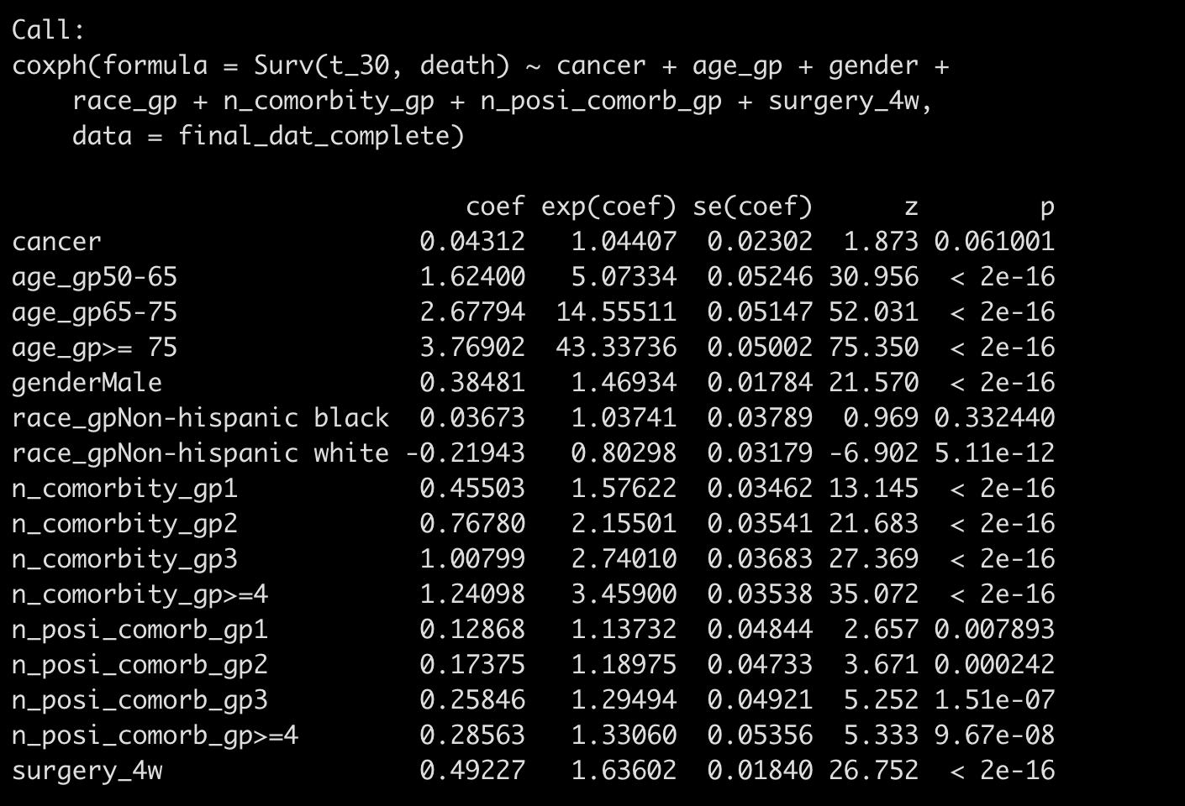
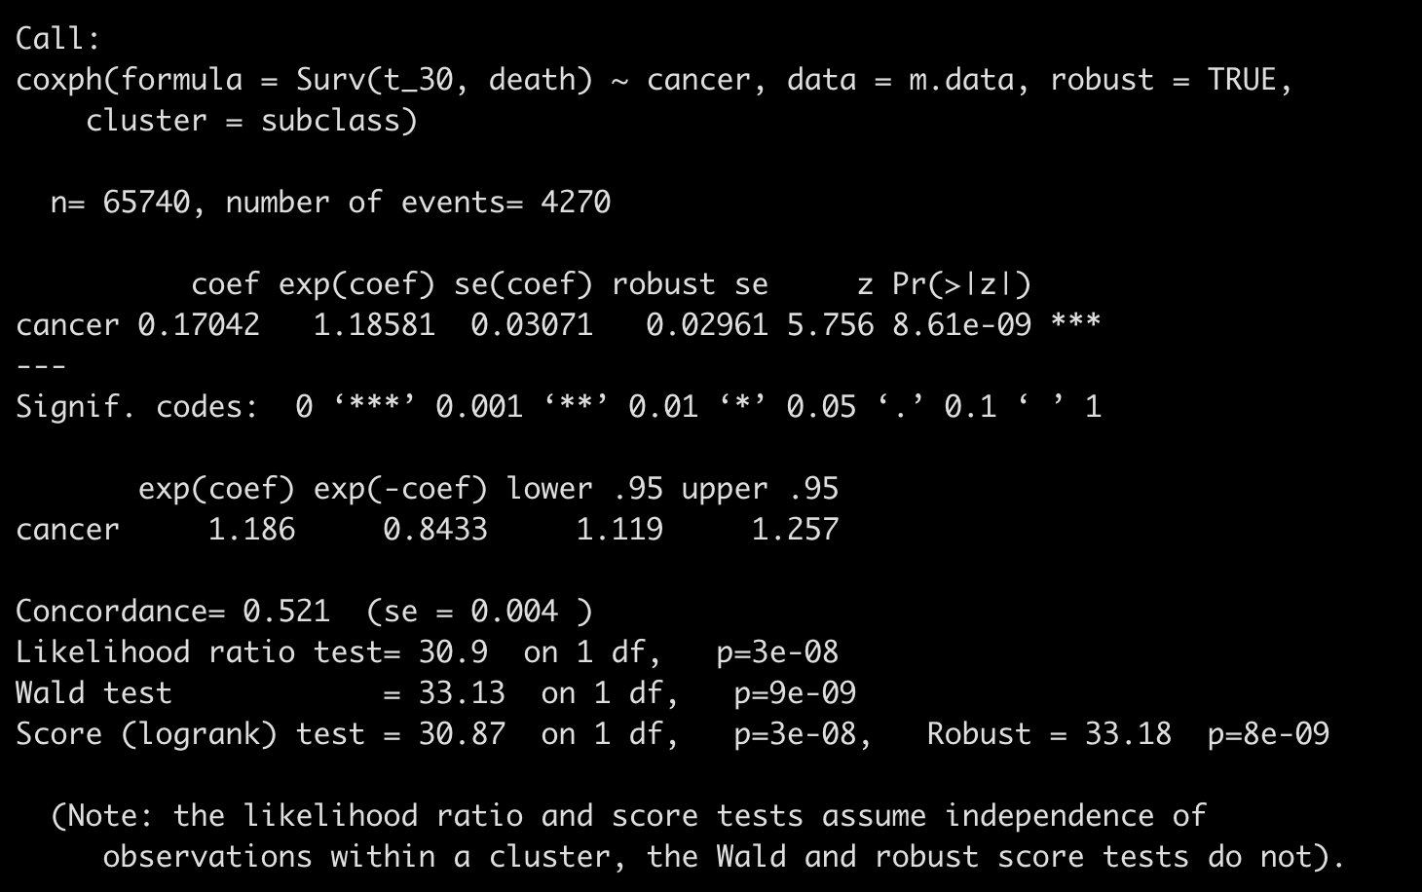
Without consider interaction
Average treatment effect in treated
Average effect in an unknown population

Slide 6
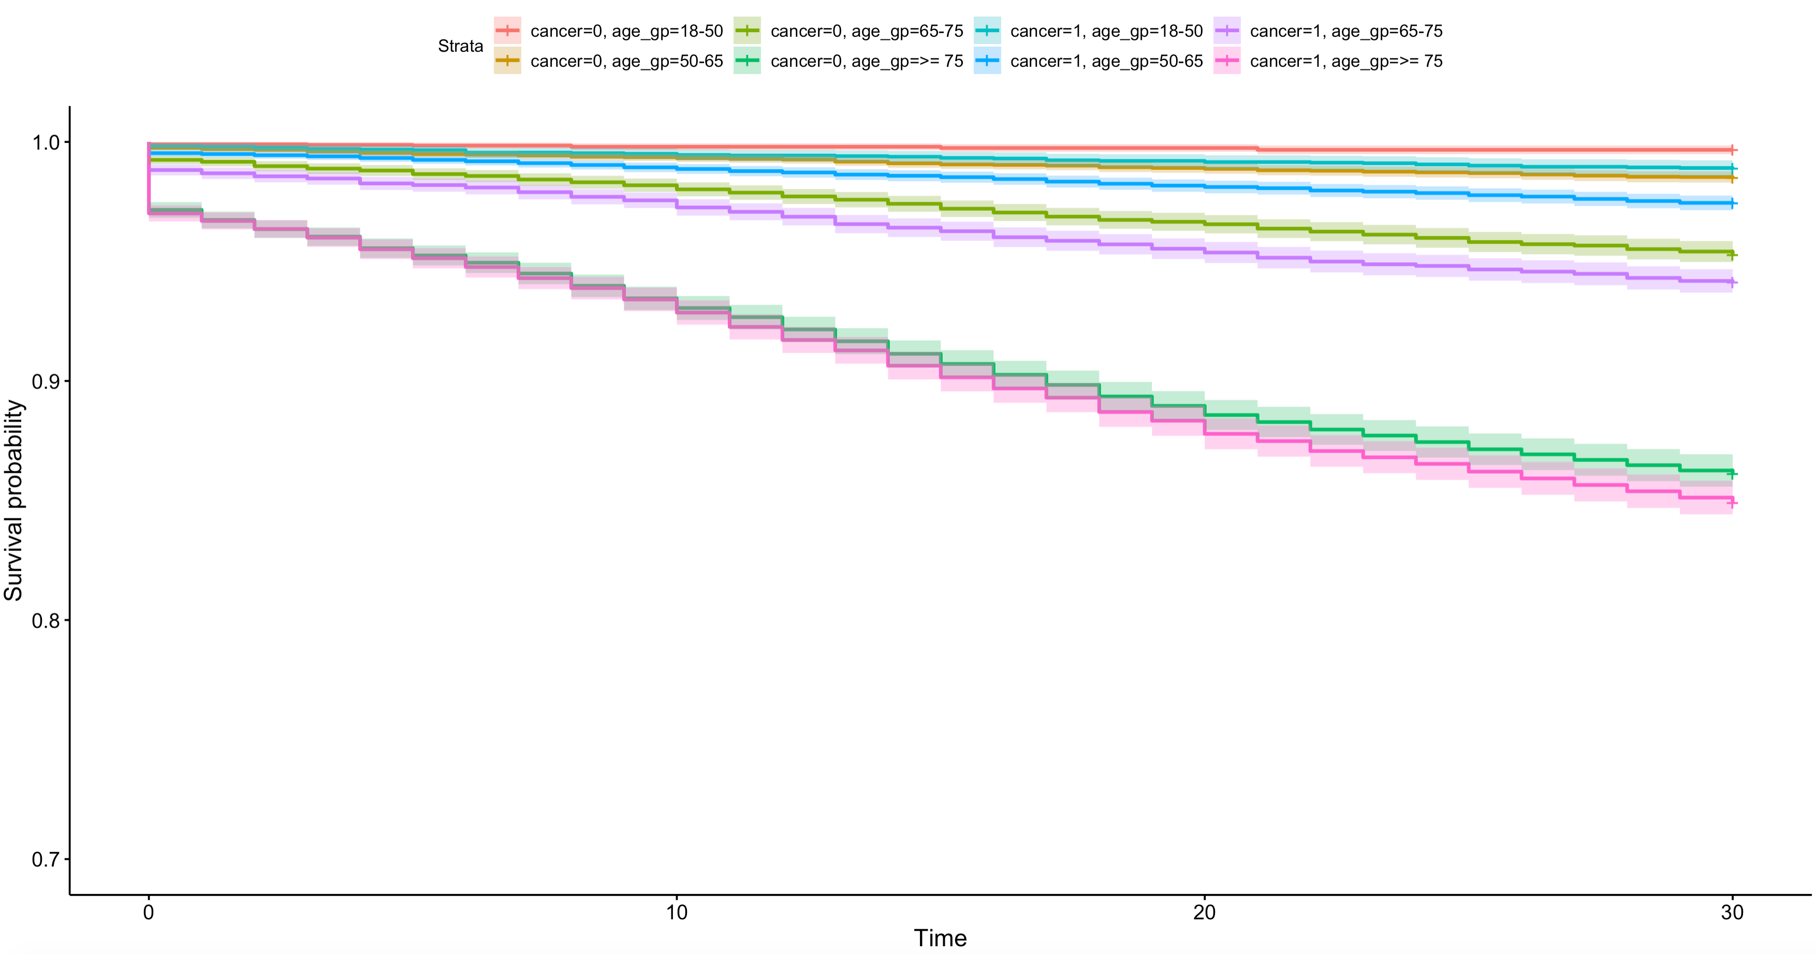

Slide 7
Few modification
use n_comorbity_gp, n_posi_comorb_gp as categorical variable instead of n_comorbity, n_posi_ comorb as continuous variable
Age_gp was used instead of age as a continuous variable
Surgery_4w was used in matching

