Slide 1


+
Racket + Docs
Kevin Zhang
Jakob Hain

Slide 2
Concept
Documentation for Racket
Javadocs for Racket
Write documentation alongside your functions
Design Recipe 101
Data definitions
Signatures
Purpose Statements
Examples
Convert Documentation Code to Scribble
Render HTML using Scribble
Other Features
Compile-time type-checking, examples double as types
Identifiers in raw text (e.g. purpose statements) are resolved, arrows point to binds

Slide 3
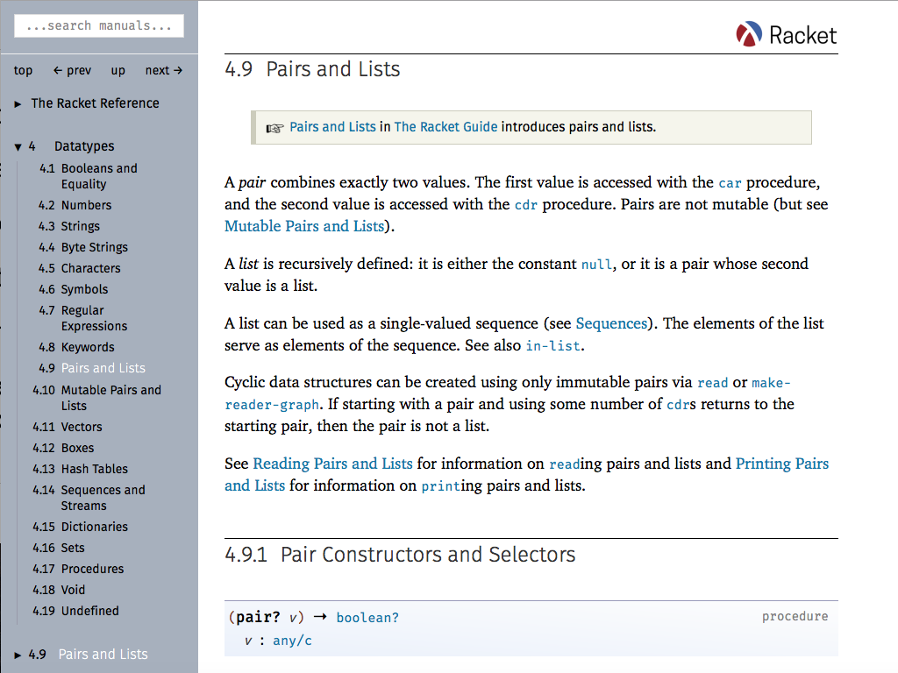
Syntax
Defining Datatypes
(define-data name [: - Type ...+ ] [Interpretation: String] [Example: Expr ...])
Documenting Functions
(define-docs (f a ...) [Signature: Type ...+ -> Type] [Purpose: String ...] [Example: (Expr => Expr) ...])
(define (f a ...) ...)
Compiling Docs into Webpages
(compile-docs path)
Formatted Racket Documentation

Slide 4
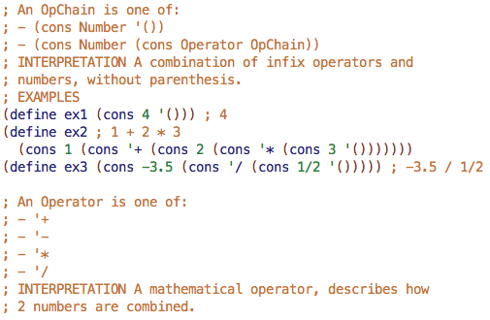
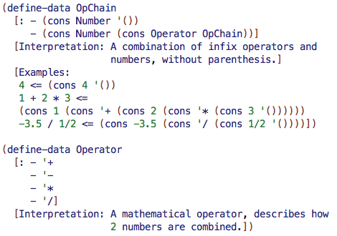
Semantics
Fundamentals I
Racket + Docs

Slide 5
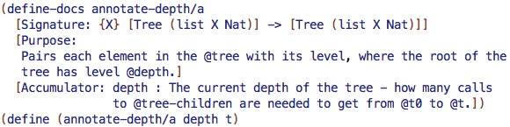
Additional
Type checking - Verifies typed function inputs conform to type
Example checking - Examples double as check-equal? tests
Interpolate Racket code in raw text (e.g. purpose statements) using @
Resolve identifiers within this code (arrows)

Slide 6
Github
Github Repository: https://github.com/FDWraith/Racket-Docs

