Slide 1
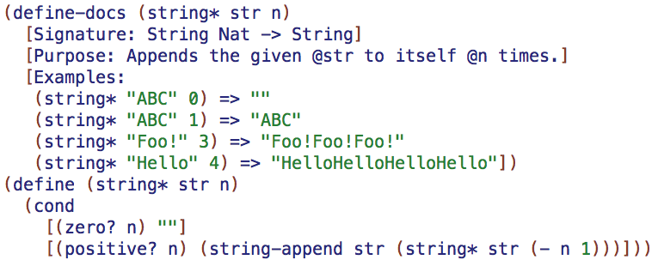
Racket+Docs
Jakob Hain, Kevin Zhang

Slide 2
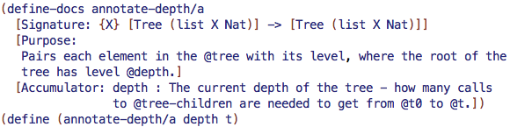
Concept
Inline documentation of Racket code.
The compiler can use this documentation:
Syntax highlighting, bind arrows to references.
Examples double as tests and are verified correct.
Basic type-checking.
The program has an additional function, (compile-docs path). This function "compiles" the docs into a web-page, which resembles the official Racket docs, and saves it to the given path.
Like JavaDoc for Racket, but explicit forms, not fancy comments.

Slide 3
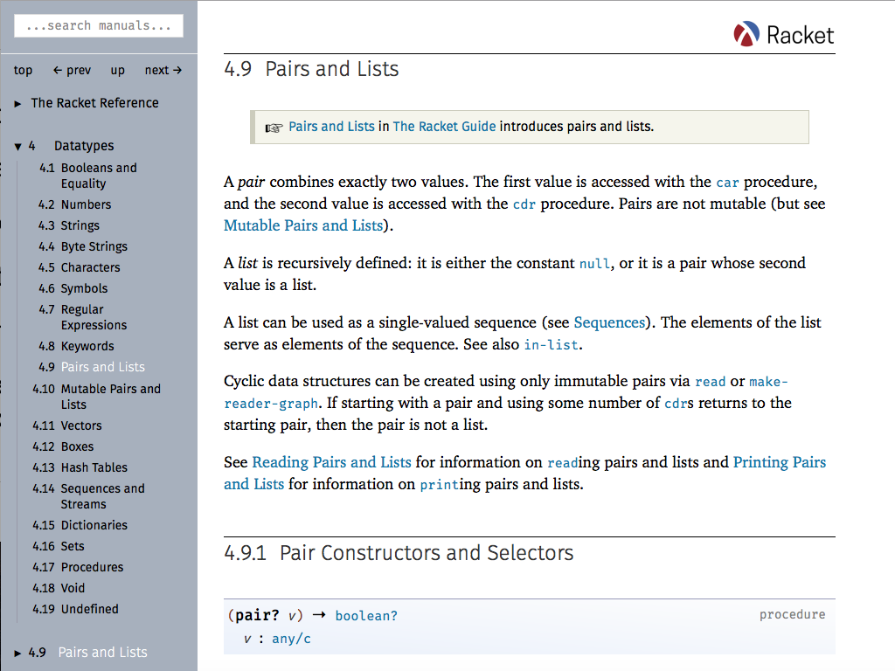
What the documentation might look like

Slide 4
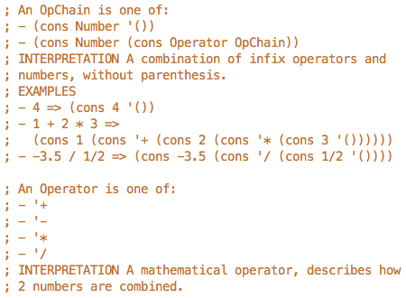
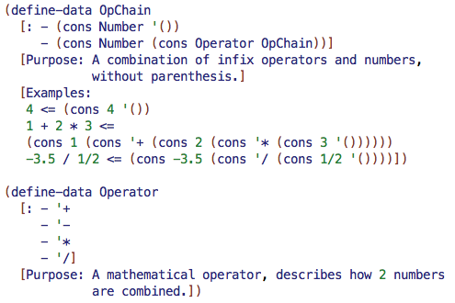
Comparison
Fundies 1 | Racket + Docs
Documented in comments. | Documented in explicit forms.
No highlighting or IDE support. | Syntax highlighting and arrows.
Examples/uses aren't checked. | Examples/uses type-checked.
Manually create web-page docs. | Web-page automatically created.

