Slide 1
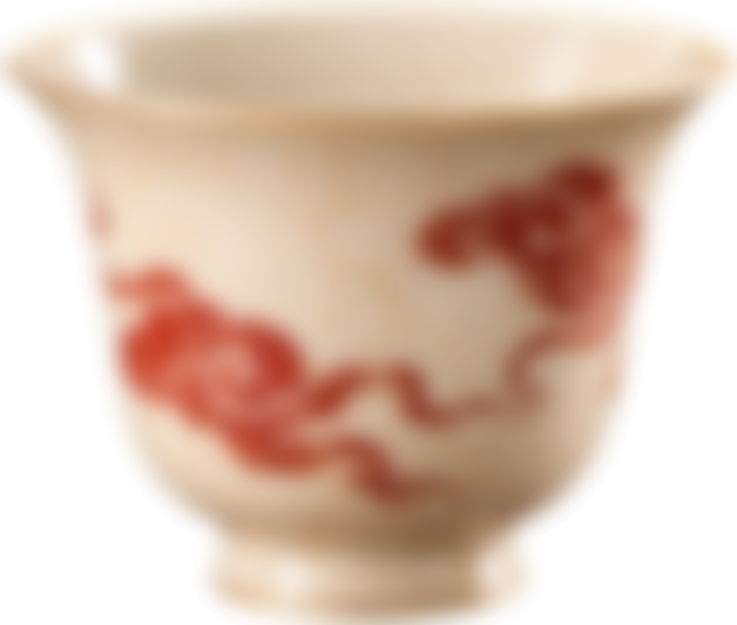
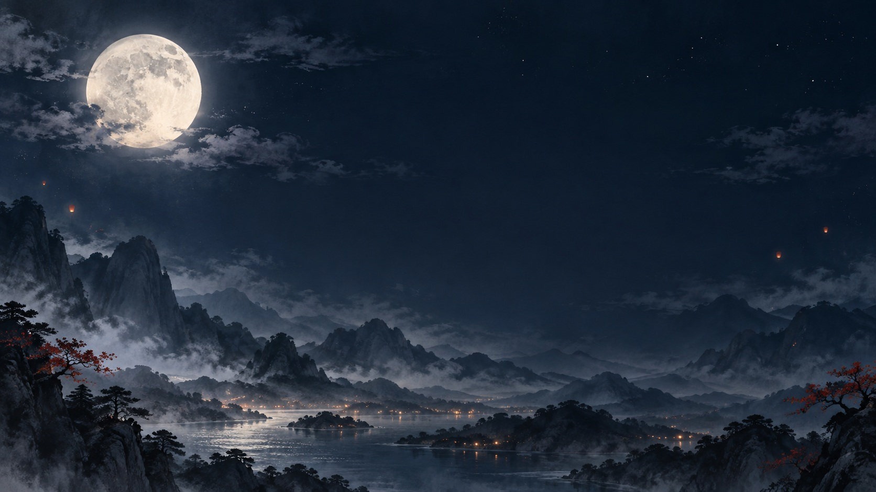
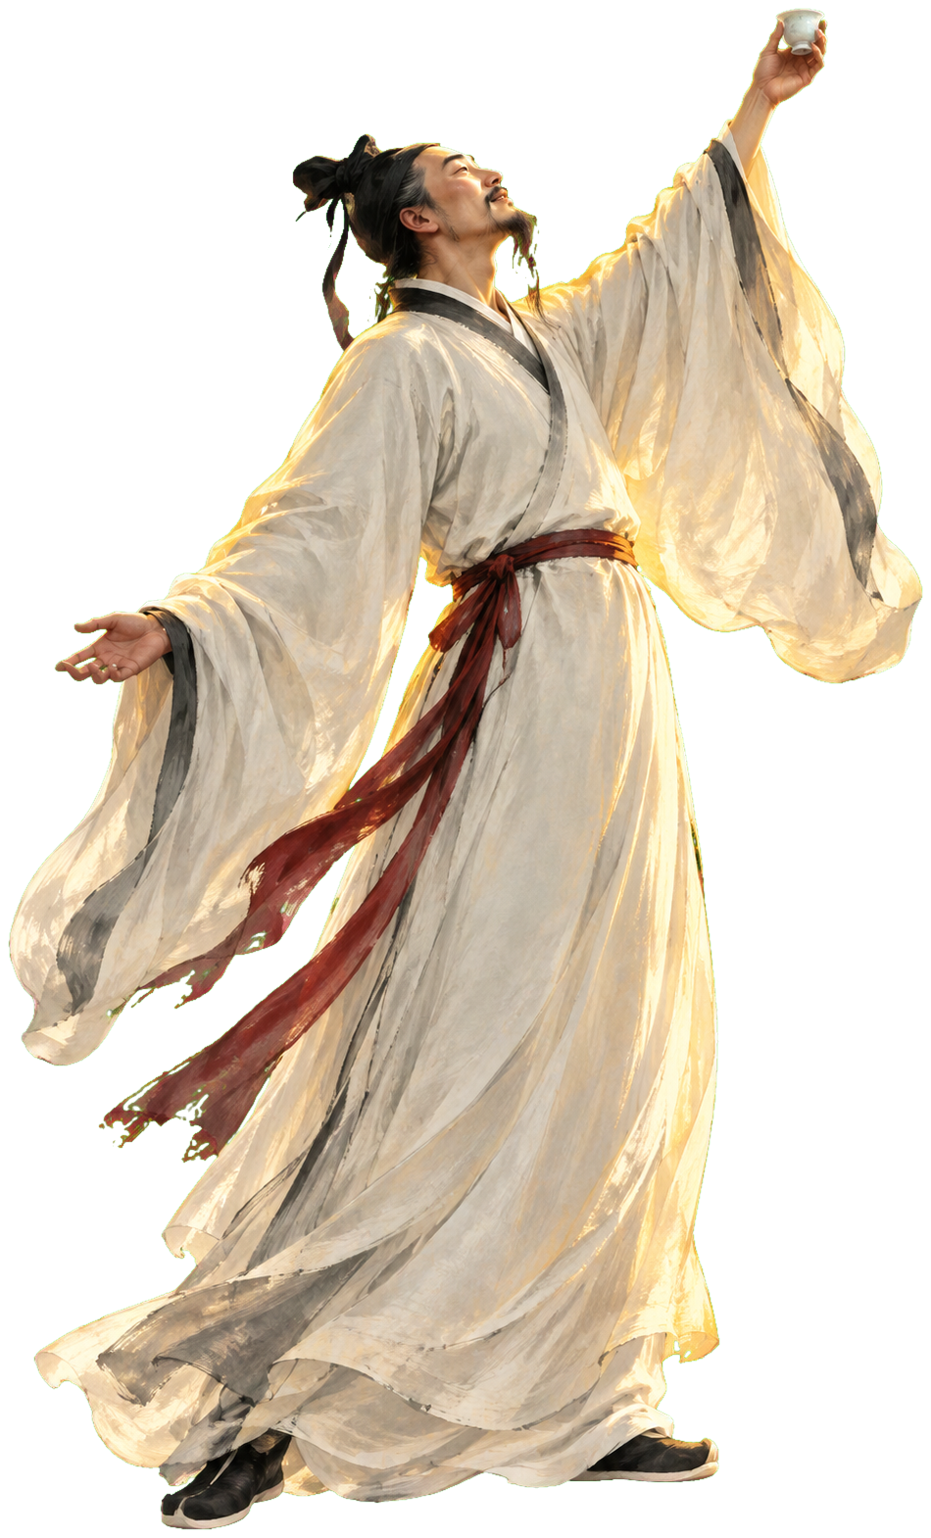
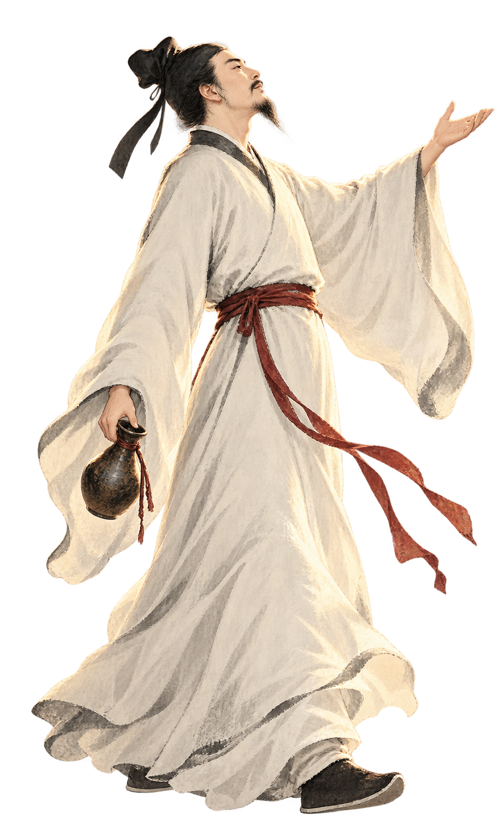
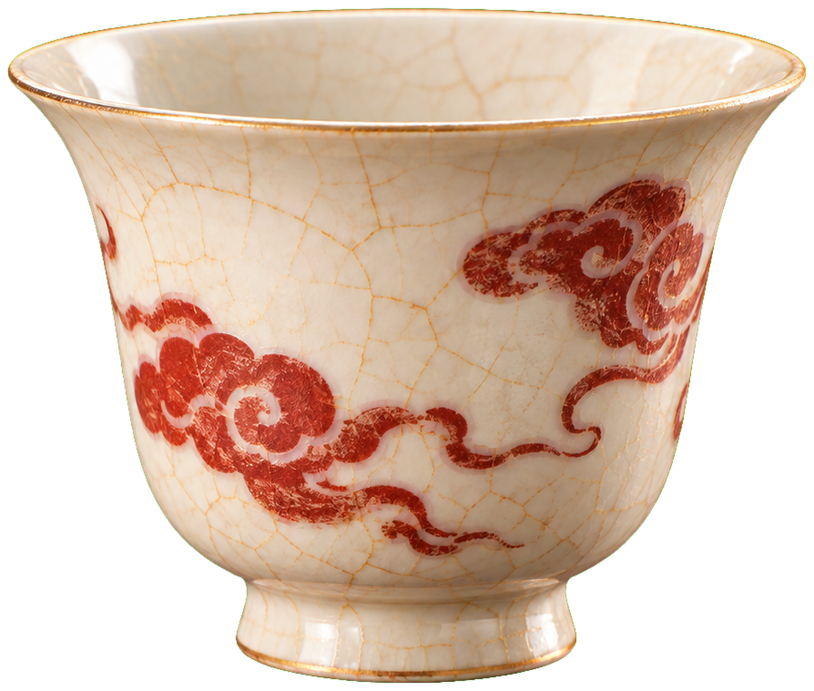
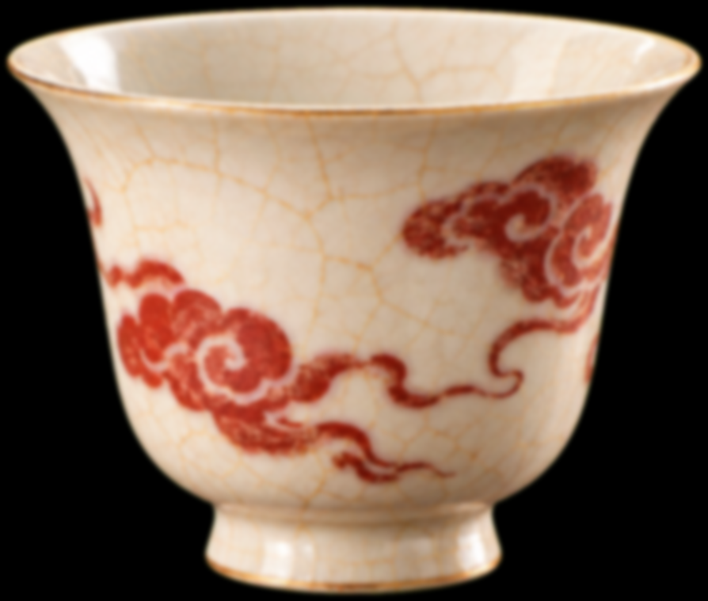
李白
举杯邀明月
Notes:
Parallax state A. Li Bai raises a cup under the moon. Nine sharp cups form the back layer, six softly focused cups form the middle layer, and three strongly defocused cups form the foreground. Historical reference: https://commons.wikimedia.org/wiki/File:LiBai.jpg (public domain). Character and cup cutouts were generated from the reference for this demonstration.

Slide 2
李白
举杯邀明月
Notes:
Parallax state B. This slide is a full duplicate of state A. The first pose exits left while the reciting pose enters from the right. Back cups move least, middle cups move farther, and defocused foreground cups move farthest. Morph is applied to this slide.

