Slide 1
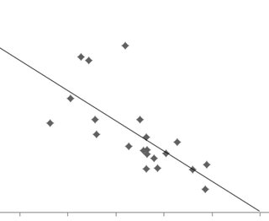
DATA HYPOTHESIS VALIDATION
Functionality
Drop Down Menus
Menu 1: Educational Attainment (“???”)
Total of 3 options
None
High School Only
College
Menu 2: Race (OPTIONAL)
Total of 9 options
All
AIAN
Asian
Black
Hispanic
Multi
NHPI
Other
White
y-axis: crime rate
x-axis: educational attainment
Scatter plot
x-axis: educational attainment (% of total)
y-axis: crime rate (offenses / total population)
outlier tracts with no residents get dropped??
Each point is the two values for a specific tract

Slide 2

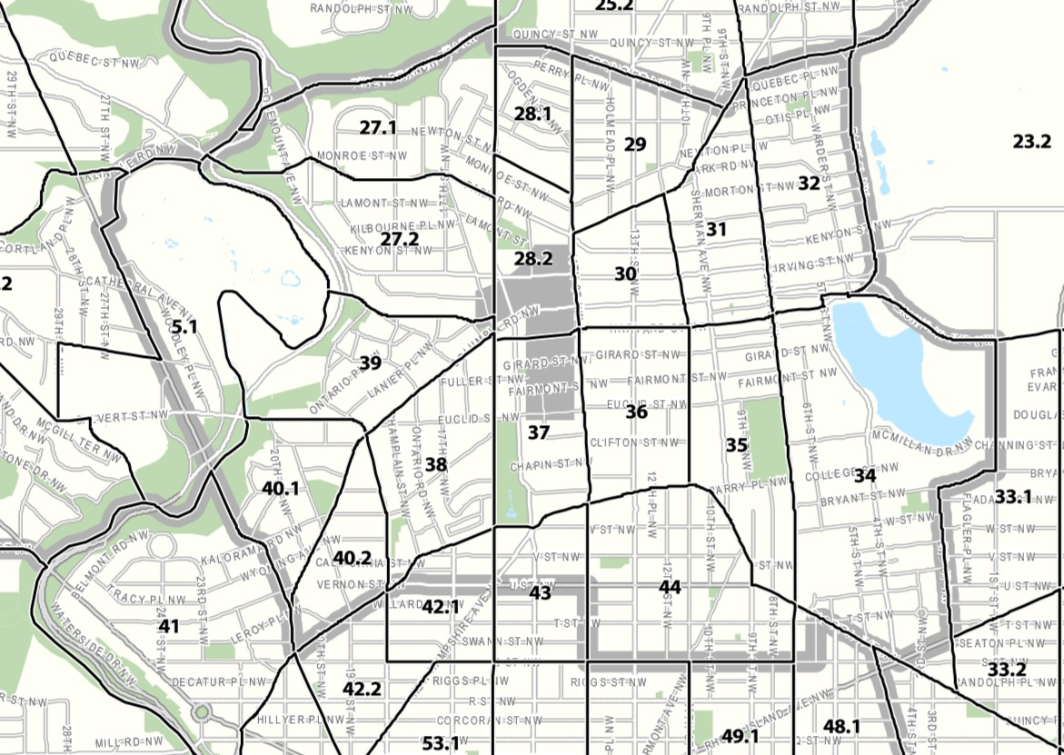
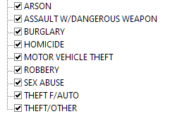
DATA EXPLORATION
Functionality
Drop Down Menu for entire map
Menu 1: Educational attainment
Total of 3 options (Less than high school, High school, College)
Menu 2: Type of Crime (“OFFENSE”)
Total of 9 options ( )
Menu 3: Gender (optional)
Total of 3 options (all, male, female)
When clicking on pin
map zooms in and tract fills map, pins display for each crime committed in that tract by location
pop-up displays data relevant to that tract
Census Tract # (“CENSUS_TRACT”)
Total Offenses (“OFFENSE”)
Total Population (“POP_TOTAL”)
data tables/visualizations update to show vital signs for that tract
Vis 1: crimes by type (pie chart?)
Vis 2: high school attainment by race (bar?)
Vis 3: college attainment by race (bar?)
Map with census tracts outlined, shading is heat map dependent upon educational attainment
Each tract becomes shaded (darker) on mouse over
Each tract has one pin which displays a summary of data for that tract

