Slide 1
SONiC-VPP
Shashidhar Patil shaship@cisco.com
Sameer Nanajkar sananajk@cisco.com

Slide 2
What is SONiC ?
Software for Open Networking in the Cloud
Is an open-source network operating system based on Linux
SAI (Switch Abstraction Interface) API for dealing with forwarding engine in a platform independent way
Primarily developed by Microsoft for data center switches in Azure cloud
Is now a community driven project
SONiC architecture , wiki and SAI will be of help

Slide 3
Why SONiC-VPP ?
SONiC lacks a software forwarding engine which
Is feature rich
Is performant
Is open sourced and community driven
Runs on multiple commodity hardware
In summary VPP fits the bill

Slide 4
Use Cases
SONiC Development vehicle
Virtual Gateway
Cloud Router
Stateful Services (NAT, IPsec, etc.)

Slide 5
Abstraction
SONiC
Adapter Host 1
Operating System
SAI Interface
VPP Adapter
VPP Binary API
Name | Description
Control Stack | Upper Applications (e.g. NOS)
Adaptor | Pluggable vendor code module that implements BSP APIs for a platform
Adaptor Host | Software component of a control stack that loads Adaptor
VPP
Hardware
NIC

Slide 6
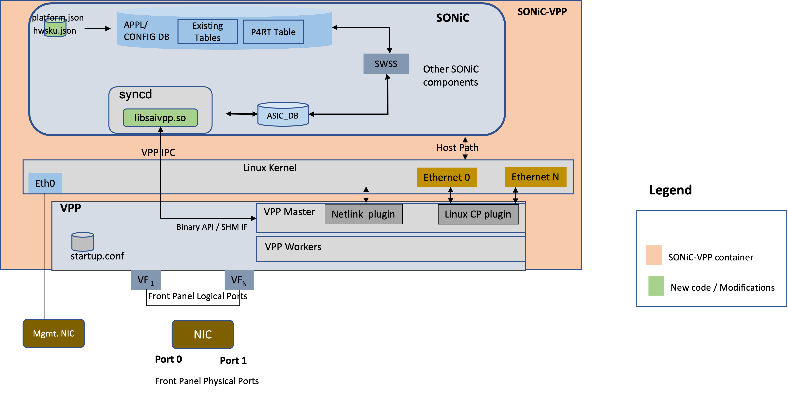
Realizing SONiC-VPP

Slide 7
Deployment Models
Single Host
Single Host w/ DPU
Multi Host
Server
Server
Server A
SONiC
SONiC
SONiC
VPP
Linux Kernel
Linux Kernel
Linux Kernel
Foundational NIC
DPU
Server B
VPP
VPP
Linux Kernel
VPP
Linux Kernel
NIC
Focus of this talk
Legend
1:1 SONiC instance – VPP instance mapping
VPP IPC
Netlink

Slide 8
SONiC-VPP Development Model
What constitutes SONiC-VPP repo ?
Makefiles, scripts, docker templates etc. which define VPP as a platform
Saivpp library implements SAI API to VPP translation, VPP Binary API etc.
How SONiC-VPP build works ?
“make sonic” and “make sonic_vm” build the SONiC images docker-sonic-vpp.gz and sonic-vpp.img.gz rept.
The build script pulls main SONiC repo and applies the patches required to build SONiC-VPP image
Prebuilt VPP package is downloaded from the internet during the build
Built SONiC images are in $REPO_DIR/build/sonic-buildimage/target/
How to manually test SONiC-VPP images ?
Testing single container image is simple
Load single container docker image (docker-sonic-vpp.gz)
Create virtual interfaces (veth pair) and assign address to one end of veth pair
Invoke “start_sonic_vpp.sh -n SOME_NAME –I vpp1,vpp2”, Voila !!!
Please refer to a simple topology test with Single container image
QEMU VM Image testing explained here
More test scenarios mentioned in the docs directory

Slide 9
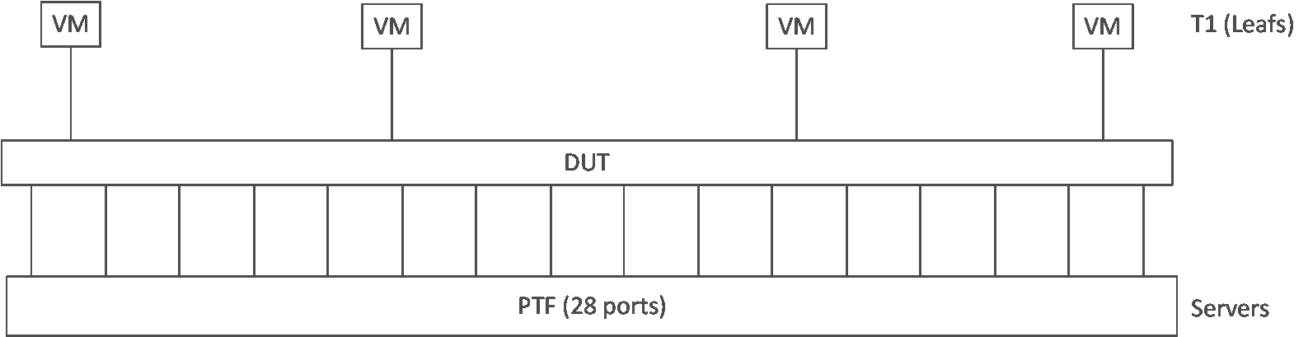
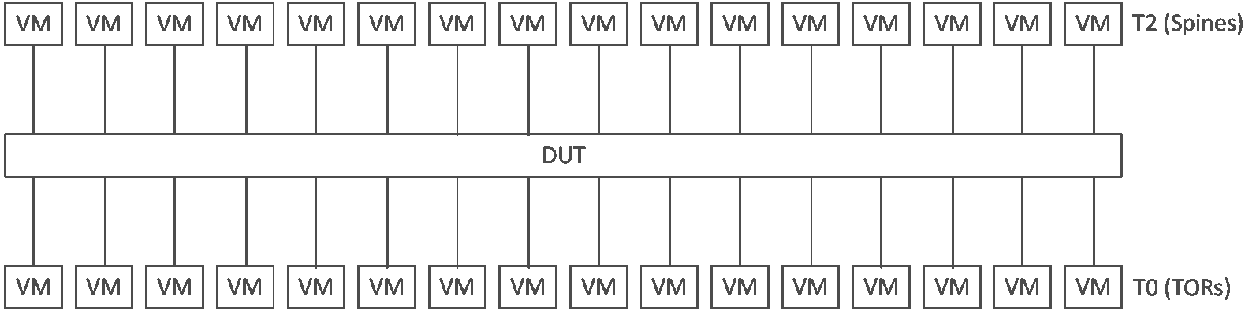
Development testing
What Sanity tests cover SONiC-VPP ?
CI pipeline for images build in place
Basic Sanity tests for interfaces, routing and routing protocols will be integrated to the CI pipeline
SONIC-PTF driven topologies (T0, T1) testing will be enabled in future once feature parity between SONiC and VPP is reached
T0 Topology
T1 Topology
DUT – Device Under Test VM - Virtual Machine
SONIC testbed topologies

Slide 10
How VPP starts ?
Linux Host
SONiC VM
VPP config
docker
VPP config
docker
start_sonic_vpp.sh
syncd.service
VPP Config
VPP config
vpp_init.sh
vpp_init.sh
syncd
startup.conf
sonic_vpp_cfg.sh
syncd
startup.conf
IPC
vpp
IPC
vpp
Container
ONESHOT
Container
VPP in Single container (Simple Topo)
VPP in a VM (Simple Topo)

Slide 11
Control Plane – VPP interactions
Syncd and vpp processes are part of the same container
Syncd connects to VPP via vpp api unix socket
syncd
SONiC
libsaivpp.so
ASIC_DB
Config State
Xlate logic
VPP binary API lib
Binary API
VPP Workers
VPP Main
VPP
Data path structures

Slide 12
Control Plane – VPP config flow
SONiC-VPP uses synchronous API handling mechanism
config objects written to DB after OK received from syncd
SONiC
Config
syncd
1
Config Notify
Req
2
SWSS
libsaivpp.so
Sync
VPP
Events
4
Config Resp / Notify
Resp / Notification
5
3
Config OK
Yes
No
Error handling logic
Redis

Slide 13
API Semantics
VPP
Binary API is a message passing API
Method types
Request/Reply (1 req –> 1 reply)
Dump/Detail (1 req –> N replies)
Events (1 req –> 1 reply + N notifications)
Large number of APIs (~1900)
SAI
Fixed operations on a set of object types
~ 100 object types
Translation of SAI APIs to VPP APIs
Non-trivial in some scenarios
Requires an intelligent glue logic (maintain state, etc.)

Slide 14
Sample API Translation (IP Routes)
SONIC Operation | SAI API | VPP API logic
Route Add | create_route_entry | vl_api_ip_route_add_del_t{ADD, route}
Route Modify | set_route_entry_attribute | vl_api_ip_route_add_del_t{DEL, old_route}, vl_api_ip_route_add_del_t{ADD, new_route}
Route Delete | remove_route_entry | vl_api_ip_route_add_del_t{DEL, route}
Route Get | get_route_entry_attribute | vl_api_ip_route_lookup_t{prefix}

Slide 15
ARP Flow
SONIC
Step | Description
1 | ARP Broadcast
2 | Internal broadcast to VFs (in NIC)
3 | Linux CP /Punt plugin uses VF to Host IF mapping to forward
4 | Linux kernel does ARP resolution & sends reply on Ethernet 0
5 | Linux CP plugin sends ARP reply to VF1
6 | VF1 sends to associated PF (Port 0)
7 | NIC sends ARP Reply on wire to Host A
Linux Kernel
Ethernet 0
Ethernet 1
172.16.1.1/24
172.16.2.1/24
VPP
ARP Reply
Linux CP plugin
5
Punt plugin
3
4
3
VF ₁
VF₂
MAC-1
2
MAC-2
6
NIC
Port 0
Port 1
Front Panel Physical Ports
1
Host B
Host A
172.16.1.2/24
7
172.16.2.2/24

Slide 16
Host Path Flow
SONiC
BGP
1 | BGP Control packet from Router A
2 | NIC redirects to VF1
3 | Linux CP /Punt plugin uses VF to Host IF mapping to forward to Ethernet 0
4 | Linux kernel send via Socket IF to BGP process
5 | BGP process reply via socket IF
6 | Ethernet 0 sends packet via Linux CP plugin to VF1
7 | NIC send BGP response to Router A
4
5
Linux Kernel
Ethernet 0
Ethernet 1
172.16.1.1/24
172.16.2.1/24
VPP
6
Linux CP plugin
3
Punt plugin
VF ₁
VF₂
MAC-1
2
MAC-2
NIC
Port 0
Port 1
Front Panel Physical Ports
1
Router A
172.16.1.2/24
7

Slide 17
Traffic Flow
SONIC
Linux Kernel
Ethernet 0
Ethernet 1
VPP
F1
Fm
VF ₁
VF₂
MAC-1
MAC-2
NIC
Port 0
Port 1
Host A
Host B
Legend
172.16.1.2/24
172.16.2.2/24
+ Caveats apply
Data path Feature

Slide 18
IP Route Add Flow
SONiC
zebra
fpmsync
P4RT
A
vpp linux_nl plugin
APPL_DB
SWSS
B
VPP Binary API
ROUTE_TABLE, P4RT_TABLE
ASIC_DB
syncd
shell
intfmgrd
libsaivpp.so
VPP bin API lib
NetLink Route add
B
Netlink Route Add
Interface IP address cfg
vl_api_ip_route_add_del_route_t
VPP
Linux Kernel
A
Legend
Netlink plugin
VPP Main
Netlink
Route add
New code / Modifications

Slide 19
Current Status
Source code at sonic-net
Build generates (via “make sonic” and “make sonic_vm”
Single container image (docker-sonic-vpp.gz)
QEMU VM image (sonic-vpp.img.gz)
Support for virtual(veth) and physical network interfaces (including SR-IOV VFs)
Basic features supported
Interfaces and sub-interfaces configuration and statistics
VRF and routes configuration
IPv4/IPv6 Routing, IPv4 multipath routing (ECMP)
Routing Protocols (BGP)
SONiC CI enabled (link)

Slide 20
Roadmap
Phase I
Interfaces and sub interfaces
IPv4, IPv6 routing, adjacencies
VRF and routing protocol support(BGP)
Build system for single container and VM images
Basic test framework
Phase II
VPP configurability
Debugging support
SONiC-VPP migration to debian bullseye distribution
VPP migration to bullseye 23-xx-release
Loopback interface provisioning
VLAN, port channel (LAG)
ACL support
Phase III
L2 Switching, STP
QOS, Policer
OSPF, IS-IS
Phase IV
IPsec
NAT
MACSEC
Stateful Firewall
Roadmap details

