Slide 1
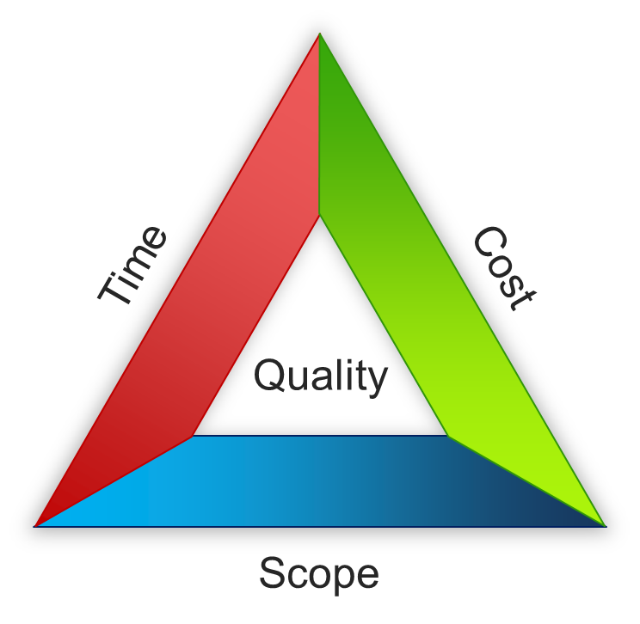
Software Project Management
Mrs Samreen Razzaq

Slide 2
OUTLINE
Introduction
Introduction of PM Tools
PMI Framework, PMI Process Groups
Project Planning
Project Evaluation
Selection of an Appropriate Approach in Project
Software Effort Estimation
Activity Planning
Risk Management
Risk Control, RMMM
Resource Allocation
Review and Evaluation

Slide 3
Textbook(s)
• Software Project Management by Bob Hughes and Mike Cotterell, McGraw-Hill Education; 5th Edition (2009). ISBN-10: 0077122798
• A Guide to the Project Management Body of Knowledge, 3rd Edition (PMBOK Guides), ISBN-13: 978-1930699458

Slide 4
What is software project management? Is it really different from ‘ordinary’ project management?
How do you know when a project has been successful? For example, do the expectations of the customer/client match those of the developers?
Notes:
The two key questions are:
What exactly is software project management?
This is going to be tackled by looking firstly at what is meant by ‘project’. We are then going to examine whether ‘software project management’ is really different from ‘normal’ project management. Is there anything special about software as opposed to other engineered artefacts?
2. How do we define whether a project is a success or not?
The point about studying project management is to be able to have successful projects. So how do we know if we have been successful?

Slide 5
What is a project?
“A specific plan or design”
“A planned undertaking”
“A large undertaking e.g. a public works scheme”
Longmans dictionary
Key points above are planning and size of task
Notes:
Here are some definitions of ‘project’. No doubt there are other ones: for example
‘Unique process, consisting of a set of coordinated and controlled activities with start and finish dates, undertaken to achieve an objective conforming to specific requirements, including constraints of time, cost and resources’
BSO ISO 10006: 1997

Slide 6
Characteristics of projects
A task is more ‘project-like’ if it is:
Non-routine
Planned
Aiming at a specific target
Work carried out for a customer
Involving several specialisms
Made up of several different phases
Constrained by time and resources
Large and/or complex
Notes:
Exercise 1.1 in the Software Project Management text is a good way of introducing this material if you have time. I have found this exercise to be a good ‘ice-breaker’. Get each student to list the example activities in an order which matches the degree to which they merit the description of ‘project’. You can create a grid on a whiteboard with the projects on the vertical axis and the positions 1st, 2nd, 3rd etc on the horizontal axis. You then go through asking how many put ‘producing a newspaper’ first, second, etc. (Avoid making jokes about this being like the Eurovision song contest). This is time-consuming but it does mean that every student participates in building up a general picture of people’s perceptions, and you can discuss disagreements in perceptions as you go along.

Slide 7
Are software projects really different from other projects?
Not really! …but…
Invisibility
Complexity
Conformity
Flexibility
make software more problematic to build than other engineered artefacts.
Notes:
This is based on Fred Brooks’ paper No Silver Bullet: Essence and Accidents of Software Engineering which appeared in IEEE Computer 20(4) pp10-19 April 1987

Slide 8
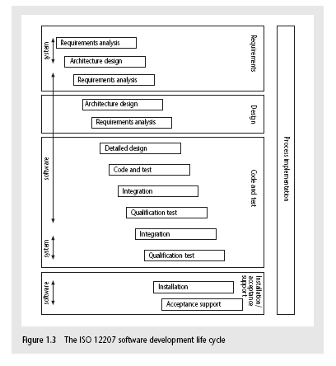
The software development life-cycle (ISO 12207)
Notes:
This section of the lecture discusses the software development life cycle. Note that this is a technical model. It identifies the technical constraints on the order activities are done. This does NOT imply that a ‘waterfall’ approach is the only way to organize projects. The technical model could be implemented as increments or in an evolutionary manner.

Slide 9
ISO 12207 life-cycle
Requirements analysis
Requirements elicitation: what does the client need?
Analysis: converting ‘customer-facing’ requirements into equivalents that developers can understand
Requirements will cover
Functions
Quality
Resource constraints i.e. costs
Notes:
The key point here is that requirement analysis has to face in (at least) two different directions. It needs to communicate and elicit the requirements of the users, speaking in their language. It needs to organize and translate those requirements into a form that developers can understand and relate to.

Slide 10
ISO 12207 life-cycle
Architecture design
Based on system requirements
Defines components of system: hardware, software, organizational
Software requirements will come out of this
Code and test
Of individual components
Integration
Putting the components together
Notes:
The software project will almost certainly be part of a larger project which has non-software elements. In a software engineering environment it could be the software will be embedded in hardware product of some kind. Thus there are system requirements for the product as a whole and software requirements for the software element.
In a business information systems environment, the software development could be a relatively minor part of a much larger organizational change project.

Slide 11
ISO12207 continued
Qualification testing
Testing the system (not just the software)
Installation
The process of making the system operational
Includes setting up standing data, setting system parameters, installing on operational hardware platforms, user training etc
Acceptance support
Including maintenance and enhancement
Notes:
The confusion about what ‘implementation’ really means could be mentioned. Does it mean implementing the design (that is, coding) or implementing the complete system in its user environment? It is best to use ‘installation’ to describe the latter in order to avoid confusion.

Slide 12
Some ways of categorizing projects
Distinguishing different types of project is important as different types of task need different project approaches e.g.
Information systems versus embedded systems
Objective-based versus product-based
Notes:
With objective-based projects, a general objective or problem is defined, and there are several different ways in which that objective could be reached. The project team have freedom to select what appears to be the most appropriate approach.
With product-based projects, the product is already very strictly defined and the development team’s job is to implement the specification with which they have been presented.
Arguably, information systems projects are more likely to be objective-based than is the case with software engineering.
In many cases, an objective-based project could consider a problem and recommend a solution that is then implemented by a product-based project.
Exercise 1.5 in the text is relevant here.

Slide 13
What is management?
This involves the following activities:
Planning – deciding what is to be done
Organizing – making arrangements
Staffing – selecting the right people for the job
Directing – giving instructions
continued…
Notes:
This list is based on one that can be found in Introduction to Software Project Management and Quality Assurance by Darrel Ince, Helen Sharp and Mark Woodman, McGraw-Hill, 1993.

Slide 14
What is management? (continued)
Monitoring – checking on progress
Controlling – taking action to remedy hold-ups
Innovating – coming up with solutions when problems emerge
Representing – communicating with clients, users, developers and other stakeholders
Notes:
Exercise 1.6 (a day in the life of a project manager) is of relevance here.

Slide 15
Setting objectives
Answering the question ‘What do we have to do to have a success?’
Need for a project authority
Sets the project scope
Allocates/approves costs
Could be one person - or a group
Project Board
Project Management Board
Steering committee
Notes:
Different people who are involved in a project (Stakeholders) will have different interests in the project and are likely to see different outcomes as being important.
For example, end-users would want a system that is ‘user-friendly’, that is, easy to learn and to use, and a system that helps rather than hinders them from doing their jobs. Their managers may be more interested in whether the new system would allow them to reduce staffing levels.
It is important therefore that a set of clearly defined objectives are identified and published for the project. Some individual or group needs to be pinpointed who acts as the main client for the project.
See Exercise 1.7 in the text.

Slide 16
Objectives
Informally, the objective of a project can be defined by completing the statement:
The project will be regarded as a success if………………………………..
Rather like post-conditions for the project
Focus on what will be put in place, rather than how activities will be carried out
Notes:
The focus here needs to be on what the situation will be when the project is completed. In what ways will the world be different? The objectives should avoid describing activities:
e.g. ‘a new payroll application will be operational by 4th April’ not ‘design and code a new payroll application’

Slide 17
Objectives should be SMART
S – specific, that is, concrete and well-defined
M – measurable, that is, satisfaction of the objective can be objectively judged
A – achievable, that is, it is within the power of the individual or group concerned to meet the target
R – relevant, the objective must relevant to the true purpose of the project
T – time constrained: there is defined point in time by which the objective should be achieved
Notes:
I have seen some places where the R is said to stand for ‘resource-constrained’, that is that there is a target cost associated with the achievement of the objective.

Slide 18
Goals/sub-objectives
These are steps along the way to achieving the objective. Informally, these can be defined by completing the sentence…
Objective X will be achieved
IF the following goals are all achieved
A……………
B……………
C…………… etc
Notes:
Scoring a goal in football is a ‘goal’ or sub-objective on the way to achieving the overall objective of winning the match. Sub-objectives and objectives can be nested in a hierarchy, so that the objective of winning the match could itself be a goal or sub-objective on the way to winning the league etc.

Slide 19
Goals/sub-objectives continued
Often a goal can be allocated to an individual.
Individual may have the capability of achieving goal, but not the objective on their own e.g.
Objective – user satisfaction with software product
Analyst goal – accurate requirements
Developer goal – software that is reliable
Notes:
Goals can be formulated in such a way that they represent what an individual or group need to do to contribute to the success of the project’s objectives.
In the example above, the analyst or developer, by themselves, cannot guarantee user satisfaction. However, the analyst can contribute to the achievement of the objective by making sure the users’ requirements are accurately recorded and the developer by making sure that the software is reliable.
See Exercise 1.7 in the text.

Slide 20
Measures of effectiveness
How do we know that the goal or objective has been achieved?
By a practical test, that can be objectively assessed.
e.g. for user satisfaction with software product:
Repeat business – they buy further products from us
Number of complaints – if low etc etc
Notes:
See Exercise 1.8 in the text.

Slide 21
Stakeholders
These are people who have a stake or interest in the project
In general, they could be users/clients or developers/implementers
They could be:
Within the project team
Outside the project team, but within the same organization
Outside both the project team and the organization
Notes:
Each stakeholder will have their own goals and concerns in relation to the project which may be different from those of the project as a whole. For example, a software developer might work to make a living, pay the mortgage, learn new things, solve interesting problems. The main stakeholders need, however, to understand and accept the overall project objectives.

