Slide 1


Spring Boot CW1 Presentation Internet Technologies - COMP10020
Paul Craig | Kieran Langley | David Mould | Lea-line Saad
B01791953 | B01731066 | B00417433 | B01796664

Slide 2
Spring Boot
Summary
Overview
Introduction
Examples
Technology
Tutorial
Conclusion

Slide 3




Spring Boot
Overview // What is Spring Boot?
Spring Boot is a framework built for Java, specifically designed to make it quick and easy to develop and deploy applications — whether they’re web-based, microservices, or even non-web applications. Spring Boot is part of the larger Spring ecosystem, which includes a variety of frameworks and tools that can be used alongside Spring Boot to enhance your applications. Spring Boot also comes equipped with several embedded web servers to help with rapid deployment such as Tomcat, Undertow, Netty, or Jetty. This helps significantly with development as applications can be easily and repeatedly deployed and tested leading to smoother and less obtuse development cycles Not only is Spring Boot open source, but it also includes helpful tools to make starting new projects easier — such as Spring Initializr, an online GUI that lets developers quickly create and download new project templates with all the required dependencies pre-configured.
References from; https://spring.io/projects/spring-boot, https://azure.microsoft.com/en-gb/resources/cloud-computing-dictionary/what-is-java-spring-boot, https://start.spring.io/
· Overview

Slide 4
Spring Boot
Introduction // Why have we chosen Spring Boot?
In 2024 a survey was taken by the popular website Stackoverflow in which users were asked- “Which web frameworks and web technologies have you done extensive development work in over the past year, and which do you want to work in over the next year? (If you both worked with the framework and want to continue to do so, please check both boxes in that row.)” The results shown indicate that as of 2024 roughly 11330 users stated Spring Boot as this answer – which may not seem a lot but is nearly 1/3 of Node.js and React which are both widely considered some of the most used technologies ever! (Please note the graph on itself is missing some rows but does not affect the discussion)
References from; https://survey.stackoverflow.co/2024/technology#1-web-frameworks-and-technologies
· Overview
· Introduction

Slide 5
Spring Boot
Introduction // Why have we chosen Spring boot?
As of 2025, although it remains clear that Node.js and React maintain their dominant spots – as JavaScript always will! – you can note that Spring Boot has jumped in popularity edging just behind FastAPI which Stackoverflow noted as “The +5 point increase for FastAPI is one of the most significant shifts in the web framework space”. Considering Spring Boot is a Java framework specified for web application and microservice use, this is uncommon and we believe it to be the reason why it has jumped in popularity and will continue to do so! (Please note the graph on itself is missing some rows but does not affect the discussion)
References from; https://survey.stackoverflow.co/2024/technology#1-web-frameworks-and-technologies, https://survey.stackoverflow.co/2025/technology#1-web-frameworks-and-technologies
· Overview
· Introduction

Slide 6


Spring Boot
Introduction // Pros & Cons
Pros Rapid development: auto-configuration and starter dependencies Standalone: includes an embedded server Integrates seamlessly with the Spring ecosystem : Spring Data, Spring Security, Spring Cloud… Production-ready : e.g. Spring Boot Actuator Large, active community and excellent documentation |  | Cons Applications: can be heavier than minimal frameworks Relies on a lot of auto-configuration and hidden behaviour Use of starter packages can lead to dependency bloat Scaling large systems is a challenge : complexity Not always the best choice for very small or resource-constrained services
References from; https://docs.spring.io/spring-boot/reference/features/index.html, https://spring.io/projects/spring-boot#overview, https://www.researchgate.net/publication/362747012_An_Analysis_of_the_Significance_of_Spring_Boot_in_The_Market, https://en.wikipedia.org/wiki/Spring_Boot
· Overview
· Introduction

Slide 7
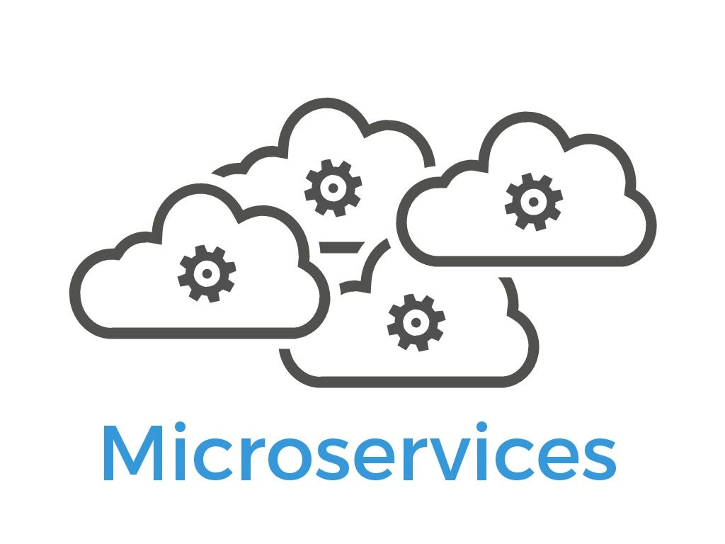






Spring Boot
Scenario // Common use cases
References from: https://spring.io/projects/spring-boot#overview , https://docs.spring.io/spring-boot/index.html, https://en.wikipedia.org/wiki/Spring_Boot, https://www.researchgate.net/publication/362747012_An_Analysis_of_the_Significance_of_Spring_Boot_in_The_Market
· Overview
· Introduction
· Examples
Microservice architectures
Web and backend APIs
Cloud-native environments
Event-driven or reactive systems
Enterprise applications

Slide 8
Spring Boot
Scenario // Example: Order Service for an E-Commerce Platform
References from: https://spring.io/projects/spring-boot#overview , https://docs.spring.io/spring-boot/index.html , https://en.wikipedia.org/wiki/Spring_Boot, https://www.researchgate.net/publication/362747012_An_Analysis_of_the_Significance_of_Spring_Boot_in_The_Market
· Overview
· Introduction
· Examples
Online shop where customers place orders
Products
Orders
Receives order request
Checks data
Verifies stock
Saves in database
Users
@RestController
SpringData
SpringBoot Actuator

Slide 9

Spring Boot
Professional Use Cases // Real World Application
Spring Boot is well-established in the world of e-commerce and online applications. In 2018, to deal with an ever-growing customer base, Netflix shifted all their existing services over to Spring Boot. This improved current services, and future-proofed it by adding robustness and reliability to its servers even during peak usage. Netflix has since built architecture using Spring Boot to help with its services. Trivago also utilises Spring Boot to handle microservices and to deal with countless personalised deals constantly being delivered to users.
References from; https://www.packtpub.com/en-us/learning/how-to-tutorials/netflix-adopts-spring-boot-as-its-core-java-framework, https://medium.com/@ShantKhayalian/deep-dive-how-netflix-uses-spring-boot-for-high-scale-microservices-30315235818c, https://www.youtube.com/watch?v=XpunFFS-n8I , https://medium.com/@himanshu675/why-spring-boot-still-dominates-5-insane-projects-that-shut-down-the-haters-89bdf493896e
· Overview
· Introduction
· Examples

Slide 10
Spring Boot
Database Integration // Spring Boot Simplifies Database Working
Spring Boot is a very powerful tool to utilise when constructing webapps that are constantly interacting with database architectures. Being an aspect of Spring designed specifically for the purpose of simplifying Java software development and streamlining processes, Spring Boot has in-built features that remove a lot of the frustrations that come with manually configuring databases through every step of development. While being built using the wider Spring as its base, Spring Boot puts emphasis on being simpler to develop with, leading to getting more working prototypes deployed, and less time spent painstakingly trying to maneuver a framework to fit a specific need.
References from; https://dev.to/dilipkumar_0418/understanding-database-connection-management-in-spring-boot-with-hibernate-and-spring-data-jpa-3h14 , https://www.geeksforgeeks.org/advance-java/spring-boot/, https://hibernate.org/orm/
· Overview
· Introduction
· Examples
· Technology

Slide 11
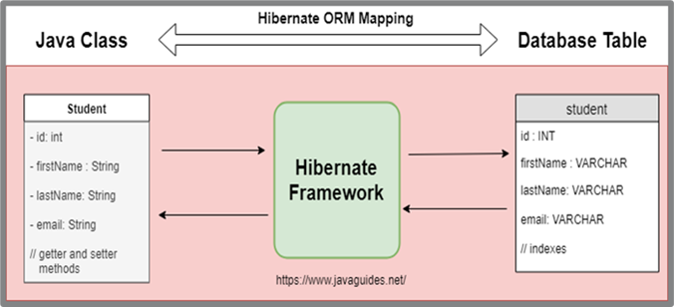
Spring Boot
Database Integration // JPA and ORM Support
Spring Boot uses the Spring Data JPA (Java Persistence API) which is used for swift data searching by producing queries automatically based on methods defined in repository interfaces within the Java application (CRUD operations etc.) and requires a JPA implementation or provider to function properly. One such implementation is Hibernate, an Object-Relational Mapping framework designed to parse large amounts of relational data from Java objects which allows users to seamlessly integrate database functionality into Spring Boot applications they build. | Data Conversion via Hibernate
References from; https://dev.to/dilipkumar_0418/understanding-database-connection-management-in-spring-boot-with-hibernate-and-spring-data-jpa-3h14 , https://www.geeksforgeeks.org/java/how-to-work-with-databases-using-spring-boot/, https://hibernate.org/orm/ , https://dzone.com/articles/what-is-the-difference-between-hibernate-and-sprin-1
· Overview
· Introduction
· Examples
· Technology

Slide 12
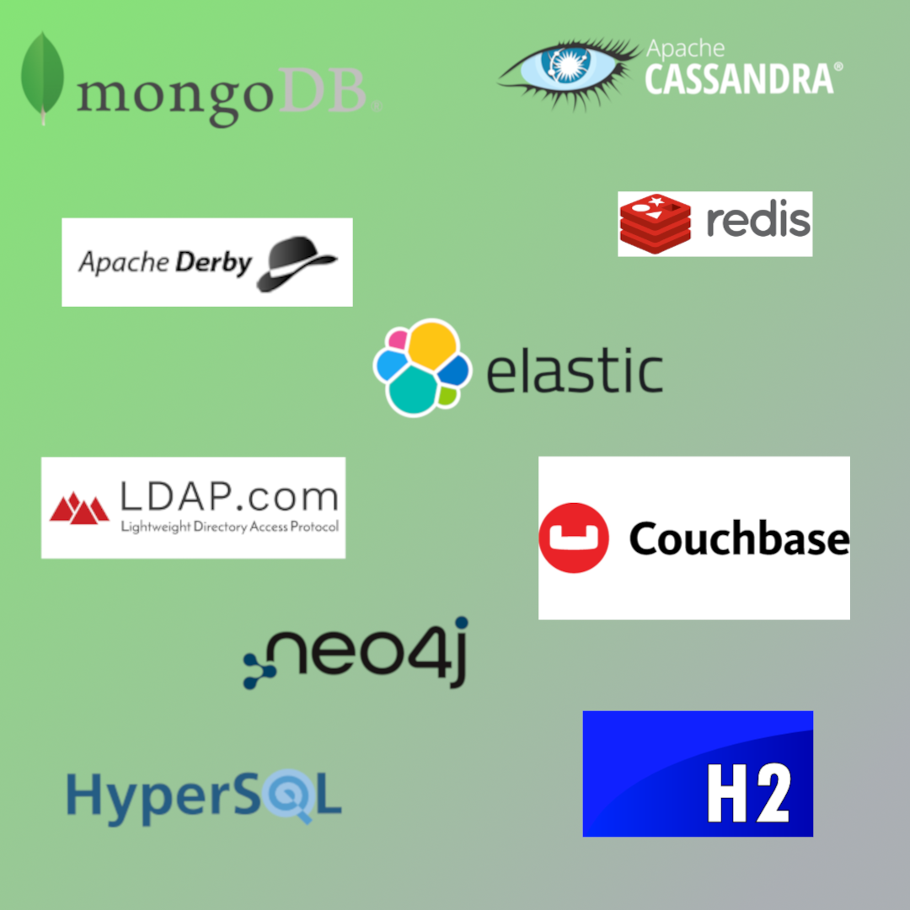
Spring Boot
Database Integration // In-built Framework Support
Spring Boot also includes built in support that allows users building software using the Spring Boot framework to automatically configure databases built using certain database software.
References from; https://docs.spring.io/spring-boot/reference/data/sql.html, https://docs.spring.io/spring-boot/reference/data/nosql.html
· Overview
· Introduction
· Examples
· Technology
Relational
Non-Relational
• H2
• HSQL
• Derby
• Cassandra
• Couchbase
• Elasticsearch
• LDAP
• MongoDB
• Neo4J
• Redis
• Geode*

Slide 13
Spring Boot
Technical overview // How Spring Boot works
Spring Boot uses annotations with the @ tag. @RestController is used to detect APIs. @GetMapping is used to direct HTTP get requests to the correct function. In this example code @SpringBootApplication is used to trigger Spring Boots auto-configuration and component scanning. Spring Boot automatically injects any required class dependencies needed to run the application. For webapps it uses its own embedded Tomcat server (No manual setup required). (Spring Boot automatically connects everything behind the scenes: controllers, services, and any components we define.)
References from; https://spring.io/why-spring, https://spring.io/quickstart, https://spring.io/guides
· Overview
· Introduction
Example Code
· Examples
· Technology
// Search function
@GetMapping("/search")
public List<Person> searchPeople(@RequestParam String name) {
String search = name.toLowerCase();
return people.stream()
.filter(p -> p.getName().toLowerCase().contains(search))
.toList();
}
// Application Entry point
@SpringBootApplication
public class Coursework1Application {
public static void main(String[] args) {
SpringApplication.run(Coursework1Application.class, args);
}
}
· Tutorial

Slide 14
Spring Boot
Technical overview // Demonstration App
References from; https://spring.io/why-spring, https://spring.io/quickstart, https://spring.io/guides
· Overview
· Introduction
@RestController
@RequestMapping("/api/people")
@CrossOrigin(origins = "*") // allows HTML/JS to access API
public class DemoApplication {
// Arraylist to hold people
private List<Person> people = new ArrayList<>(Arrays.asList(
new Person(1L, "Taylor Swift", "Singer-Songwriter", 34, "taylor.jpg"),
new Person(2L, "Chris Hemsworth", "Actor", 41, "chris.jpg"),
new Person(3L, "Zendaya", "Actress", 28, "zendaya.jpg"),
new Person(4L, "Elon Musk", "Entrepreneur", 53, "elon.jpg"),
new Person(5L, "Ariana Grande", "Singer", 32, "ariana.jpg"),
new Person(6L, "Ryan Reynolds", "Actor", 48, "ryan.jpg"),
new Person(7L, "Emma Watson", "Actress", 35, "emma.jpg"),
new Person(8L, "Ed Sheeran", "Musician", 34, "ed.jpg")
));
@GetMapping
public List<Person> getAllPeople() {
return people;
}
// Search function
@GetMapping("/search")
public List<Person> searchPeople(@RequestParam String name) {
String search = name.toLowerCase();
return people.stream()
.filter(p -> p.getName().toLowerCase().contains(search))
.toList();
}
// Application Entry point
@SpringBootApplication
public class Coursework1Application {
public static void main(String[] args) {
SpringApplication.run(Coursework1Application.class, args);
}
· Examples
Example Code
This is simple Java code that creates a REST API for a web app where users can look up celebrities.
In this example, an ArrayList is used to store the celebrity data, but Spring Boot can also integrate with databases using Spring Data JPA.
The Java Person objects are automatically converted to JSON by a library called Jackson, which is built into Spring Boot.
· Technology
· Tutorial

Slide 15
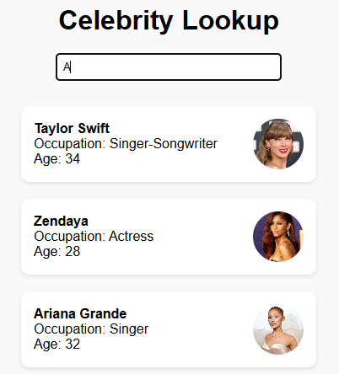
Spring Boot
Technical overview // Demonstration App
References from; https://spring.io/why-spring, https://spring.io/quickstart, https://spring.io/guides
· Overview
· Introduction
· Examples
Frontend Integration
A HTML frontend was created to interact with the API.
When the user starts typing in the lookup field, JavaScript sends a fetch request to the API to search for a celebrity using the data entered.
If a match or partial match is found it is loaded into the page using JavaScript.
· Technology
· Tutorial

Slide 16
Spring Boot
Conclusion // Assessment of Spring Boot
With focus on quick, consistent deployments, it's not hard to see why Spring Boot is picking up momentum among Java developers looking to migrate existing software to more modern, forward-thinking frameworks. As well as among startups looking to develop applications and quickly get working Prototypes and proof of concepts deployed. Spring Boot is only getting more popular year-by-year as shown via Stackoverflow survey taken, and with large scale businesses building architecture through Spring Boot, it's obvious that Spring Boot isn't going anywhere, anytime soon.
· Overview
· Introduction
· Examples
· Technology
· Tutorial
· Conclusion

