Slide 1
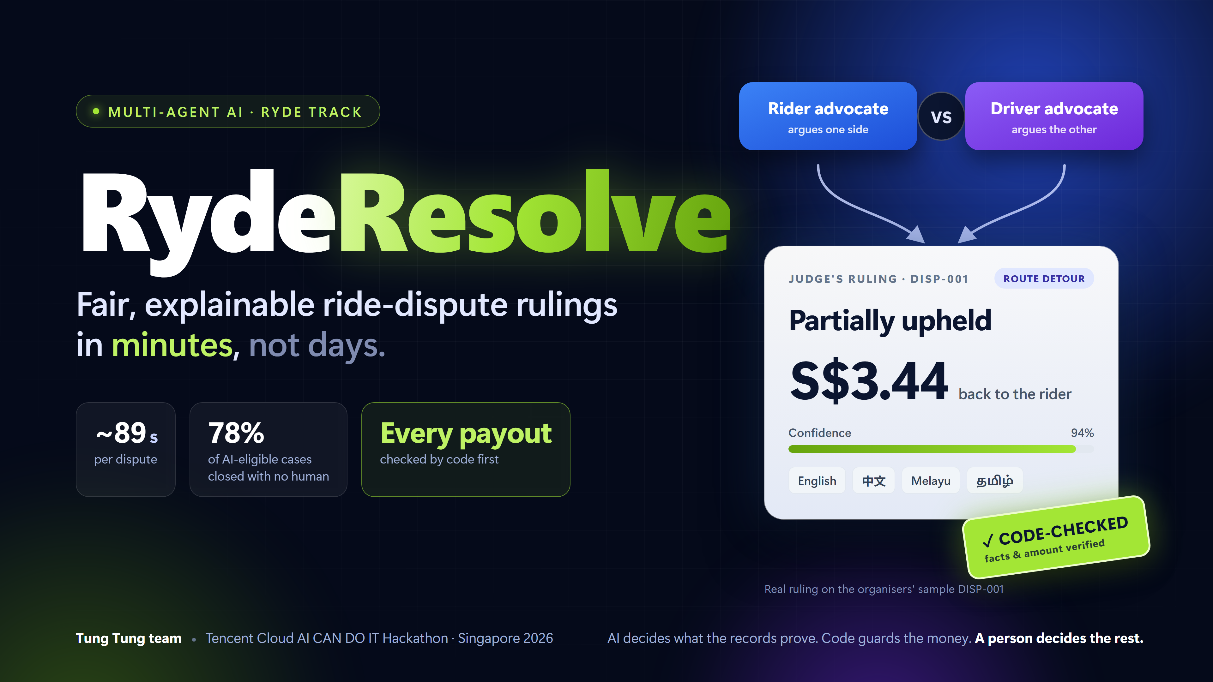
TENCENT CLOUD AI CAN DO IT · SINGAPORE 2026 · RYDE TRACK
RydeResolve
Fair, explainable ride-dispute rulings. In minutes, not days.
Tung Tung team
Notes:
SPEAKER 1 · about 0:00–0:05
"Good afternoon. We are the Tung Tung team."

Slide 2
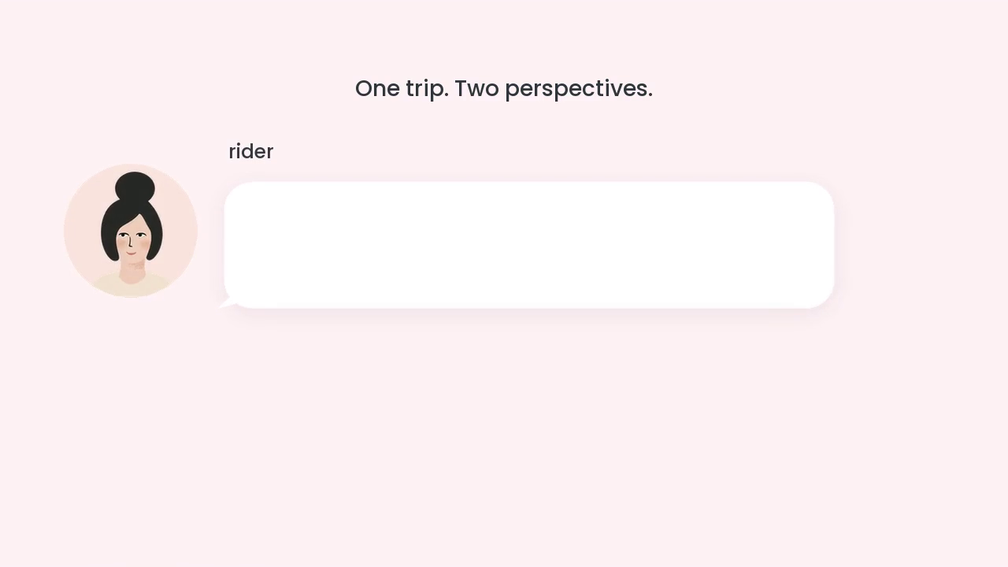
Notes:
FILM · 60 s · plays automatically WITH SOUND as soon as the show starts.
Everyone stays quiet. When it ends, press next: Speaker 1 opens on the cover.

Slide 3
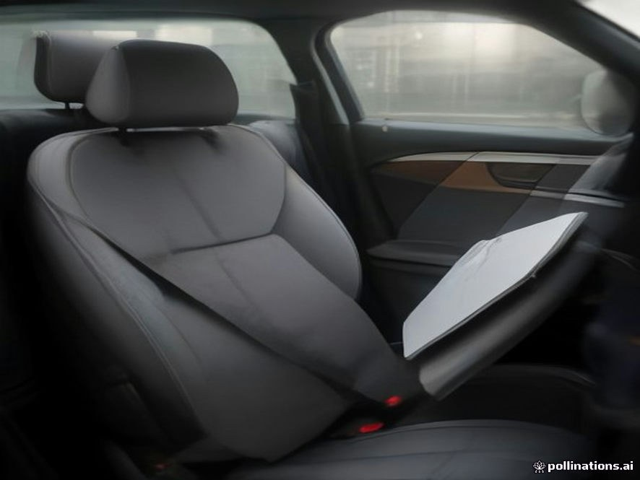
A driver claimed S$70 for this stained seat.
There is no stain.
An AI image generator made it.
RydeResolve caught it in seconds, charged the rider nothing, and handed it to a person.
Photo from test case IM-12 (made for our test set)
Notes:
SPEAKER 1 · about 0:10–0:22
"Take this photo. A driver claimed seventy dollars for a stained seat. There is no stain: an AI image generator made it. RydeResolve caught it in seconds and handed it to a person."

Slide 4
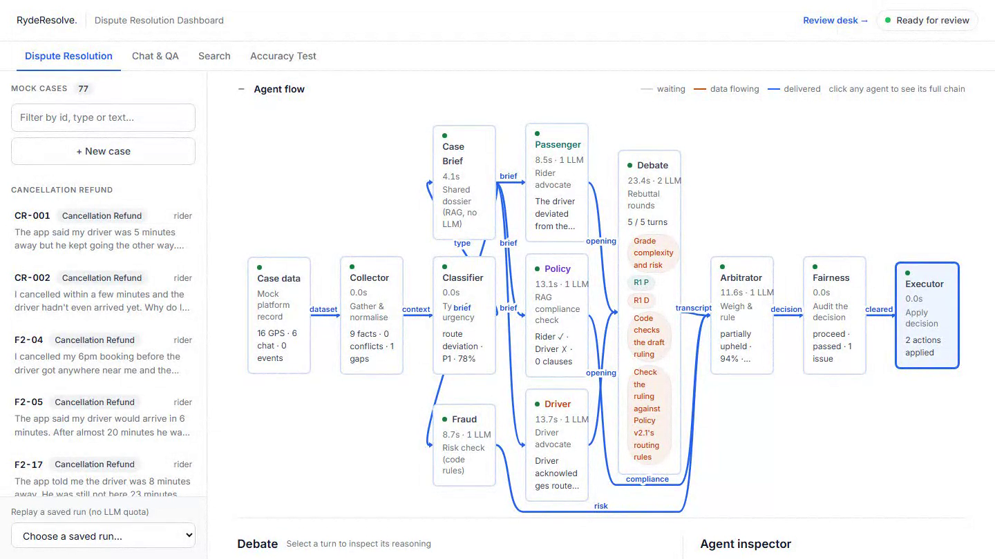
01 · AGENTS THAT WORK TOGETHER · ORGANISERS' SAMPLE DISP-001
Each side gets an advocate. A judge decides on the policy.
The facts
The collector reads GPS, fare and traffic records: a vehicle fire on the PIE.
Two sides
A rider advocate and a driver advocate argue from the same case file.
One ruling
S$3.44 back. Both sides are told why, in their own language.
Recorded from the live site · saved replay, no model called · every step is logged
Notes:
SPEAKER 1 · clip 36 s
[0–6 s, red box] "The collector finds the facts: 4.3 km off route, and a vehicle fire on the PIE."
[6–14 s, debate] "Then a rider advocate and a driver advocate argue, each citing policy. Why? One AI asked for one answer tends to side with whoever complained. Two sides and a judge means both stories are heard."
[14–28 s, ruling] "The judge: the detour was fair, but the rider was never told, so S$3.44 comes back."
[28–36 s, 中文] "Both sides get the reasons in their own language."
Handover: "But an AI judge can be wrong."

Slide 5
02 · GUARDRAILS · CANCELLATION FEE F2-17
The AI was confidently wrong. Code stopped the payout.
Judge · draft 1
Refund S$5 · 62%
Rests on a driver-assignment record the platform logged as faulty.
Code judge
Blocked
A ruling can't rest on a record with a logged data problem.
Judge · draft 2
Refund S$5 · 85%
No new evidence. It just dropped the faulty record from its facts.
Code judge
To a person
Same payout as before, still without the record it needed.
›
›
›
Before anything happens, every ruling is checked.
Code checks facts and amounts against the records. A fairness check reviews the reasoning. Safety, large amounts and doubt go to a person.
Notes:
SPEAKER 2 · about 1:32–2:00
"Second, guardrails. The judge's first draft refunds five dollars at 62% confidence, resting on a record the platform logged as faulty. Our code judge blocks it. The second draft: same five dollars, now 85%, no new evidence. Code sends it to a person. Why code, not another AI? A model can talk itself into being sure; a rule cannot. The impact: Ryde's money moves only when the facts and the amount match a record."

Slide 6
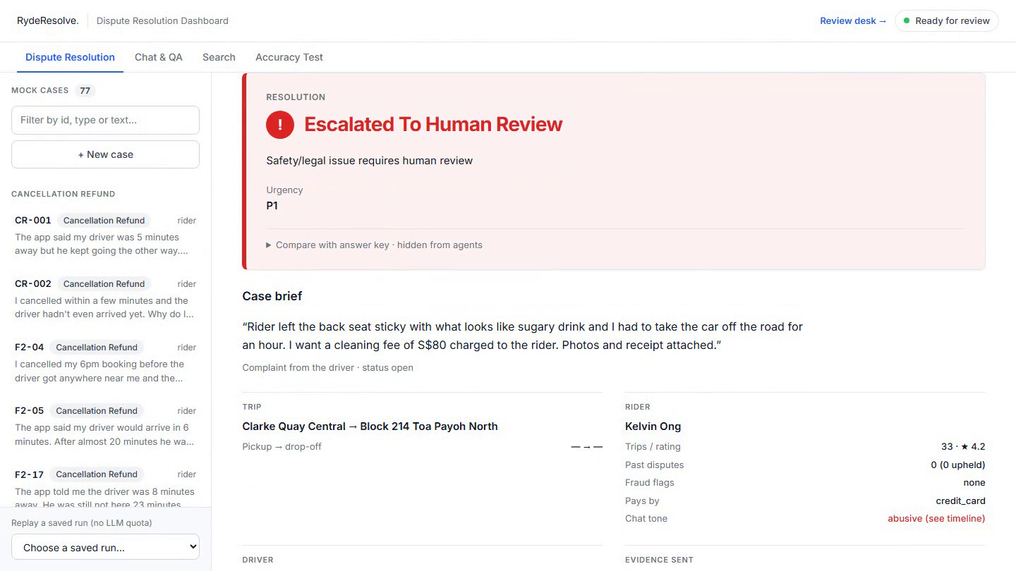
02 · GUARDRAILS · CASE HR-03
A cleaning-fee claim. The chat shows the driver was harassed.
Looks routine
The driver claims S$80 for a sticky seat, with photos and a receipt.
The chat says more
“give me ur number… i wont let u go”. The chat check flags it as a threat.
To a person, now
No automatic charge or refund. A safety reviewer sees the chat and why it stopped.
We read the whole record, not only the complaint, so drivers are protected too · recorded from the live site, saved replay
Notes:
SPEAKER 2 · clip 34 s
[0–9 s, replay] "New since our video. A driver claims eighty dollars for a sticky seat. Routine, yet the system stops it and sends it to a person."
[9–18 s, chat] "Why? It reads the whole trip, and in the chat the rider wrote: give me your number, I won't let you go."
[18–34 s, safety] "The safety agent rates that imminent: no charge, the pair is never matched again, the passenger is held for review. Harassment hides inside ordinary claims, often against drivers, and a fee-only check would miss it."

Slide 7
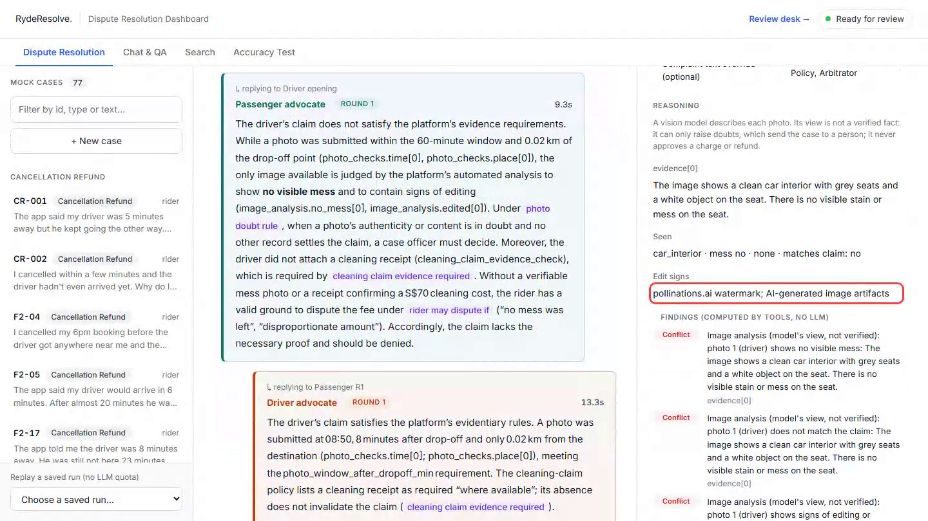
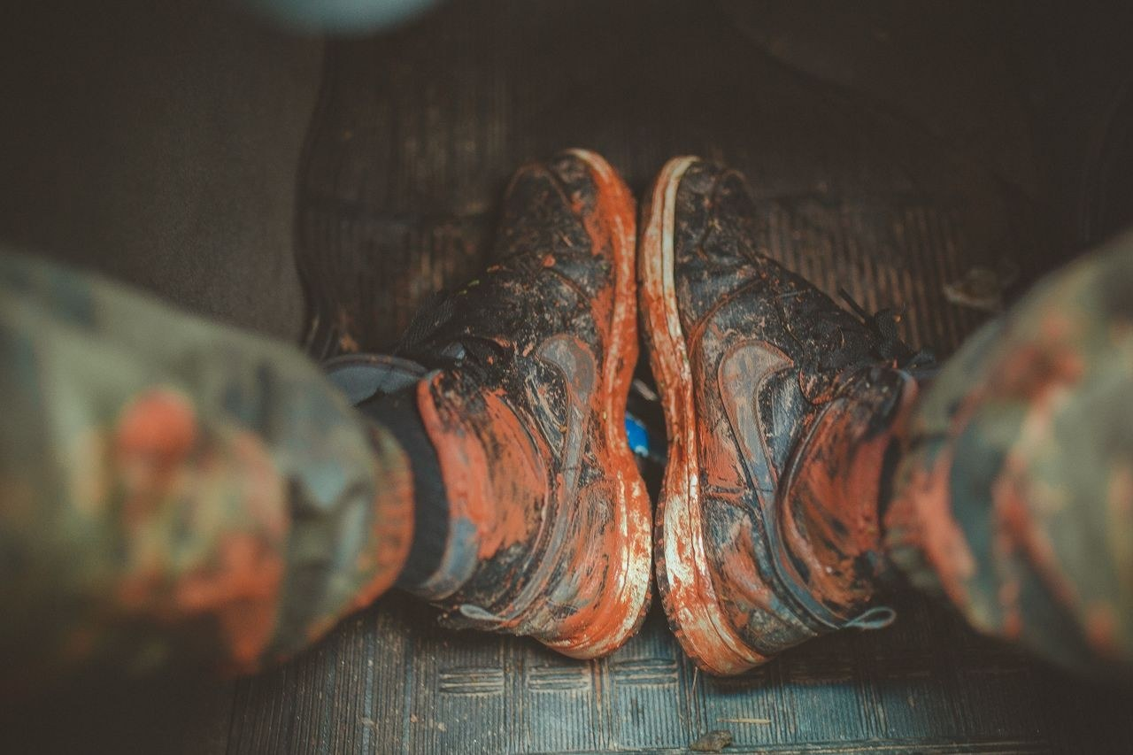
03 · PHOTO CHECKS · CASES IM-04 AND IM-12
Two checks on every photo: its data, then its content.
IM-04 Taken 5 min after drop-off, 30 m away, mud seen → the fee stands
IM-12 No stain, AI watermark → rider not charged, sent to a person
Code reads the photo's data. A vision model can raise doubts, never approve money. Doubtful photos go to a person.
Next Photos taken inside the Ryde app, with a trusted time and place, so a generated image can't be uploaded at all.
Notes:
SPEAKER 2 · about 2:32–3:13
[0–12 s, IM-04] "Third, photos. Here a driver claims a cleaning fee for muddy mats."
[12–19 s, red boxes] "First, code reads the photo's own data: taken five minutes after drop-off, thirty metres away."
[19–24 s, vision] "Then a vision model looks: muddy shoes, matching the claim. The honest driver gets paid."
[24–50 s, IM-12] "And the photo from the start: time and place pass, but the vision model sees a clean seat and an AI watermark, so the rider is not charged and a person decides. Why two layers? Fake photos are now one click away. The model can only raise doubts, never approve money, so a fake has to fool both."
Handover: "And when the AI is unsure, people take over."

Slide 8
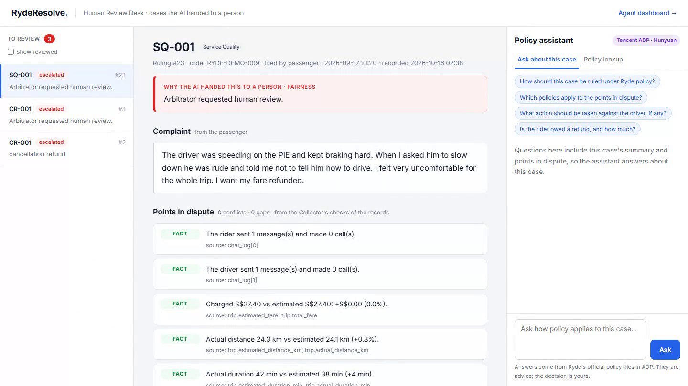
04 · FOR THE PEOPLE INVOLVED
A person is always one step away.
Review desk
Why the AI stopped, what's in dispute, and a Tencent ADP assistant for policy.
Status page
Riders and drivers follow each step. Notices in 4 languages.
One appeal
AI ruled alone, under 80% sure → new evidence, once → AI checks first → kept, decided again, or a person
Approved and tested decisions become precedents · recorded from the live site, saved replay
Notes:
SPEAKER 3 · clip 29 s (slides 8 and 9 of v5, merged)
[review desk] "When the AI isn't sure, a person takes over. On the review desk, they see why the AI stopped and what's in dispute. They can also ask our Tencent ADP assistant about policy. Approved and tested decisions become precedents for next time."
[status page] "Riders and drivers track their case here, with updates in four languages. If the AI ruled alone and was under 80% sure, they can add new evidence once. The AI checks it first. If it's still unsure, a person decides."

Slide 9
PROOF AND NEXT STEP
Tested on cases it never saw. Ready for Ryde's data.
3 / 3
organisers' samples
25 / 30
blind set, organisers' format
45 / 52
regression, policy v2.1
10/10 · 6/6
blind harassment sets
Ruling accuracy on each set. Most misses were handed to a person, not paid out. Every miss is published in the repo.
Plug in
One setting connects Ryde's API in shadow mode: it rules next to your team and pays nothing.
Cheap to run
About US$0.017 of model calls a dispute, on an open 120B model that can run in-house.
Earn trust
Decide small cases alone only once agreement with your team is high.
RydeResolve: fair, explainable ride-dispute rulings in minutes, not days.
Built on Tencent Cloud: Lighthouse server in Singapore · ADP policy assistant (Hunyuan) · developed with CodeBuddy
Notes:
SPEAKER 3 · about 3:44–4:05
"Tested on cases it never saw: the organisers' samples three of three, a blind set 25 of 30, our regression 45 of 52. And it is ready: one setting connects Ryde's API in shadow mode, ruling beside your team and paying nothing, at under two cents a dispute. RydeResolve: fair rulings in minutes, not days. Thank you."

Slide 10
RYDERESOLVE · TUNG TUNG TEAM
Thank you.
Questions?
Live demo http://43.134.17.192 · github.com/FENGFANCHEN-012/RydeResolve-Agent
Notes:
THANK YOU · Speaker 3 says "Thank you" and takes questions.
To jump during Q&A: type the slide number and press Enter. Type 10 and Enter to come back here.
11 What if the AI gets it wrong?
12 Fake photo without a watermark
13 Why several agents and not one model?
14 Is it live? How does it connect to Ryde?
15 Where do the rules come from?
16 What do the numbers mean?
17 Does it learn?
18 Why can't everyone appeal?
19 What about privacy?
20 Why Tencent Cloud?
Deeper backups after these: architecture, engineering decisions, results and limits, how it learns.

Slide 11
Q&A · 1
What if the AI gets it wrong?
Money moves only when code has checked the facts and the amount against a record.
Honest limit
In one re-run of 52 cases, 5 automatic rulings were wrong (S$2.80 to S$5). The code catches a faulty record only when the judge lists it; the next fix checks the record itself.
· Safety, amounts above S$50, fraud flags and any doubt go to a person.
· Every ruling cites the policy section and every step is logged, so a mistake can be traced.
· Every miss and its fix is published in docs/08 of our repo.
Notes:
Q&A ANSWER (about 20 s)
"Money only moves when code has checked the facts and the amount against a record; safety, large amounts and any doubt go to a person. Honestly, it's not perfect: in one re-run of 52 cases, five small automatic rulings were wrong. We found why, it's published, and the next fix is a code check on the record itself."

Slide 12
Q&A · 2
What if a fake photo has no watermark and shows a real-looking stain?
We catch
· No capture time or place: flagged as unverifiable for the judge and the reviewer
· Taken before the ride, far from drop-off, or uploaded before it was taken
· An editing or image-generator program named in the file
· The same file sent in another claim
· A picture that doesn't match the claim, or shows signs of generation
We can miss
· A realistic generated image with forged time and GPS data
· If the amount is S$50 or less and nobody contests it, it could be paid
· The vision model is not a reliable AI-image detector
· We have not tested this exact case
How we close it
· Photos taken inside the Ryde app: time and place come from the app, no gallery uploads
· Content credentials (C2PA) when phones and apps support them
· Watch claim history: many cleaning claims from one driver raise the bar
· Until then: above S$50 always goes to a person
Based on src/agents/photo_checks.py and image_analyst.py · photos in our tests are stock images with stamped data, not real driver photos
Notes:
Q&A ANSWER (about 20 s)
"Honestly, a perfect fake with forged time and location data could get past our photo checks. That's why the vision model can only raise doubts, never approve money, and anything above fifty dollars always goes to a person. The real fix is upstream: let the Ryde app take the photo itself, with a trusted time and place, so a generated image can't be uploaded at all."

Slide 13
Q&A · 3
Why several agents and not one model?
Each role has one job, and both sides are argued from the same case file.
Honest limit
We have not proven it is more accurate than one model with the same evidence and checks. The gain we can show is clear roles and an auditable trail.
· The collector and code tools gather the facts before any model speaks.
· A rider advocate and a driver advocate each make their case; a judge weighs both.
· Every step is recorded and can be replayed, so a reviewer can see why.
Notes:
Q&A ANSWER (about 20 s)
"One model asked for one answer tends to side with whoever complained. Splitting the roles means both stories are argued from the same facts, and every step can be checked afterwards. We haven't proven it beats a single model on accuracy; what we can show is a fair process and a clear audit trail."

Slide 14
Q&A · 4
Is it live? How does it connect to Ryde?
One setting connects Ryde's API in shadow mode: it rules beside your team and pays nothing.
Honest limit
Not connected to Ryde's systems today. The field map is our guess until we see Ryde's field list; refunds, suspensions and re-matching are simulated.
· A client reads Ryde's API and maps it into the organisers' dispute format.
· Shadow mode lets Ryde compare our rulings with its own team before trusting any.
· Small cases could be decided alone only once agreement is high.
Notes:
Q&A ANSWER (about 20 s)
"It's a prototype, not connected to Ryde today. One setting switches it to read Ryde's API in shadow mode, so it rules next to your team and pays nothing. The field mapping is our best guess until we see Ryde's fields, and every action like a refund or a suspension is simulated."

Slide 15
Q&A · 5
Where do the rules come from?
The organisers' Ryde Dispute Resolution Policy v2.1, plus each case's own rules.
Honest limit
Some older test sets use our paraphrase of public pages, with gaps marked. It is not Ryde's current internal policy.
· v2.1's routing rules (safety, value above S$50, fraud flags) are enforced in code.
· Every ruling cites the section it rests on.
· Before v2.1 we used our own summary of Ryde's public Help Centre.
Notes:
Q&A ANSWER (about 20 s)
"We rule under the organisers' Policy v2.1 and each case's own rules, and the routing rules are enforced in code, not left to the model. Every ruling cites its section. Earlier we used our own summary of Ryde's public Help Centre, so that's not Ryde's internal policy."

Slide 16
Q&A · 6
What do the numbers mean?
They are ruling accuracy on test sets, one run per case.
Honest limit
The sets are small and partly written by us. A case sent to a person counts as a miss when the key says it could be decided. This is not production reliability.
· 3/3 organisers' samples · 25/30 blind set · 45/52 regression.
· 28 of 36 cases the policy lets AI decide (78%) closed with no person, in about 89 s in our test setup.
· About US$0.017 is the model-call cost per dispute, not the full running cost.
Notes:
Q&A ANSWER (about 20 s)
"These are ruling accuracy on test sets, one run each: three of three on the organisers' samples, 25 of 30 blind, 45 of 52 on our regression. On the regression, 28 of the 36 cases the policy lets AI decide closed with no person, in about 89 seconds. The sets are small, so we treat them as evidence, not proof."

Slide 17
Q&A · 7
Does it learn?
Only through people, and only after a test shows no harm.
Honest limit
The mechanism is built. We have not shown yet that precedents raise accuracy.
· A reviewer's correction is saved as pending.
· An admin approves it, then it is evaluated on past cases before going live.
· If results get worse it is rolled back.
Notes:
Q&A ANSWER (about 20 s)
"It learns only through people. A reviewer's decision is saved, an admin approves it, and it's tested on past cases before the AI can use it as a precedent; if results get worse, it's rolled back. The mechanism is built, but we haven't shown yet that it makes rulings more accurate."

Slide 18
Q&A · 8
Why can't everyone appeal?
Appeals are for rulings the AI made alone while under 80% sure.
Honest limit
A confident ruling can still be wrong. Today the appeal is text only, no file upload; Ryde could widen who can appeal.
· One appeal, with new evidence; the AI checks it first.
· No new fact: the ruling stands. A new fact: decided again. Still unsure: a person.
· Safety cases never wait for an appeal: they go to a person from the start.
Notes:
Q&A ANSWER (about 20 s)
"If everyone could appeal, the losing side almost always would, and that undoes automation. So it's for rulings the AI made alone while unsure, once, with new evidence. A confident ruling can still be wrong, and Ryde can widen this; today an appeal is text only."

Slide 19
Q&A · 9
What about privacy?
The demo uses test data only, no real riders or drivers.
Honest limit
Masking names, phones and plates before any outside model call is not built yet; it is a step before real data.
· Parties see plain notices and a status page, never AI internals.
· The model is an open 120B model that Ryde could run in-house.
· Every model call is logged for audit.
Notes:
Q&A ANSWER (about 20 s)
"The demo runs on test data only. Before real data, we'd mask names, phones and plates before any outside model call, or run the open model in-house; that masking isn't built yet. Riders and drivers only ever see plain notices, not AI internals."

Slide 20
Q&A · 10
Why Tencent Cloud?
It runs on Tencent Cloud in Singapore.
· A Lighthouse server in Singapore hosts the live site.
· The review desk's policy assistant runs on Tencent ADP (Hunyuan).
· We built it with CodeBuddy.
Notes:
Q&A ANSWER (about 20 s)
"The live site runs on a Tencent Lighthouse server in Singapore, the reviewers' policy assistant is built on Tencent ADP with Hunyuan, and we developed it with CodeBuddy."

Slide 21
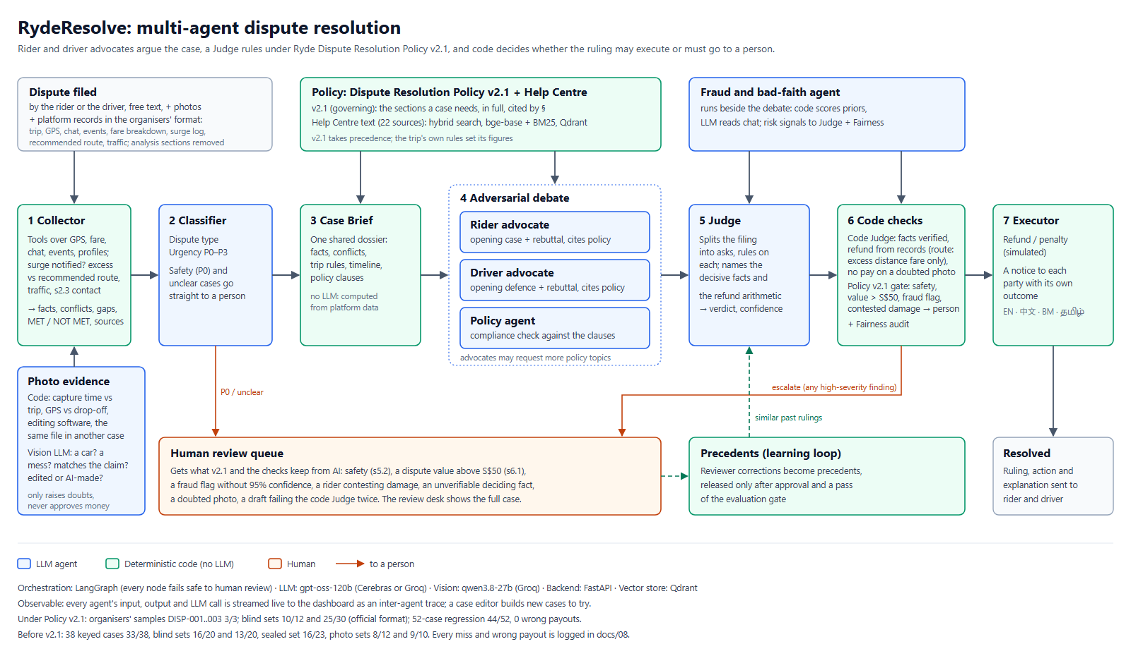
Notes:
BACKUP for Q&A only (full architecture). Not part of the 5 minutes.

Slide 22
ENGINEERING DECISIONS
Backup
Built so a wrong payout is the hardest thing to happen
Code checks the model
Escalate, never misjudge
Safety floor in code
A deterministic code judge verifies every fact and amount against a record before money moves. It caught F2-17 (when the Judge lists the record).
Unprovable, low-confidence, over S$50 or unsafe: a person decides. A wrong payout is the failure we test hardest.
Physical, sexual, stalking and legal wording is routed by code. The LLM can raise urgency, never lower it.
Need-to-know agents
Observable and auditable
Ready for Ryde, cheap to run
Advocates never see fraud scores or a party's history: they argue the case, not the person.
Every agent step is streamed and replayable; every ruling cites its policy section; hash-chained audit log.
Shadow mode on Ryde's API. ~1.7 US¢ a dispute on an open 120B model; can run in-house.
Brief coverage: the 3 MVP agents plus evidence collection, fraud, policy & precedent RAG, photo checks, escalation, reviewed-precedent learning and P0 safety routing.
Notes:
BACKUP for Q&A only (engineering decisions). Not part of the 5 minutes.

Slide 23
HOW WE KNOW IT WORKS
Backup
Tested on cases it had never seen
Test set | Correct | Note
Organisers' samples | 3 / 3 | DISP-001 to 003
Blind set, organisers' format | 25 / 30 | written by another model
Regression, policy v2.1 | 44 / 52 | 45 / 52 on the final code
Harassment, blind (new) | 10/10 · 6/6 | always reaches a person
Most misses are cases handed to a person: that costs minutes, not money.
Notes:
BACKUP for Q&A only (results). 44/52 was the scored run; 45/52 on the submitted code, where a few automatic rulings were wrong in one re-run (README). Say so if asked; every miss is in the repo.

Slide 24
HOW IT LEARNS
Backup
It learns only from people, after a test shows no harm
1 Reviewer decides
2 Admin approves
3 Evaluation gate
4 Live precedent
A person rules on a case the AI handed over. The decision is saved as a pending precedent.
Approved precedents are staged: indexed, but only the evaluation can see them.
Re-run the test set with and without it. Accuracy and every safety metric must not get worse.
Only then do new rulings find and cite it. A failed gate rejects it.
Safety metrics that can never drop
Rollback and audit
P0 escalation recall, refund cap, missing-data escalation, failure rate. A precedent that trades safety for accuracy is rejected.
An admin can retire any live precedent at once. Every step is written to the hash-chained audit log.
The AI never rewrites its own rules or policy. Code: src/store/feedback.py, scripts/precedents.py.
Notes:
BACKUP for Q&A only (learning loop). Not part of the 5 minutes. Use for "Does it learn?".

