Slide 1
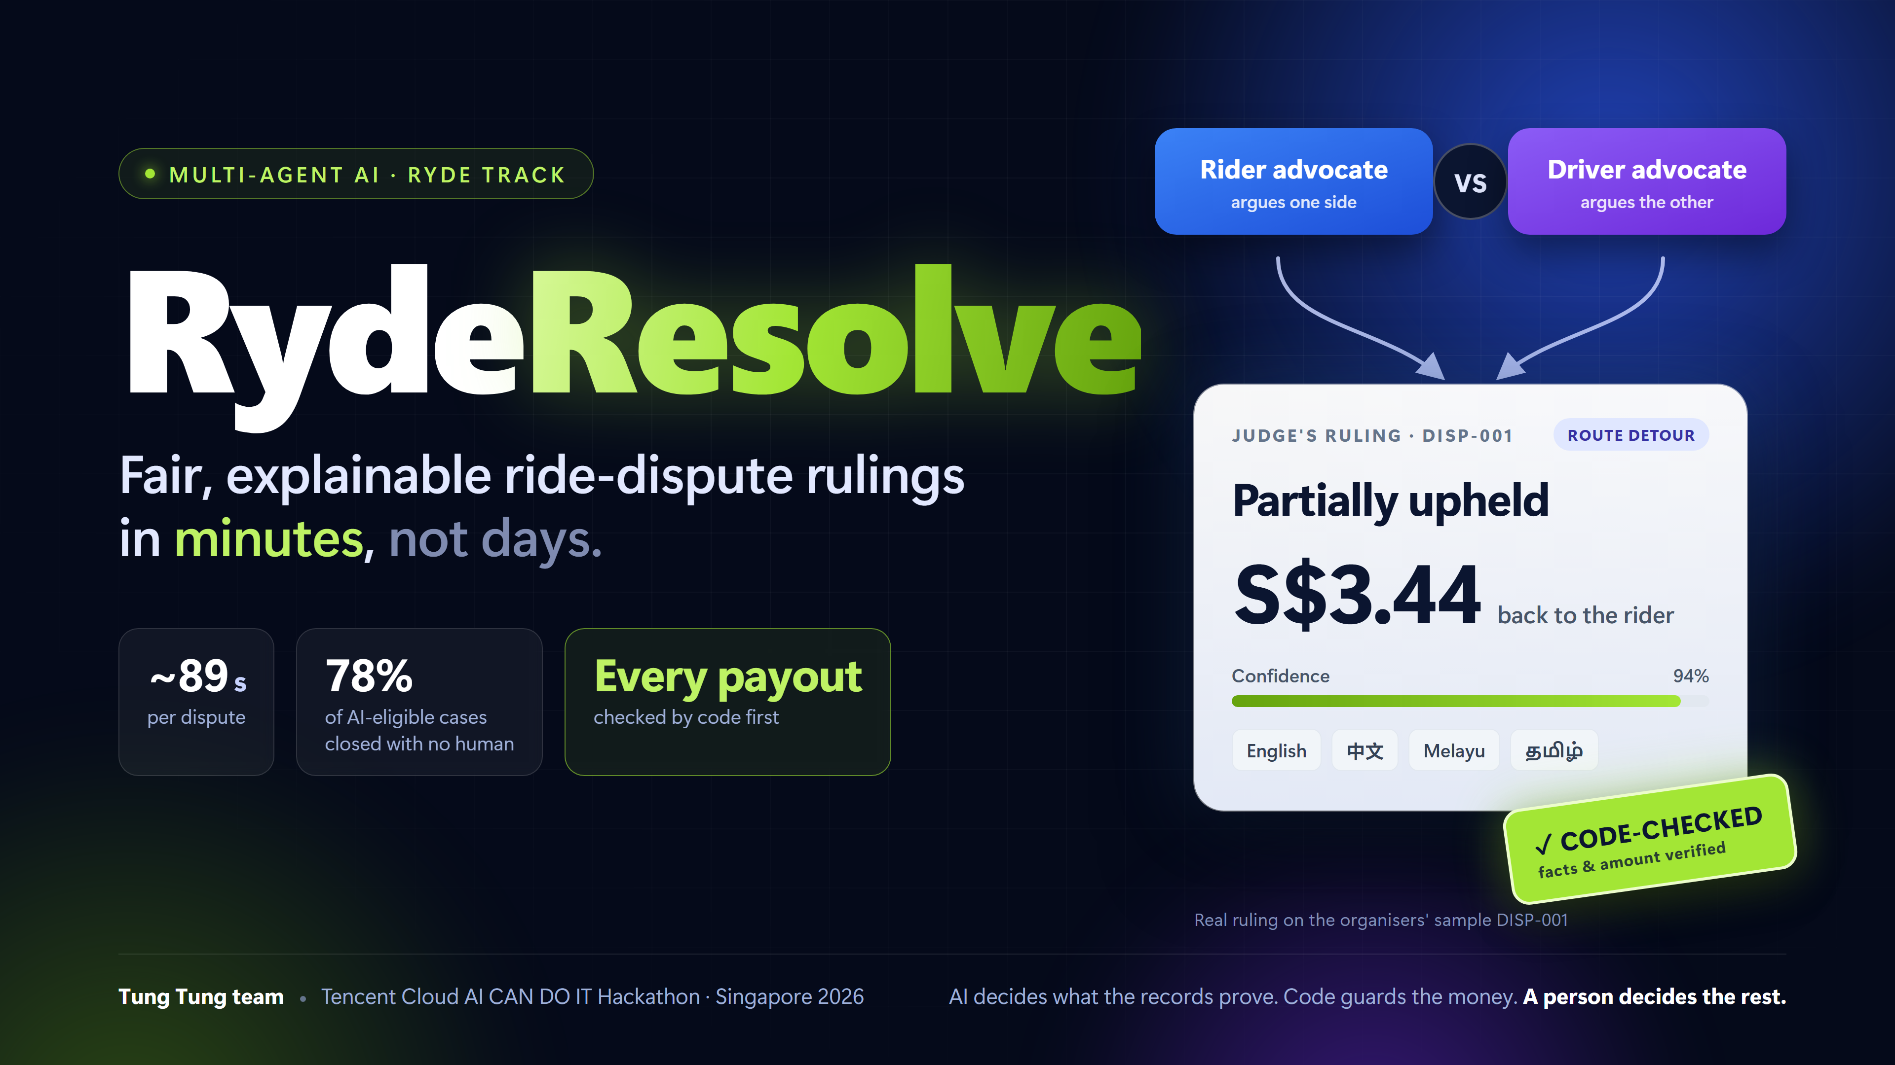
Notes:
SPEAKER 1 · about 0:00–0:10
"Good afternoon. We are the Tung Tung team, and this is RydeResolve: AI agents that settle disputes between Ryde riders and drivers, fairly, in minutes instead of days."

Slide 2
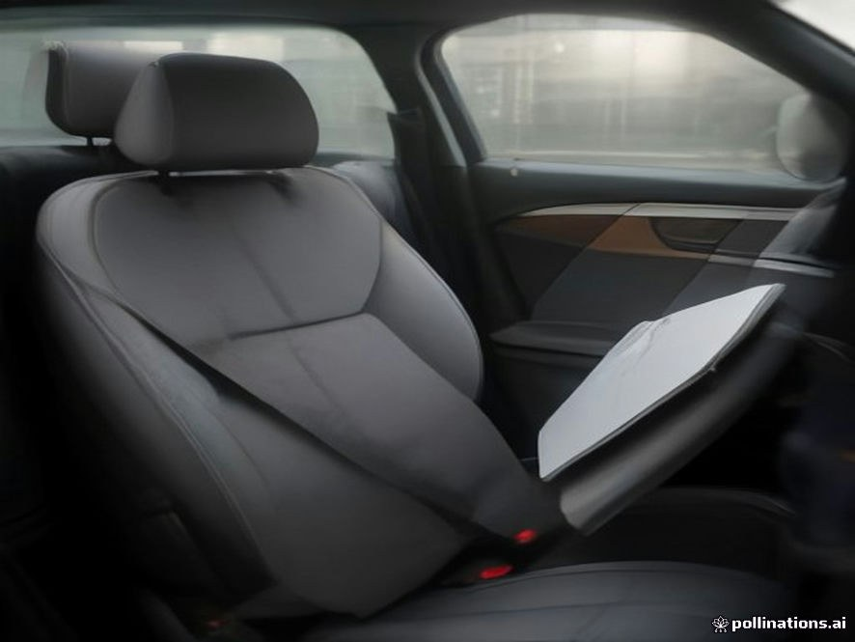
RYDERESOLVE · AI DISPUTE RESOLUTION FOR RYDE
A driver claimed S$70 for a stained seat with this photo.
There is no stain. The picture was made by an AI image generator.
RydeResolve caught it in seconds, charged the rider nothing, and handed it to a person.
Photo from test case IM-12 (made for our test set)
Notes:
SPEAKER 1 · about 0:10–0:22
"Take this photo. A driver claimed seventy dollars for a stained seat. There is no stain: an AI image generator made it. RydeResolve caught it in seconds and handed it to a person."

Slide 3
PROBLEM STATEMENT · RYDE TRACK
Disputes are slow, inconsistent, and easy to game
Problem statement (Ryde): “Gather evidence, build cases, apply company policy and issue fair rulings quickly, transparently, and without human intervention for the majority of standard disputes.”
Riders and drivers wait 24–72 h
→
A ruling in about 90 seconds
Agents work on the trip records together: GPS, chat, fare, photos, history.
Two staff, two answers
→
One policy, every fact checked by code
Each ruling cites Ryde's policy by section; code checks each fact and amount.
Nobody explains why
→
Both sides told why, in their language
English · 中文 · Melayu · தமிழ், a status page, and one appeal with new evidence.
→
Photos checked twice
Fake or doubtful evidence
Code reads when and where a photo was taken; a vision model checks what it shows.
Safety lost in a queue
→
Safety goes straight to a person
Harassment in the complaint or in the chat: decided in code, never by the model alone.
Our rule: AI decides what the records prove. Code guards the money. A person decides the rest.
Notes:
SPEAKER 1 · about 0:22–0:49
"Our problem statement, from Ryde: gather evidence, apply company policy and issue fair rulings, quickly and transparently, without a person for most standard disputes. Today people wait days, two staff can rule differently on the same facts, nobody explains why, evidence can be faked, and a safety report can sit in a queue. So our rule: the AI decides what the records prove, code guards the money, and a person decides the rest."

Slide 4
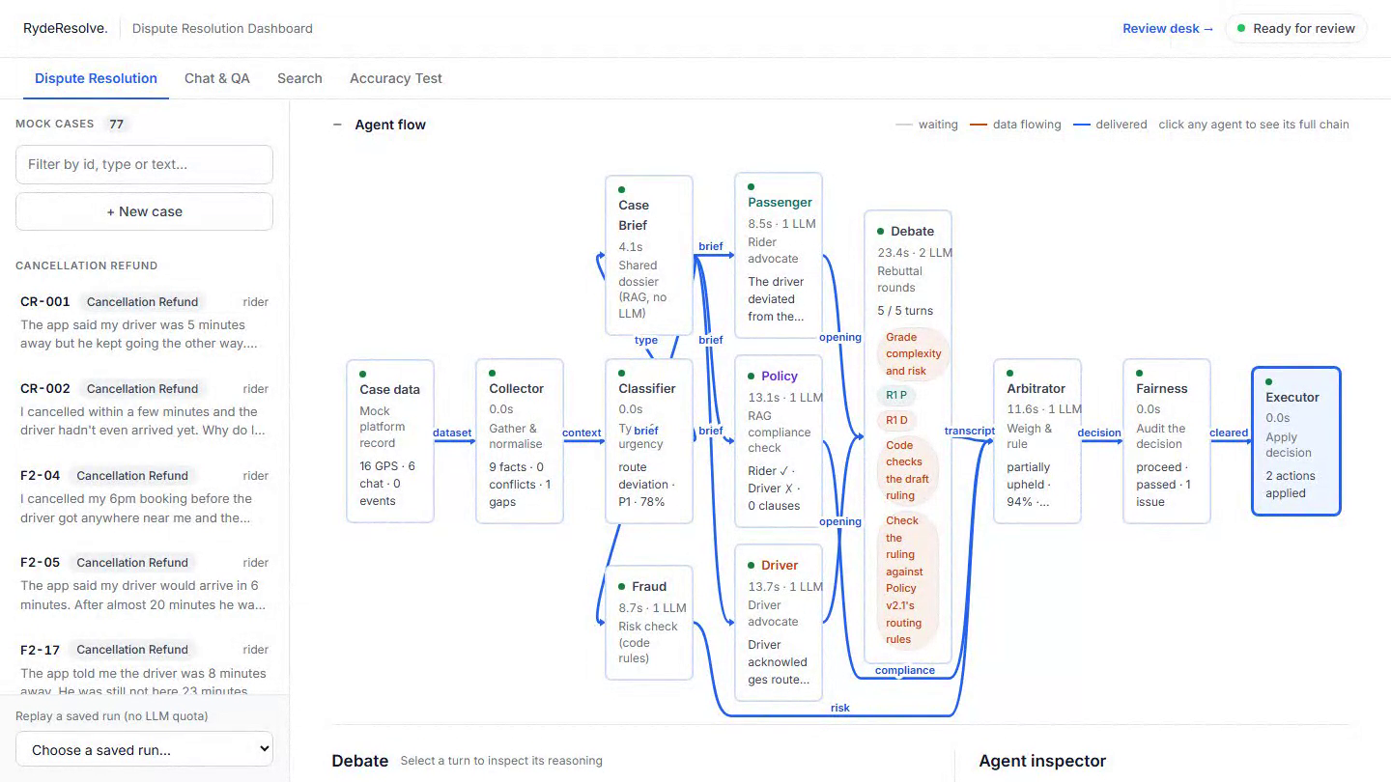
① AGENTS THAT WORK TOGETHER · ORGANISERS' SAMPLE DISP-001
Each side gets an advocate. A judge rules on the policy.
11 agents, one case
Collector reads GPS, fare and traffic records: a vehicle fire on the PIE. Fraud, photo and policy checks run in parallel.
Rider vs driver
Each advocate argues one side and cites the policy. Neither sees fraud scores: they argue the case, not the person.
S$3.44, told to both
Rerouted for the fire but never told the rider: excess fare back, s1.2–1.3. Notice in 4 languages.
Rider and driver each have someone arguing for them, and both are told why.
Recorded from the live site (saved replay, no model called) · every step replayable and in a hash-chained audit log
Notes:
SPEAKER 1 · about 0:49–1:32
[0–14 s, agents light up] "First, agents that work together. This is the organisers' own sample replaying: eleven agents, each with one job, passing the case along."
[14–19 s, red box] "The collector finds the facts: 4.3 km off route, and a vehicle fire on the PIE."
[19–27 s, debate] "Then a rider advocate and a driver advocate argue, each citing policy. Why? One AI asked for one answer tends to side with whoever complained. Two sides and a judge means both stories are heard."
[27–36 s, ruling] "The judge: the detour was fair, but the rider was never told, so S$3.44 comes back."
[36–44 s, 中文] "Both sides get the reasons in their own language. The impact: the same facts get the same ruling, with reasons, in about ninety seconds."
Handover: "But an AI judge can be wrong."

Slide 5
② GUARDRAILS · CANCELLATION FEE F2-17
The AI was confidently wrong. Code stopped the payout.
Judge, draft 1
Code judge
Judge, draft 2
Code judge
Refund S$5 · confidence 62%
Blocked
Refund S$5 · confidence 85%
To a person
→
→
→
Rests on a driver-assignment record the platform logged as faulty.
A ruling cannot rest on a record with a logged data problem.
No new evidence. It just dropped the faulty record from its list of facts.
Same payout as the blocked draft, without the record it rested on.
Every ruling passes these checks before anything happens:
Facts and amounts
Safety, harassment
Over S$50 or unsure
checked against a record, in code
to a person; the model can raise urgency, never lower it
to a person (policy gate in code)
Photos
Notices
Appeal
a vision model can raise doubts, never approve money
written by code from the ruling: never promise money it did not give
once, under 80% confidence, with new evidence; AI re-checks, else a person
Code checks the model. The model never checks itself.
Notes:
SPEAKER 2 · about 1:32–2:00
"Second, guardrails. The judge's first draft refunds five dollars at 62% confidence, resting on a record the platform logged as faulty. Our code judge blocks it. The second draft: same five dollars, now 85%, no new evidence. Code sends it to a person. Why code, not another AI? A model can talk itself into being sure; a rule cannot. The impact: Ryde's money moves only when the facts and the amount match a record."

Slide 6
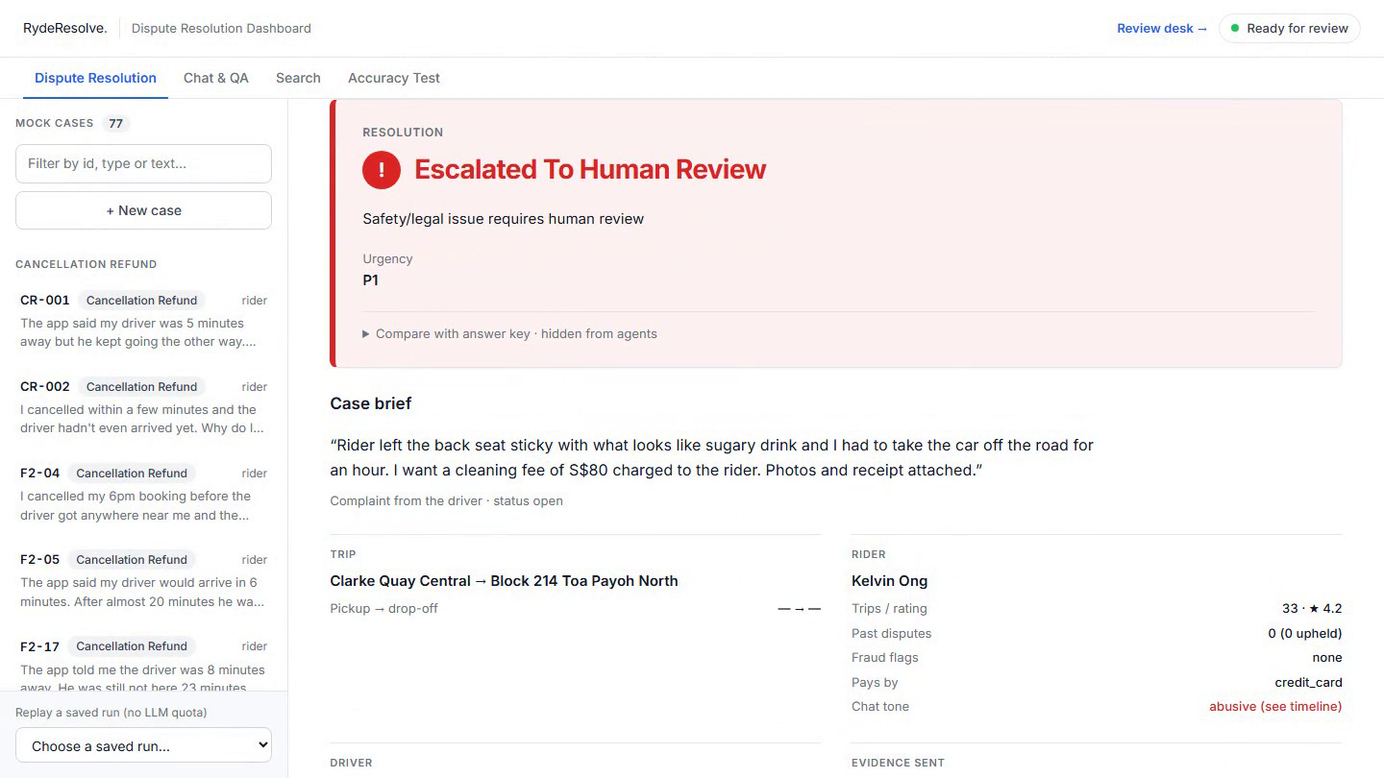
② GUARDRAILS · NEW SINCE THE VIDEO · CASE HR-03
A cleaning-fee claim. The chat shows the driver was harassed.
Looks routine
Driver claims S$80: sticky drink on the seat, photos and receipt attached.
The chat says more
"give me ur number… i wont let u go". The chat check labels it a threat.
To a person, now
No automatic charge or refund. A safety reviewer sees the chat, the claim and why it stopped.
We read the whole record, not only the complaint, and drivers are protected too.
Recorded from the live site (saved replay, no model called) · http://43.134.17.192 · blind harassment sets 10/10 and 6/6
Notes:
SPEAKER 2 · about 2:00–2:32
[0–9 s, replay] "New since our video. A driver claims eighty dollars for a sticky seat. Routine, yet the system stops it and sends it to a person."
[9–18 s, chat] "Why? It reads the whole trip, and in the chat the rider wrote: give me your number, I won't let you go."
[18–34 s, safety] "The safety agent rates that imminent: no charge, the pair is never matched again, the passenger is held for review. Harassment hides inside ordinary claims, often against drivers, and a fee-only check would miss it. Blind tests: ten of ten."

Slide 7
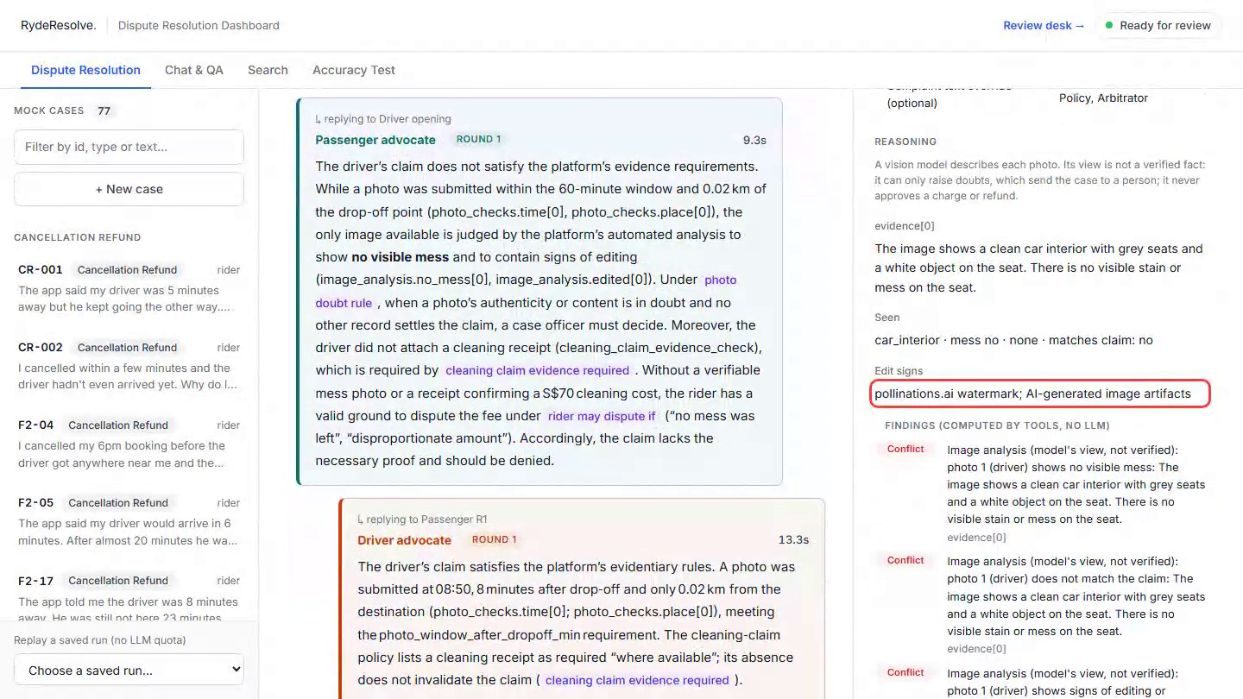
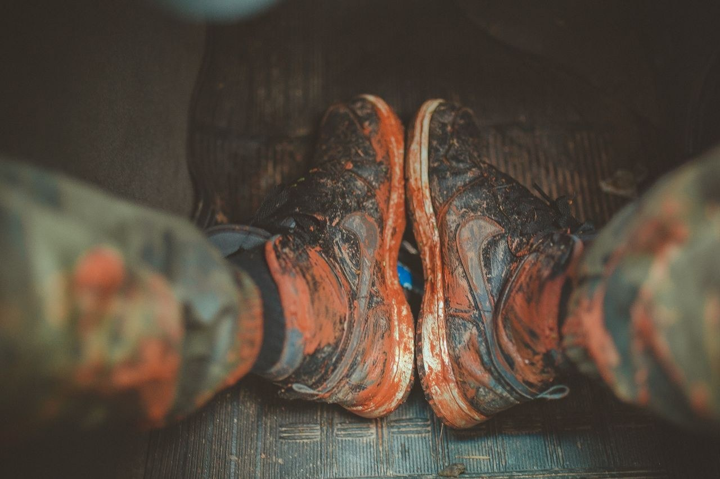
③ PHOTO CHECKS · CASES IM-04 AND IM-12
Two checks on every photo: its data, then its content
IM-04 · taken 5 min after drop-off, 30 m away, mud seen → fee stands
IM-12 · no stain, AI watermark → rider not charged, to a person
Honest drivers get paid. Faked photos never move money.
Recorded from the live site (saved replay, no model called) · http://43.134.17.192
Notes:
SPEAKER 2 · about 2:32–3:13
[0–12 s, IM-04] "Third, photos. Here a driver claims a cleaning fee for muddy mats."
[12–19 s, red boxes] "First, code reads the photo's own data: taken five minutes after drop-off, thirty metres away."
[19–24 s, vision] "Then a vision model looks: muddy shoes, matching the claim. The honest driver gets paid."
[24–50 s, IM-12] "And the photo from the start: time and place pass, but the vision model sees a clean seat and an AI watermark, so the rider is not charged and a person decides. Why two layers? Fake photos are now one click away. The model can only raise doubts, never approve money, so a fake has to fool both."
Handover: "And when the AI is unsure, people take over."

Slide 8
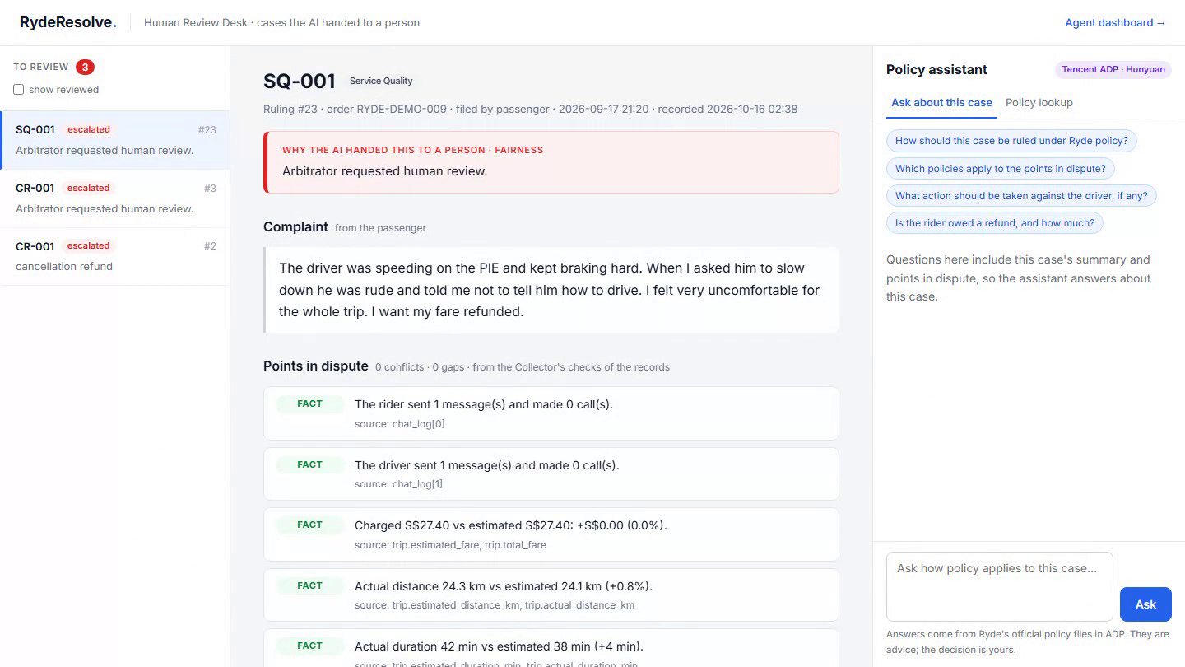
FOR THE PEOPLE INVOLVED
A person is always one step away
Review desk
Why the AI stopped, the facts in dispute, a Tencent ADP assistant for policy questions. The reviewer decides; tested decisions become precedents.
Status page
Riders and drivers follow each step to the final decision, in plain words.
Accessible
Notices in 4 languages; skip link, live updates for screen readers, higher contrast.
One appeal with new evidence where the AI was unsure; the AI re-checks first.
Recorded from the live site (saved replay, no model called) · http://43.134.17.192
Notes:
SPEAKER 3 · about 3:13–3:44
[0–20 s, review desk] "This is the review desk, where the AI hands cases over: why it stopped, the facts in dispute, and a Tencent ADP assistant for policy. Automation fails on the hard cases: safety, fakes, large amounts. Here the reviewer starts with the evidence gathered, and once a test shows no harm, their decision becomes a precedent the AI uses next time."
[20–29 s, status page] "Riders and drivers follow their case on a status page, get notices in four languages, and can appeal once when the AI was unsure."

Slide 9
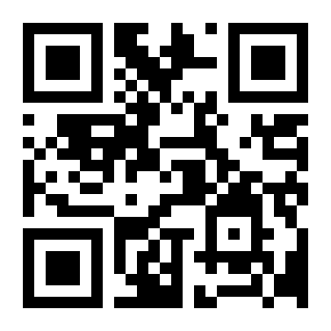
PROOF AND NEXT STEP
Tested on cases it never saw. Ready for Ryde's data.
3 / 3
25 / 30
45 / 52
10/10 · 6/6
organisers' samples
blind set, organisers' format
regression, policy v2.1
blind harassment sets
Most misses are cases handed to a person: minutes, not money. Every miss and its fix is published in the repo.
Plug in
Cheap to run
Earn trust
One setting connects Ryde's API in shadow mode: it rules next to your team and pays nothing.
About US$0.017 a dispute on an open 120B model that can run in-house.
Decide small cases alone only once agreement with your team is high.
RydeResolve: fair, explainable ride-dispute rulings in minutes, not days.
Built on Tencent Cloud: Lighthouse server in Singapore · ADP policy assistant (Hunyuan) · developed with CodeBuddy
Try it live · access code in our submission
Notes:
SPEAKER 3 · about 3:44–4:05
"Tested on cases it never saw: the organisers' samples three of three, a blind set 25 of 30, our regression 45 of 52. And it is ready: one setting connects Ryde's API in shadow mode, ruling beside your team and paying nothing, at under two cents a dispute. RydeResolve: fair rulings in minutes, not days. Thank you."

Slide 10
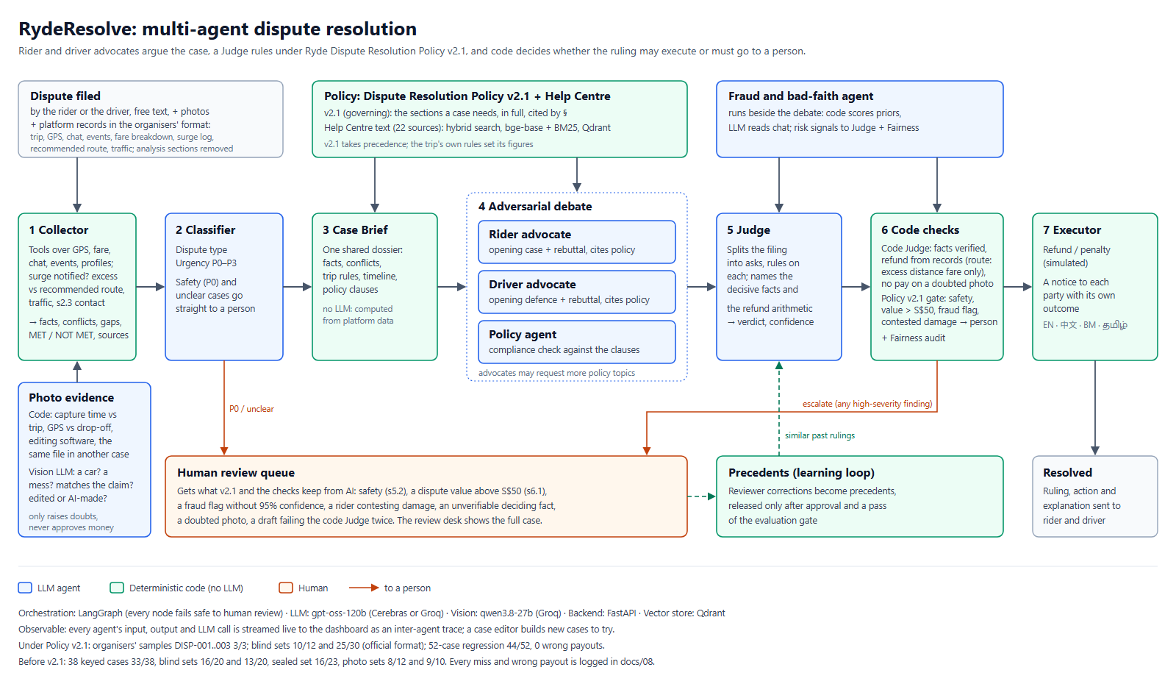
Notes:
BACKUP for Q&A only (full architecture). Not part of the 5 minutes.

Slide 11
ENGINEERING DECISIONS
Backup
Built so a wrong payout is the hardest thing to happen
Code checks the model
Escalate, never misjudge
Safety floor in code
A deterministic code judge verifies every fact and amount against a record before money moves. It caught F2-17 (when the Judge lists the record).
Unprovable, low-confidence, over S$50 or unsafe: a person decides. A wrong payout is the failure we test hardest.
Physical, sexual, stalking and legal wording is routed by code. The LLM can raise urgency, never lower it.
Need-to-know agents
Observable and auditable
Ready for Ryde, cheap to run
Advocates never see fraud scores or a party's history: they argue the case, not the person.
Every agent step is streamed and replayable; every ruling cites its policy section; hash-chained audit log.
Shadow mode on Ryde's API. ~1.7 US¢ a dispute on an open 120B model; can run in-house.
Brief coverage: the 3 MVP agents plus evidence collection, fraud, policy & precedent RAG, photo checks, escalation, reviewed-precedent learning and P0 safety routing.
Notes:
BACKUP for Q&A only (engineering decisions). Not part of the 5 minutes.

Slide 12
HOW WE KNOW IT WORKS
Backup
Tested on cases it had never seen
Test set | Correct | Note
Organisers' samples | 3 / 3 | DISP-001 to 003
Blind set, organisers' format | 25 / 30 | written by another model
Regression, policy v2.1 | 44 / 52 | 45 / 52 on the final code
Harassment, blind (new) | 10/10 · 6/6 | always reaches a person
Most misses are cases handed to a person: that costs minutes, not money.
Notes:
BACKUP for Q&A only (results). 44/52 was the scored run; 45/52 on the submitted code, where a few automatic rulings were wrong in one re-run (README). Say so if asked; every miss is in the repo.

Slide 13
HOW IT LEARNS
Backup
It learns only from people, after a test shows no harm
1 Reviewer decides
2 Admin approves
3 Evaluation gate
4 Live precedent
A person rules on a case the AI handed over. The decision is saved as a pending precedent.
Approved precedents are staged: indexed, but only the evaluation can see them.
Re-run the test set with and without it. Accuracy and every safety metric must not get worse.
Only then do new rulings find and cite it. A failed gate rejects it.
Safety metrics that can never drop
Rollback and audit
P0 escalation recall, refund cap, missing-data escalation, failure rate. A precedent that trades safety for accuracy is rejected.
An admin can retire any live precedent at once. Every step is written to the hash-chained audit log.
The AI never rewrites its own rules or policy. Code: src/store/feedback.py, scripts/precedents.py.
Notes:
BACKUP for Q&A only (learning loop). Not part of the 5 minutes. Use for "Does it learn?".

