Slide 1
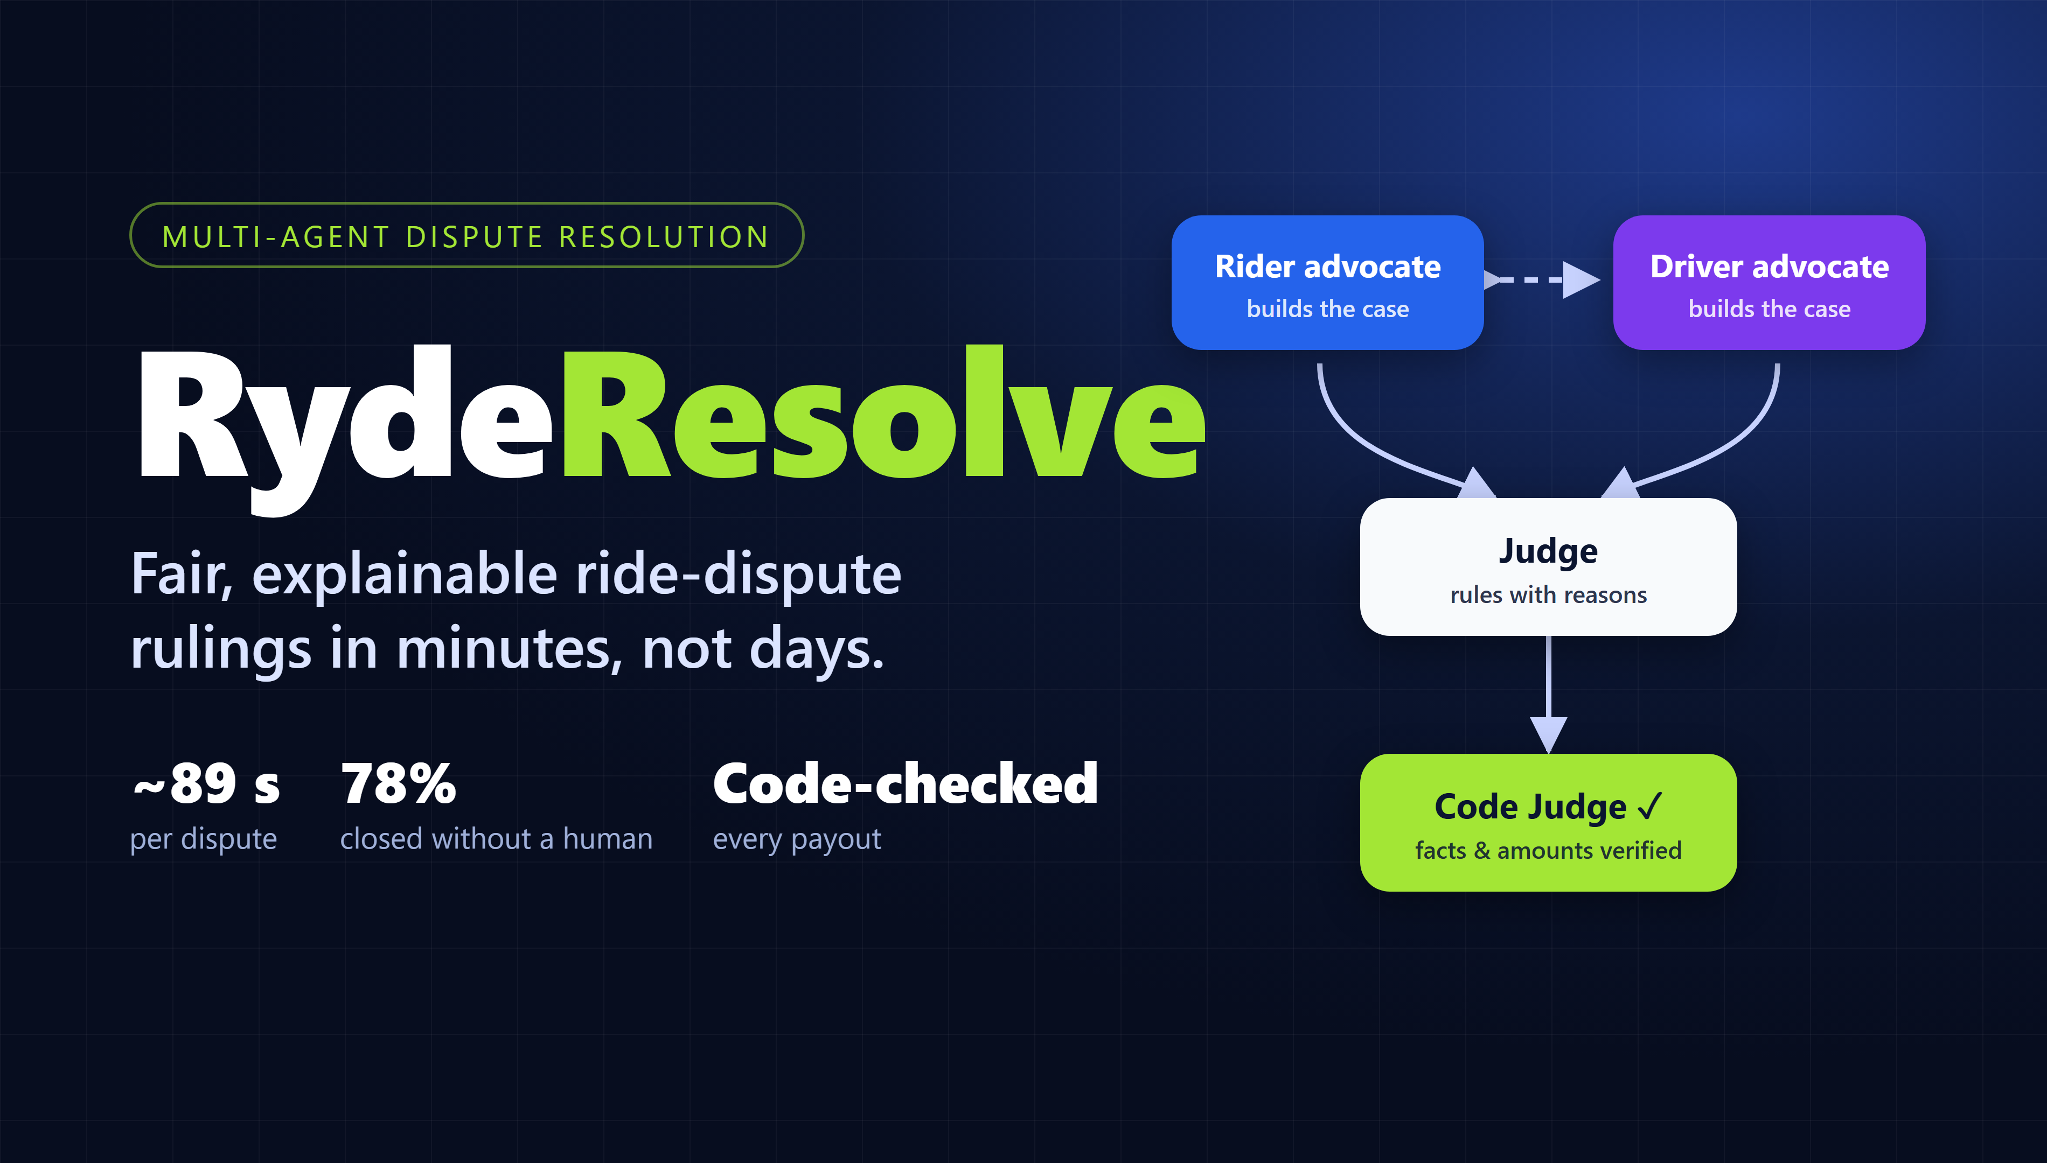
Notes:
SPEAKER 1 (0:00). Already on screen while the team walks up. Do not read it.
Start talking straight away on the next slide.

Slide 2
THE PROBLEM · RYDE'S CHALLENGE
Speaker 1 · 0:00–0:20
Rule rider–driver disputes fairly, fast, without a person
“Gather evidence, build cases, apply company policy and issue fair rulings quickly, transparently, and without human intervention for the majority of standard disputes.”
Ryde track brief, Tencent Cloud AI CAN DO IT 2026
24–72 h
High cost
Inconsistent
Churn
to resolve a dispute today
every dispute read by hand
two agents, same facts, different rulings
riders and drivers who feel treated unfairly
Our rule: automate what can be proven from the records. A person decides the rest.
Notes:
SPEAKER 1 (0:00-0:20)
"Ryde asked for a system that rules rider-driver disputes fairly, fast and without a person for most standard cases. Today a dispute takes 24 to 72 hours, every one is read by hand, two agents can rule differently on the same facts, and people who feel treated unfairly leave. Our rule: automate what can be proven from the records; a person decides the rest."

Slide 3
PAIN POINT → WHAT WE BUILT
Speaker 1 · 0:20–0:45
Each pain point has an answer you can check
→
Under 2 minutes
24–72 h
Agents work in parallel on the trip records: GPS, chat, fare, photos, history.
→
~1.7 US¢ per dispute
High cost
A person only for what cannot be proven, safety, or over S$50.
→
Same policy, checked by code
Inconsistent rulings
Every ruling cites policy v2.1 by section; code verifies every fact and amount against a record.
→
Both sides argued and told why
Feeling treated unfairly
Rider and driver advocates; reasons sent to both in 4 languages; status page; appeal with new evidence.
Watch for each of these in the four demos that follow.
Notes:
SPEAKER 1 (0:20-0:45)
"Each pain point has an answer you can check. 24 to 72 hours becomes under two minutes. Cost: about 1.7 US cents a dispute, and a person only for what cannot be proven. Inconsistency: every ruling applies the same policy by section, and code verifies every fact and amount. Fairness: both sides get an advocate, both get the reasons in their language, a status page, and an appeal where the AI was unsure."

Slide 4
HOW IT WORKS
Speaker 1 · 0:45–0:55
A team of AI agents, checked by code
Rider advocate
argues + cites policy
Paid
proven
Records
GPS · chat · fare · policy v2.1
Judge
rules with reasons
Code checks
every fact + amount
Driver advocate
argues + cites policy
A person
not proven
Around them: evidence, photo, fraud and fairness checks.
Safety cases skip the AI ruling and go straight to a person.
Notes:
SPEAKER 1 (0:45-0:55)
"Behind it: a rider advocate, a driver advocate and a judge, with evidence, photo, fraud and fairness checks around them, and code checking every fact. Here it is running."

Slide 5
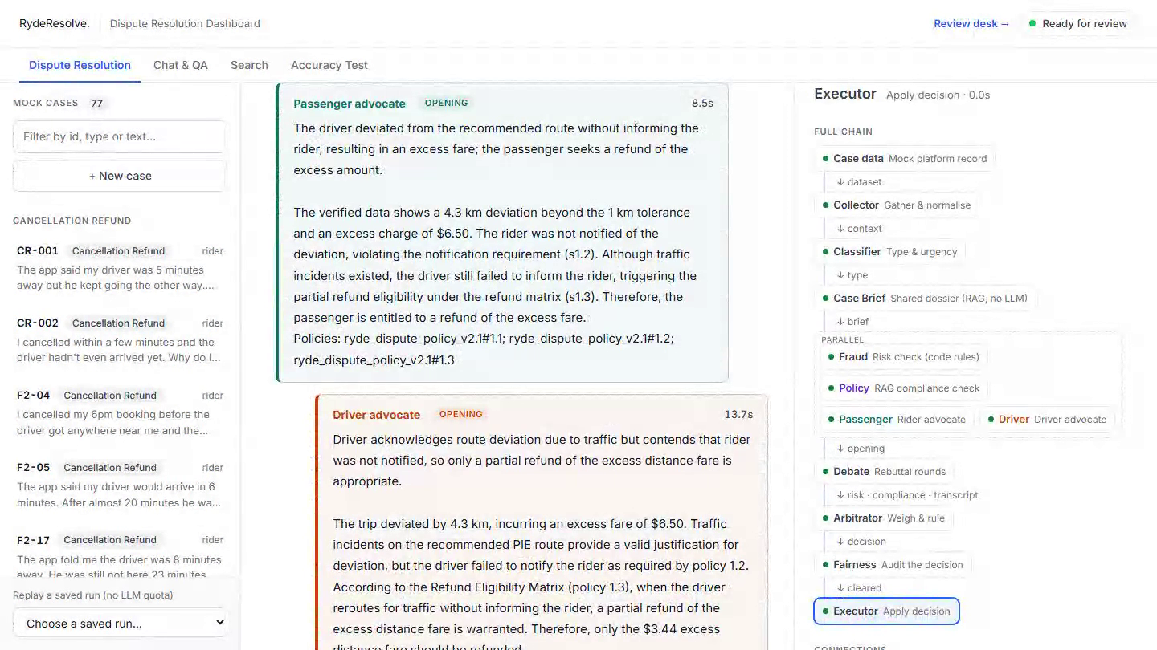
DEMO 1 · ORGANISERS' SAMPLE DISP-001
Speaker 1 · 0:55–1:35
Route deviation: proven, paid, explained
24.8 km vs 20.5 km
Code reads the records: driven vs recommended route, plus a vehicle fire on the PIE.
Two advocates
Rider: asked at 13:24, no reply. Driver: the PIE was on fire. Both cite policy.
S$3.44 back
Rerouted but not told (s1.3): the excess-distance fare only. Every fact traced, under S$10, executed.
Notice to both parties in English · 中文 · Melayu · தமிழ்
Recorded from the live site (saved replay, no model called) · http://43.134.17.192
Notes:
SPEAKER 1 (0:55-1:35). The clip plays by itself; speak over it.
"This is the organisers' route-deviation sample: Orchard Central to Changi T3. The rider says the driver took a long route and never told her."
[Collector on screen] "Code reads the records: 24.8 km driven against 20.5 recommended, and a vehicle fire on the PIE during the trip."
[Debate on screen] "The rider's advocate: she asked at 13:24 and got no answer. The driver's advocate: the PIE was on fire. Both cite the policy."
[Verdict on screen] "Partially upheld, S$3.44. Rerouted for traffic but not told, so the excess-distance fare comes back. Every fact is traced to a record, it is under S$10, so it is final."
[Notices, 中文 / Melayu] "Both parties get a notice built by code, in four languages."
Handover: "But what happens when the AI gets it wrong?"

Slide 6
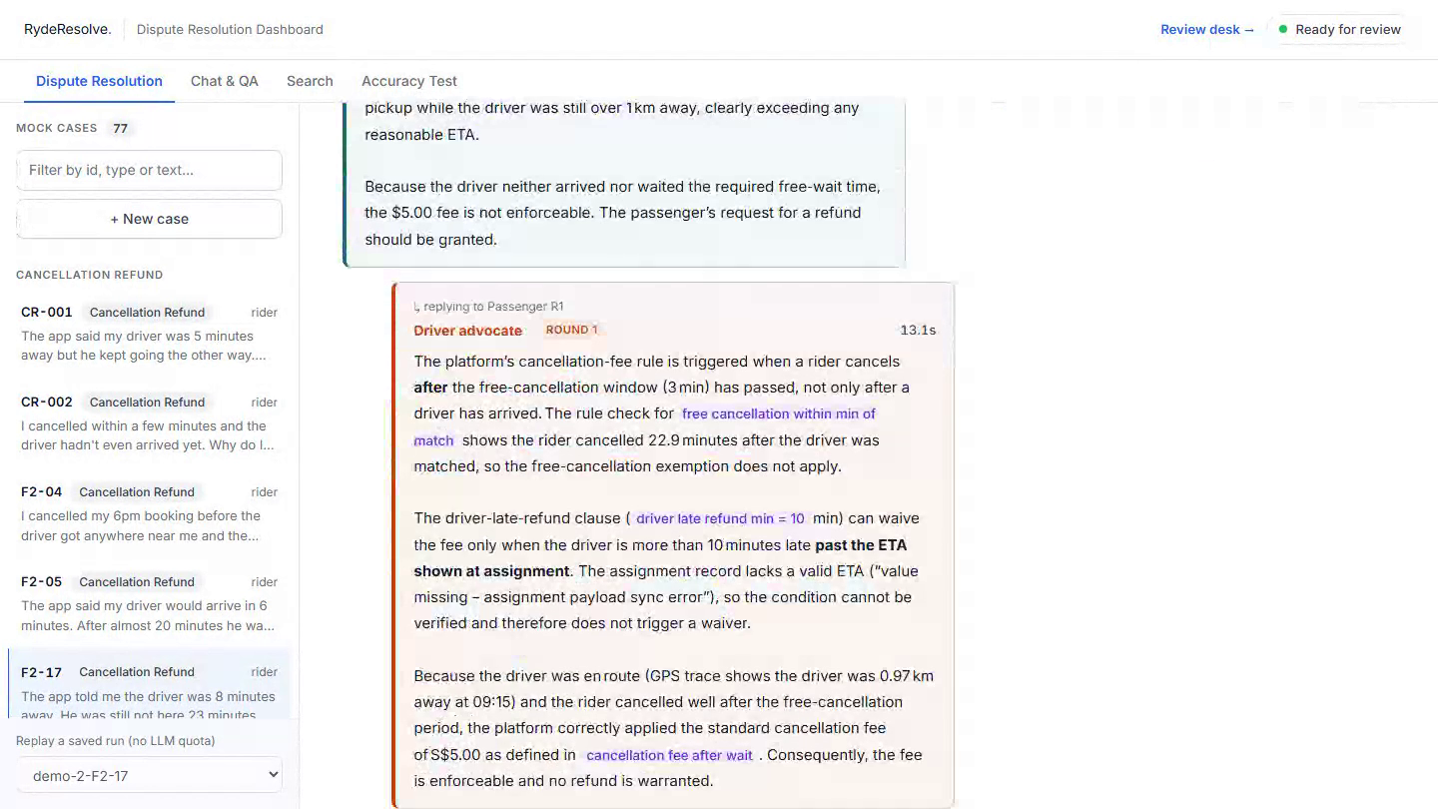
DEMO 2 · CANCELLATION FEE F2-17
Speaker 2 · 1:35–2:10
The AI was wrong. Code caught it.
Draft 1: S$5 · 62%
The Judge refunds, resting on an assignment record with a logged data problem.
Blocked by code
The code judge rejects the draft and lists what it cannot prove.
Draft 2: S$5 · 85%
Same payout, higher confidence, no new evidence. Code stops it again: a person decides.
Code checks the model. The model never checks itself.
Recorded from the live site (saved replay, no model called) · http://43.134.17.192
Notes:
SPEAKER 2 (1:35-2:10).
"This is the case we are proudest of, because the system was wrong and caught itself."
"The rider cancelled after 23 minutes and was charged S$5. But the driver-assignment record has a logged data problem."
[Judge on screen] "First draft: refund S$5 at 62% confidence, resting on that questioned record. The code judge blocks it."
[Debate on screen] "Second draft: still S$5, confidence now 85%, with no new evidence. Code sees the same payout and sends it to a person."
"That is why code checks the model, and the model never checks itself."

Slide 7
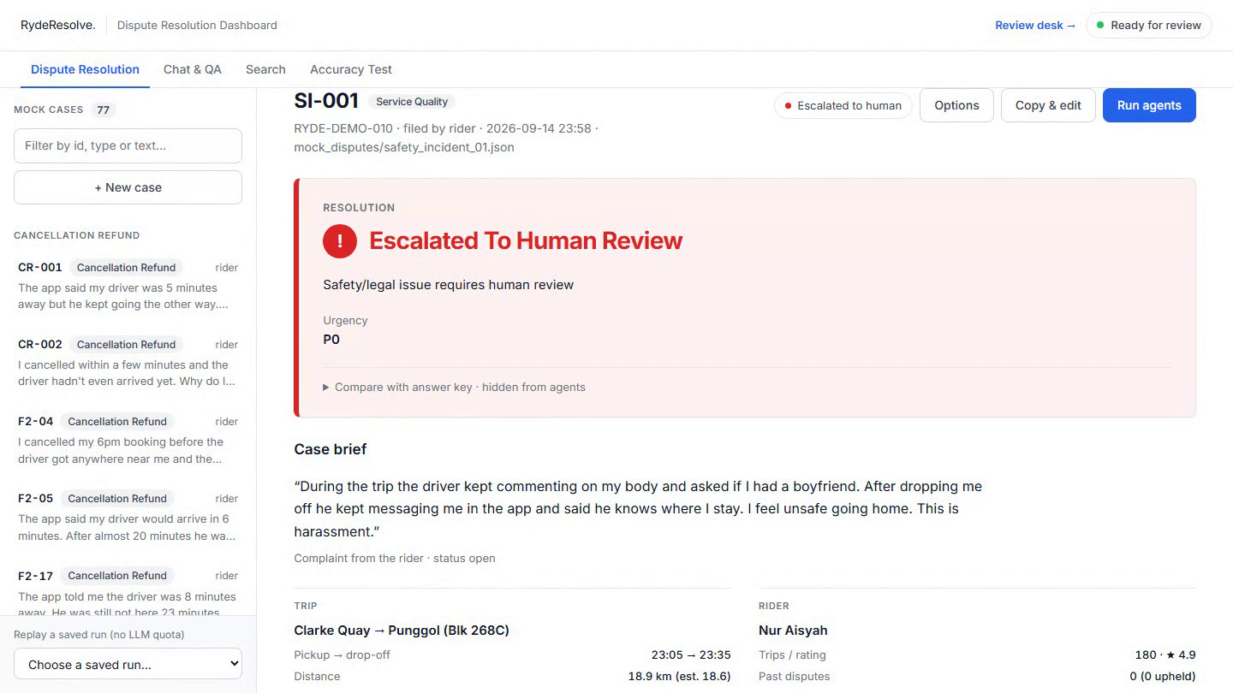
DEMO 3 · SAFETY SI-001
Speaker 2 · 2:10–2:22
Safety is never automated
P0 in under 1 s
"He kept commenting on my body and said he knows where I stay."
No debate, no judge
Straight to a person. No money moves until a specialist acts.
10/10 · 6/6
Harassment, two blind test sets, after we hardened this path.
Harassment routes on the message itself, not on a keyword list alone.
Recorded from the live site (saved replay, no model called) · http://43.134.17.192
Notes:
SPEAKER 2 (2:10-2:22).
"A rider writes: the driver kept commenting on my body and said he knows where I stay. The safety scan marks it P0 in under a second. No advocates, no judge: a person, and no money moves."
"On two blind harassment sets: 10 out of 10 and 6 out of 6."

Slide 8
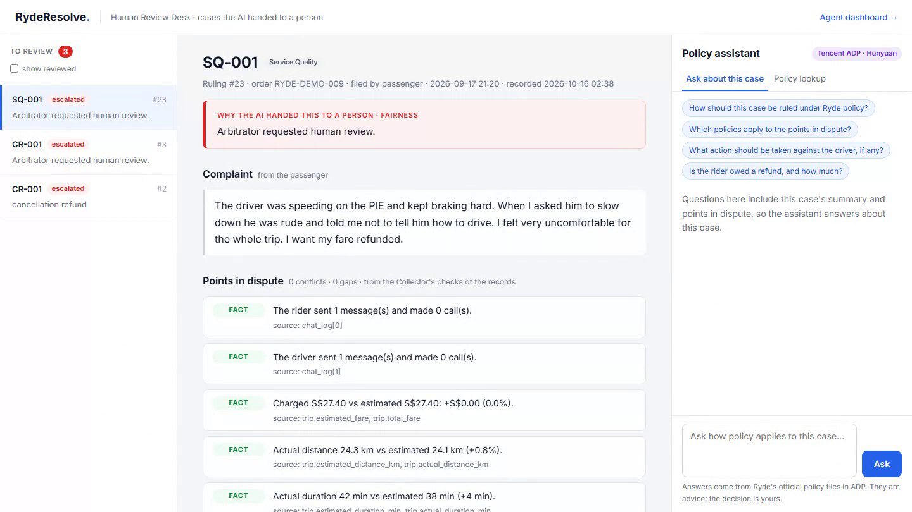
DEMO 4 · PEOPLE IN THE LOOP
Speaker 2 · 2:22–2:47
A person is always one step away
Review desk
Why the AI stopped, the facts in dispute, and Tencent ADP for policy questions. The reviewer decides.
Track this case
Riders and drivers see each step to the final decision. No AI internals shown.
Appeal = new evidence
Only on rulings under 80% confidence, once. The AI re-checks first; a person if still unsure.
Saying "I disagree" is not new evidence: the AI keeps deciding, people see what it cannot settle.
Recorded from the live site (saved replay, no model called) · http://43.134.17.192
Notes:
SPEAKER 2 (2:22-2:47).
[Review desk on screen] "Every case the AI hands over lands on the review desk: why it stopped, the facts in dispute, and a Tencent ADP assistant for policy questions. The person decides, and that decision can become a precedent only after an evaluation gate."
[Status page on screen] "Riders and drivers get a status page: every step to the final decision, without exposing the AI's internals."
"And they can appeal, but only where the AI was unsure, below 80% confidence, once, and only with new evidence. The AI checks it first; if it is still unsure, a person decides."
Handover: "So how do we know it works?"

Slide 9
ENGINEERING DECISIONS
Speaker 3 · 2:47–3:15
Built so a wrong payout is the hardest thing to happen
Code checks the model
Escalate, never misjudge
Safety floor in code
A deterministic code judge verifies every fact and amount against a record before money moves. It caught F2-17.
Unprovable, low-confidence, over S$50 or unsafe: a person decides. 52 cases, 0 wrong payouts.
Physical, sexual, stalking and legal wording is routed by code. The LLM can raise urgency, never lower it.
Need-to-know agents
Observable and auditable
Ready for Ryde, cheap to run
Advocates never see fraud scores or a party's history: they argue the case, not the person.
Every agent step is streamed and replayable; every ruling cites its policy section; hash-chained audit log.
Shadow mode on Ryde's API. ~1.7 US¢ a dispute on an open 120B model; can run in-house.
Brief coverage: the 3 MVP agents plus evidence collection, fraud, policy & precedent RAG, photo checks, escalation, reviewed-precedent learning and P0 safety routing.
Notes:
SPEAKER 3 (2:47-3:15)
"What we are proudest of is engineering, not prompts. Code checks the model: every fact and amount is verified against a record before money moves. When it cannot be proven, a person decides: 52 cases, zero wrong payouts. Safety is decided in code; the model can never lower it. Advocates only see what their role needs. Every step is replayable and every ruling is in a hash-chained audit log. And it is ready for Ryde's API in shadow mode at under two cents a dispute."

Slide 10
HOW WE KNOW IT WORKS
Speaker 3 · 3:15–3:35
Tested on cases it had never seen
Test set | Correct | Note
Organisers' samples | 3 / 3 | DISP-001 to 003
Blind set, organisers' format | 25 / 30 | written by another model
Regression, policy v2.1 | 44 / 52 | 0 wrong payouts
Harassment, blind (new) | 10/10 · 6/6 | always reaches a person
Most misses are cases handed to a person: that costs minutes, not money.
Notes:
SPEAKER 3 (3:15-3:35)
"The organisers' three samples: 3 of 3. A 30-case blind set in their format: 25 of 30. 52 cases under the current policy: 44 of 52 with zero wrong payouts. Most misses are cases handed to a person: minutes, not money."

Slide 11
WHAT HAPPENS NEXT
Speaker 3 · 3:35–4:00
Built and ready: shadow mode on real disputes
1. Read live disputes
through Ryde's API
2. Rule next to the human
pays nothing
3. Earn the right
small cases alone, once agreement is high
RydeResolve
Fair, explainable ride-dispute rulings in minutes, not days.
Notes:
SPEAKER 3 (3:35-4:00)
"The next step is real data, and it is already built: one setting connects Ryde's API in shadow mode. It rules next to the human, pays nothing, and earns the right to decide small cases alone. RydeResolve: fair, explainable ride-dispute rulings in minutes, not days. Thank you."

Slide 12
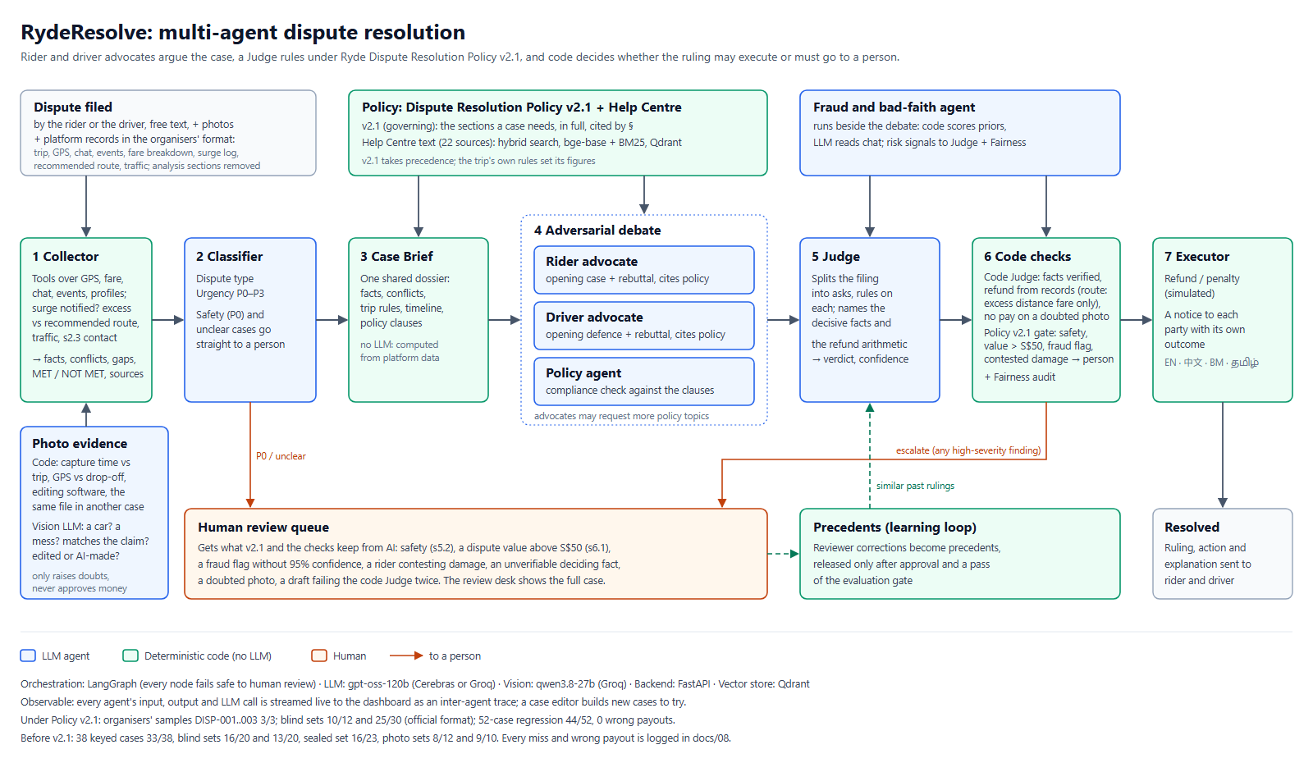
Notes:
BACKUP for Q&A only (full architecture). Not part of the 5 minutes.

